Slide 1
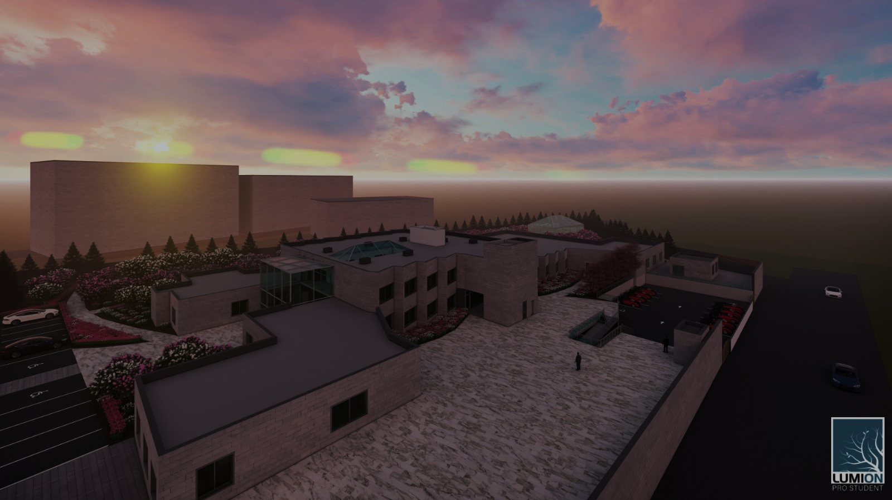

Faculty of Engineering & Information Technology
Department of Building Engineering
Graduation Project - II
Design An Elderly Home In Nablus City
Prepared By:
Amer Abu Al-huda
Mohammad Zawawi
Rafat Abu Al-haija
Supervisor:
Eng. Fady Fatayer

Slide 2

Introduction
Description of the project.
Architectural design.
Environmental design.
Contents
Contents
Structural design.
Mechanical design.
Electrical design.
Quantity surveying.

Slide 3
The project is about design an elderly home.
Analysis the building.
INTRODUCTION
Finding the problems.
Solve problems.

Slide 4
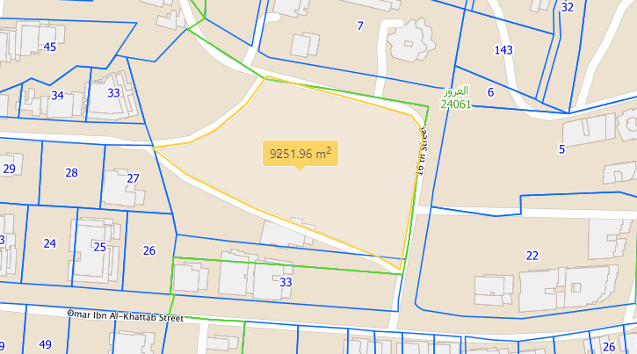
DESCRIPTION OF THE PROJECT.

Slide 5
Architectural Aspect
PROJECT 2
5
Bubble Diagram
Reception
Entrance
Entrance
Bedrooms
Administrative spaces
Healthcare areas
Staff areas
Bedrooms
Bedrooms
Bedrooms
Set area
Cafeteria
Multi-purpose area
Activity areas
Laundry
Corridor

Slide 6
Architectural Aspect
PROJECT 2
6
Redesigned
Modification areas:
Added areas:
Emergency stair.
Healthcare center.
Cafeteria.
Emergency elevator.
Laundry.
Mechanical and electrical room.
Archive file room.
Smoking room.
Equipment storage room.
Reception.
Accountant office.
Housekeeping storage room.
Staff lounge and staff bedrooms.
Hair salon.
Maintenance workshop.

Slide 7
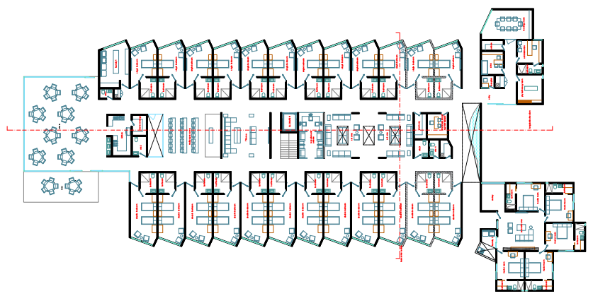
PROJECT 2
7
The ground floor before re-design:

Slide 8
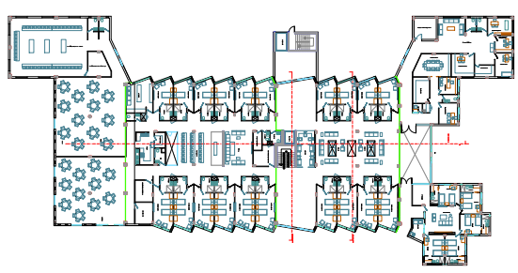
The ground floor after re-design:

Slide 9
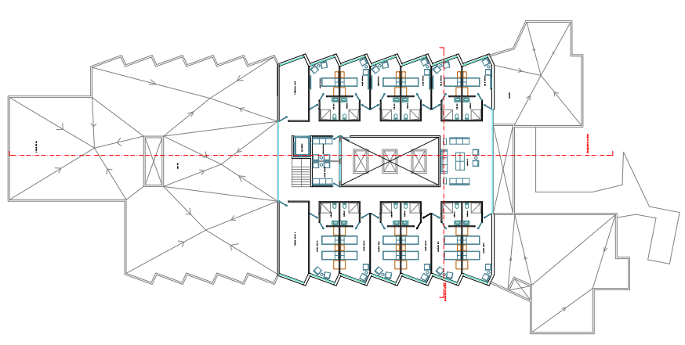
PROJECT 2
9
The first floor before re-design:

Slide 10
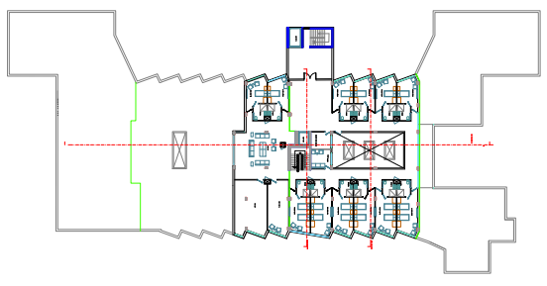
The first floor after re-design:

Slide 11
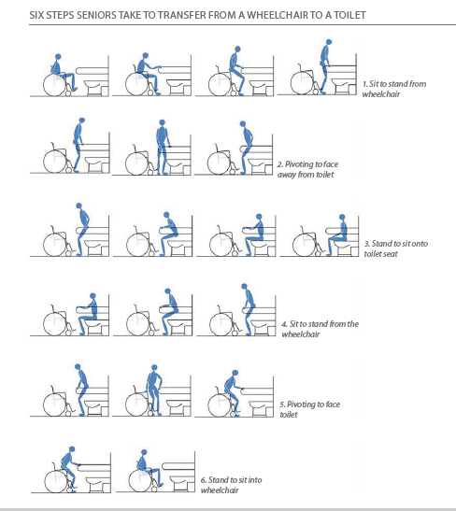
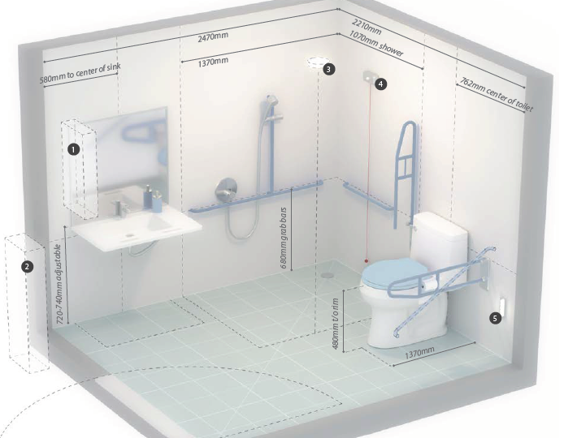
Bathroom design:

Slide 12
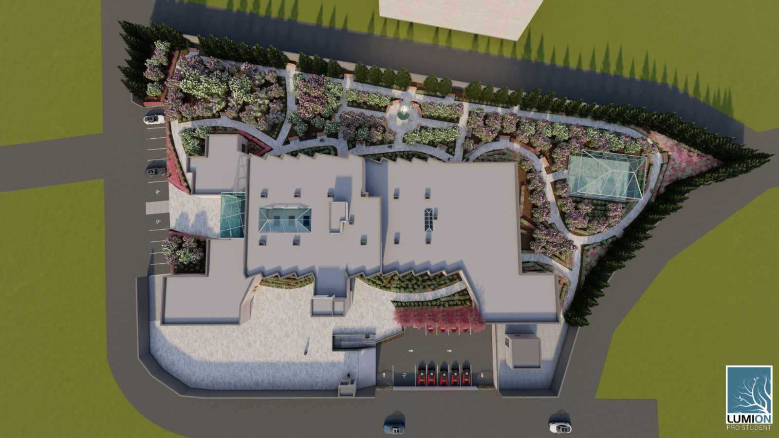
Site plan after re-design:

Slide 13
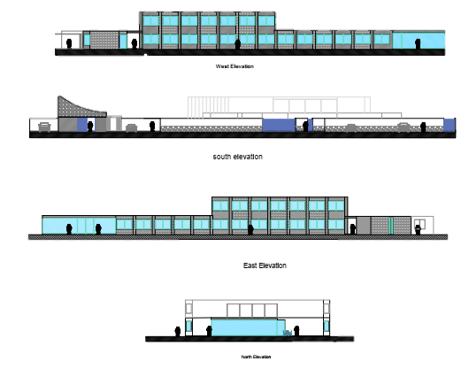
Elevations
before
re-design:

Slide 14
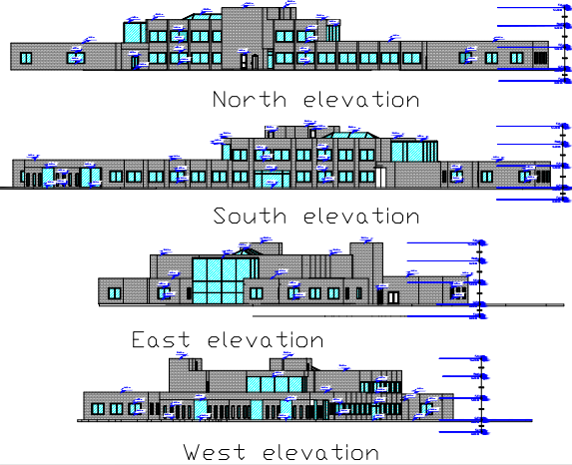
Elevations
after
re-design:

Slide 15
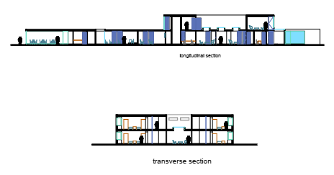
Sections before re-design :

Slide 16
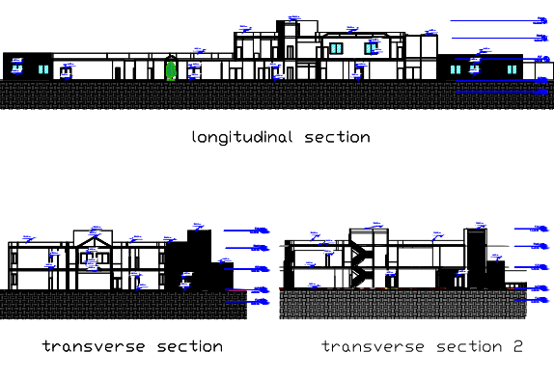
Sections after re-design :

Slide 17
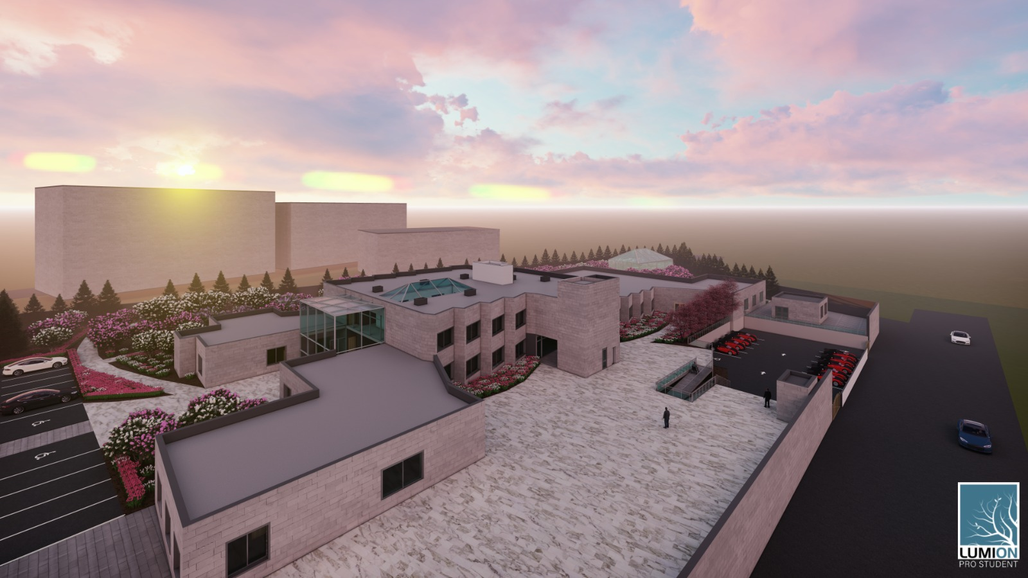
3D views:

Slide 18
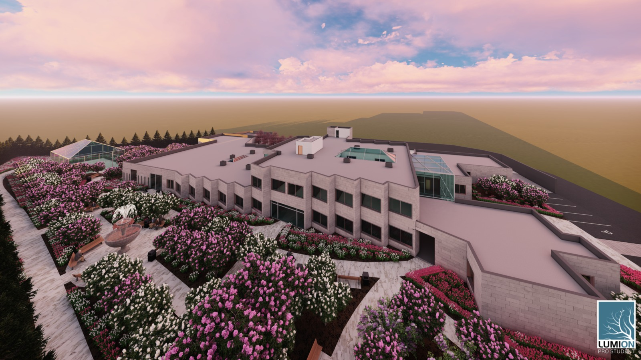
3D views:

Slide 19





Environmental Aspect
Daylighting
Solar insolation
Heating and cooling load
Wind analysis
Thermal comfort

Slide 20
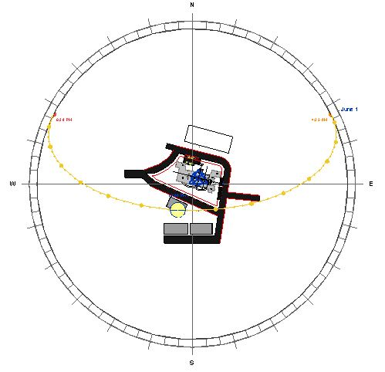
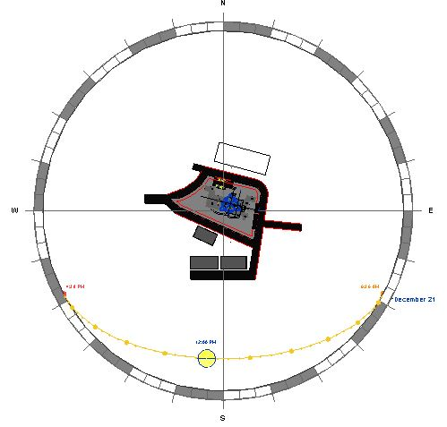
Sun Path
Summer
Winter

Slide 21
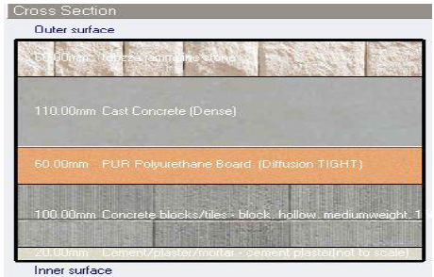
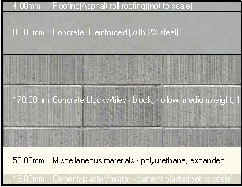
Materials Used in Project
External wall cross section
Roof cross section

Slide 22
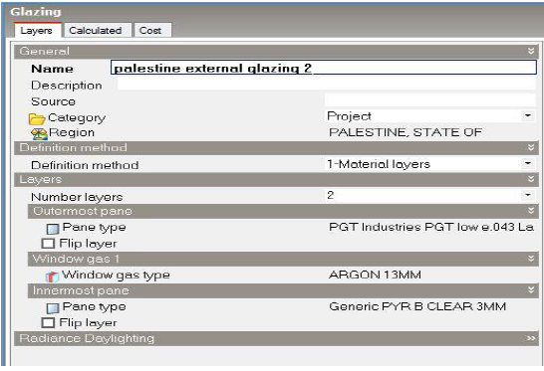
Materials Used in Project
Window Layers
U-value Table

Slide 23

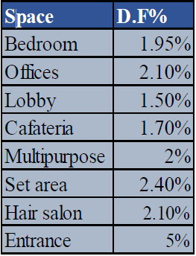
Daylighting
Daylight factors for some spaces in elderly home project.
D.F standard for spaces D.F values in project

Slide 24
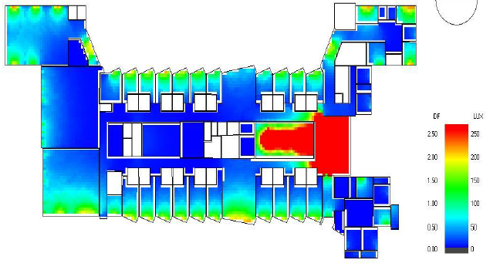
3D views:
PROJECT 2
24
Daylighting factor for ground floor after
re-design
Avg D.F before modification = 5% Avg D.F after modification = 2.75%

Slide 25
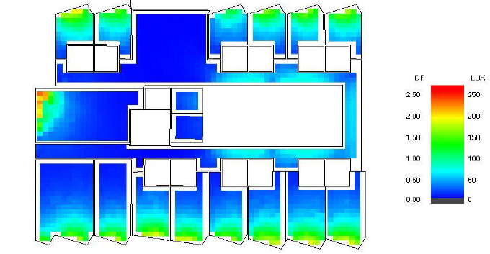
3D views:
PROJECT 2
25
Daylighting factor for First floor After
re-design

Slide 26
01
02
Amount of solar energy for building before improvement for solar radiation
Amount of solar energy for building after improvement for solar radiation

Slide 27
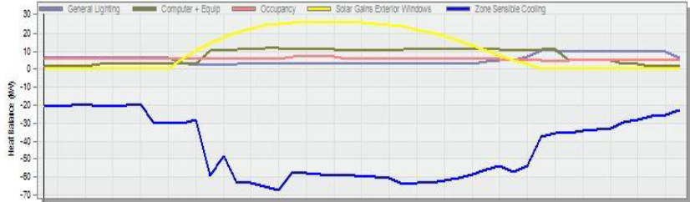
Heating and cooling load
Cooling Load graph
Cooling Load values
Cooling Load design capacity

Slide 28
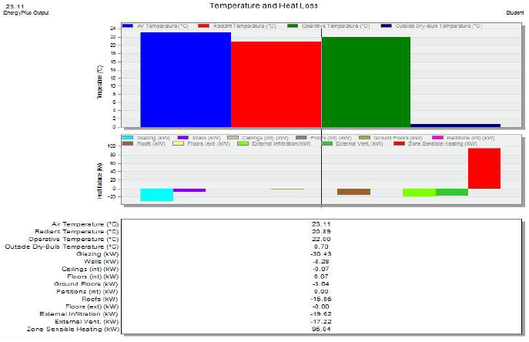
Heating and cooling load
Heating Load graph
Heating Load values

Slide 29
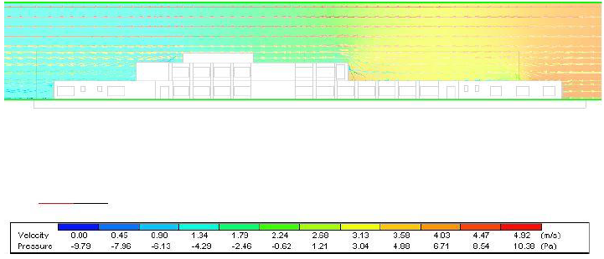
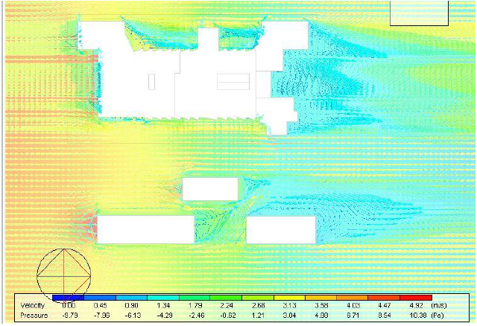
CFD & Wind
Side External CFD
Top External CFD

Slide 30
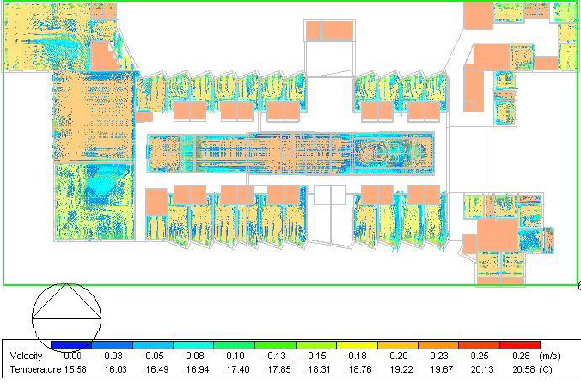
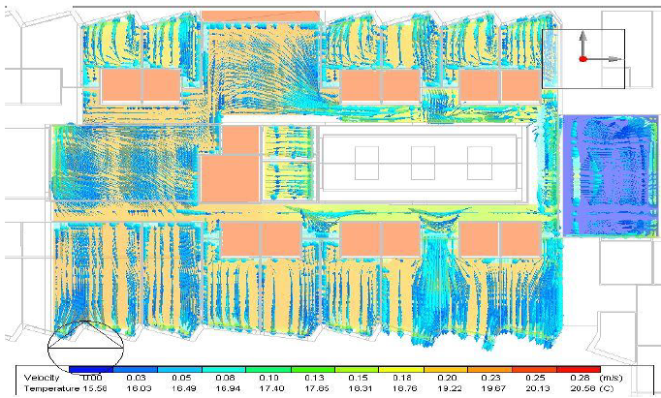
CFD & Wind
G.F Internal CFD
F.F Internal CFD

Slide 31
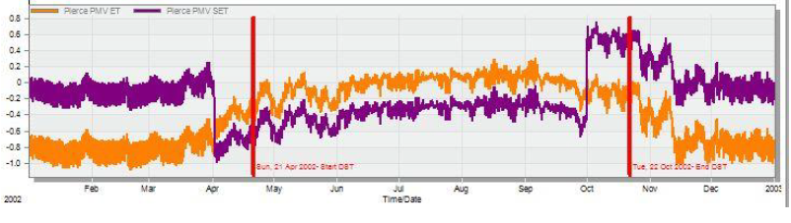
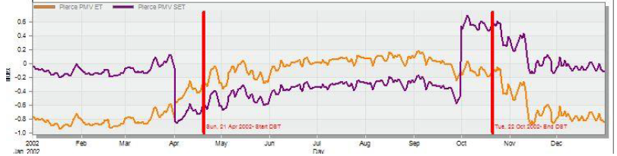
Thermal comfort (PMV Analysis)
Hourly PMV graph
Daily PMV graph

Slide 32
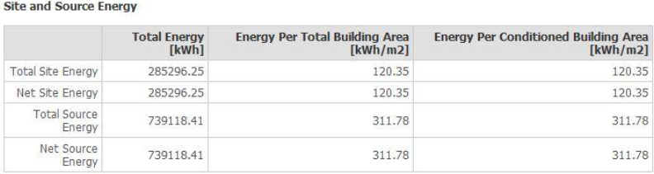
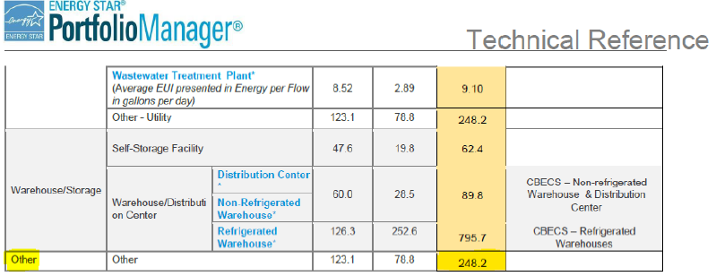
Energy consumption
Total Site Energy

Slide 33
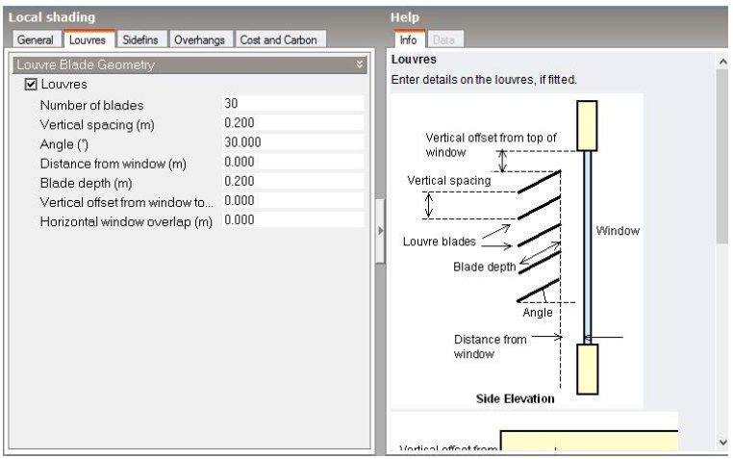
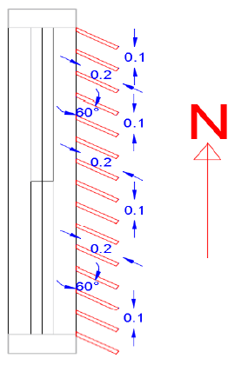
Shading Systems
Horizontal louvers
Vertical louvers

Slide 34
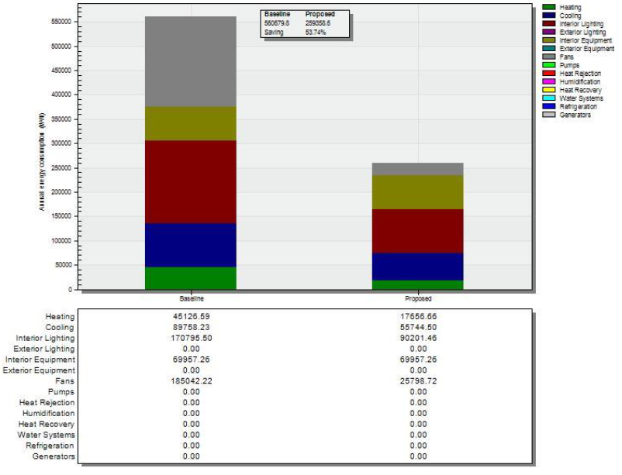
Baseline Analysis

Slide 35

Structural Aspect
Slab design.
Beams design.
Contents
Columns & shear walls design
Footings design
Water tank design

Slide 36

Design data
PROJECT 2
36
Materials
Codes
Compressive strength of concrete B350 → (F’c = 28 Mpa).
ACI 318-14
Weight per unit volume for concrete = 25 KN/m3.
ASCE
Yielding strength of steel (fy) = 420 Mpa.
UBC -97
Elasticity of steel (E) = 200 Gpa.
Weight per unit volume for steel = 78 KN/m3.

Slide 37
Design data
PROJECT 2
37
Design Loads
Seismic Loads
Live load = 2.5 KN/m2
Zone type 2B Z= 0.2
SID for two way ribbed slab = 5.52 KN/m2
Ca = 0.24
SID for one way ribbed slab = 5.42 KN/m2
Cv = 0.32
SID for external walls = 18 KN/m
I = 1
SID for curtain walls = 2.16 KN/m
R = 6.5

Slide 38
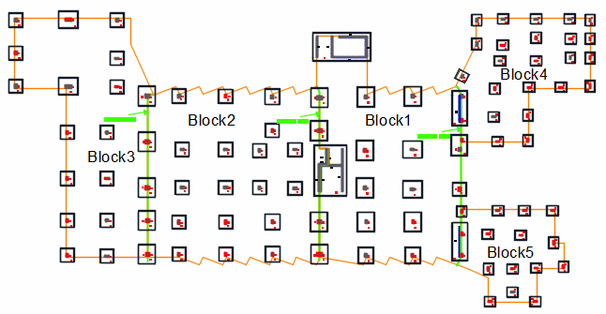
Structural Aspect

Slide 39
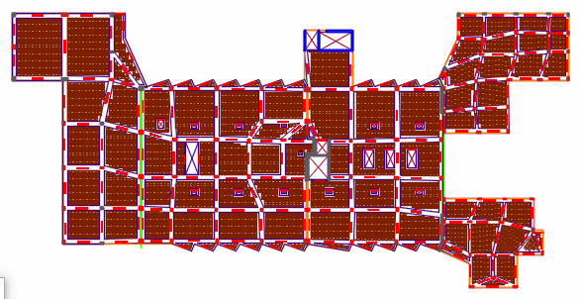
Structural Aspect

Slide 40
Checks for block 1
Analysis Checks
Check | Result
Compatibility Check | Ok
Equilibrium check | Ok
Dead Load | Ok
Live Load | Ok
SID Load | Ok
Internal Force Check | Result
Columns | Ok
Beams | Not Ok
Slab | Ok
Design Check
Check | Result
Deflection for slab | Ok
Deflection for beams | Ok
Shear Check | Ok
Seismic Checks
Check | Result
Period check. | Ok
Modal mass participation ratio | Ok
Base shear (scale factor) | Ok
Drift | Ok
∆−P Effects | Ok

Slide 41
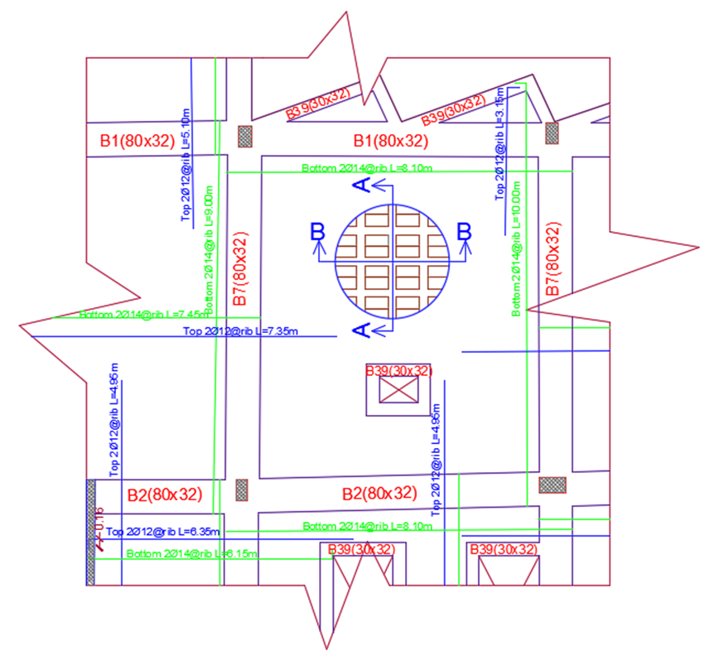
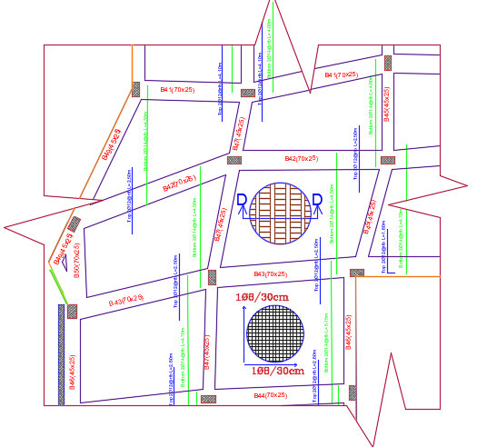
Slab Reinforcement
Two way ribbed slab
One way ribbed slab

Slide 42
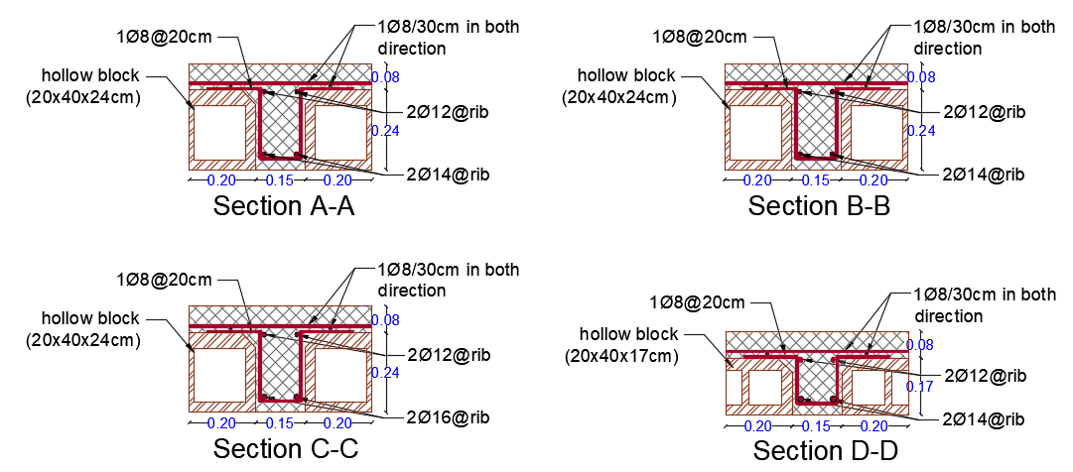
Slab Reinforcement
Sections in slabs

Slide 43
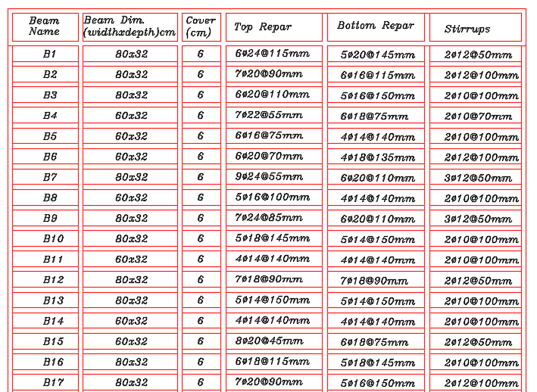
Beams Reinforcement
Beams table

Slide 44
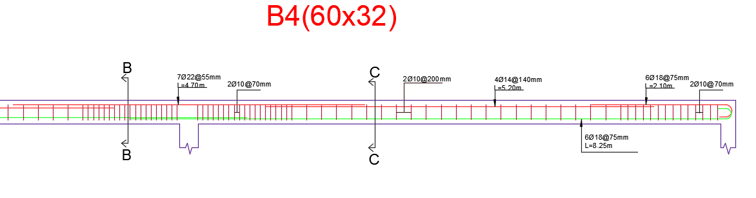
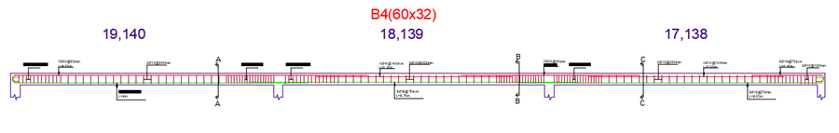
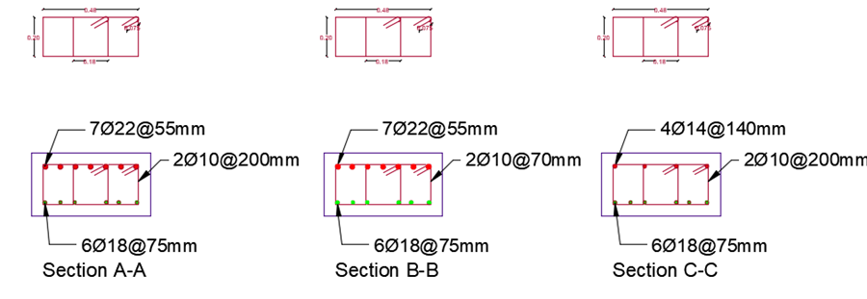
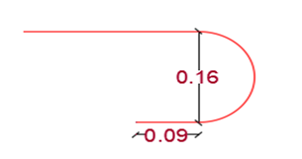
Beams Reinforcement
Beams table

Slide 45
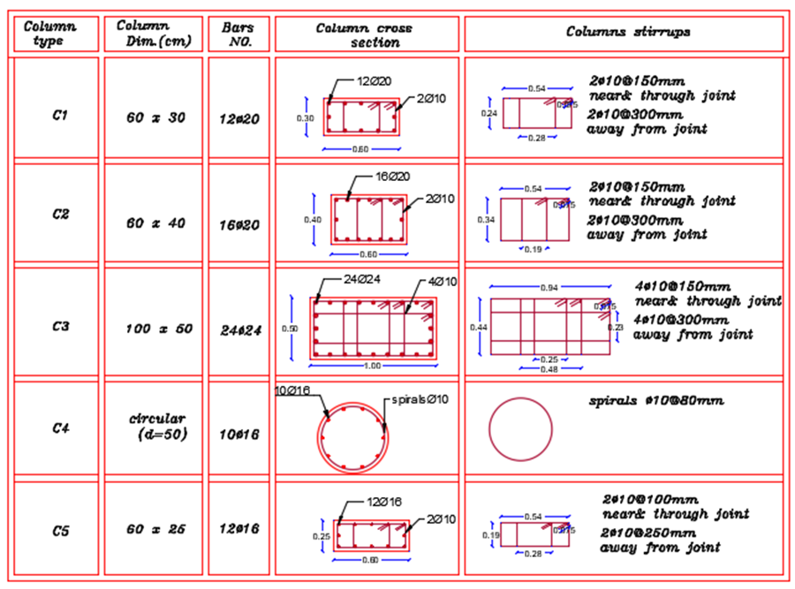
Columns Reinforcement
Columns table

Slide 46
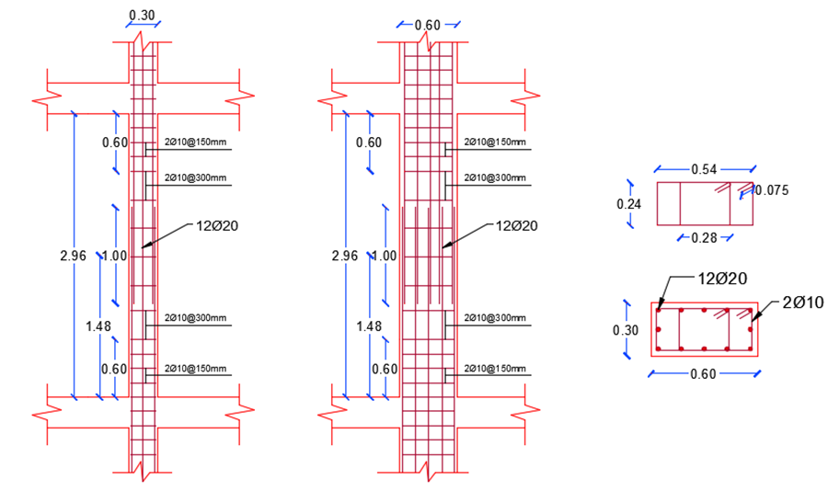
Columns Reinforcement
Column (C1) Details

Slide 47
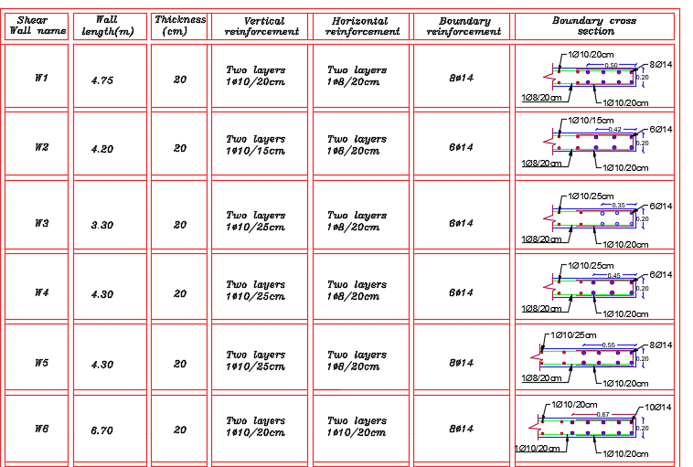
Shear walls Reinforcement
Shear walls table

Slide 48
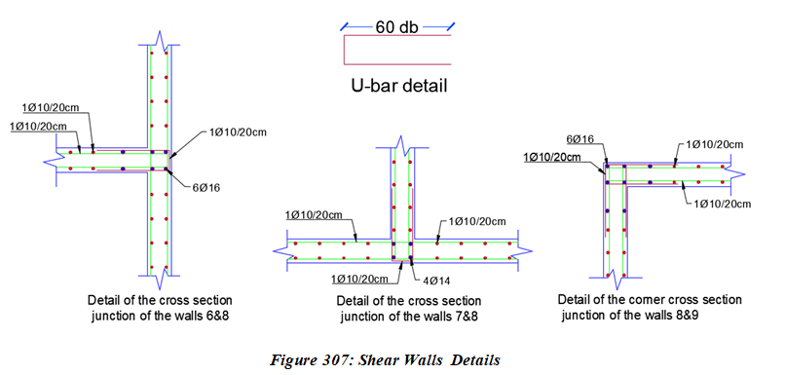

Shear walls Reinforcement
Shear walls sections

Slide 49

Shear walls Reinforcement
Shear wall (W1) details

Slide 50

Footings Reinforcement
Footing layout

Slide 51
Footing Checks
Footing Checks
Check | Result
Punching shear | Ok
Bearing capacity | Ok
Settlement | Ok
Shear | Ok

Slide 52

Footings Reinforcement
Footing table

Slide 53


Footings Reinforcement
Footing (F1) details

Slide 54

Water Tank Design
Design Data
Length = 15m
Width = 15m
Height = 5m
ɣ𝑠𝑜𝑖𝑙 = 18 KN/𝑚3
ɣ𝑤𝑎𝑡𝑒𝑟 = 10 KN/𝑚3
q all = 300 KN/m2

Slide 55
Water Tank Checks
Analysis Checks
Check | Result
Compatibility | Ok
Equilibrium | Ok
Design Checks
Check | Result
Footing
Bearing capacity | Ok
Settlement | Ok
Shear | Ok
Walls
Shear | Ok
Axial | Ok
Slab
Shear | Ok
Deflection | Ok

Slide 56


Water Tank Reinforcement
Water tank sections

Slide 57
Electrical design
Artificial lighting design
Power design
Contents
Acoustical design

Slide 58

Artificial lighting design

Slide 59
Artificial lighting design

Slide 60
Artificial lighting design
Internal

Slide 61
Artificial lighting design
Internal

Slide 62
Artificial lighting design
External

Slide 63
Artificial lighting design
External
Working mode for this type of luminaires is working with 30% intensity when there is no action below the lamp and 100% when people pass in sensor range.
This type works 15 hours in full charge and its need 6 hour to charge full power.

Slide 64
Artificial lighting design
External

Slide 65

Artificial lighting design
G.F lighting distribution layout

Slide 66


Power design
Distribution Boards

Slide 67

Power design

Slide 68

Power design

Slide 69




Acoustical design
Ceiling
External walls
Partitions

Slide 70




Acoustical design

Slide 71
Mechanical Design
H-VAC system design.
Firefighting system design.
Contents
Water supply.
Water drainage.
Rain water Drainage and Harvesting.

Slide 72


H-VAC system design

Slide 73

H-VAC system design
G.F H-VAC layout

Slide 74


H-VAC system design
New technology used in H-VAC systems to kill viruses and microorganisms

Slide 75


Firefighting system design

Slide 76



Firefighting system design
Fire Hose Station

Slide 77
Firefighting system design
Smoke Detector
Heat Detector
Visual Alarm
Manual Call Point

Slide 78



Firefighting system design
Main Pump
Jockey Pump
Fire Pump Controller

Slide 79

Firefighting system design
G.F Fire System Layout

Slide 80


Water supply

Slide 81



Water supply

Slide 82
Water supply

Slide 83

Water drainage

Slide 84
Water drainage
Drainage pipes size and slope

Slide 85
Rain Water Drainage and Harvesting
The rainfall quantity in Nablus city is 600 mm.
The roof area which the water is drained is 2500 m2.
The volume of drainage water is equal to
2500*0.6 = 1500 m3.
- Design water tank with capacity 1125 m3 to save this . water to use it for landscape and fire system.

Slide 86

Rain Water Drainage and Harvesting

Slide 87


Total area for two floors equal 3134 $m^{2}$.
The cost for each square meter equal 2,476 NIS/$m^{2}$
Total cost for project 7,760,347 NIS
Cost Estimate
Areas

Slide 88
Cost Estimate

Slide 89
Thank You
YOUR QUESTIONS, PLEASE!

