Slide 1

Vertical Drawing Robot

Slide 2
Contents
Introduction
Methodology
- Hardware design
- Software
Constraints & future work

Slide 3
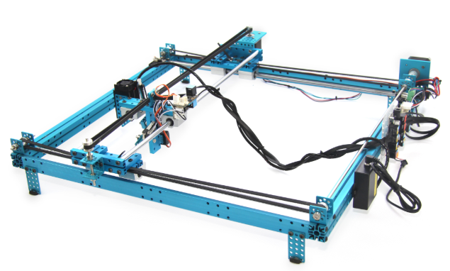
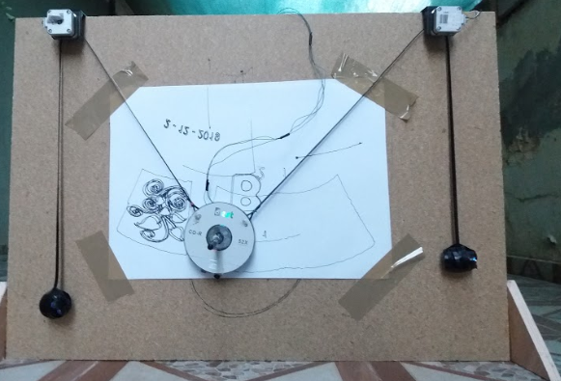
Introduction
Traditional drawing machines
VS
Vertical drawing machine

Slide 4
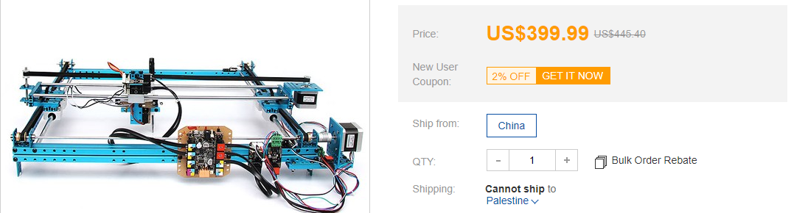
Introduction
Traditional drawing machines
VS
<100$

Slide 5
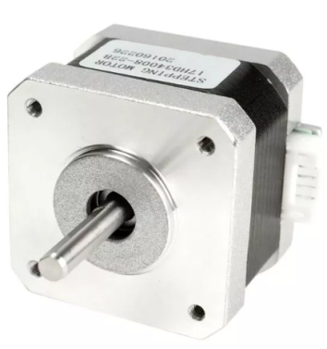
HW components
Stepper motors

Slide 6
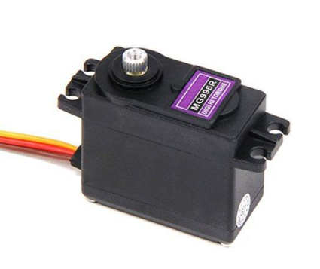
HW components
Stepper motors
Servo motor

Slide 7
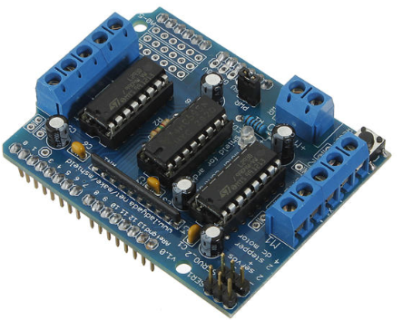
HW components
Stepper motors
Servo motor
Motor driver shield

Slide 8
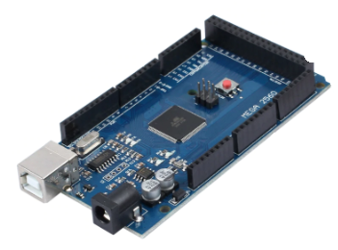
HW components
Stepper motors
Servo motor
Motor driver shield
Arduino microcontroller

Slide 9
How does it work

Slide 10
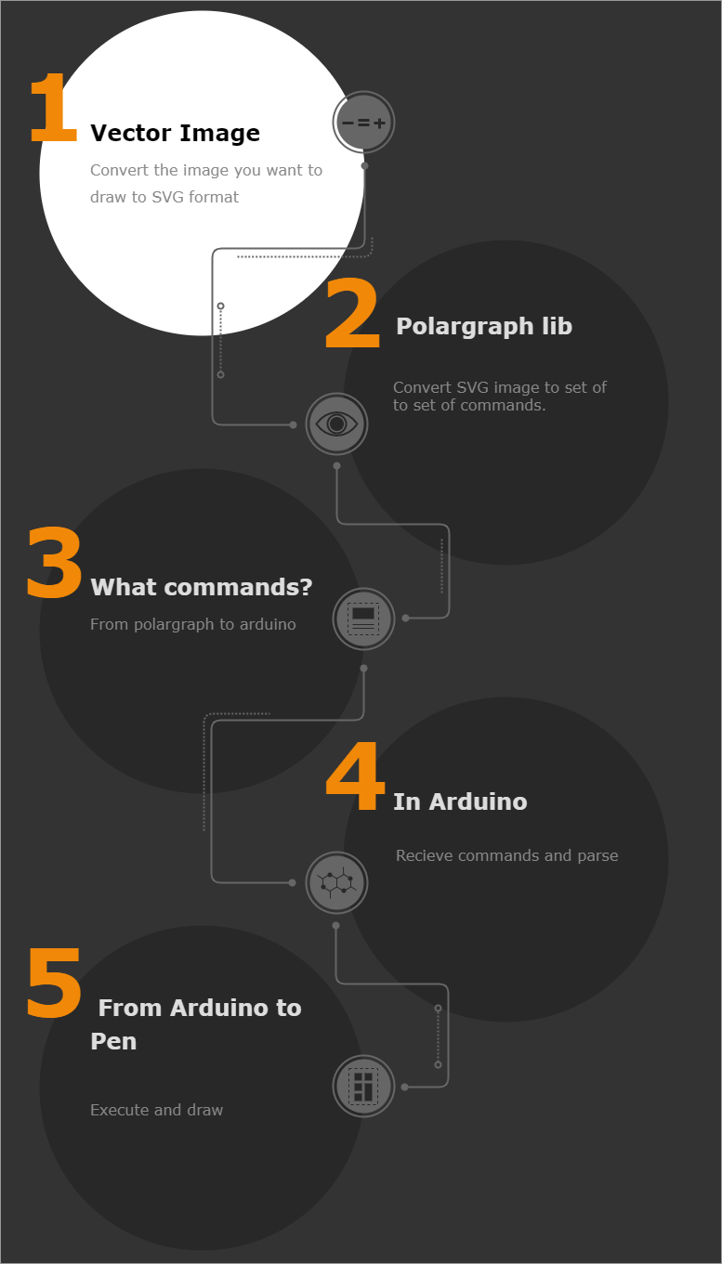

Slide 11
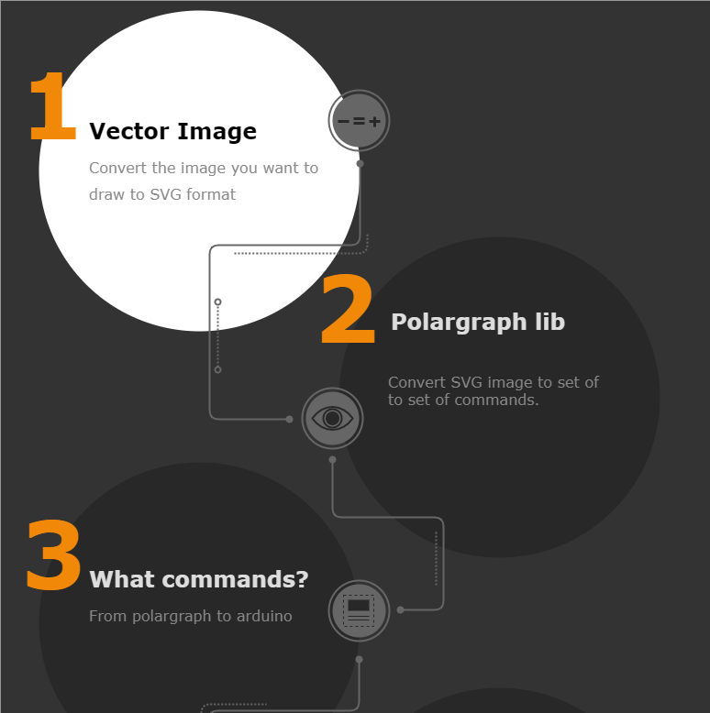

Slide 12
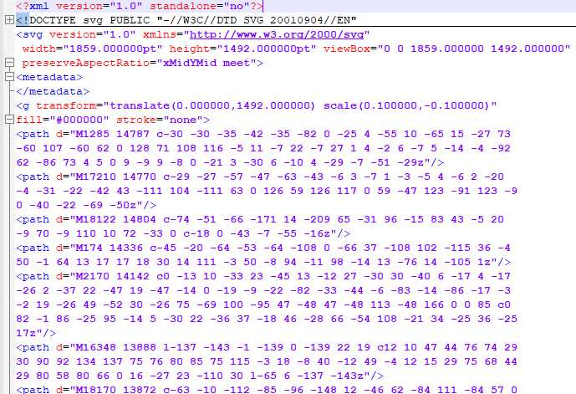
SVG format example

Slide 13
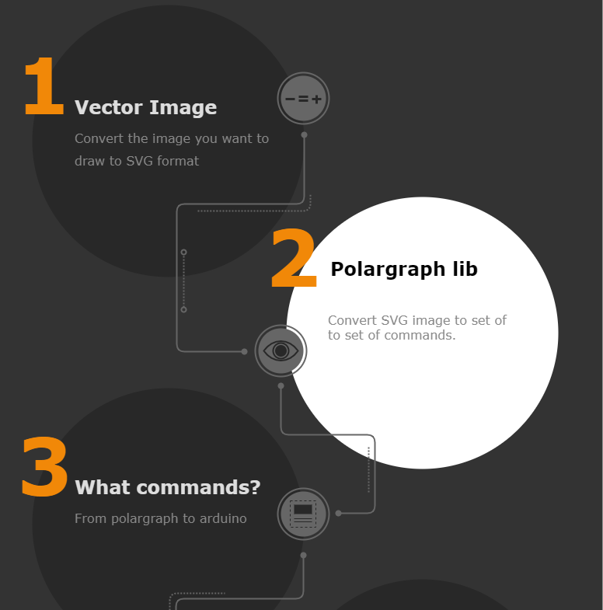

Slide 14

Processing is a flexible software sketchbook and a language for learning how to code within the context of the visual arts.

Slide 15
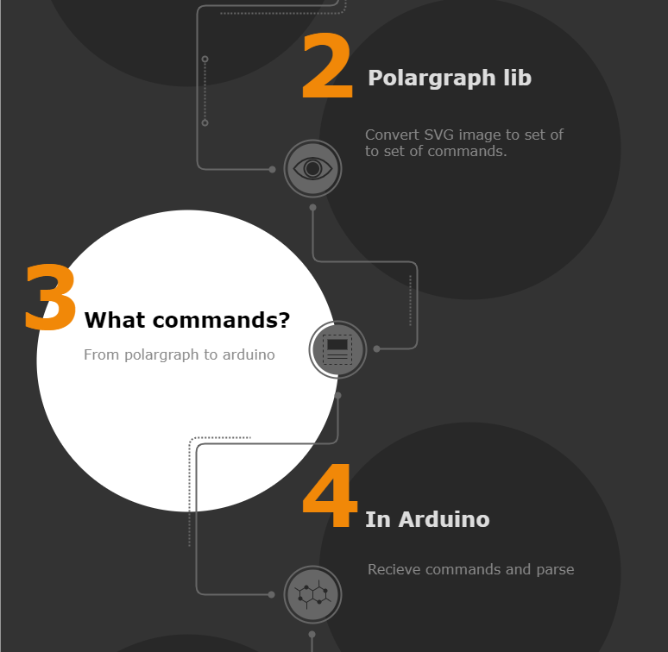

Slide 16
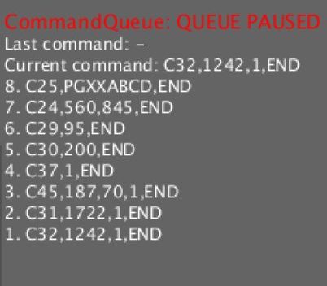

Slide 17
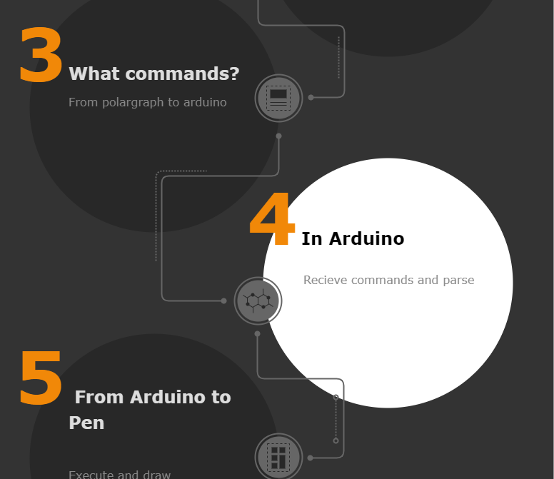

Slide 18
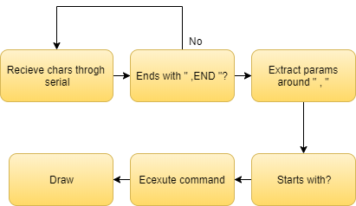
s

Slide 19
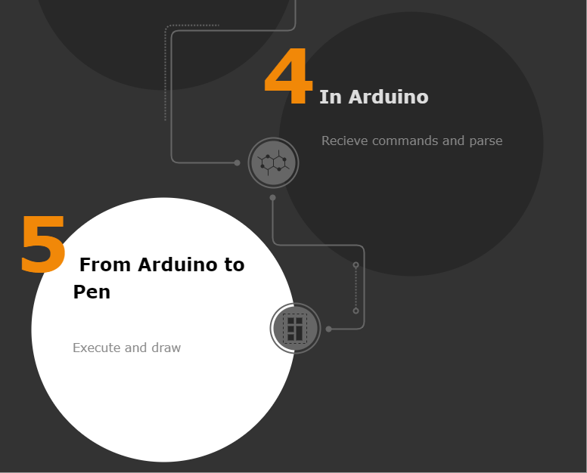

Slide 20
