Slide 1
Propeller display
Supervisor :Dr. Ashraf Armoush
Presented by :Shurooq Salahat
Reem Amer

Slide 2
Outline
Introduction
Main features
Motivation
Hardware component
Android application
Implementation
Problems
Future work
Demo

Slide 3
Introduction
Propeller display is a special kind of circular LED display which mainly emphasizes on POV (Persistence of Vision) technology to display text in attractive way. It could be useful in advertisements and education.

Slide 4
Introduction
What are we doing?
Blinking the LEDs and turning on the DC motor. POV displays will always persist!

Slide 5
Main Features
Display Text (Arabic and English).
Display clock.
Send text via Bluetooth.
Animation.

Slide 6
Motivation
This project is very exciting and attractive among advertising and education fields. It could be used in shops to attract people, museums and in any place needs it. Moreover, it is very interesting for learning children.

Slide 7
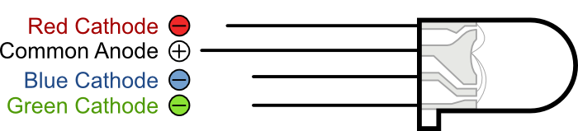
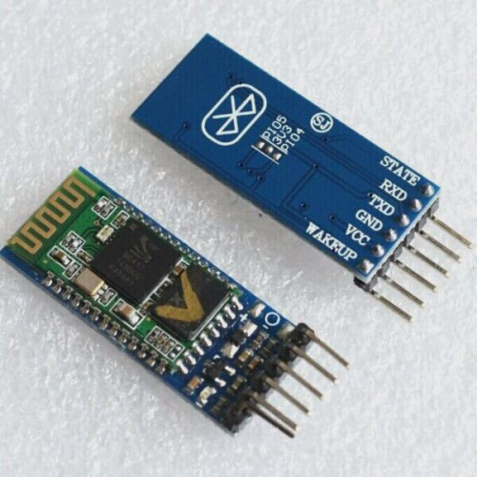
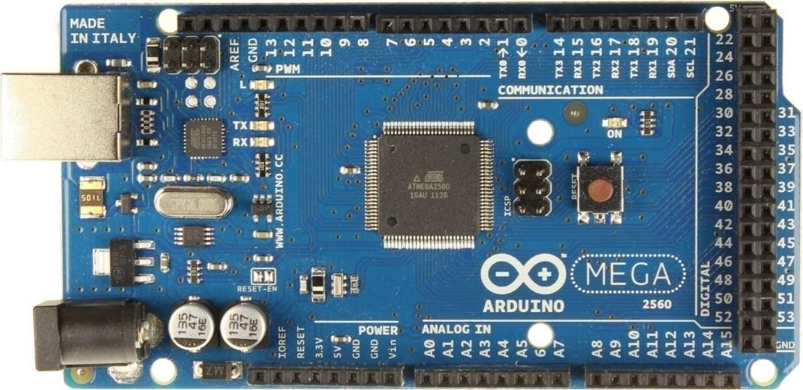
Hardware component
RGB LEDs
Shift Registers SN74HC595
HC-05 Serial Bluetooth Module
Arduino Mega

Slide 8
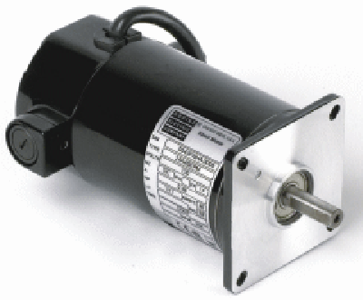
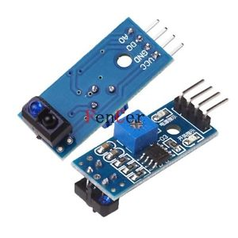
Hardware component
Power supply
DC Motor 12v
IR reflective module.
Rechargeable GP battery 9v

Slide 9
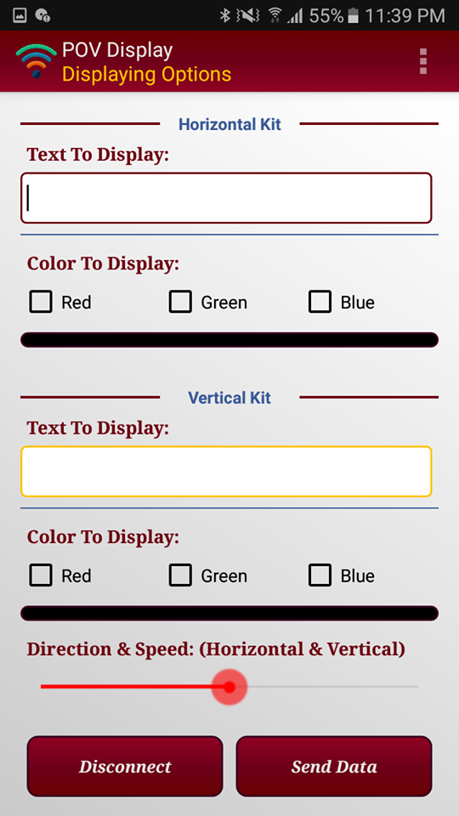
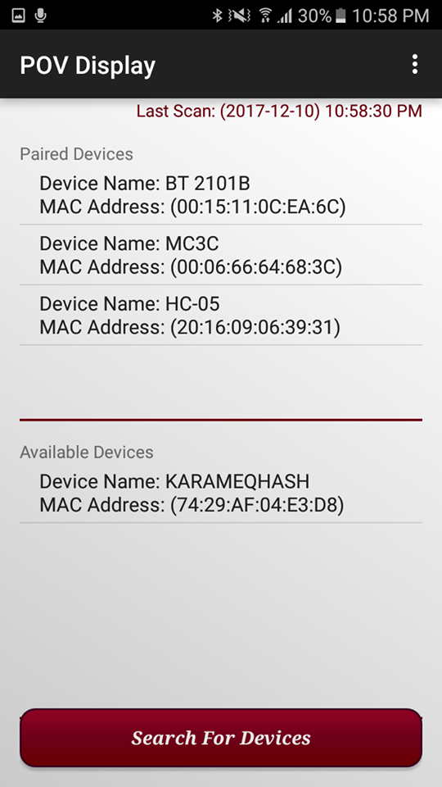
Android application

Slide 10
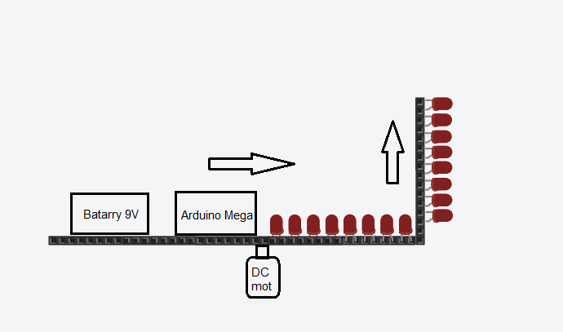
Implementation

Slide 11
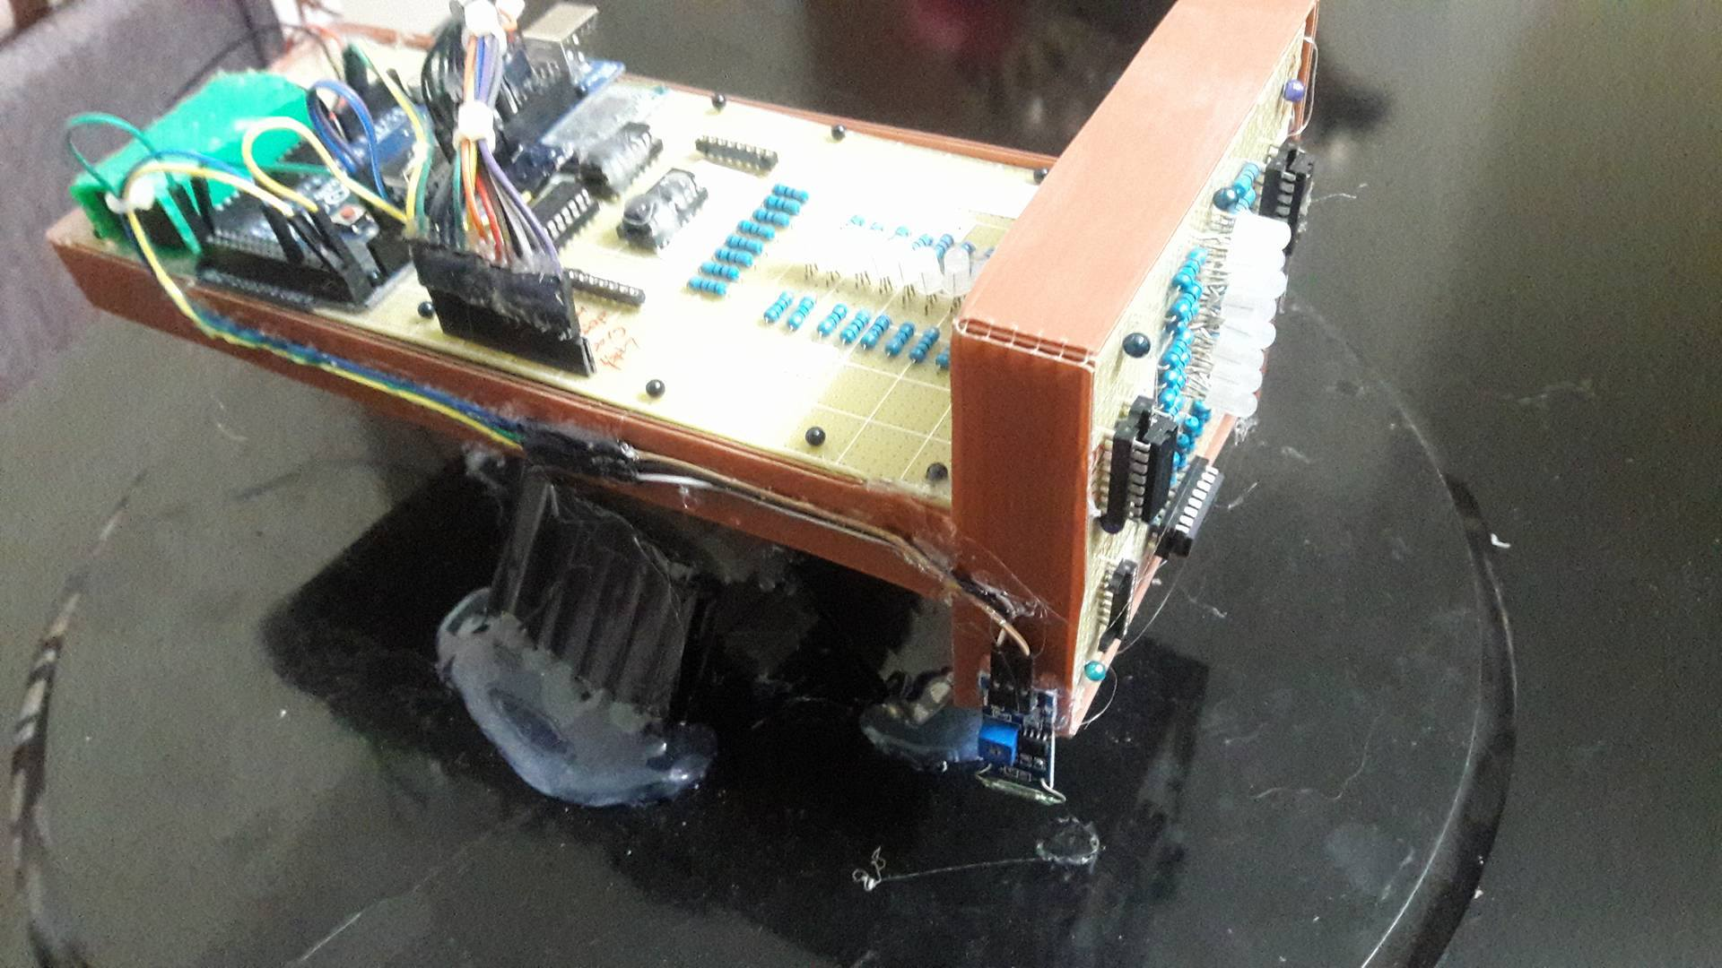
Implementation

Slide 12
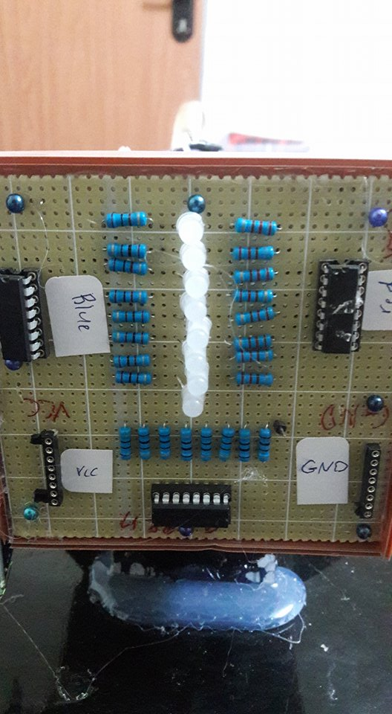
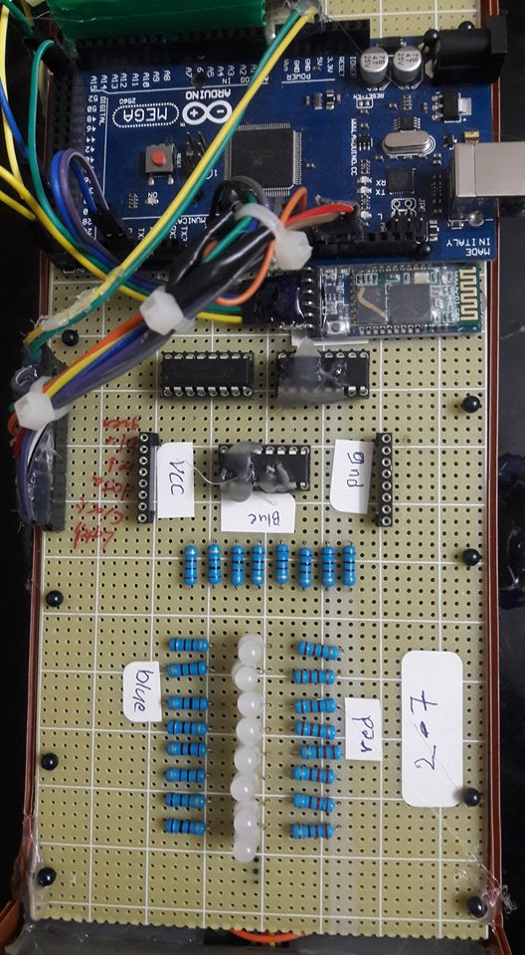
Implementation
Vertical Kit
Horizontal Kit

Slide 13
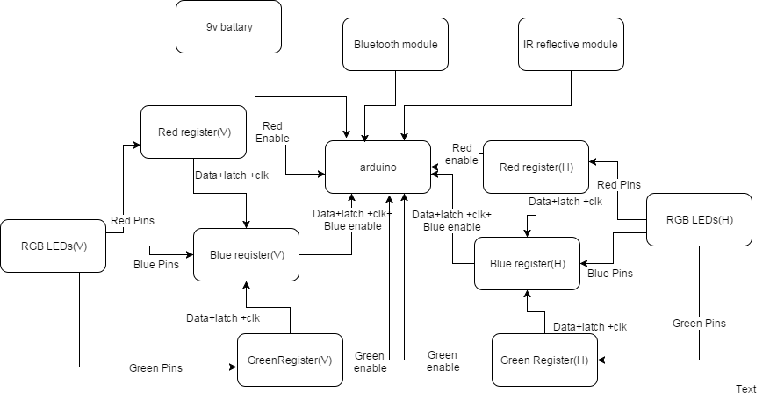
Implementation

Slide 14
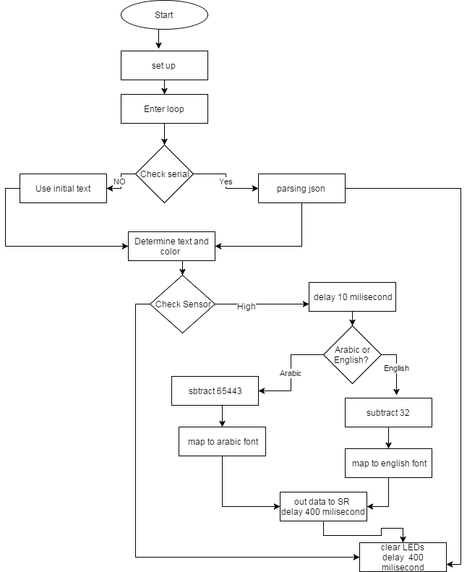
Implementation

Slide 15
Problems
Synchronization and delaying between letters, it was very hard to detect a special delay between patterns and letters to put every letter in its right position.
The kind of motor to use in which it can bear high weight.

Slide 16
Problems
Dealing with Arabic letters and representing a special pattern for each letter.
Combine kits together and balance them on motor, the system was very unstable and vibrated a lot due to the weight imbalance.

Slide 17
Problems
Writing code that synchronizes all components together.
Determine the appropriate sensor.

Slide 18
Future work
Add inner view to kit.
develop project to support more languages and professional animations.
increase number of LEDs to get more clear and large view.

Slide 19
Demo Time

Slide 20
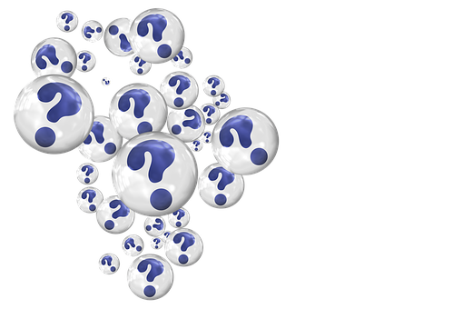
Thank You
Any Questions?

