Slide 1

HAND IN HAND
Presented by:
Aya Qartallo
Raya Ahmad
Supervisors:
Dr. Sufyan Samara

Slide 2

01
Problems
02
Solutions
03
Implementation
04
Architecture
05
06
Design
Client Side
07
Server Side
08
Final Results
09
Challenges
10
Future Work

Slide 3

Problems
Difficulty searching.
Difficulty submitting attachments.
Feeling embarrassed.
Difficulty finding needy students.

Slide 4

Solutions
Sending notifications.
Displaying compatible aids.
Electronic submission.
Reduce the feeling of shyness.
Donation section & sending notifications.

Slide 5
Features
Notifications
Dark & Light Theme
Chatting
Arabic & English Language
Searching Feature

Slide 6
Implementation
Android App
Design
Client Side
Server Side
Website

Slide 7
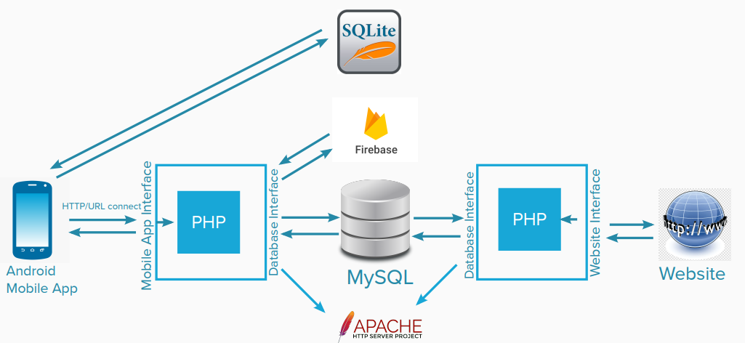
Architecture
MVC

Slide 8
Design
No templates
Shape & colors symmetry
Design smoothness
Easy to understand & use

Slide 9
Client Side
Receiving responses as JSON
Using POST & GET method
Send HTTP Request

Slide 10

Good documentation
Beautiful UI
Easy to learn

Slide 11

Good documentation
Beautiful UI

Slide 12





Server Side

Slide 13

Final Results
We achieved the desired goals of the application.
Properly functioning mobile application.
System of notifications to notify users.

Slide 14

Challenges
Communicate with the official in the Loans and Aid Department.
Learning and implementation at the same time.
Find clear sources to learn Flutter.

Slide 15

Future Work
iOS version development.
Adding an analysis system for requests.
Expand the application to include abroad scholarships.

Slide 16

Thank you for watching
THANKS FOR LISTENING

