Slide 1
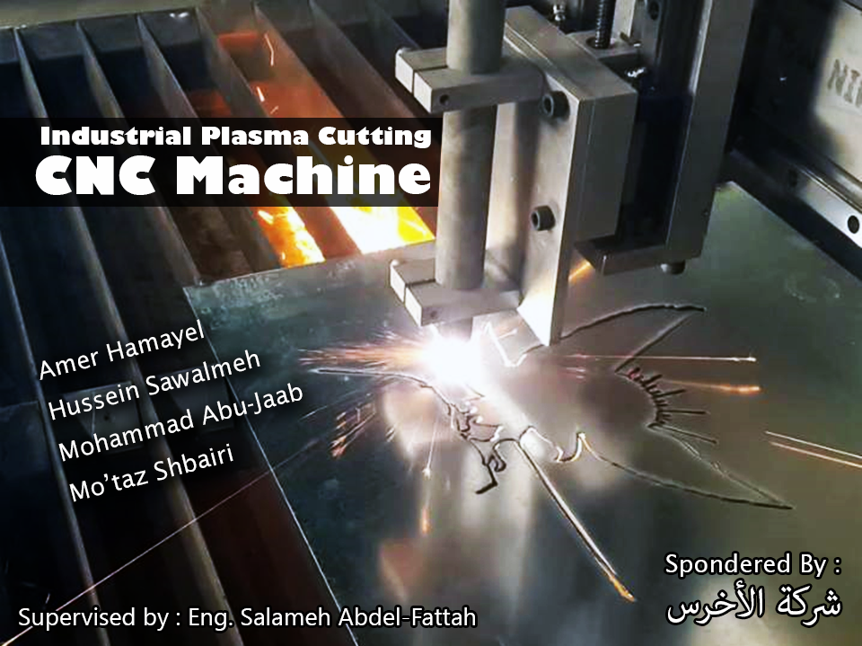
Industrial Plasma cutting CNC Machine

Slide 2
Outlines
What is Plasma CNC machine
Mechanical architecture
Electrical components
  Motors
  Sensors
  Protection
Control
Results and Future work
Recommendations

Slide 3
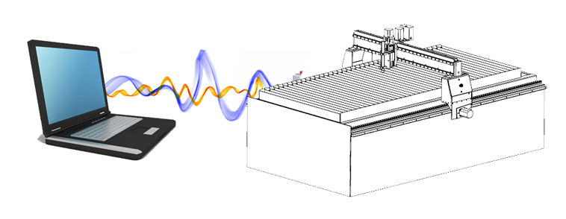
What is CNC
Computer Numerical Control
CAD Drawing Physical Part
Notes:
It/s an computer numerical control that reciver

Slide 4
What is plasma
4th state of the material
Use the hot compressed air to cut metal
Solid
Liquid
Gas
Plasma

Slide 5
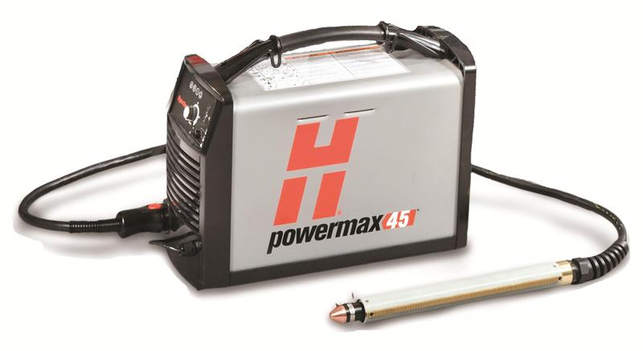
Hypertherm Plasma Machine
Hypertherm PowerMax 45
6 Bar Compressed Air
Thicknesses up to 9mm

Slide 6
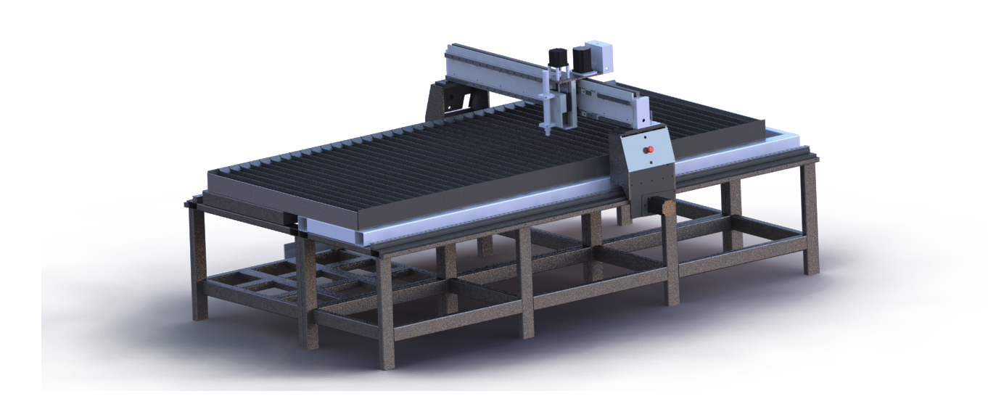
Mechanical Design

Slide 7
General Overview
Video of rotating model

Slide 8
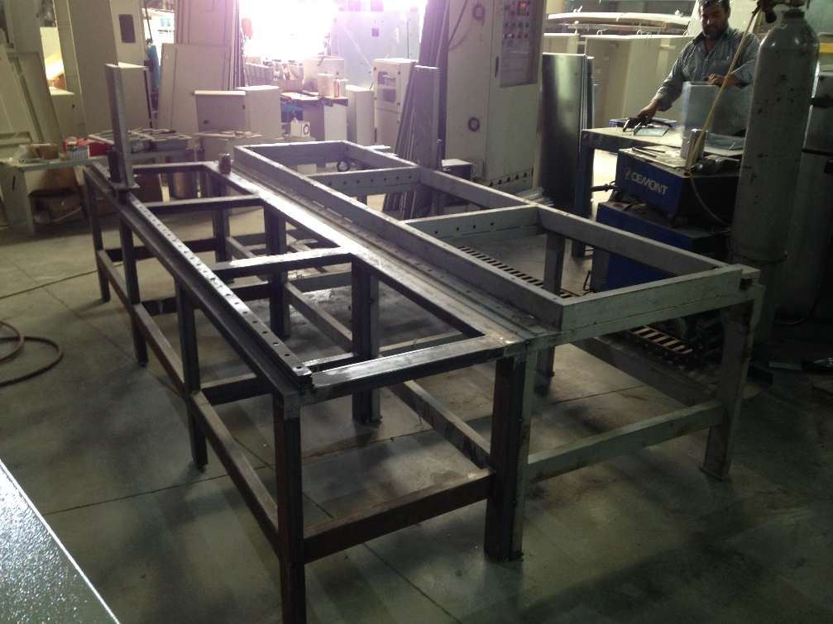
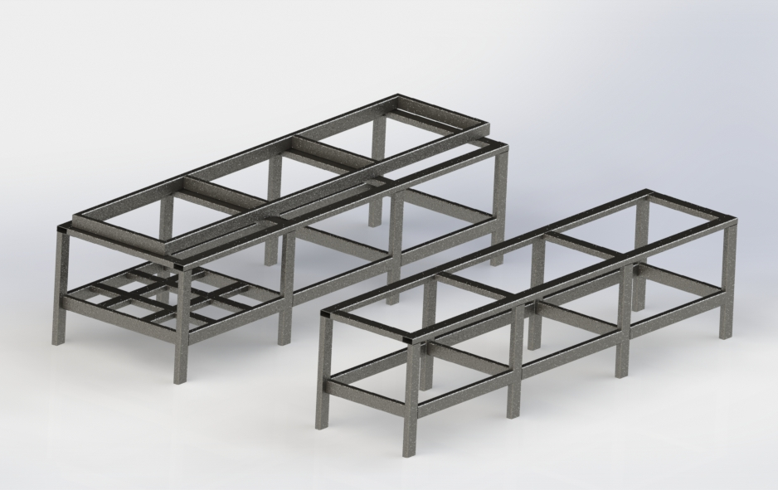
Frame design
Available woodworking Frame
An extension

Slide 9
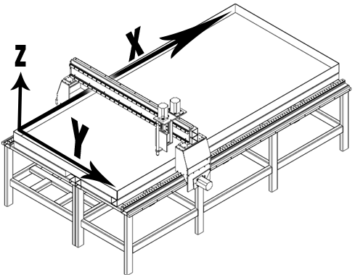
CNC Axes

Slide 10
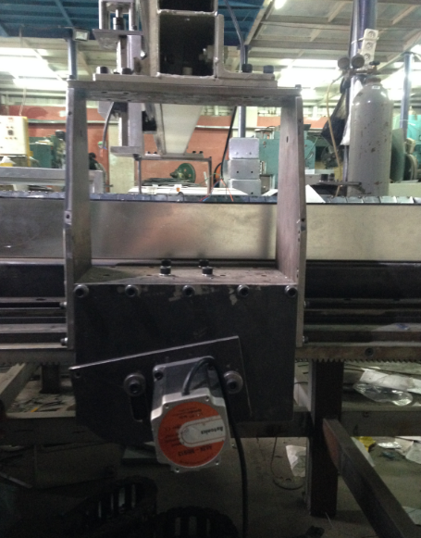
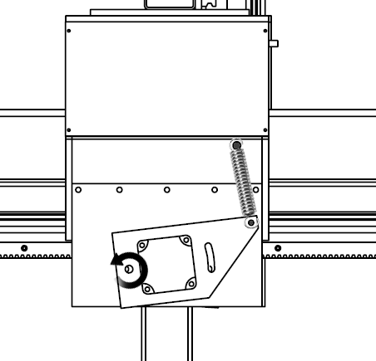
X-axis
Rail
Rack

Slide 11
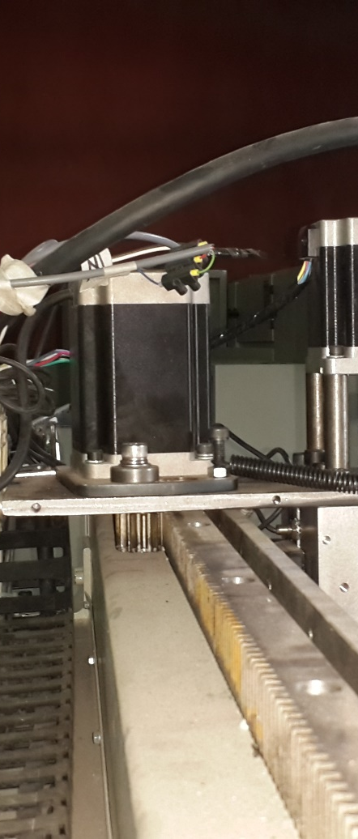
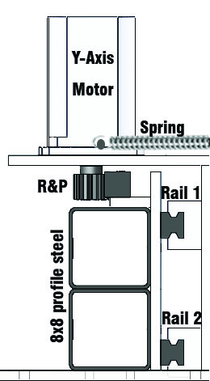
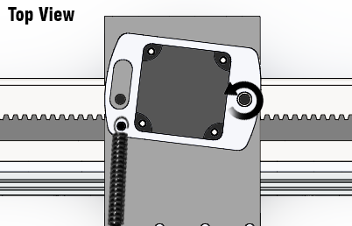
Y-Axis

Slide 12
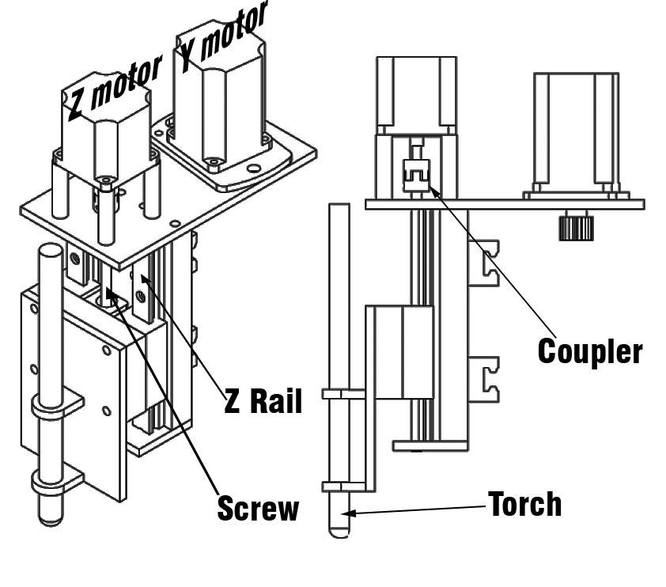
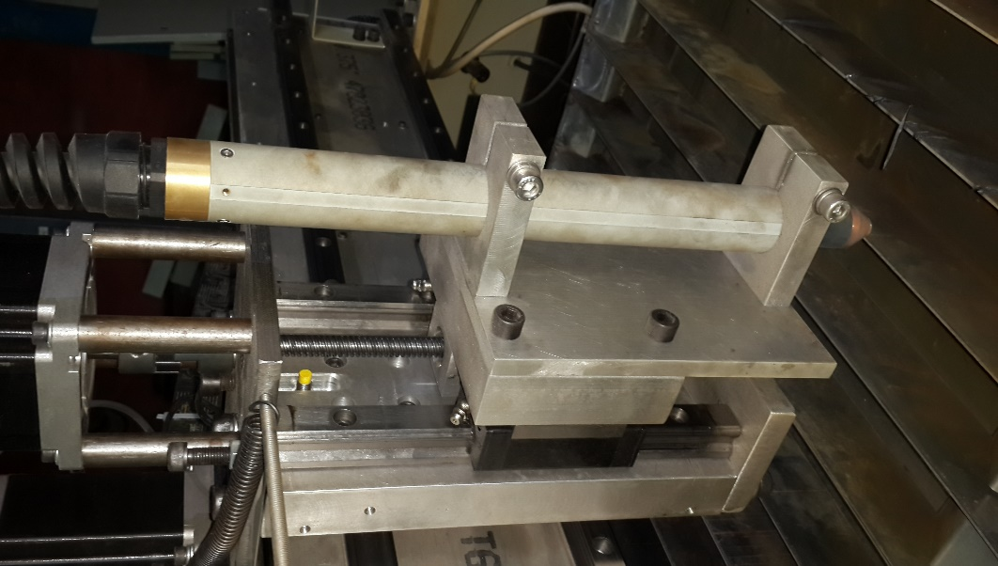
Z-axis

Slide 13
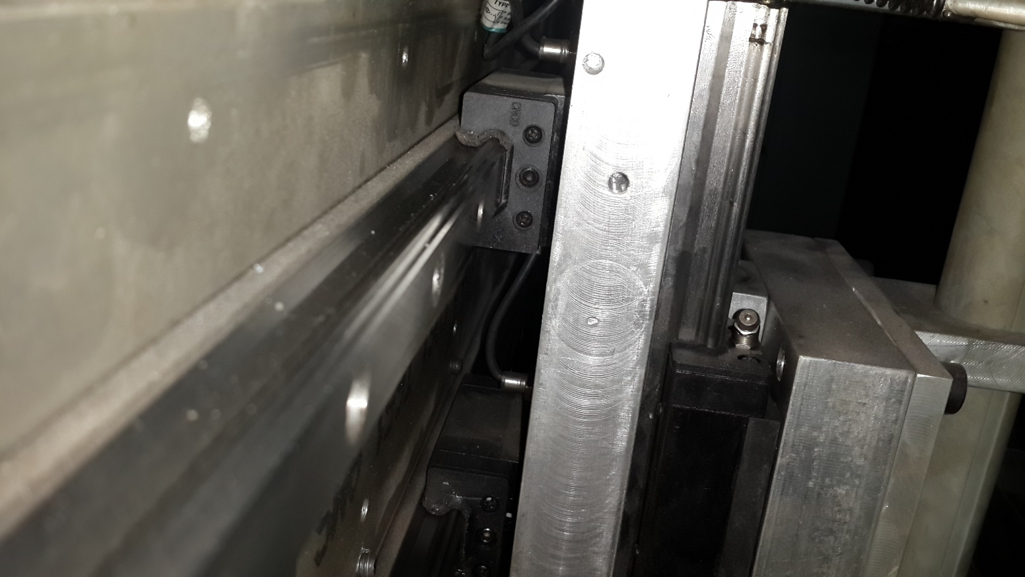
Rails
Y and Z rails
Notes:
Profile rails were used in this project due to …..
This kind of rails were used in all 3 axis...

Slide 14
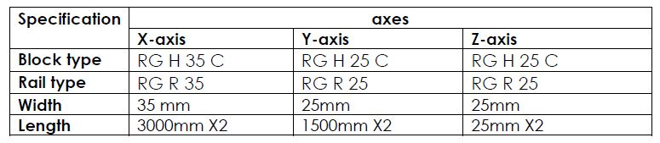
Rails
Rails used in each Axis
Notes:
This table shows the specifications of these rails
We can see that the X axis has rail width of 35 which is higher than Y and Z, this is because of the high load exerted on it

Slide 15
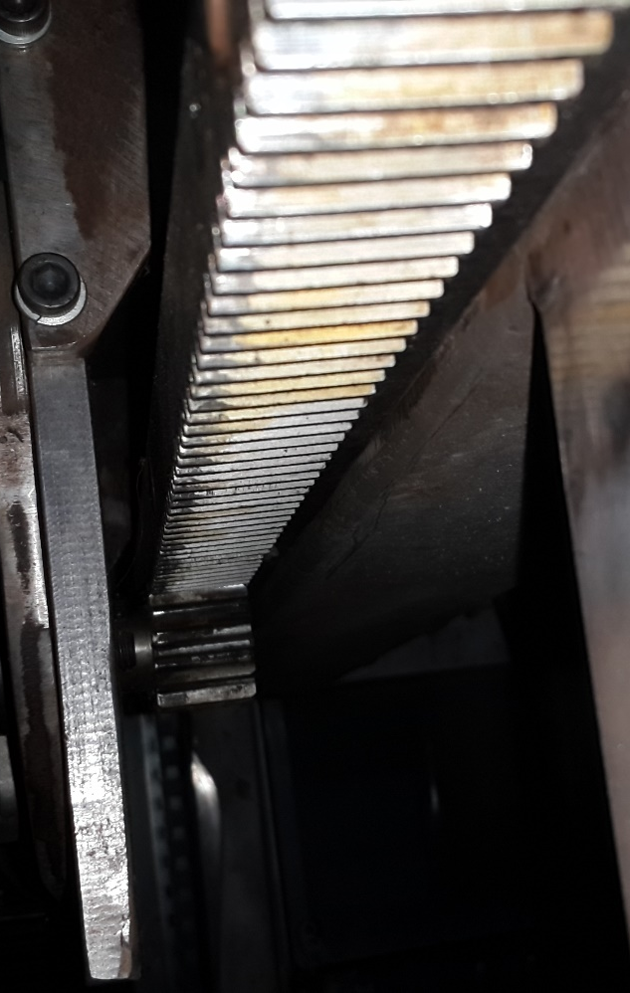
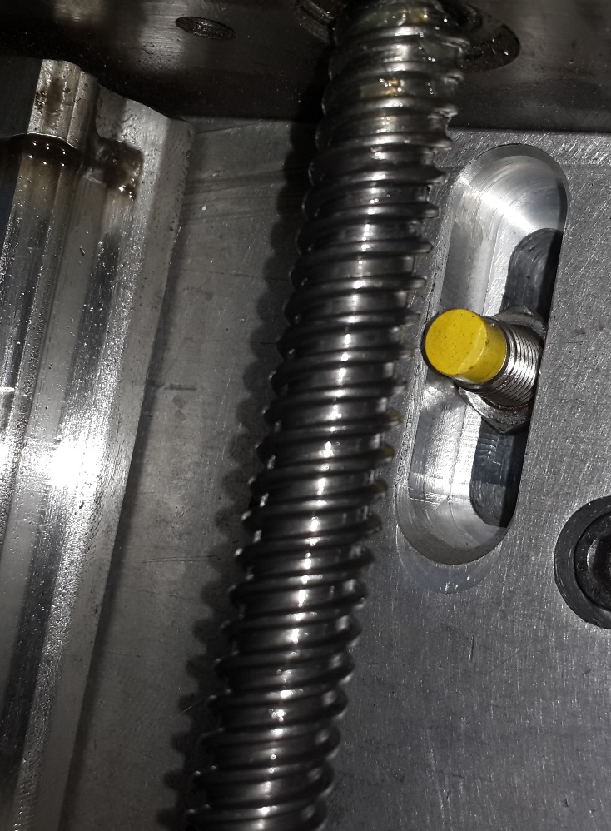
Transmission system
Rack and Pinion
Lead Screw
Notes:
convert rotational motion into rectilinear motion.
Rack & Pinion
most popular for longer distances.
Were used for x & y axes.
Lower cost
Used when Accurate Motion is required
Short Distances → was used for z axis. (250 mm)
Higher Cost

Slide 16
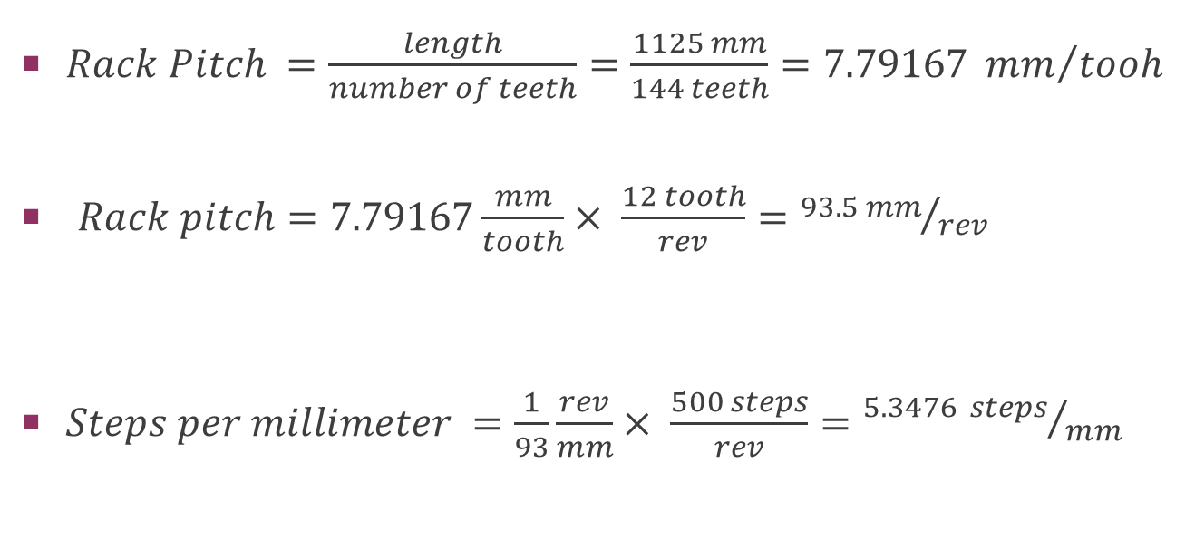
X and Y Motors Tuning (R&P)
$Rack Pitch =\frac{length}{number of teeth}=\frac{1125 mm}{144 teeth}=7.79167 {mm}/{tooh}$
$Rack pitch=7.79167\frac{mm}{tooth}× \frac{12 tooth}{rev}={93.5 mm}/{rev}$
$Steps per millimeter =\frac{1}{93}\frac{rev}{mm}× \frac{500 steps}{rev}={5.3476 steps}/{mm}$
Notes:
Motor tuning is the process of telling the CNC software how much pulses it needs
to travel 1 millimeter in a given axis.the pinion has a 12 teeth.
Form the motors datasheet; they have 500 step per revolution. So we get:
40 mm in x-axis
40*5.3476 = 214 steps.
ــــــــــــــــــــــــــــــــــــــــــــــــــــــــــــــــــــــــــــ
It’s worth mentioning to say that the error is not accumulated and it will be compensated in the next movement
command.

Slide 17
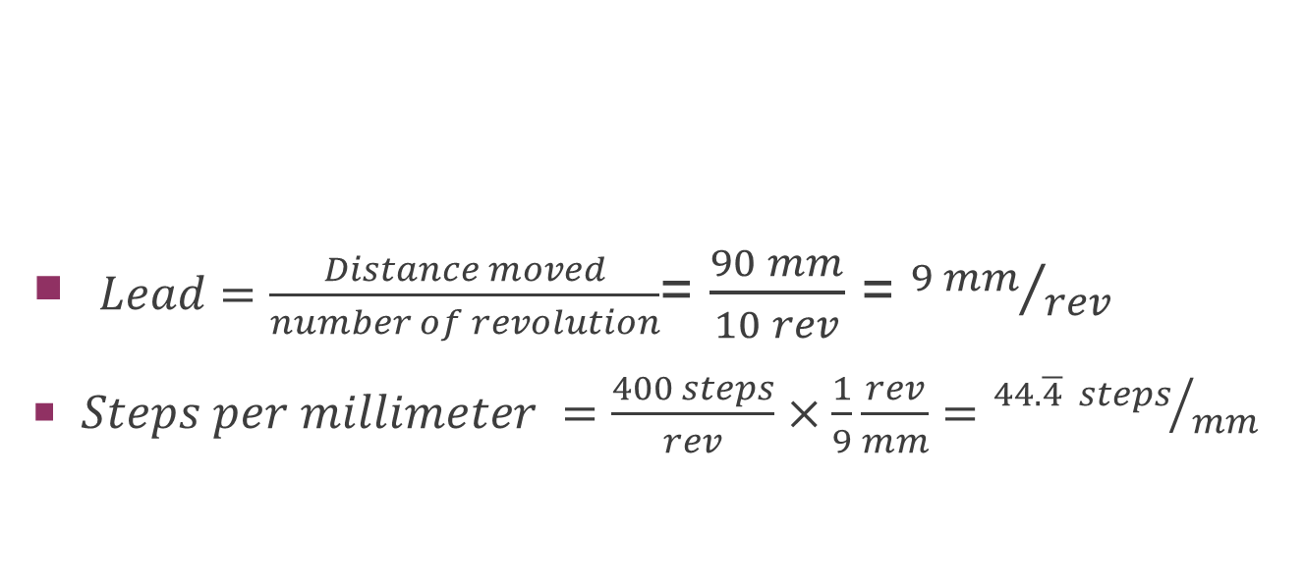
Z motor Tuning (Screw)
$Lead=\frac{Distance moved}{number of revolution}$= $\frac{90 mm}{10 rev}$ = ${9 mm}/{rev}$
$Steps per millimeter =\frac{400 steps}{rev}×\frac{1}{9}\frac{rev}{mm}={44.\overline{4} steps}/{mm}$
Notes:
Form the motor datasheet; it h as 400 step per revolution. So … etc.
Also
the error here is not accumulated and it will be compensated in the next movement
command.

Slide 18
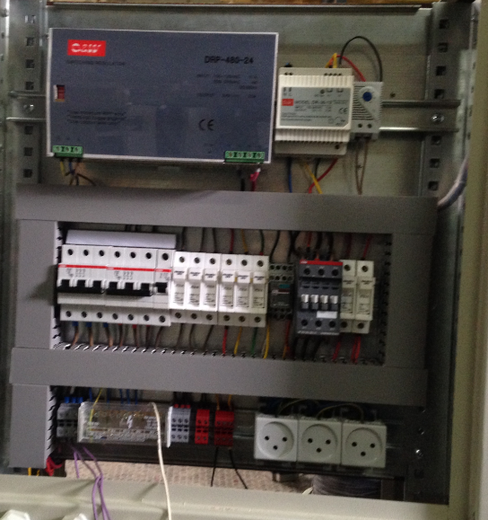
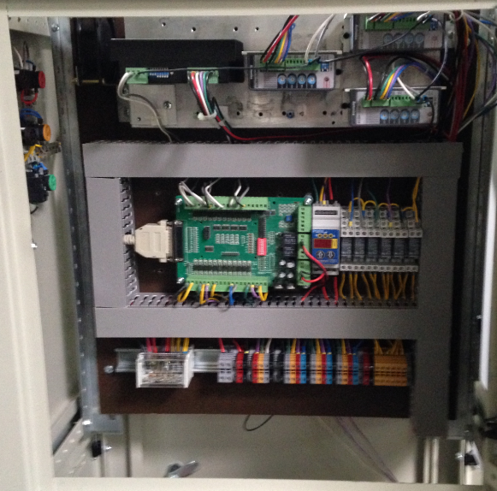
Electrical Components

Slide 19
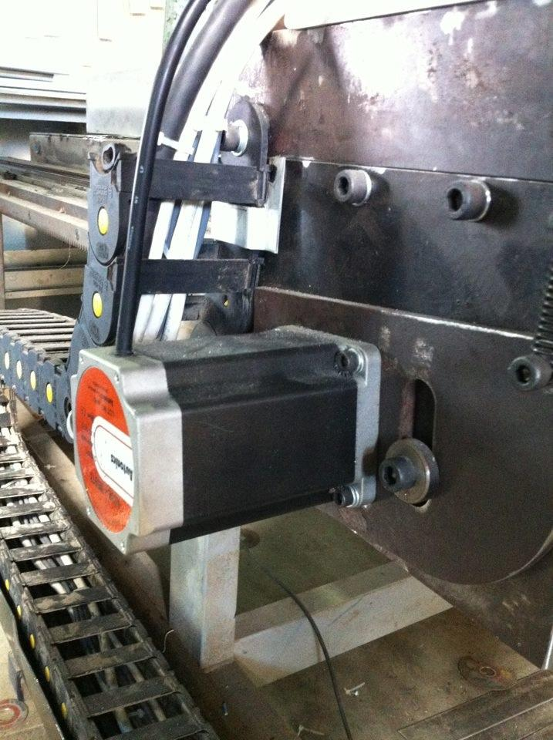
Stepper motor
Selection of stepper motor due to
Low cost
Simple control
High accuracy
Speed and torque
Two types of stepper were used
2-phase unipolar
5-phase

Slide 20
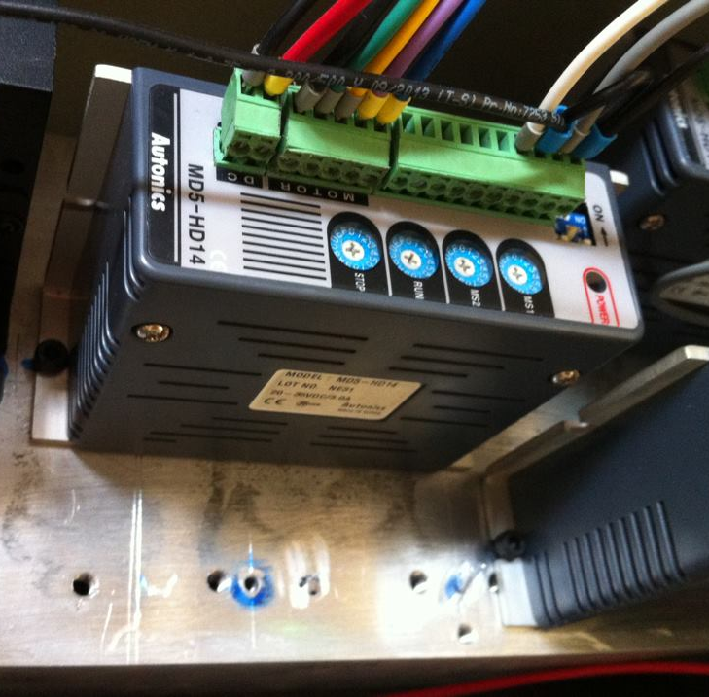
Drivers
makes the control of stepper motor simple and flexible
Receives Pulse and Direction signals
Power required: 24VDC, 3A

Slide 21
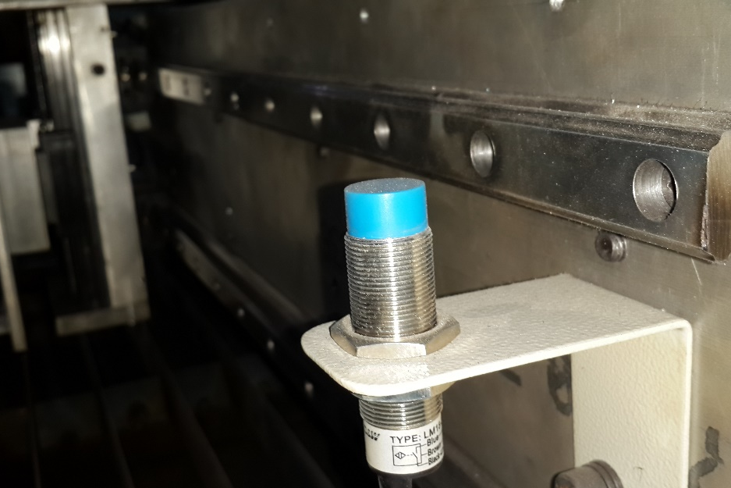
Limit switches
Inductive proximity sensors were used
prevents machine damage
Six limit switches

Slide 22
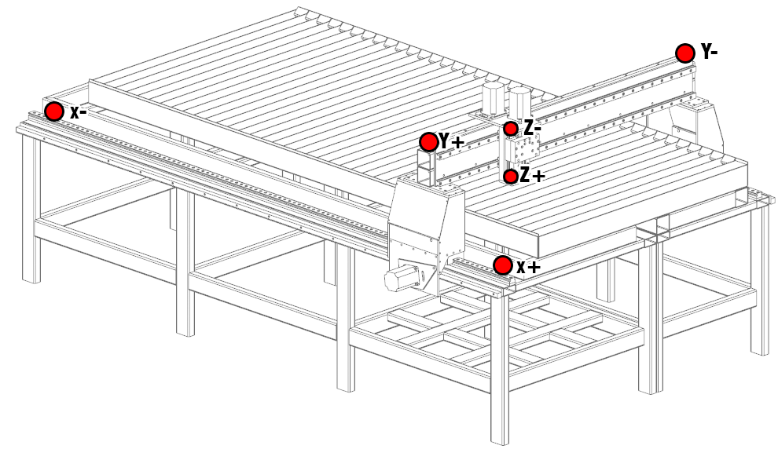
Positions of Limit switches

Slide 23
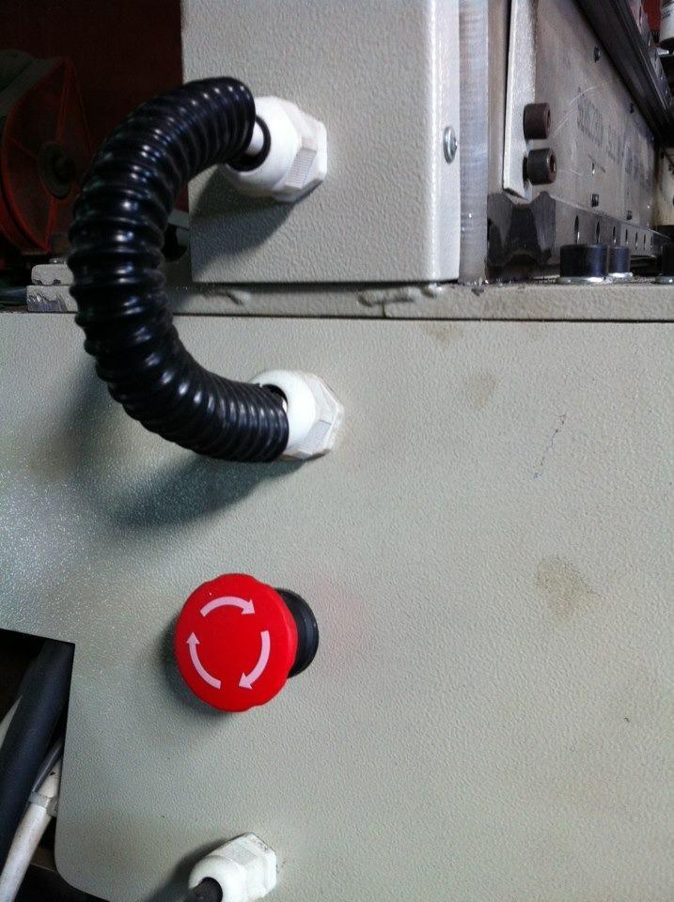
Emergency stop
Normally closed switches
Series connection
Stops all machine’s activities
Send signal to alert the software

Slide 24
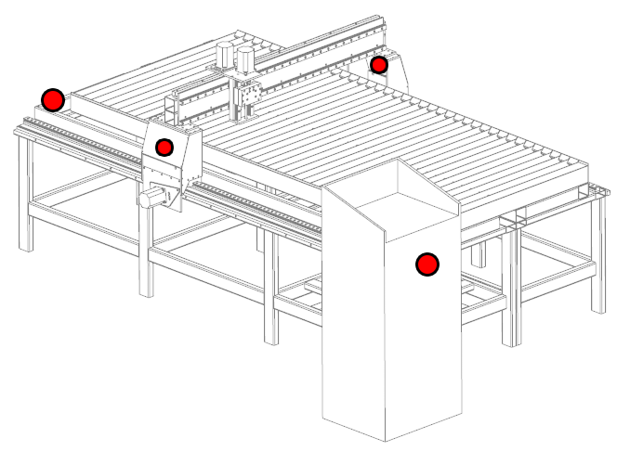
Positions of Emergency Stop
It should be reachable any where

Slide 25
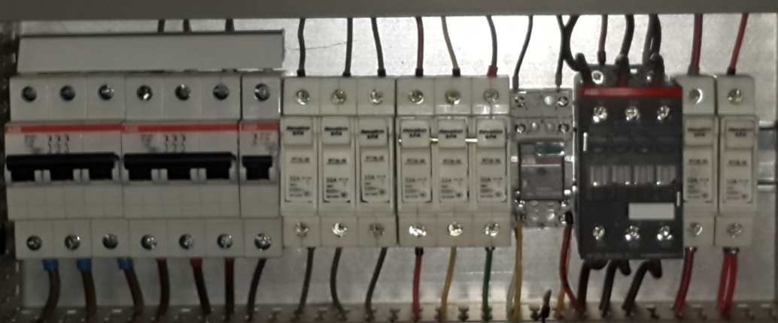
Electronics components protection
Circuit breaker to avoid short circuit effects
Fuses to limit current
Heat-sink,fan,thermostat to avoid heat effects

Slide 26

Power supply
Two main power supply
24 VDC , 20A for drivers, limit switches, fan and contactor coil
12 VDC , 2A for breakout board

Slide 27
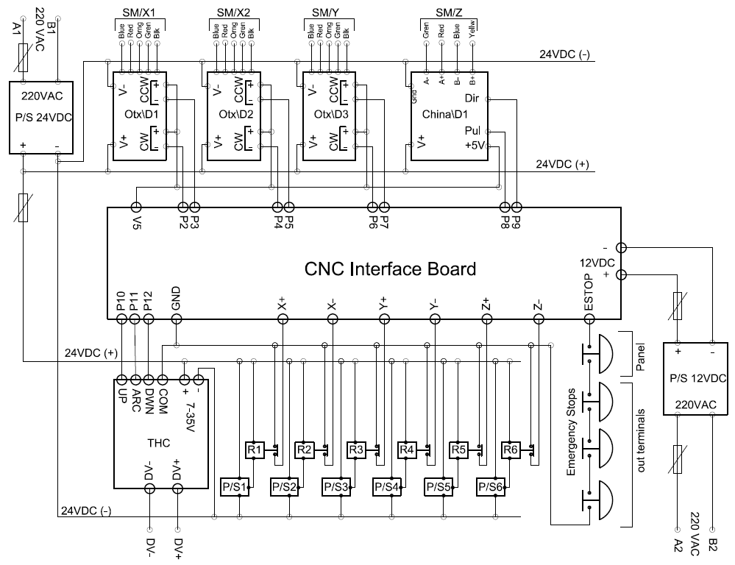
Complete control circuit

Slide 28
Control

Slide 29
CAD drawing software
Computer Aided Drawing
It draws the part as a vector image
Saved as DXF

Slide 30
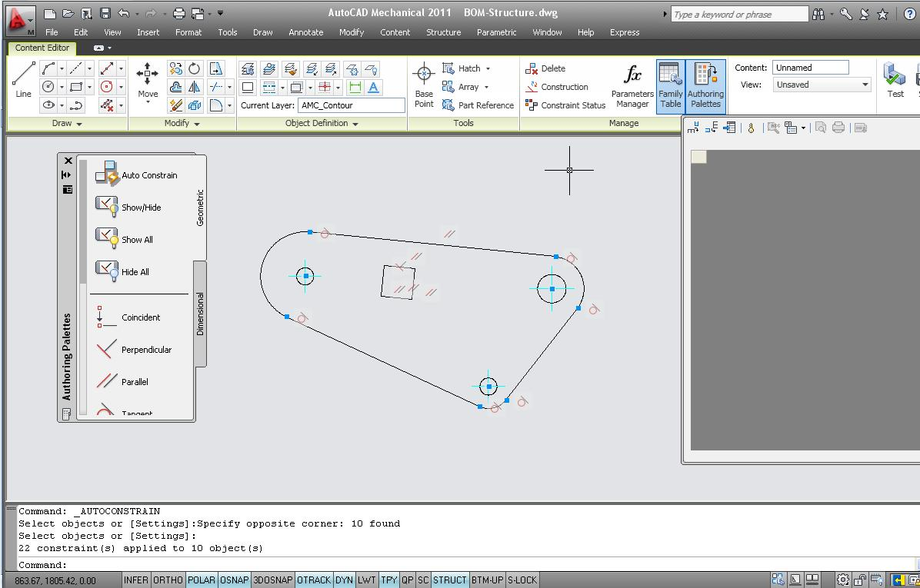
CAD drawing software
Software Example
AutoCAD
Corel Draw
Adobe Illustrator
AutoCAD software

Slide 31
Cam Software
Computer Aided Manufacturing
It converts the DXF to machine instruction language G-Code
Parameters needed to be optimized is
  Offset
  Speeds
  Lead in

Slide 32
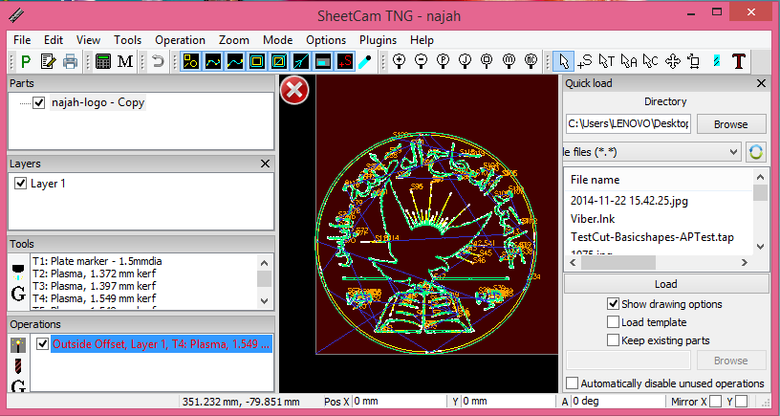
CAM Software
Software Example
SheetCAM
CamBam
SheetCAM Software

Slide 33
Control Software
It converts the G-Code into Pulse signals through the parallel port

Slide 34
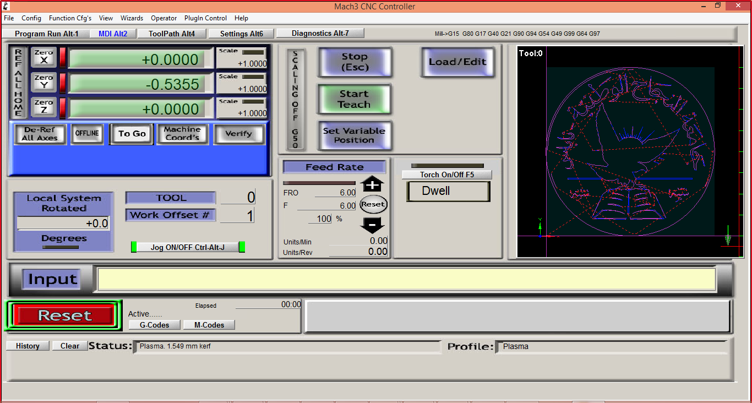
MACH3
Flexible
Customizable
Provides Adjustable Acceleration
Can handle with several inputs and feedback

Slide 35
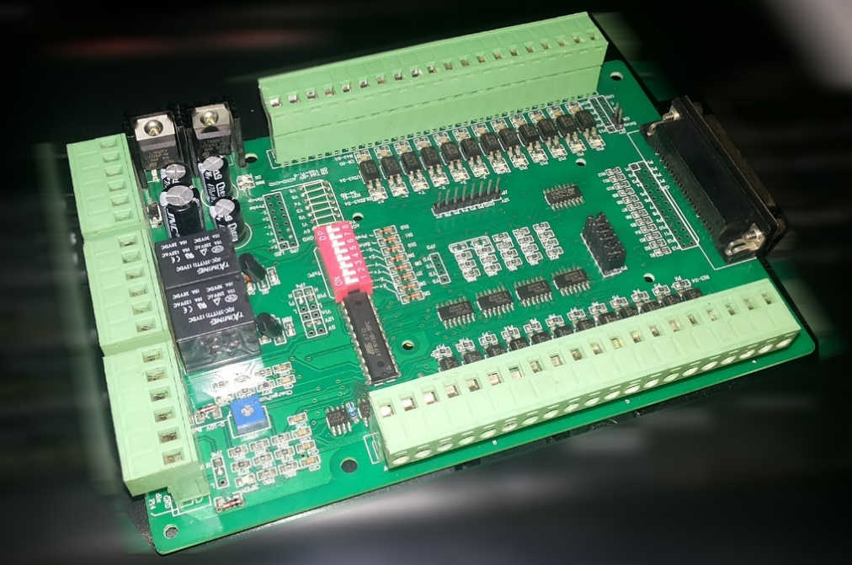

BOB
  Communicate Via Parallel Port
  Provides Opto-isolation
  MACH3 $→$ Motors
  Inputs $→$ MACH3

Slide 36
Torch Height control (THC)
Torch-Plate Gap height must be consistent
  If LOW torch head will be damaged
  If HIGH Arc will not transfer
THC is used to maintain the gap height distance

Slide 37
THC Principle of work
Arc voltage depends on the Gap distance
  If HIGH > higher voltage
  If LOW > lower voltage
Voltage is the feedback
Z-axis moves until getting the required height.

Slide 38
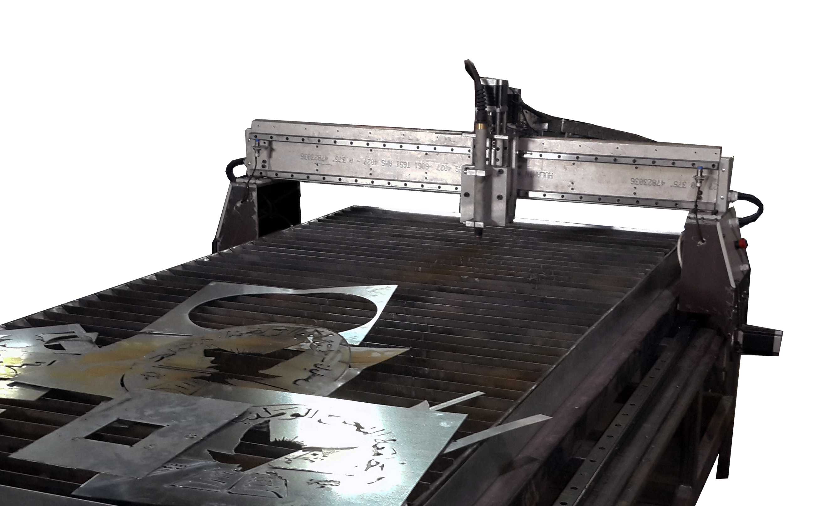
Results

Slide 39
Results
We get a CNC with cutting dimensions of 280x130
Cut thicknesses up to 1 cm

Slide 40
Vedio of cutting vedio

Slide 41


Slide 42
Recommendations
Make sure time is enough
Make sure you and your team have the skills required to achieve such a project.
Be organized and plan for every tiny detail. And do make documentations.
The one should have the ability to work under pressure. As well as to be responsible of many decisions required to be done through the project.

Slide 43
THANK YOU

