Slide 1

An-Najah National University
Networks and Security Department
Graduation Project
Fog Network Orchestration for Heterogeneous Networks
Team Members: Raghad Jawabreh, Narmeen Darwashe
Advisor: Dr. Othman Othman

Slide 2
Agenda
Introduction
Problem & Motivation
Traditional Solutions
Mining techniques
Mining Detection and Prevention System (MDPS) design
Evaluation & Results
Future Work
Conclusion
Paper Acceptance

Slide 3
Introduction
Internet of Things (IoT)
Cryptocurrency & Blockchain
Pools

Slide 4

Internet of Things (IoT)
Everything (objects) in everyday life are connected to Internet and able to identify themselves to other objects
Representing network of connected objects exchanging data
Poor security or even none at all

Slide 5
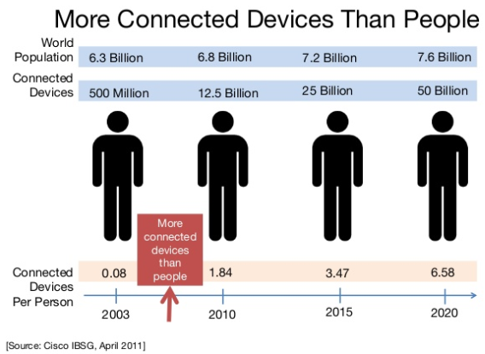

Slide 6

Cryptocurrency
Digital currency, money exchange without bank
Huge attention and investment
1603 currencies
Total Market Cap: $381,019,238,087
Examples; Bitcoin, Monero and Ripple

Slide 7

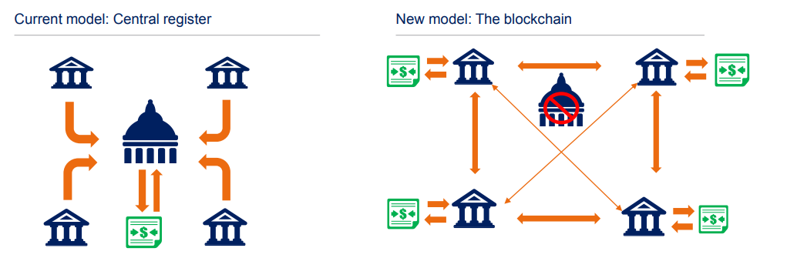
Blockchain
Ledger is every transaction happened in network
Each node has same ledger
Mining confirms transactions and secures network

Slide 8
Pools
Pooling of resources by miners, who share their processing power over a network, to split the reward equally, according to the amount of work they contributed.

Slide 9
Problem & Motivation
Cybercriminals steal processing power
Create cluster of slaves called botnet
Bots mine cryptocurrency for botmaster
“Very likely to have bots mining cryptocurrency”

Slide 10
Statistics
On Feb 2018, Smominru infected 526,000 devices, mined 9,000 Monero coins, worth $3.6 million
On Feb 2014, Linux.Darlloz infected 31, 716, mined 42, 438 Dogecoins
Mirai botnet infected 148,000, used for mining
On May 2018, WinstarNssmMinerv infected 500,00 devices .

Slide 11
Mining techniques
Web Mining: uses JavaScript code in browsers
Ex; coinhive service
Software Mining: application that connects to pools or network to allow mining
Ex; MinerGate

Slide 12
Traditional solutions .. inadequate ?!
Browser extensions: Block if matched with blacklisted domains
Doesn’t care about content, evaded by copying code to non-blacklisted domains
2. Block domains in hosts file
Vulnerable to domains not listed
3. Antivirus software
NOT capable of detecting fileless malware
Clever software remain undetected
WinstarNssmMiner can shut down AV
Most IoT can’t install AV

Slide 13

“Kaspersky Lab experts predict that Web miners could be 2018’s most common threat. In 2017 our security solutions stopped the launch of Web miners on more than 70 million occasions.”
Source: How Kaspersky Lab products protect against miners

Slide 14
Mining Detection and Prevention System (MDPS)
“ MDPS is a software that operates on a gateway; makes it a solid defence that secures all connected devices from cryptocurrency mining .”
MDPS represent proxy server
Intermediary between clients and Internet
Generate on-the-fly certificate to trick clients into believing it is the server
CLUE: connection to mining pools or cryptocurrency network is a MUST to perform mining

Slide 15
MDPS Design

Slide 16
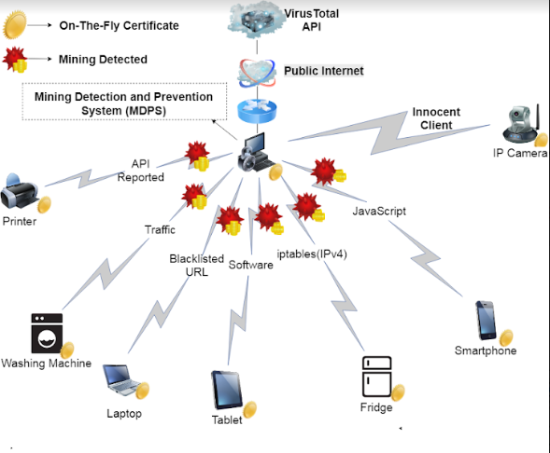

Slide 17
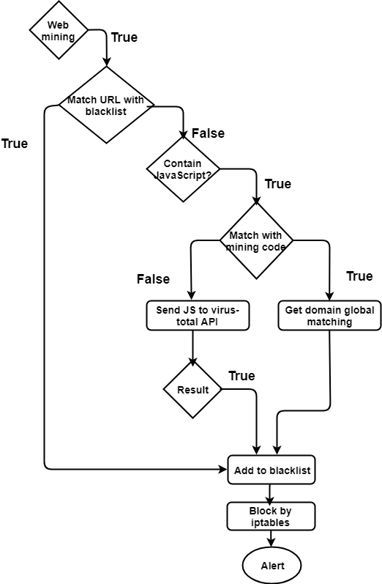
Web Mining Mitigation
Algorithm

Slide 18
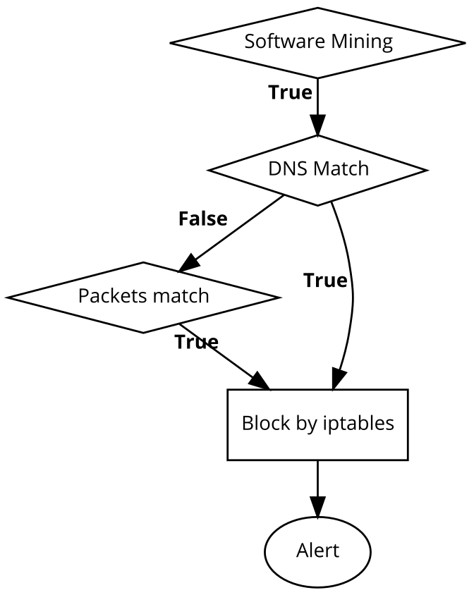
Software Mining Mitigation Algorithm

Slide 19
Evaluation & Results
Comparison between MDPS and Antiviruses
MDPS | Kaspersky | BitDefender | Comodo | McAfee | Avast
✓ | X | X | X | X | X | Plasma
✓ | ✓ | ✓ | ✓ | ✓ | X | EthDcrMiner64.exe
✓ | X | X | X | X | ✓ | MinerGate
✓ | X | X | X | X | X | FLUXMINER
✓ | X | X | X | X | ✓ | Silent-Miner-XMR-Monero
✓ | X | X | X | ✓ | ✓ | Stealth Miner
✓ | ✓ | X | X | X | X | ccminer

Slide 20
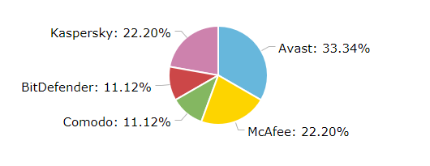
Detection percentage

Slide 21
Detection percentage of MDPS and VirusTotal
MDPS | VirusTotal
✓ | X | Plasma
✓ | (72.3%)✓ | EthDcrMiner64.exe
✓ | (11.45%)✓ | MinerGate
✓ | X | FLUXMINER
✓ | (4.9%)✓ | Silent-Miner-XMR-Monero
✓ | X | Stealth Miner

Slide 22
Future Work
1- MDPS Sandbox: isolated testing without exposing critical system to danger.
2- MDPS API: aggregates many antivirus products and online scan engines to check for miners
3- Cloud: create massive blacklist that approximately contain all mining websites and pools

Slide 23
Conclusion
MDPS is a software that operates on a gateway; makes it a solid defence that secures all connected devices from cryptocurrency mining.

Slide 24


Paper Acceptance
MDPS paper is accepted for presentation and publication at ACM International Conference (ICFNDS) on Future Networks and Distributed Systems.
Event will be held at Middle East University, Amman, Jordan, on June 26-27, 2018.

Slide 25
References
[1] https://www.finder.com.au/why-banks-are-running-towards-the-blockchain
[2]https://www.intel.com/content/dam/www/public/us/en/documents/white-papers/future-retail-through-iot-paper.pdf
[3] http://www.cloudbus.org/papers/Internet-of-Things-Vision-Future2012.pdf
[4]https://www.intel.com/content/dam/www/public/us/en/documents/white-papers/future-retail-through-iot-paper.pdf
[5]https://medium.com/michiganblockchain/the-world-of-blockchain-f3b268e3d748
[6]Kishore Angrishi, Turning Internet of Things(IoT) into Internet of Vulnerabilities (IoV) : IoT Botnets https://arxiv.org/pdf/1702.03681.pdf

