Slide 1
TEMPERATURE
CONTROLLER

Slide 2
Objective Of Project
Our project aimed to provide design for a practical circuit that can provide us a possibility of power controlling, while control the input power we can control the output whatever it is, it may be motion, lighting, temperature ,etc.
We will provide an application that considered as an example of the system which we can control its output, this system will be the heater, and its output is temperature.

Slide 3
The control can be achieved by more ways :On-Off, Phase Firing and Zero Firing controller , but we will use the Zero firing controller using ARDUINO language to program a Microcontroller( ARDUINO MEGA) that considered as the Brain of our project.

Slide 4
THE EQUIPMENTS

Slide 5
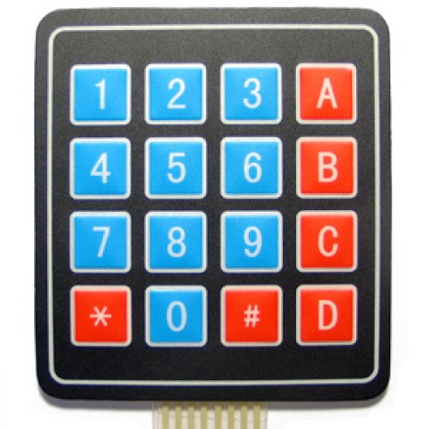
KEYPad
Keypad provides a communication between the user and hardware .
The user use it to insert the desired temperature.

Slide 6
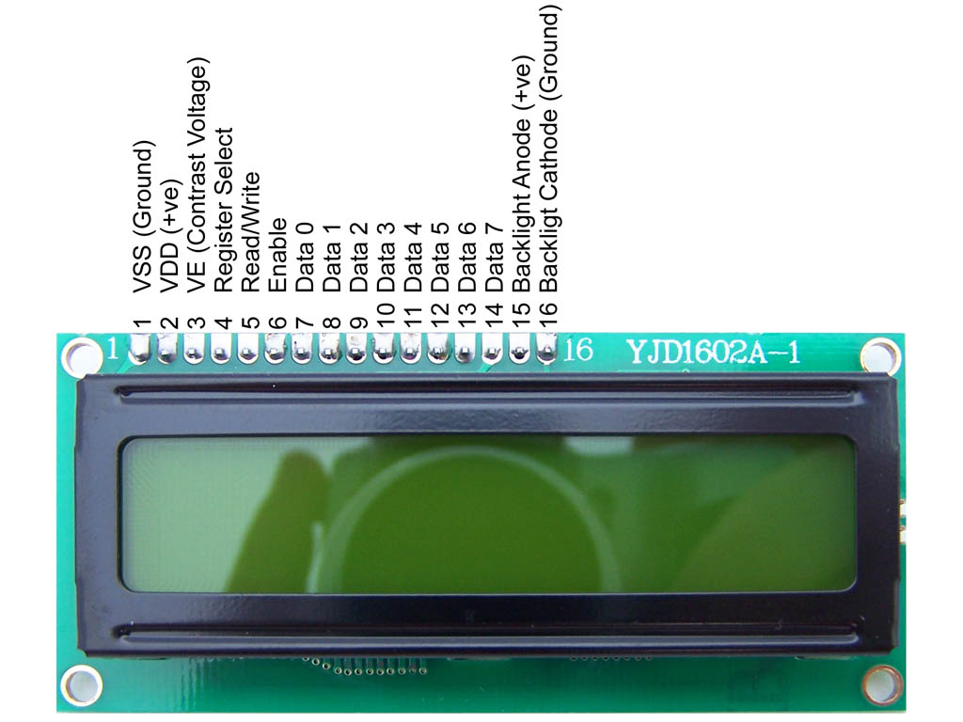
LCD
View the temperature value .
display the instructions that the user should follow to run the project.

Slide 7
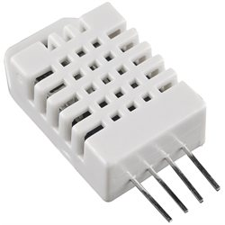
DHT22
The DHT22 is a basic, low-cost digital temperature and humidity sensor that work as a feedback connecting the application system.
This sensor measures the temperature in specific place.

Slide 8
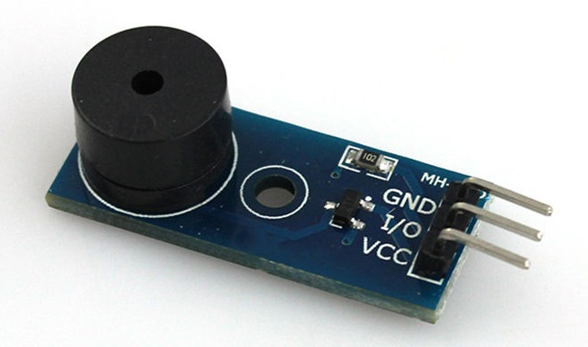
Buzzer
For warnings

Slide 9
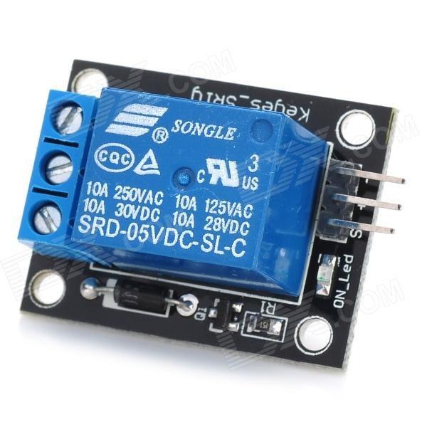
Relay
A relay is an electrically operated switch .
Relays are used where it is necessary to control a circuit by a separate low-power signal, or where several circuits must be controlled by one signal

Slide 10
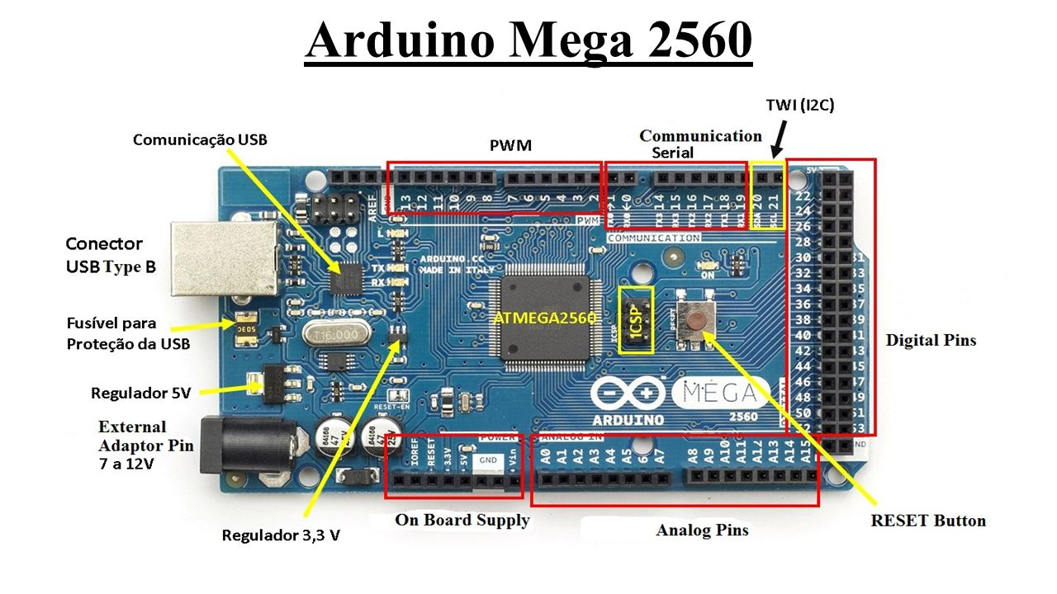
ARDUINO MEGA

Slide 11
It is the brain of the project, depending on the code that installed on it, we chose it because it has a good size of memory also a good number of input output pins .
It has 54 digital input/output pins (of which 14 can be used as PWM outputs),
16 analog inputs,
4 UARTs (hardware serial ports),
a 16 MHz crystal oscillator,
a USB connection,
a power jack,
an ICSP header, and a reset button.

Slide 12
Zero Firing

Slide 13
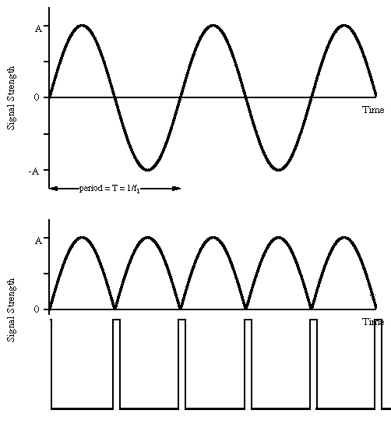

Slide 14
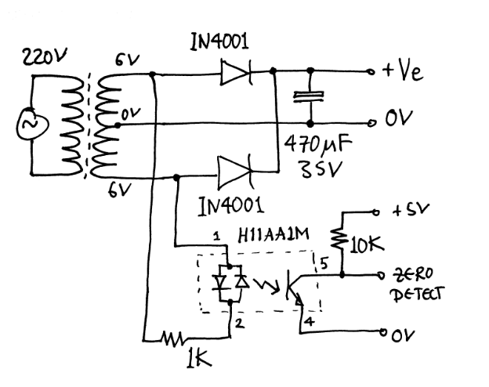
Project circuits
Zero crossing detector

Slide 15
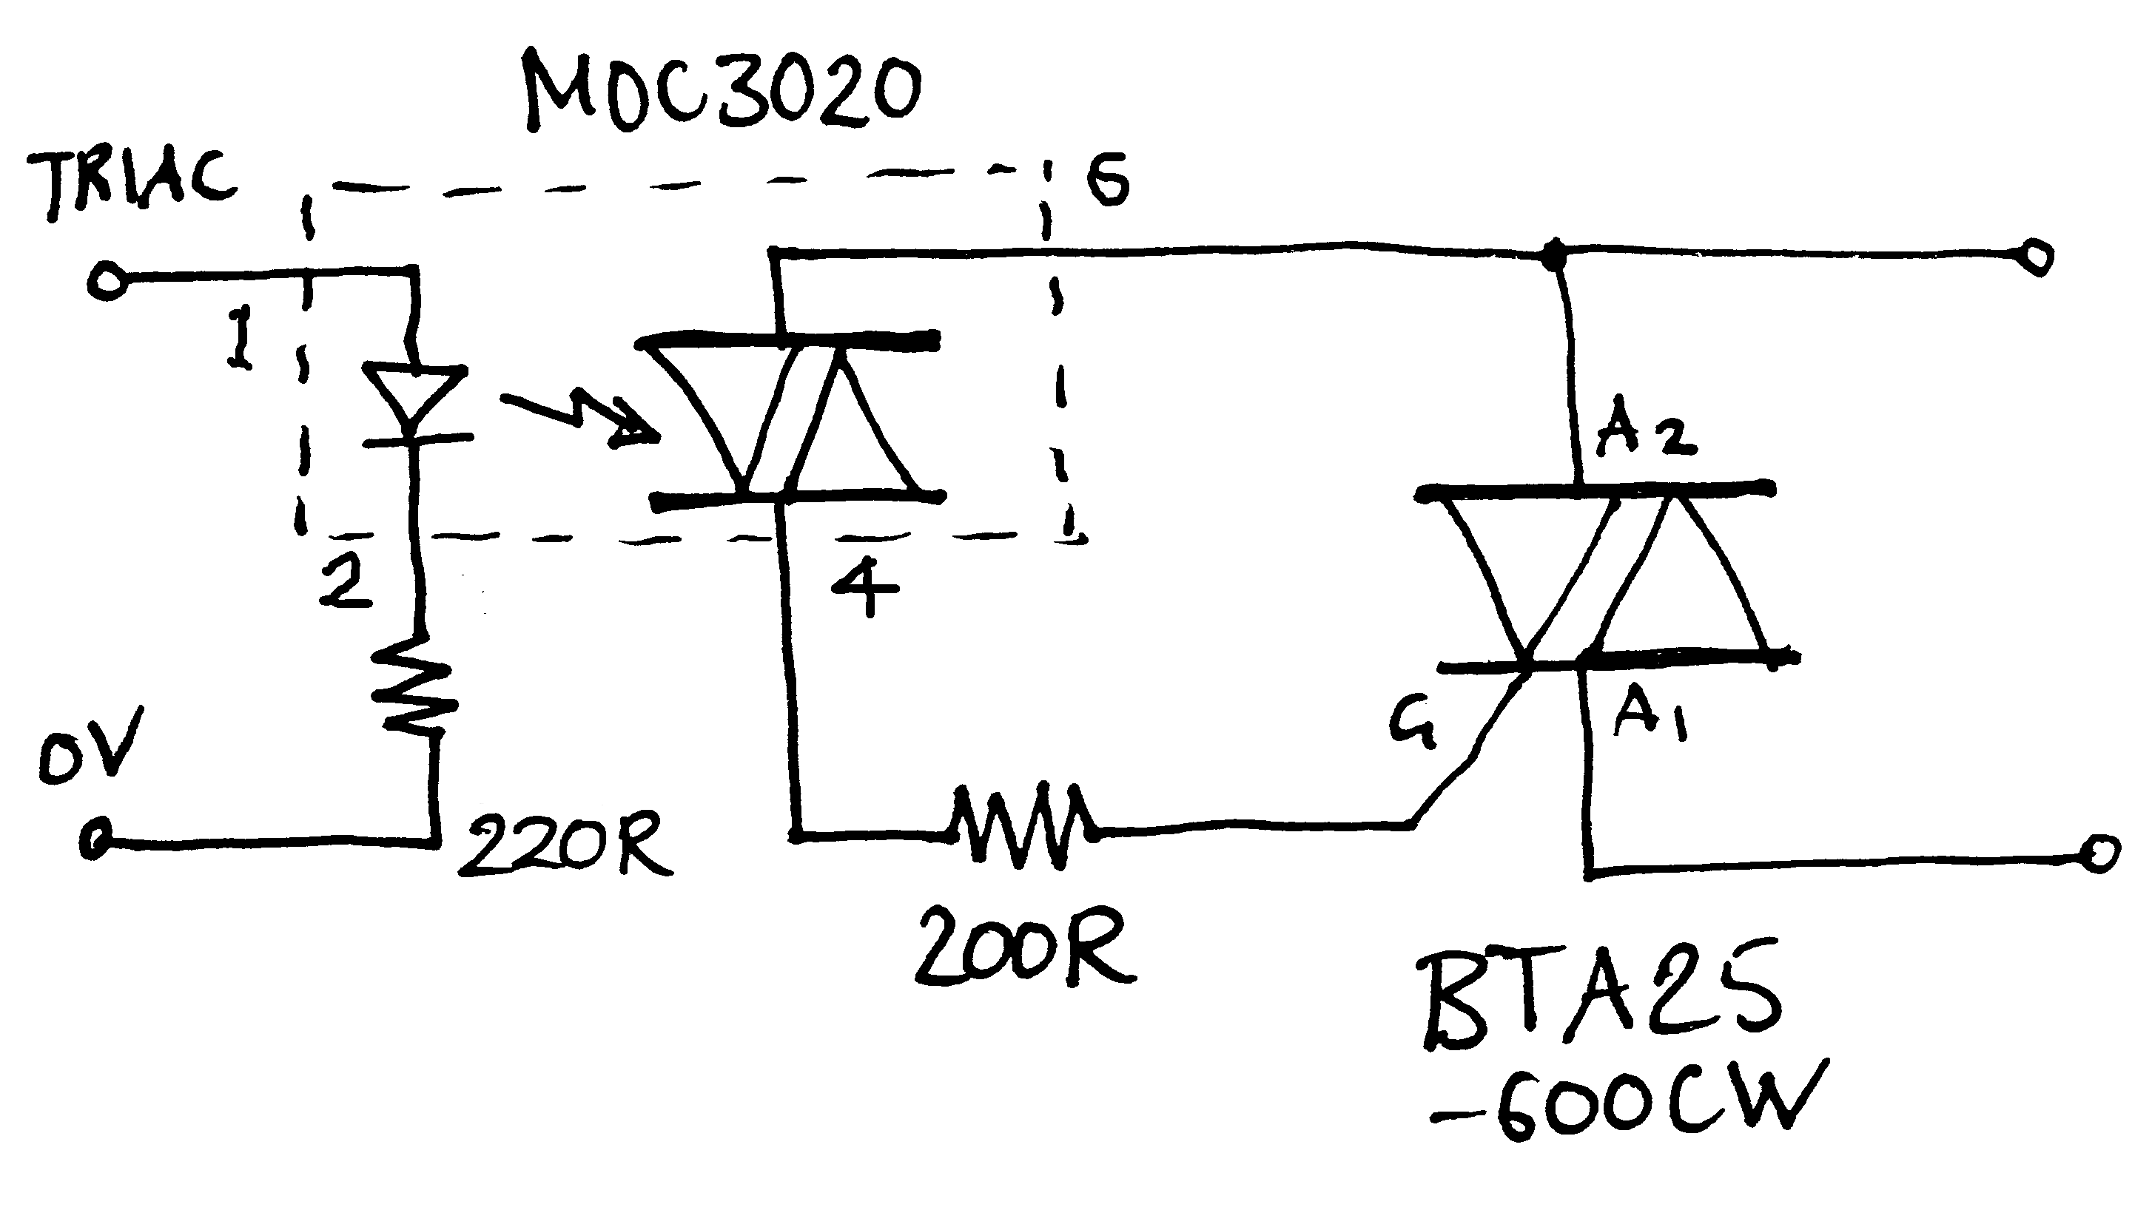
The Triac driver circuit

Slide 16
Problems & Solutions

Slide 17
The zero detecting circuit that we use, was not too satisfy and didn’t give us the wanted result, so we used another circuit that is more suitable.
There was not a Reset condition, we solved it by put a short circuit.

Slide 18
In the AC cct which is similarly to the DC cct we have faced a problem with choosing the suitable Resistance , By this reason ,we looked for it on internet, so we tried more than circuit.
The code that we used had some errors but we solved it.

Slide 19
We want to use 2 channels by using 2 heaters but when we use an Arduino Mege we have a problem how to connect 2 heaters in two different pins as outputs, because we have an limits I/O pins so we connect the 2 heaters as 1 heater by take an voltage average and then enter it to the Arduino.

