Slide 1

Customizable Service Provider Platform
Students:
Yaqout Salameh & Shahd Lubbadeh
Supervisor:
Dr. Anas Toma

Slide 2
Outlines
Introduction
Functionalities
Technologies Used
Live Demo
Future Work
Notes & Questions

Slide 3
Introduction
What is ‘Customizable Service Provider Platform’?
Why ‘Customizable Service Provider Platform’?
How will this help?
How did we achieve this?

Slide 4
Functionalities

Slide 5
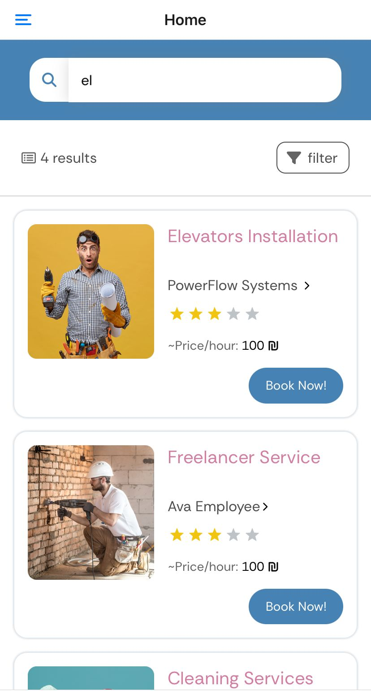
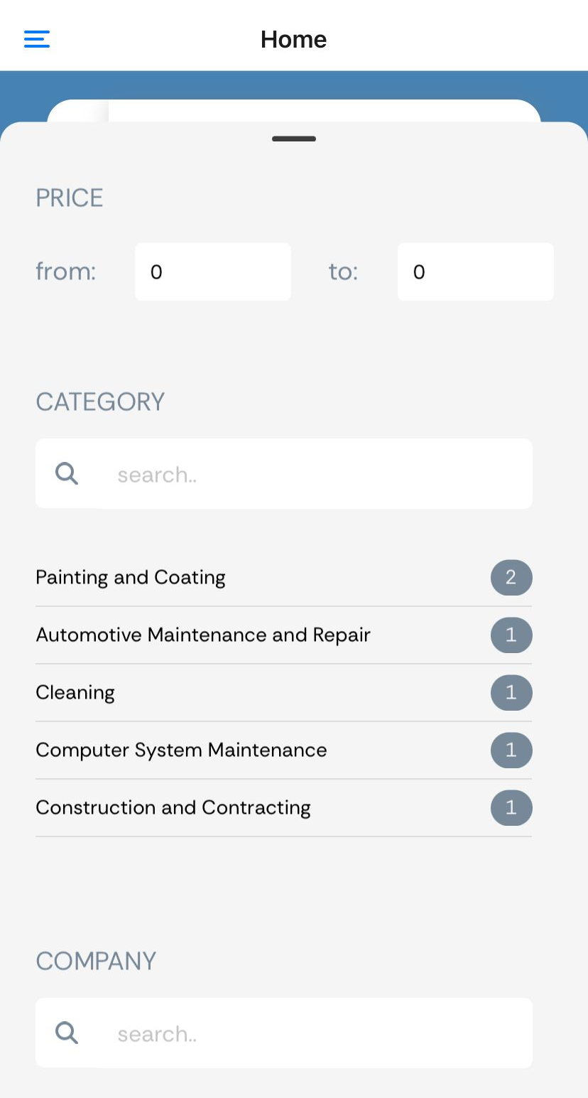
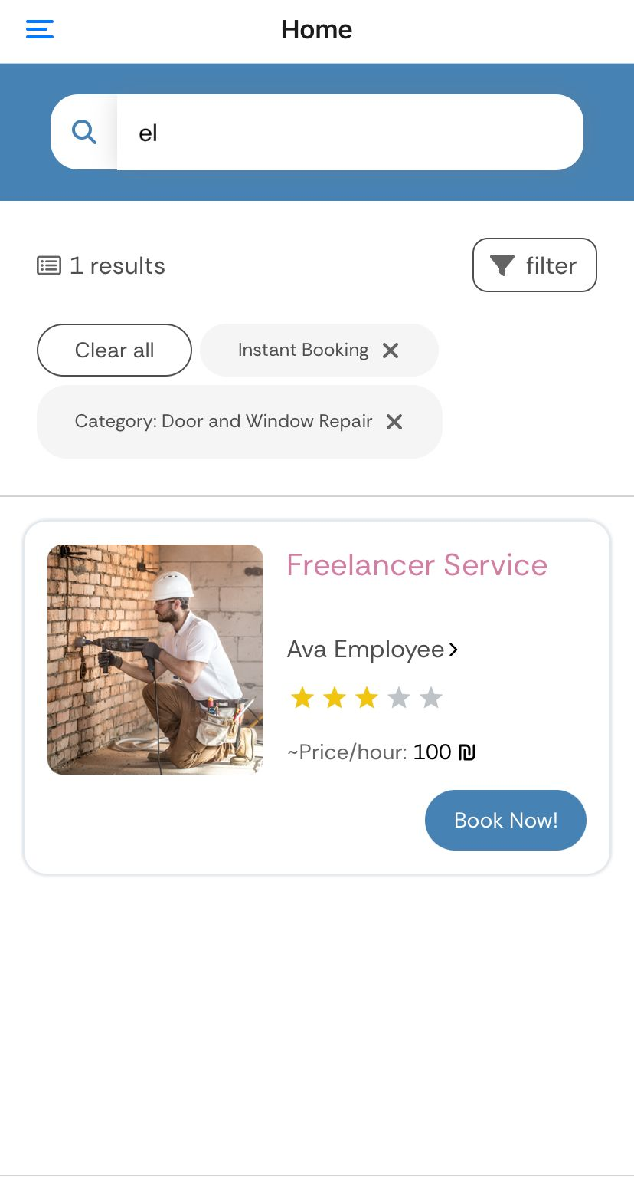
Search Experience
Customers discover services and find what they need effortlessly

Slide 6
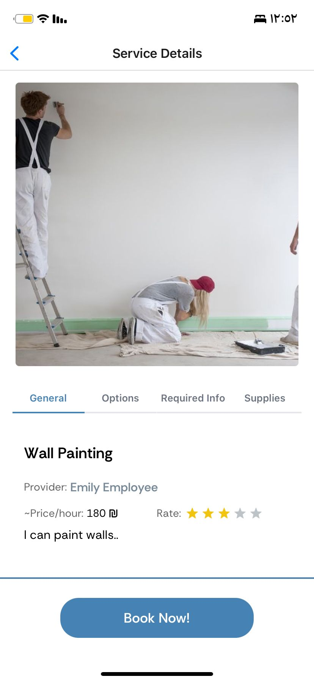
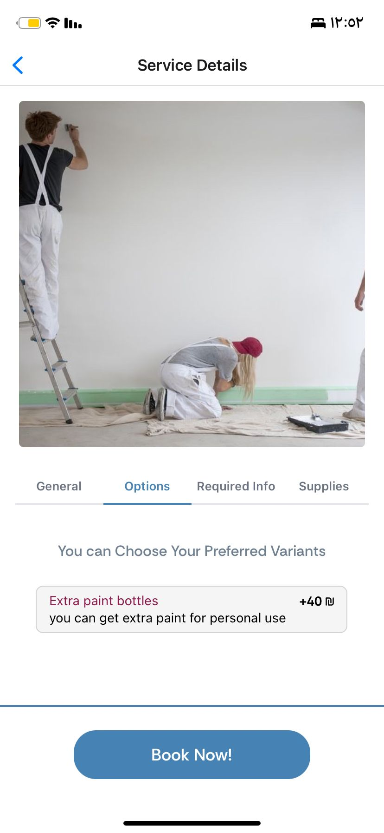
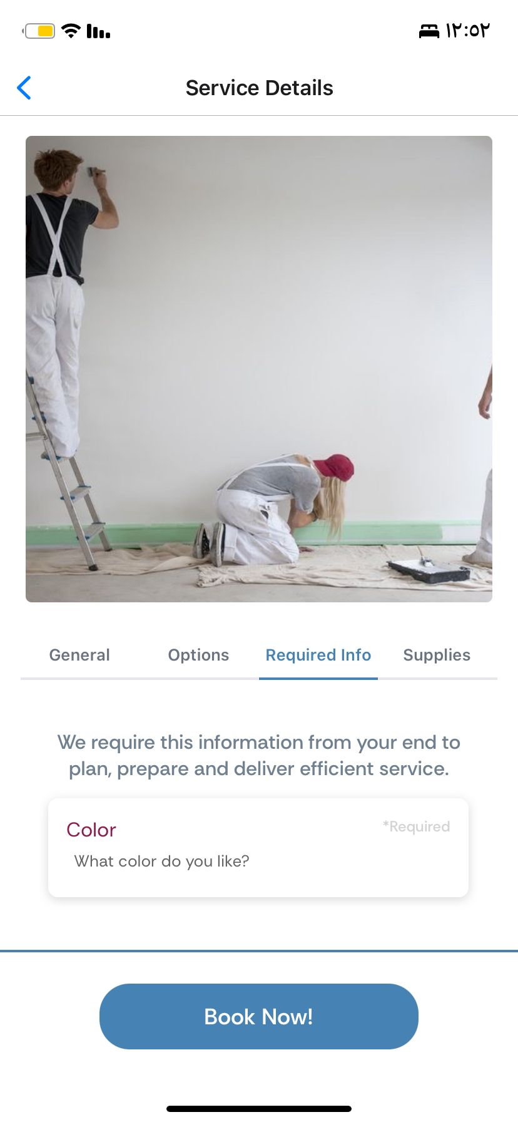
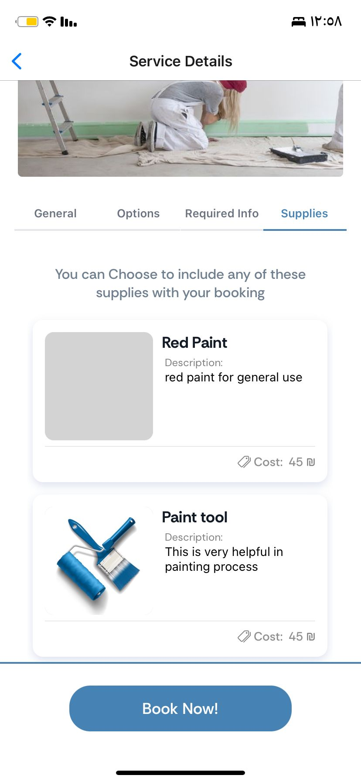
Transparency: Building Confidence and Competitive Environment
comprehensive information about services before making any booking

Slide 7
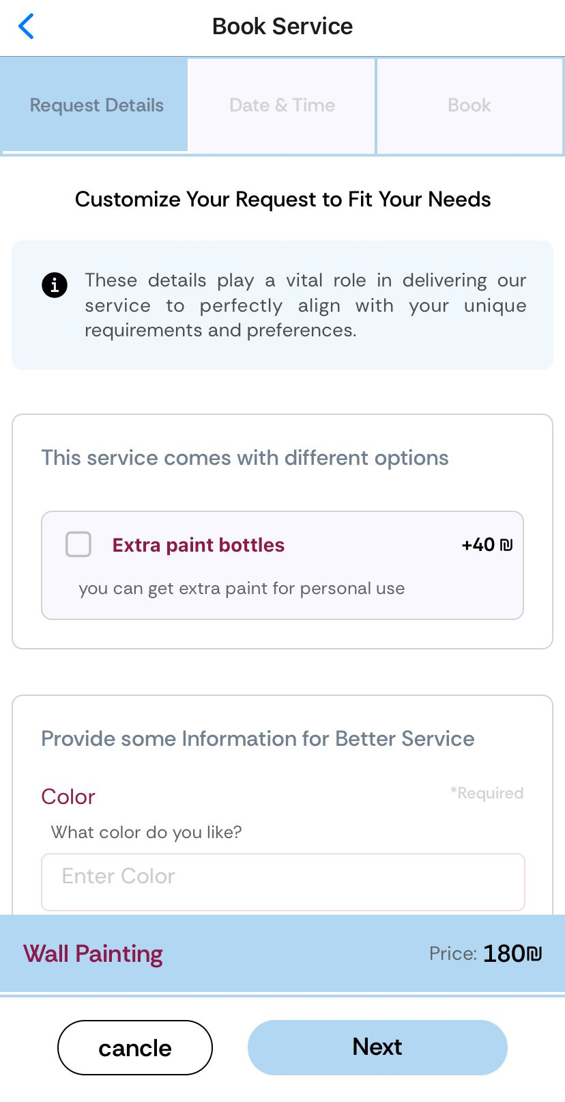
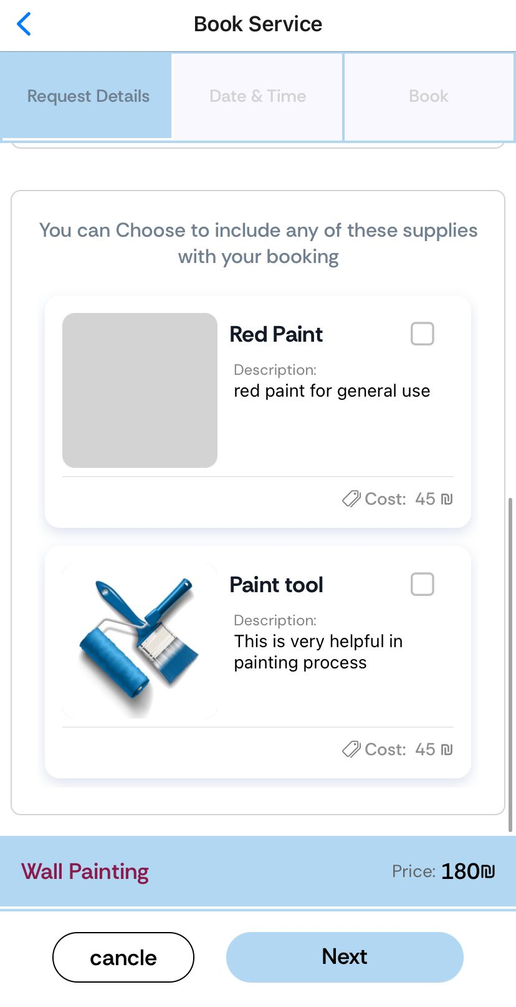
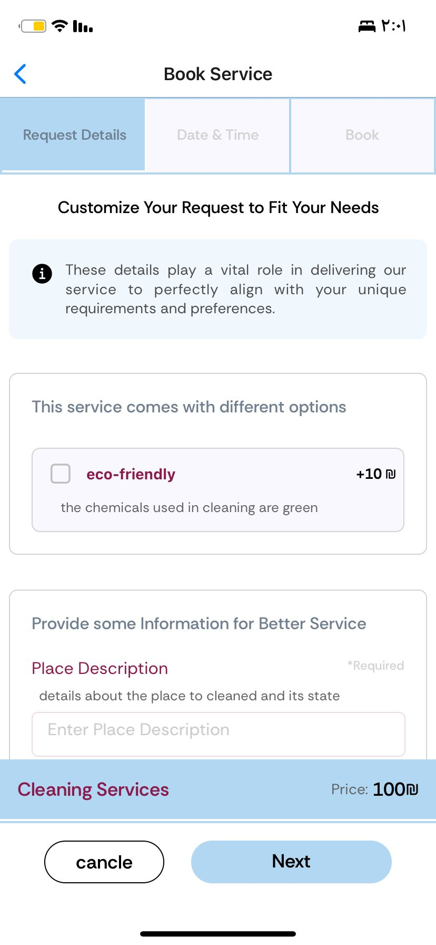
Service Booking System
Fit Customer Preferences and Customizations

Slide 8
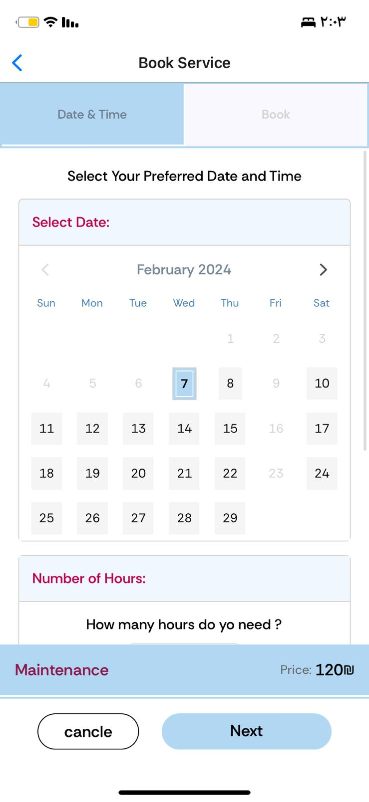
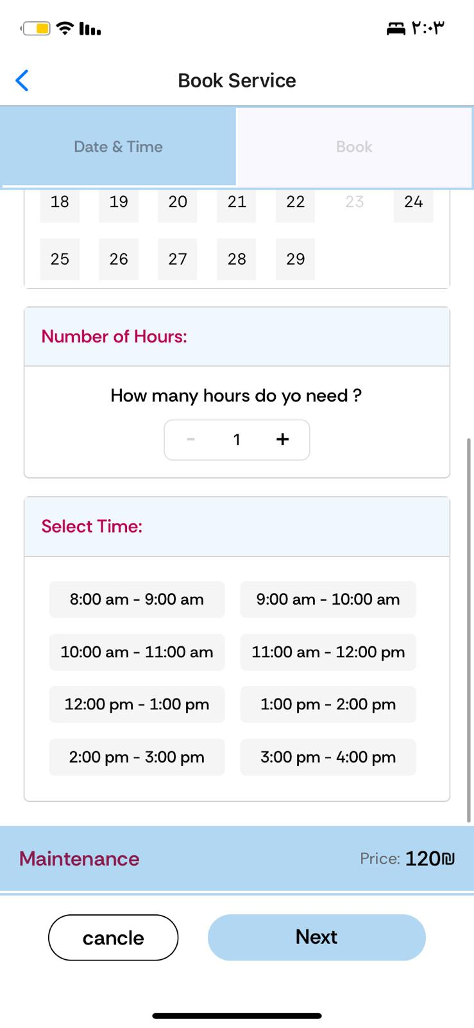
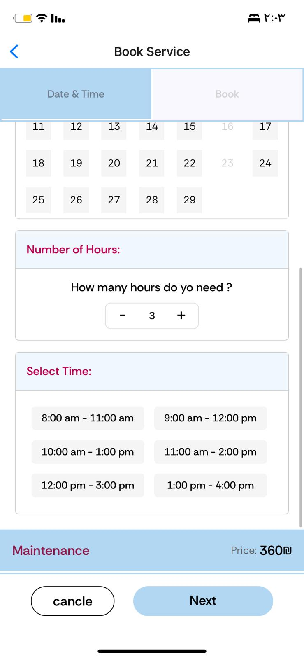
Booking Process depends on service type
Instant Booking

Slide 9
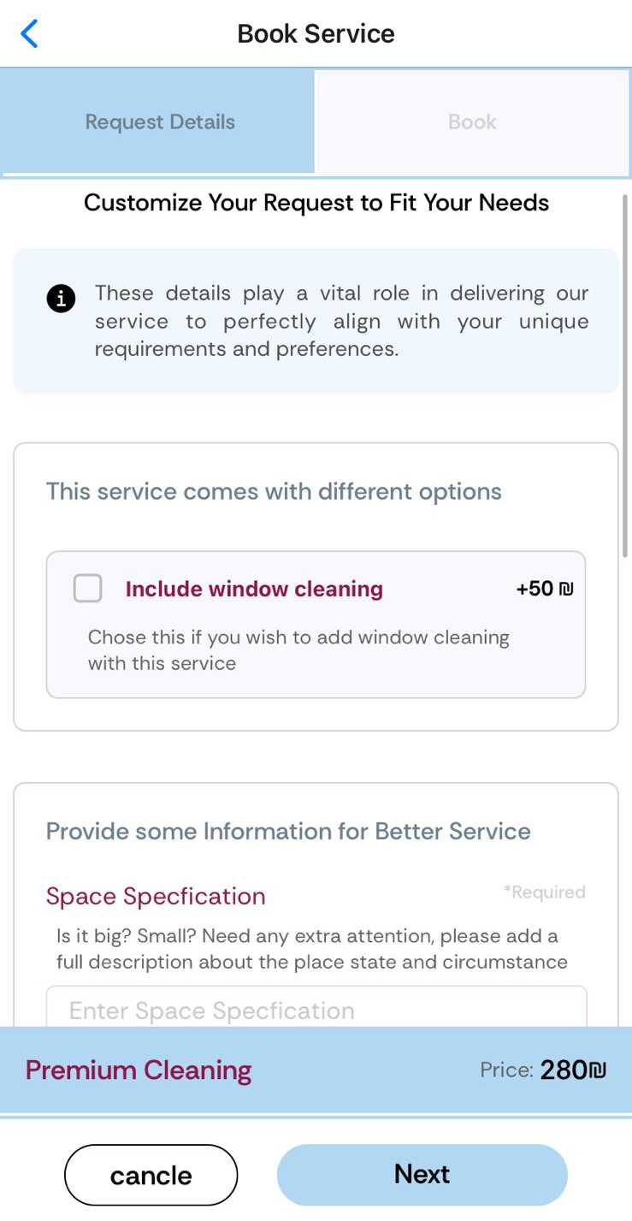
Booking Process depends on service type
(1) Consultation
(2) Instant Booking service without details

Slide 10
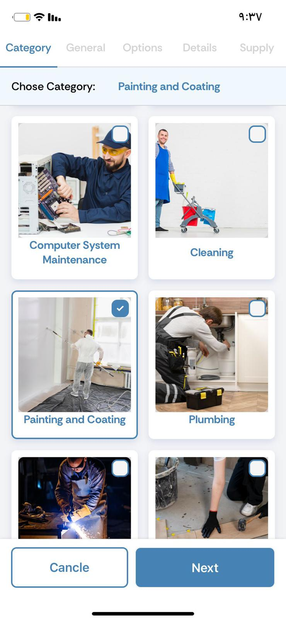
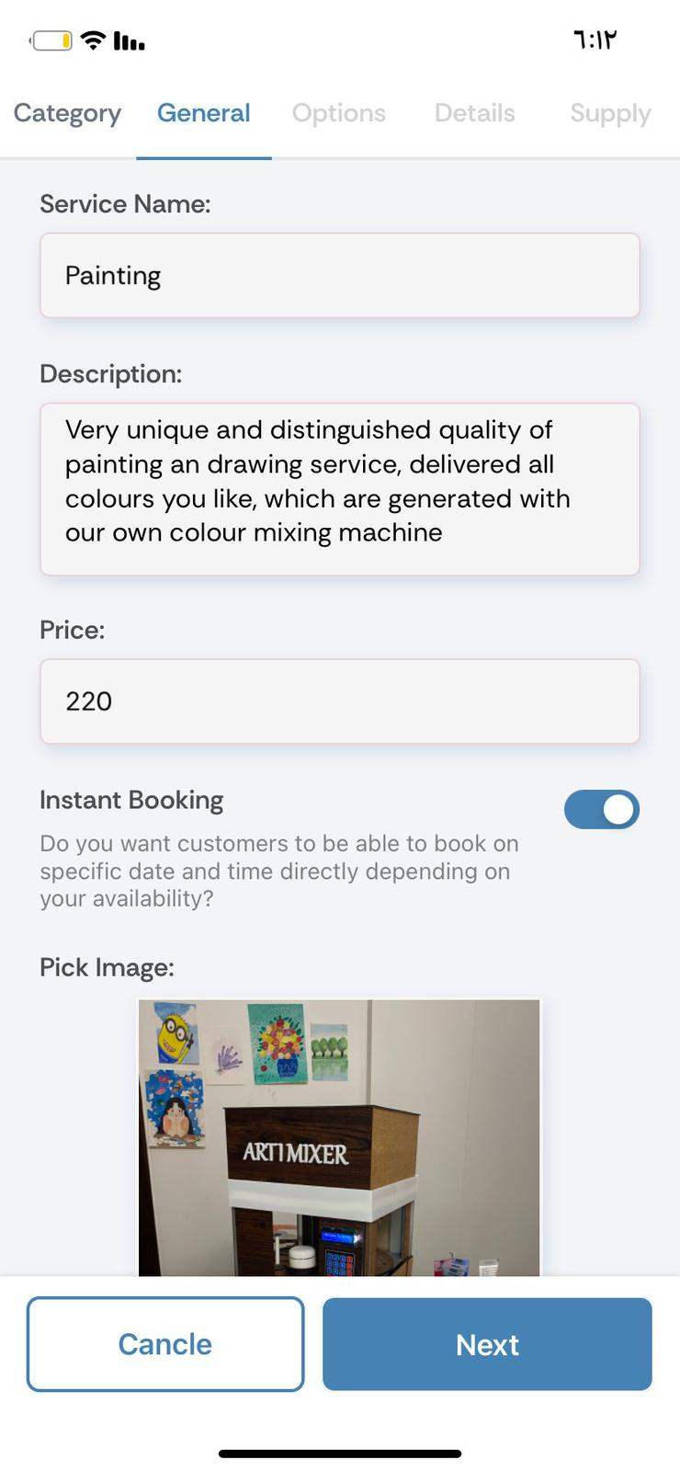
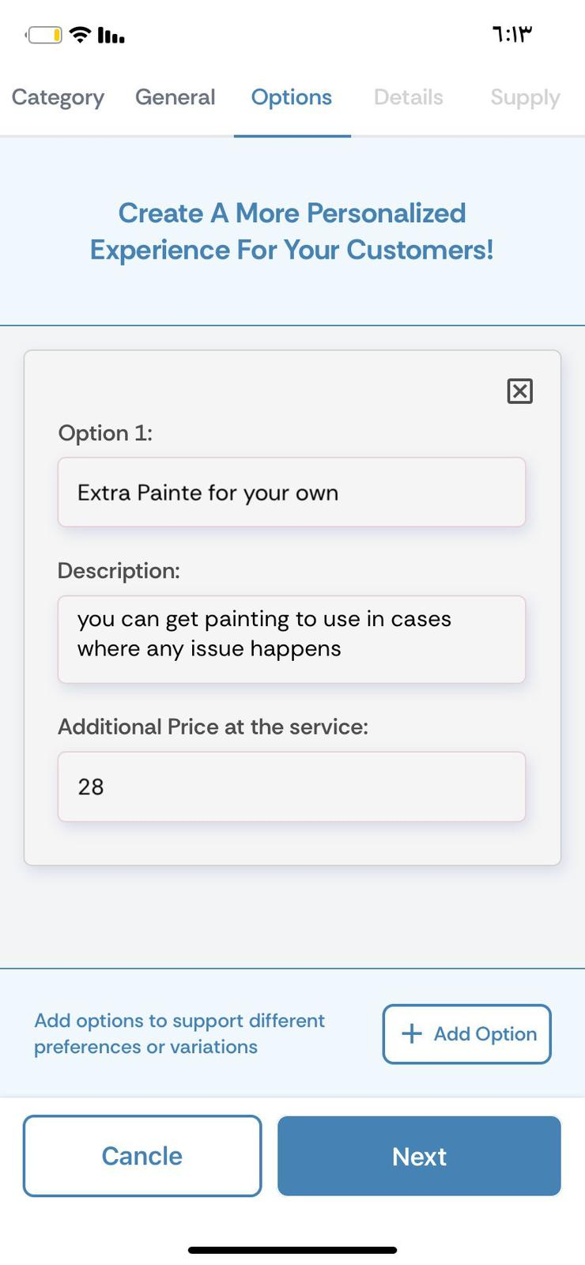
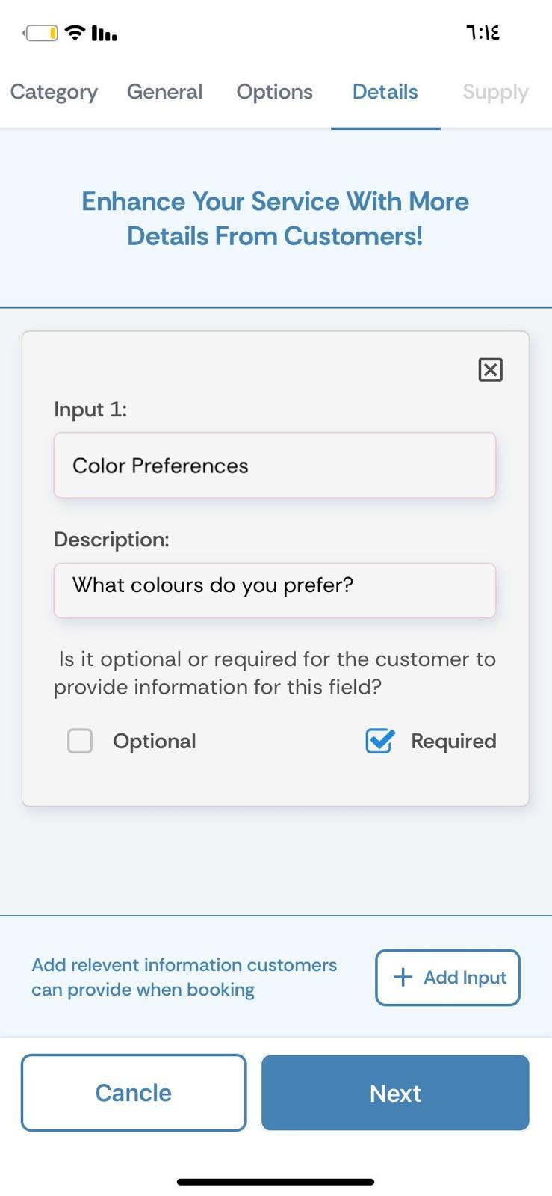
Self-Employeed: Add Services on Your own Terms

Slide 11
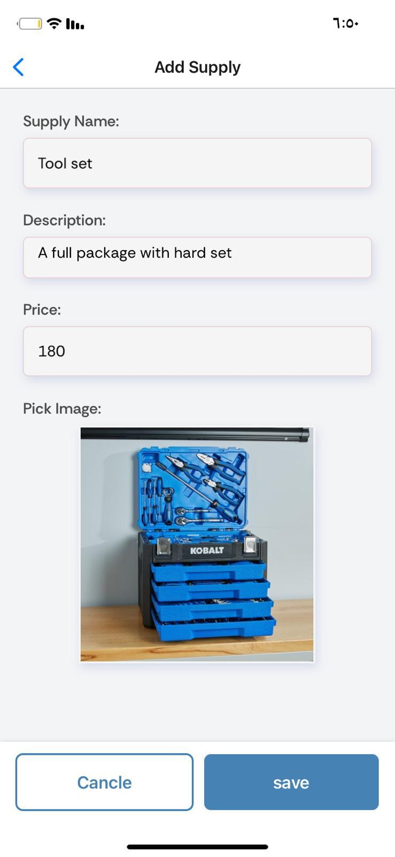
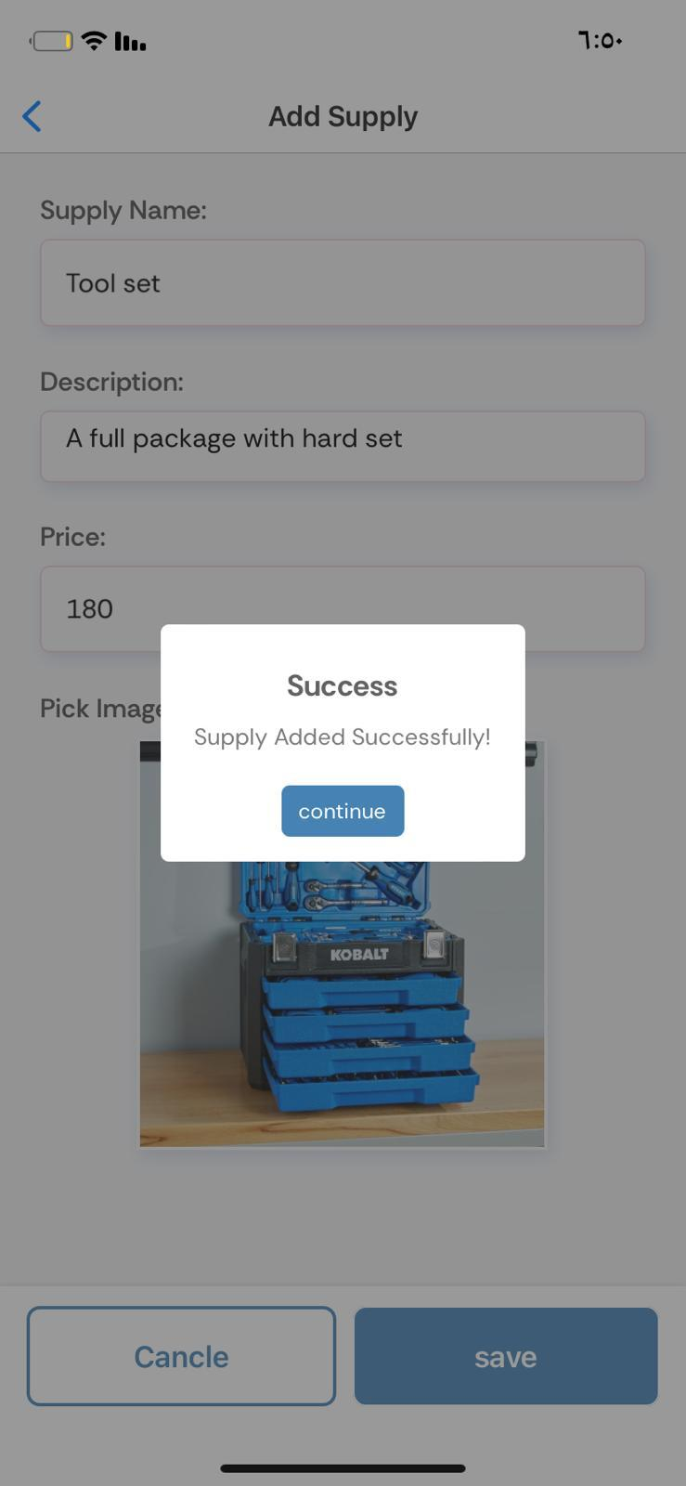
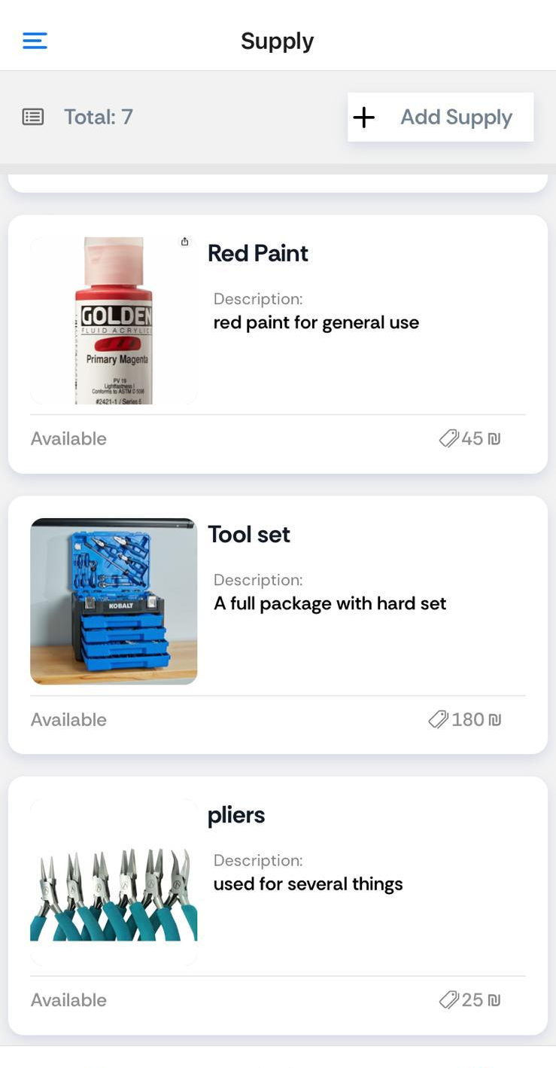
Service Supply

Slide 12
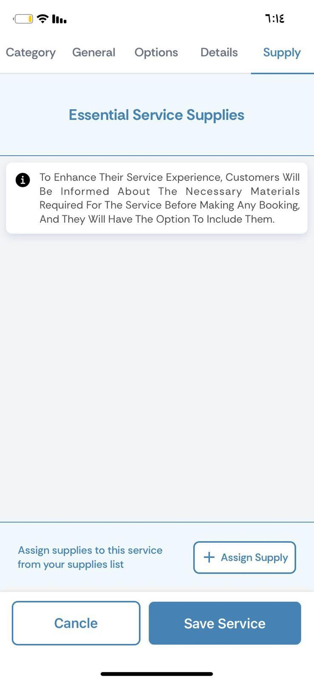
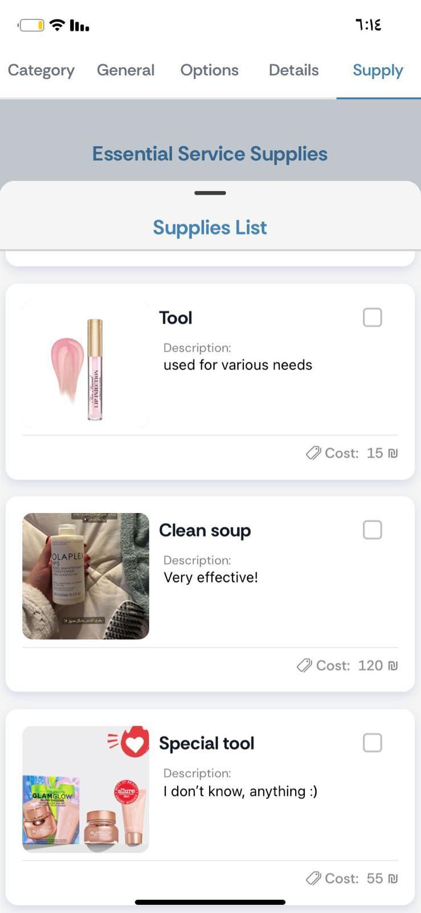
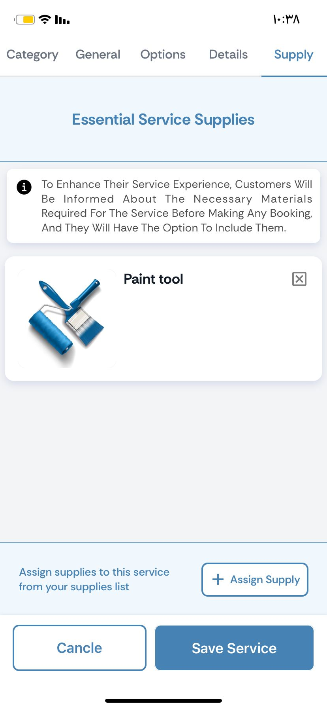
Assign Supply To Service

Slide 13
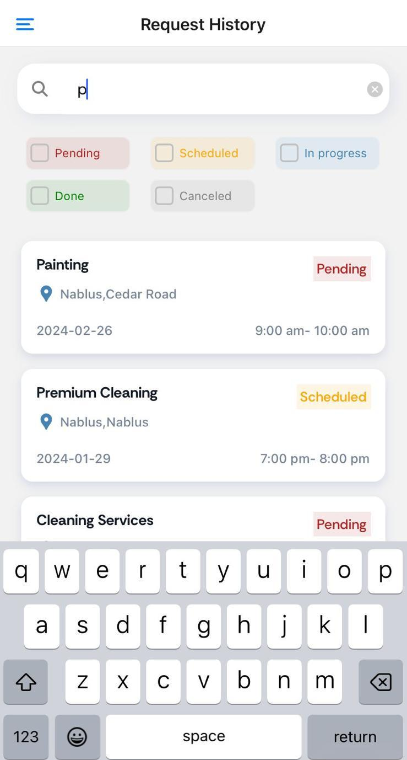
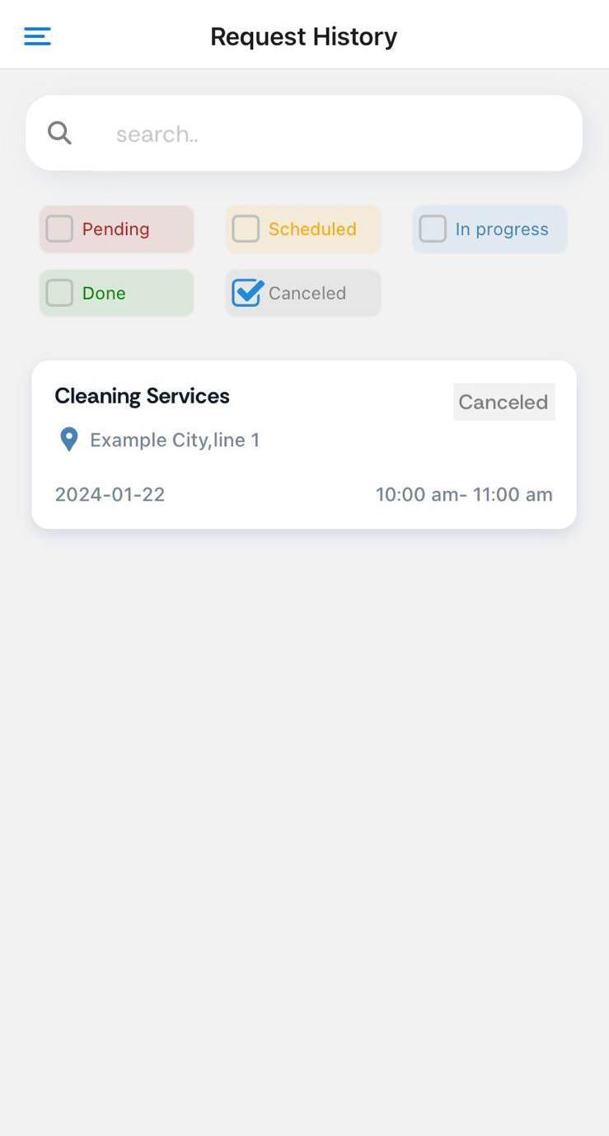
Handling Customer Request

Slide 14
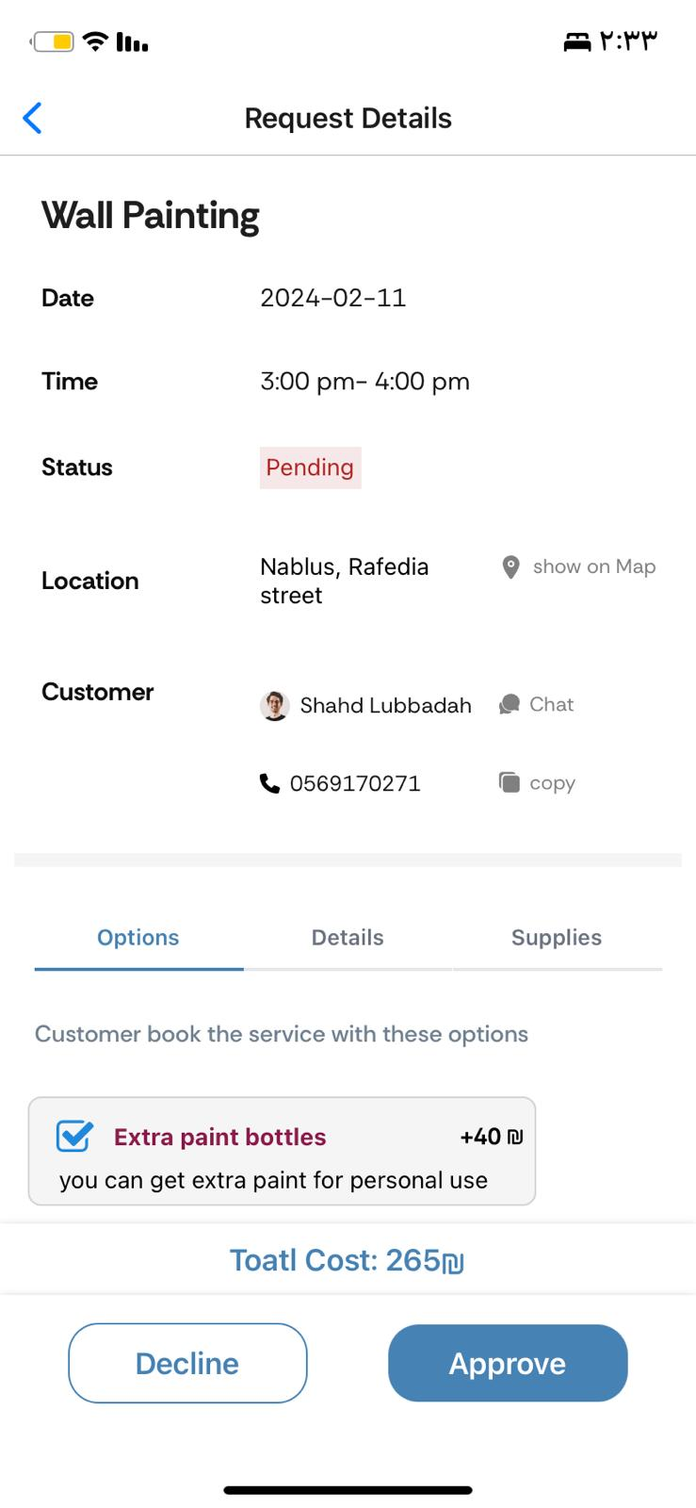
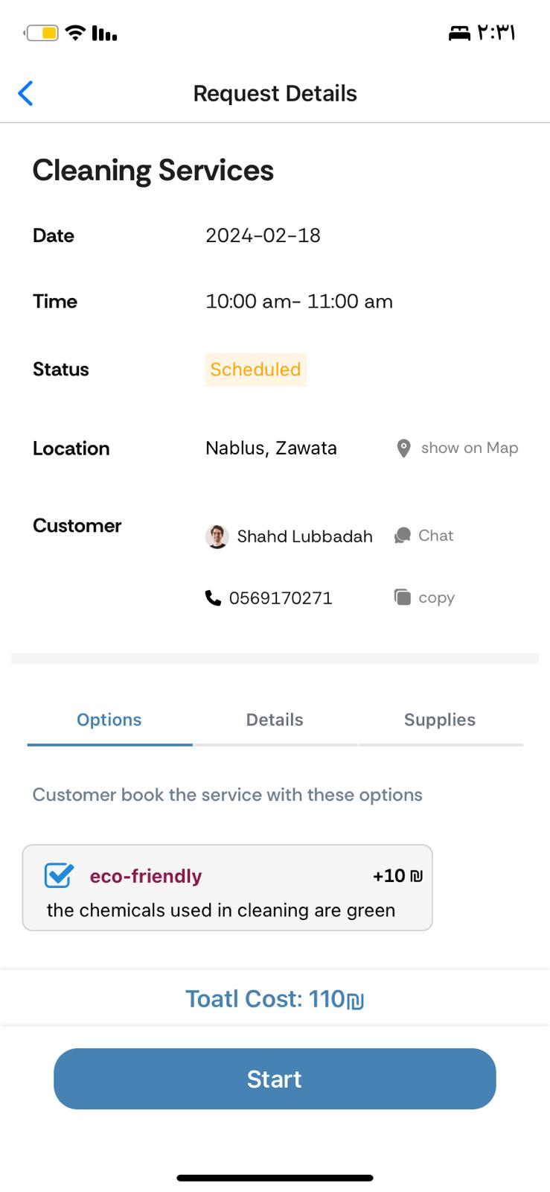
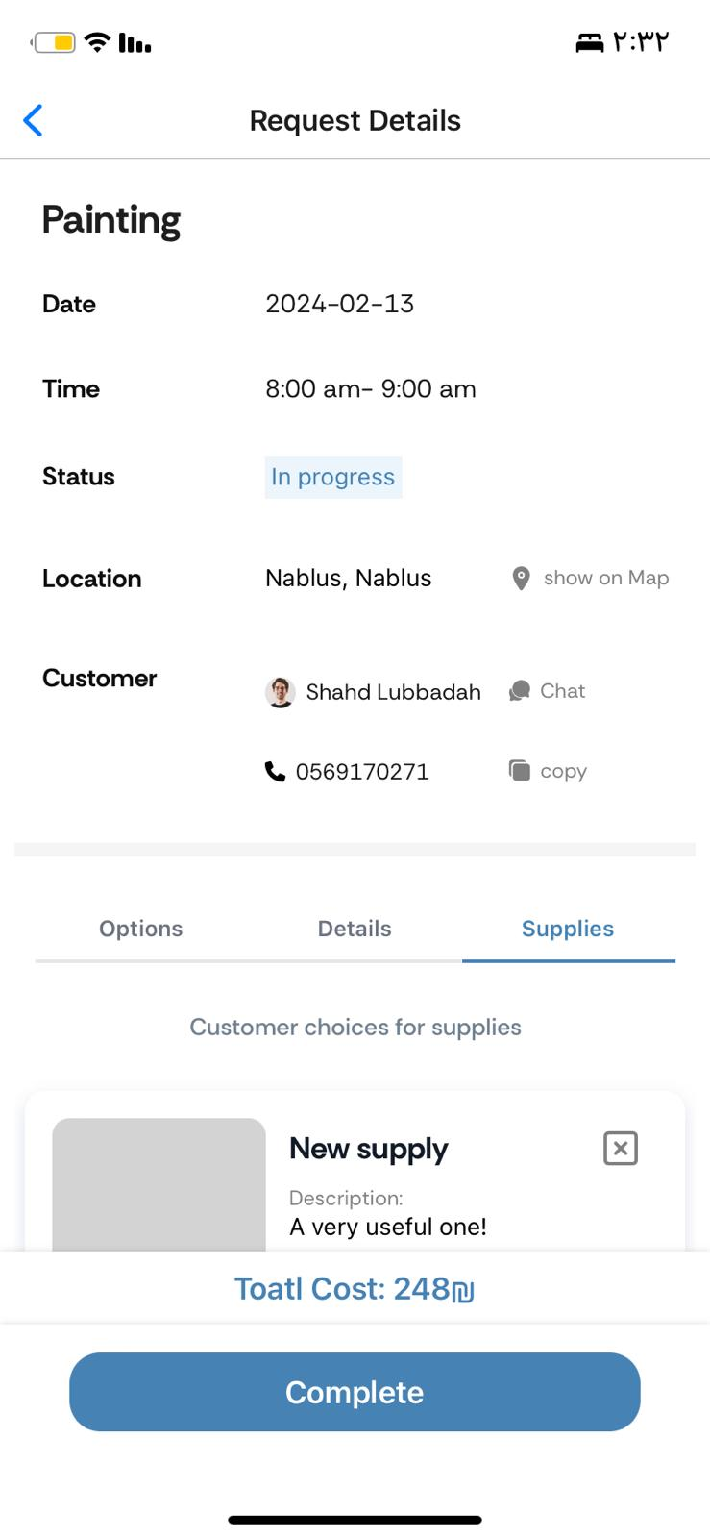
Handling Customer Request

Slide 15
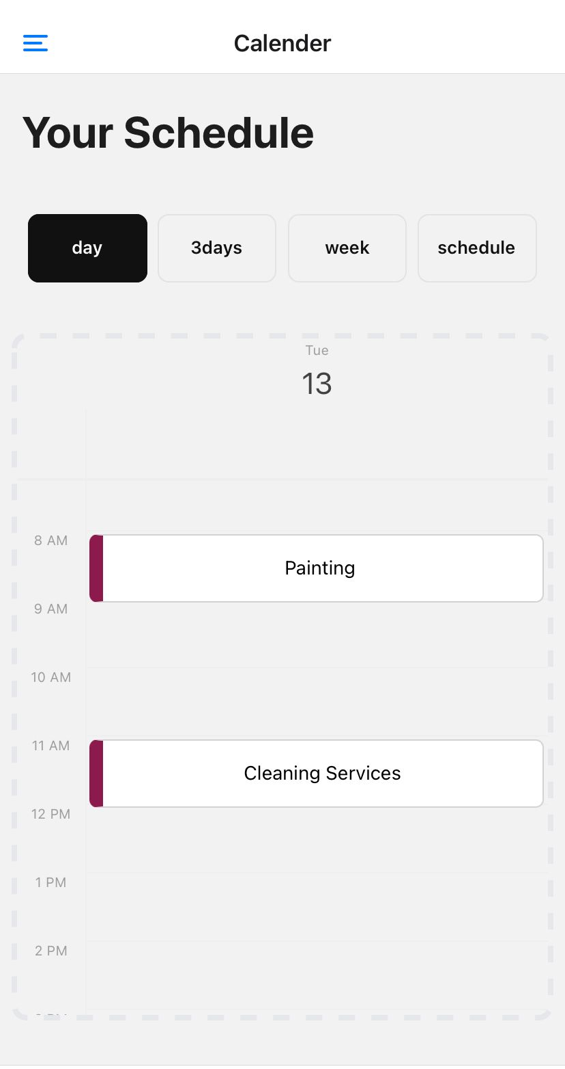
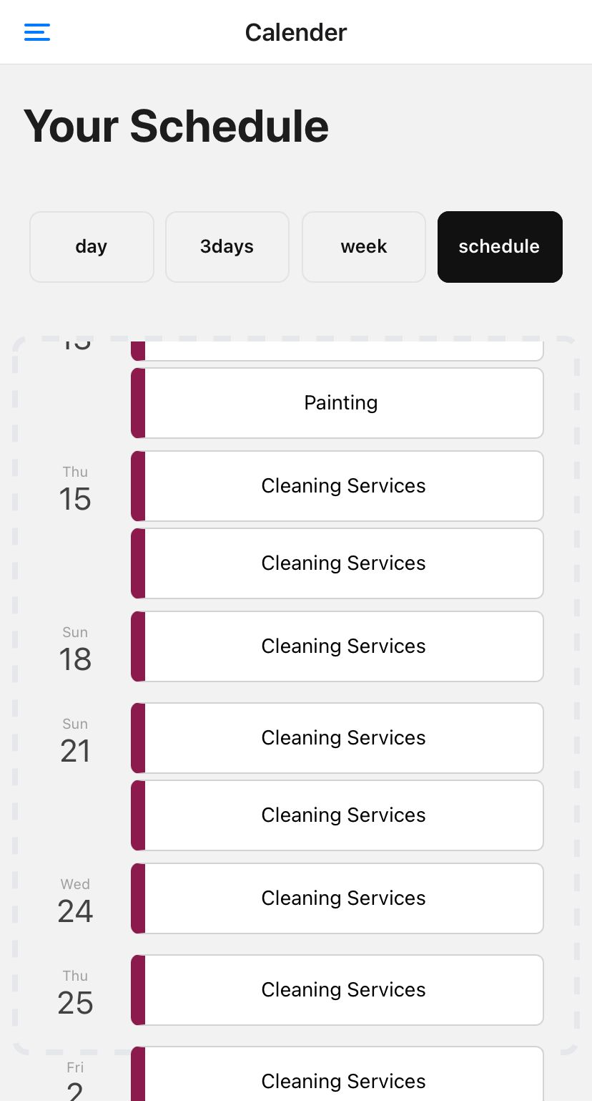
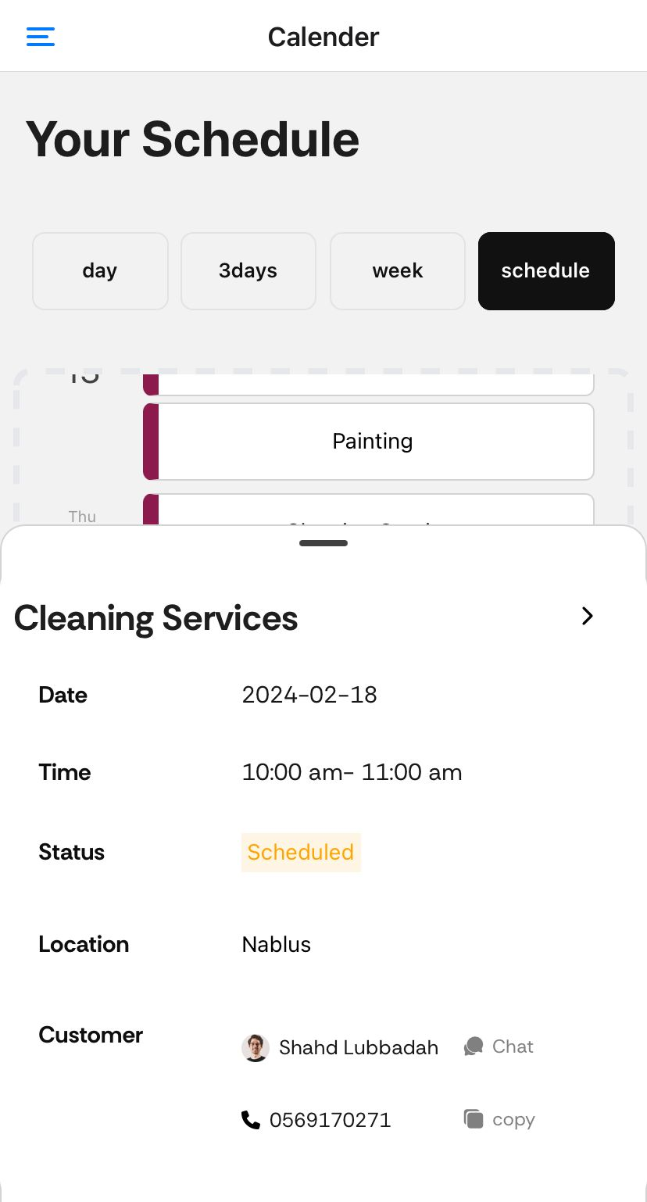
Calendar to Organize Appointment
Never Miss Appointment!

Slide 16
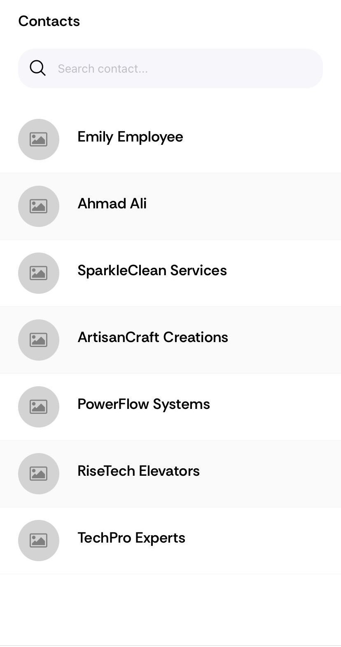
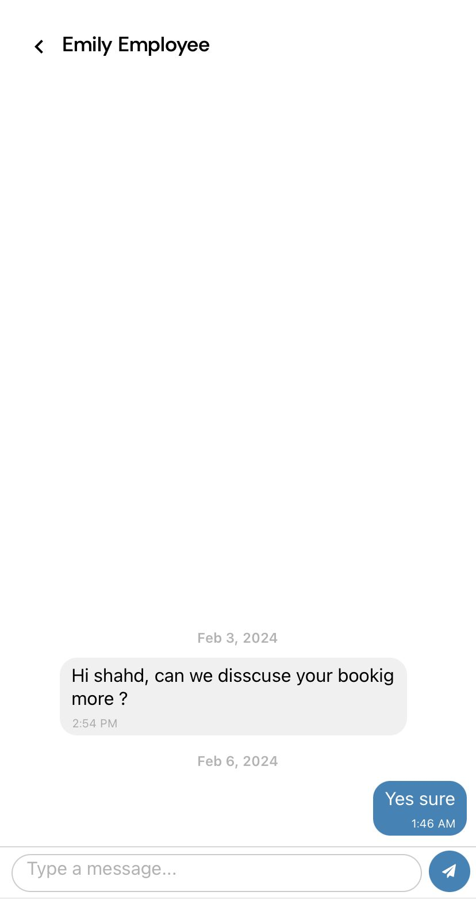
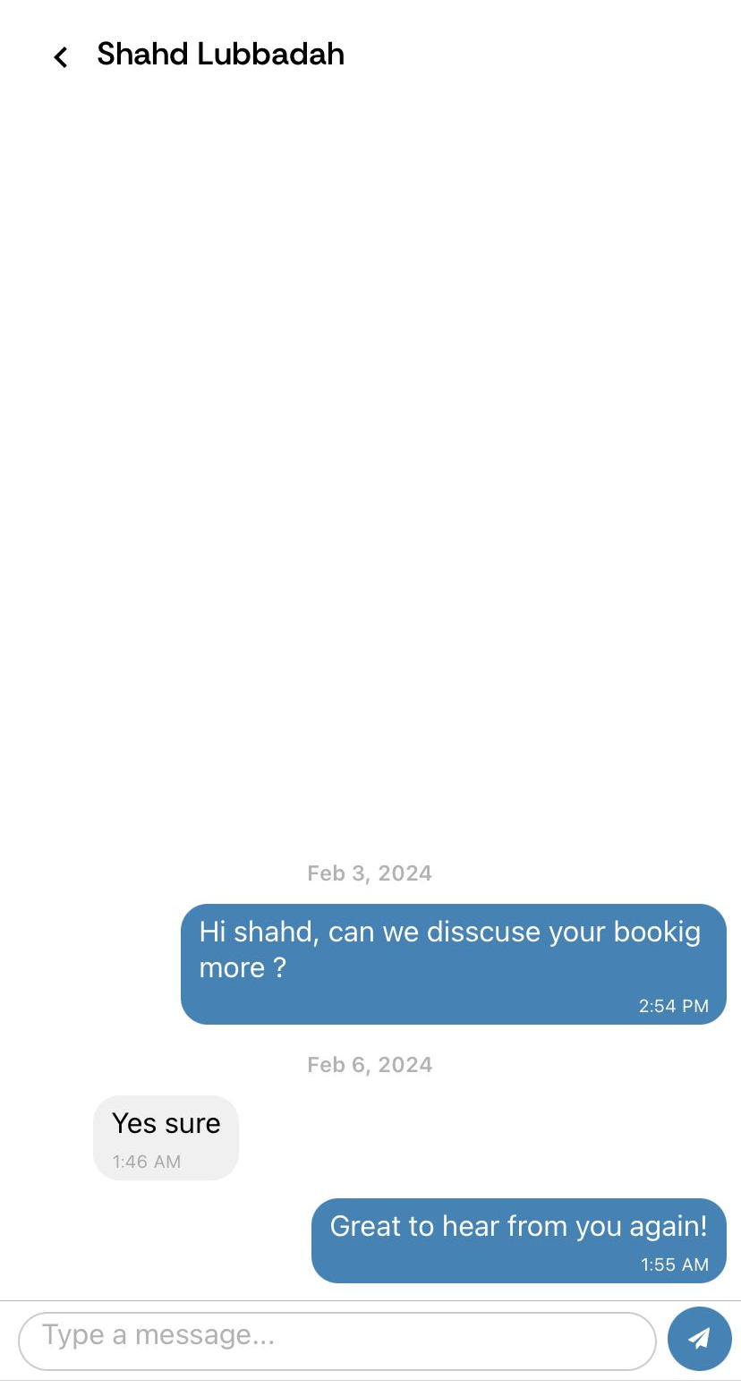
Seamless Communication Between Customers and Providers

Slide 17
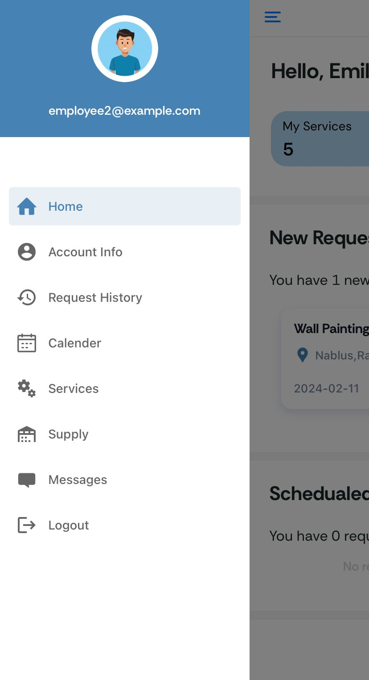
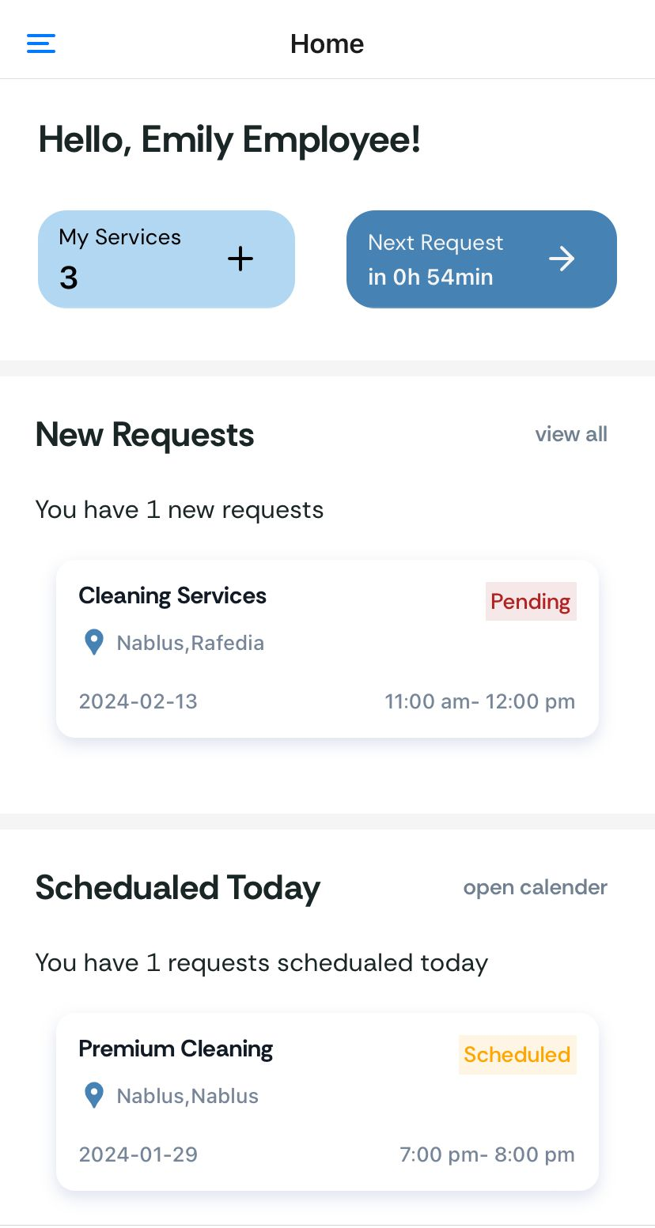
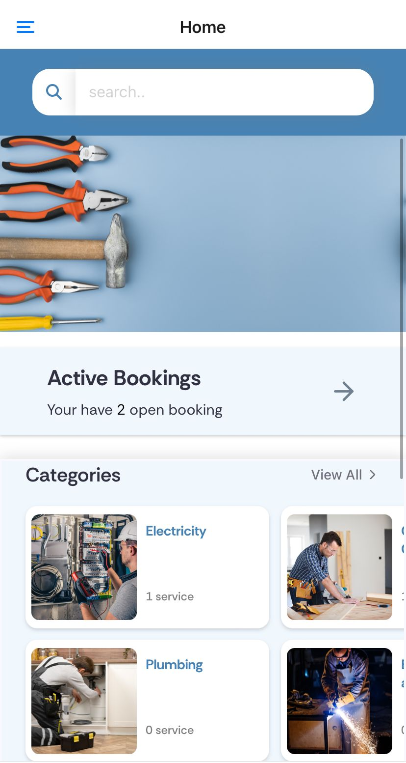
Easy Access: to a Better User Experience
(1) Worker Side
(2) Customer Side

Slide 18

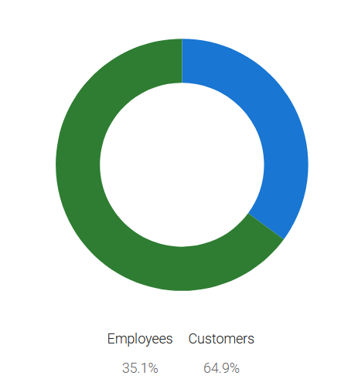
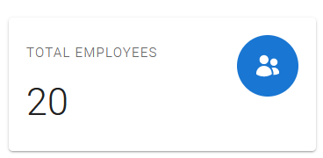
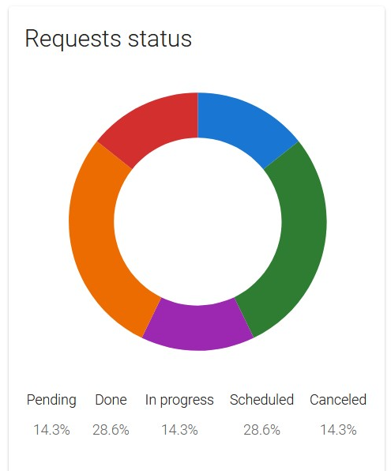
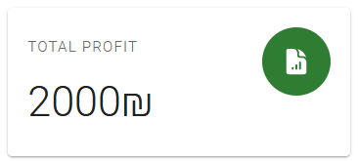
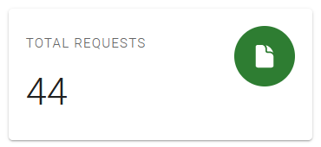
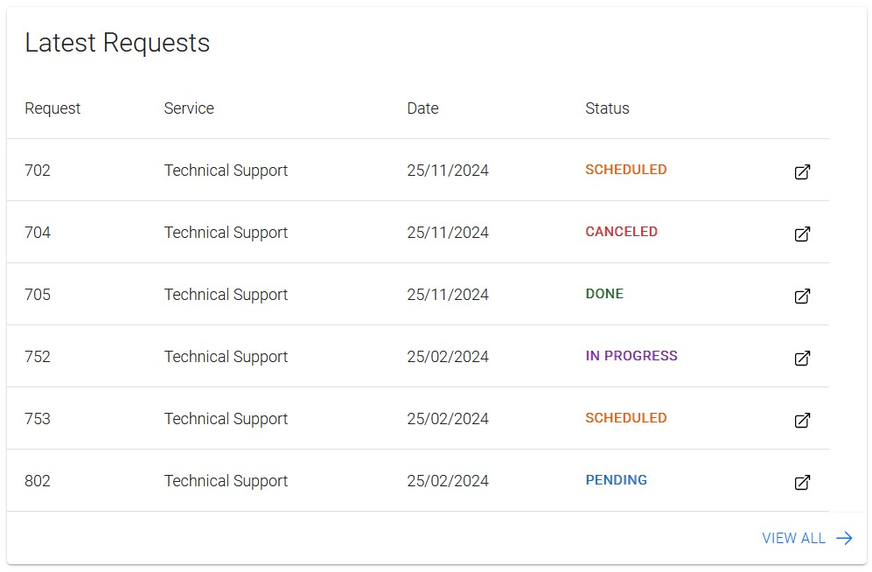
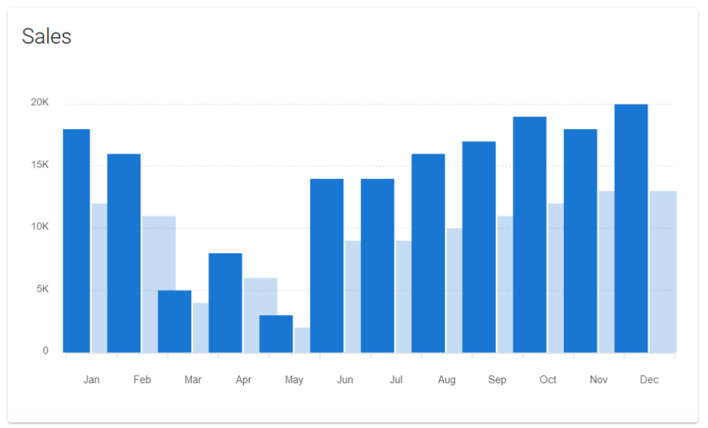

Slide 19
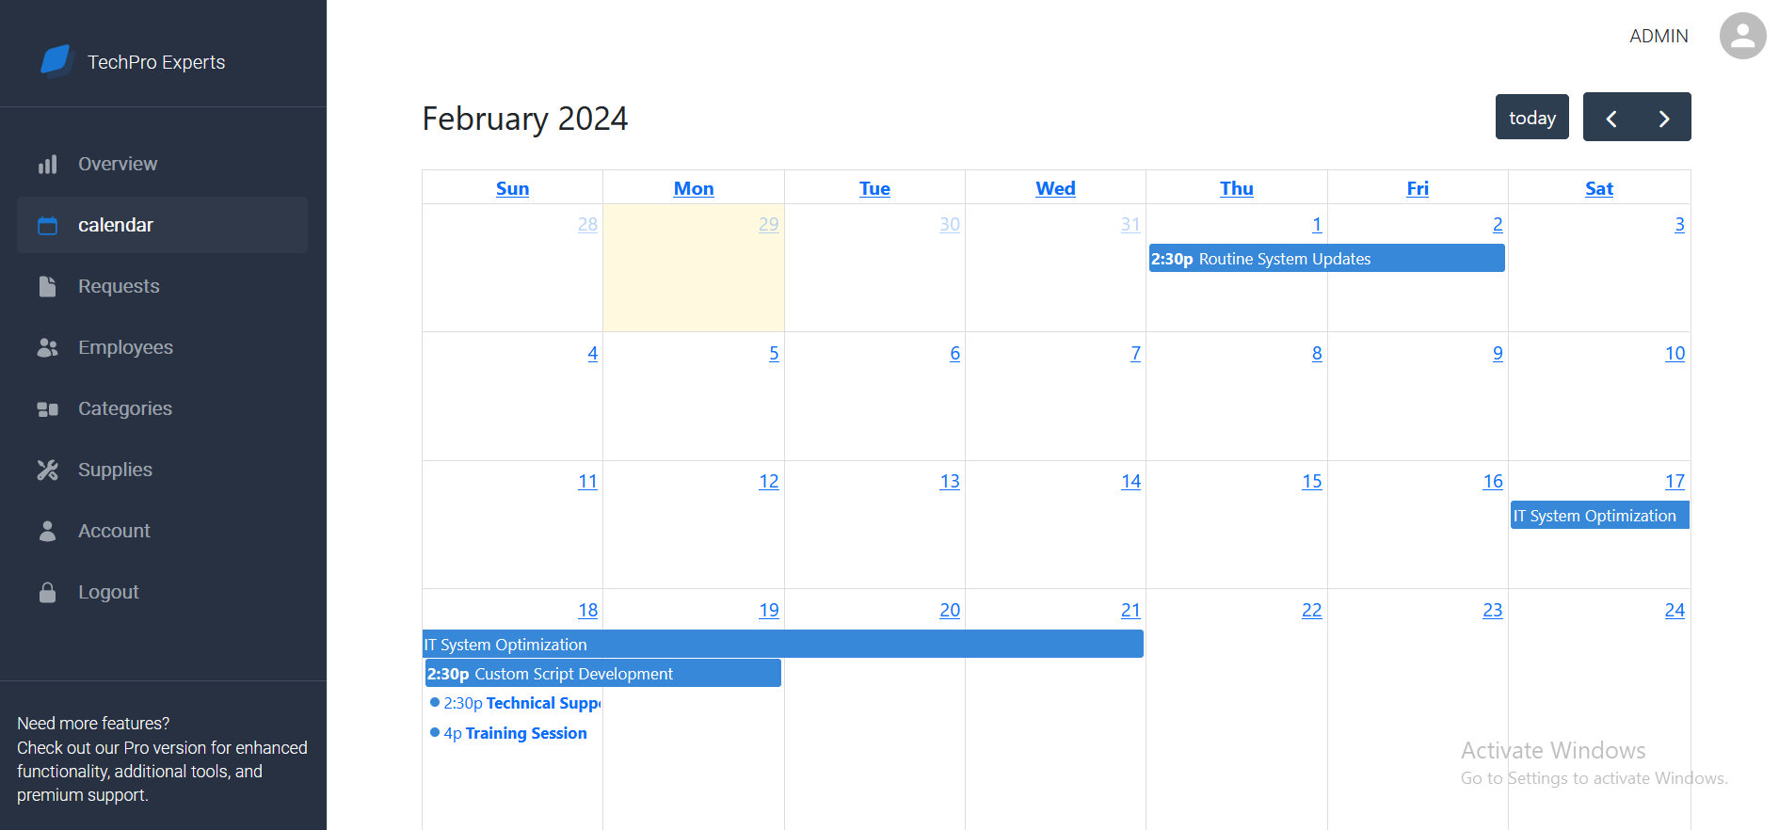
Calendar

Slide 20
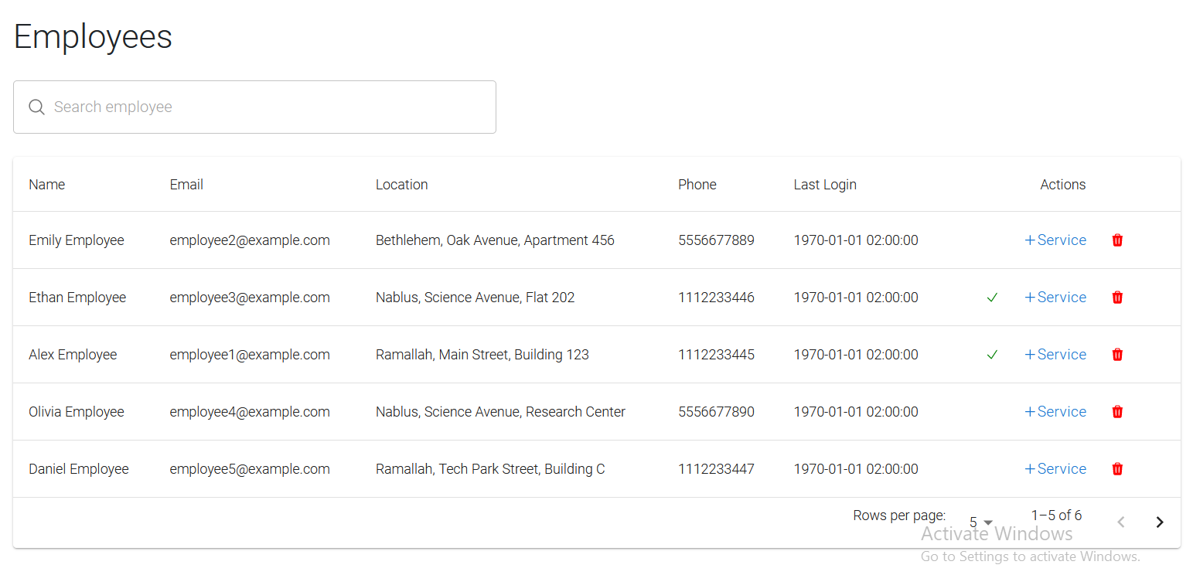

Slide 21
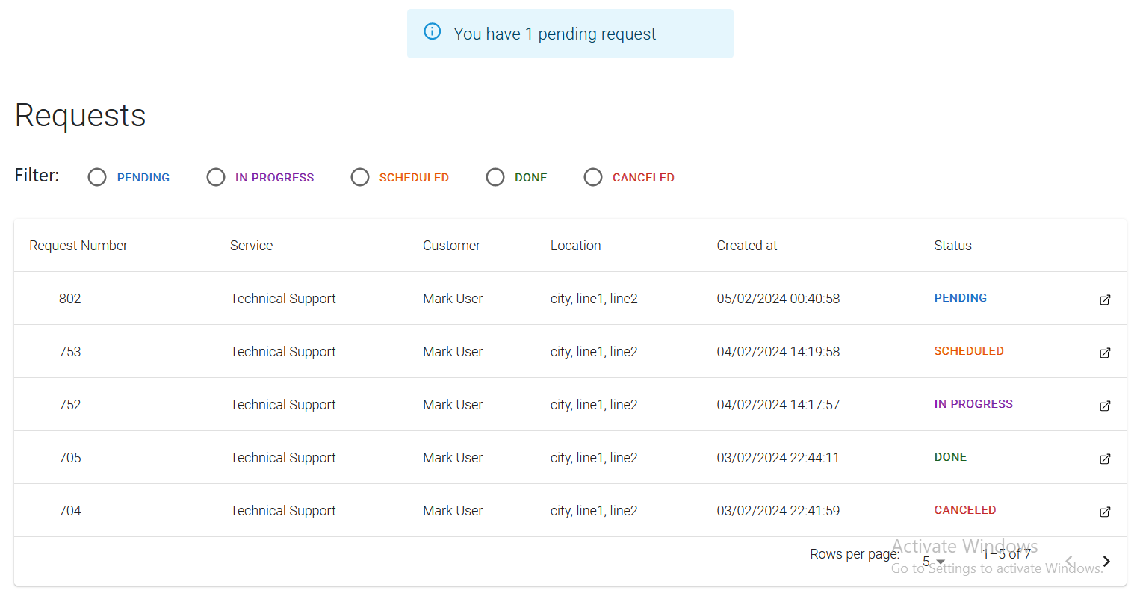

Slide 22
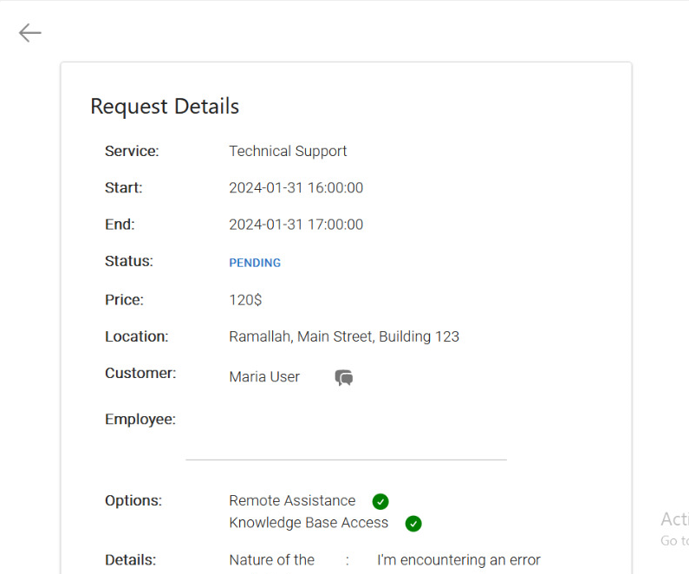
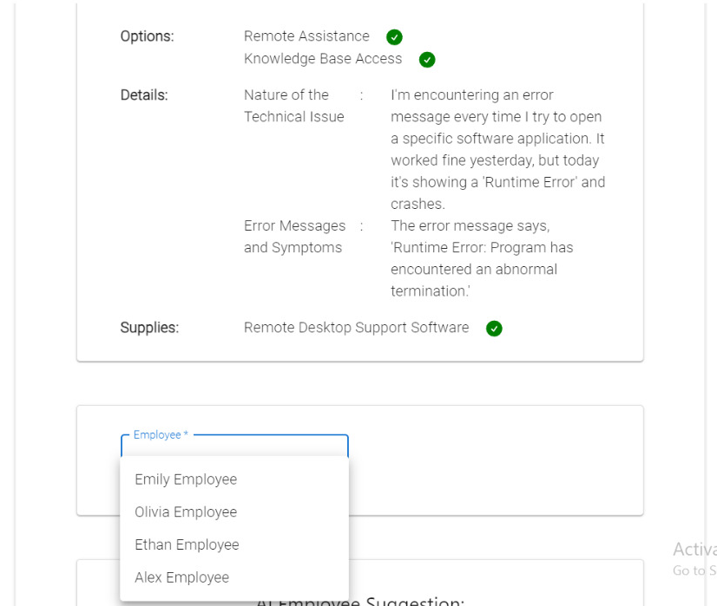


Slide 23


Slide 24



Slide 25


Slide 26




Slide 27


Slide 28



Slide 29



Technologies Used
React
React Native
Spring Boot

Slide 30

Swagger API Documentation

Slide 31



Technologies Used
Docker, GitHub Actions, and AWS EC2.
AWS RDS

Slide 32
Live Demo …

Slide 33
Future Work
Evolution into a Social Platform
Suppliers and Inventory Management
Comprehensive HR Management
Innovative Service Request System

Slide 34
Notes & Questions

Slide 35
Thank you!

