Slide 1
Design of A Sewer Network For Dyer abu daif Village
Prepared by :
Mahmoud Opisi
Husam Abboushi
Khalil Sunjoq
Iyad Omar
Submitted to : Dr. AbdALhaleem Kader

Slide 2
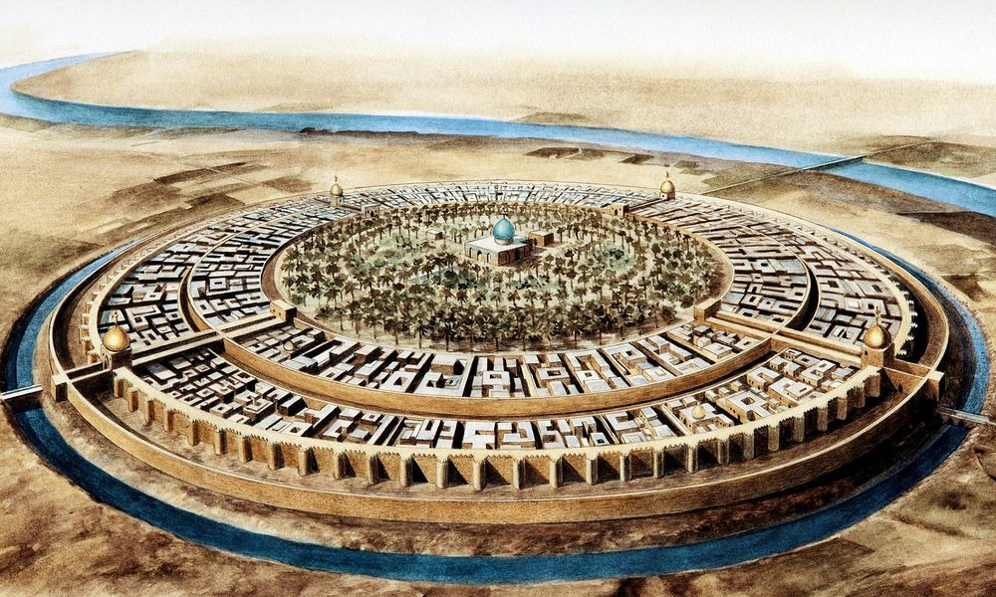
Introduction
The most important element to the human being in life is water, where 80% of water demand is converted to wastewater.

Slide 3
Objectives
The main objectives of this project are:
Design a wastewater collection network.
To calculate the cost of the WWCN.

Slide 4
SIGNIFICANCE OF THE WORK
There are no any network in this village for disposal the waste water
So its a big problem for this village

Slide 5
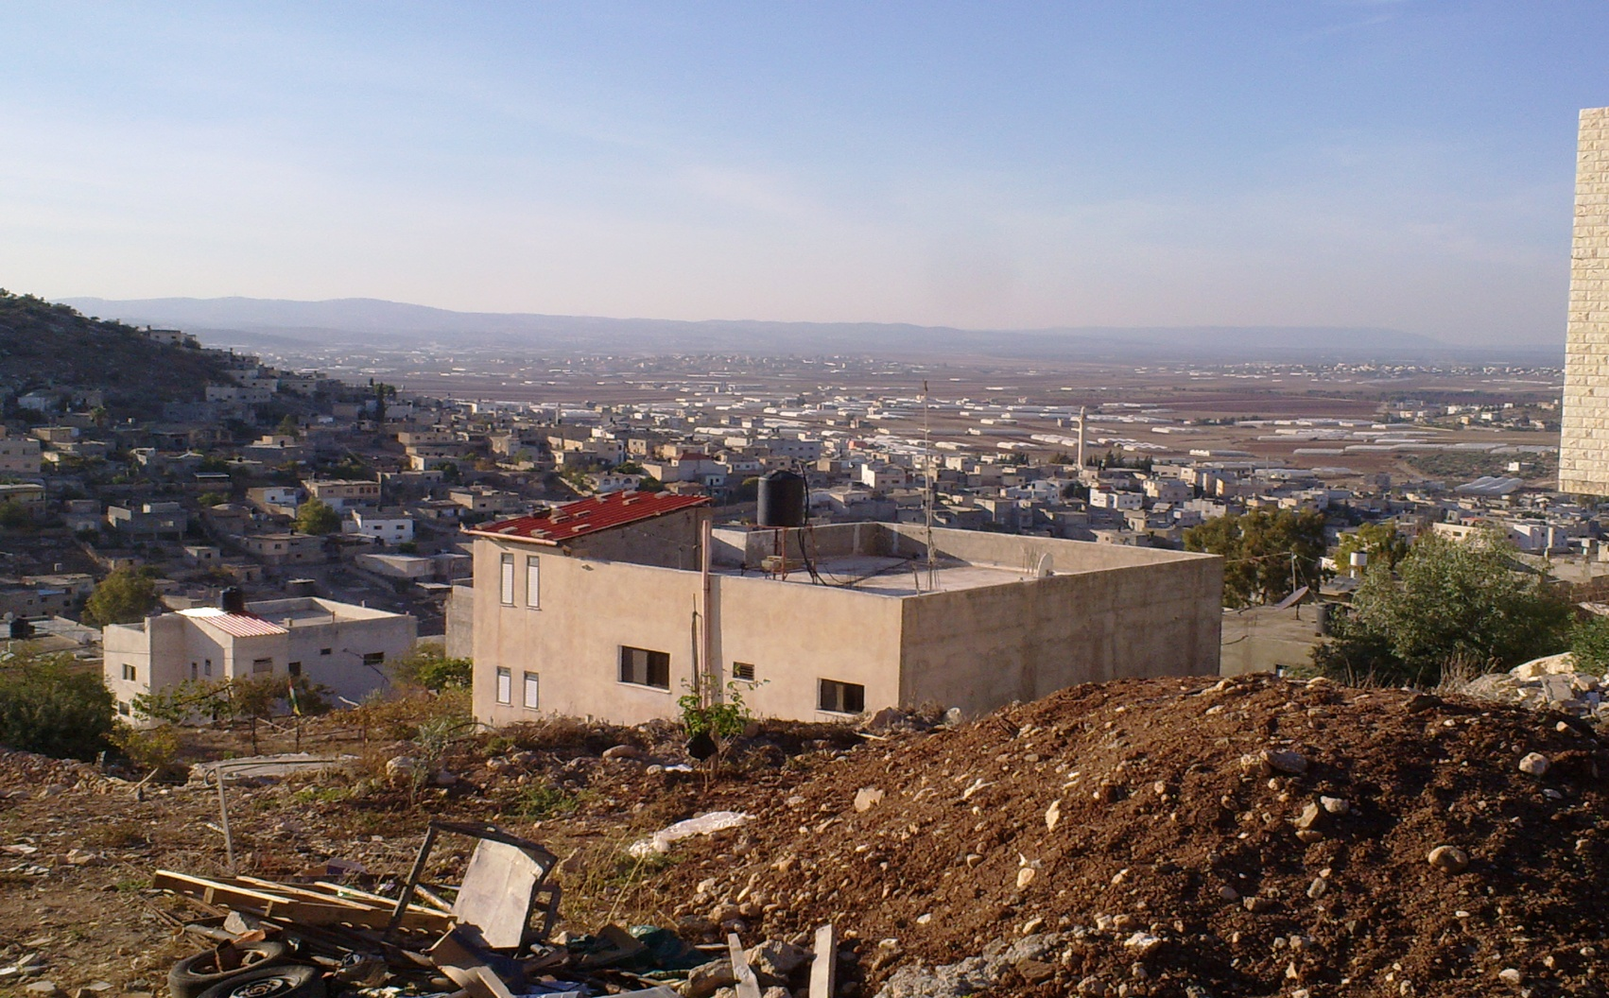
STUDY AREA :Dyer Abu Dai’f Village

Slide 6
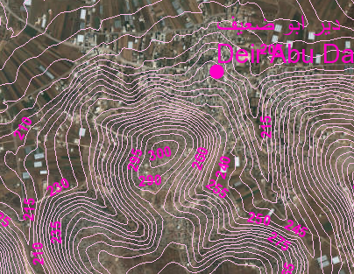
TOPOGRAPHY

Slide 7
TOPOGRAPHY
Maximum elevation = 275 m above MSL
Minimum elevation =210 m above MSL
Mean elevation = 230 m above MSL

Slide 8
AREA AND LAND USE
Total Area = 14000 donums
Built up Area = 3600 donums
Agricultural land = 9700 donums
Open areas = 800 donums

Slide 9
Methodology
Data Collection.
Designing by Sewer CAD program.
Results and recommendations.
Preparation of data

Slide 10
DATA COLLECTION
Boundary of the study area.
Contour map
Roads network
Structural plane
Population number

Slide 11
Preparation of data
Calculation the Population
P(t)=P. *e^(k*t)
Future population ( 2042 ) = 17363 capita

Slide 12
Calculation of Sanitary Load
Demand = 125L /day / capita
Assume hourly factor = 3.5
Wastewater generation 80%
Load calculation = Wastewater generation + infiltration
Wastewater generation =
0.8 * 0.125 * 17363 * 3.5 = 6077 CM /day
Infiltration = 0.2 * 0.8 * 0.125 * 17363 = 347.26 CM / day
Sanitary load = 6077 + 347.26 = 6424.26 CM / day

Slide 13
Sewer Collection Network
Sewer Systems
Sewerage Elements

Slide 14
Related hydraulic concepts
A General procedure for design flow rates quantification.
Average water consumption (l pcd).
Average wastewater generation (80% of water consumption).
Total average wastewater flow = average wastewater x community size.
Max hourly waste water (which is the design value) = total average waste water x hourly factor.

Slide 15


Related hydraulic concepts
The Energy Equation.
Friction Loss Methods.

Slide 16
Draw the Network by SewerCAD program.
Length of conduit will not exceed 50 m.
Avoid making closed loops.
Putting manholes every intersection and curves

Slide 17
CONSTRAINTS
Velocity ( 0.6 – 3 )m/s.
Cover ( 0.8 – 5.5 )m.
Slope( 1 – 15 )%.

Slide 18
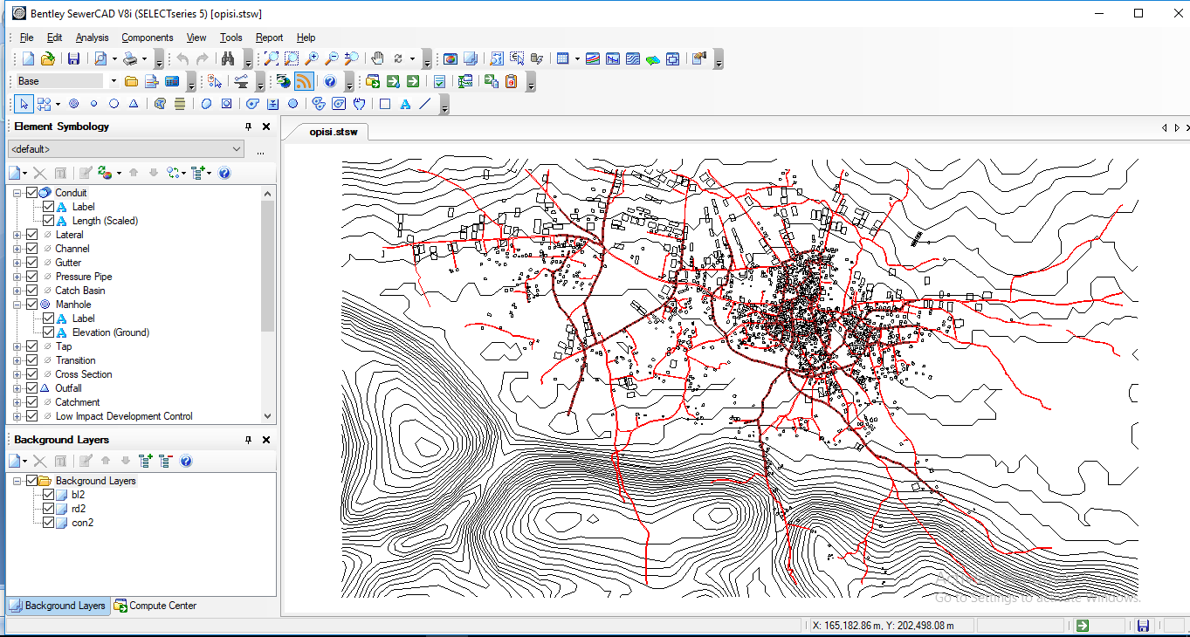
Draw the Network by SewerCAD program.

Slide 19
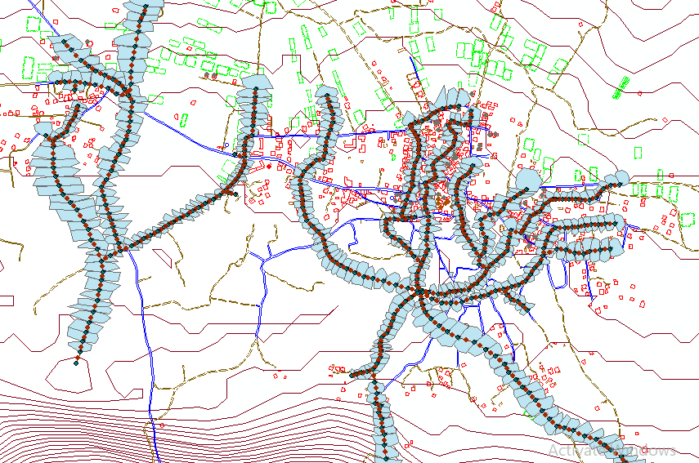
Allocating the area for each manhole
Allocating areas by ArcGIS programe.

Slide 20
Load on manholes
We base in calculation in the population base
So we need to calculate:
The population per each manhole
The Unit Load per manhole

Slide 21
Calculating the population per each manhole
population for each manhole(person) =
(Area covered by each manhole)*(population density)

Slide 22
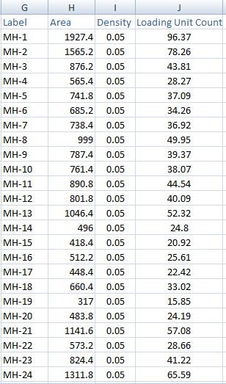
Calculating the population on each manhole
        The population per each manhole

Slide 23
Calculating the unit load per each manhole
Unit Load per manhole = (water consumption * % of wastewater generation*PHF)+ (water consumption * % of wastewater generation* infiltration)
Unit Load per manhole =350 L/day

Slide 24
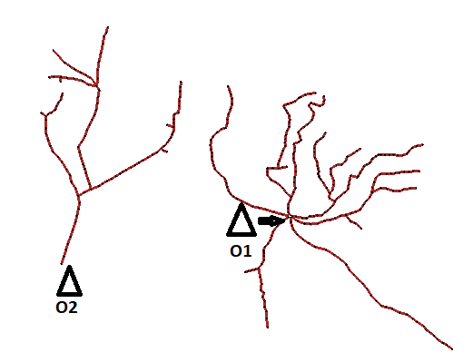
Layout the network
We have two outfalls in the area.

Slide 25
RESULTS

Slide 26
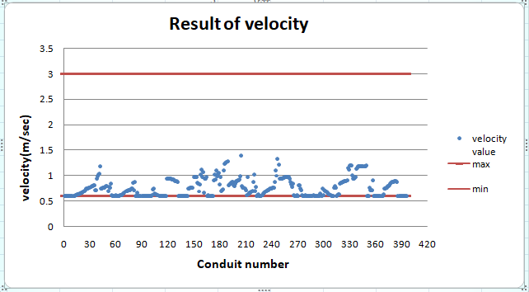

Slide 27
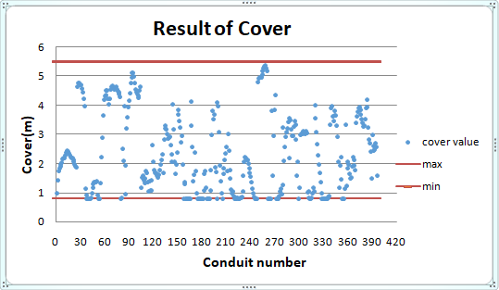

Slide 28
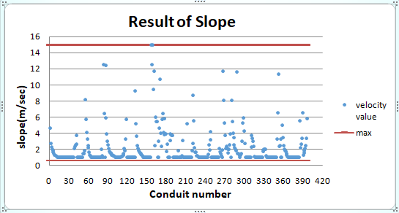

Slide 29
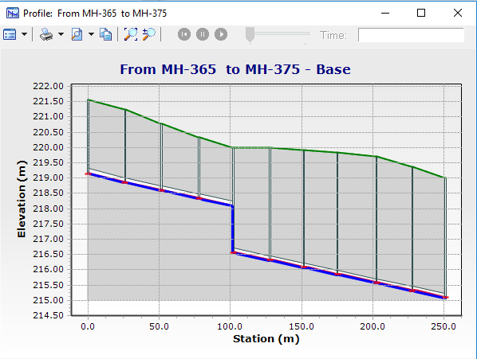
Profile ( MH-365-MH-375) contain drop manhole at MH-370

Slide 30
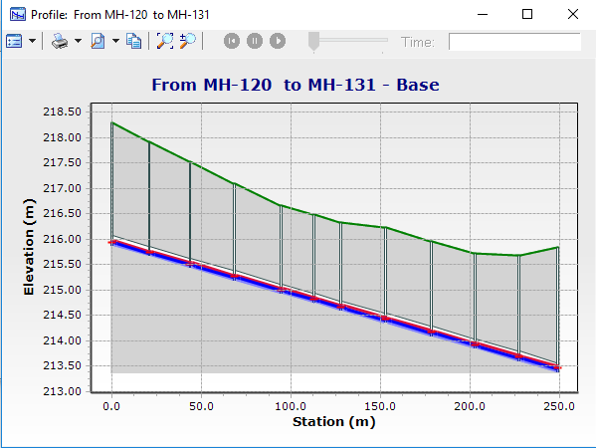
Profile (MH-120 to MH-131) dose not contain any drop manholes

Slide 31
To calculate the cost of the WWCN for Dyer Abu Dai’f village
To estimate the total cost of the network you should calculate four part of cost:
Excavation cost.
Cost of pipe.
Cost of manhole.
Cost of repaving.

Slide 32
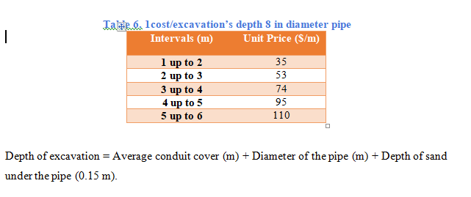
Excavation cost

Slide 33
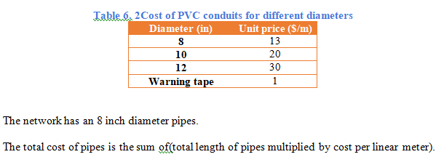
Cost of pipe (conduit)

Slide 34
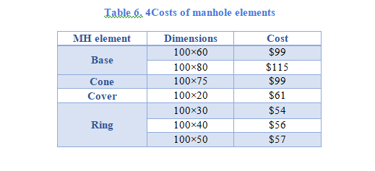
Cost of manholes

Slide 35
Cost of repaving
The cost of asphalt layer per cubic meter is 18$ at
width equal 0.8m

Slide 36
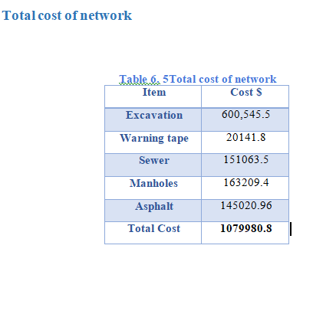
Total cost of the network

Slide 37
Conclusion:
All constraints are achieved and there are no problems in the model, and all the results are in the ranges as specifications and criteria
We used 8 inch diameters for all conduits and PVC material, So the network its economical .

Slide 38
Recommendation:
We recommend constructing a sewer network because the people will be very pleased and most of their problems will be removed.

Slide 39
Thank you

