Slide 1
Insects Killer
PREPARED BY: aLADDIN oDEH && ABDULAZIZ MASOUD
SUPERVISED BY: DR. RAED AL-QADI

Slide 2
Outline:
What is Insect Killer ?
Hardware Layout
Communication protocols
Manual Mode – Android App
Automatic Mode – image processing

Slide 3
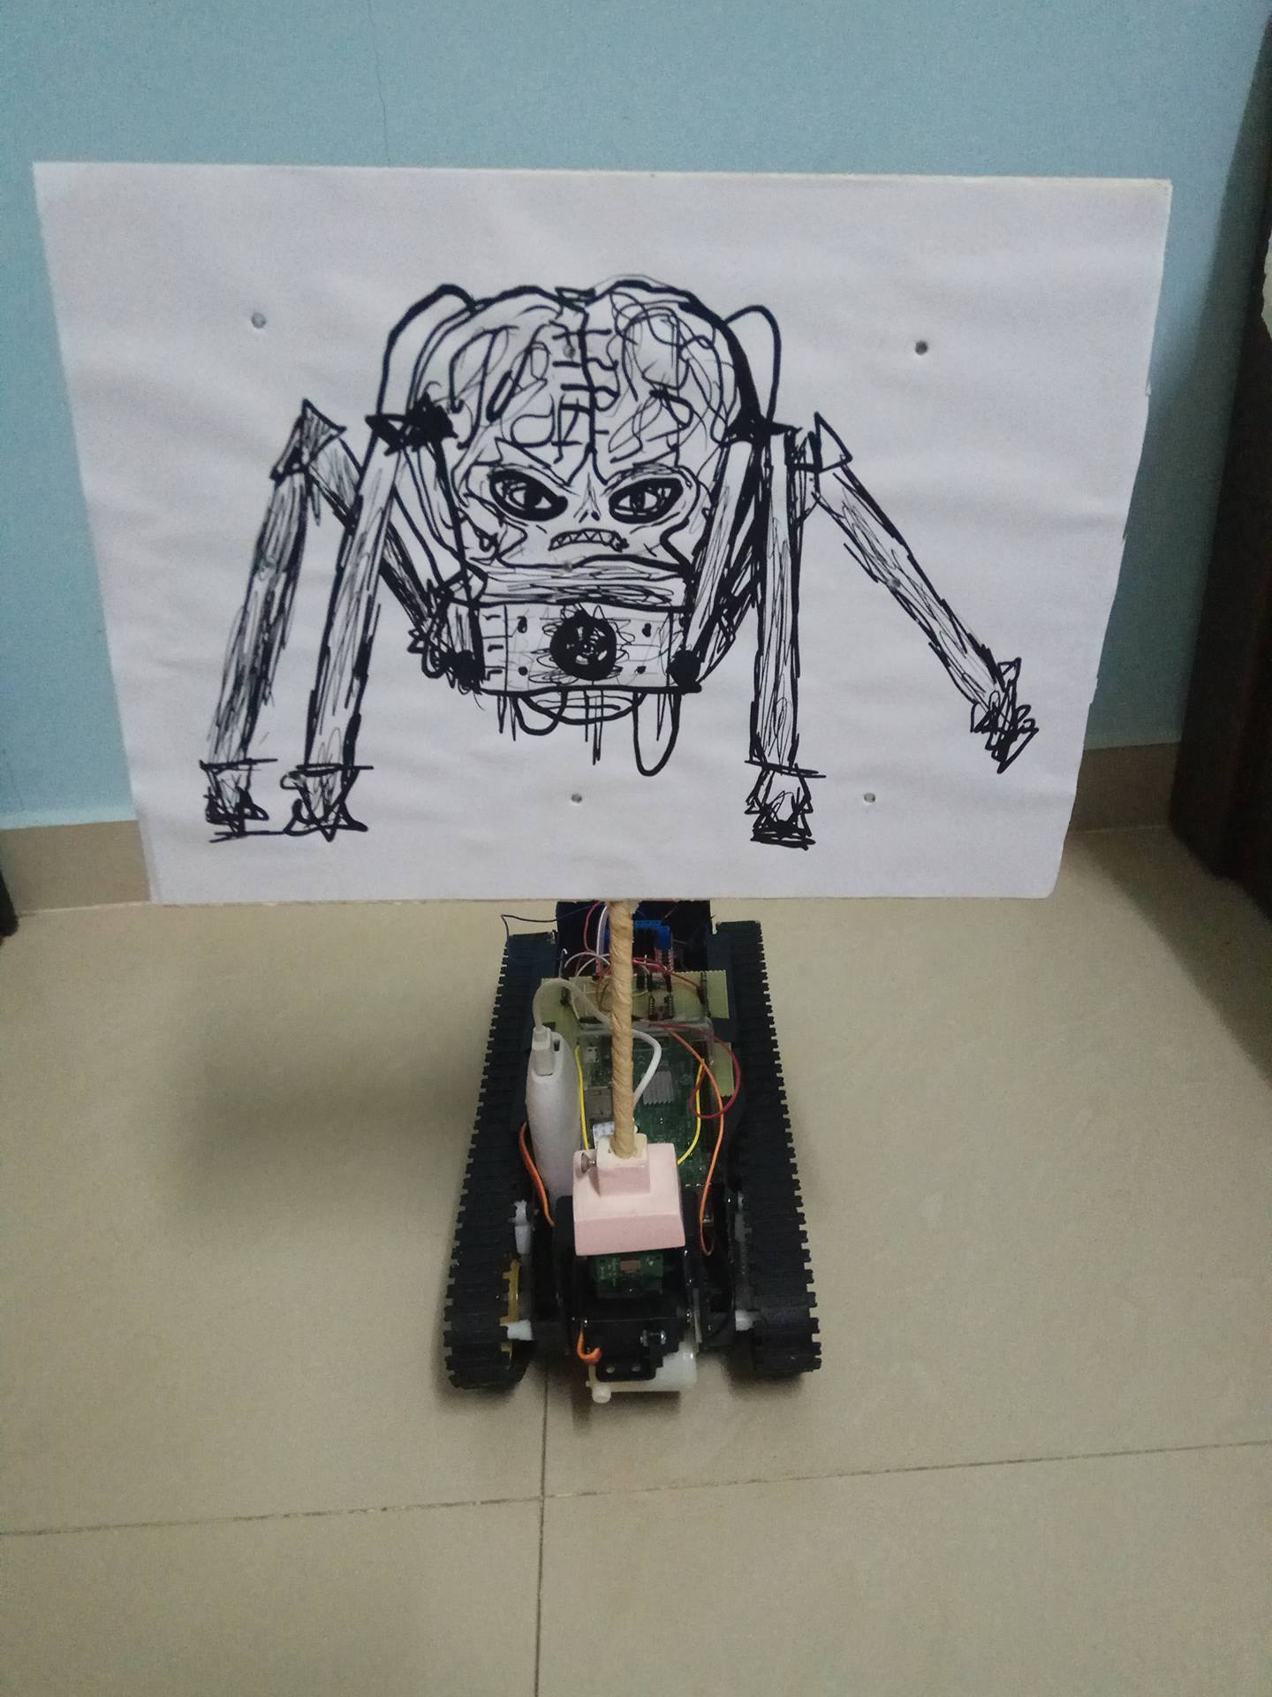
What is insect Killer ?
A robot that kills insects !
The user can control it .
It can work automatically.

Slide 4
Hardware Layout
The equipment used:
The tank
H-bridge
Water pump
Servo motor + brackets
Arduino mega
Power bank – lithium
Raspberry pi 3 model b
Raspberry camera module
Transistors,resistors,wires, button and board

Slide 5
Hardware Layout
The circuit diagram:

Slide 6
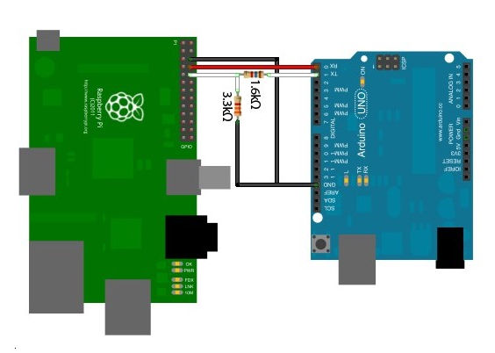
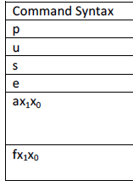
Communication protocols
Main communication between raspberry pi and Arduino :

Slide 7
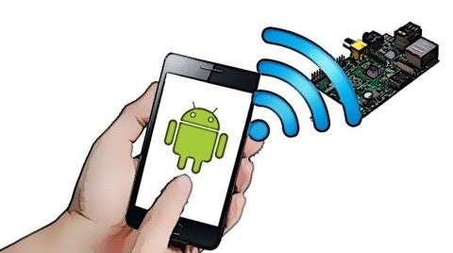
Communication protocols
Manual Mode (Android and raspberry pi )

Slide 8
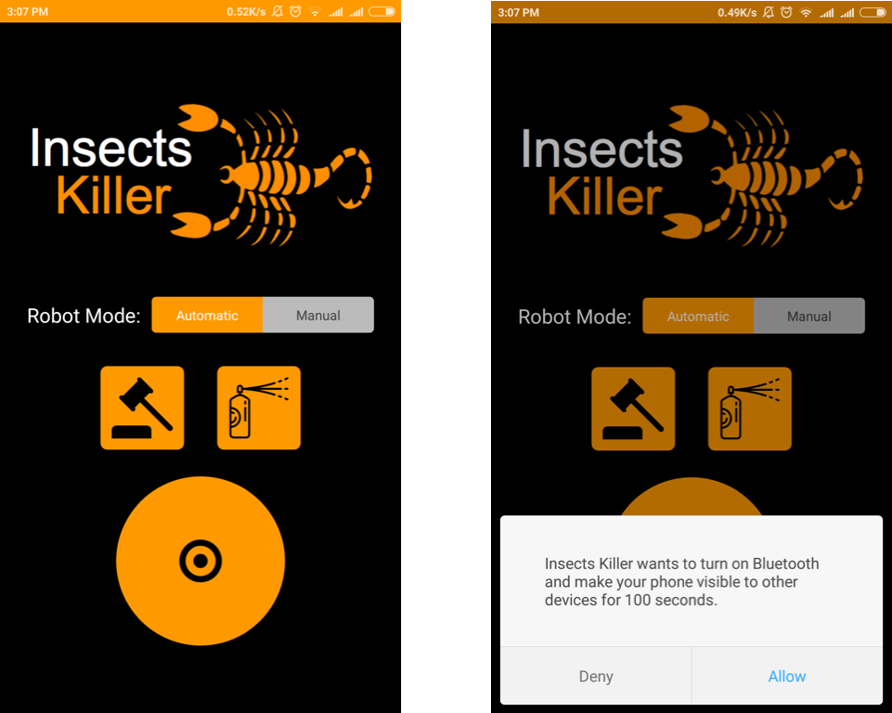
Manual Mode (Android App)
The user can change modes.
The default mode is automatic.
The user can :
Control the direction and the speed.
Control the water pump.
Control the hammer.

Slide 9
Automatic Mode
The First Attempt (The ultimate detection) : Failed !
The pre-trained Neural network model made by Google !
The problem :
Take too much time processing one frame.
The image must contain a big and clear representation.

Slide 10
Automatic Mode
The Second Attempt (Building a Neural network) : Failed !
The google model wasn’t specialize to insects .
We tried to build our own model .
The problem:
To build a simple model we need at least 7000 images.
Even if we collected such data : special hardware is needed !

Slide 11
Automatic Mode
The final Approach (Basic image processing) :
To achieve the goal in such limited processing power device , the detection was based on :
1- The shape
2- The color

Slide 12
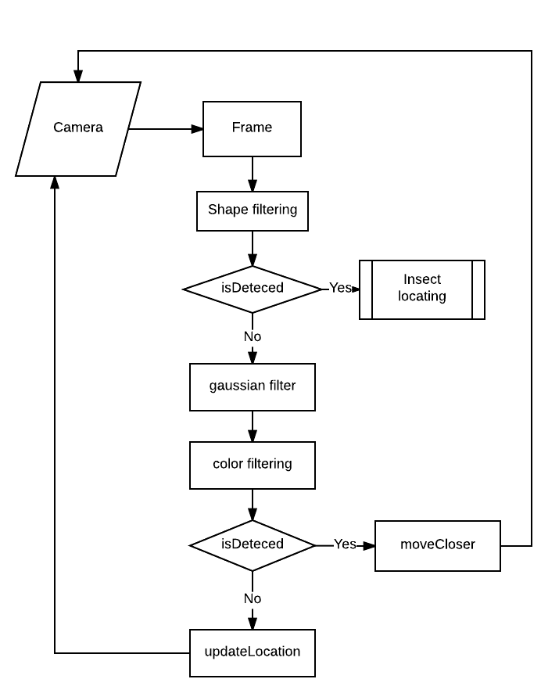
Automatic Mode
The Algorithm Overview :
Frame To Action

Slide 13
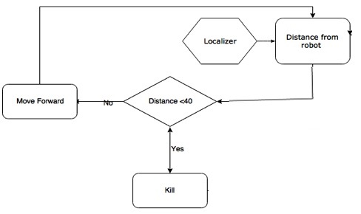
Automatic Mode
Locating the insect .
The input is a bounding box containing the insect.

Slide 14
Demo

Slide 15
Thanks

