Slide 1

MM Player
Supervised by:
Dr. Luai Malhis.
Prepared by:
Mustafa Assaf & Mahmoud Musa

Slide 2
Layout
Introduction
System hardware
Work flow
The features of MM player
Problems and Solutions.
Demo

Slide 3
Introduction
Our project is called MM Player. This MM Player is a device run an mp3 files. It has a touch screen, this touch screen display a buttons, in this buttons, the user can send their command. For example, the can play a next mp3 file. And it also display the file that is played.

Slide 4
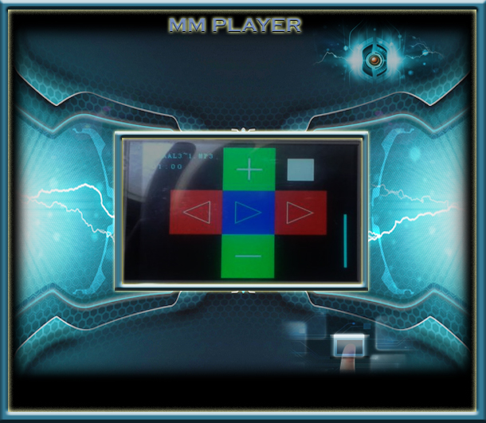
Introduction .. cont.

Slide 5
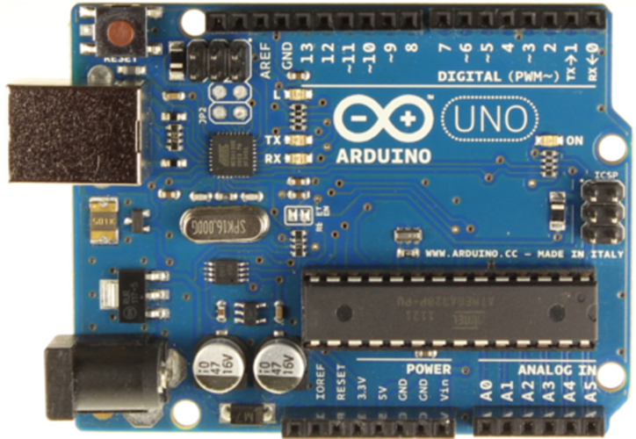
System hardware.
Arduino
In our project, the Arduino is used to connect the components to each other’s and to build a touch screen driver and to send mp3 files to mp3 shield.

Slide 6
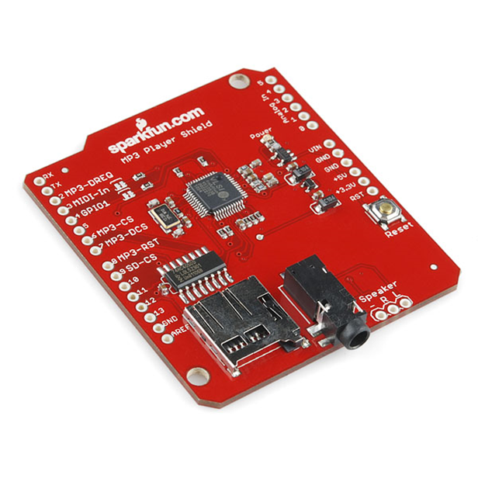
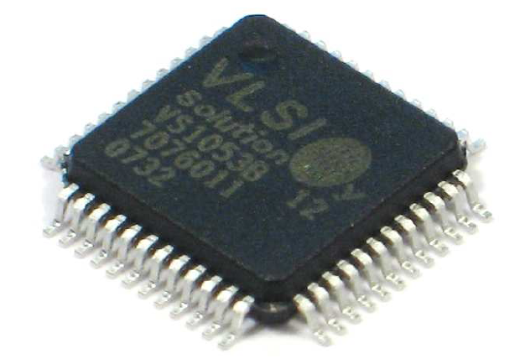
System hardware.
MP3 Player Shield
This is the main component in our project. This shield contain the VS1053B MP3 audio decoder IC to decode audio files.

Slide 7
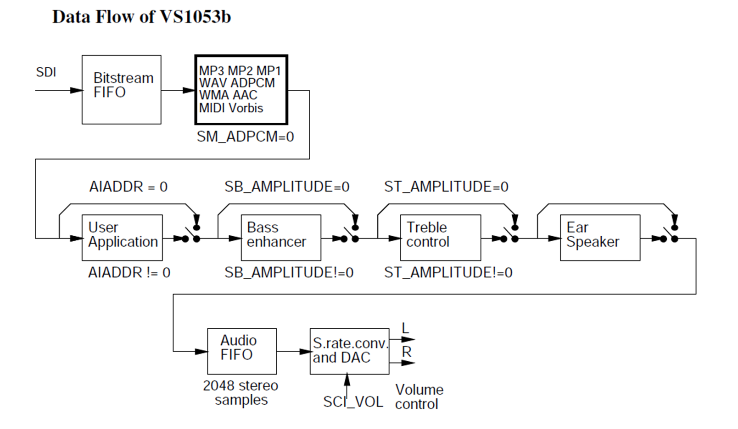
System hardware.
MP3 Player Shield .. count
The VS1053 receives its input bit stream through a serial input bus (SPI). After the stream has been decoded by the IC, the audio is sent out to stereo headphone jack.

Slide 8
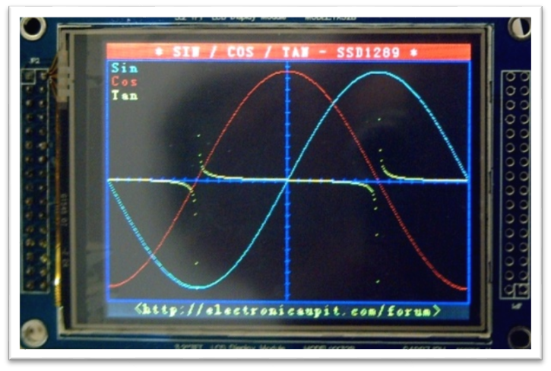
System hardware.
TFT LCD Screen
It is a TFT LCD Screen Module , 38 pins interface , not just a LCD break but include the Touch.
It’s a 65K color, 320*240 (resolution), and 3.2 inch TFT LCD screen.
The Screen include a controller SSD1289, it’s a support 16bit data interface

Slide 9
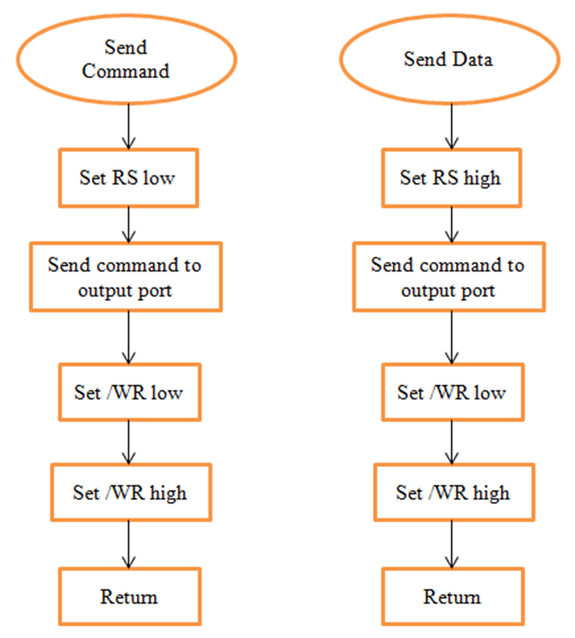
System hardware.
TFT LCD Screen
LCD Screen

Slide 10
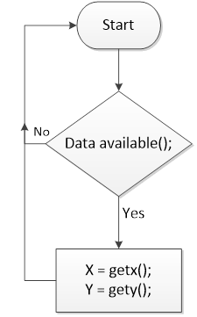
System hardware.
TFT LCD Screen
Touch Screen
DEMO

Slide 11
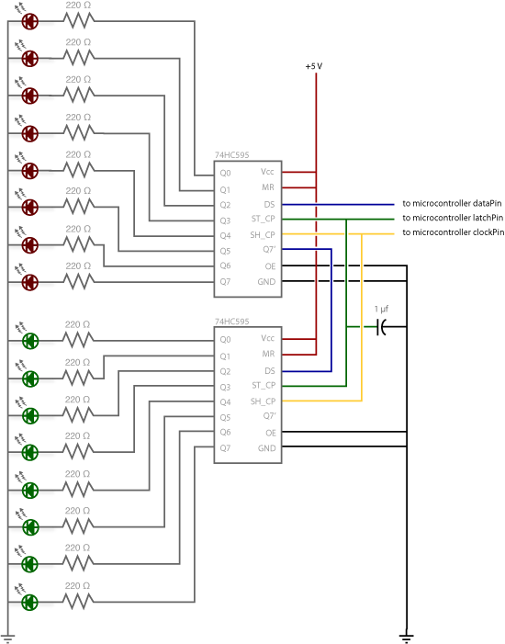
System hardware.
Shift register
we used two shift registers to control 16 outputs pins using only three pins.

Slide 12
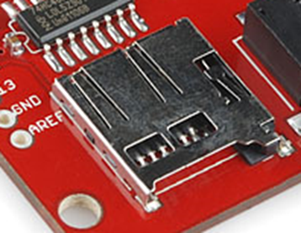
System hardware.
SD card
In our project we have a SD card that store an mp3 files.
The socket of SD card build on mp3 shield.
The size of SD card that is used in our project is 2 GB

Slide 13
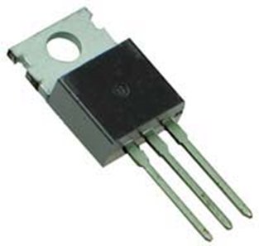
System hardware
Regulator
In our project we use a regulator along with 10uF and 0.1uF to create a 5V output on a 9V power supply.

Slide 14
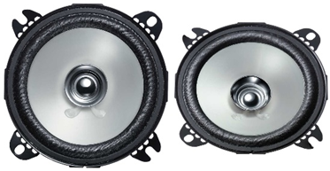
System hardware
Speaker
we used an internal speaker with an amplifier. And our project also support external speaker. And it don’t allow the internal speaker to work when the external is exist.

Slide 15
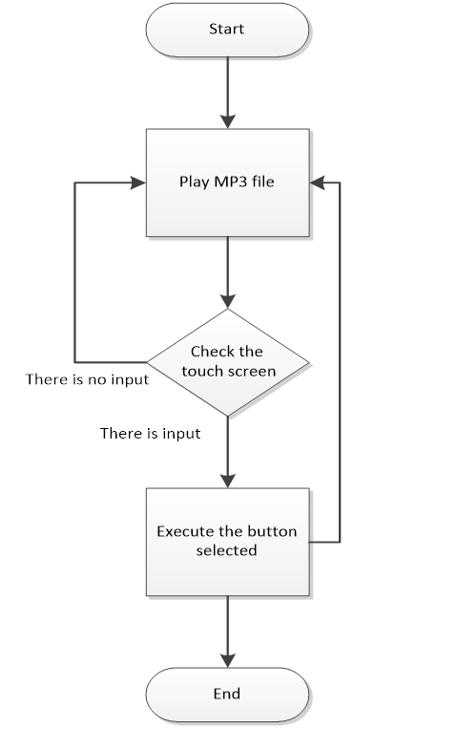
Work flow

Slide 16
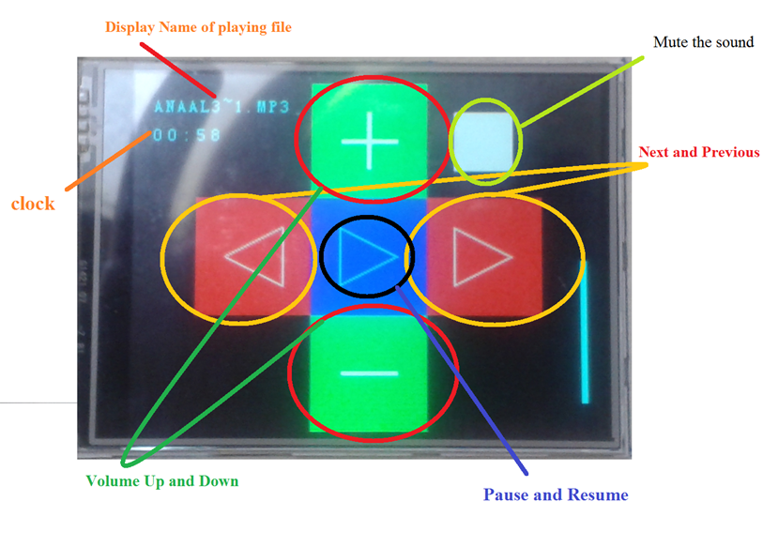
The features of MM player

Slide 17
Problem and solution
We was faced a lot of problem in our project, we can summarize this problem as the following points:
Low flash memory (program space).
Few number of pin in Arduino.
Write a driver for LCD.

Slide 18
Low flash memory
MM player has a flash memory of 32k bytes.
A lot of limitations in writing a code.
We solve this problem by writing a very efficient code and make a lot of optimization in the code.

Slide 19
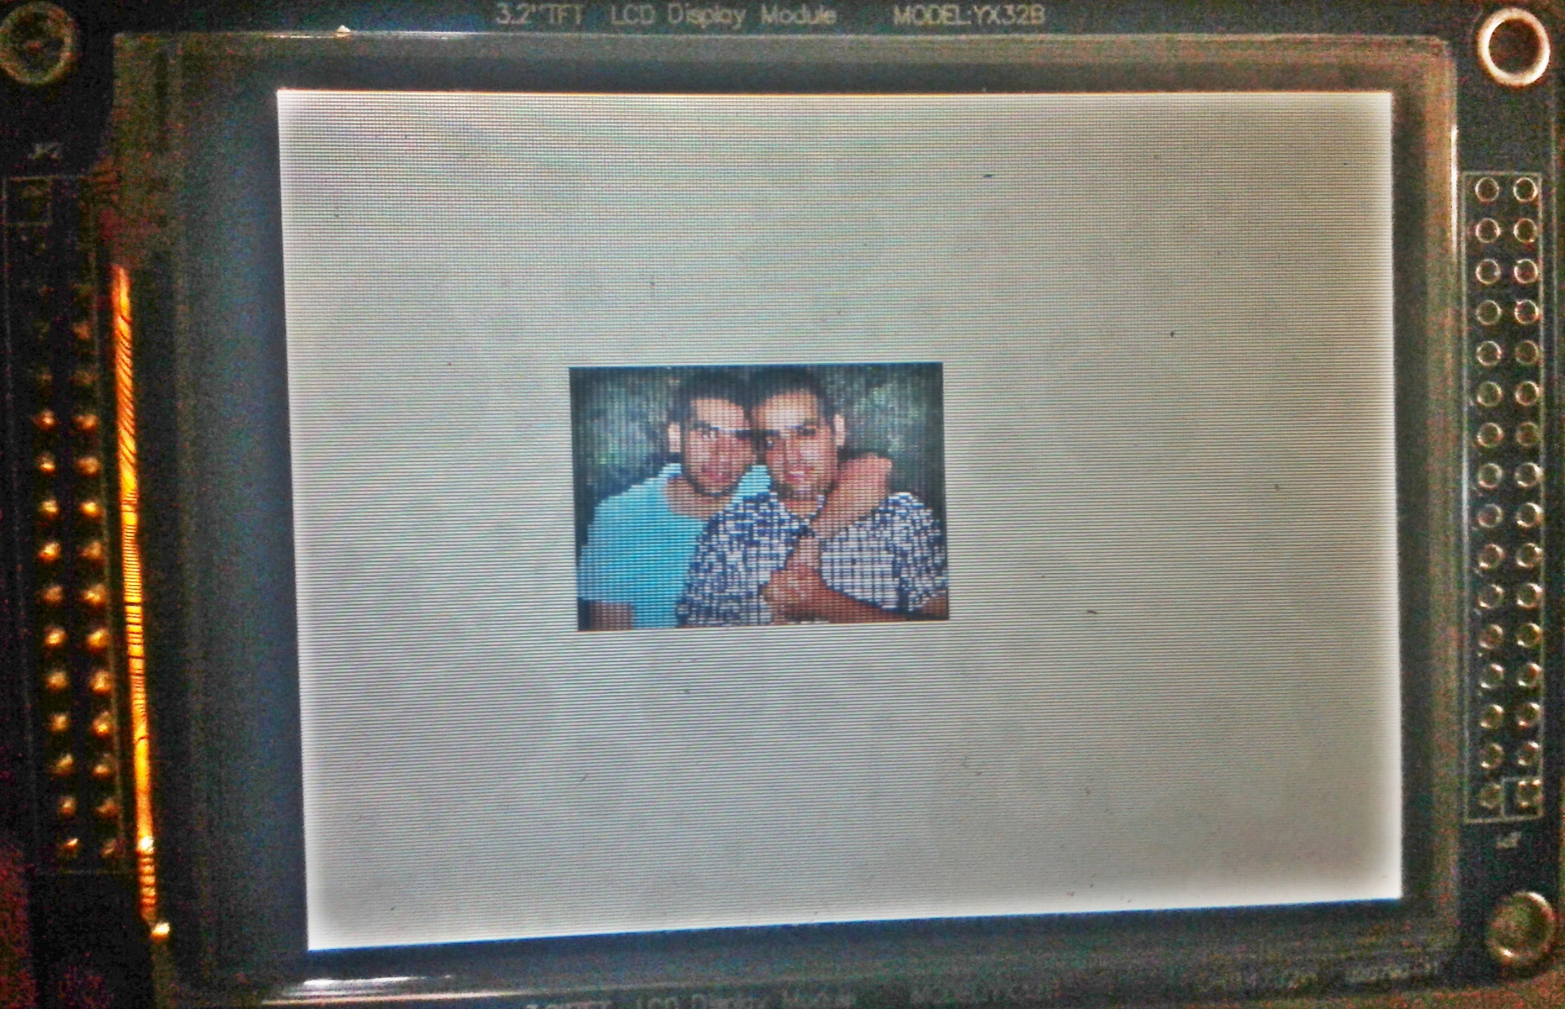
Low flash memory

Slide 20
Few number of pin in Arduino
The Arduino Uno that we used in our project has only 20 pins.
And this number of pins are very few. Because the project has a screen which the screen has a 38 pins.
To solve this problem we use a shift register to map 16 pins to Arduino using only 3 pins.

Slide 21
Write a driver for LCD
We change the way of transfer data from parallel to serial to minimize number of pins that is used.
Because of above, we face a problem to write the driver a generate the correct signals.

Slide 22
Demo

Slide 23
Any Question?

Slide 24
☺ Thank You ☺

