Slide 1
Tripify
Created By : Laila Ayman , Shahd mahmoud
Supervisor: Dr.Amjad abu Hassan

Slide 2
Introduction:
Our Tripify project aims to make it easier for people who want to create their trip, where the user (the trip creator) can book all the services related to their trip, provided by the service provider (the vendor), which are controlled by the administrator.

Slide 3
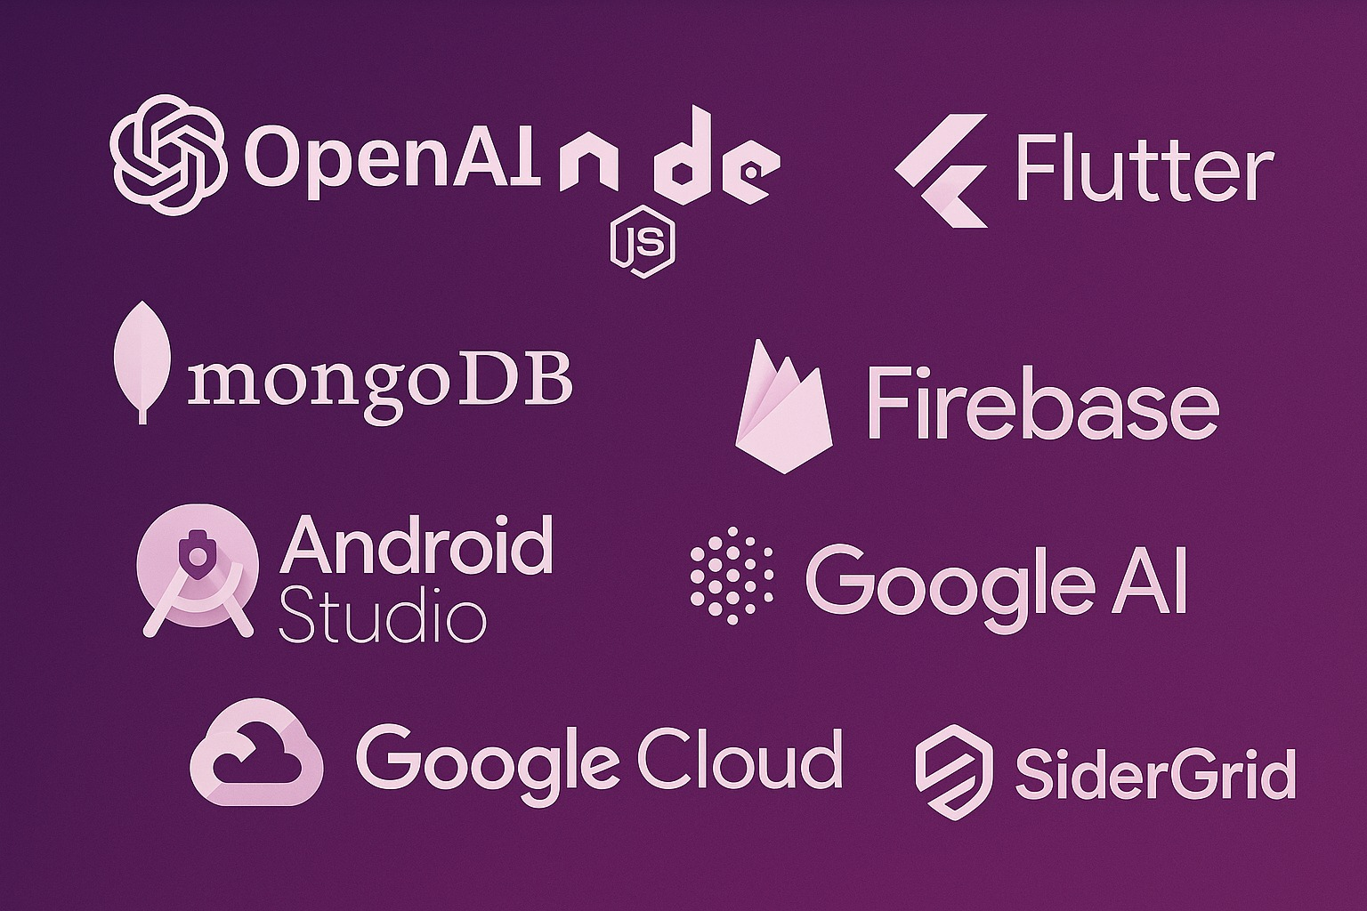
Tools :

Slide 4
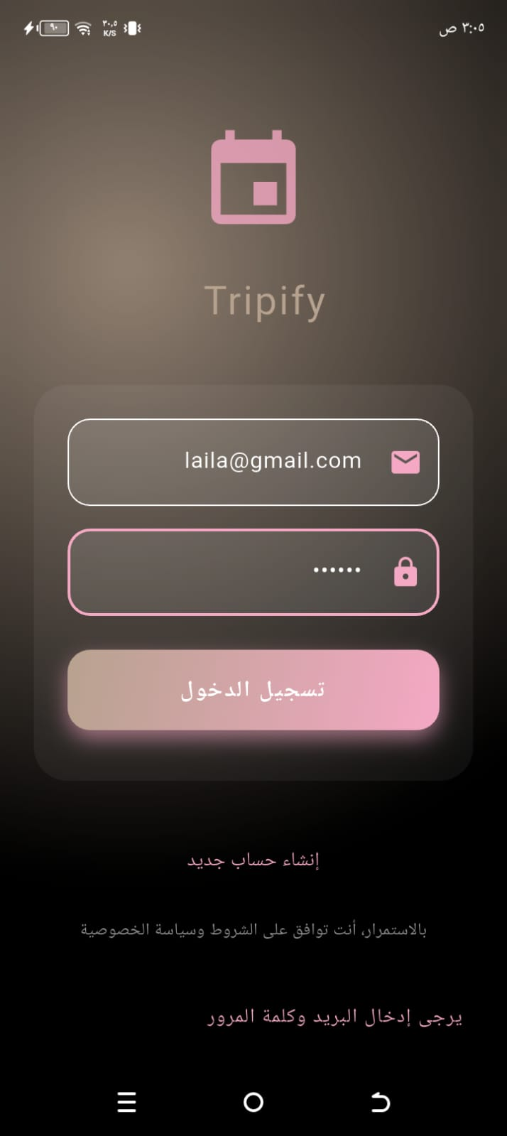
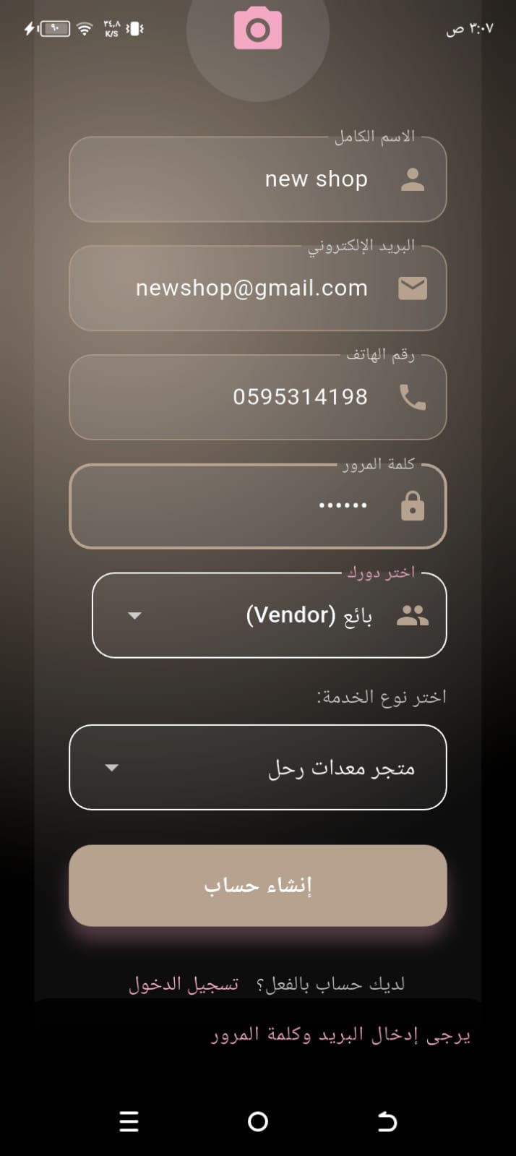
Features:
Authentication:
we have registration. If any of the users has an account, he can log in using his name and email. If he does not have an account, he can create an account and enter his information. He must choose whether he is a service provider or an user in order to enter them to their pages.

Slide 5
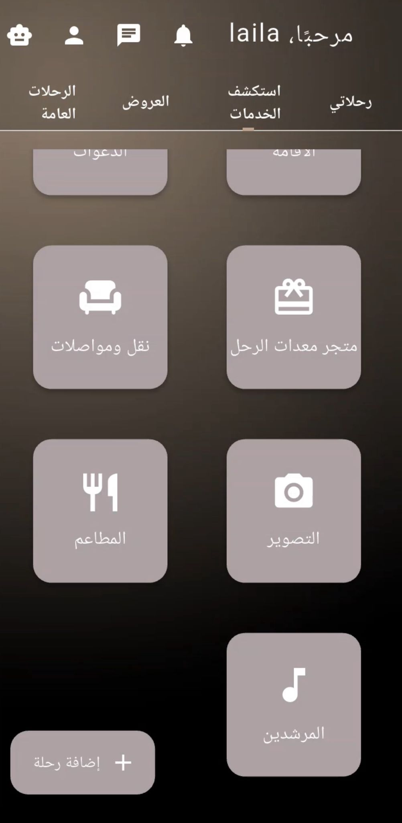
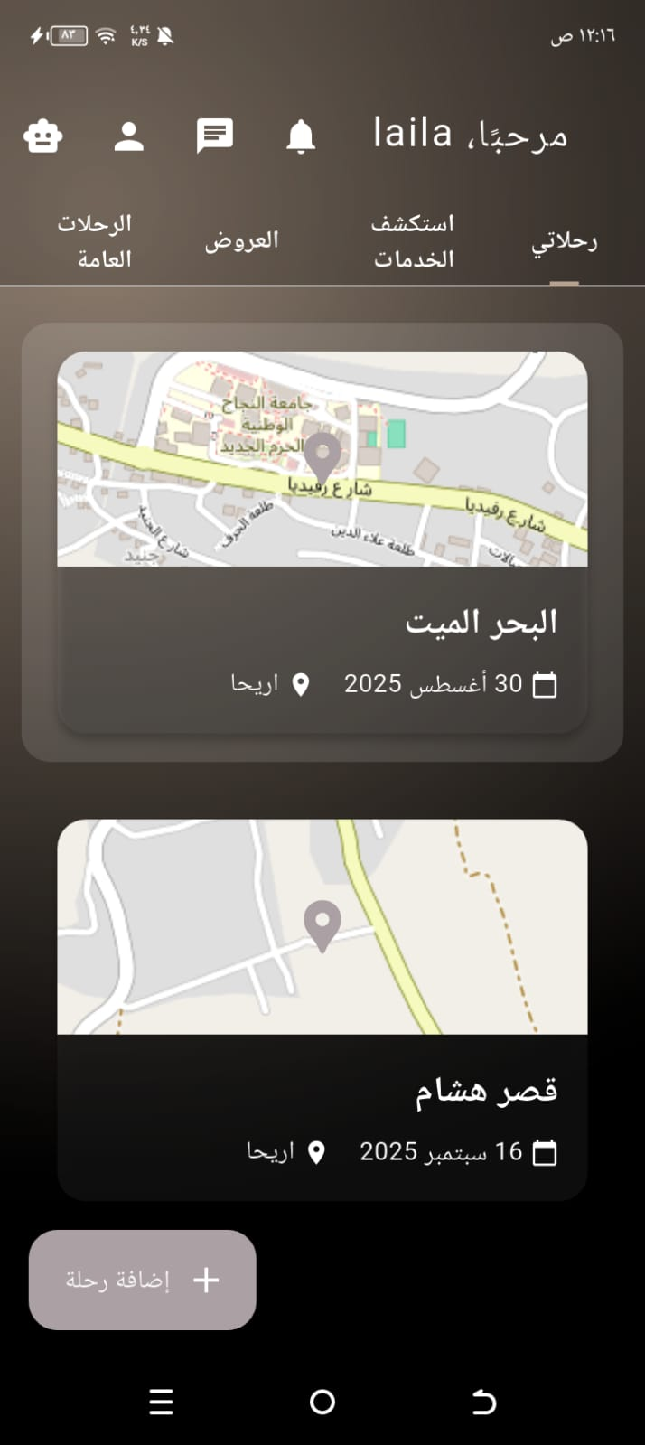
User:
When a user logs in, their activities will be displayed.
The "Explore Services" page displays all the service providers available in the app, including transportation, food, photographers, and more.

Slide 6
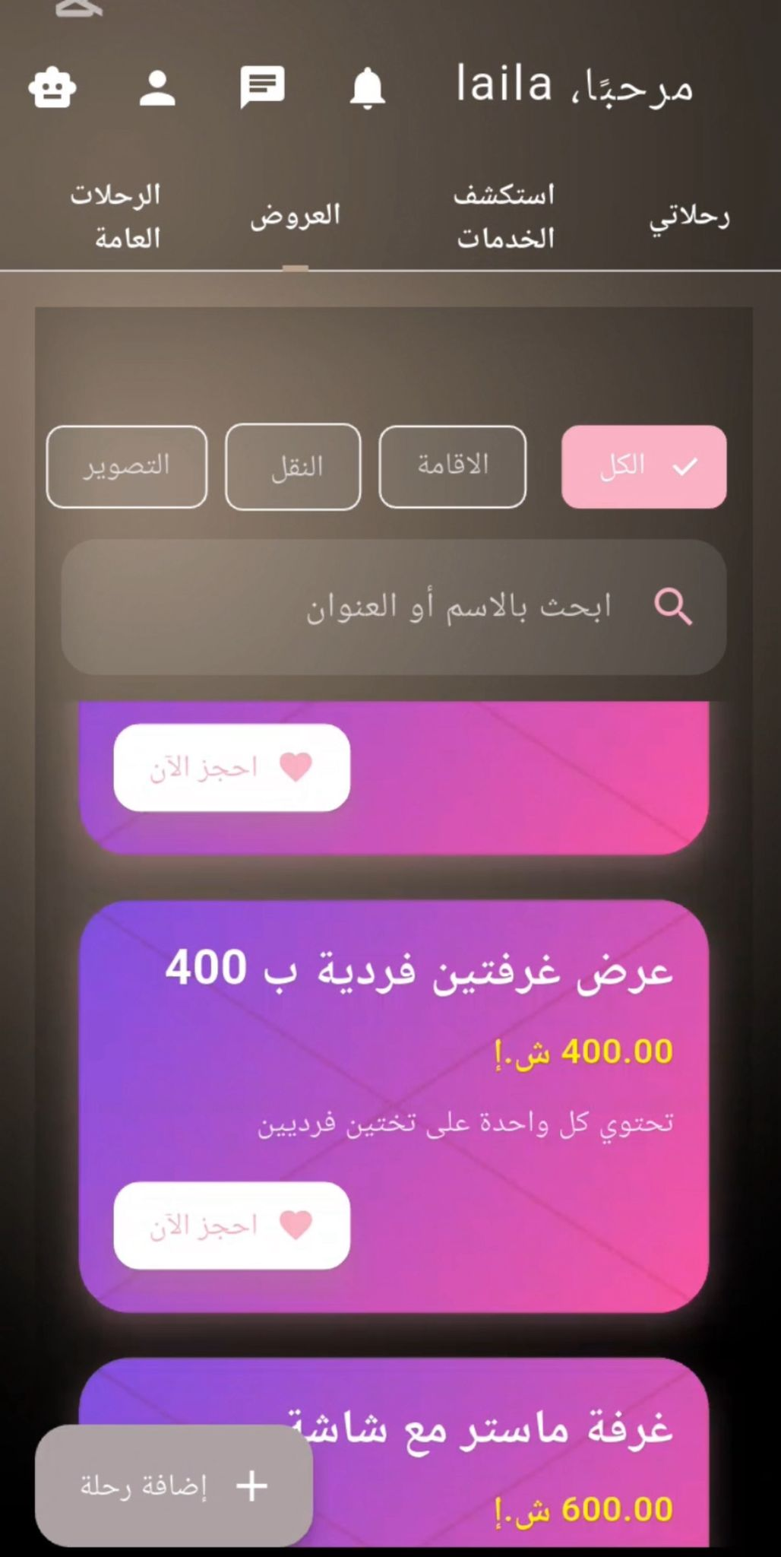
User:
The Offers page displays all the offers available in the app for all services, including photography, accommodation, food, transportation, guides, and more, from all service providers.
You can filter and navigate offers, and search by provider name or offer name.

Slide 7
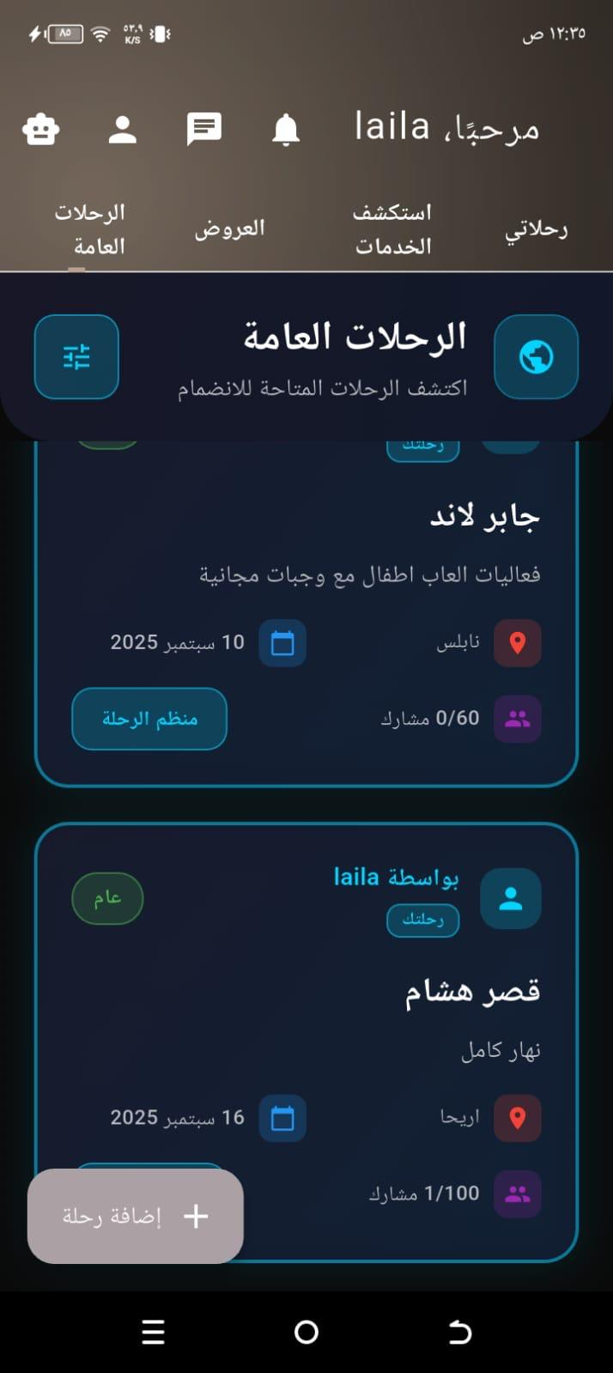
User:
Displays public trips to be booked from the user.

Slide 8
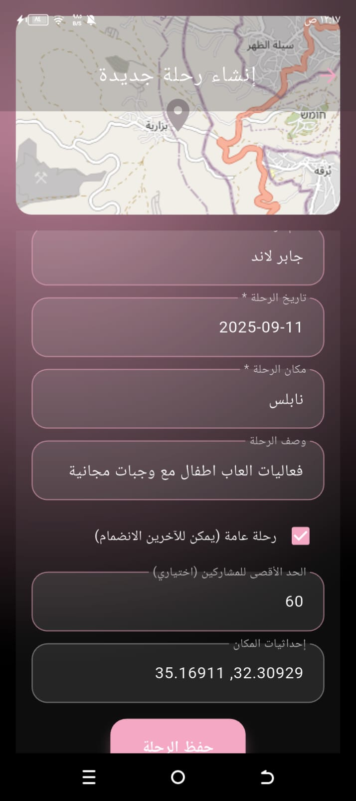
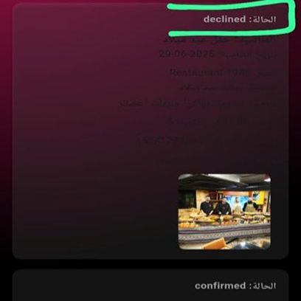
Create a Trip:
When you click the Create Trip button, you will enter the trip name, date, location, description, and coordinates of the location if you are directly there.
The reservations page displays all flight reservations and their status: approved, declined, or pending.

Slide 9
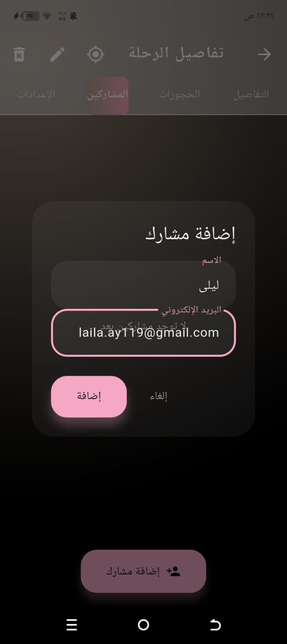
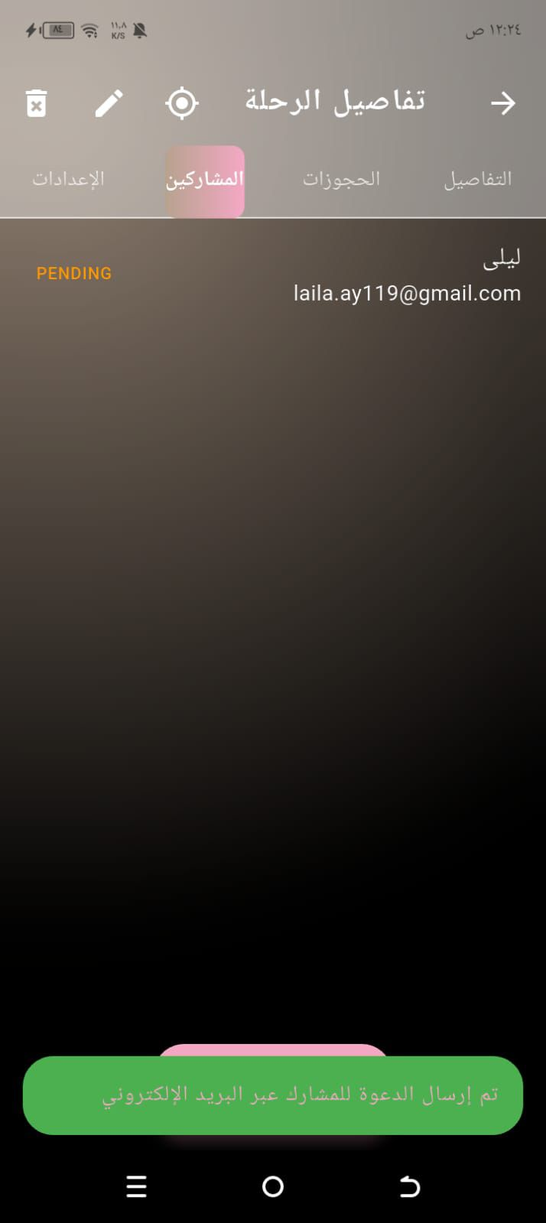
Invite a participant:
On the Participants page, enter the participant's name and send the invitation directly to your email. The names of the invited participants will be displayed, along with their attendance status.

Slide 10

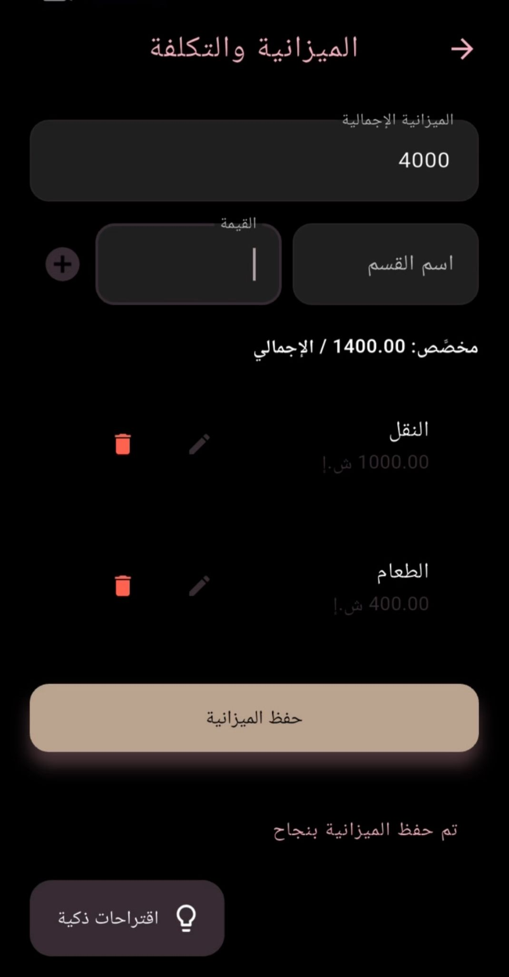
Setteings:
The budget appears in the settings:
He sets the budget for the trip and for each section, then clicks on Smart Suggestions. All the services in the app that fit his occasion and the budget for the section he selected appear, and he can book them immediately.

Slide 11
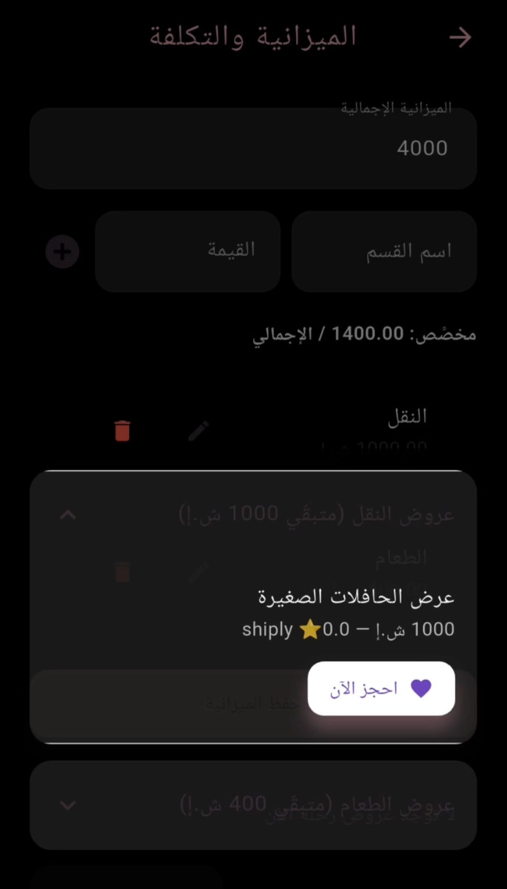
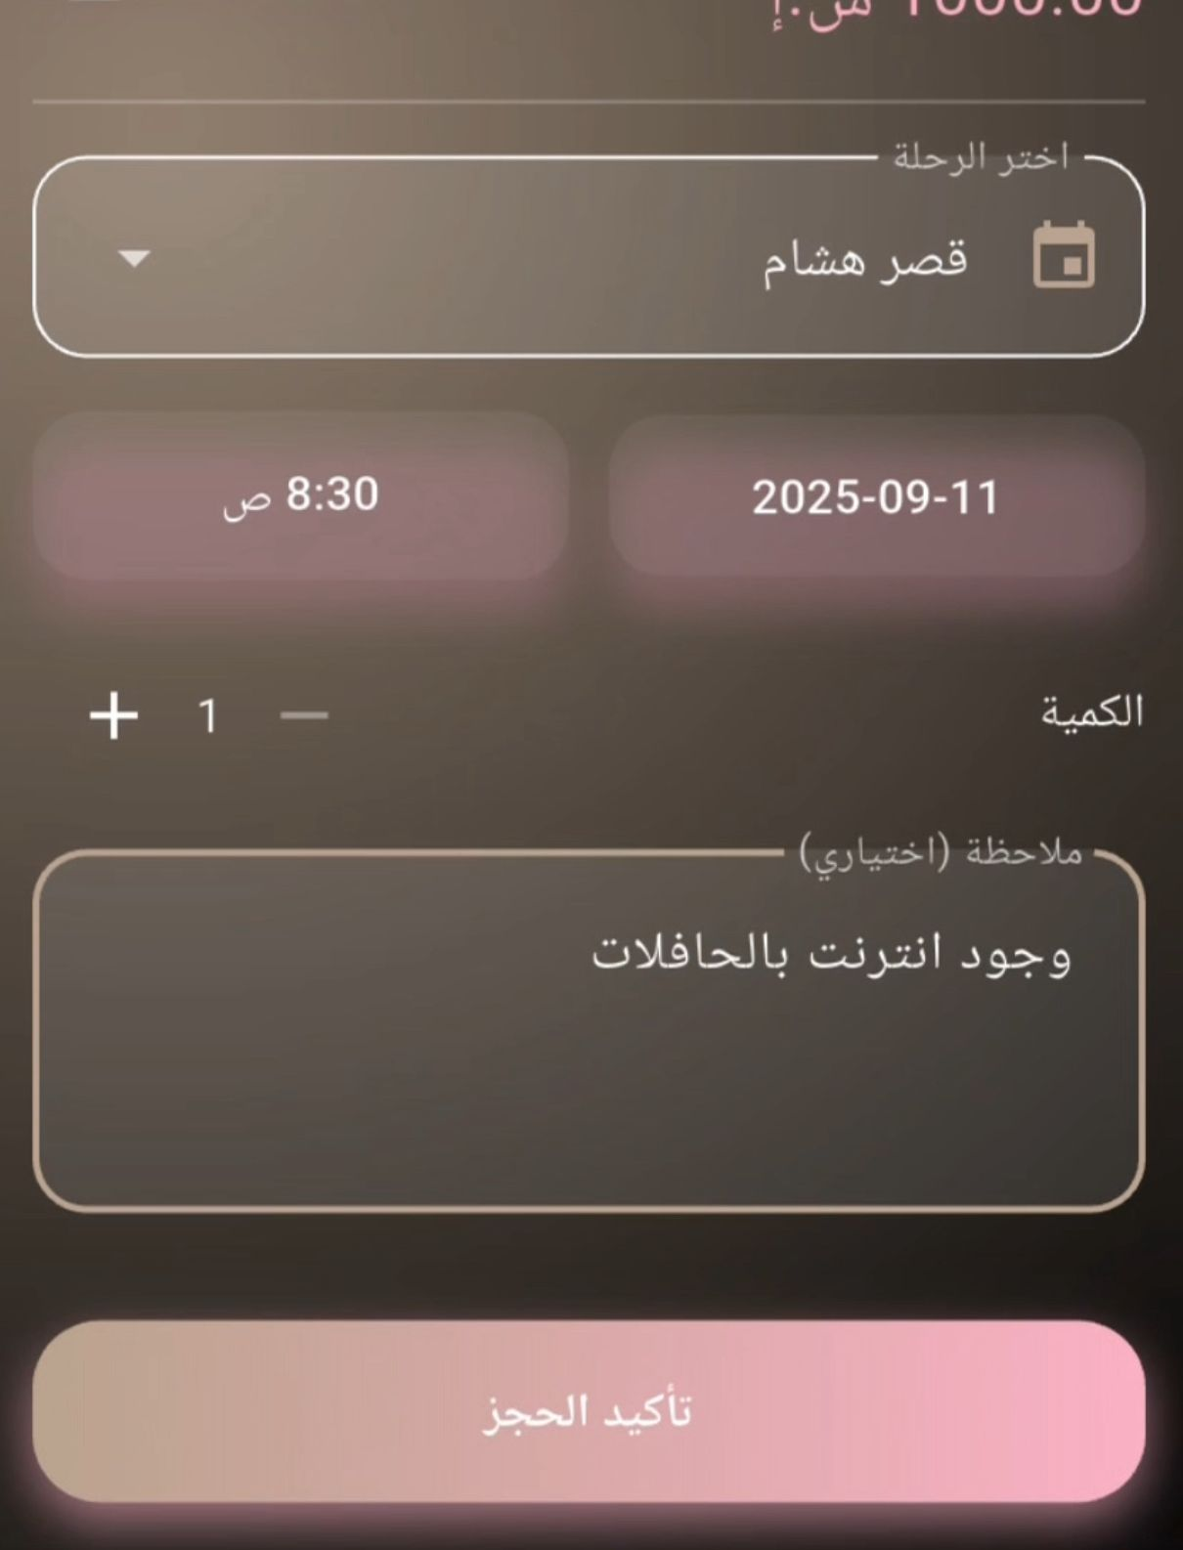
Setteings:
When you set a budget for a specific section, all offers that fit your budget will be displayed. You can then book the offer directly.
The booking page appears:
This displays all the organizer's events. You can select the trip you want to book the offer for, specify the time and date you want the offer to arrive, and provide additional notes.

Slide 12
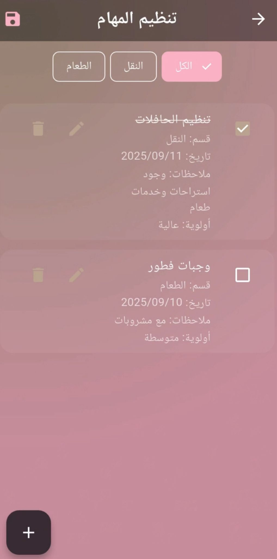
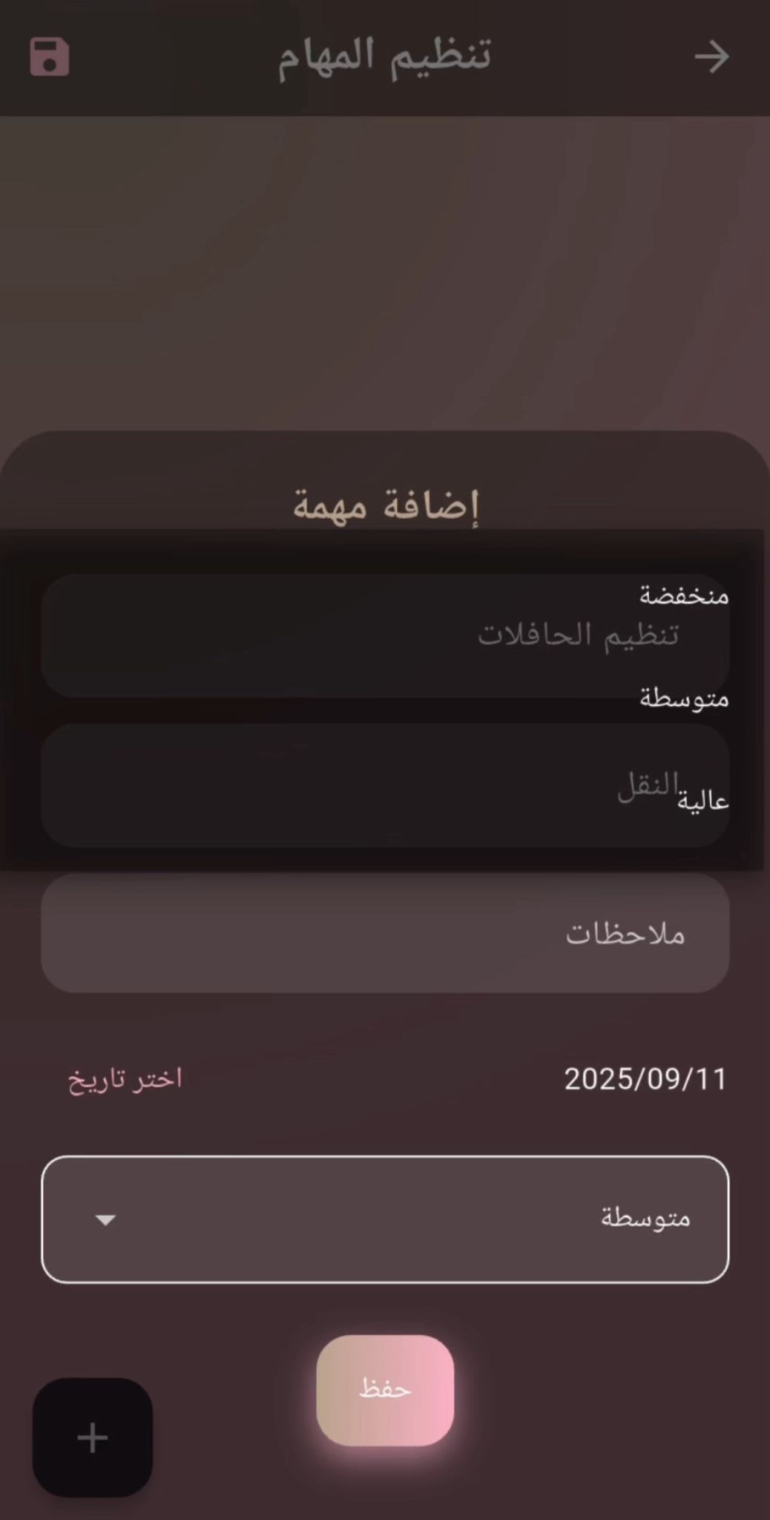
The tasks:
On the tasks page, he adds his tasks, specifying which section they belong to, where filtering is done according to the type of section, and he specifies the priority: high, medium, low, and the ability to delete and modify.

Slide 13
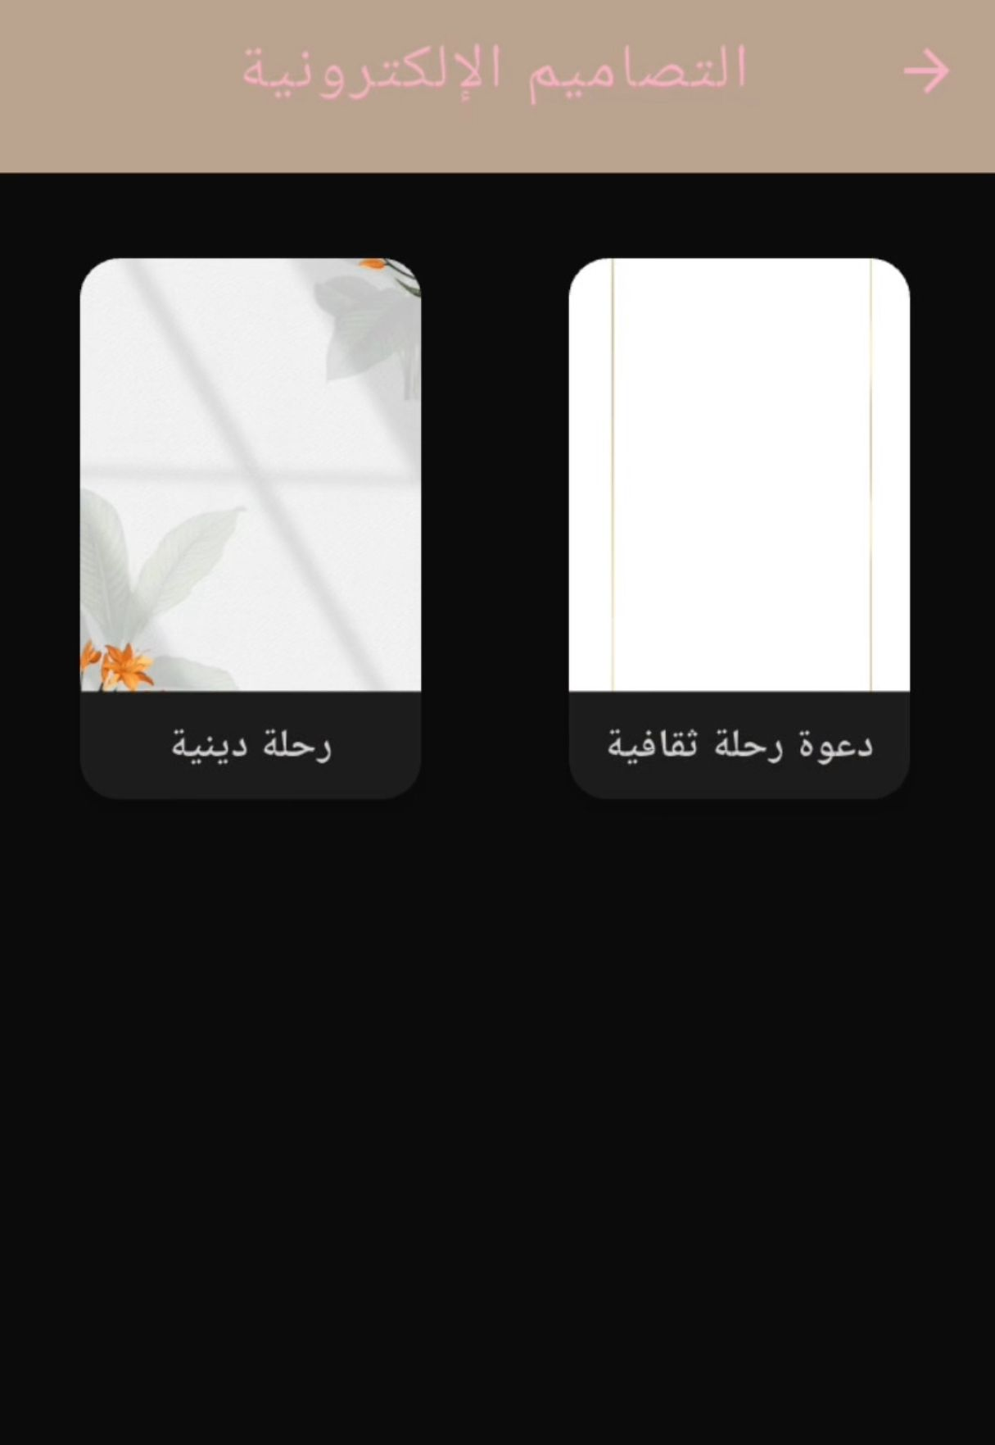
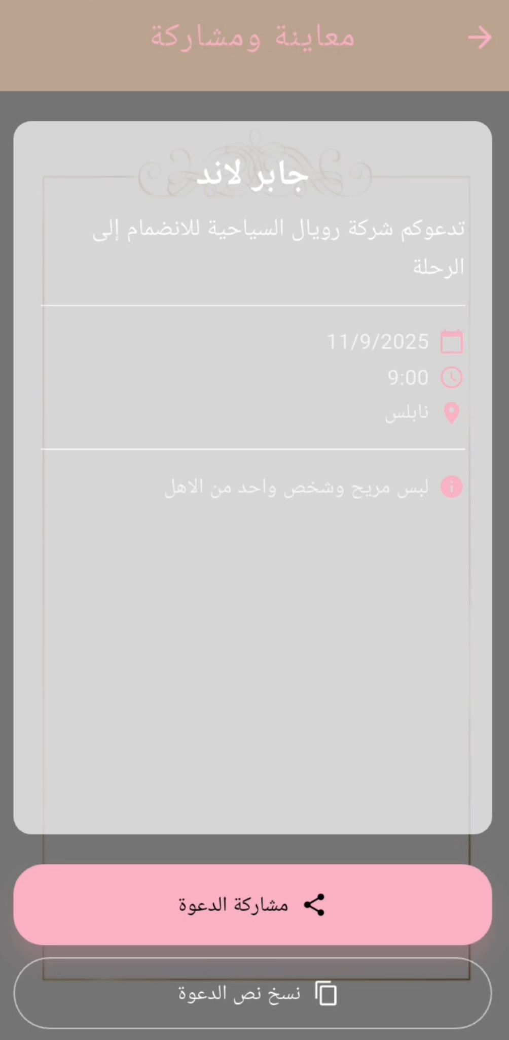
Electronic invitations:
He chooses a design that suits his trip, writes the invitation details such as name, place, date and notes, and then creates it.

Slide 14
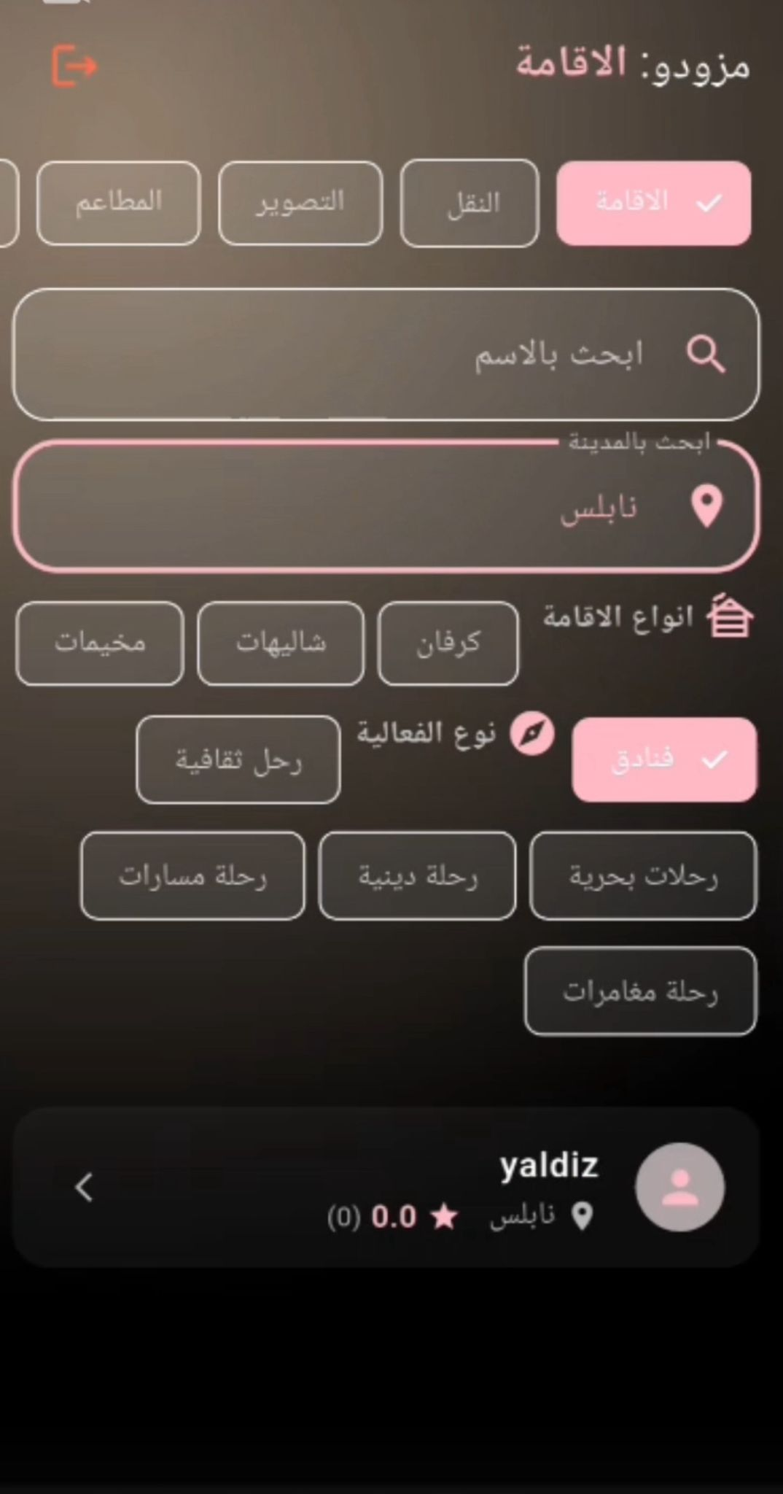
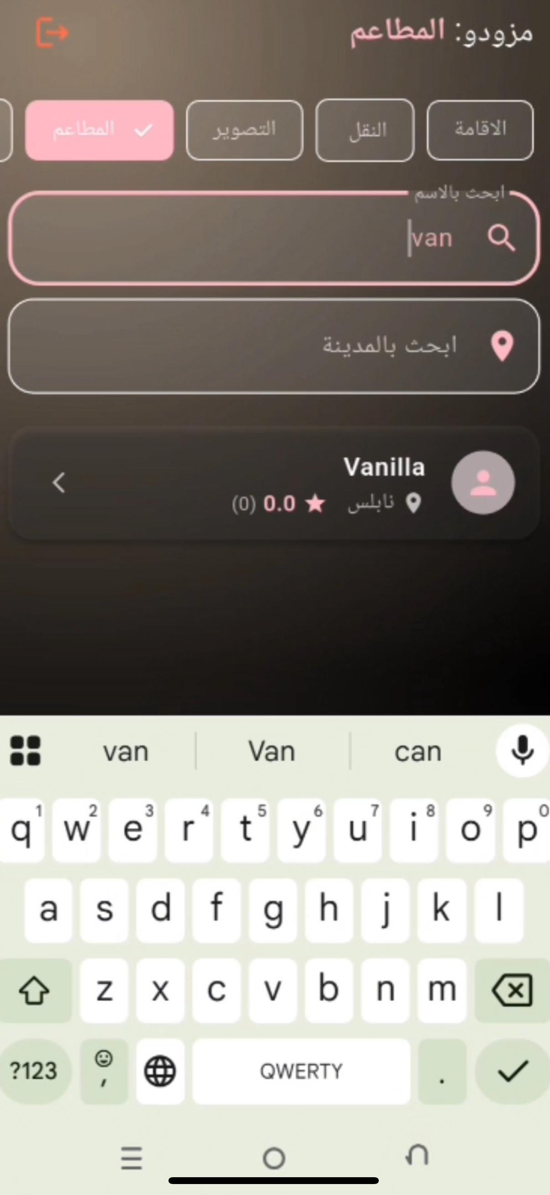
Service providers who appear to the organizer:
He chooses one of the services, and here is the accommodation. He can easily navigate between other services without having to return. He can search for service providers by name or city name. For example, "Nablus" will show him "Who is in Nablus?"

Slide 15
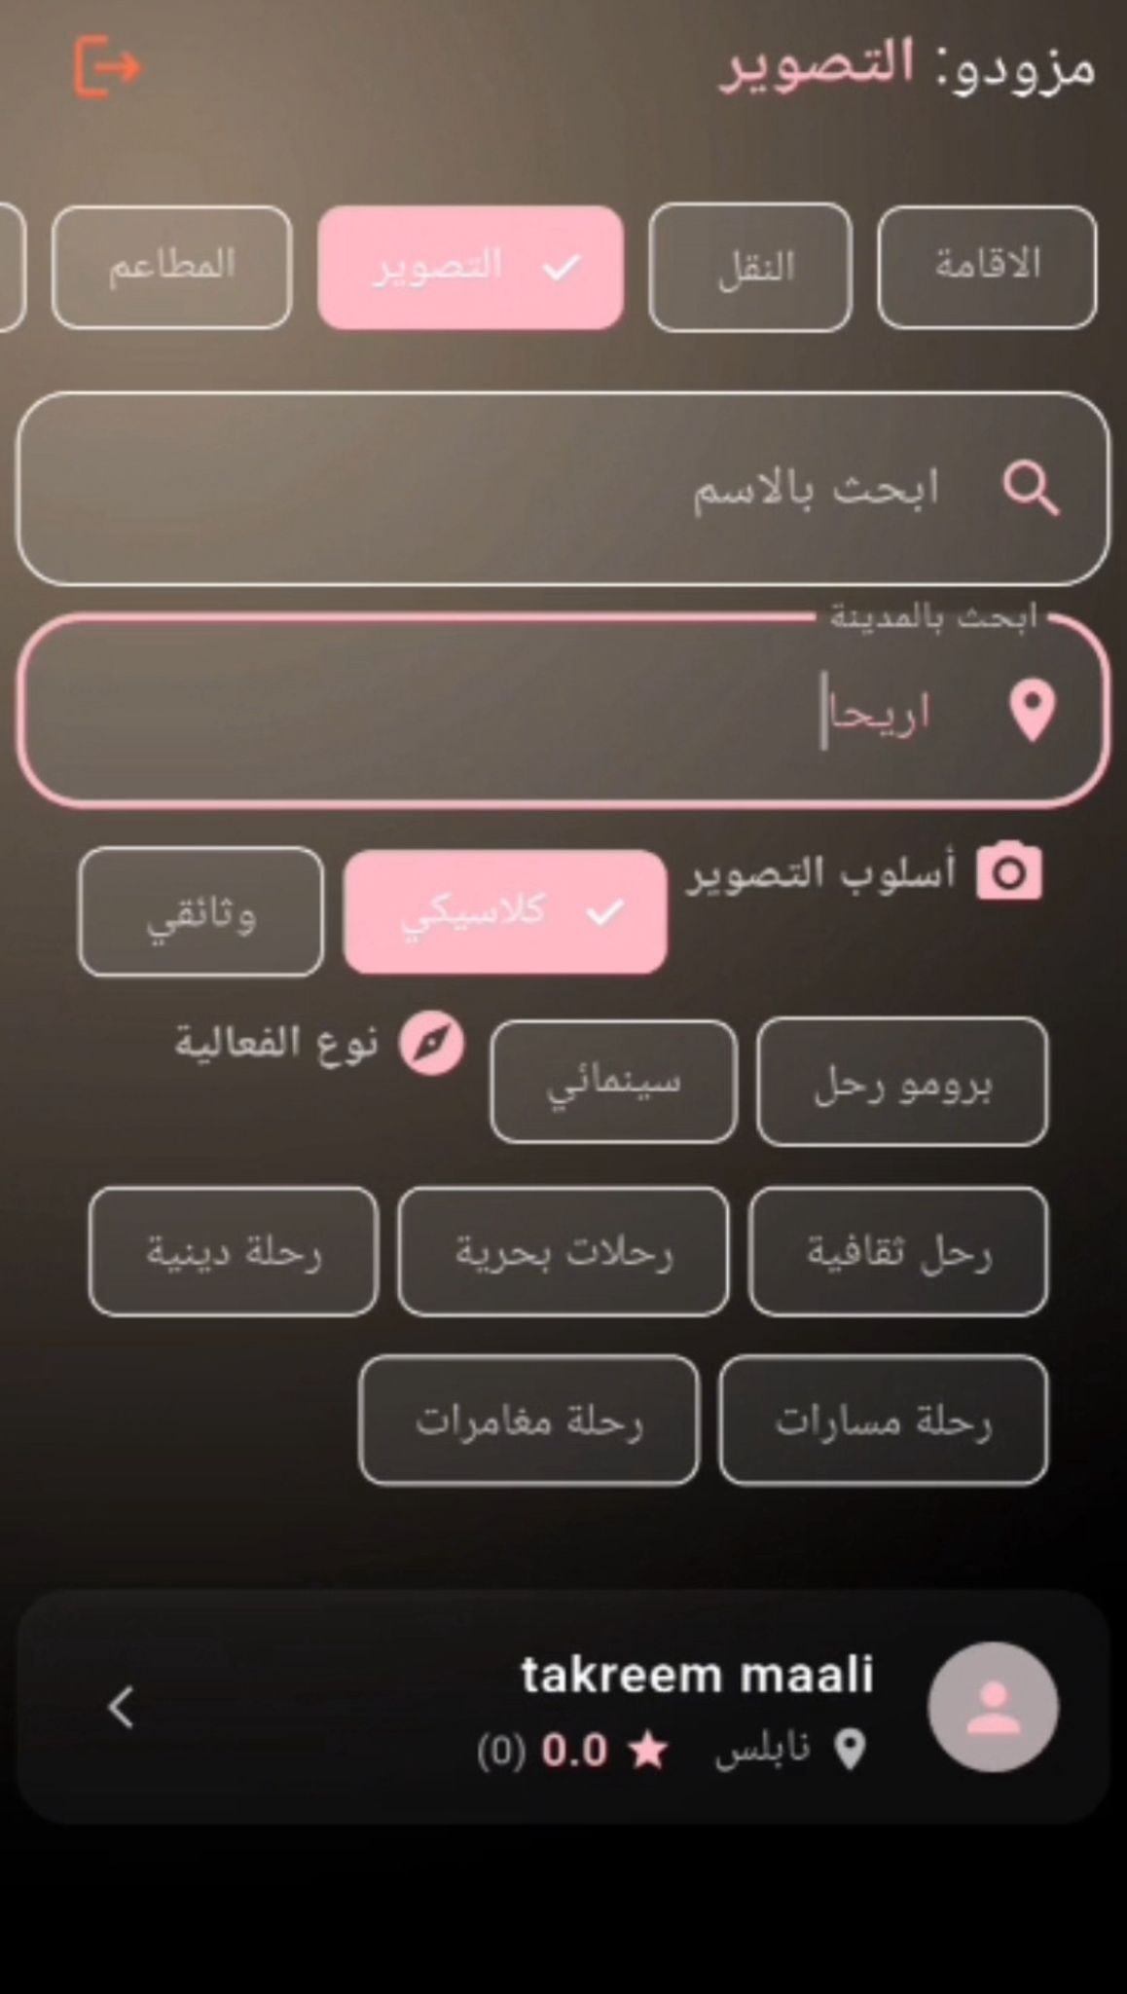
Service providers who appear to the organizer:

Slide 16
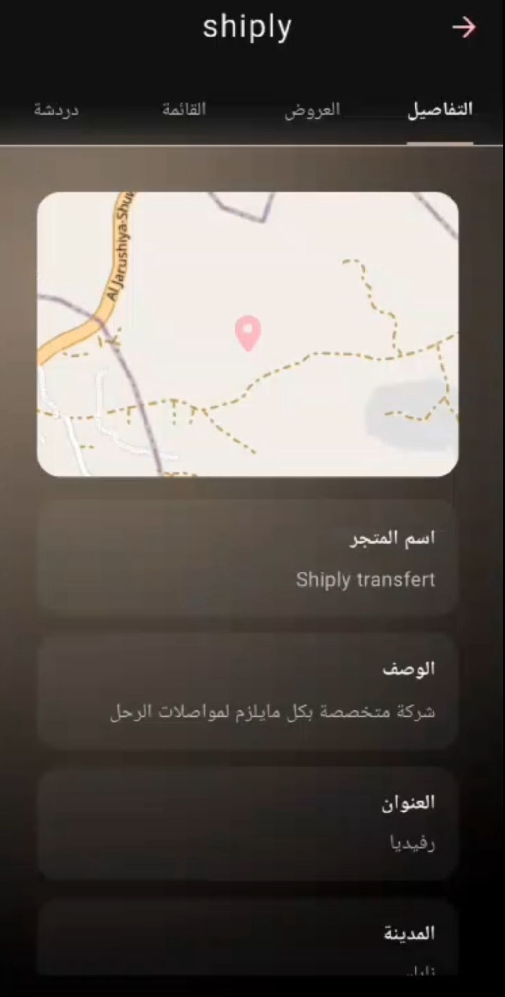
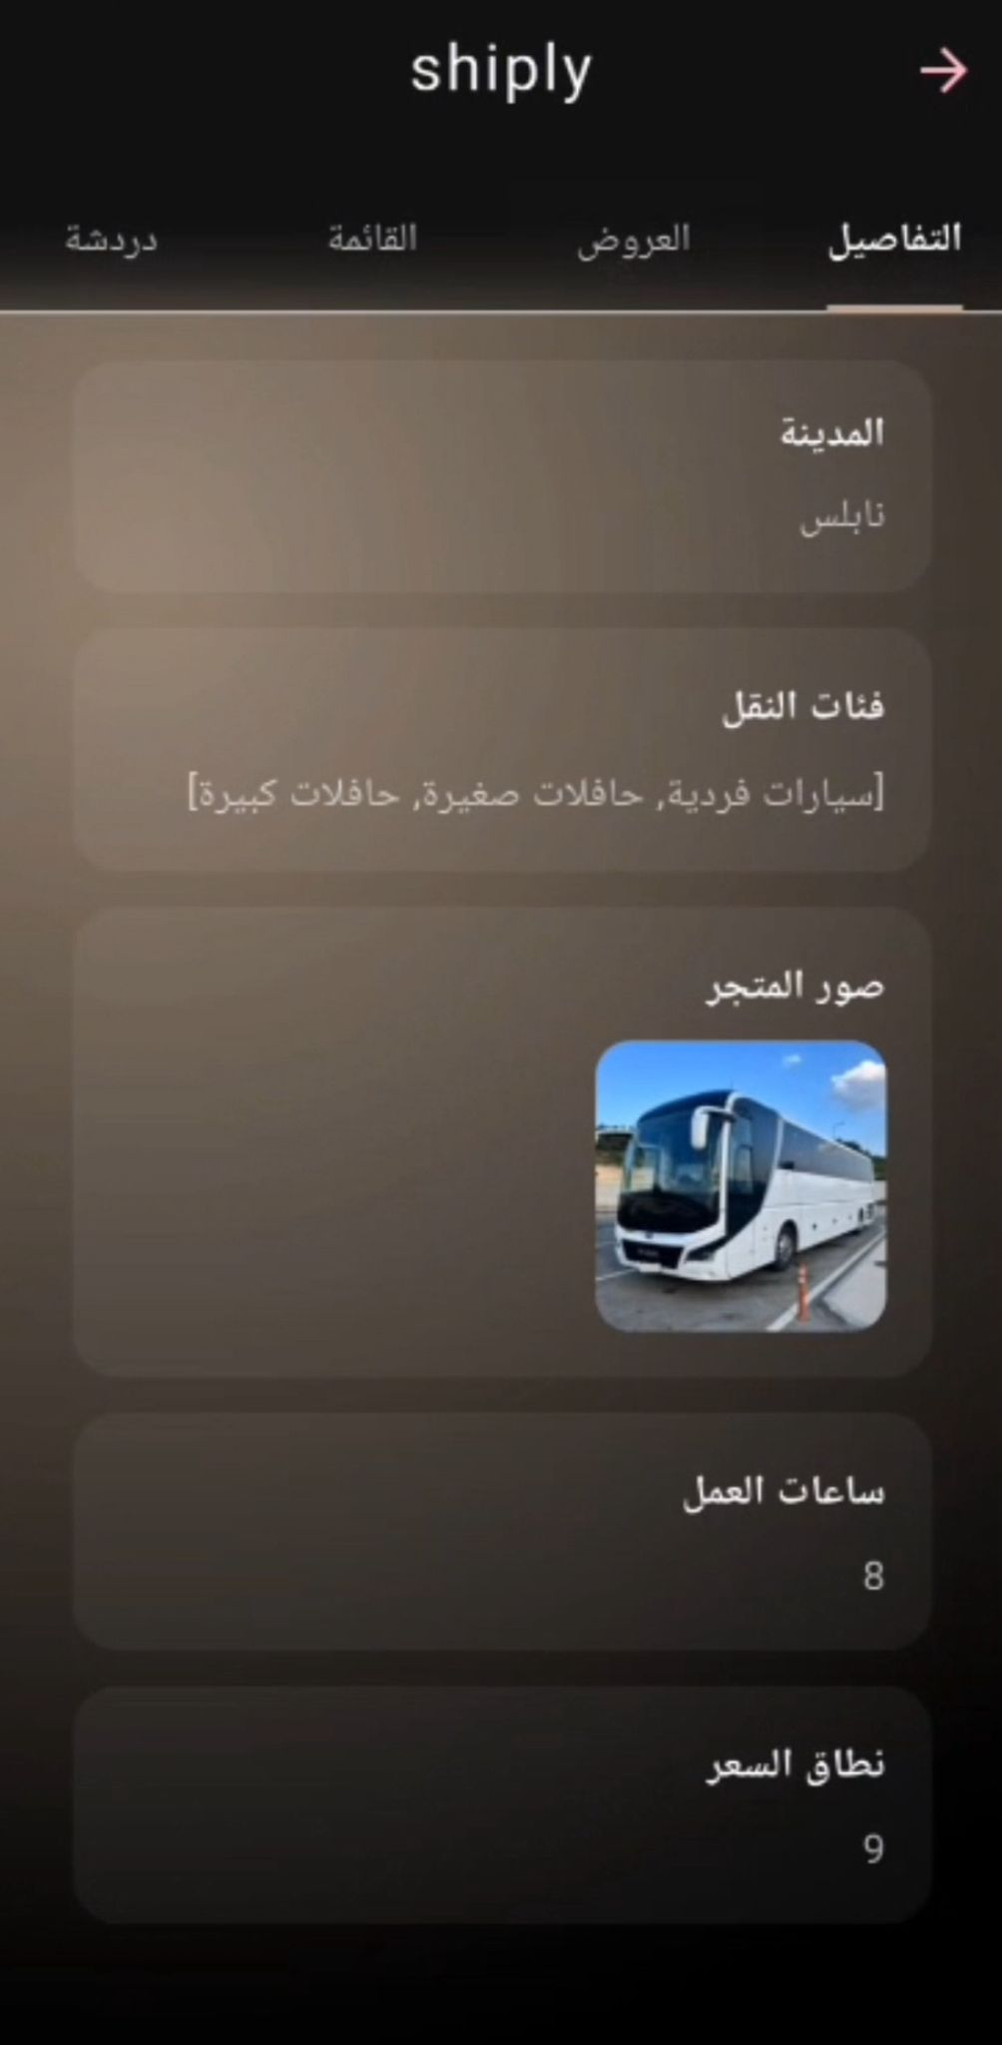
Service provider’s page:
When he click on the provider's name, his details page will appear.

Slide 17
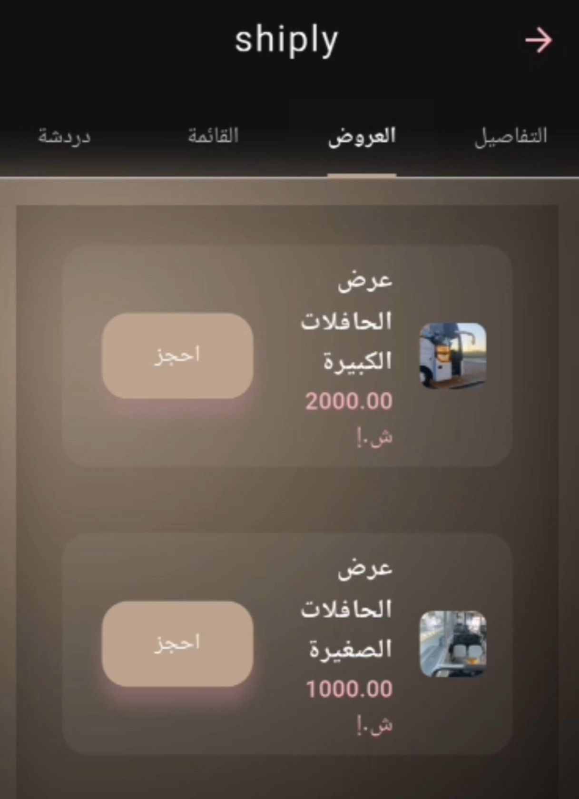
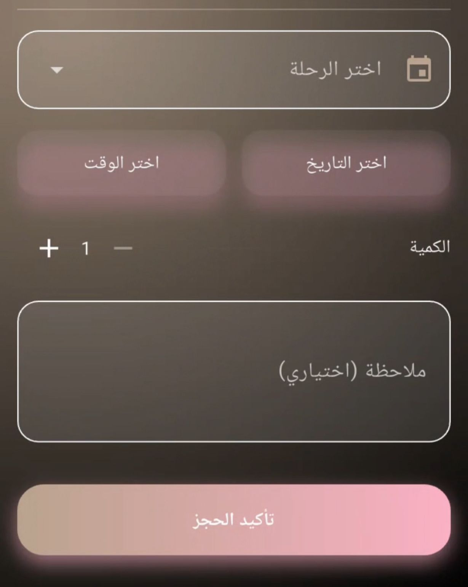
Service provider’s page:
The offers provided by the service provider will appear here, and the organizer can book directly from here. When he clicks the “Book Now” button, a page will appear for him to enter certain details, and then a notification will be sent to the user asking whether his booking has been accepted or not.

Slide 18
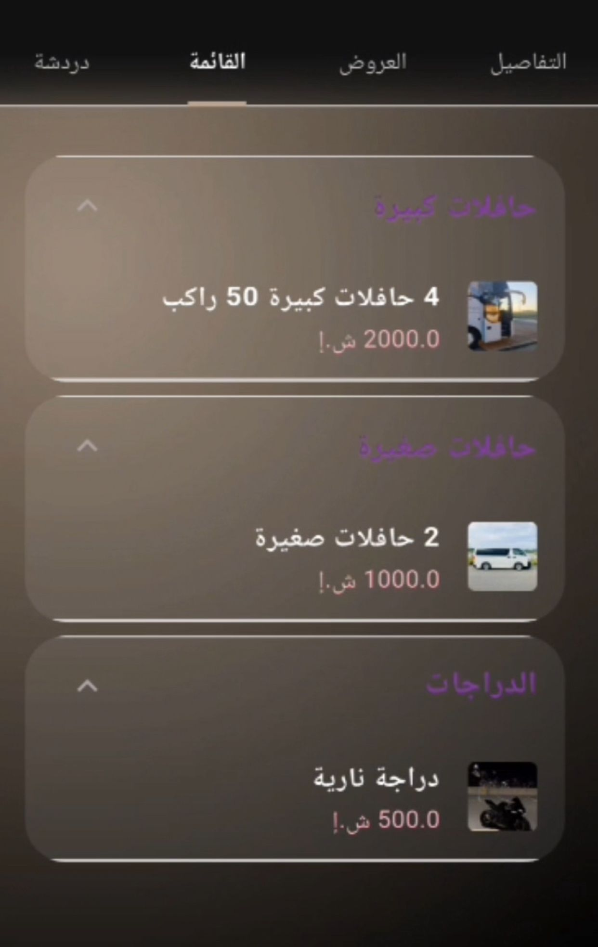
Service provider’s page:
In the menu, it creates several lists, each list according to a specific trip, to display items related to that trip, with details of the name, price, and photo, and it can also book directly.

Slide 19
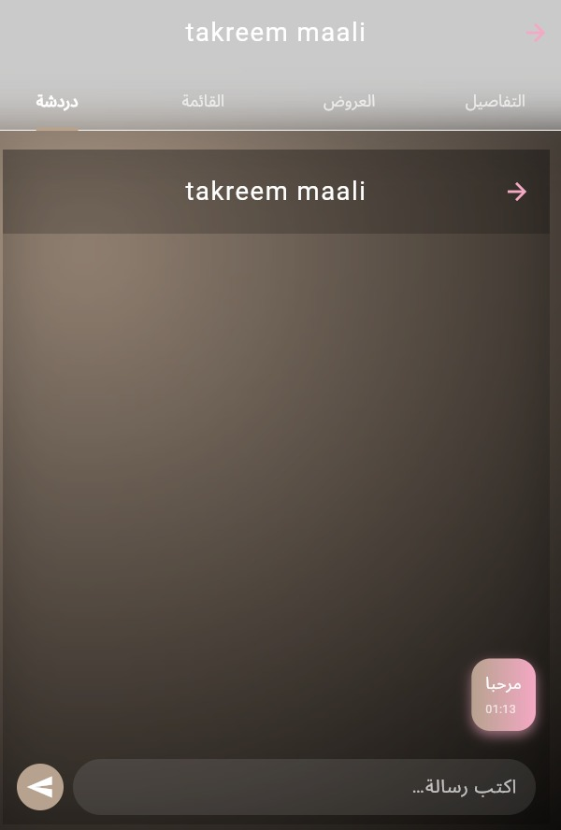
Service provider’s page:
Here a chat window appears so that the user (the trip owner) can communicate directly with the service provider to ask any questions directly.

Slide 20
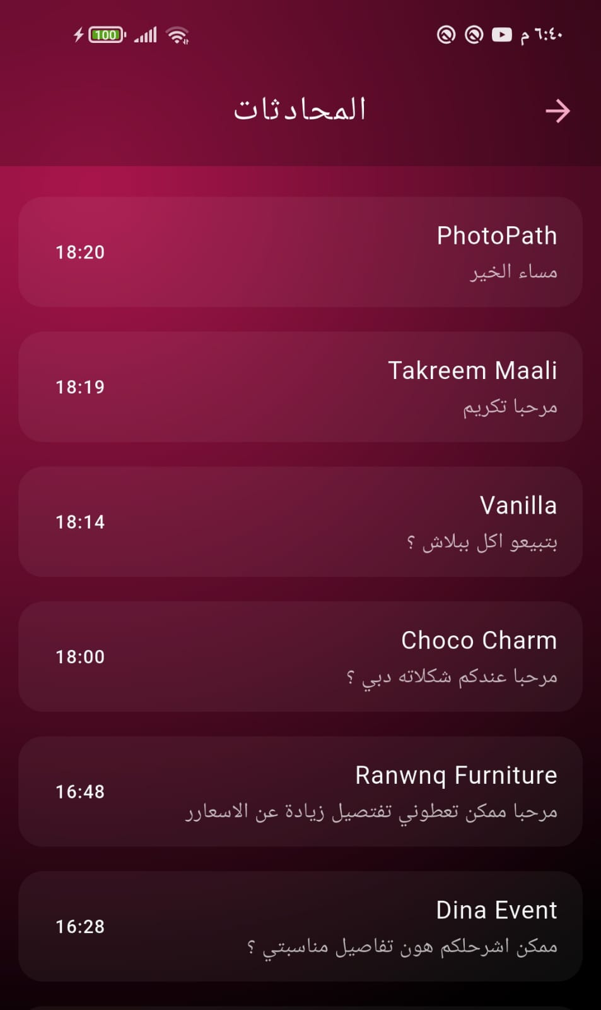
Chat :
At the top of the screen, the trip creator will see all the conversations they have had with service providers, and can navigate directly between conversations to connect directly with any service provider.

Slide 21
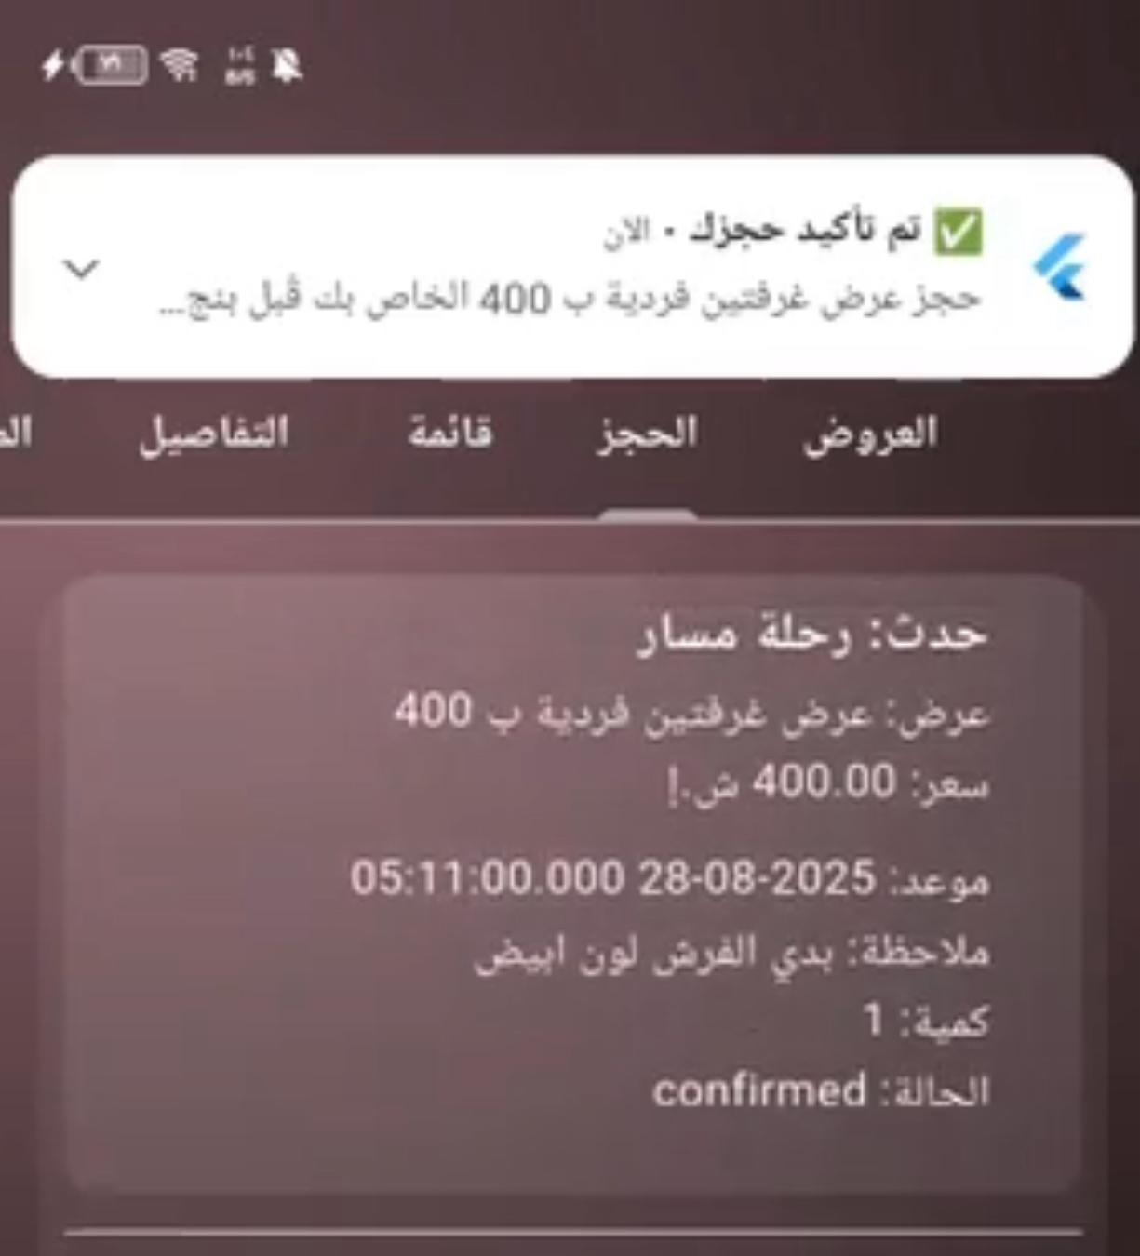
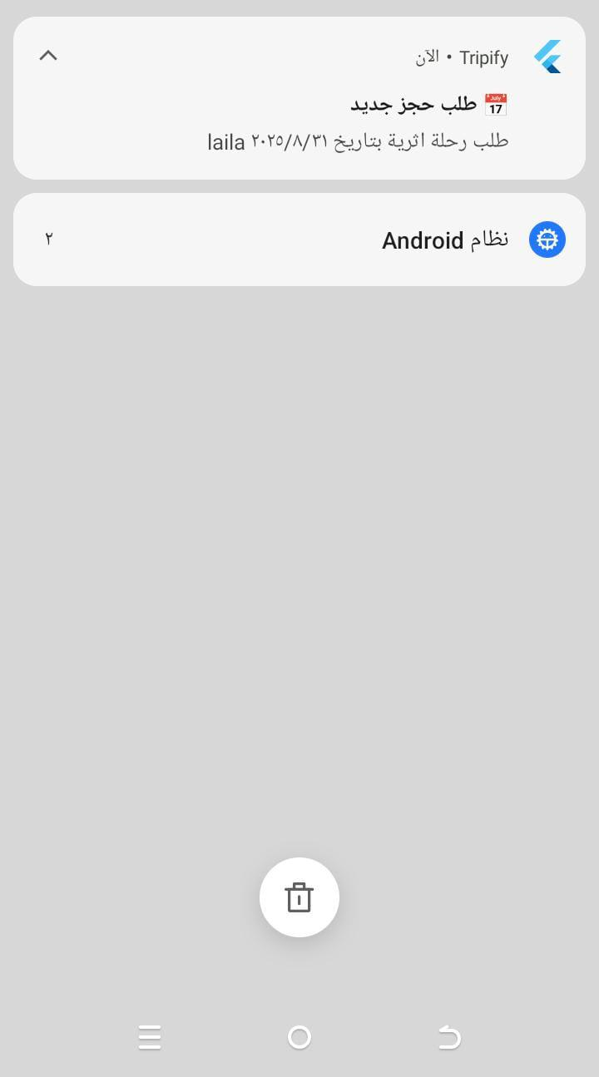
Notifications:
All notifications are shown to the user whether the reservations for services have been approved or not.

Slide 22
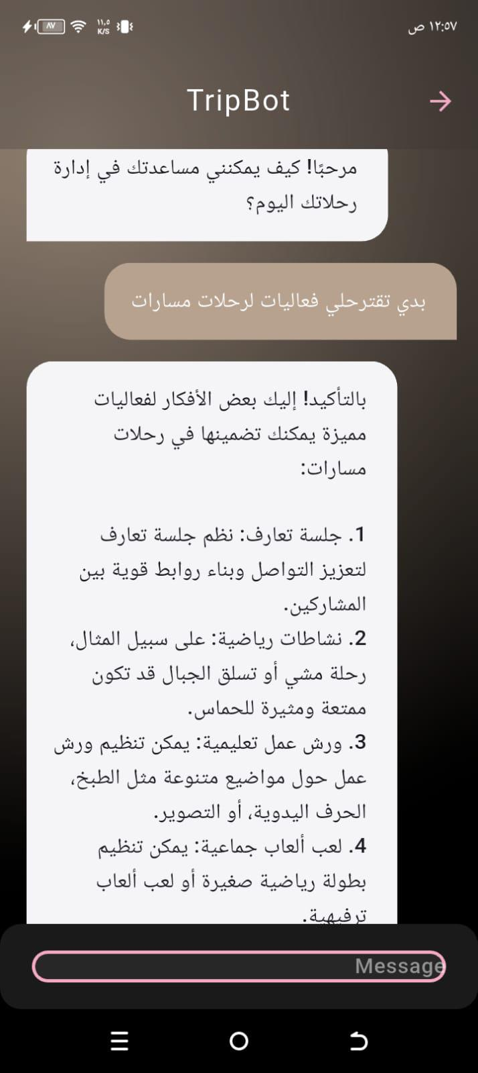
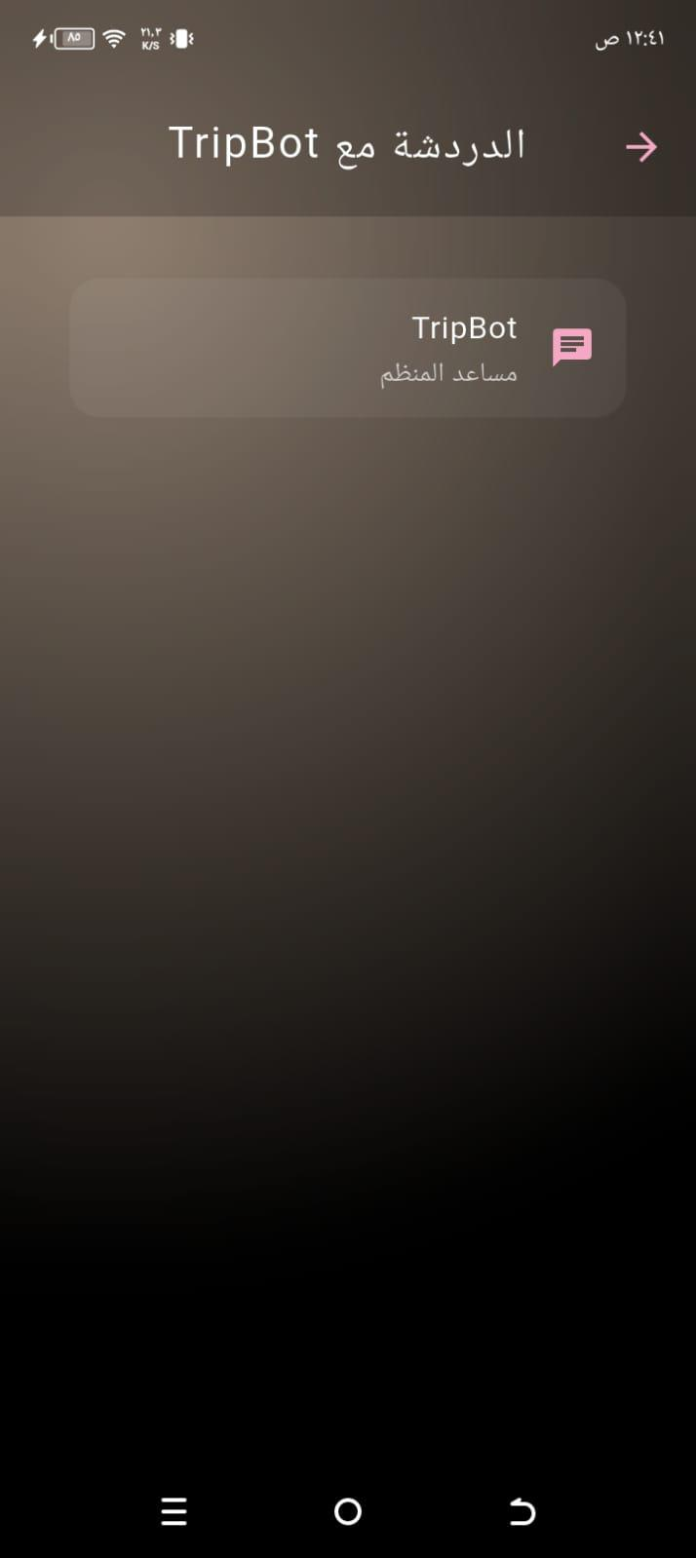
Chatbot:
We've integrated an intelligent chatbot feature to enhance the user experience, especially for tour operators who want to easily book services for their trips. Additional details help them streamline their event planning. The chatbot suggests the best available options, including tour locations, buffet services, accommodations, photographers, and guides, all tailored to the user's needs and preferences. This helps save time and effort, while ensuring a more professional and seamless event planning experience.

Slide 23
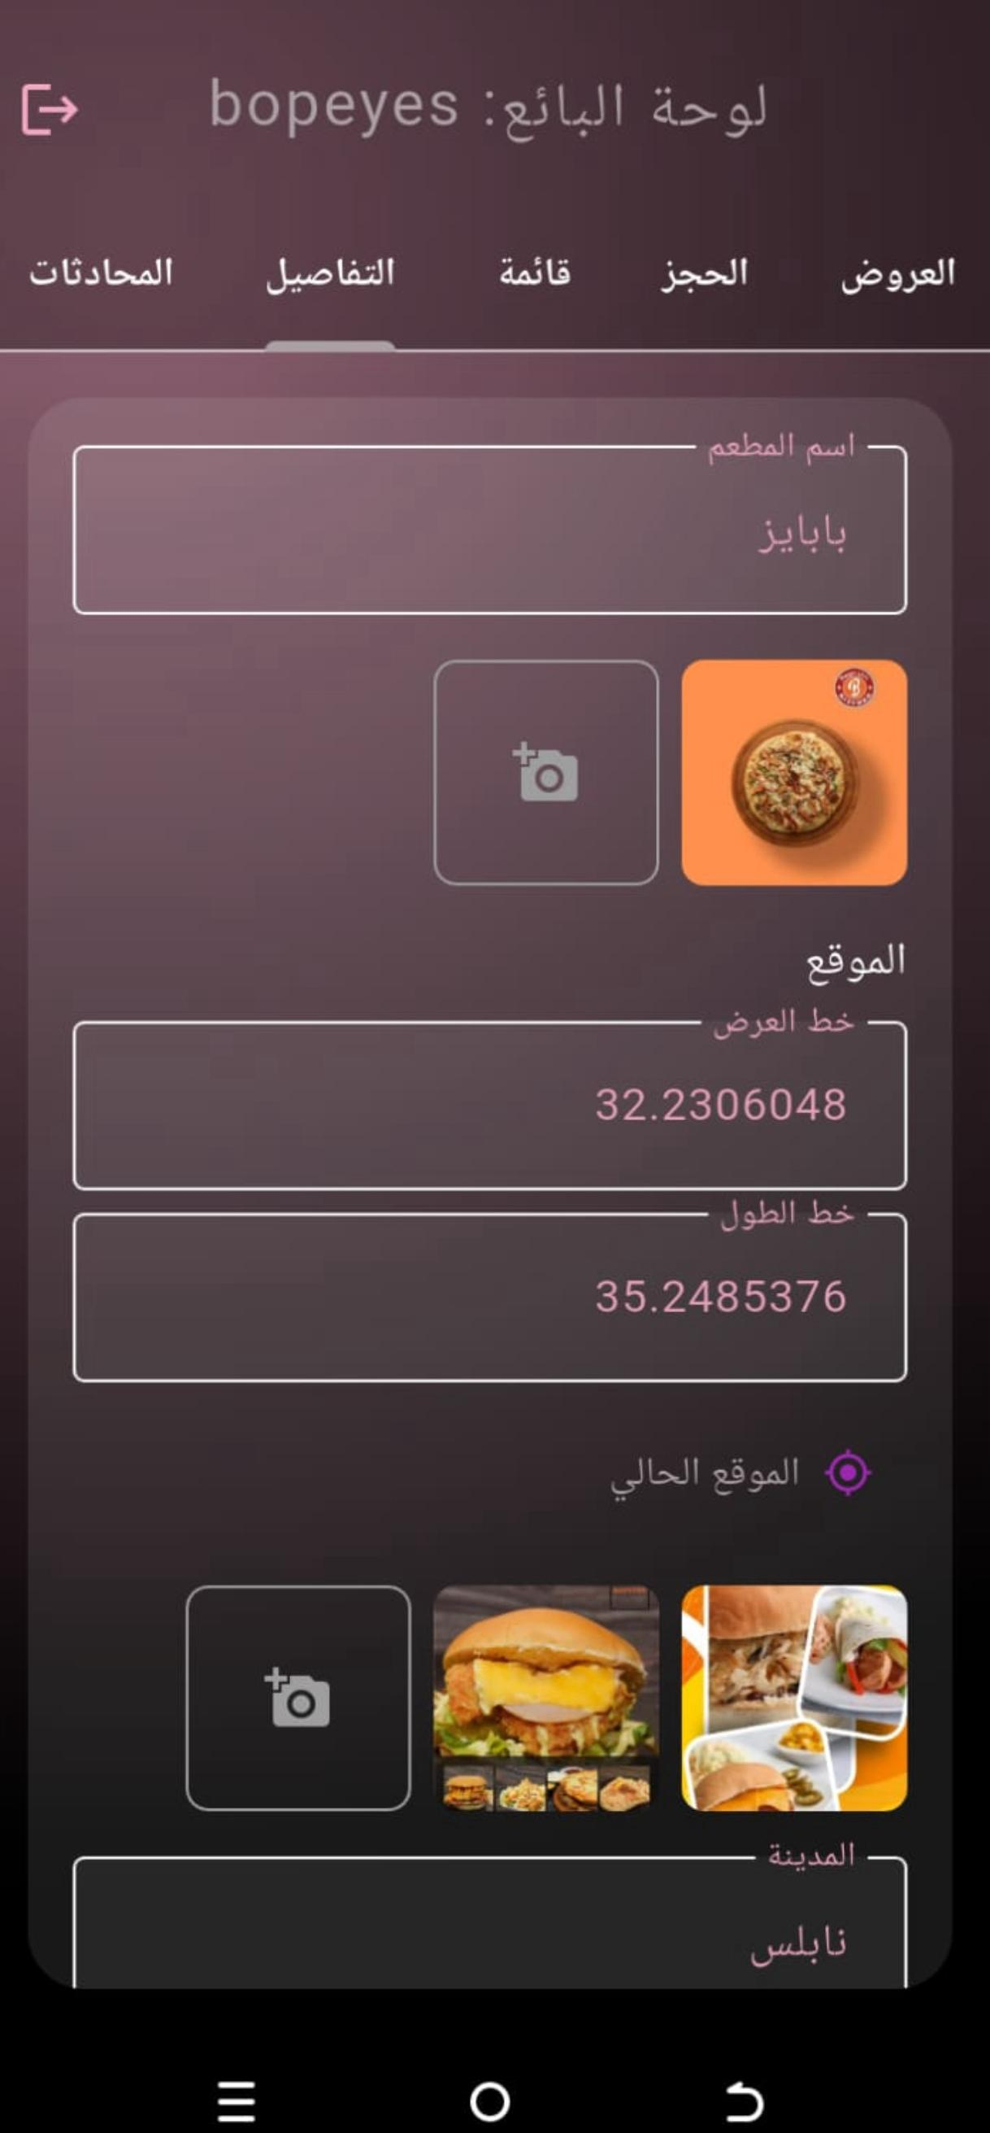
Service provider control over its information:
He logs into his account and sees all his information, his name, his location, his photos, and the price range. He can edit or delete details. In the reservations section, all the reservations of the user who requested his offers appear, and he accepts or rejects them.

Slide 24
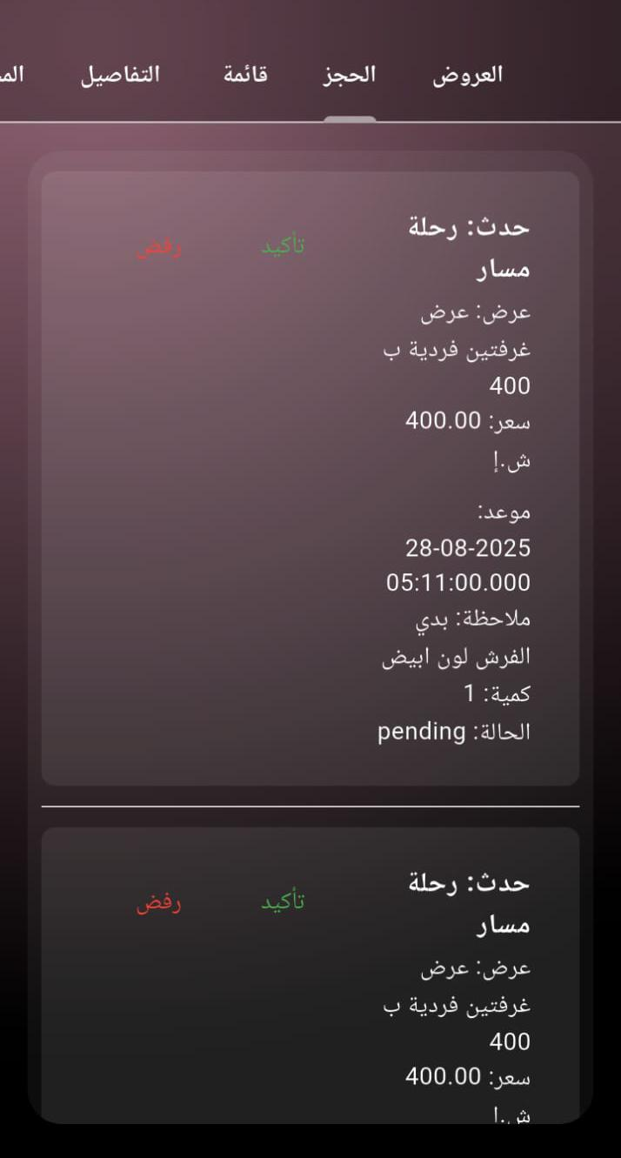
Service provider control over its information:
On this page, he will see all the user' reservations that they have chosen from his offers, so that he can approve or reject them.

Slide 25
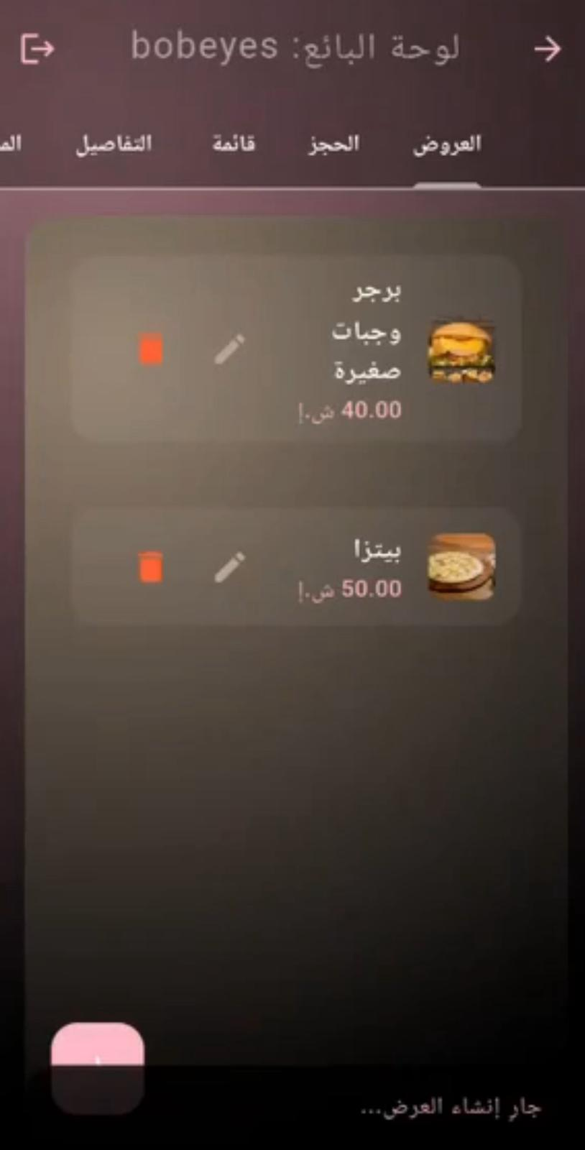
Service provider control over its information:
The service provider adds a new offer from the offers page. The offer name, description, images, and price are written. After creating the offer, there is the possibility of modifying and deleting it.

Slide 26
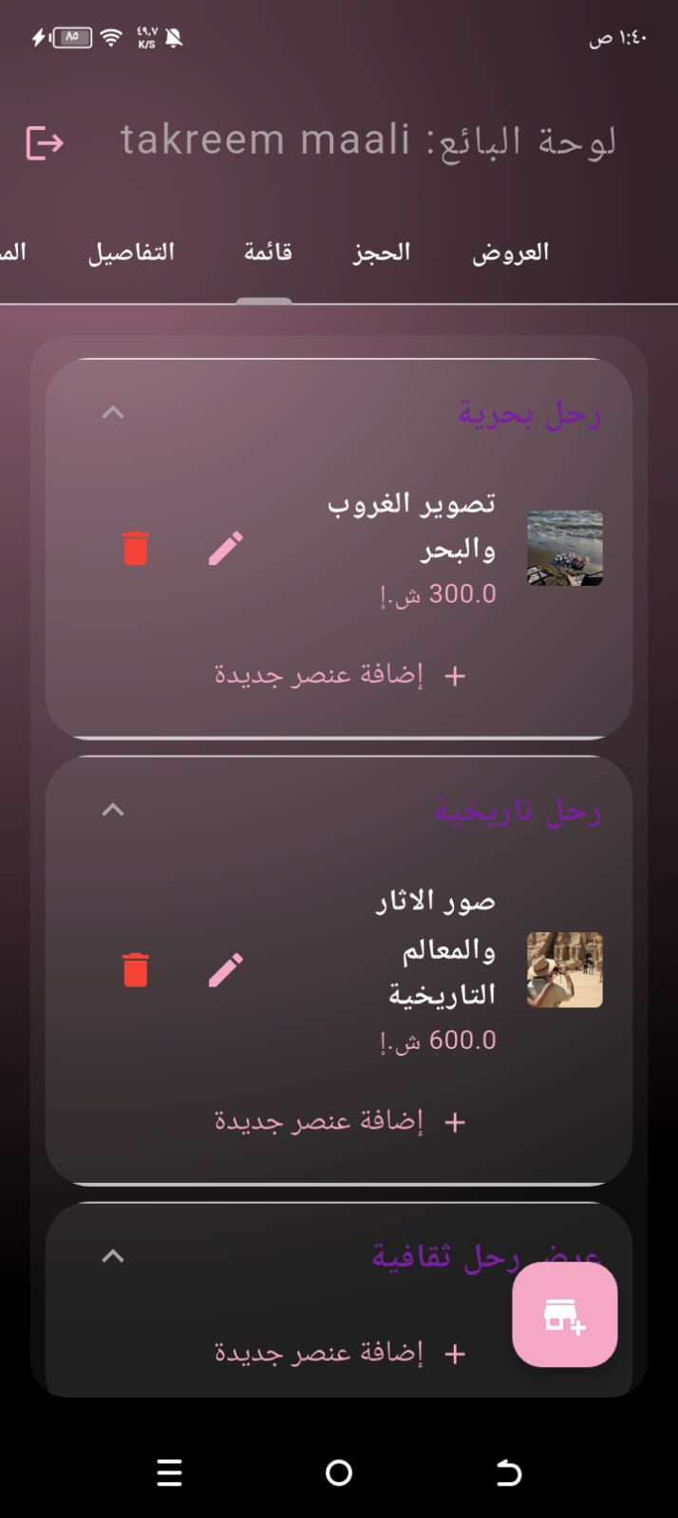
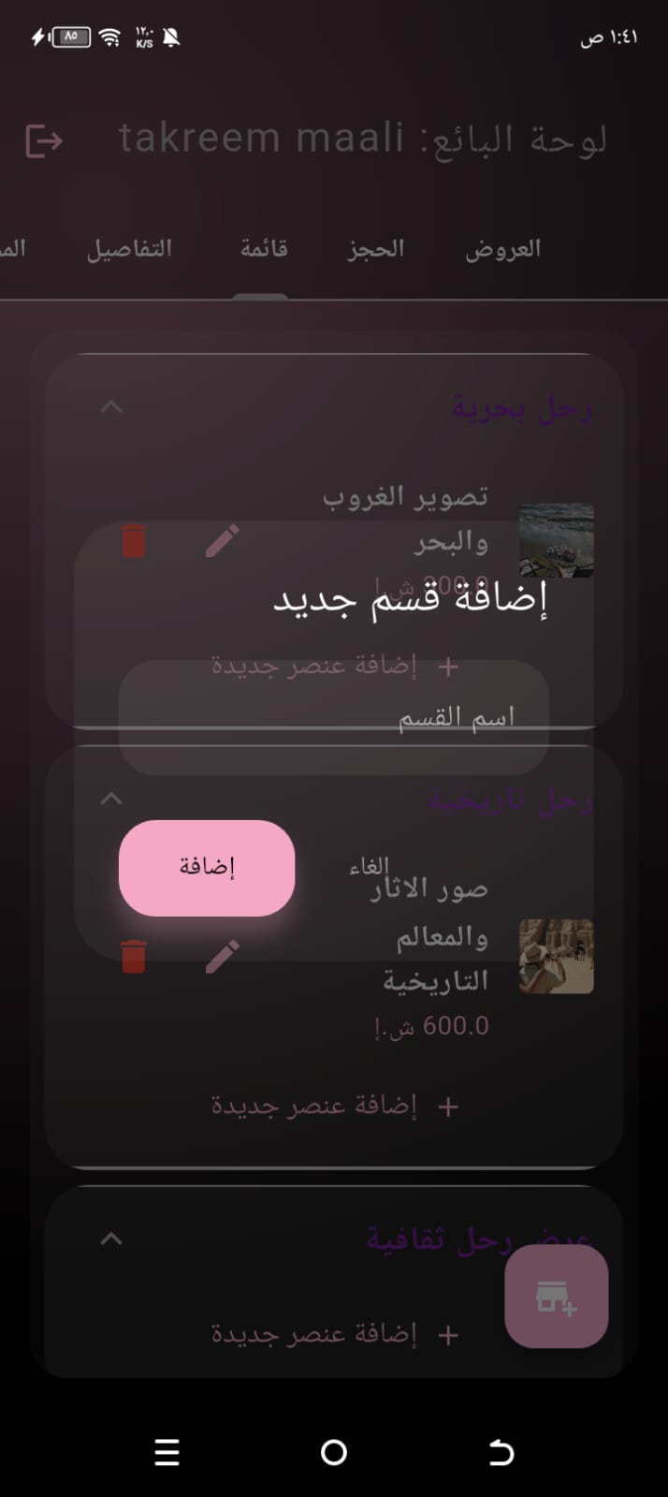
Service provider control over its information:
On the list page, you can add a new section and name it for the trip. Then, click "Add Item" to add a photo, name, and price.
You can also edit and delete the item.

Slide 27
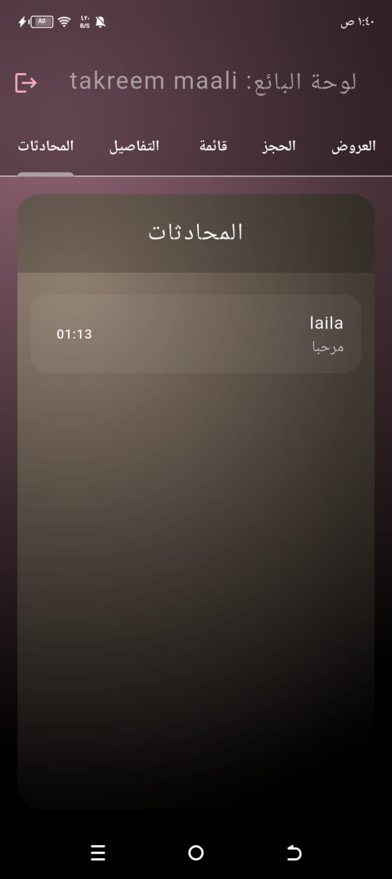
Service provider control over its information:
On this page, the service provider
will see everyone who sent him messages.

Slide 28
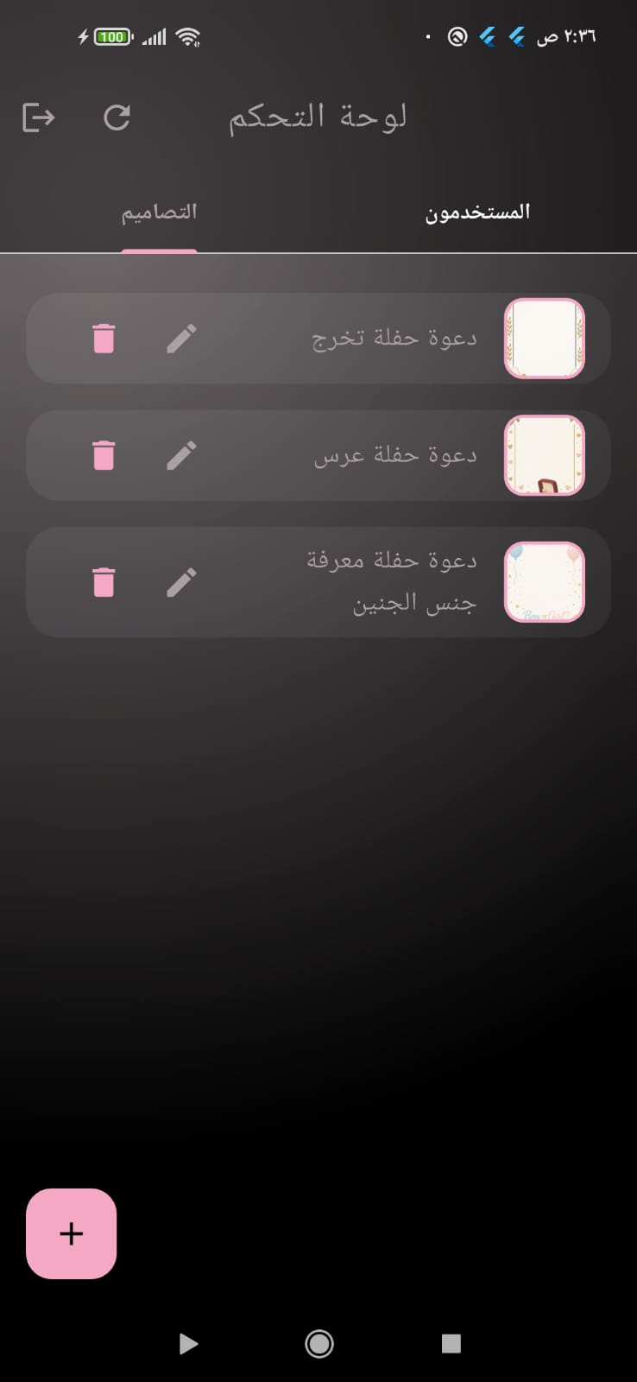
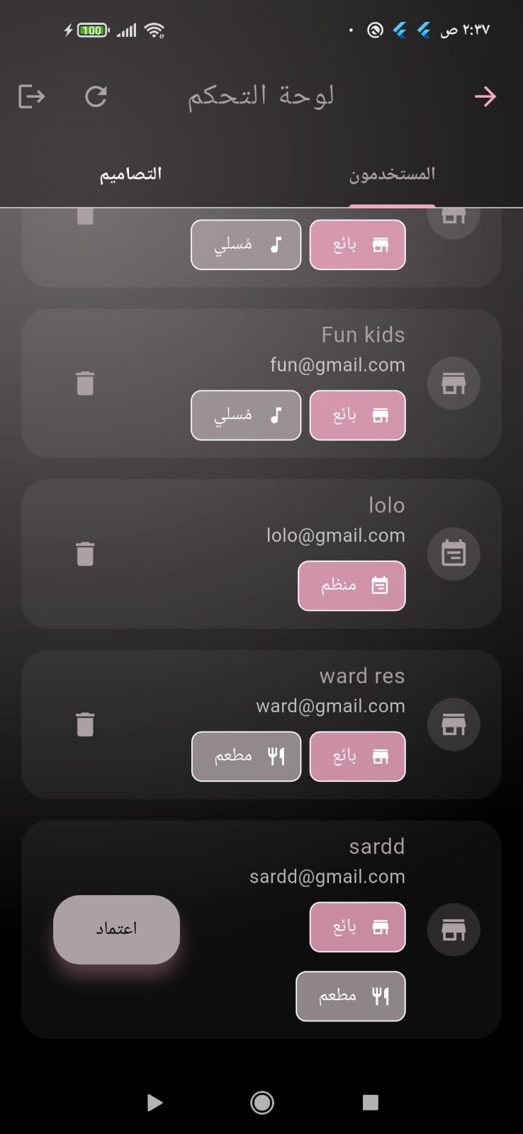
Admin:
It displays all user accounts for the app, whether they are trip creators or service providers, approves service provider accounts, and allows users to edit and delete them. It also adds invitation designs that appear when users create an e-invitation.

Slide 29
Future work :
On the administration page, which allows administrators to control whether to accept or remove service providers or add designs, we thought of adding a new feature: adding a new service. An administrator should be able to add a new service. We have six services, and the events are constantly evolving, with new ideas emerging from time to time. Therefore, we thought of giving the administrator the ability to add a new service with its details.
Enable users to visualize their travel or accommodation using augmented reality technology to help them make realistic decisions.
Multilingual support.
Integration of electronic payment methods.

