Slide 1
Data Analysis-Data Mining and Reporting

Slide 2
Outline
Introduction
About the Project
Project Goals
Project Plan
Data Problems & Solutions
Used Tools
Data Acquisition
Data Analysis
Our Problems

Slide 3

Introduction
About the Project
Project Goals

Slide 4
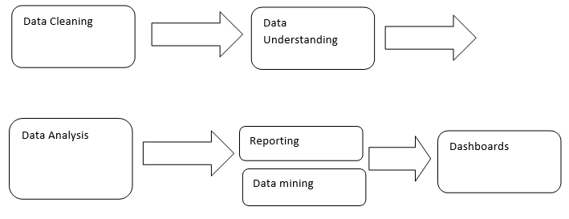



Project Plan

Slide 5

Data Acquisition: Difficulties & Solutions

Slide 6



Used Tools
Pentaho Tool
Microsoft Power BI
R Language

Slide 7
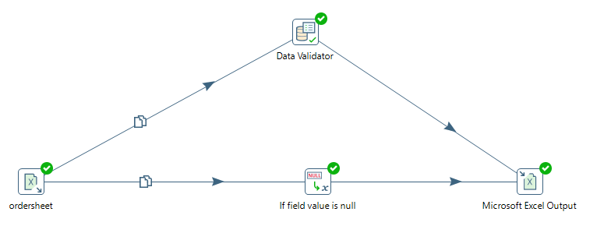
Data Cleaning
Step1

Slide 8
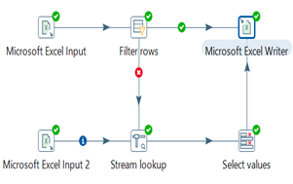
Data Cleaning (cont.)
Step2

Slide 9
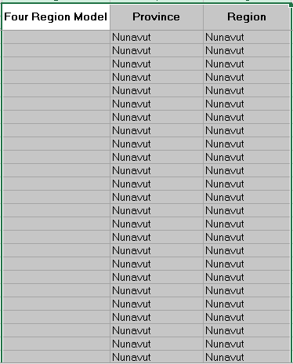
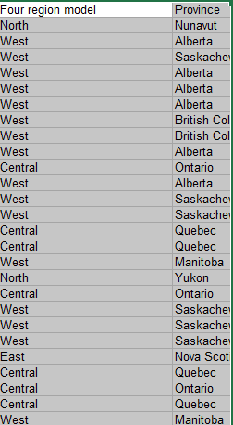
Data Cleaning (cont.)
Result of step2

Slide 10
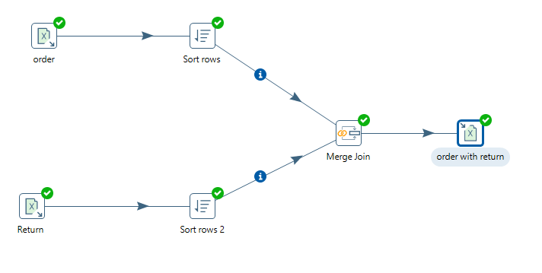
Data Cleaning (cont.)
Step3 marge join between the sheet of(order and return)

Slide 11
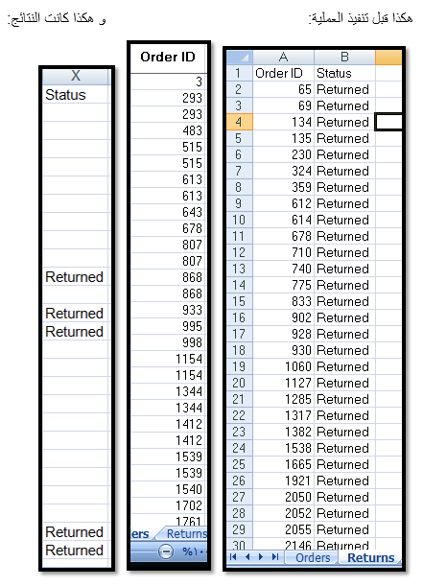
Data Cleaning (cont.)
Result of merge join

Slide 12
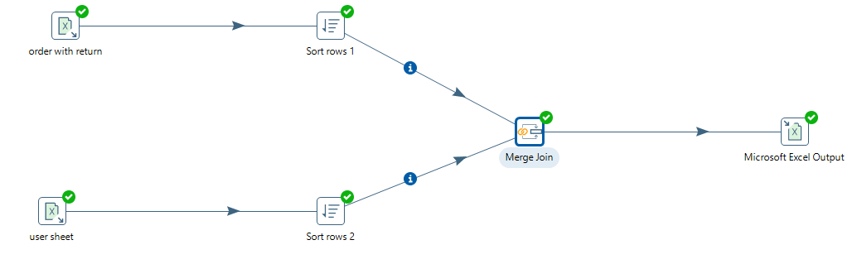
Data Cleaning (cont.)
Step4 :marge join between the sheet of(order and return , user)

Slide 13
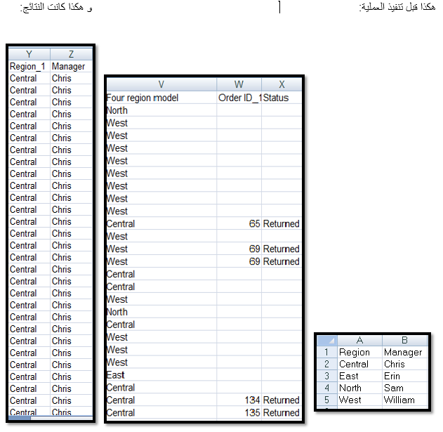
Data Cleaning (cont.)
Result of marge join

Slide 14

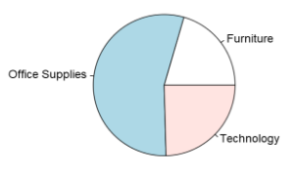
Reporting /Dashboard
Most products are returned by product- category

Slide 15
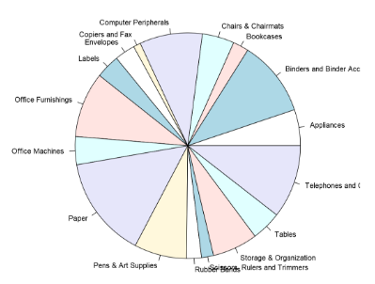
Reporting /Dashboard (cont.)
Most products are returned by product- subcategory

Slide 16
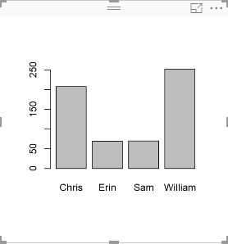
Reporting /Dashboard (cont.)
Most products are returned by Manger

Slide 17
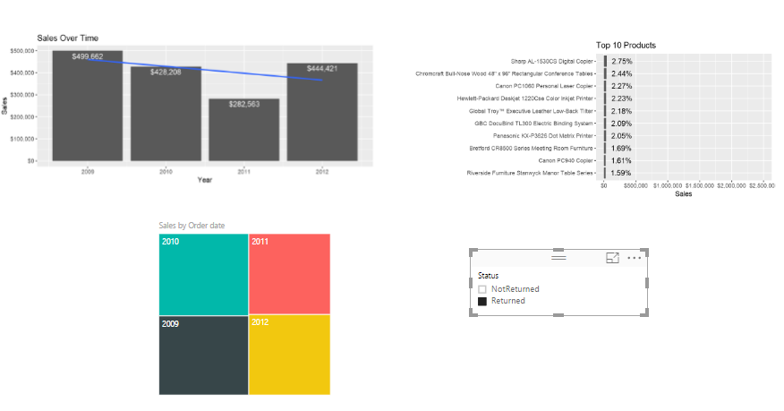
Reporting /Dashboard (cont.)
Most ten product soled

Slide 18
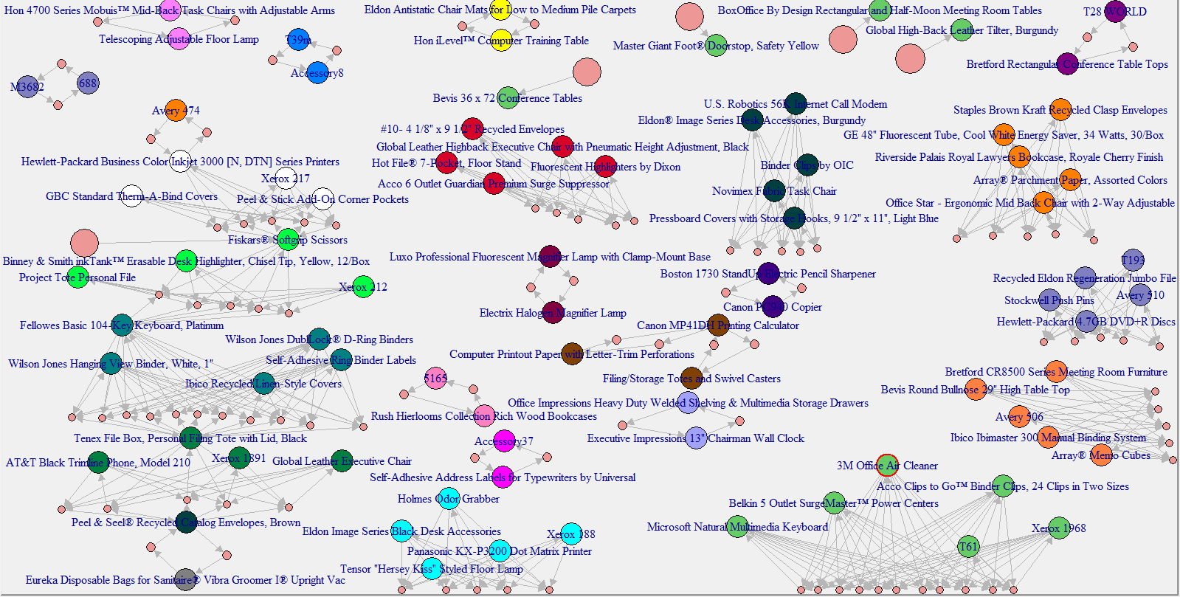
Association / Basket Analysis

Slide 19
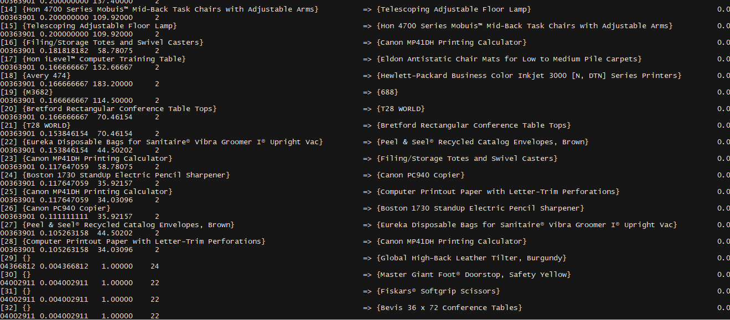
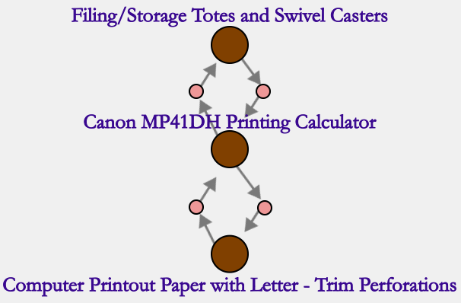
Association / Basket Analysis (cont.)

Slide 20
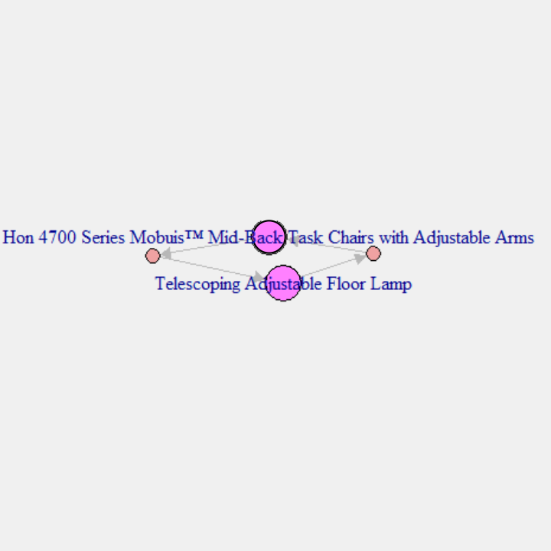
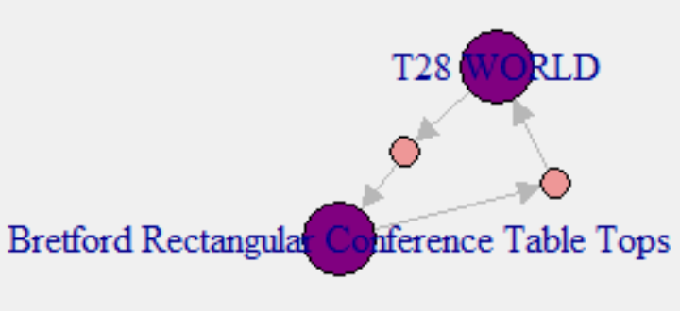
Association / Basket Analysis (cont.)

Slide 21
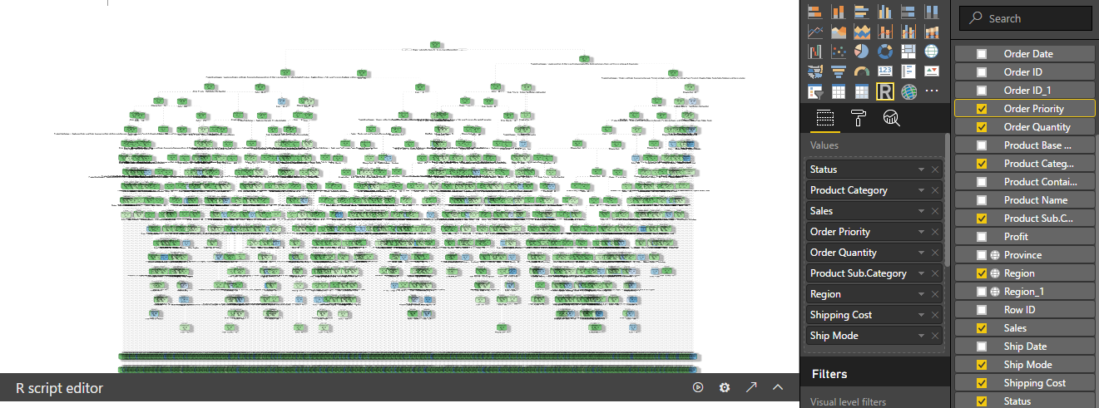
Prediction decision tree

Slide 22
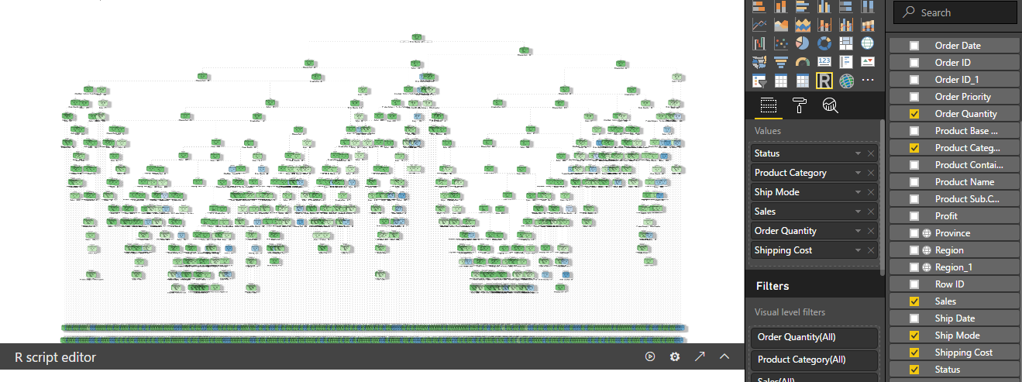
Prediction decision tree (cont.)

Slide 23
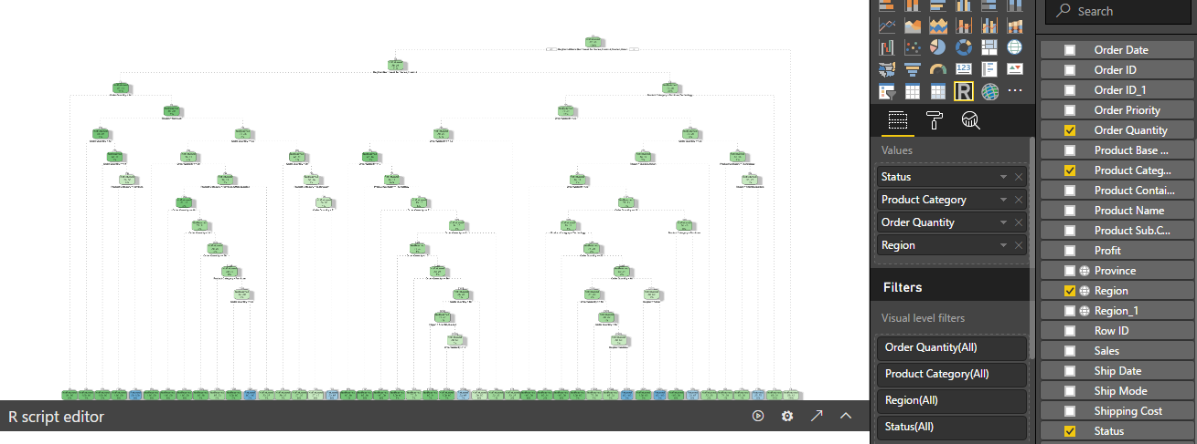
Prediction decision tree (cont.)

Slide 24
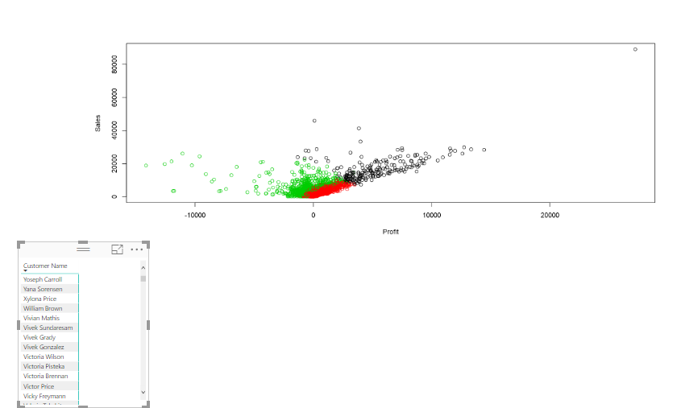
Cluster

Slide 25
Thank you ☺

