Slide 1
Feasibility Study for Thermoforming Production Plant

Slide 2
Introduction
Problem statement
The Palestinian market consumes yearly large quantities of different thermoformed plastic products like disposable dishes, cups, fruits and sweets containers; it is expected that the demand on such products is continuously increasing and exceeds the supply. However, almost all of these products are imported from outside Palestine and there are no considerable local producers. Such a problem can be solved by establishing a local thermoforming industry.

Slide 3
Introduction
Objectives
    Conduct a proper and sufficient market study.
    Perform relevant technical study covering machinery, layout, etc.
    Perform the necessary financial analysis to judge on the feasibility of such industry.
    To support in providing Palestine Palestinian market with sufficient need of thermoforming products.
    To improve the project team skills in feasibility studies.

Slide 4
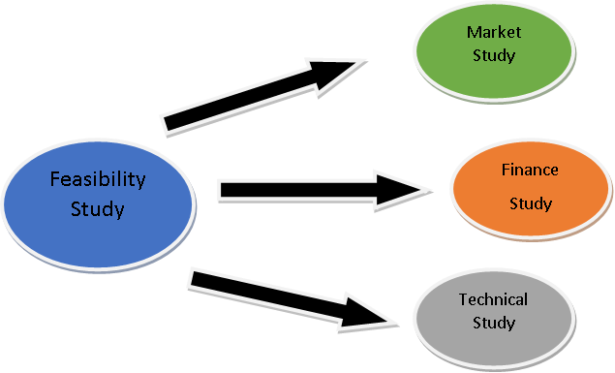
Introduction
Scope of the work
The feasibility study consists mainly of market study, technical study and financial study as shown below

Slide 5
Literature Review
There are two main subjects we studied about:
Thermoforming production process
How to prepare an industrial feasibility study

Slide 6
Literature Review
Thermoforming production process
Definition of thermoforming
Principle of thermoforming
Applications of thermoforming
Forming Processes

Slide 7
Literature Review
Industrial Feasibility Study
Definition of Industrial Feasibility study
Industrial Feasibility study Divisions:
Market study
Technical study
Financial study

Slide 8

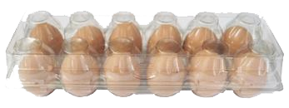
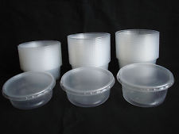
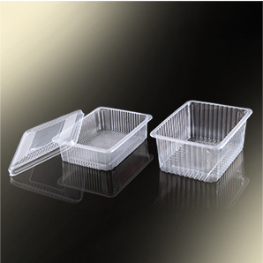
Methodology
Identified products
Cups
Eggs containers
Containers and lids
Sweet Containers

Slide 9
Methodology
Production process
* Determine what process would be used to produce the identified products.
* Determine the raw materials which would be used.
* Study the dimensions of the production processes which were chosen.

Slide 10
Methodology
Market
* Determine the volume of demand and the Market share of each product.
* Study the desires of customers according to the dimensions of the products.
* Study the cost of manufacturing and importing.
* Study the availability of raw material in the local market.

Slide 11
Methodology
Data Collection Tools
a- Interviews
b- Questionnaires
* Supermarket Questionnaire
* Manufactures Questionnaire
* Importers Questionnaire

Slide 12
Methodology
Technical Study
Defining Stages of Production processes
Main Equipment ,Machines and Row material needed for the factory
Facility Planning and Plant layout
Human resources needed and the organization structure of the factory
Facility location

Slide 13
Methodology
Financial Study
Determines the Start-up Capital
Determines the Operational Cost
Financial Analysis for the factory
Determine Break-Even Quantities

Slide 14
Results & Analysis
Importers and manufactures questionnaires analysis
Imported quantities vs. National quantities

Slide 15
Results & Analysis
Market share for each product

Slide 16
Results & Analysis
Production quantities for the identified product
Identified products quantities and market shares

Slide 17
Results & Analysis
Main Equipment ,Machines and Row material needed for the factory
Thermoforming Production Machine
Products Molds
Crushing Machine
Sheets Extruder
Packaging Machine

Slide 18
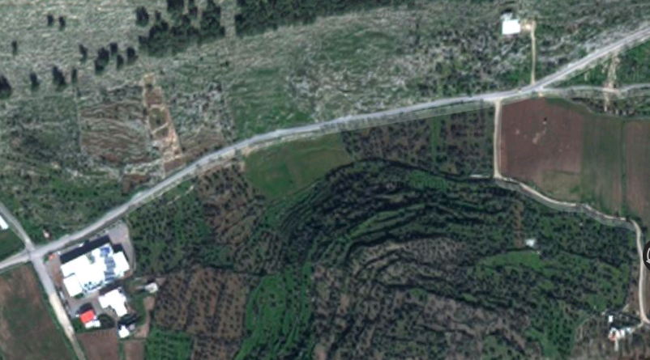
Results & Analysis
Facility Location
Main criteria used to choose the facility location
Closeness to customers
Closeness to the crossing borders
Competitive land price
Availability of manpower
The land belongs to Palestinian Authority
( classified as A region)
Area where the factory is located

Slide 19
Results & Analysis
Human resources needed in the factory
Categories | Number
Manager | 1
Secretary | 1
quality control supervisor | 1
production line supervisor | 1
Technician for maintenance | 1
Accountant | 1
Stores supervisor | 1
Sales and Purchasing supervisor | 1
Marketing supervisor | 1
Workers | 5
Total | 13
Human Recourses needed in the factory

Slide 20
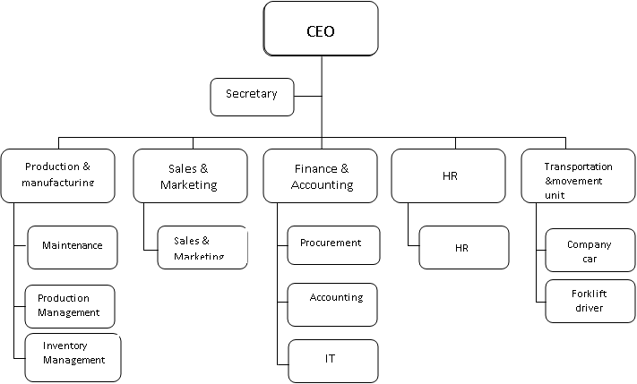
Results & Analysis
Organization Structure of the factory

Slide 21
Results & Analysis
Determines the Startup Capital Amounts
the startup capital consists of the following elements
Land Price
Construction Cost
Electricity Cost
Production Equipment cost
Water System cost
Products Mold Cost
Other Supportive Production Cost

Slide 22
Results & Analysis
Determines the Operational Cost
the operational cost consists of the following elements
Row Material Cost
Energy Consumption Cost
Total Salaries
Depreciation Cost
Insurance Cost
Other Related Cost

Slide 23
Results & Analysis
Financial Analysis for the factory
We Identified the total monthly production cost and then distributed it among
the identified product as shown in table below
Identified Product | Production Cost Proportion
Cups | 0.42
Cans and their Covers | 0.14
Sweet Containers | 0.02
Plates | 0.42

Slide 24
Results & Analysis
Determine Unit Cost from each Product
We defined the unit as one cartoon for each product, so the unit cost
is equal to cost per cartoon
Total product cost per period = product proportion from the production cost + Raw Material Cost
Cost per Cartoon = Total Product cost / # of product produced per period
Net profit per cartoon
Gross Profit per cartoon = Cartoon Selling Price - Cost per Cartoon
Net Profit per Cartoon = Gross Profit per cartoon - Gross Profit per cartoon * Direct Tax

Slide 25
Results & Analysis
Breakeven Quantities
we computed the total number of cartoons needed to be produced
from each product to achieve factory’s breakeven state by using the
below equation
Fixed cost assigned to the product – (profit per unit * # of units needed) = 0

Slide 26
Results & Analysis
Project Evaluation
We used many criteria to evaluate the feasibility of the project which are :
Payback Period = Cost of Investment \ Annual Cash Flow
Cost of investment = Startup Capital Cost + Raw Material cost
Rate of Return = Annual Profit \ Cost of Investment
Net Present Value = ∑ {Net Period Cash Flow/ (1+R) ^T} - Initial Investment

Slide 27
Results & Analysis
Sensitivity Analysis
We applied the sensitivity analysis on the increasing the market share
for each product vs the net profit as shown below

Slide 28
Conclusions
There are two main sources for covering the west bank demand which are importing and manufacturing without appearance for importing form Israel
Breakeven quantity from the Cups, Cans and their Covers, Sweet Containers
and plates per month respectively equals to 6094 , 668, 101 and 1683 cartoons.
Annual profit from the identified products = 5,087,254 NIS
Rate of Return = 56.4 % which is an attractive return for an investor who is new in the market and for the investors who owns similar investments, is very acceptable rate

Slide 29
Conclusions
Payback Period = 1.77 years , which is a short period and attractive to invest in this project
Net Present value equals to 6,292,704.78 NIS using interest rate = 2.30 % from the Housing Bank for Trade and Finance . The NPV represents a positive value, so this a good indicator of project’s profitability
Plant layout

Slide 30
Recommendations
We recommends to construct the thermoforming factory in Tulkarem, at the main way of Balaa’ Town
To improve the factory market shares from each product after one year of construction
To import the specified raw material with its associated chemical characteristic to decrease the amount of scrap
To study of increase the variety of product in order to increase the factory market share.
To hire qualified employees to increase and improve the factory productivity

Slide 31


