Slide 1
An-Najah National University Faculty of Engineering
Electrical Engineering Department
Graduation project 2
Solar vacuum cleaner
Supervisor Dr. Haneen Al-utt
By:
Eng. (Yahya Balatia)
Eng. (Firas Lubaddeh)
Eng. (Ahmad Sarhan)

Slide 2
INTRODUCTION
Cleaning the environment around us is one of the important duties of each and every individual. Bigger the area to be cleaned, greater number of people will be needed. Some places will be so dirty that cleaning such areas causes huge impact on health. In this project, an automated vacuum cleaner is designed. It consists of a RC car to which a vacuum cleaner is attached. Ultrasonic sensor is attached to the front of the car which is used to measure the distance if any obstacle is detected. If suppose there is an obstacle, the car changes its course as per the code. Vacuum cleaner consists of CPU Fan which runs by a battery. The cleaner has space to collect the dust. Once it gets filled, it should be removed and cleaned manually.

Slide 3
AIMS AND OBJECTIVES
Mainly, this project aims to
Reducing the workforce
cleaning houses and surrounding environment
Saving electrical energy
Use in dangerous places (without ventilation)

Slide 4
SCOPE OF THE WORK
The robot uses a battery that is constantly charged by a solar panel as it is drained by the motors. This provides a longer battery life when it is exposed to sun rays. The system consists of a vacuum cleaner with added ultrasonic sensor for obstacle detection.
Advantages
Easy and instant cleaning
Vacuum Cleaning for dust collection
Solar power supply for long battery life
Self-control Operation

Slide 5
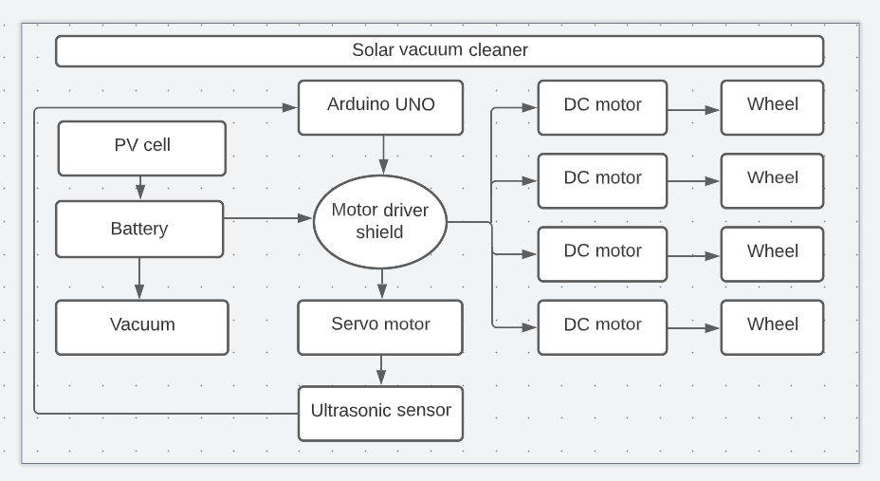
High Level Overview of solar vacuum cleaner (block diagram system)

Slide 6
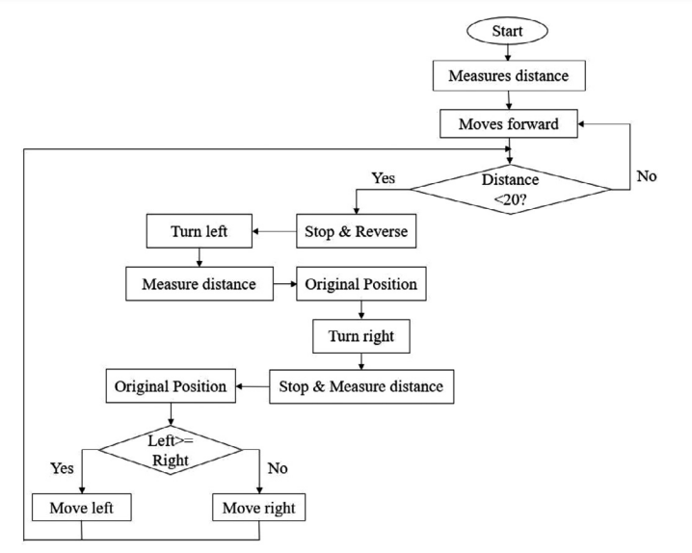
SOFTWARE DESIGN
The flow chart of this process:

Slide 7
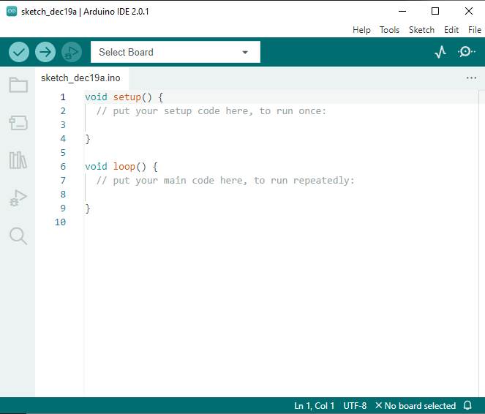
Arduino code
The software used in this project, Arduino IDE. This is an application written in C and C++. Programs can be written and uploaded to Arduino boards.

Slide 8
HARDWARE DESIGN
Arduino UNO
Motor Driver Shield
Batteries
CPU fan
DC motors
Ultrasonic sensor
Wheels
PV cell
Servo motor

Slide 9
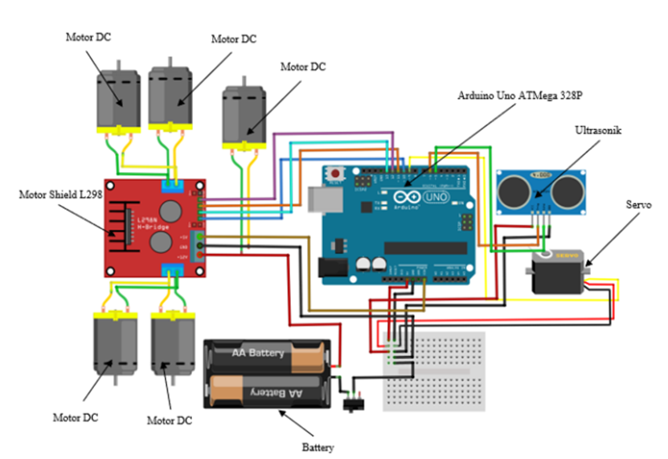
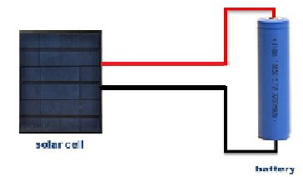
Hardware schematic(PV-cell + Battery)
Hardware schematic (servo motor +Arduino UNO+ DC motors)

Slide 10
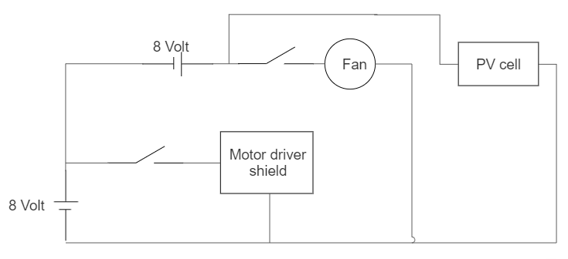
Hardware schematic

Slide 11
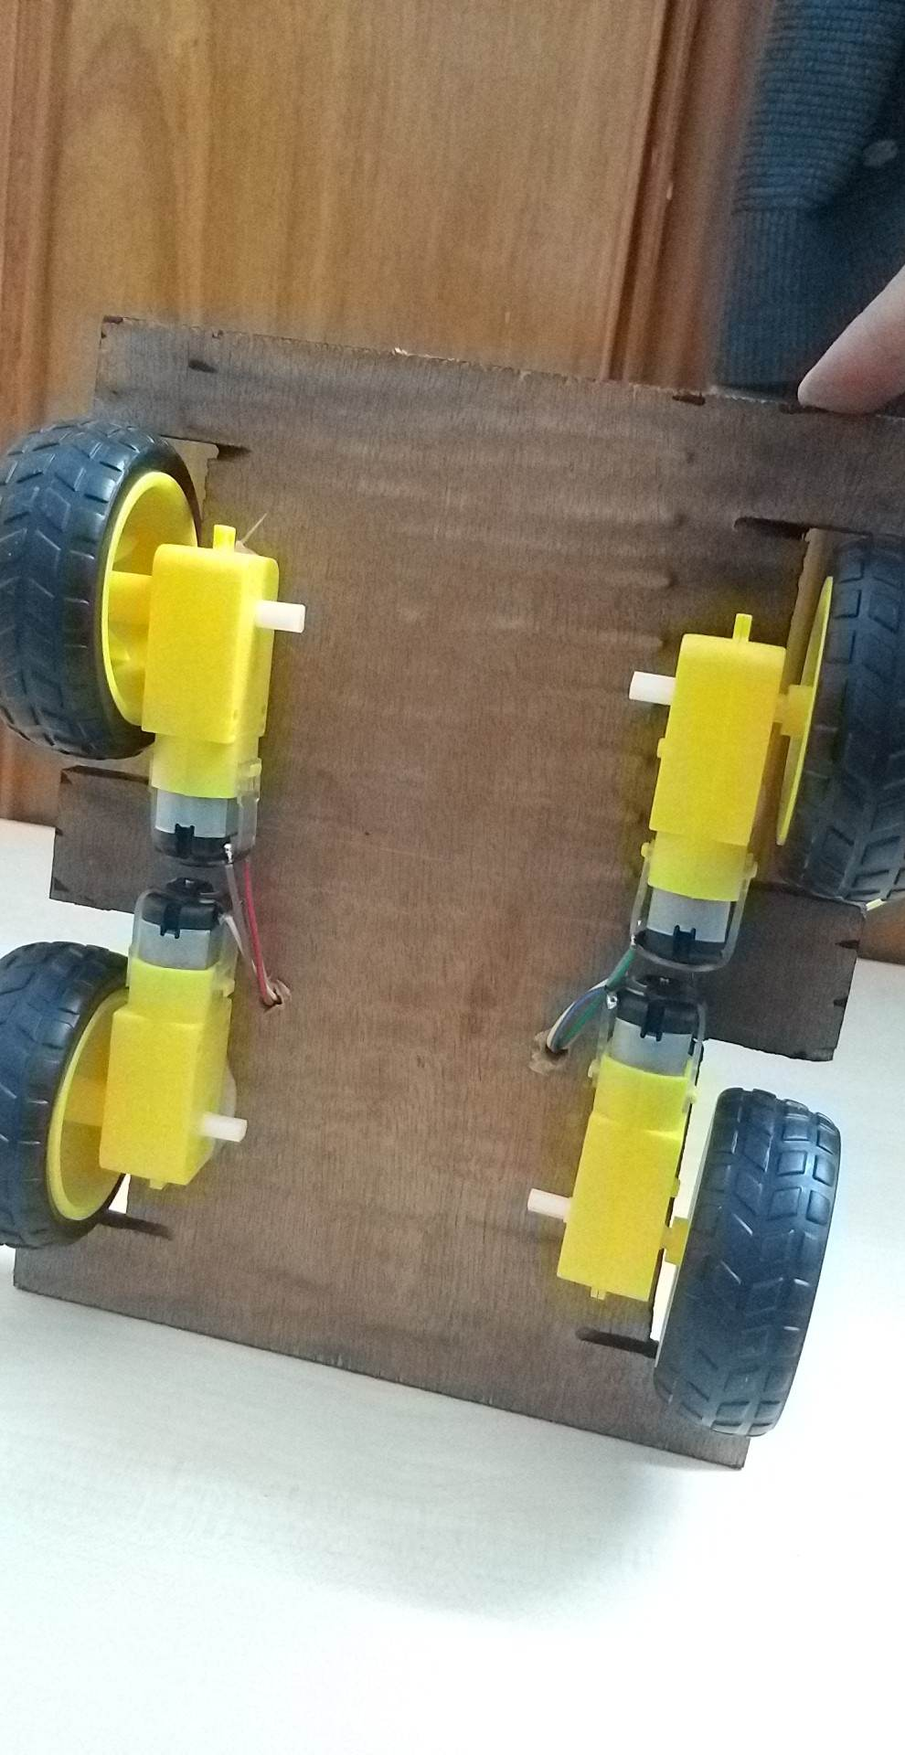
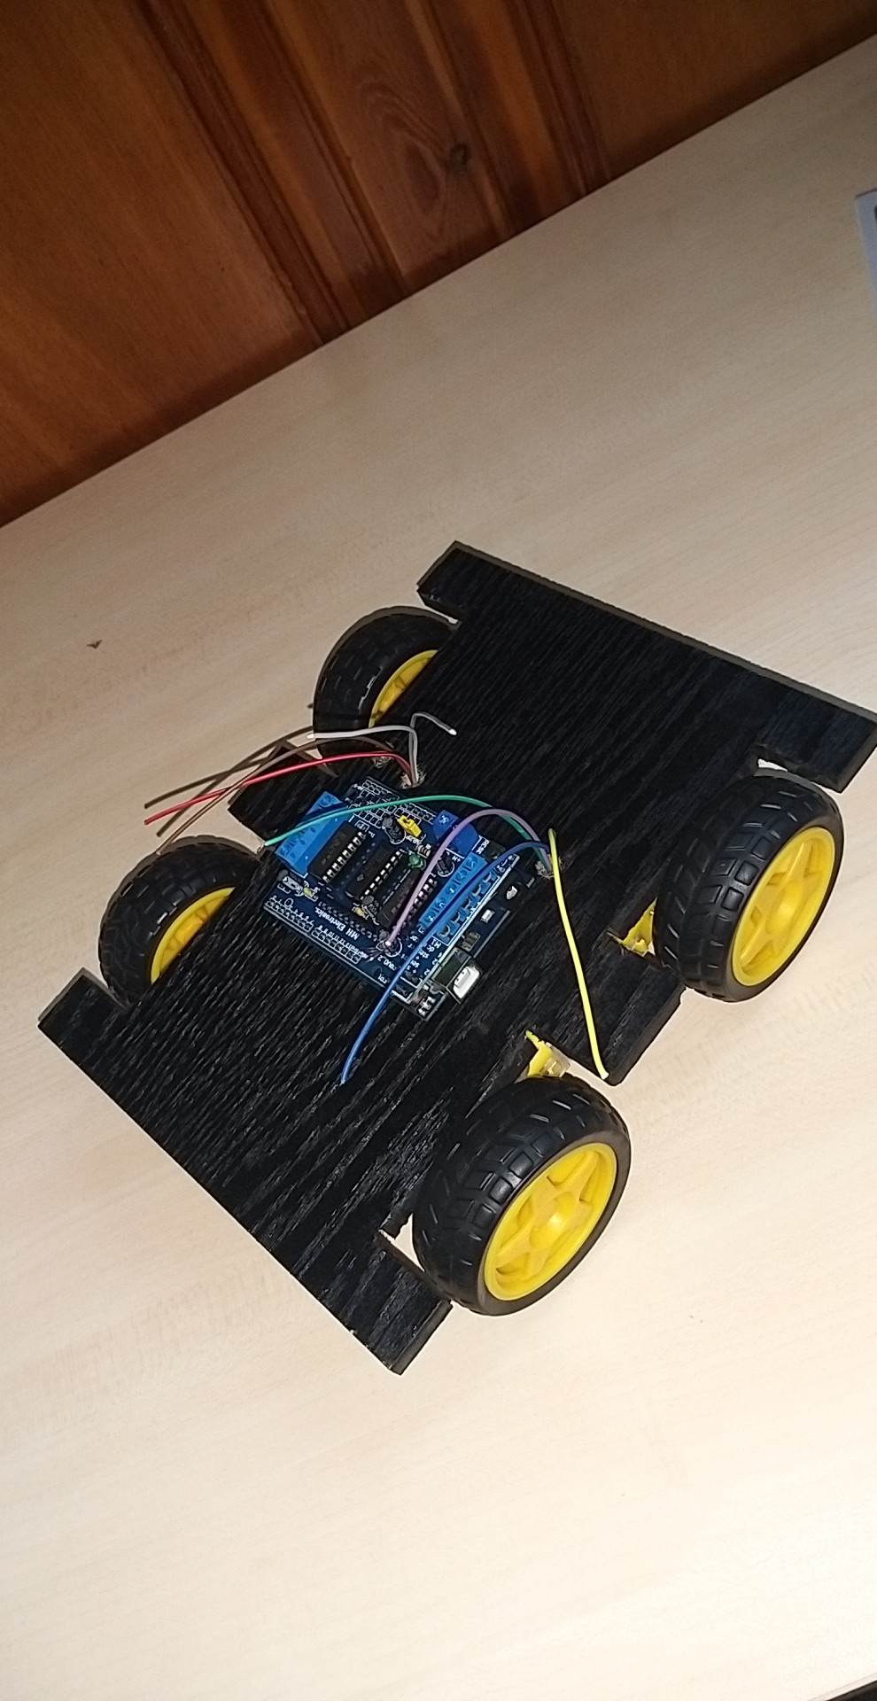
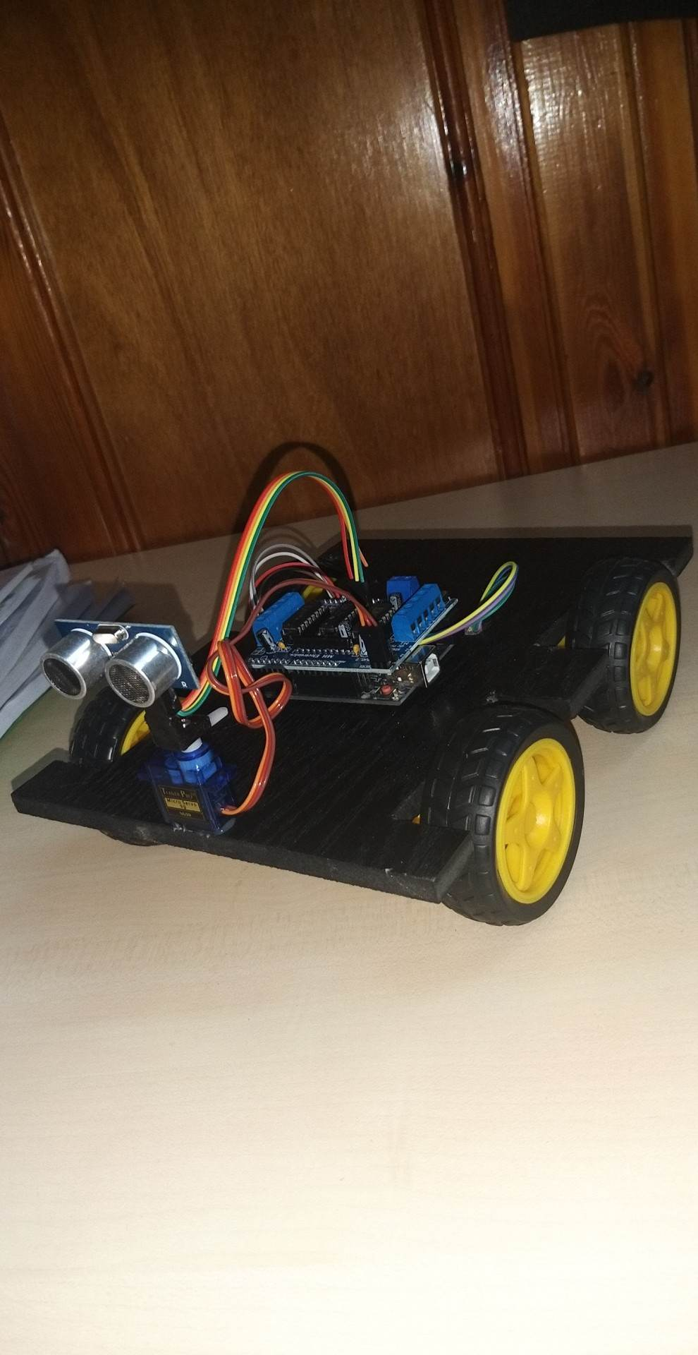

Slide 12
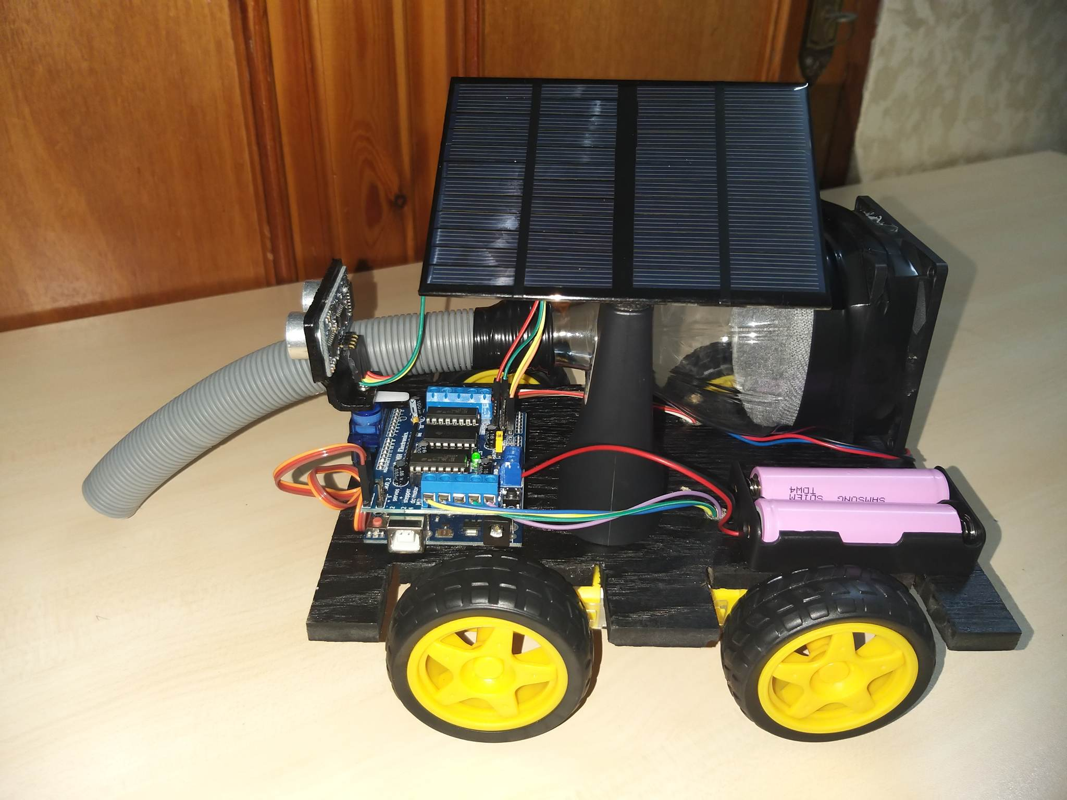

Slide 13
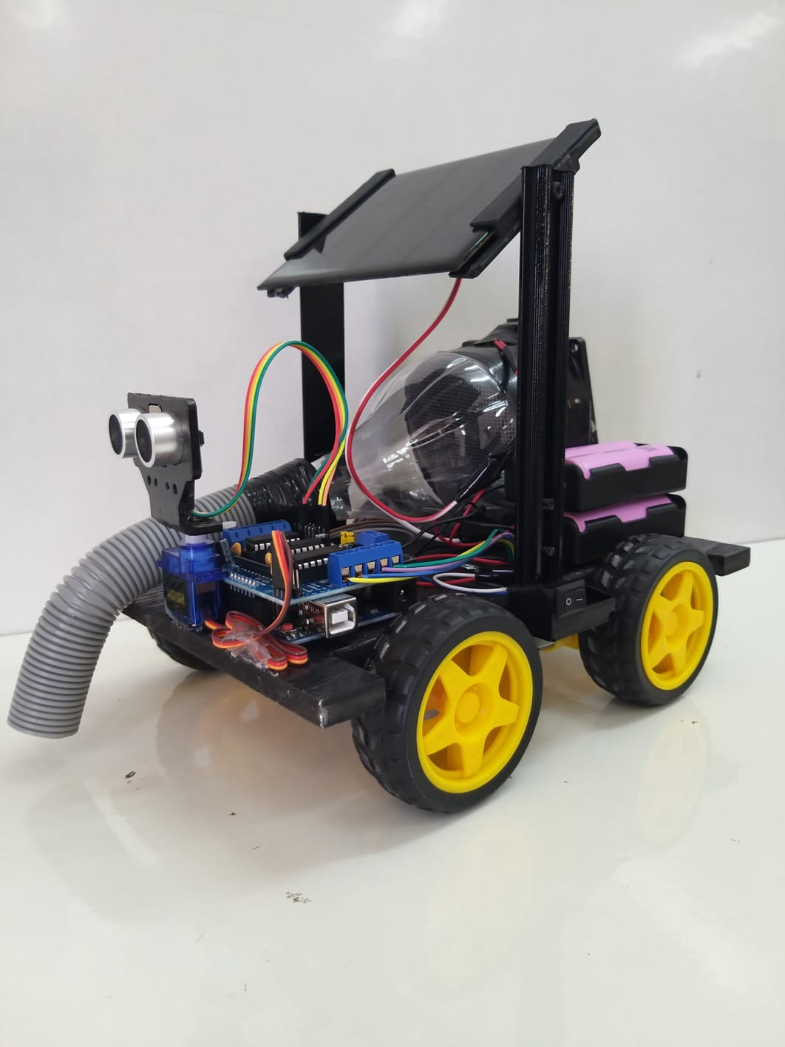
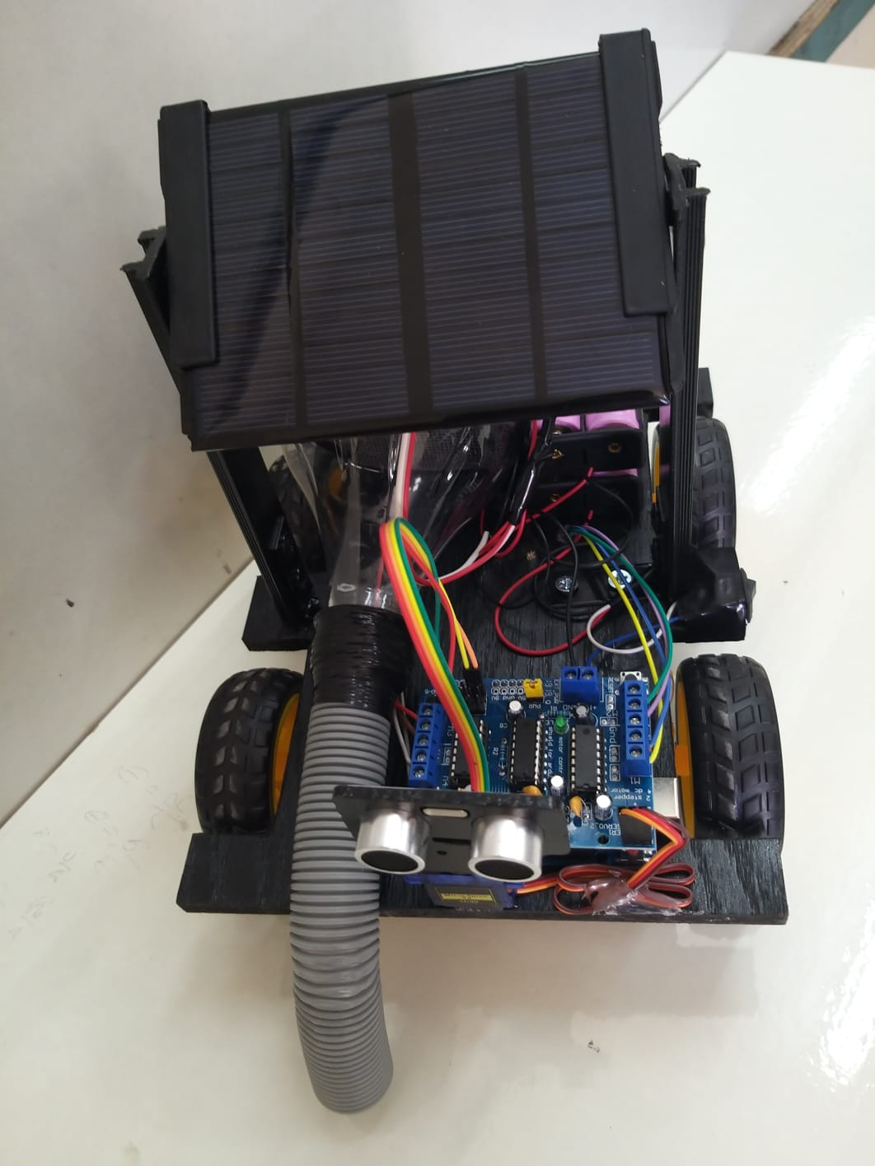

Slide 14
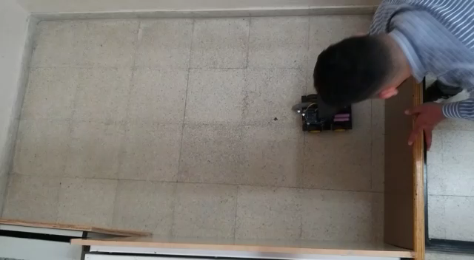

Slide 15
Acknowledgements
In 18 years of studying, we had much experiences, we had been affected be many people, friends and teachers. To all of them who helped us to reach this place.
To our parents, for pushing us forward every time, for giving hope and prayers when we needed it, and moreover when they hear our name, for teaching us the first letters our had spoken, until our graduation and after that we will always learn from them.
To our doctors and teachers in the bachelor degree study, especially doctor Haneen Al-utt, who had helped us in many ways, to become a better engineer and a good researcher.

Slide 16
Thank you

