Slide 1

PlantShot
Plant Disease Detector
Prepared by :
Ahmad Jammal
Lamees Shaar
Motaz Attallah
Supervisors :
Dr. Abdel-Razzak Natsheh
Dr. Amjad Hawash
Dr. Raed AlKowni

Slide 2

Outline
Introduction
Motivation
Challenges
Considered Viruses
Used Libraries
Workflow
Classifiers Comparison
Mobile Application
Future Works
Conclusion

Slide 3
Introduction
It is a plant disease diagnostic app.
Supports farmers worldwide to recognize tomato viruses just by sending a picture.
Notes:
البندورة هو محصول مهم في فلسطين ، بالرغم من وجود عدة افات من بكتيريا و فيروسات و غيرها تلحق الاذى بالبندورة ، الا ان الفيروسات هي الاكثر انتشارا و تظهر اعراضها على اوراق البندورة .
و تظهر اعراض تؤدي في نهاية المطاف الى موت النبتة ، وبالتالي يؤدي الى انخفاض في المستوى الانتاجي. كنتيجة لذلك لا بد من وجود نظام اوتوماتيكي يشخص حالة النبتة من الاعراض التي تظهر عليها من خلال معالجة الصورة ومن ثم يتم تصنيفها للمرض المصابه فيه (بتحكي بشكل مفصل اكتر يعني)
ف وجود هذا النظام وفر الوقت و الجهد والتكلفة من قبل الخبراء ، خصوصا في الدول النامية يوجد مسافات كبيرة بين االمزارعين و الخبراء ...

Slide 4
Motivation
Requested by the Faculty of Science Department of Biology.
Importance of image processing and Artificial intelligent in the future.
farmers' lack of knowledge of diseases and methods of prevention from each one.
combining IT field with other fields is very important.
learning new language to build our project like python and image processing techniques

Slide 5
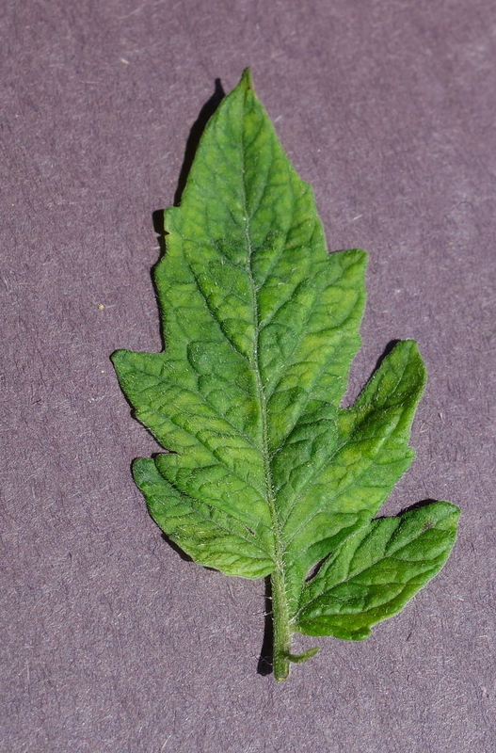
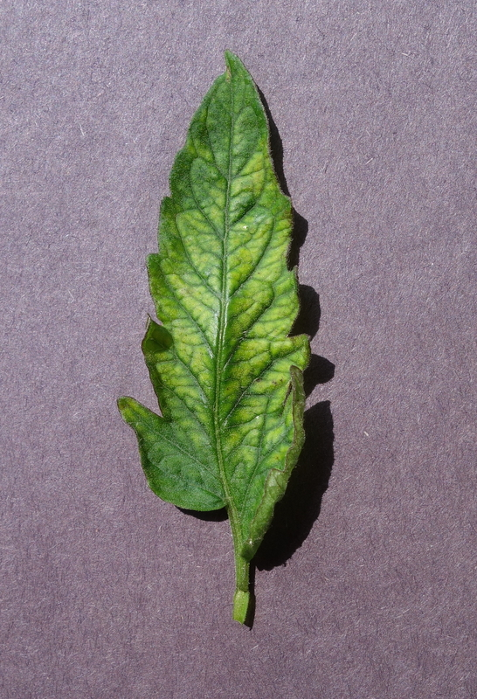
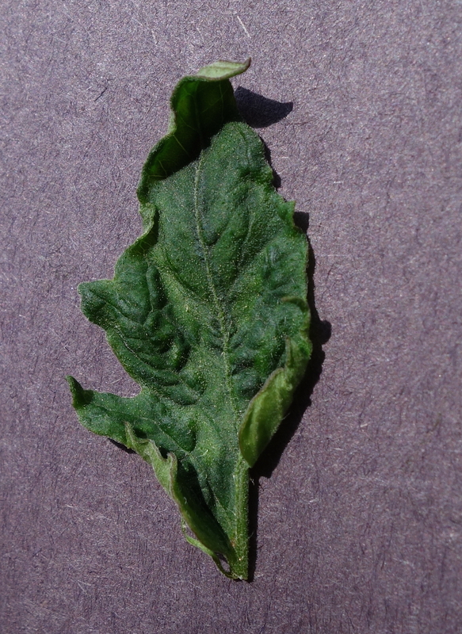
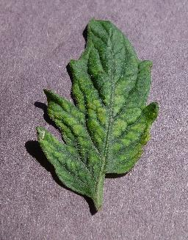
Considered Viruses
Tomato Mosaic Virus - ToMV

Slide 6
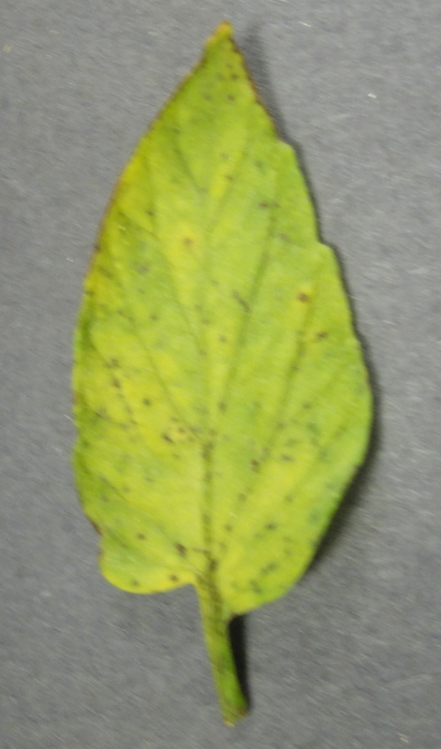
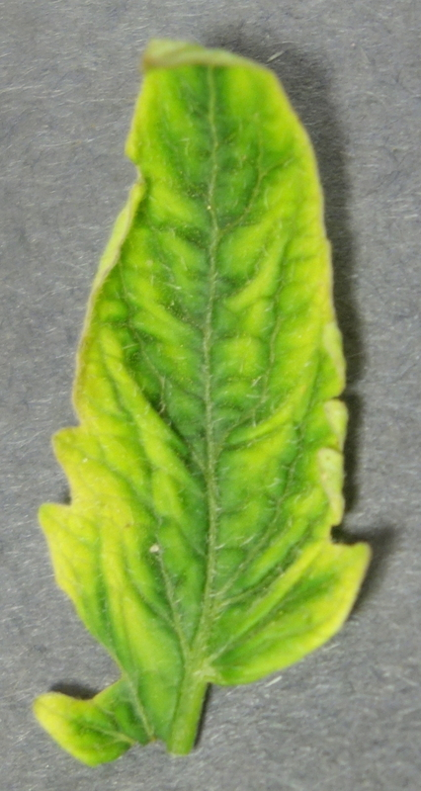
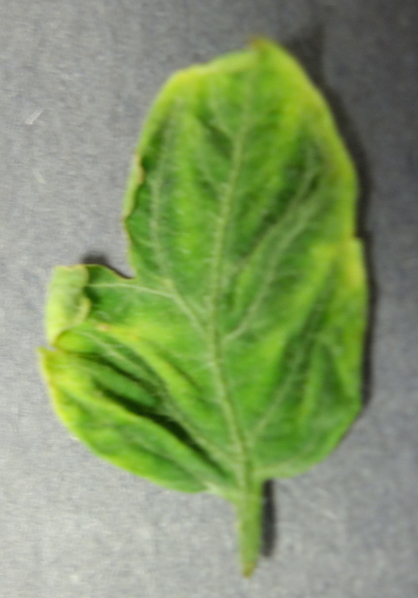
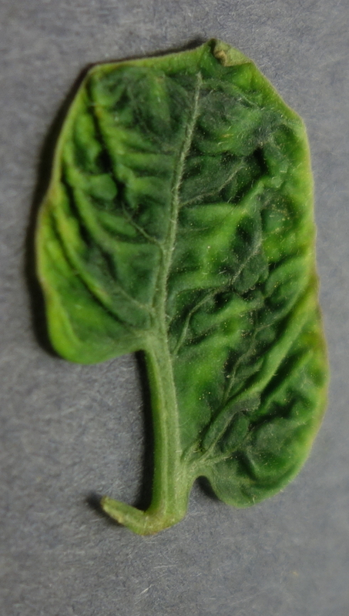
Considered Viruses – Cont.
Yellow Leaf Curl Virus - YLCV

Slide 7
Challenges
Learning new language used in project like python.
Learning python language to build our project with image processing techniques while working in it at the same time.
Segmentation process is turning point between success and failure
Getting large set of data

Slide 8
Used Libraries
OpenCV
Scikit-Learn
Numpy
Pandas
Matplotlib

Slide 9
Workflow
Image Acquisition
Preprocessing
Segmentation
Features Extraction
Classification

Slide 10
Image acquisition
The site contains 19,149 different images with a suitable residential background.
  1,591 healthy images
  373 tomato mosaic virus - ToMV
  5,357 tomato yellow curl leaf virus - YLCV

Slide 11
Preprocessing
Histogram equalization
  HE is used to enhance contrast.
  Take different images with different light conditions

Slide 12
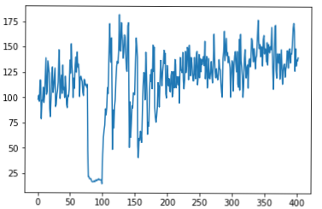
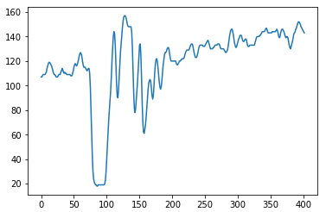
Preprocessing – Cont.
Smoothing
  Remove noise with Gaussian filter

Slide 13
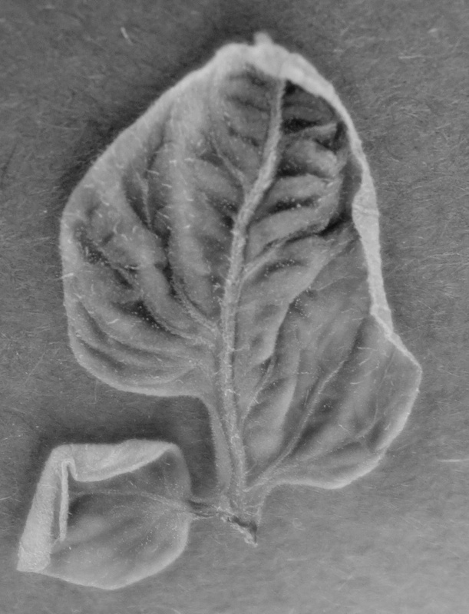
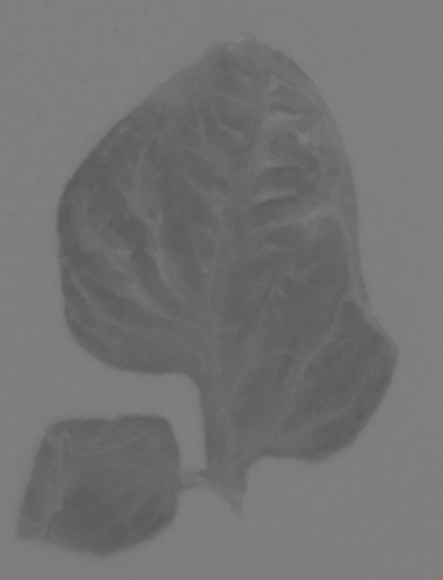
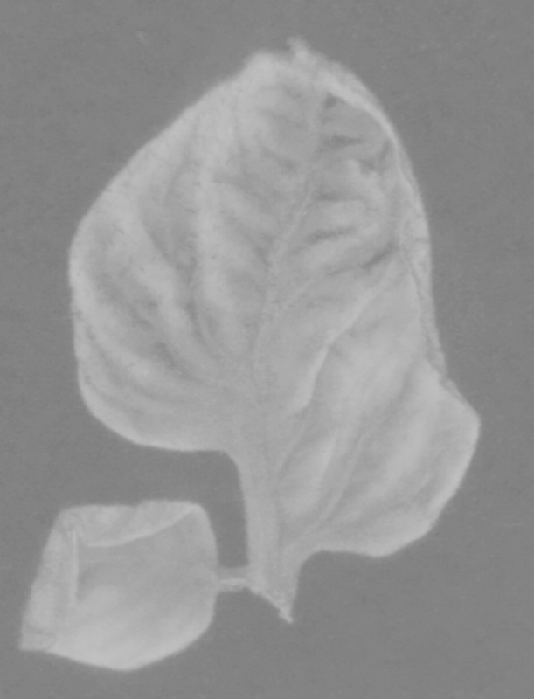
Segmentation
Converted the image to “LAB” color space.
  enables you to quantify visual differences.
L
a
b

Slide 14
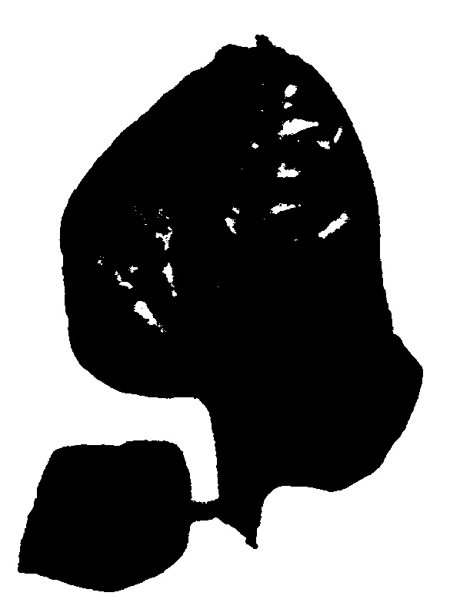
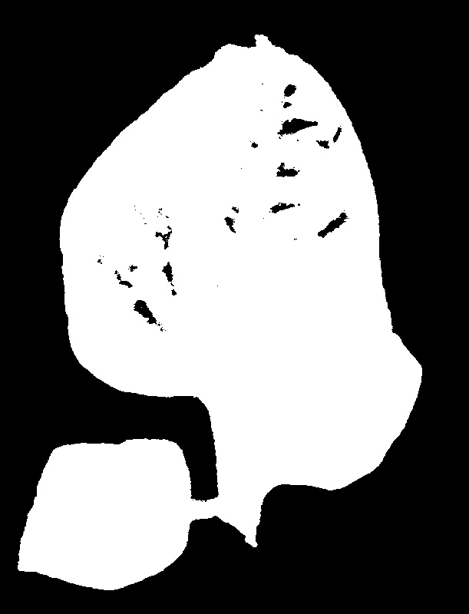
Segmentation
Thresholding "B" channel using "OTSU“ method.
Inverse the previous thresholding result.
Negative

Slide 15

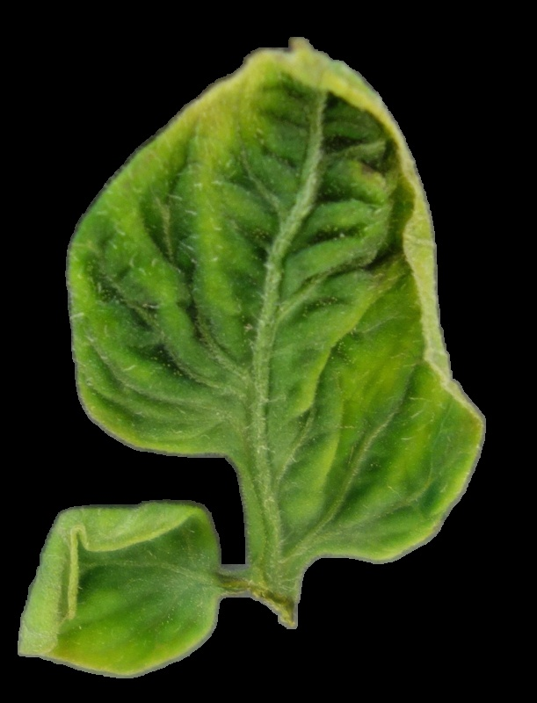
Segmentation
Closing (morphology)
  Remove the small holes in the image
Closing

Slide 16
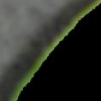

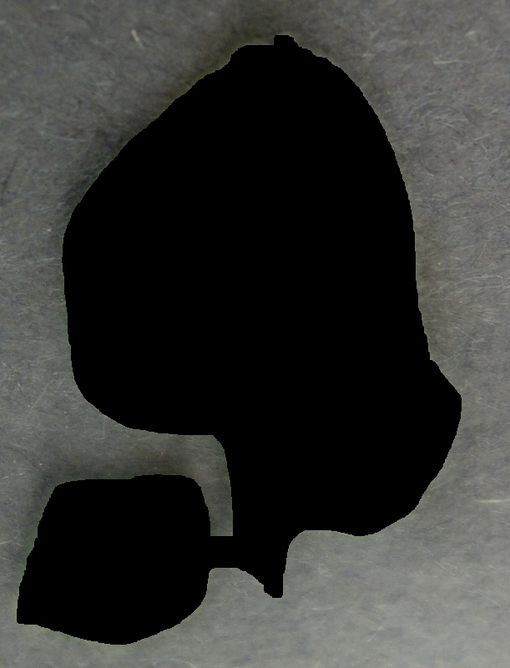
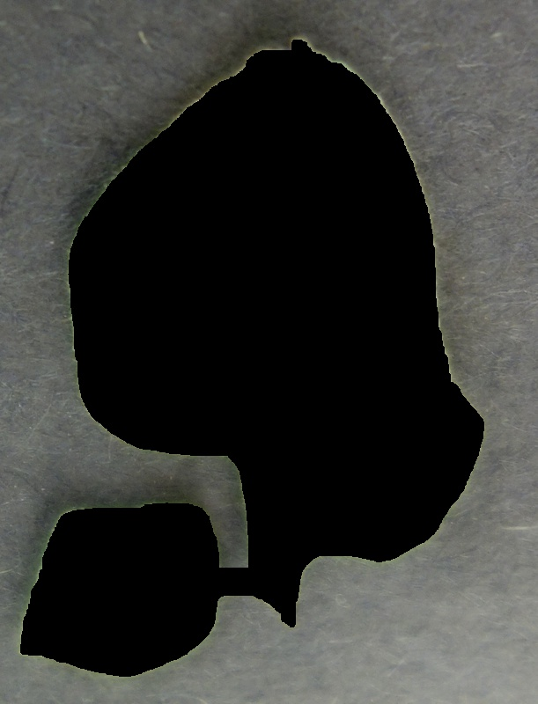
Segmentation
Dilation(morphology)
  Uses for expanding the shapes contained in the input image.
Dilation
Recognized Leaf

Slide 17
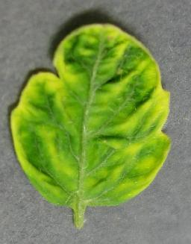
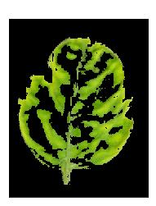
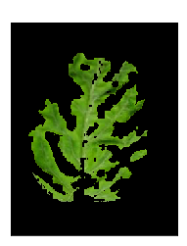

Features Extraction
Yellow/Green Percent Extraction
Yellow
Green
53%
43%

Slide 18
Features Extraction – Cont.
Other features :
Mean , Standard Deviation , Skewness – ( R , G , B )
Mean , Standard Deviation , Skewness , Entropy
Variance Covariance

Slide 19
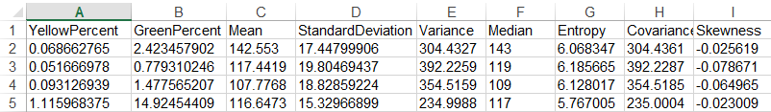
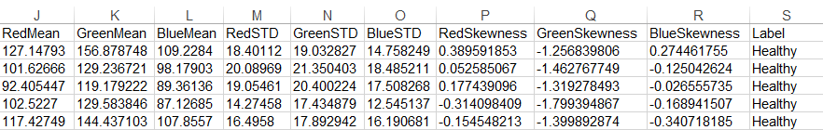
Features Extraction – Cont.
The extracted values are stored in the excel sheet and used as a database for classification.

Slide 20
Classifiers
Decision Tree Classifier
Multi-layer Perceptron
Random Forest Classifier
K-Neighbors Classifier

Slide 21
Classification Accuracy
Full DataSet
Training Set
Test Set

Slide 22
Classification Accuracy – Cont.
Cross Validation :
Full DataSet
Fold 1
Fold 2
Rows are
randomly
assigned
Fold 3
Fold 4
Fold 5
Fold 6
Fold 7
Fold 8
Fold 9
Fold 10

Slide 23
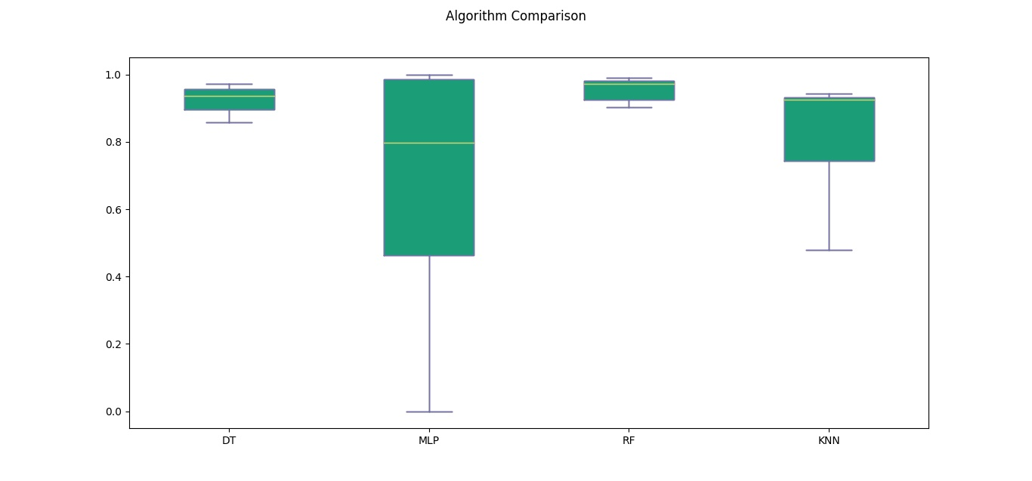
Classification Accuracy – Cont.

Slide 24
Program Output
RandomForest Cross validation : 0.97 (+/- 0.02) No of Correct predictions is 97.000000 No of Incorrect predictions is 3.000000 accuracy_score is 0.970000 | Decision Tree Cross validation : 0.93 (+/- 0.01) No of Correct predictions is 94.000000 No of Incorrect predictions is 6.000000 accuracy score is 0.940000
KNeighborsClassifier Cross validation : 0.86 (+/- 0.01) No of Correct predictions is 84.000000 No of Incorrect predictions is 16.000000 accuracy_score is 0.840000 | MLPClassifiers Cross validation : 0.73 (+/- 0.00) No of Correct predictions is 76.000000 No of Incorrect predictions is 24.000000 accuracy_score is 0.760000

Slide 25
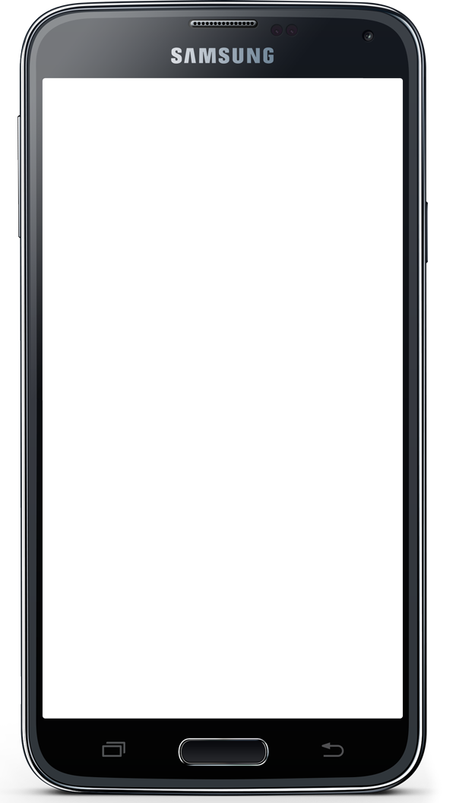
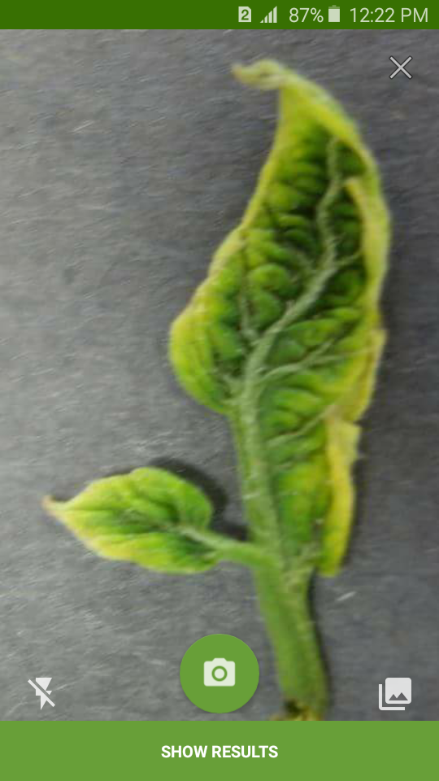
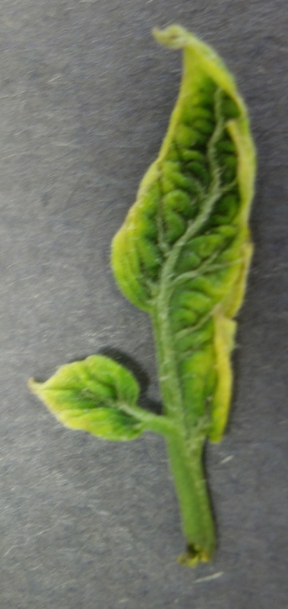



Mobile Application
Client
1- Send an image(json) to server
Python server for image processing
Android Volley Library
3- Server returns an result
(type of disease with other data)
2- Server-side image classification based in features extracted

Slide 26
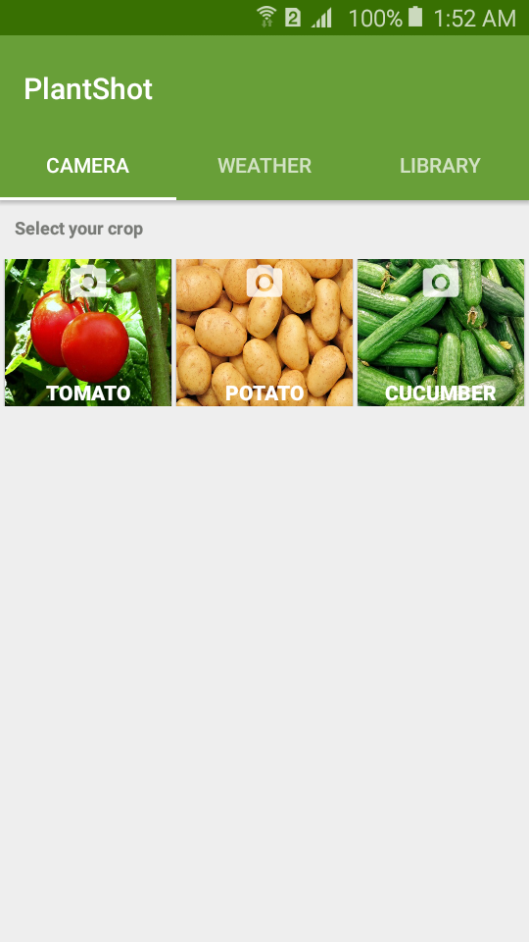
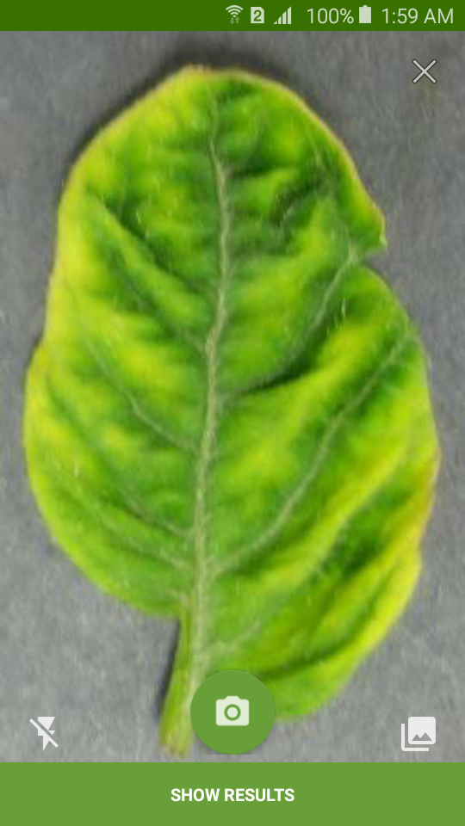
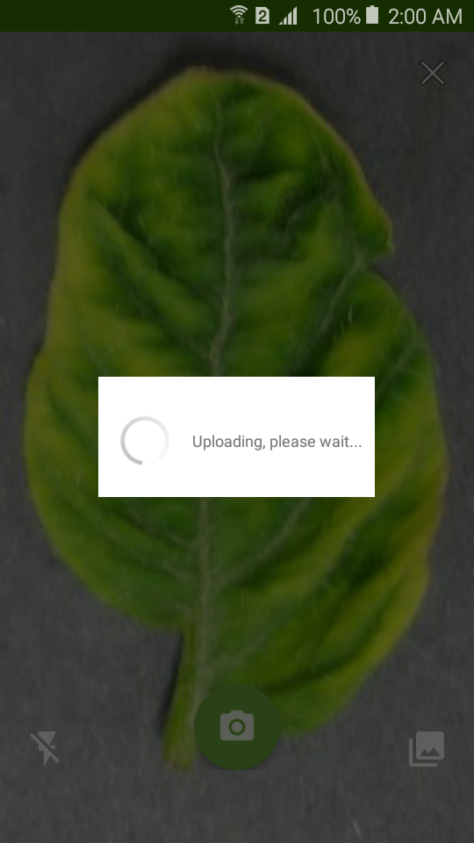
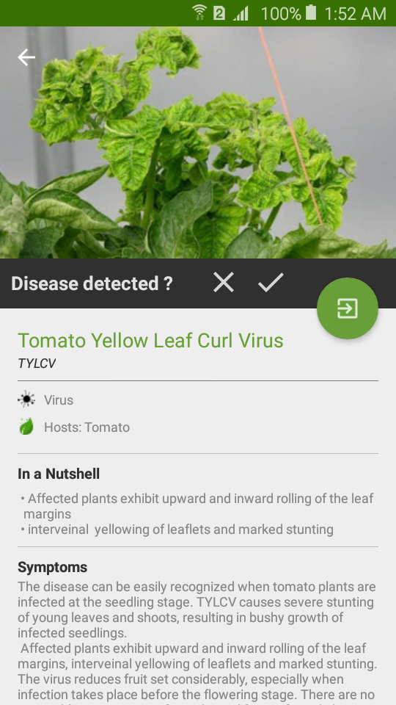

Mobile Application – Cont.
Main
Camera
Uploading
Result
Select from gallery

Slide 27
Live Demo

Slide 28
Future Work
Make detection for other crops disease.
PREDICTIONS : early warning systems and predictions of crop failures based on the processed data and weather forecasts.
MONITORING TOOL : Mapping of the spatial distribution of cultivated plants and their damages. Based on the collected information via the camera feature and tagged with GPS coordinates.
Share image with expert group
Build social network between farmer

Slide 29
Conclusion
Manually, naked eye observation gives poor accuracy but with the existing of automated artificial intelligent detection of plant disease system gives high accuracy, consuming time and effort and easy to process.

Slide 30
Any questions ?
Thank You

