Slide 1
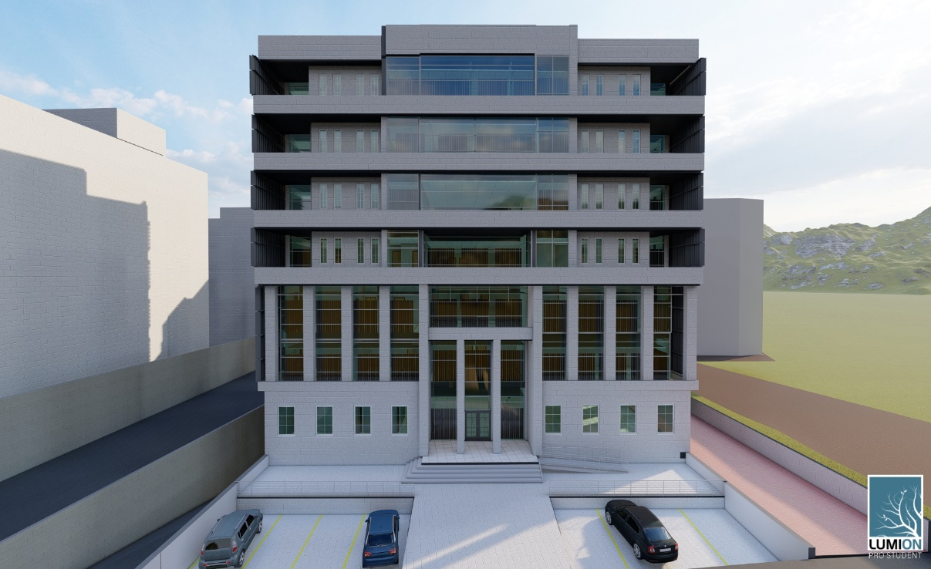

Anti-corruption commission building project
An-Najah National university
Faculty of Engineering
Building Engineering Department
Supervisor :
Mutasim Baba’
Prepared by :
Loai Eyad Abd
Haya Nour
Ahmad Khaseb

Slide 2
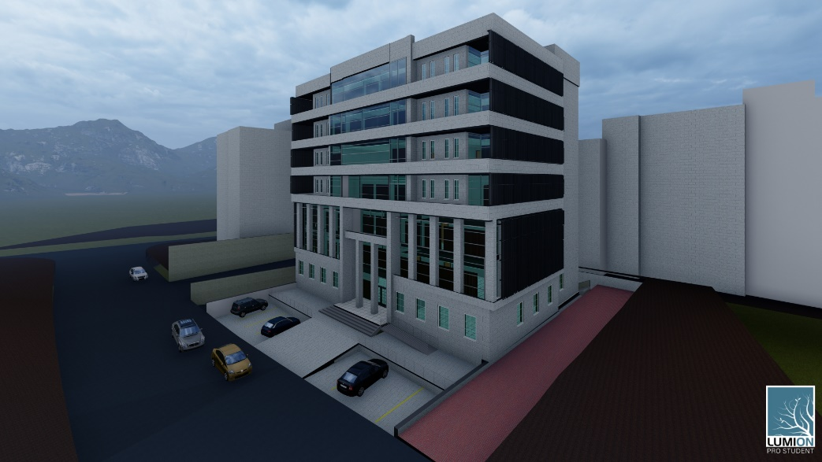
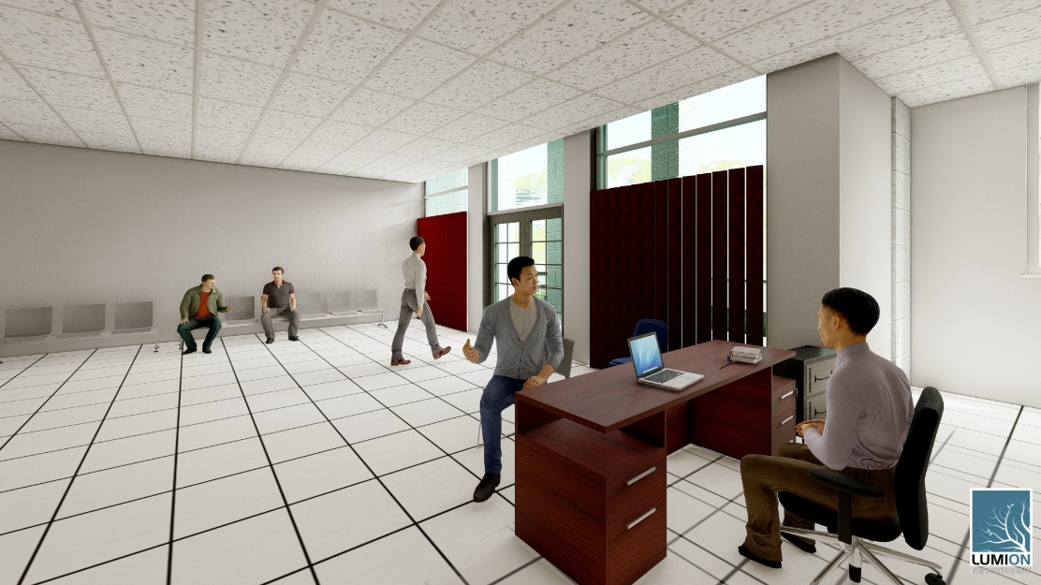
OUTLINES
Introduction
Site description
Architectural design
Environmental design
Structural design
mechanical design
Electrical design
Quantity surveying

Slide 3
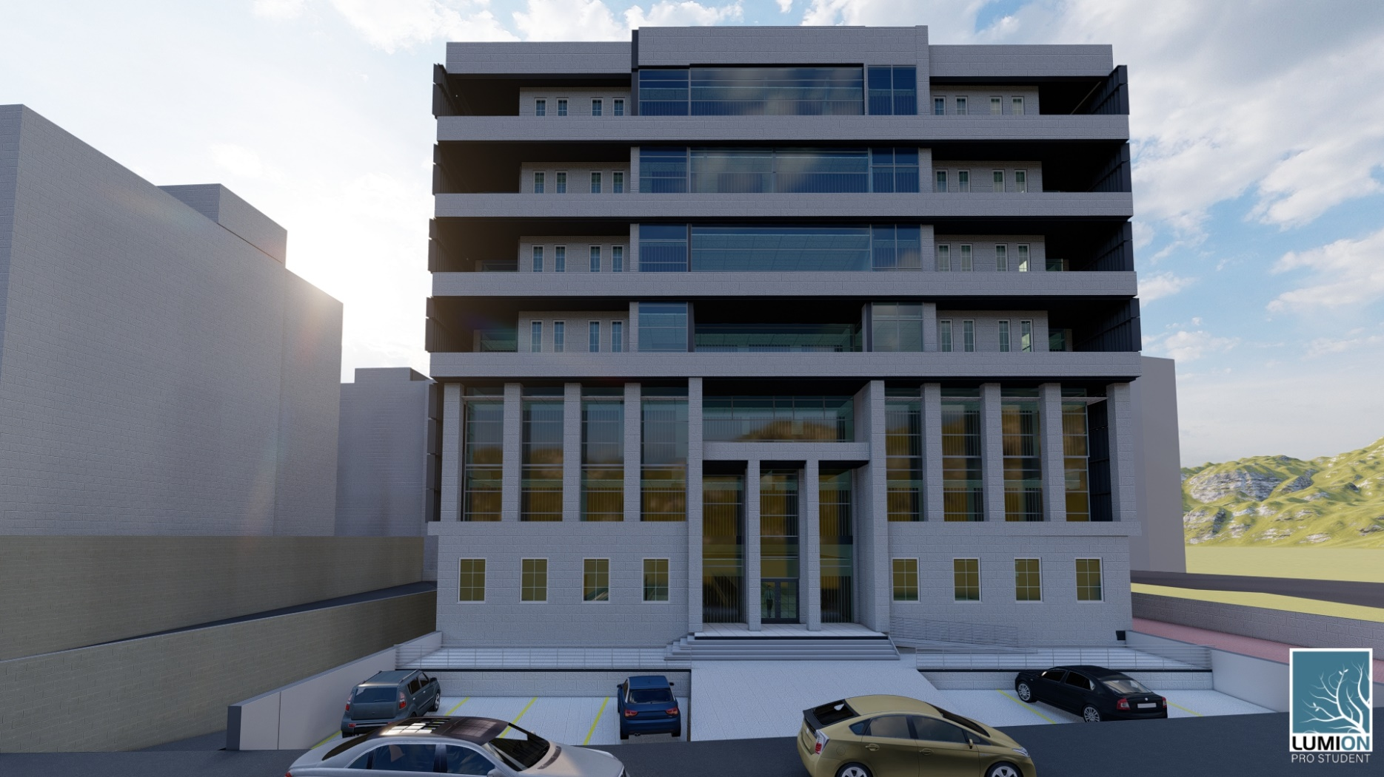
Introduction

Slide 4
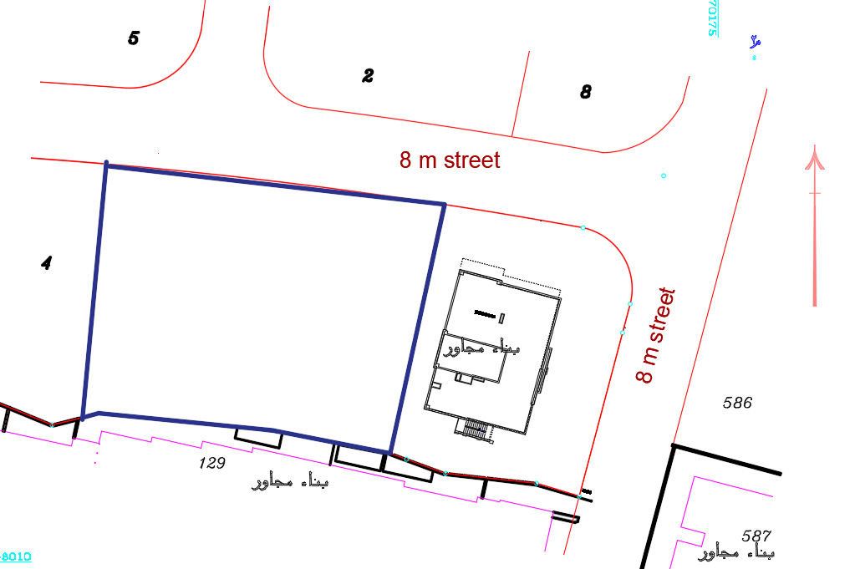
Site description
Location : Ramallah – Al-Balooa’ neighborhood - (31o55’34" N , 35o12’41" E )
Area:
straight land
Total area 1846 m2
Surrounding
- 2 streets ( 8 m)
- Office building from East
height is (22.5 m )
Commercial building
From South height is (24.5 m)

Slide 5
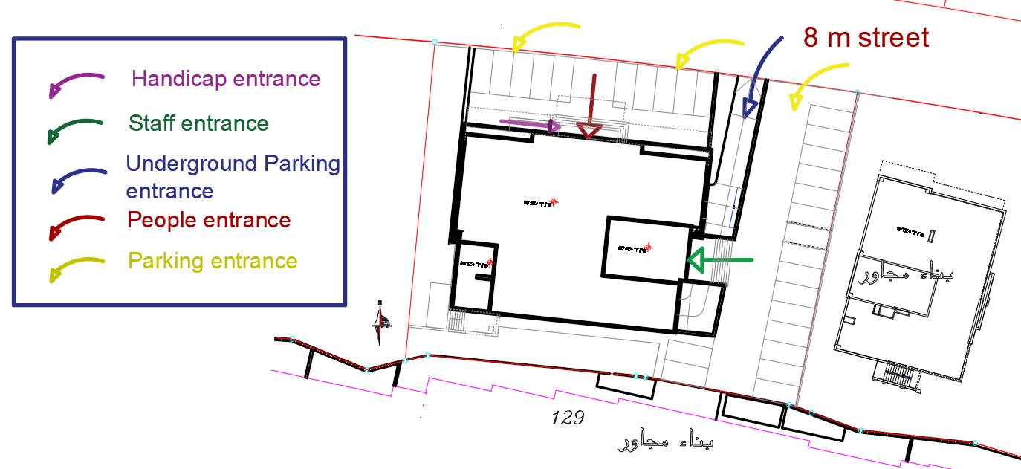
Site Accessibility
Site Plan

Slide 6
Architectural Design

Slide 7
Project Description
Second basement
First basement
Ground floor
First floor
Second floor
Third floor
Fourth floor
Fifth floor
Sixth floor
Total area
Stair
7 floors, in addition to two basement as a parking .
Total area of the building equals to 6220 m2
Contains approximately 200 employee .
817
m2
830
m2
613
m2
635
m2
659
m2
634
m2
634
m2
634
m2
634
m2
119
m2
6220
m2

Slide 8
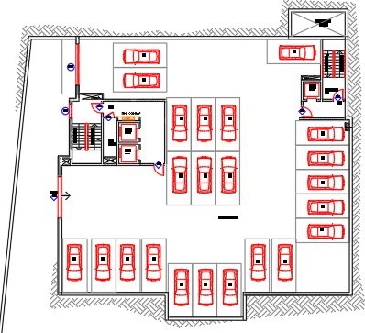
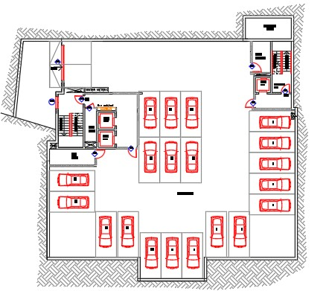
Architectural Design
The design for first basement floor
The design for second basement floor

Slide 9
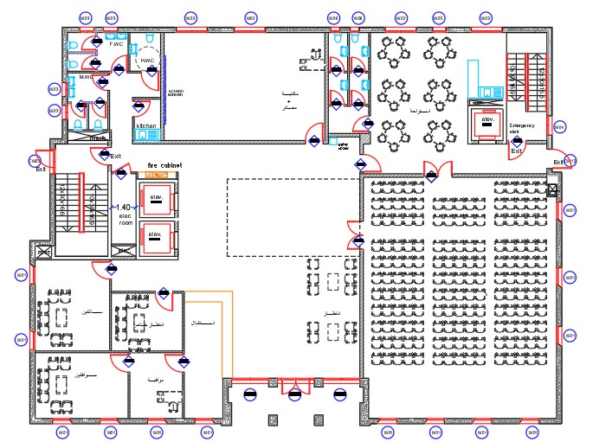
Architectural Design
The design for Ground floor

Slide 10
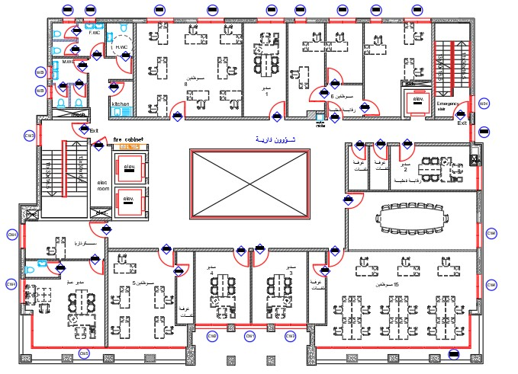
Architectural Design
The design for First floor

Slide 11
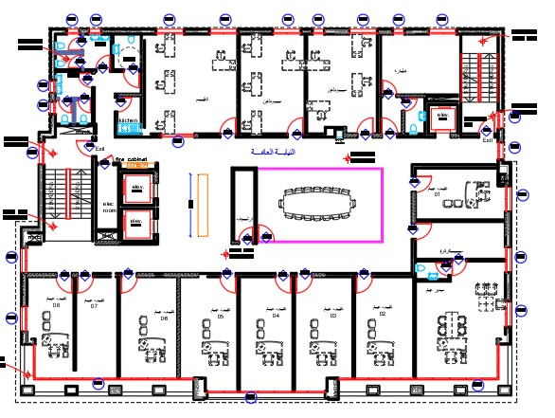
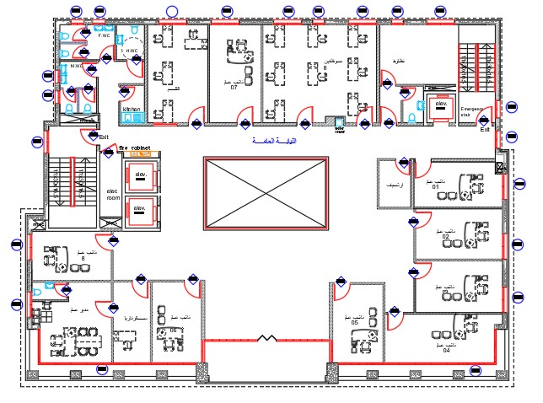
Architectural Design
The old design for Second floor
The new design for Second floor

Slide 12
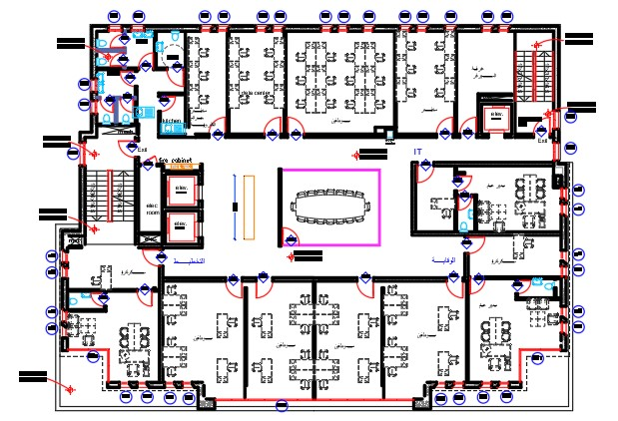
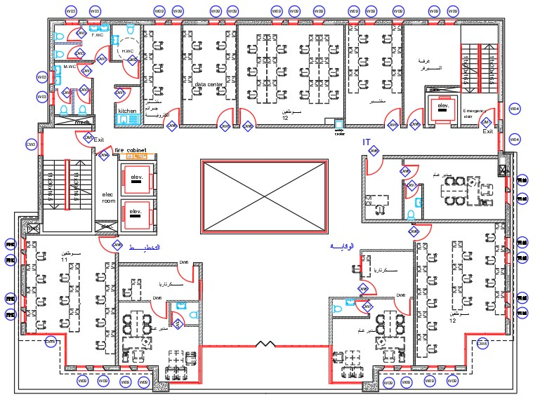
Architectural Design
The old design for Third floor
The new design for Third floor

Slide 13
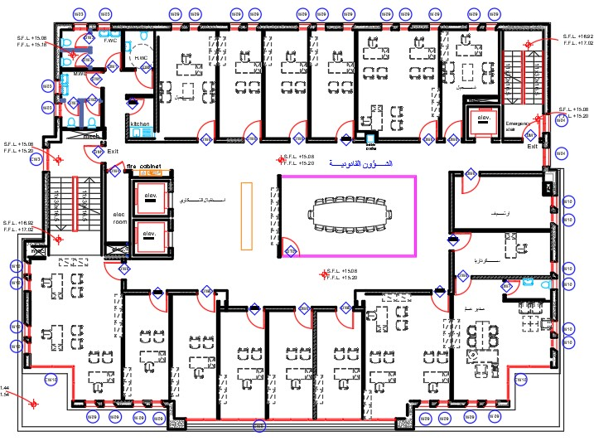
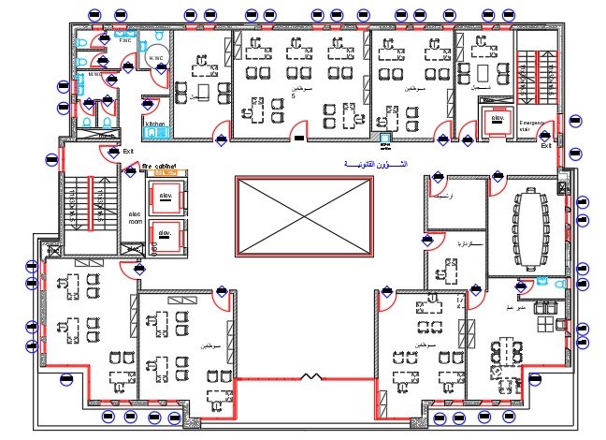
Architectural Design
The old design for Fourth floor
The new design for Fourth floor

Slide 14
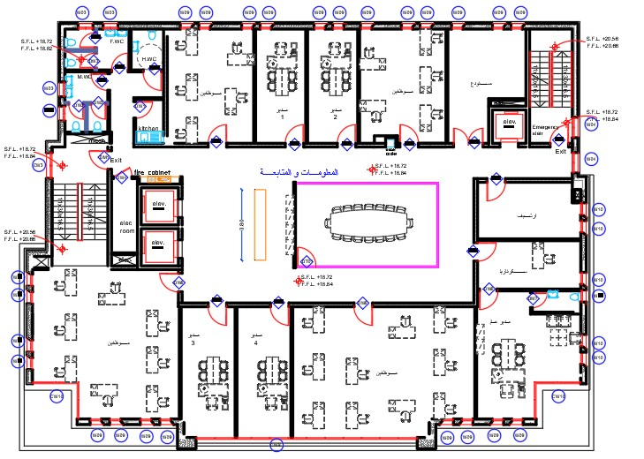
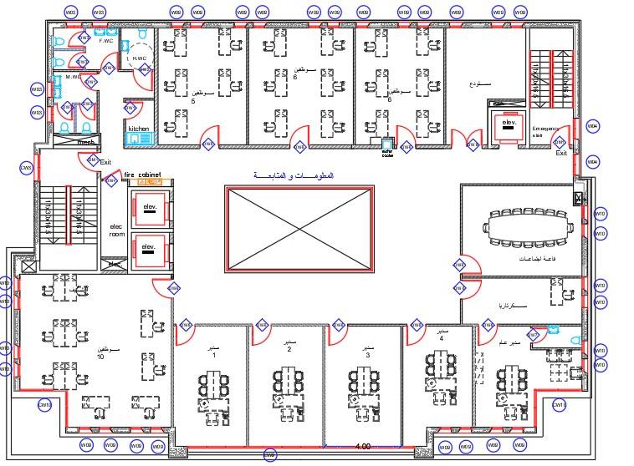
Architectural Design
The old design for Fifth floor
The new design for Fifth floor

Slide 15
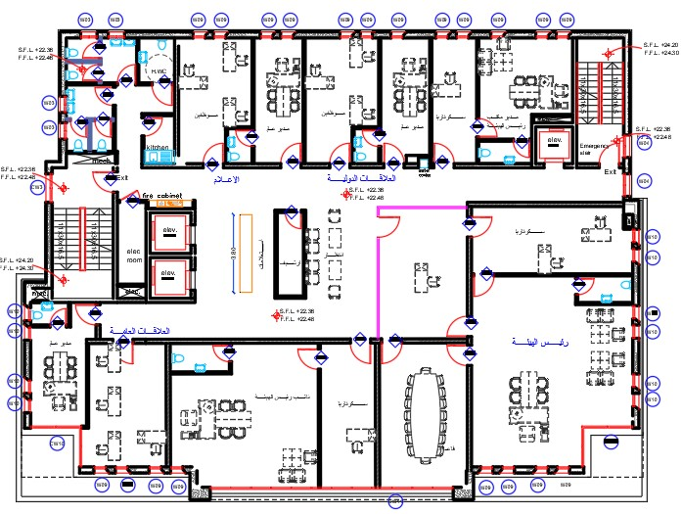
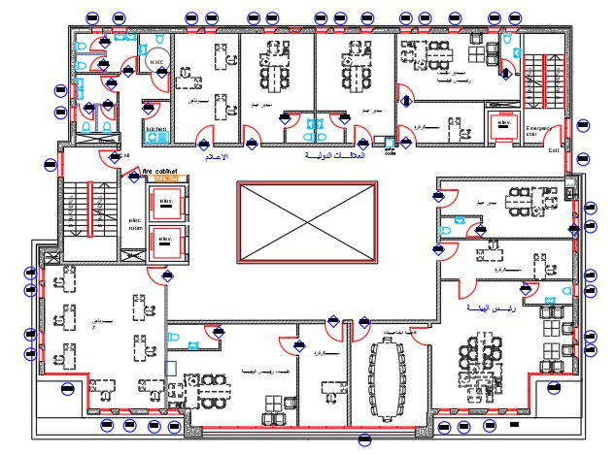
Architectural Design
The old design for Sixth floor
The new design for sixth floor

Slide 16
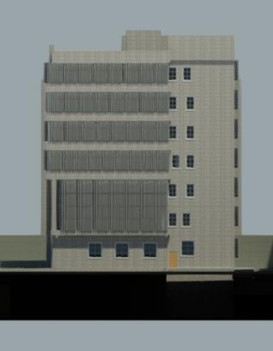
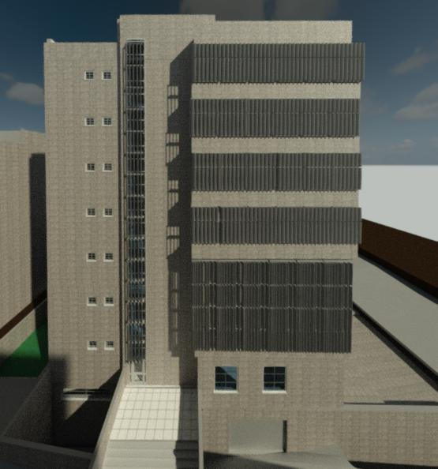
Elevations
East Elevation
West Elevation

Slide 17
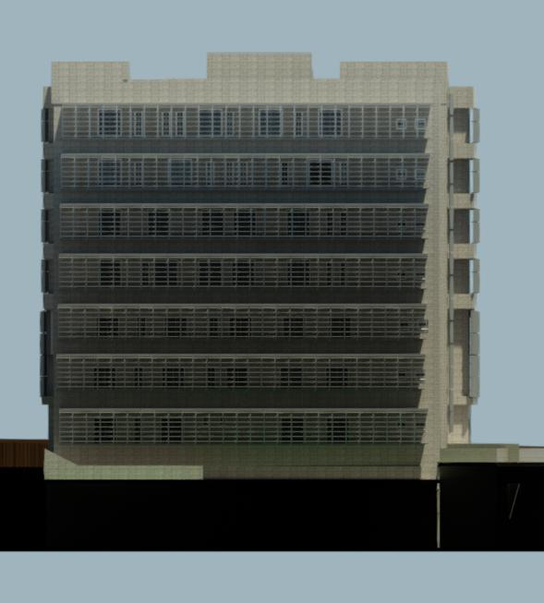
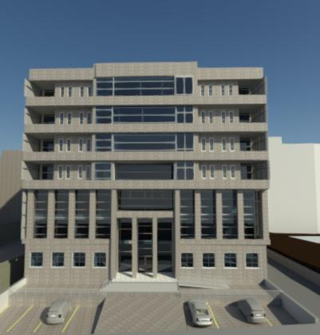
Elevations
South Elevation
North Elevation

Slide 18
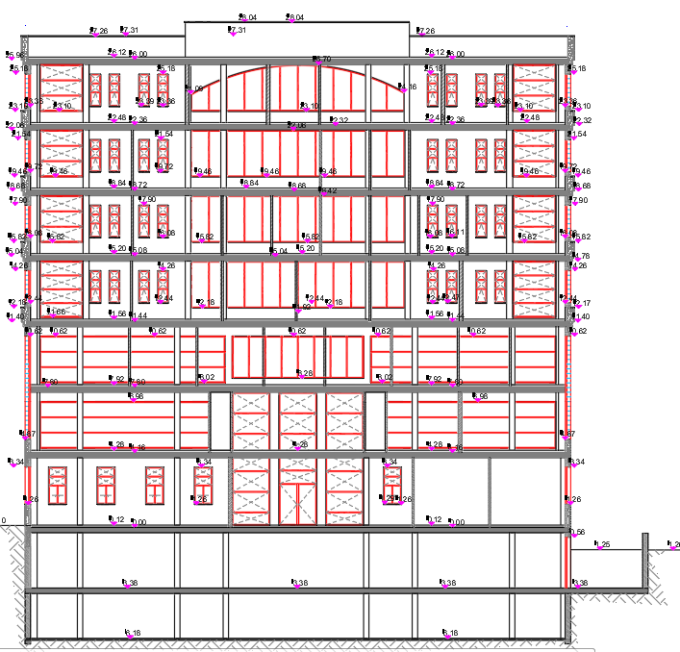
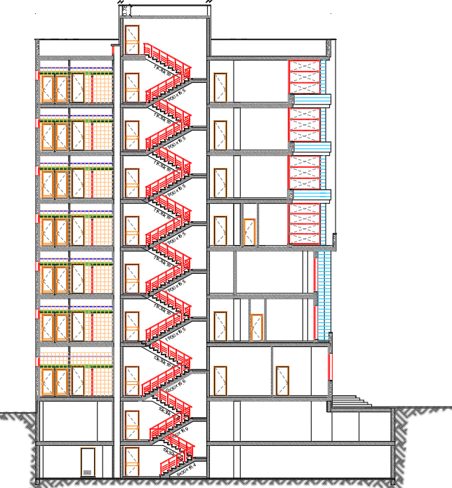
SECTIONS
A-A section
B-B section

Slide 19
Environmental design
Material properties
Thermal analysis
Acoustical design
Daylighting
shading

Slide 20
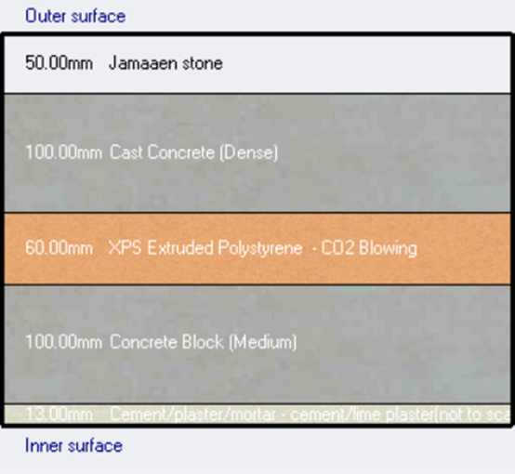
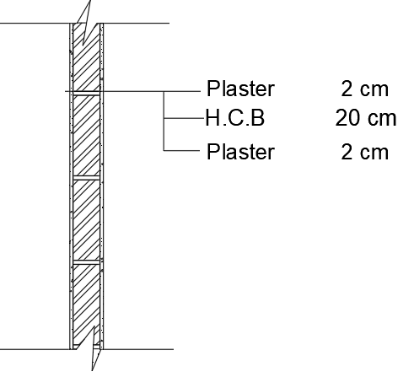
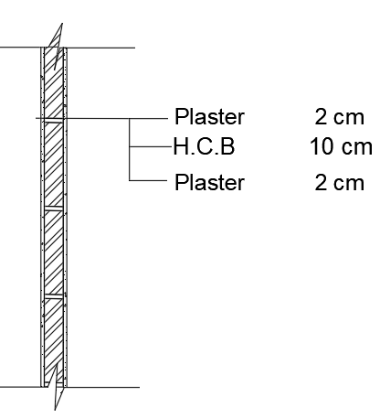



Material properties
External wall
Internal wall

Slide 21
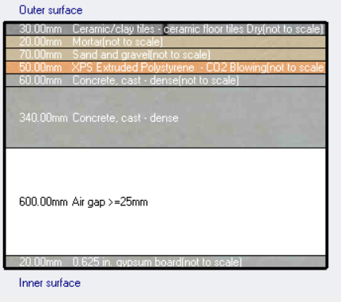

Internal floors

Slide 22
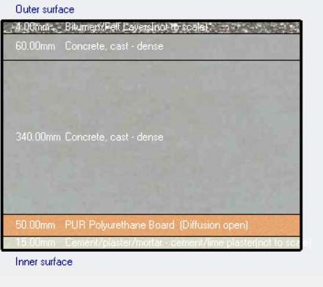

Roof slab

Slide 23

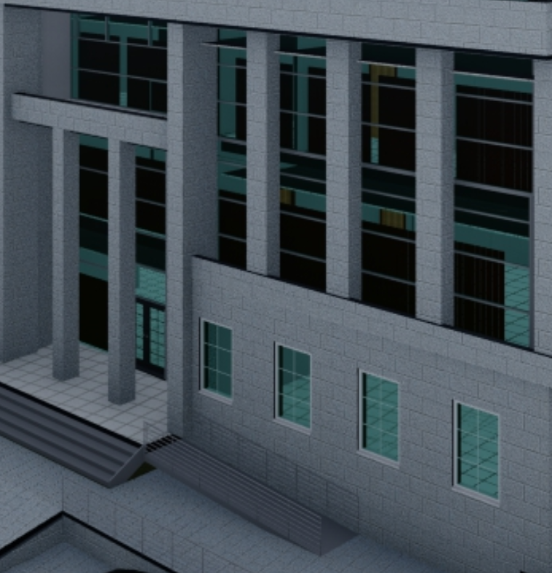
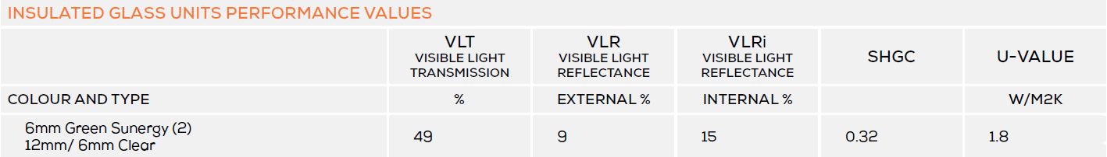
Glass Type
Double low thermal emissivity Glass
Green 6mm/12mm air gap

Slide 24
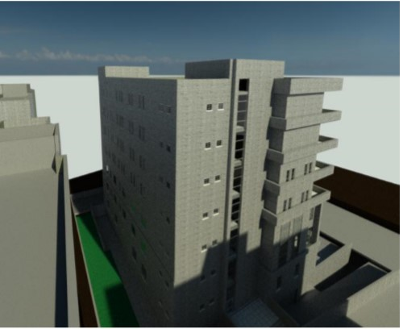
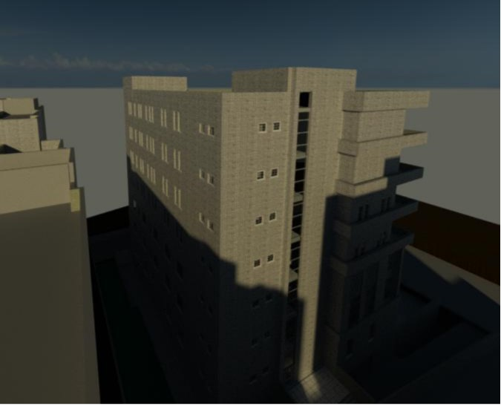
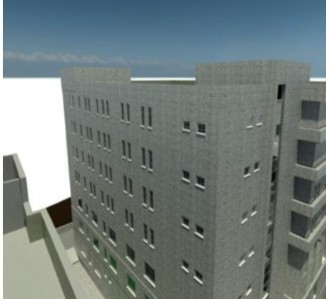
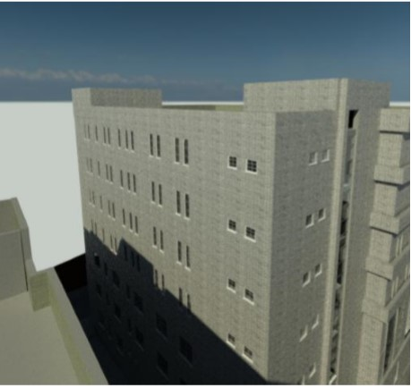
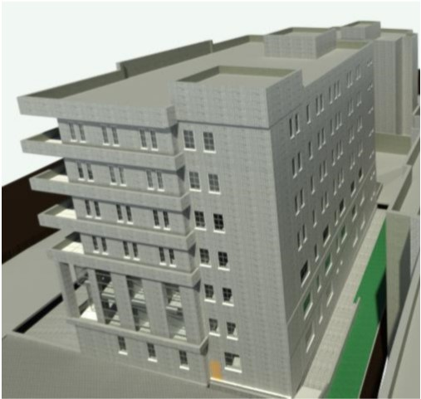
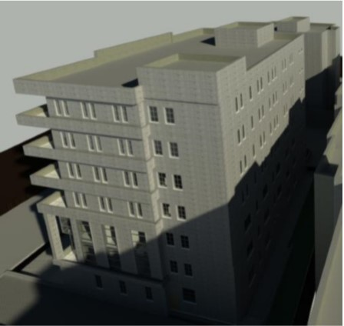
shadowing
Summer
Winter
9 AM
12 PM
12 PM
Winter
Summer
Winter
Summer
3 PM

Slide 25
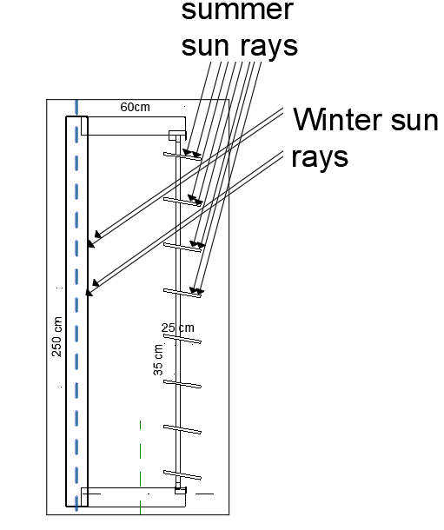
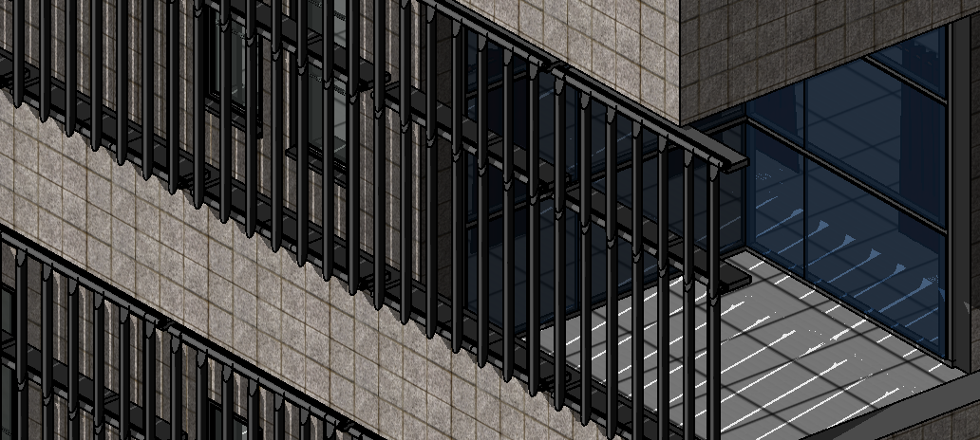
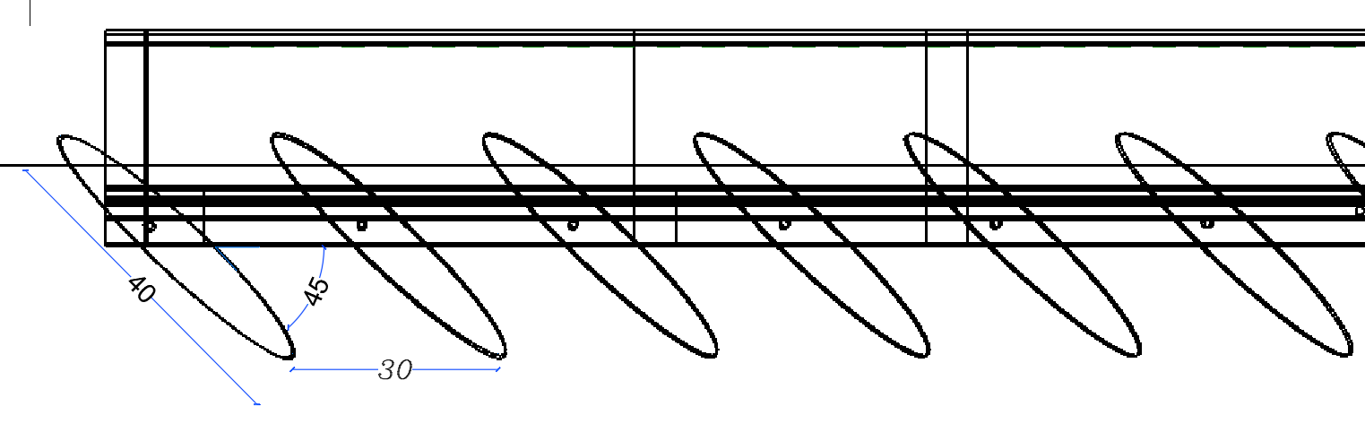
Shading
Vertical Louvers on East & West elevations :
Shutters on South elevation:

Slide 26
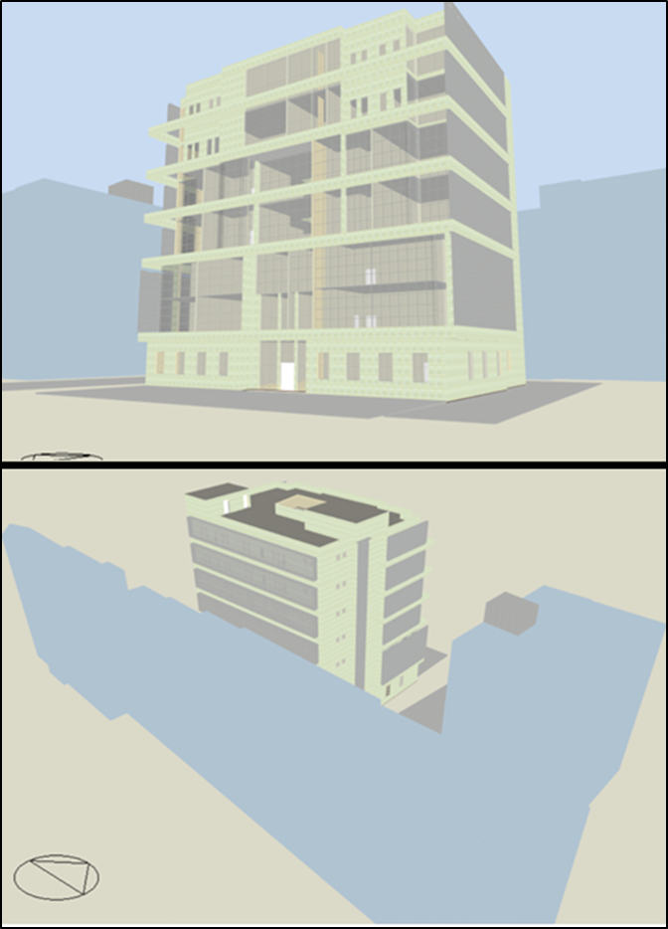

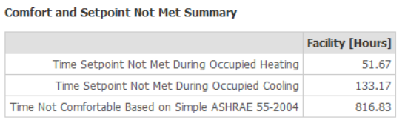
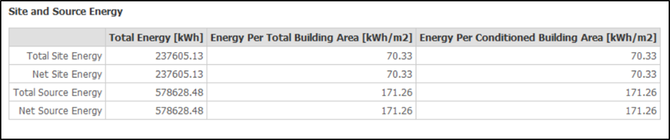
Thermal analysis
Cooling load = 182 KW ( Avg = 54 w/m² )
Total Building Energy = 70.33 KWh/m²

Slide 27
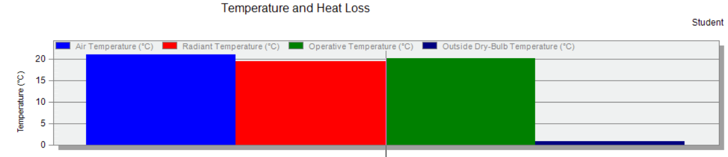
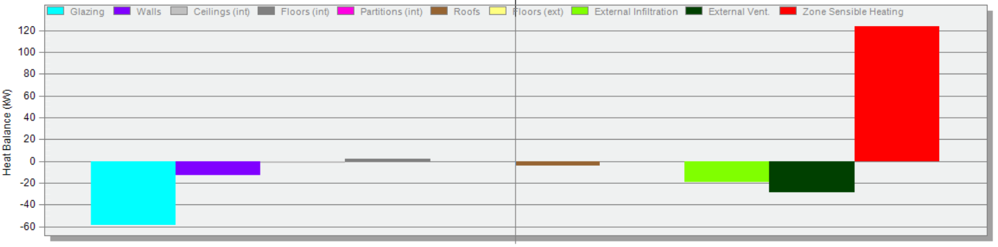
Heating load

Slide 28
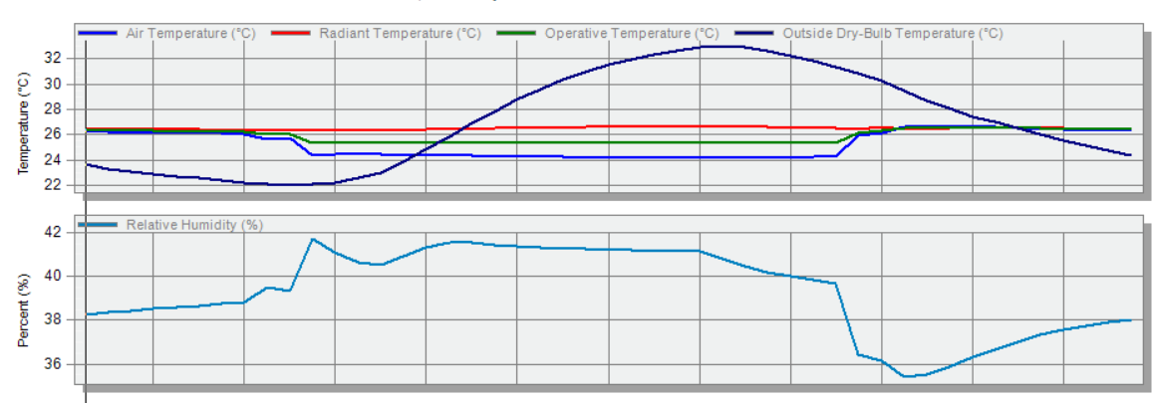
Cooling load
Cooling load = 182 KW ( Avg = 54 w/m² )

Slide 29
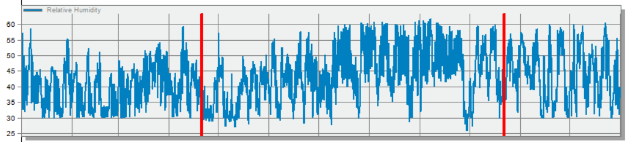
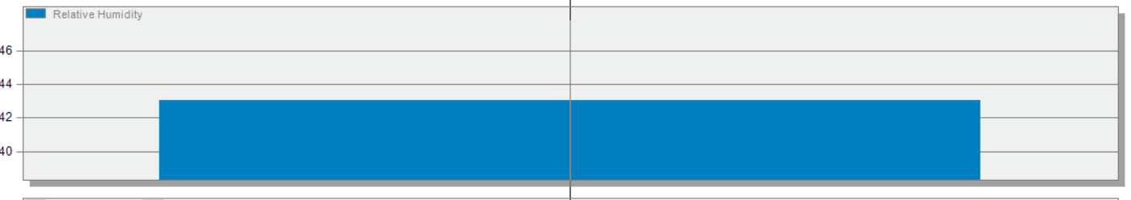

Thermal comfort Analysis

Slide 30


Solarium
30

Slide 31


Solarium
Winter day :
31

Slide 32

Solarium
Summer day :
32

Slide 33


Daylight
For Ground Floor:
After Modification
Before Modification
33

Slide 34

Daylight
For First Floor:
After Modification
Before Modification
34

Slide 35

Daylight
For Sixth Floor:
After Modification
Before Modification
35

Slide 36
Acoustical analysis
Material:

Slide 37


Acoustical analysis
Reverberation time
Office room:
With full occupancy :
With 50% occupancy:

Slide 38

Acoustical analysis
Reverberation time
With empty room :
 | Empty | 50% | Full
Frequency | RT60 | RT60 | RT60
63 Hz | 0.7 | 0.69 | 0.68
125Hz | 0.71 | 0.70 | 0.70
250Hz | 0.63 | 0.62 | 0.61
500Hz | 0.51 | 0.50 | 0.49
1000Hz | 0.50 | 0.49 | 0.49
2000Hz | 0.54 | 0.53 | 0.52
4000Hz | 0.48 | 0.48 | 0.47
8000Hz | 0.36 | 0.36 | 0.36
16000Hz | 0.36 | 0.36 | 0.36

Slide 39


Acoustical analysis
STC calculation :
Layers | Thickness (mm) | Density(kg/m³)
Cement | 20 | 1500
Block | 100 | 1250
Cement | 20 | 1500

Slide 40


Acoustical analysis
For IIC :
Layers | Thickness (mm) | Density(kg/m³)
Tile | 30 | 2100
Mortar | 20 | 2162
Concrete | 40 | 2500
Block | 340 | 1250

Slide 41
Structural analysis
Codes
- ACI 318-14
- UBC -97
Material
- Compressive strength ( fʹc ) = 28MPa
- Yielding strength of steel (fy) = 420 Mpa.
Bearing capacity =400 kN /m2
Designed load
SID = 5.9 KN/m2
Live load = 2.5 KN/m2

Slide 42
Structural analysis
EQ Loads (UBC97):
I= 1 Cv=0.32
R= 5.5 Ca=0.22
Z= 0.15 Ct= 0.0731

Slide 43

Structural analysis
Checks
Compatibility check
Equilibrium check
Stress σ & Strain ɛ check
Period check
Drift check
Base shear check
ok
ok
ok
ok
ok
ok

Slide 44


Slab Reinforcement
- Thickness =40cm
2- way ribbed slab

Slide 45




Beams system
Hidden beams

Slide 46


Columns system
column tag | Dimension (cm) | Reinforcement | Stirrups distribution
C1 | 100x40 | 12ø20 | 4ø10
C2 | 150×40 | 12ø22 | 3ø10

Slide 47


Shear wall design

Slide 48

Footings Design

Slide 49

Single Footing

Slide 50


Design of water tank
Horizontal section
Vertical section

Slide 51


Design of retaining walls

Slide 52

Stairs design

Slide 53
Electrical design
Socket distribution
Artificial lighting
Load speaker

Slide 54


Electrical design
Sockets design

Slide 55


Lighting and switches distribution

Slide 56



Electrical design
Artificial lighting
multipurpose hall
Luminaires

Slide 57



Electrical design
Artificial lighting
Cafeteria
Luminaires

Slide 58

Load speaker
PRO-16RC
Frequency Range | 50hz - 20khz +/- 4db
Coverage Angle | 105
Sensitivity | 94 Db @ 2.83v / 1m
Mounting Depth | 26.562cm
Product Weight | 11.25Lbs (5.11kg)

Slide 59



Mechanical design

Slide 60


Water System
underground water tank capacity = 63 m³.
Diameter Of Pipes
Vertical | Horizontal | Branch
2 '' | 1.25'' | 0.5''

Slide 61


Drainage system

Slide 62


Drainage system
Storm water

Slide 63

Fire Fighting System
Sprinkler
Smoke Detector
Fire Extinguisher
Heat Detector

Slide 64

Emergency Exit

Slide 65

Elevators

Slide 66




HVAC System
System size : 200 Kw
two outdoor unit
each one 100 Kw

Slide 67




HVAC System
Fan coil :
in each floor 3 units

Slide 68



HVAC System
Diffusers :
Type 1 – in Multipurpose room :
Low noise criteria diffusers

Slide 69



HVAC System
Diffusers :
Type 2 – in corridors :
2-way & 3 way diffusers

Slide 70



HVAC System
Diffusers :
Type 3 – in offices :
4-way diffusers

Slide 71

HVAC System
Ground floor

Slide 72

HVAC System
Fifth floor

Slide 73


Systems integration
G.F

Slide 74

Systems integration
4.F

Slide 75

Project cost
The total cost of the project is 5,067,876 ₪ , And the unit cost is 817.40 ₪/m²
75

Slide 76

Thank you
for listening

