Slide 1
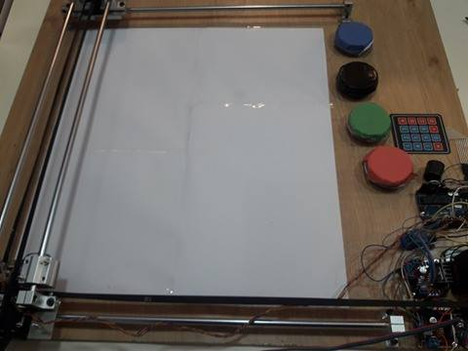
Color Sorting Machine
Duha Jitan Fayhaa Odeh

Slide 2
Outline:
What is Color Sorting Machine.
Tools used in our project
Main parts of the project
How Color Sorting work?
Demo

Slide 3
Definition
  Color Sorting:
  is a CNC machine that used to Classification and distinction of colors, this relies on a specific algorithm to define and move an object.

Slide 4

Tools used in Color sorting
Languages
      Arduino
Tools
      Arduino C

Slide 5
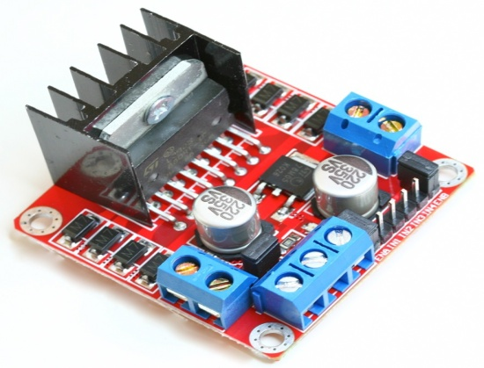

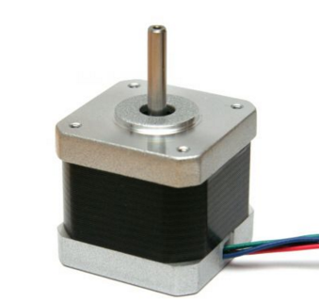
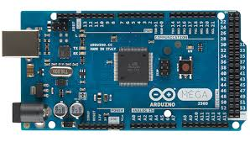
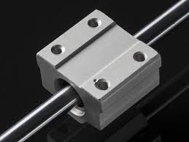
The Hardware Parts

Slide 6
The Demo

Slide 7


