Slide 1

Graduation Project 2-68591/1
A comparative study between traditionally designed Residential Buildings (Al-Jenan Housing-Jenin) and a green building model
Prepared by:
Heba Amad
Mohammad Daraghma
Osaid Masri
Zaid Marmash
Under the supervision of: Dr. Mutasem Babaa

Slide 2
Outline
Introduction.
Site analysis.
Architectural design.
Structural design.
Environmental design.
Electro mechanical design.
Comparing between traditional buildings and green buildings.
Al-Maqdisi Project.
Quantity survey & cost.

Slide 3
Introduction
What is the idea of the project ?
What is the main objectives of the project ?

Slide 4
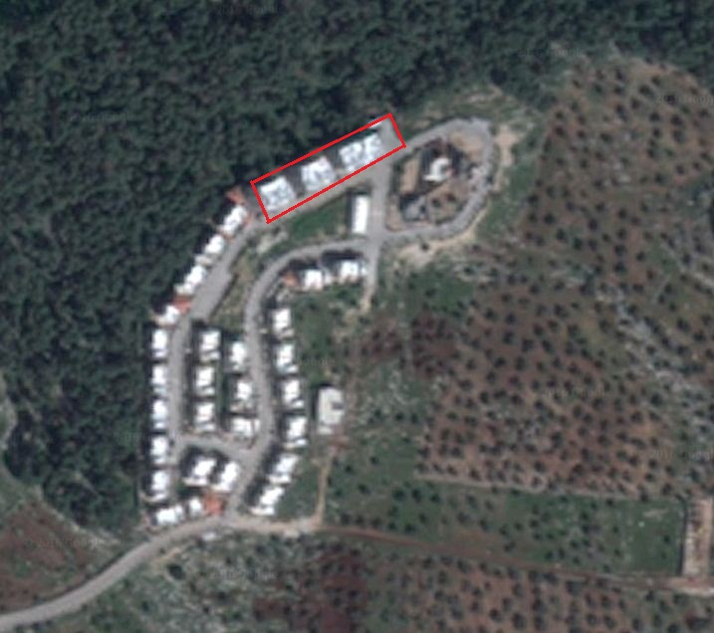
Site analysis
Al-Jenan Housing is located at Jenin, Palestine.

Slide 5
Topography & Area
The land has a slight slope (6% slope), the lowest point elevation is 65.5m and the highest point is 71.5m. The piece of land selected for the buildings has a total area of 1456 m²

Slide 6
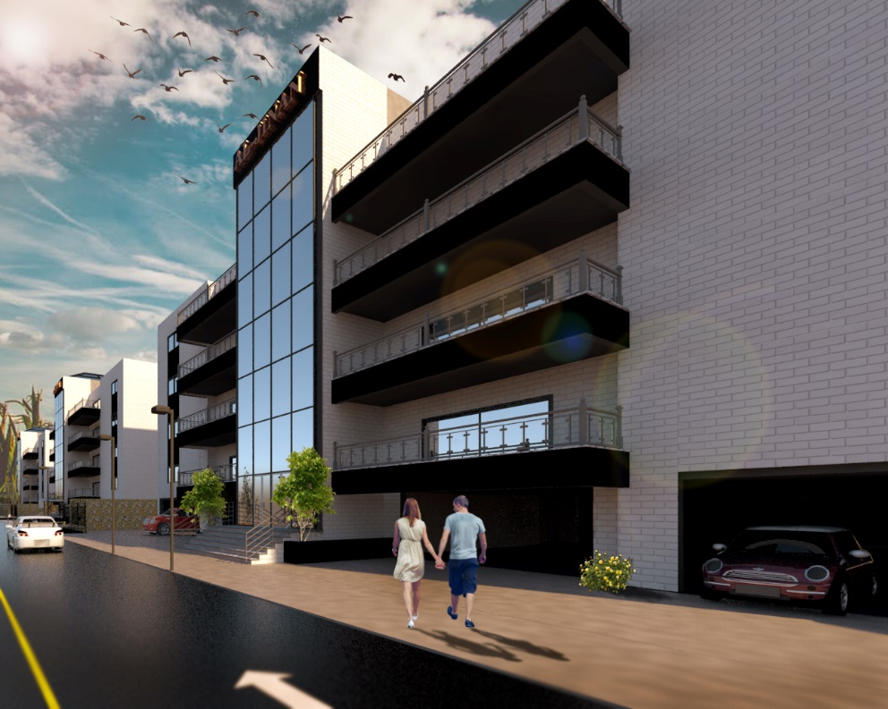
Architectural design

Slide 7
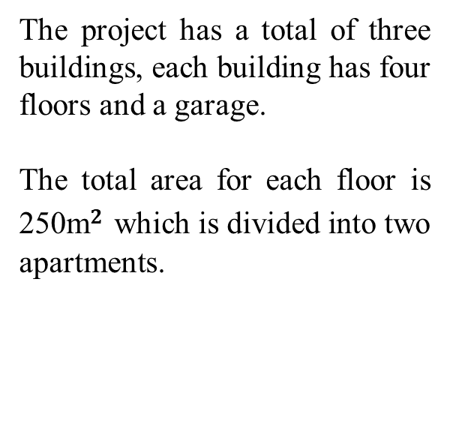
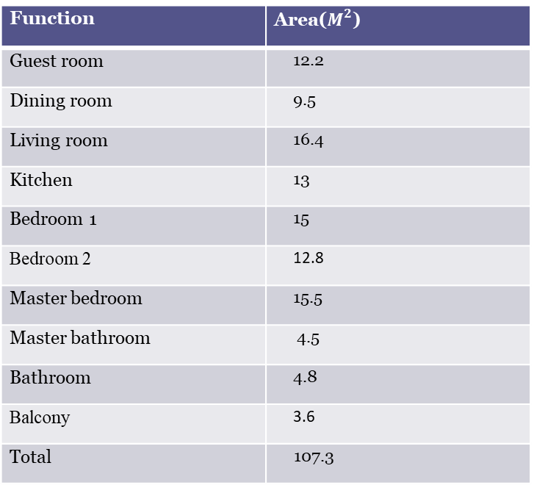
Project program
The project has a total of three buildings, each building has four floors and a garage.
The total area for each floor is 250m$2$ which is divided into two apartments.
Function | Area($M^{2}$)
Guest room | 12.2
Dining room | 9.5
Living room | 16.4
Kitchen | 13
Bedroom 1 | 15
Bedroom 2 | 12.8
Master bedroom | 15.5
Master bathroom | 4.5
Bathroom | 4.8
Balcony | 3.6
Total | 107.3

Slide 8
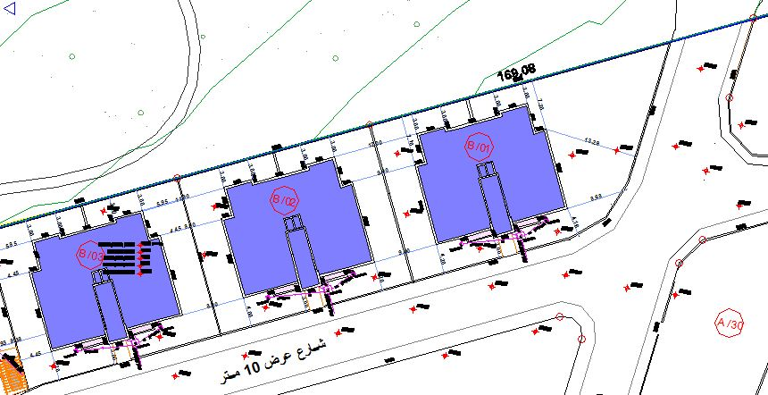
Architectural plans
Site plan
Traditional design

Slide 9
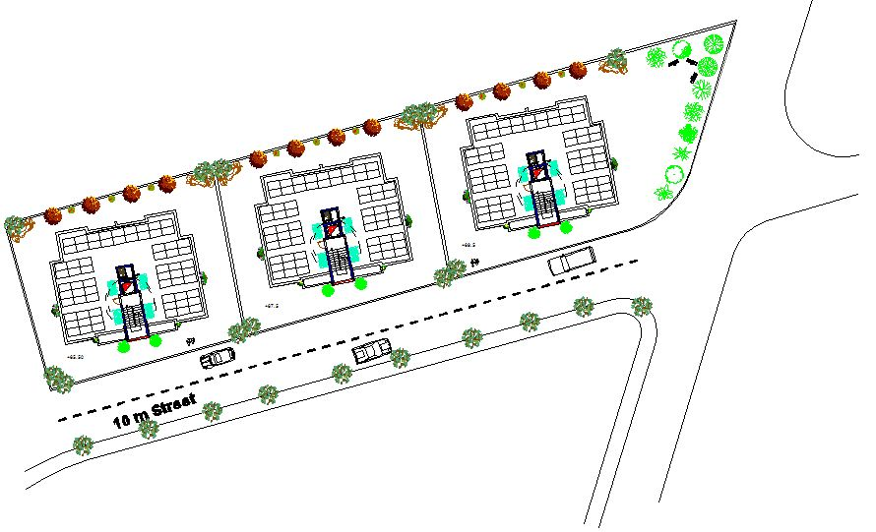
Architectural plans
Site plan
Green design

Slide 10
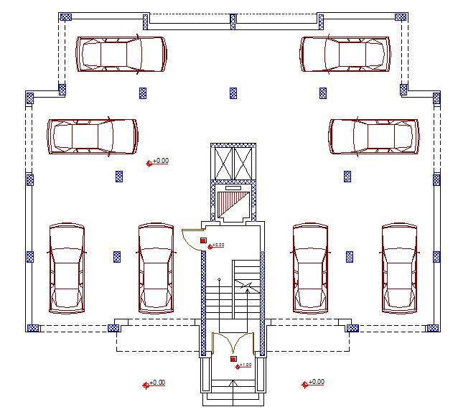
Architectural plans
Garage

Slide 11
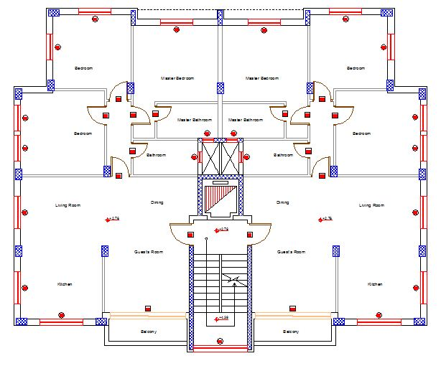
Architectural plans
Master plan

Slide 12
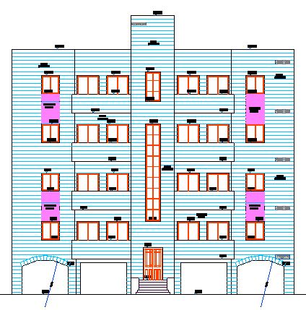
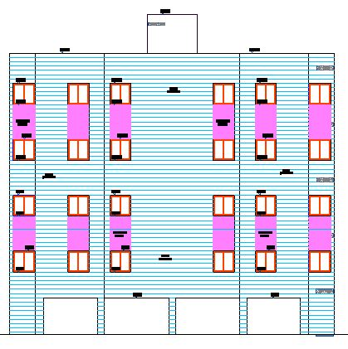
Architectural plans
Elevations
South elevation
North elevation

Slide 13
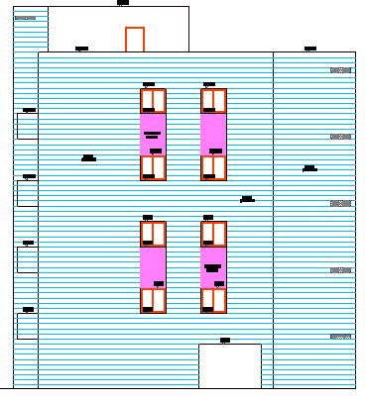
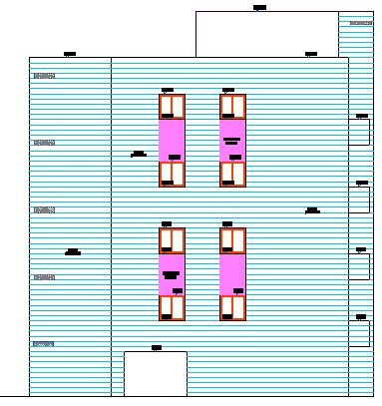
Architectural plans
Elevations
East elevation
West elevation

Slide 14
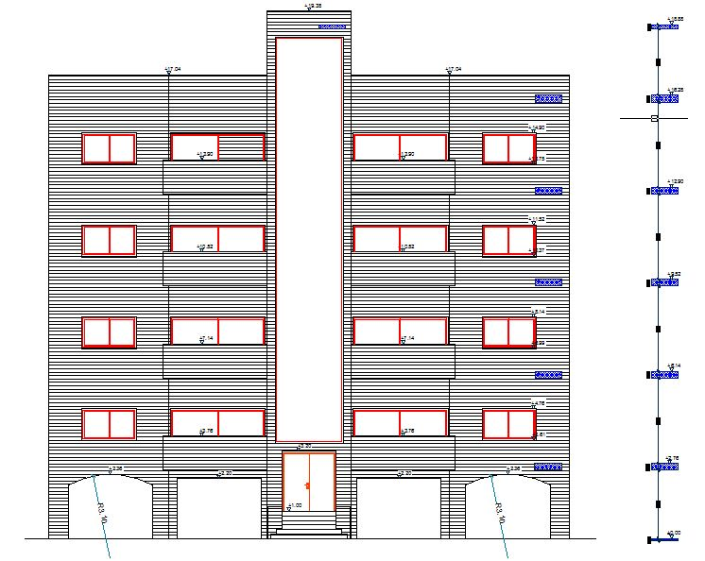
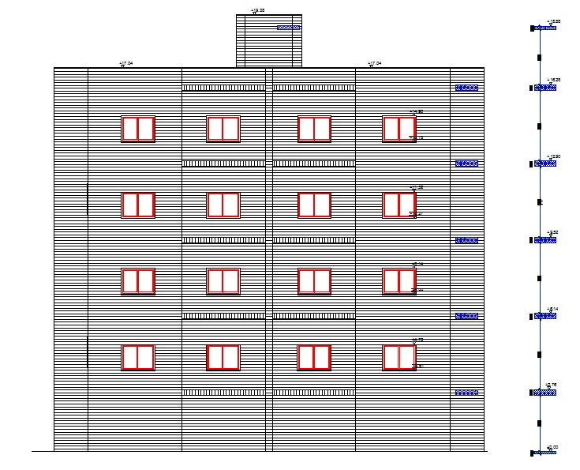
Architectural plans
Elevations
South elevation
North elevation

Slide 15
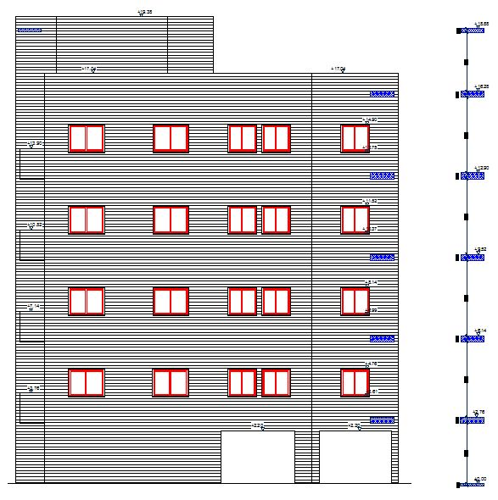
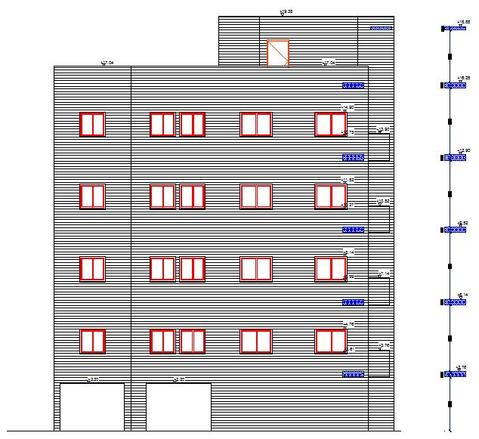
Architectural plans
Elevations
East elevation
West elevation

Slide 16
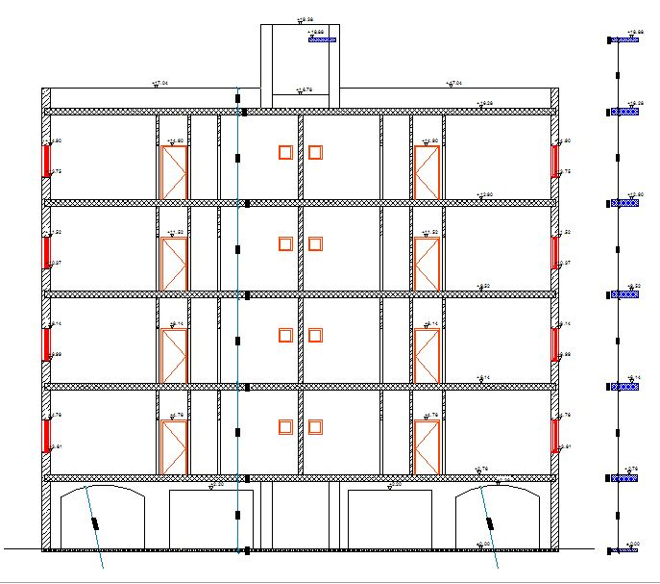
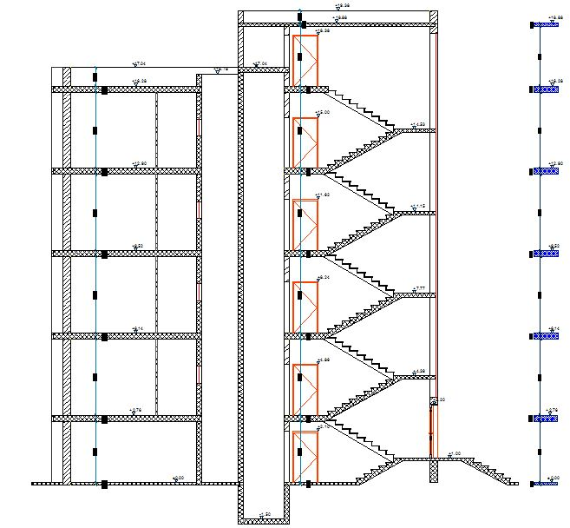
Architectural plans
Sections
Section A-A
Section B-B

Slide 17
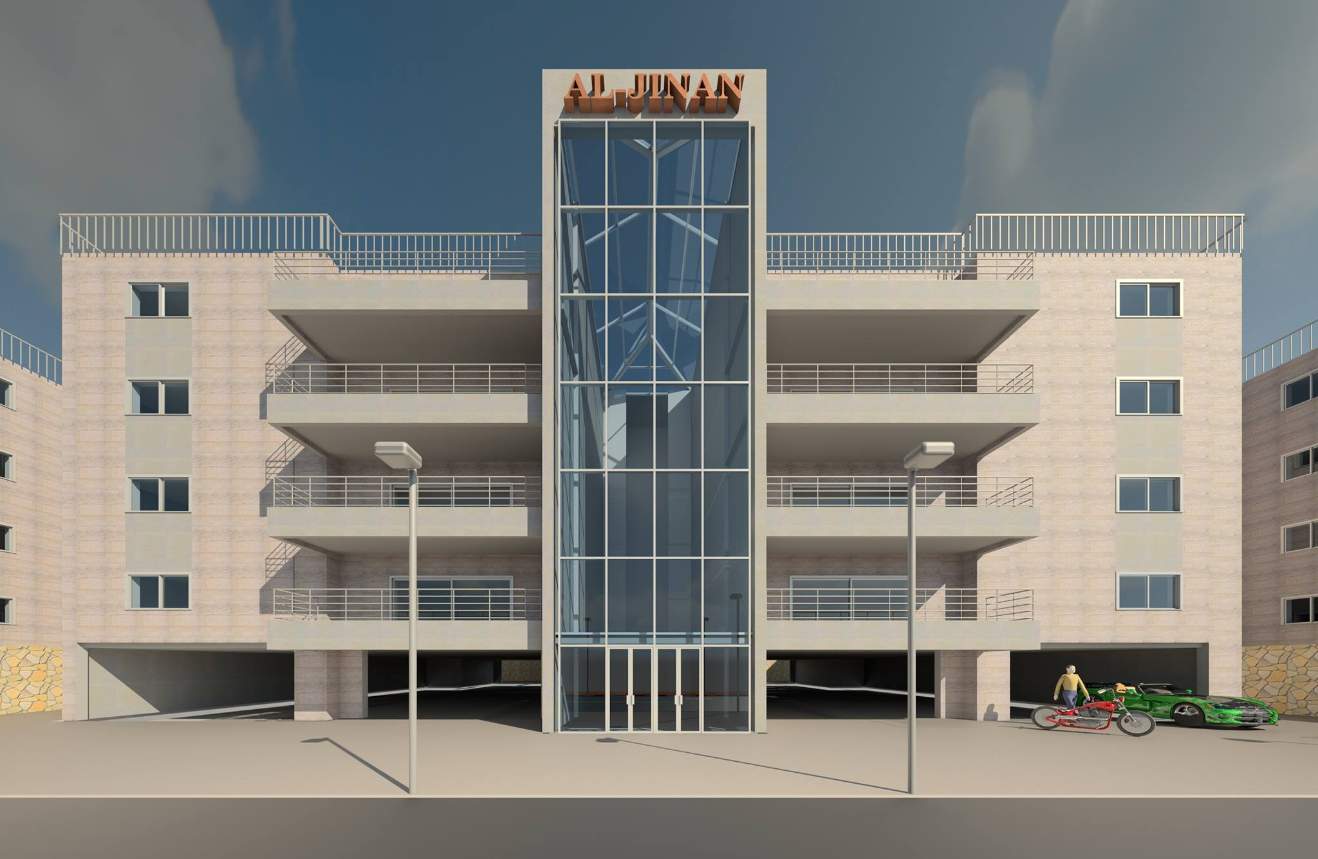
Architectural plans
3D model

Slide 18
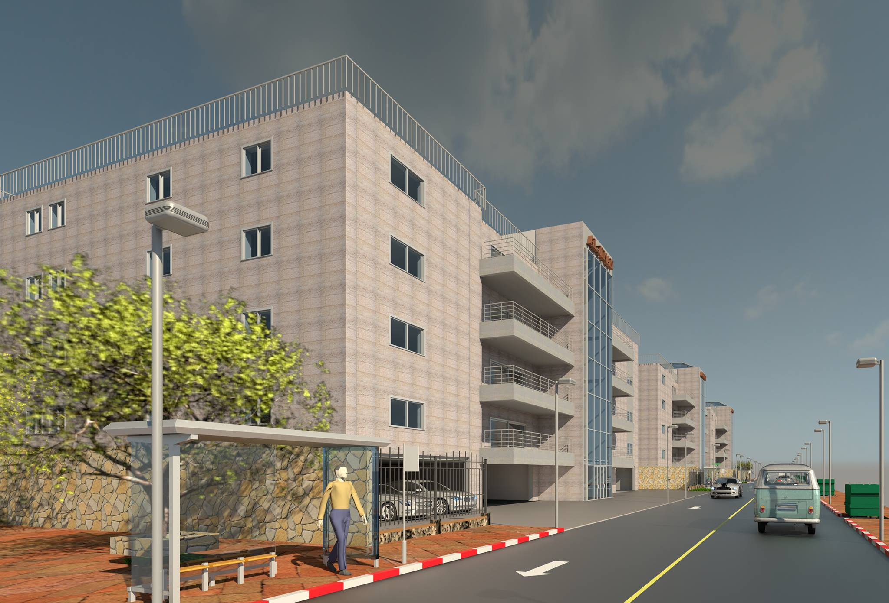
Architectural plans
3D model

Slide 19
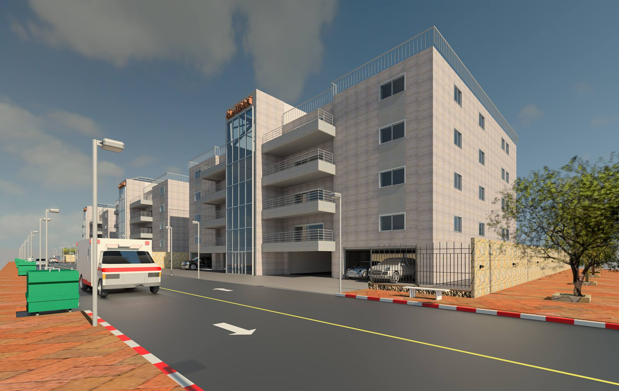
Architectural plans
3D model

Slide 20
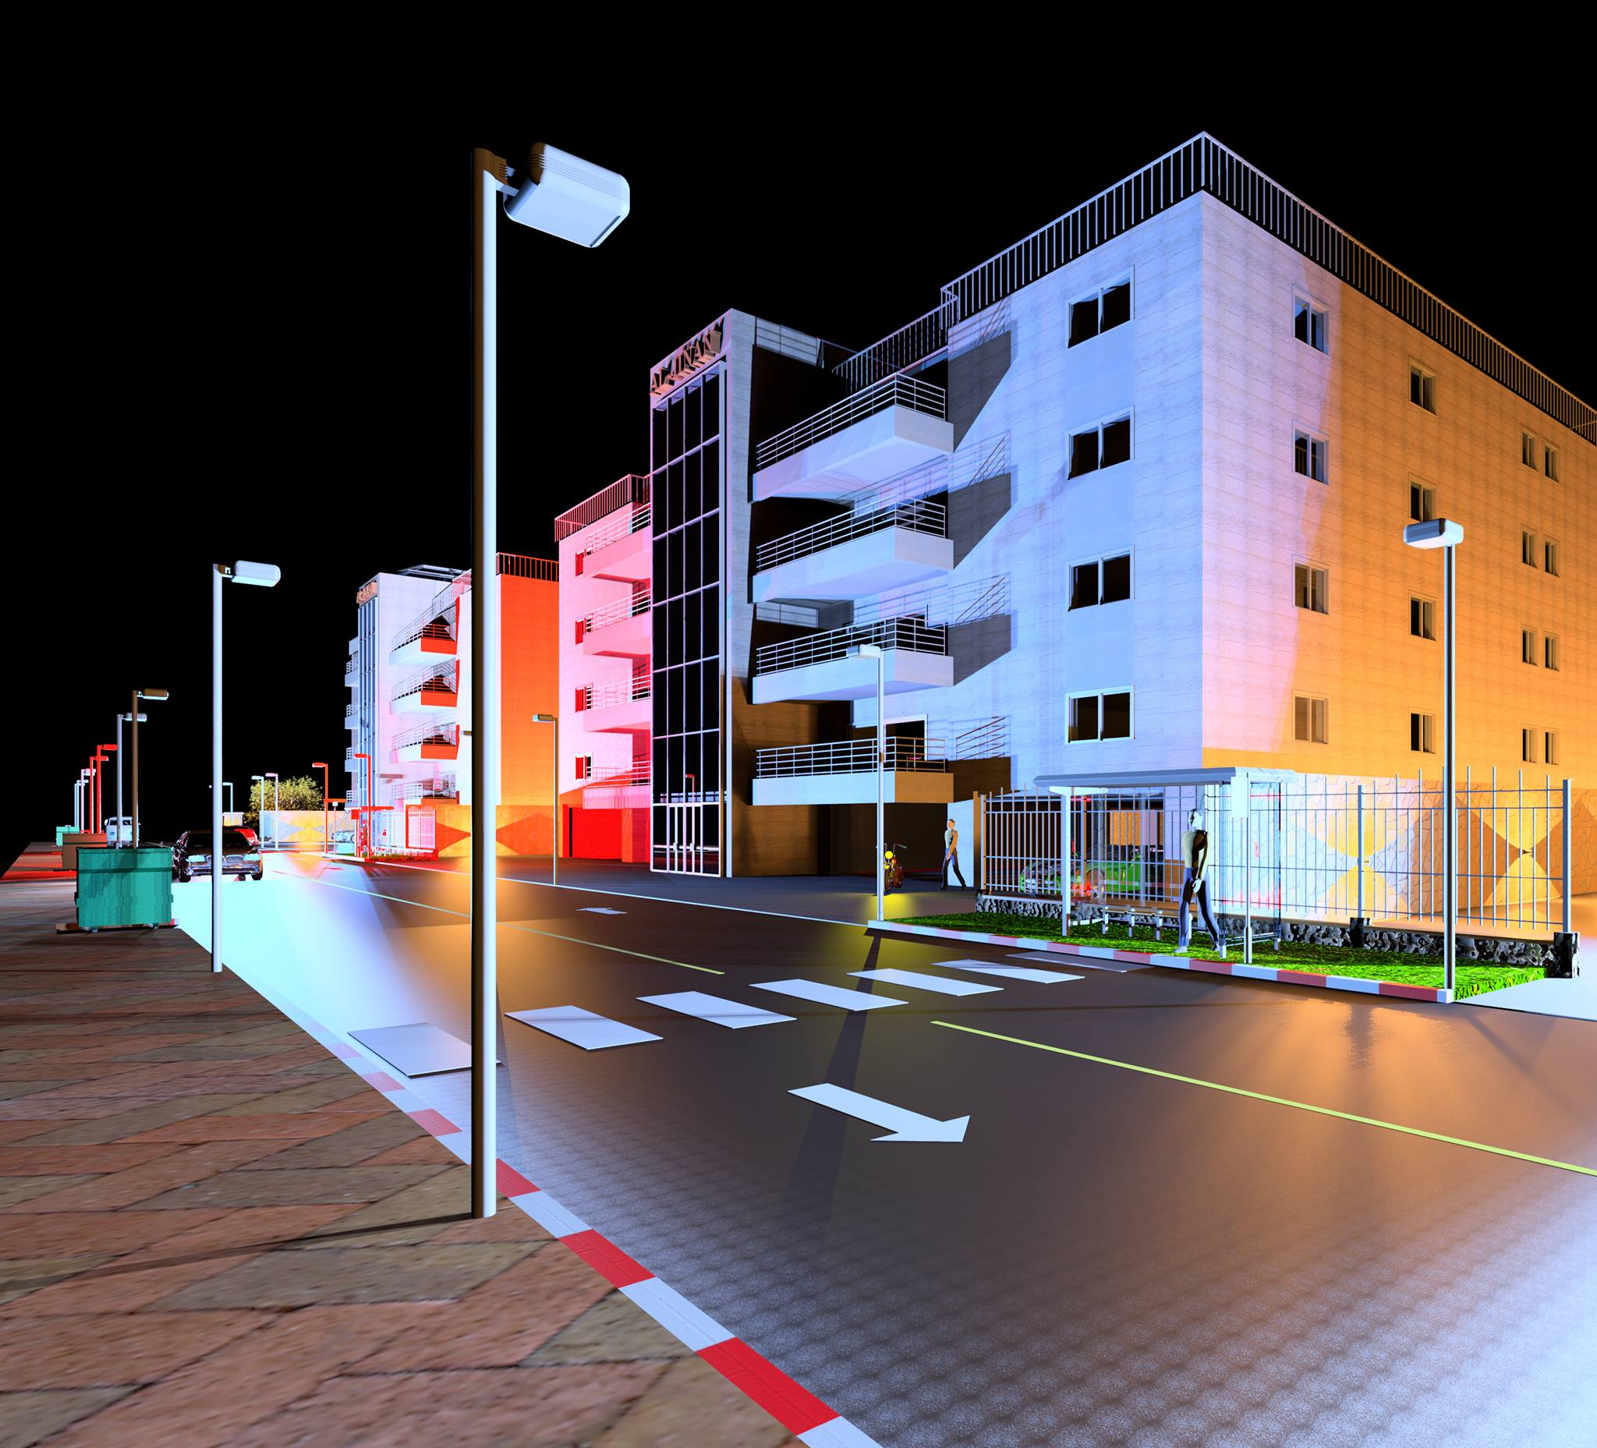
Architectural plans
3D model

Slide 21
Structural Design
Codes & Standards:
    ACI -318-11 for reinforced concrete structural design.
    UBC -97 for earthquake design.
    ASCE 7 2010 for load combinations.

Slide 22
Structural Design
Design data:
      Concrete strength for slabs and beams, f’c=24 mpa.
      Concrete strength for columns and shear walls ,f’c=28 mpa.
      Steel yield strength fy=420 mpa.
      Bearing capacity for soil =350 kN/m².
      Live load= 2.5 (kN/m²).
      Super imposed dead load=4 (kN/m²).

Slide 23
Structural Design
Lateral loads:
    The city of structure is Jenin.
    The seismic zone factor. Z=0.2.
    The soil profile is type Sc.
    The acceleration seismic coefficient Ca=0.24
    The velocity seismic coefficient Cv=0.32.
    The Seismic importance factor is 1.
    The structural design type is intermediate, R=5.5.

Slide 24
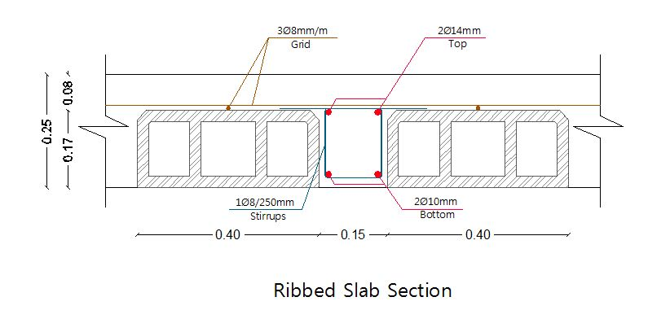
Structural Design
Slab
25cm ribbed slab

Slide 25
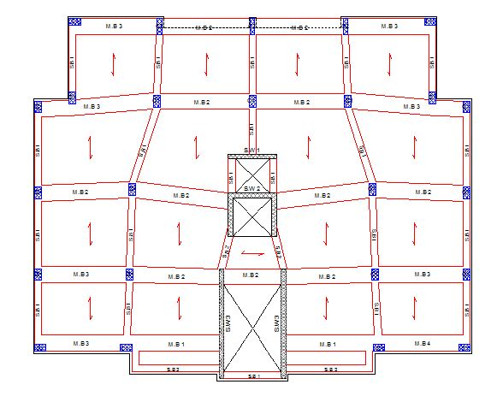
Structural Design
Beams layout

Slide 26
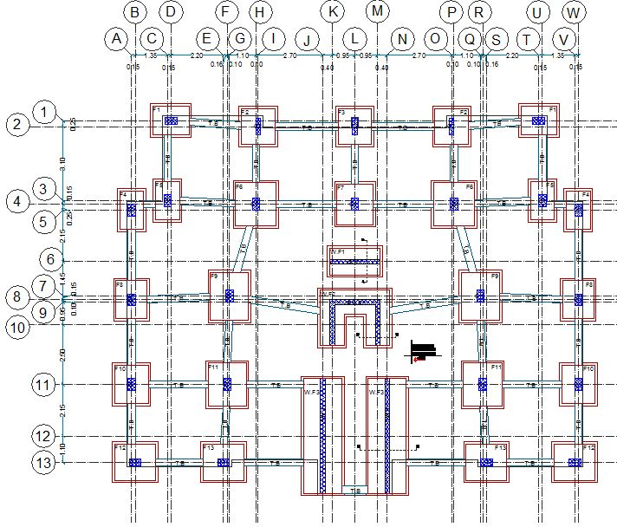
Structural Design
Columns and footing layout

Slide 27
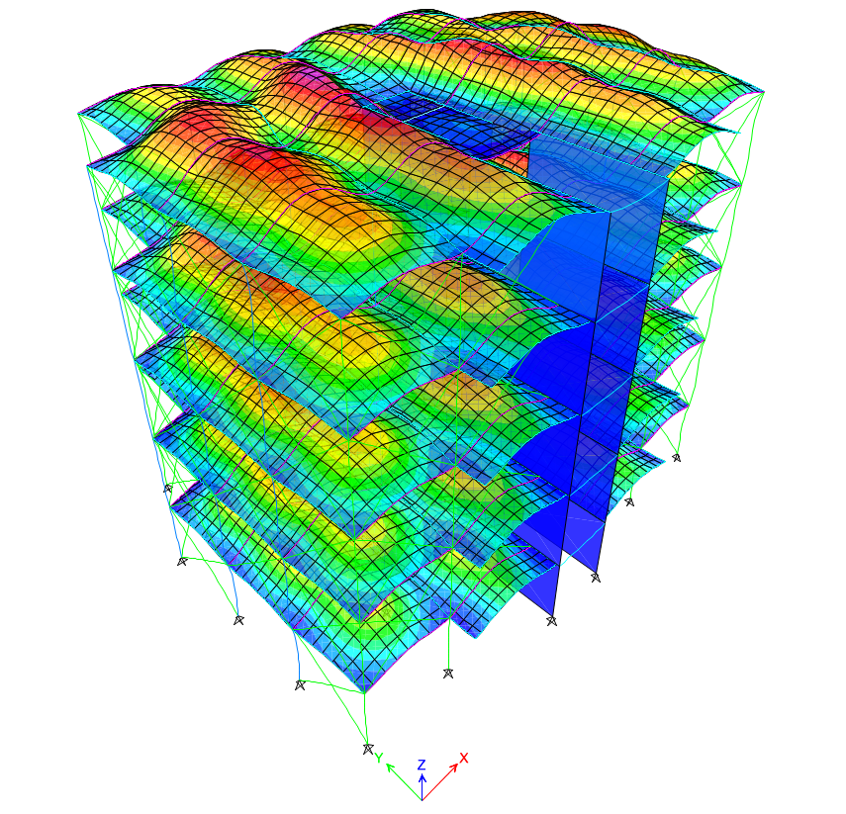
Structural Design
Model

Slide 28
Structural Design
Validity of ETABS model
There are three main checks that must be performed on the model before design, these are:
  Compatibility Check
  Equilibrium Check
  Internal forces check

Slide 29
Structural Design
Compatibility Check
The compatibility of the structure is checked by making sure all the elements of the structure move together.
The check was OK.

Slide 30
Structural Design
Equilibrium Check
The equilibrium check was performed by comparing the results of the base reactions from ETABS to the manual calculations.
 | ETABs results | Manual calculations | % error
Dead | 9322.07 | 9799.39 | 4.8%
Wall | 8242.58 | 7900.72 | 4.3%
SID | 7734.88 | 7692.56 | 0.55%
Live | 3170.03 | 3152.69 | 0.55%

Slide 31
Structural Design
Internal forces check
The internal forces check is performed by comparing the results of manual and ETABS calculation for one column, beam and slab.
 | ETABs results | Manual calculations | % error
Column | 1351.66 | 1345.44 | 0.4%
Slab | 19.28 | 20.73 | 6.9%
Beam | 108.47 | 104.8 | 3.3%

Slide 32
Structural Design
Slab reinforcement

Slide 33
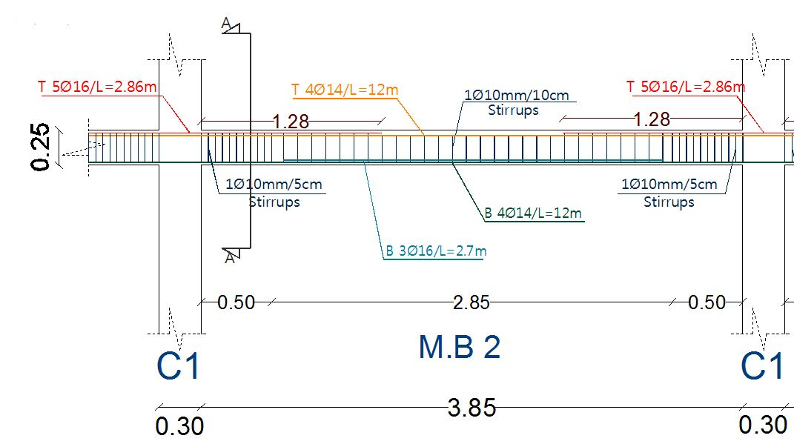
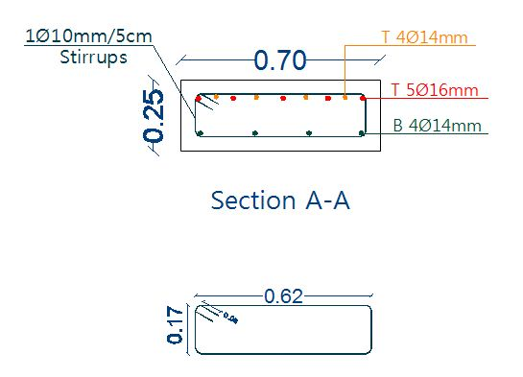
Structural Design
Beams reinforcement

Slide 34
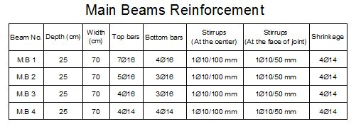
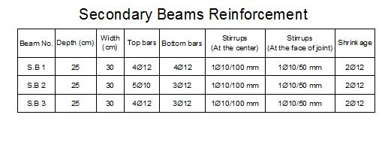
Structural Design
Beams reinforcement

Slide 35
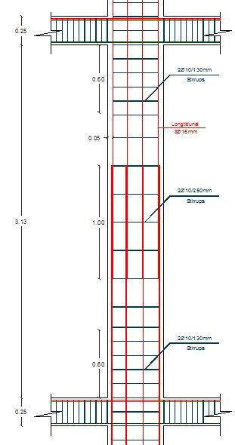
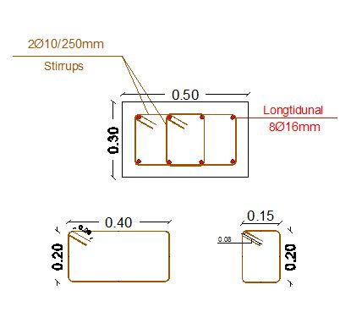
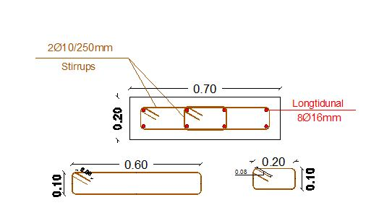
Structural Design
Columns reinforcement

Slide 36
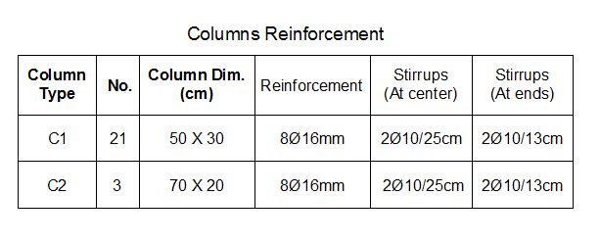
Structural Design
Columns reinforcement

Slide 37
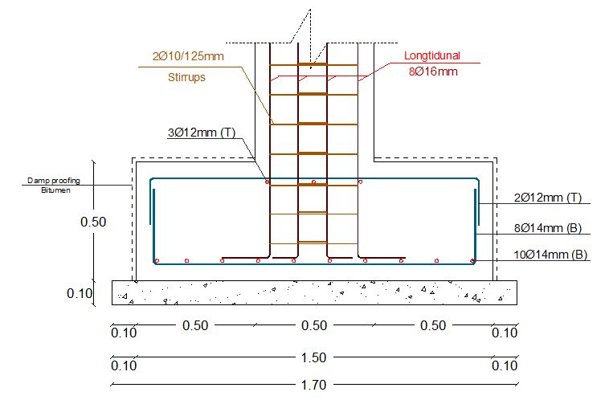
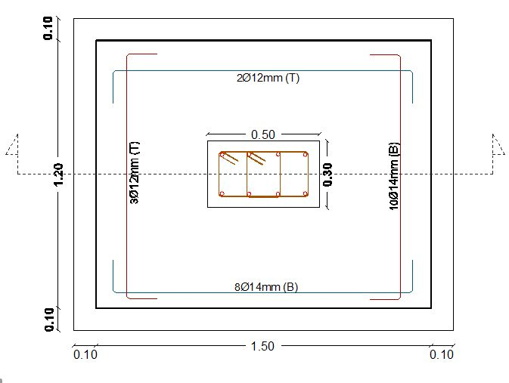
Structural Design
Footing reinforcement

Slide 38
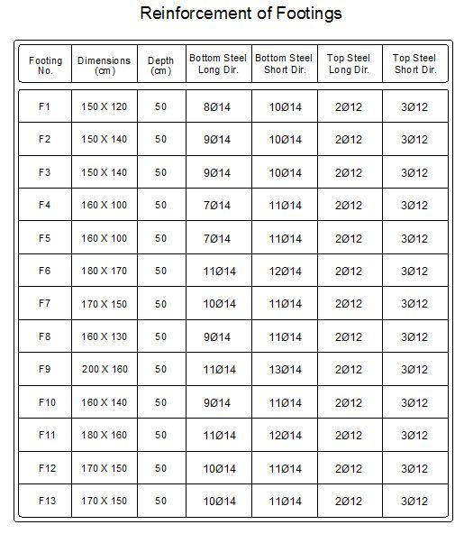
Structural Design
Footing reinforcement

Slide 39
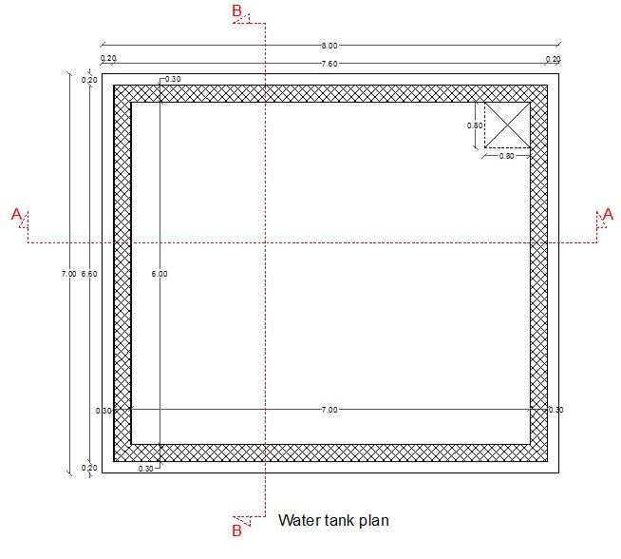
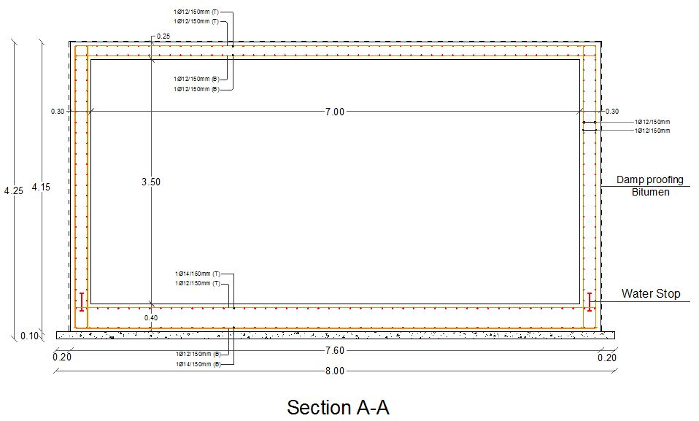
Structural Design
Water tank reinforcement

Slide 40
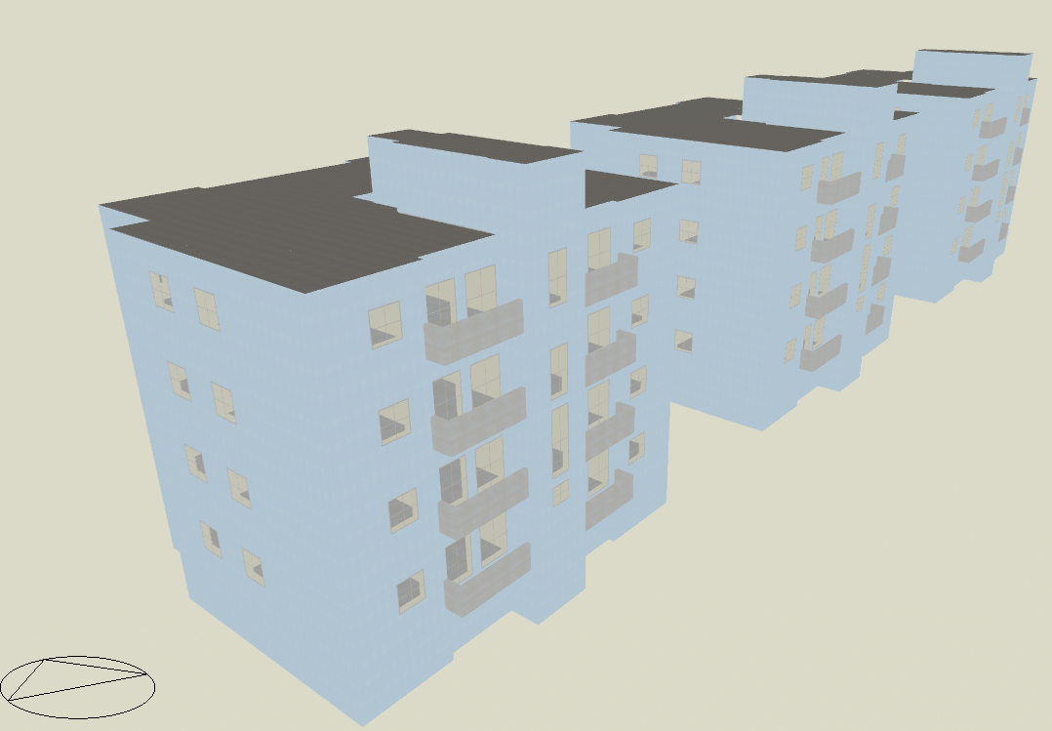
Environmental Design
3D model for the traditional design.

Slide 41
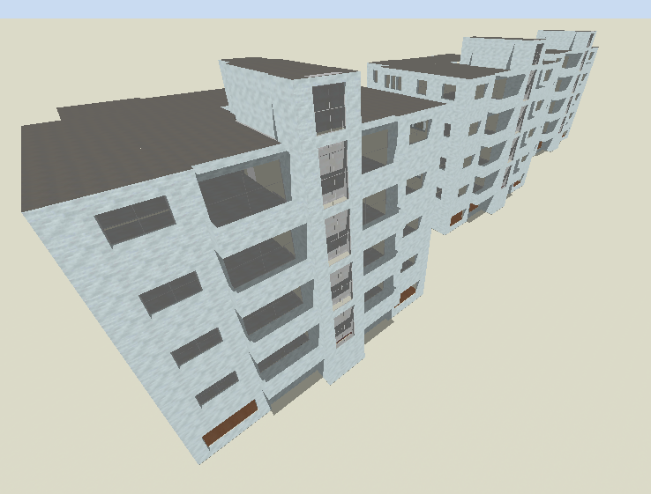
Environmental Design
3D model for the green design.

Slide 42
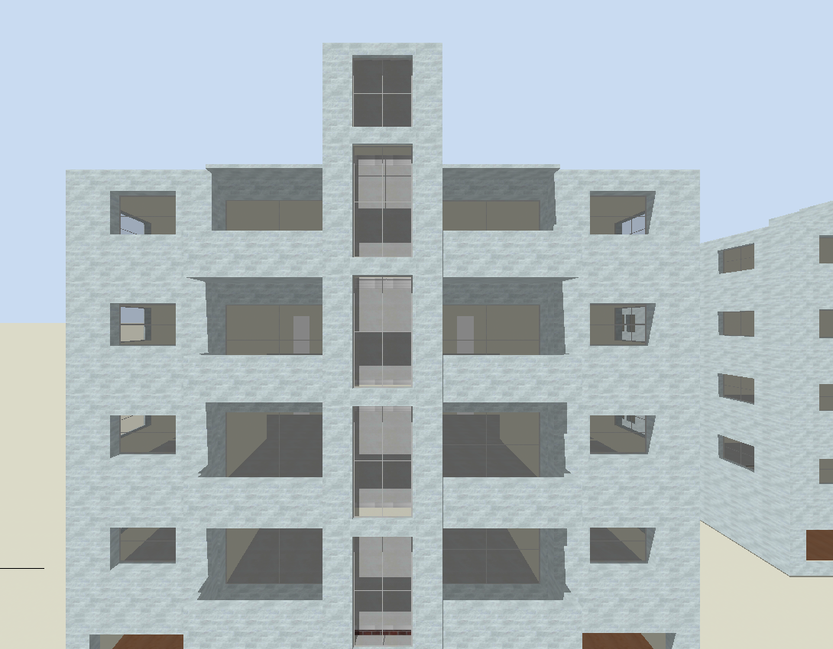
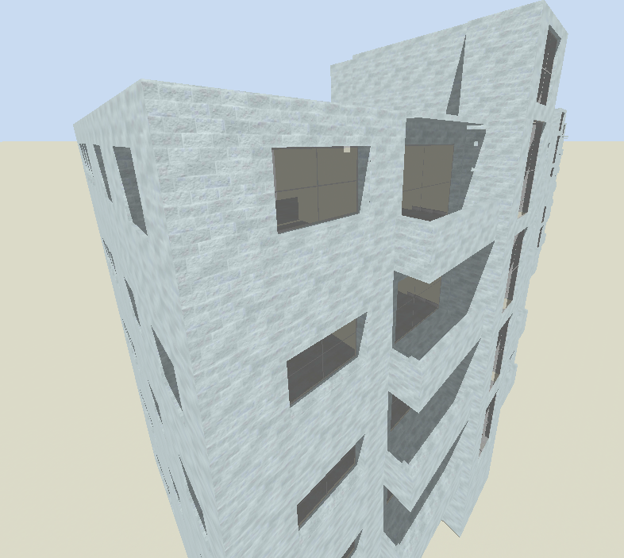
Environmental Design
Passive solar techniques

Slide 43
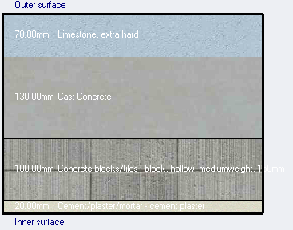
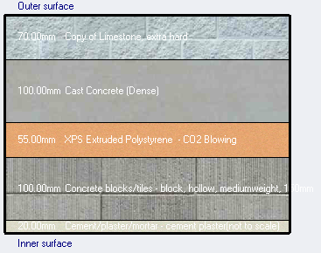
Environmental Design
Materials used in buildings
External wall
Traditional Green

Slide 44
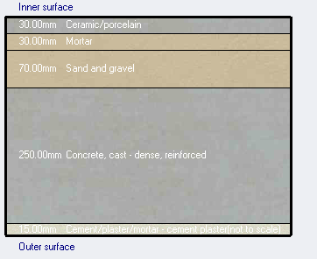
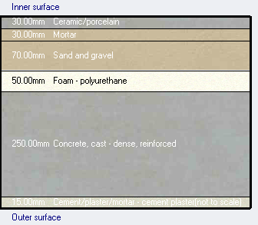
Environmental Design
Materials used in buildings
Internal slab
Traditional Green

Slide 45
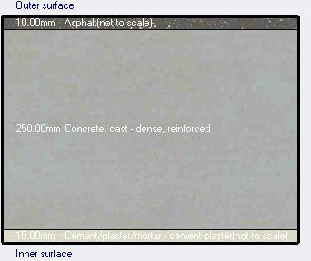
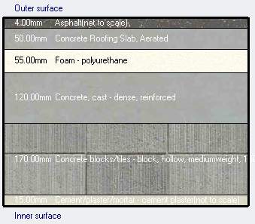
Environmental Design
Materials used in buildings
Flat roof
Traditional Green

Slide 46
Environmental Design
Glass type
Traditional
Single clear glass (6mm).
No thermal break.
Green
Double low emittance clear glass (6mm/13mm).
Aluminum frame with thermal break.

Slide 47
Environmental Design
Palestinian requirements |  | Green building |  | Traditional building
Element | Value | Value | Fit/Not | Value | Fit/Not
External walls | 0.5 w/m2.k | 0.481 | Fit | 1.982 | Not
External roof | 0.39 w/m2.k | 0.373 | Fit | 2.869 | Not
Internal floor | 0.46 w/m2.k | 0.426 | Fit | 1.811 | Not
Glass | 2.1 w/m2.k | 1.761 | Fit | 5.778 | Not

Slide 48
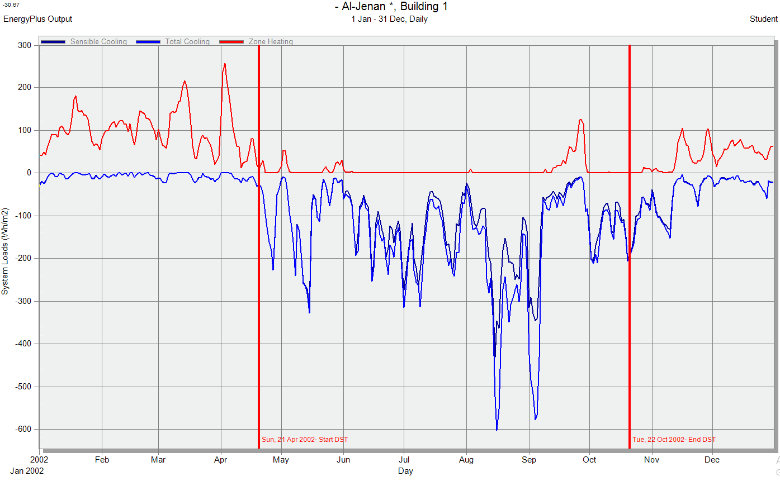
Environmental Design
System loads (Wh/m2)

Slide 49

Environmental Design
Thermal analysis
Electricity Intensity [kWh/m2] | District Cooling Intensity [kWh/m2] | District Heating Intensity [kWh/m2]
51.98 | 63.08 | 67.25

Slide 50

Environmental Design
Thermal analysis
Electricity Intensity [kWh/m2] | District Cooling Intensity [kWh/m2] | District Heating Intensity [kWh/m2]
37.41 | 32.79 | 21.22

Slide 51


Environmental Design

Slide 52

Al-Maqdisi Project
Al-Rashid building
Is a five story traditional Palestinian residential building.
Located at Nablus city.

Slide 53
Al-Maqdisi Project
Winter case
Autumn case

Slide 54
Al-Maqdisi Project

Slide 55
Al-Maqdisi Project

Slide 56

Environmental Design
Daylight factor

Slide 57
Environmental Design
Daylight factor
Appartment | Zone | Average daylight factor (%)
Appartment 1 | Master bedroom | 1.736
 | Bedroom1 | 3.192
 | Bedroom2 | 1.835
 | Living room | 2.936
 | Kitchen | 4.306
Appartment2 | Master bedroom | 1.648
 | Bedroom1 | 3.194
 | Bedroom2 | 1.895
 | Living room | 2.760
 | Kitchen | 4.252
Total | 2.758

Slide 58

Electro-Mechanical Design
Drainage system
Storm water.
Grey water.
Black water.

Slide 59

Electro-Mechanical Design
Water distribution system
Cold water.
Hot water.
Grey water
(flush tanks).

Slide 60
Electro-Mechanical Design
Water distribution system
 | Vertical | Horizontal | Meters | Branches
Diameter of pipes | 2 in | 1 in | 1 in | ½ in Critical ¾ in
We used for the last two floors auxiliary pumps 12,6 psi respectively.

Slide 61

Electro-Mechanical Design
Water distribution system
Water tank.
Domestic hot water tank.
Grey water tank.

Slide 62

Electro-Mechanical Design
Under floor system
Main heating system.
Evacuated tubes.
Boiler.

Slide 63

Electro-Mechanical Design
VRF system

Slide 64
Electro-Mechanical Design
VRF system
Zone | Max Design Capacity (Kw) | Ton Refrigerator Capacity (RT) | Capacity of indoor unit (RT)
Bedroom1 | 0.93 | 0.264441 | 0.5
Bedroom2 | 0.95 | 0.2701279 | 0.5
Master bedroom | 0.8 | 0.227476 | 0.5
Guest & living room | 1.5 | 0.426518 | 0.5
Dining room | 1.5 | 0.426518 | 0.5

Slide 65
Electro-Mechanical Design
Sound Transmission Class.
 | Internal walls | External walls
Layers | 20 mm plaster board on lath | Stones 70 mm.
 | Hollow concrete block (thickness 140 mm) | Concrete 130 mm.
 |  | XPS Polystyrene 55 mm.
 | 20 mm plaster board on lath | Block 100 mm.
 |  | 20 mm plaster board.
STC value | 50 dB | 57 dB

Slide 66

Electro-Mechanical Design
Photovoltaic system

Slide 67

Electro-Mechanical Design
Photovoltaic system
19140 Wp can be produced per year.

Slide 68

Electro-Mechanical Design
Artificial lighting
Type of room | Level of illuminance (lux)
Bedroom | 300 - 400 (Task)
Bathroom | 100 - 200
Dining room | 100 - 200
Guest room | 200 - 300
Living room | 200 - 300
Kitchen | 400 - 500
Corridor | 100 - 150
Balcony | 100 - 150
Stairs | 100 - 150

Slide 69


Electro-Mechanical Design
Artificial lighting

Slide 70


Electro-Mechanical Design
Artificial lighting

Slide 71


Electro-Mechanical Design
Artificial lighting

Slide 72

Electro-Mechanical Design
Sockets

Slide 73
Electro-Mechanical Design
Sockets
Space | Single outlet (normal) | Special load
Kitchen | 4 | ---
Dining room | 2 | ---
Living room | 2 | 1
Guest room | 2 | 1
Master bedroom | 3 | 1
Master bathroom | 1 | ---
Bedroom | 3 | 1
Bathroom | 1 | 1
Bedroom | 3 | 1
Balcony | 1 | ---
Floor | No. of socket (2 A) | No. of socket (10 A) | No. of branches (3Ø2.5mm)
1st floor | 44 | 12 | 26
2nd floor | 44 | 12 | 26
3rd floor | 44 | 12 | 26
4th floor | 44 | 12 | 26

Slide 74

Electro-Mechanical Design
Branches

Slide 75

Quantity Survey and Cost
 | Total cost ($) | Unit cost ($/$m^{2}$)
Excavation works | 10251 | 8.2
Civil works | 203071.68 | 162.5
Architectural works | 330718.71 | 264.6
Mechanical works | 107030 | 85.7
Electrical works | 63426 | 50.8
Total | 714497.39 $ | 571.8 $

Slide 76


