Slide 1

Civil Engineering Department
An-Najah National University
Soil Improvement by Used burned Car Oil
Graduation Project
Prepared By:
Ameer Adarbeh
Feras Khalid
Husein Shraim
Supervised By: Dr. Isam Jardaneh

Slide 2
Content
Introduction to the soil improvement
Review different soil improvement techniques
Review of several researched regarding soil improvement using oil
Laboratory Tests
Conclusions
Notes:
Definition of soil improvement.
soil improvement technique(s) to improve the properties and parameters of different local soil type that will have problems when building foundations or other ground structures.
Purpose of soil improvement:
1-Reduce the settlement of structures .
2-Improve the shear strength of soil and thus increase the bearing capacity of shallow foundations .
3-Increase the factor of safety against possible slope failure of embankment and earth dams .
4-Reduce the shrinkage and swelling of soils .

Slide 3
Introduction
Soil improvement in its broadest sense is the alteration of any property of a soil to improve its engineering performance.
This may be either a temporary process or may be a permanent process.
The main aim of this project is to improve weak soil such as silty clay using used (burned) car oil.

Slide 4
Review different soil improvement techniques
There are many methods of soil improvements, such as : 1.Ground improvement
Soil Densification (Shallow Compaction , Deep compaction)
2.Ground reinforcement
In Situ Reinforcement (Ground Anchors , Soil Nailing , Micro piles , Rock Bolts)

Slide 5
Review different soil improvement techniques
3.Ground treatment
Admixture Soil Improvement (Surface mixing , In Situ Mixing and prepare a proper mix design in a series )
Notes:
Several laboratory tests were done on soil samples with its original state and with adding different percentages of Fly Ash. The tests done were Standard Proctor, Unconfined Compression, Liquid Limit and Plastic Limit.

Slide 6
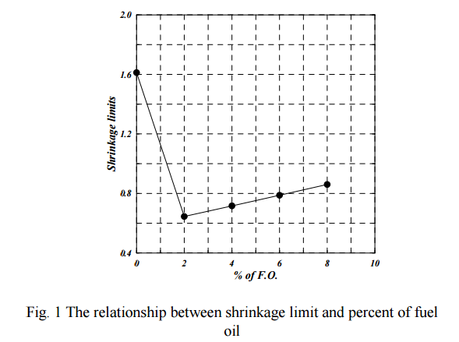
Soil improvement using oil
Case studies
Gypseous Soil Improvement using Fuel Oil
The model was sandy soil with Gypsum content of (51.6%)
-Shrinkage Limit

Slide 7
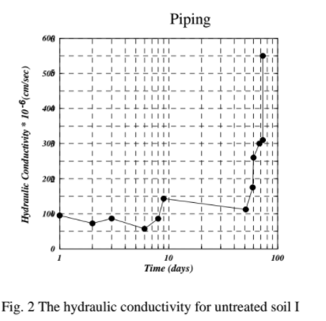
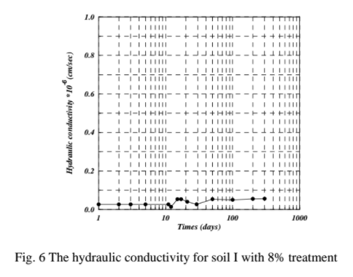
Soil improvement using oil
- Permeability
-The specimens treated with higher percents of F.O. were more durable than the specimen treated with 2% F.O., since they were stable for over 300 days and remain durable for all the period of this study.

Slide 8
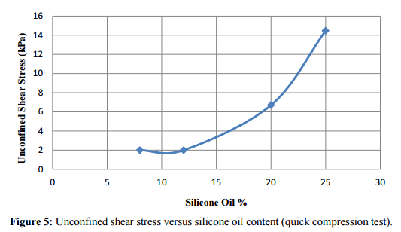
Soil improvement using oil
Gypseous Soil Improvement by Silicone Oil
This study was conducted on artificial gypseous soil (mixture of 30% sand & 70 % Pure Gypsum)treated with silicone oil in different percentages
- Unconfined Compression Test

Slide 9
Laboratory Tests
Several tests were carried out on the soil in its natural state. The same tests were carried out on the soil after adding the burned car oil at different rates (3%,5%,7% and 10%)
These Tests are:
Compaction Test (Proctor Test).
Atterberg Limit Test (Liquid Limit and Plastic Limit).
Unconfined Compression Test

Slide 10
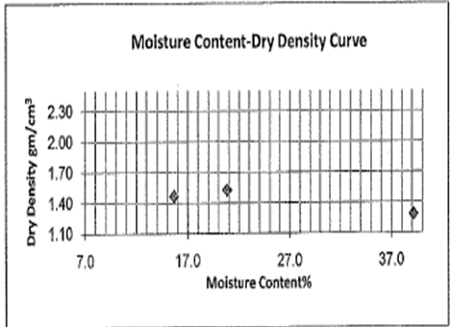

Laboratory Tests
The first step was to find out the maximum dry density and optimum moisture content of the natural soil.
This was done by Compaction (Proctor) Test

Slide 11
Laboratory Tests
The second step was to find out the Atterberg Limits (Liquid Limit and Plastic Limit) For natural soil and after adding the burned car oil at different rates
Note that in this case the total amount of liquid which water and oil should be equal the optimum moisture content

Slide 12
Laboratory Tests
Atterberg Limits test results
Trial No. | % of Burned Oil | Liquid Limit (LL) | Plastic Limit (PL) | Plasticity Index (PI)
1 | 0 | 49 | 27.5 | 21.5
2 | 3
3 | 5 | 52 | 30.6 | 21.4
4 | 7
5 | 10 | 49.5 | 28.1 | 21.1

Slide 13
Laboratory Tests
The final step was to find Unconfined Compressive Strength For natural soil and after adding the burned car oil at different rates

Slide 14
Laboratory Tests

Slide 15
Conclusions
Using specific amount of burned oil in silty clay soil of high plasticity can increase the shear strength of the soil .

Slide 16
Conclusions
but it has no influence on Atterber Limits

Slide 17


