Slide 1
بسم الله الرحمن الرحيم
((يَرْفَعِ اللَّهُ الَّذِينَ آمَنُوا مِنْكُمْ وَالَّذِينَ أُوتُوا الْعِلْمَ دَرَجَاتٍ ۚ وَاللَّهُ بِمَا تَعْمَلُونَ خَبِيرٌ))

Slide 2

AN-Najah National University.
Engineering College.
Civil Engineering Department
Graduation project II
Analysis and redesign of Tubas directories of education building

Slide 3
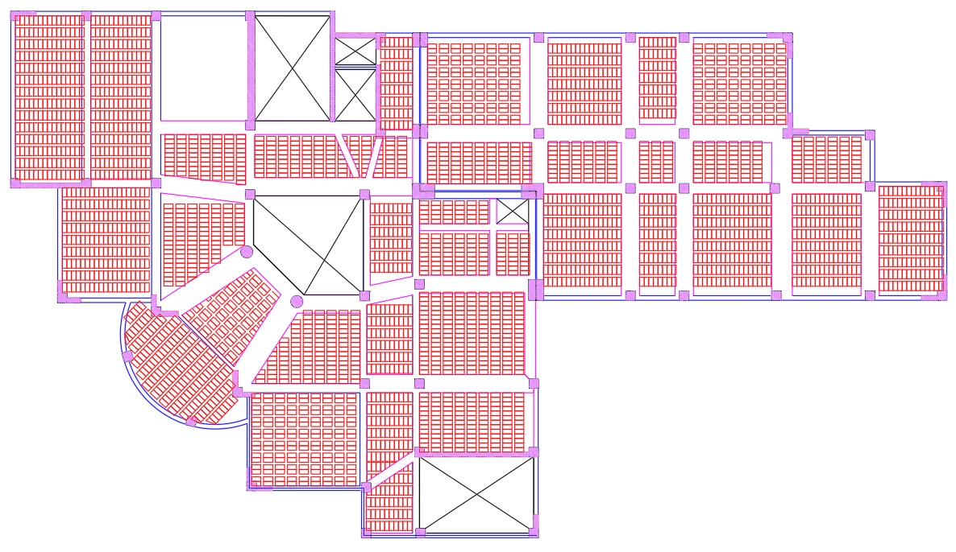
PRELIMINARY DESIGEN
Preliminary Design for slab

Slide 4
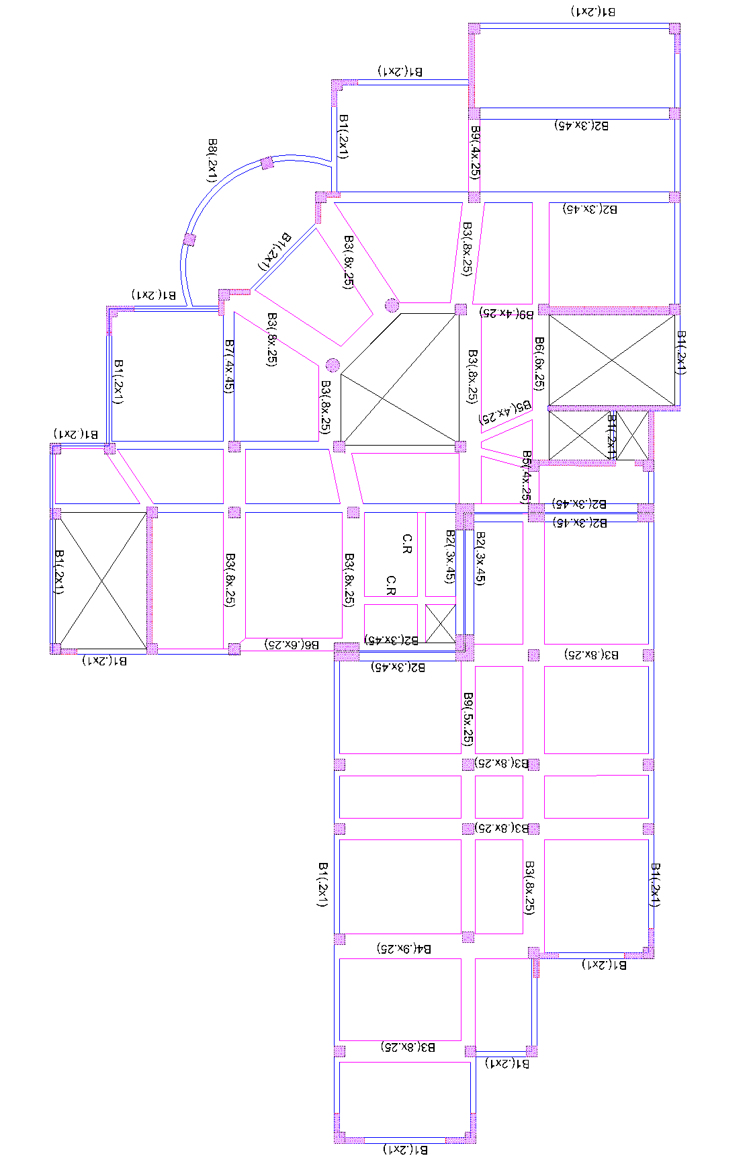
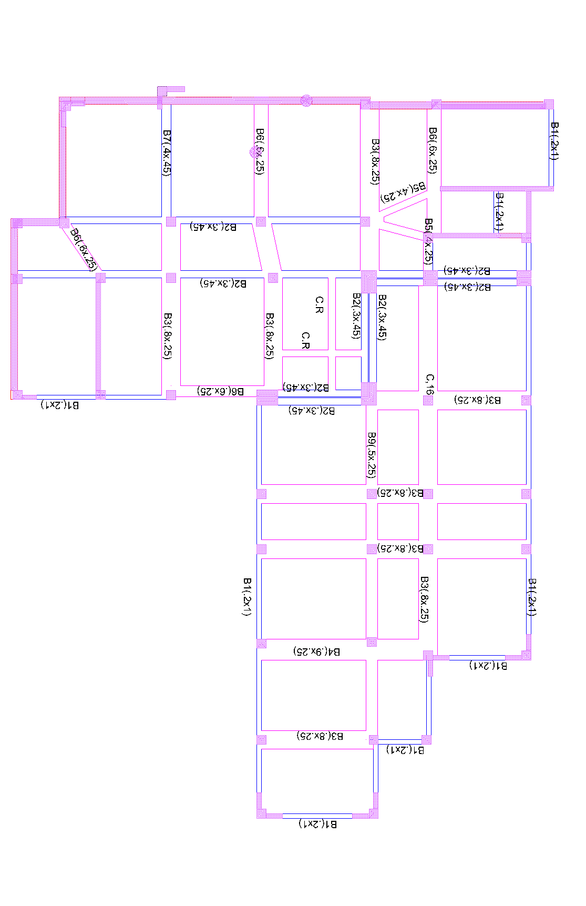
Preliminary Design for Beams

Slide 5
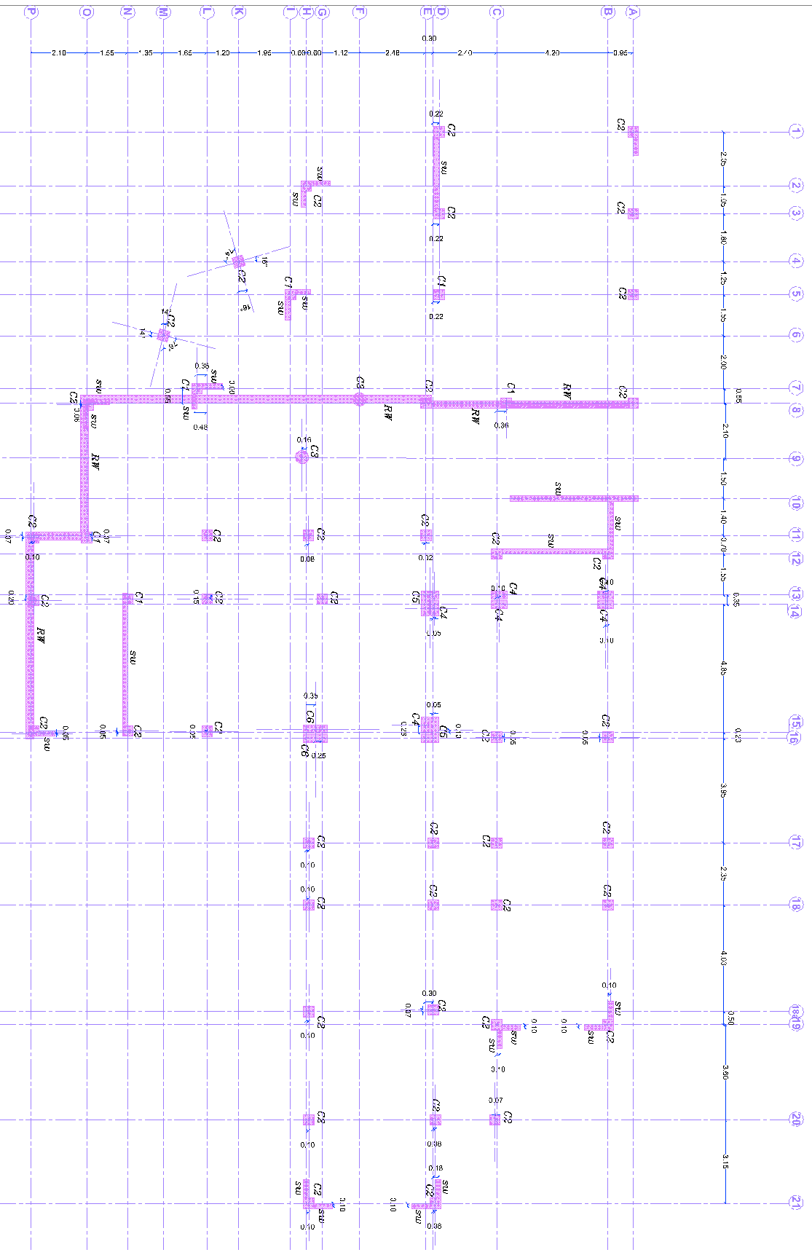
Preliminary Design for Columns:
Staute | Column capacity (KN) | Axial Force from the Gravity Loads Only (kN), on max tributary area | Dimension(mm) | Column name
ok | 2300 | 1756.4 | 40 x 40 | C1
ok | 2300 | 1555 | 40x 40 | C2
ok | 4080 | 1423.5 | D= 50 | C3
ok | 2590 | 1256.4 | 60 x 30 | C4
ok | 5630 | 2076 | 65x95L30 | C5
ok | 4114 | 2019.67 | 95 x 30 | C6

Slide 6
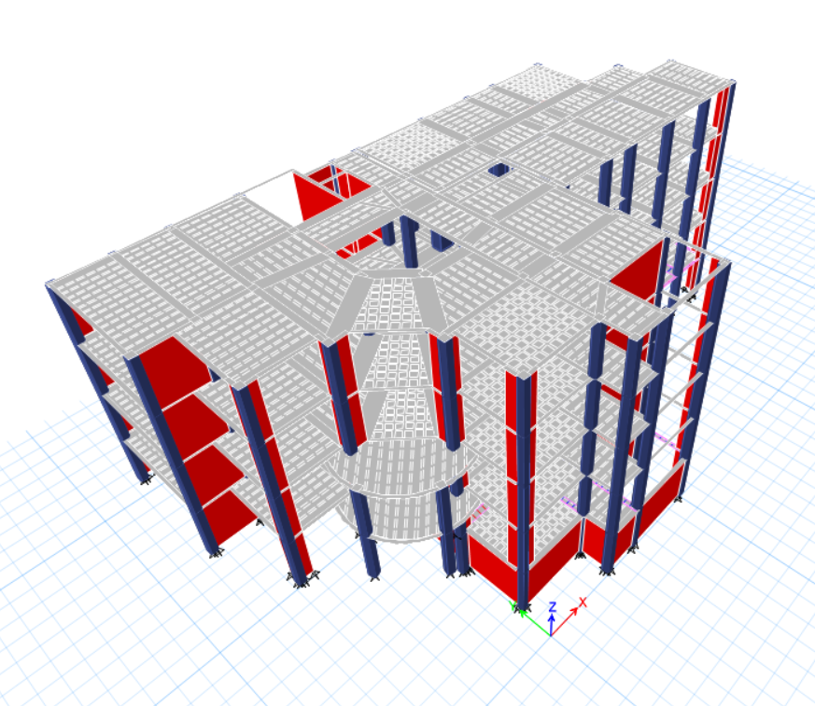
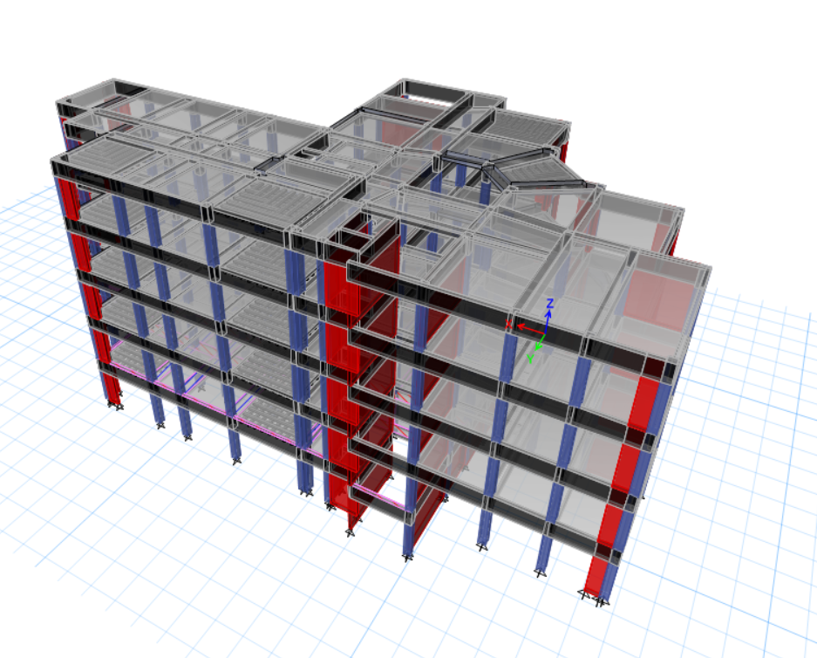
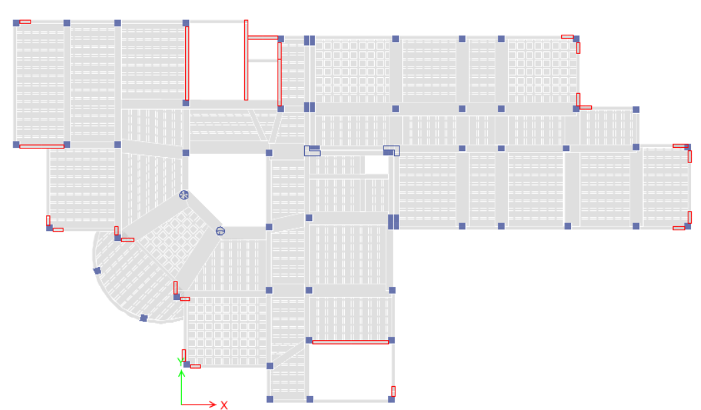
PROJECT MODLING

Slide 7
Material Definition:
Material Type | Structural Element
Concrete 28 Mpa | Slabs
Concrete 28 Mpa | Beams
Concrete 28 Mpa | Columns & Shear Walls
Concrete 28 Mpa | Stair
A615Gr60 (420 Mpa) | Reinforcement Bar
Concrete 28 Mpa | Footing

Slide 8
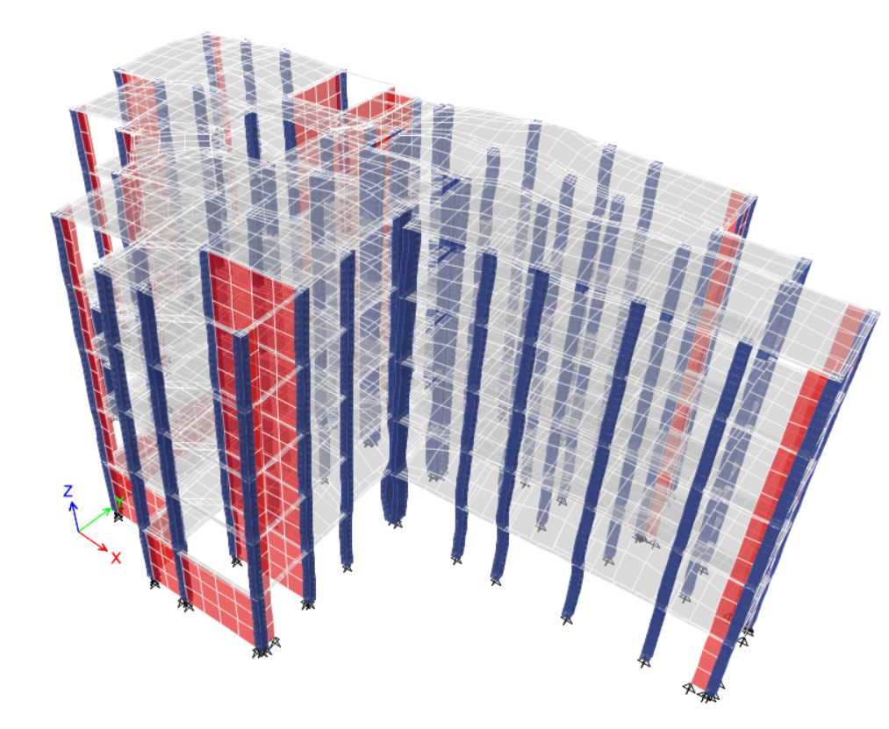
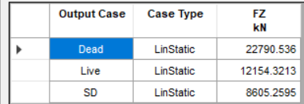
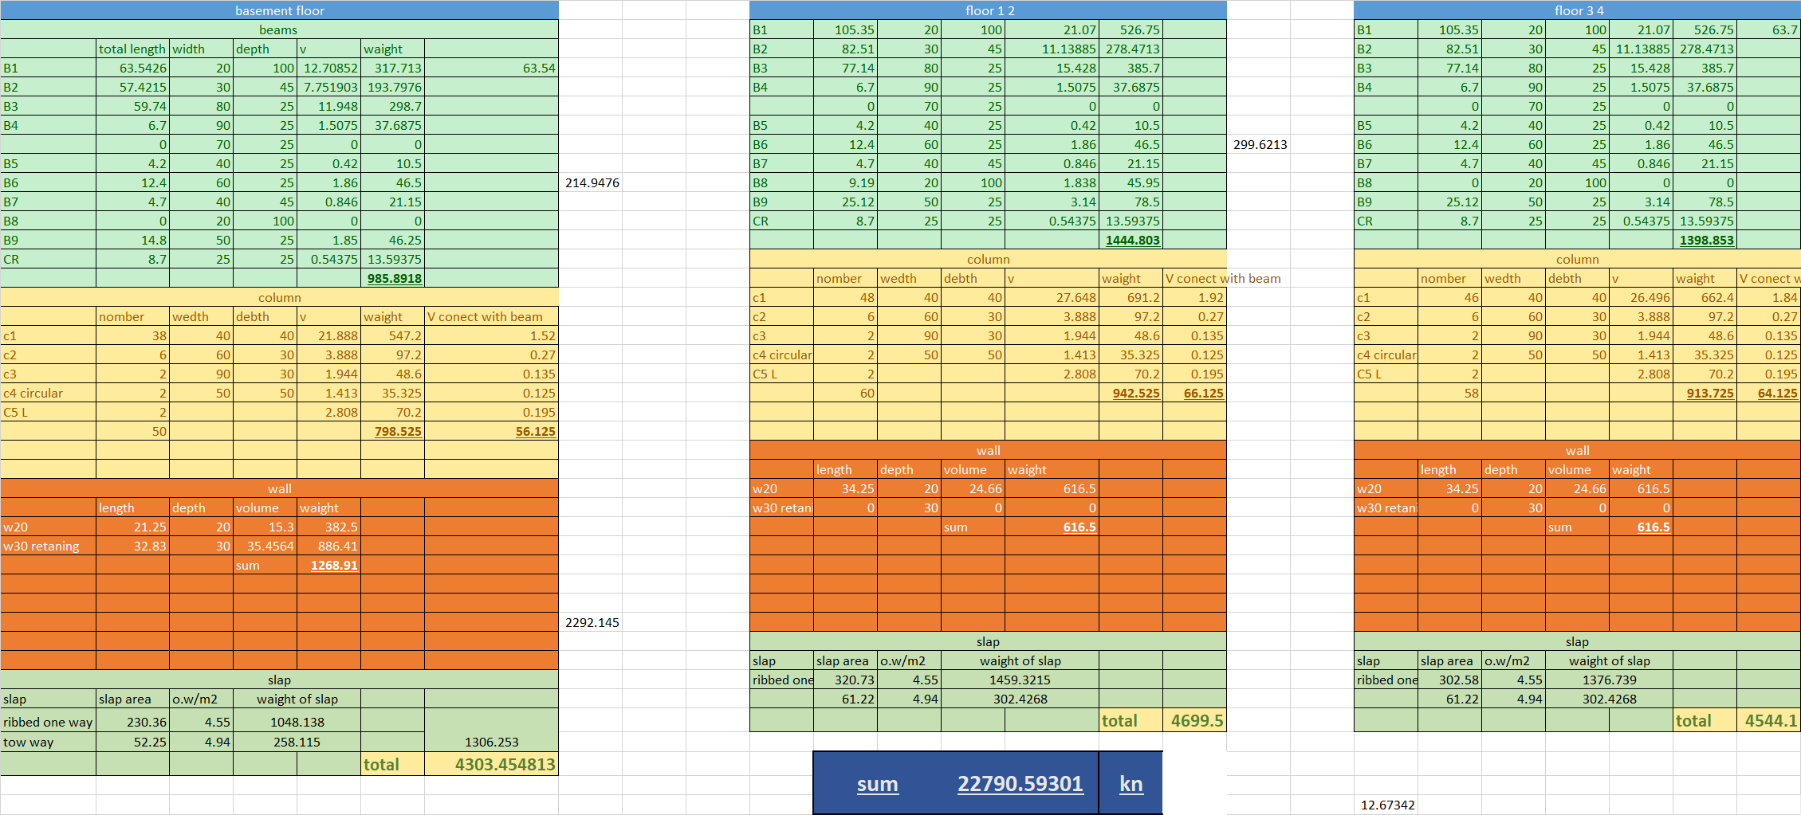
MODEL CHECKS
Compatibility Check:

Slide 9
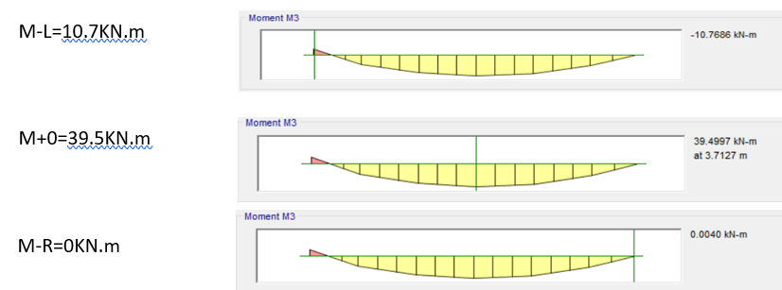
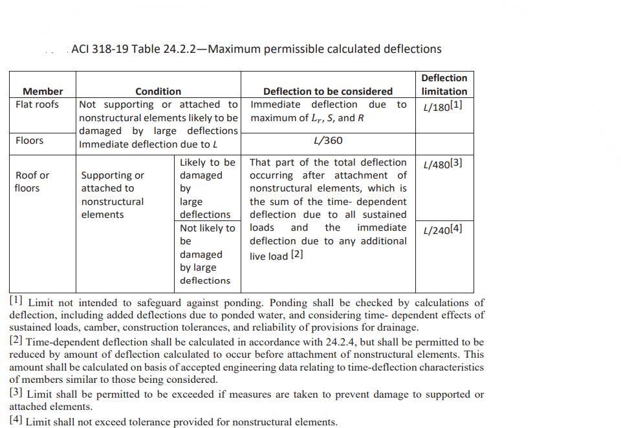

Internal Force Check:
Check of Deflection
Allowable deflection = 30.4 mm
And from ETABS by using long term combination, max deflection = 11mm

Slide 10
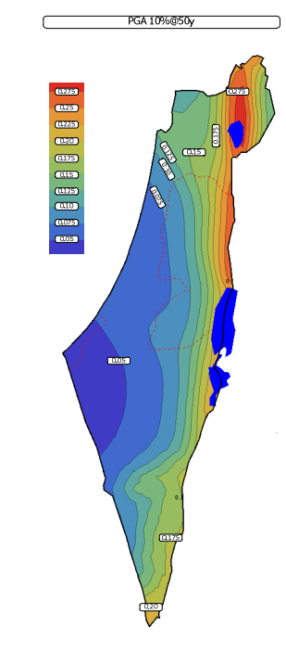
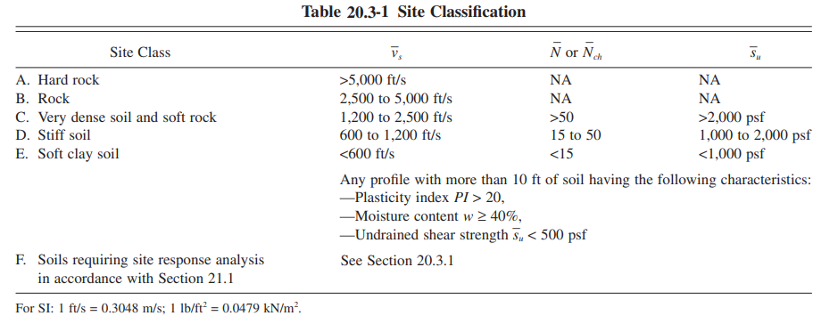
Seismic design
seismic location factors and values
Seismic ground motion values:
Determination of site soil classification
Site class: SC
seismic zone factor map

Slide 11
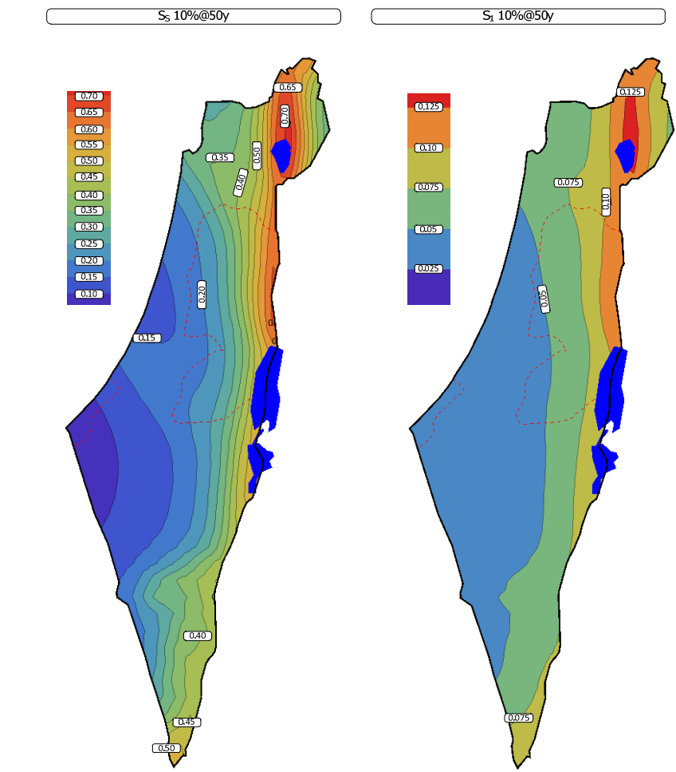
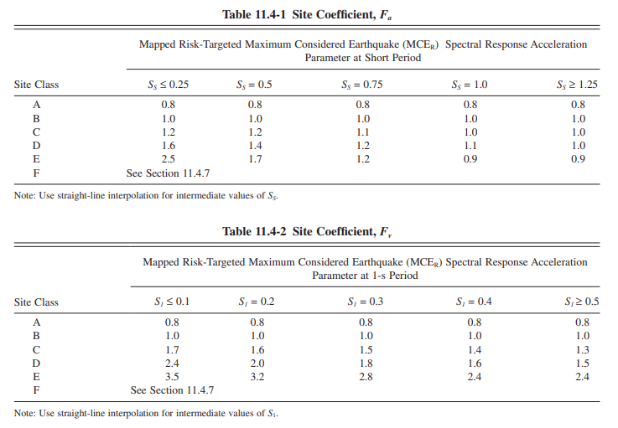
Mapped Acceleration Parameters:
S1= 0.0875 sec
Ss=0.4 sec
Fa = 1.2 & Fv = 1.7
S_{MS} = F_{a} S_{S}
S_{M1} = F_{v} S₁
acceleration parameter map S₁ and Ss

Slide 12


Determination of occupancy type (risk category):
occupancy type

Slide 13
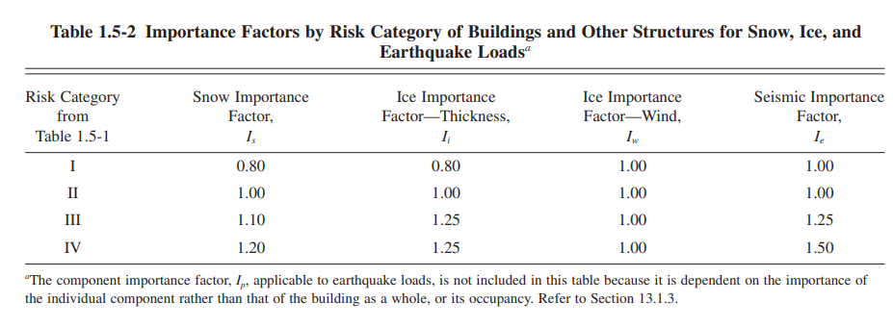
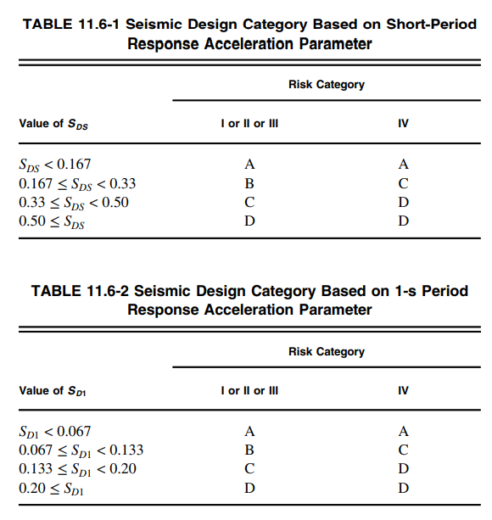
Importance factor of the structure:
Importance Factors table
Design risk category:
Seismic design category = C .

Slide 14
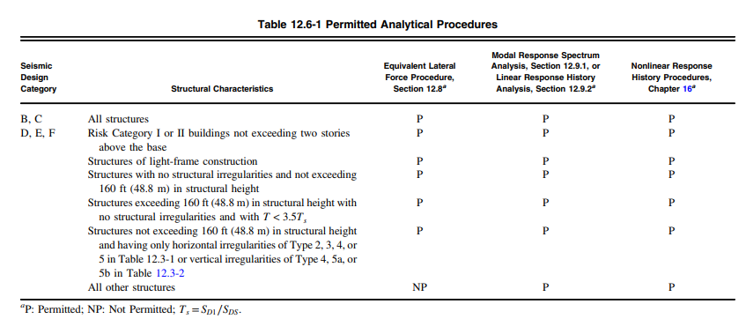
Determination of Lateral-force Procedure
1-Equivalent lateral force method (ELF method).
2-Modal response spectral analysis (MRS method).

Slide 15
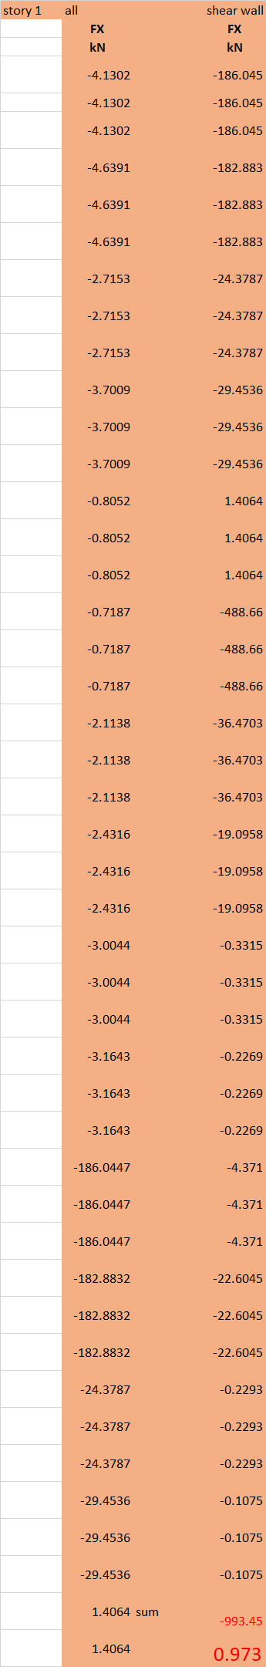
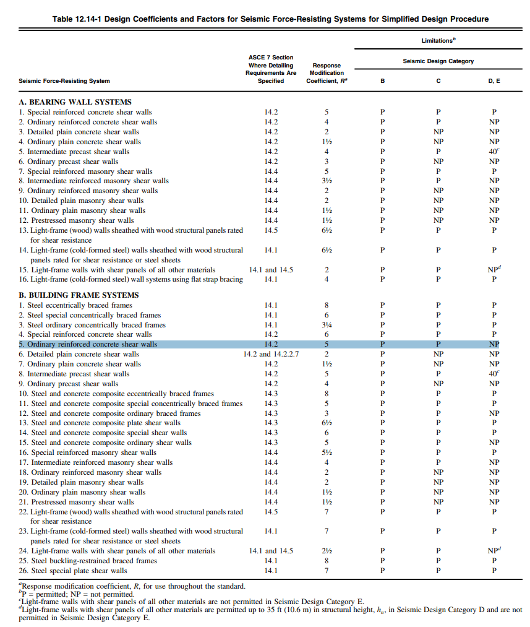
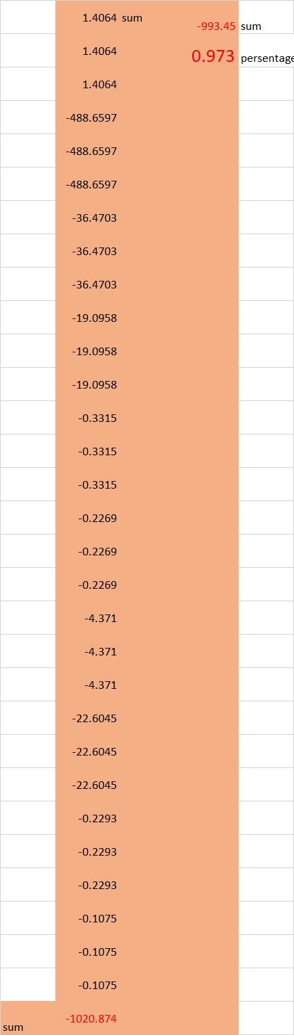
The structure system is reinforced concreate shear wall ordinary building system and lateral load resisting system of shear wall

Slide 16
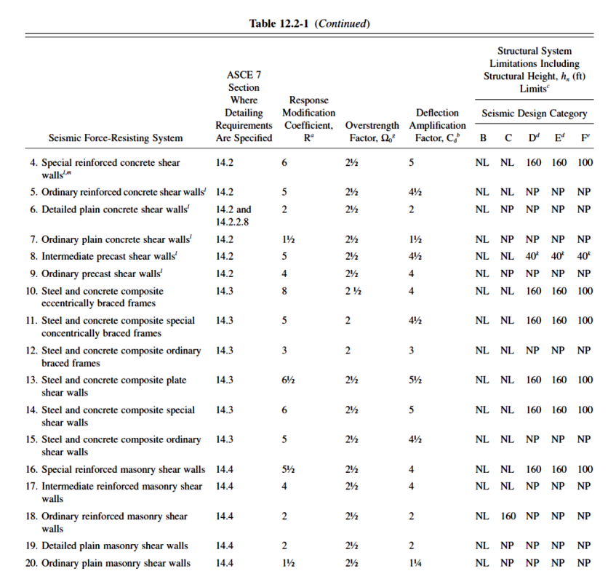
design coefficient and factor for seismic force resisting system:
Over strength factor Ω = 2.5
Deflection amplification factor C_{d} = 4.5
Response modification factor R = 5

Slide 17
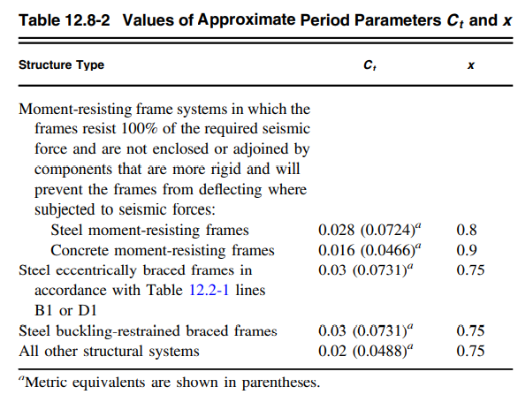

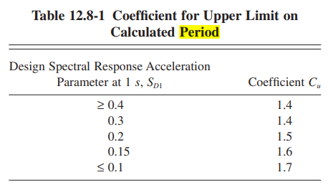
block one calculation: period calculation
Ct= 0.0488 X=0.75
Then : Ta = 0.4264 sec
Period of the structure
Cu = 1.7
Upper period limit coefficient C_{u}

Slide 18
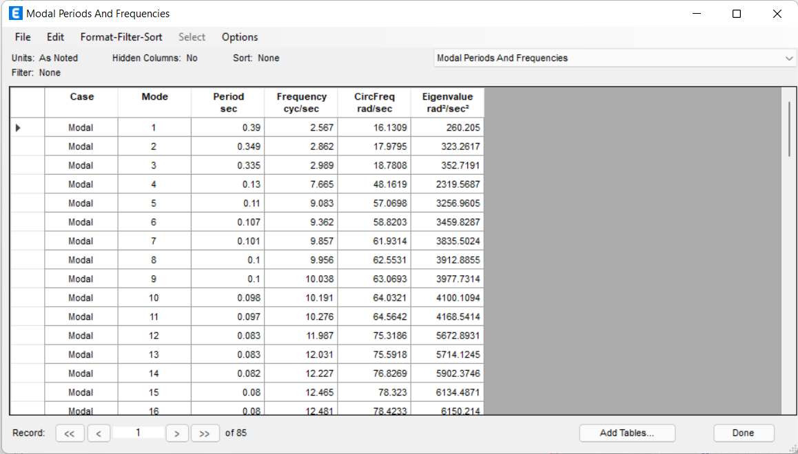
From ETABS:
The Value from ETABS must be smaller than upper limit (Ta x Cu = 0.724 sec)
X-direction:-
T = 0.39 Sec … OK
Y- direction:-
T = 0.35 Sec … OK

Slide 19
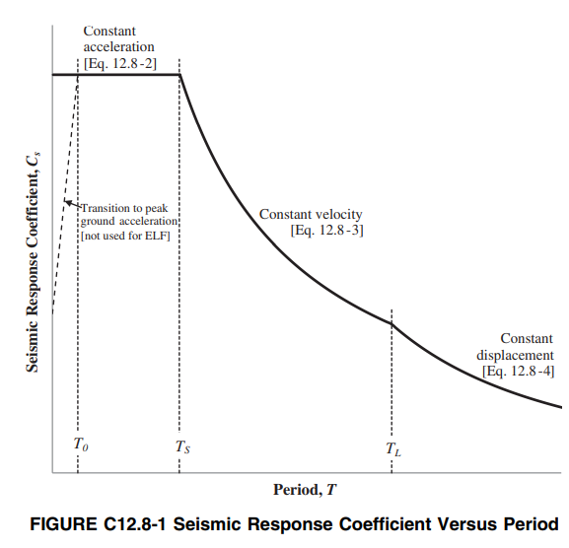

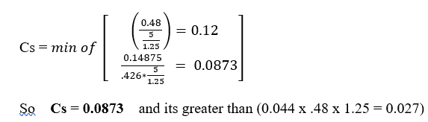
Equivalent static analysis:
Base shear reaction calculation
V = Cs W
Cs: Seismic response coefficient
Cs shall not be less than
Cs =0.044S_{DS}Ie ≥ 0.01

Slide 20
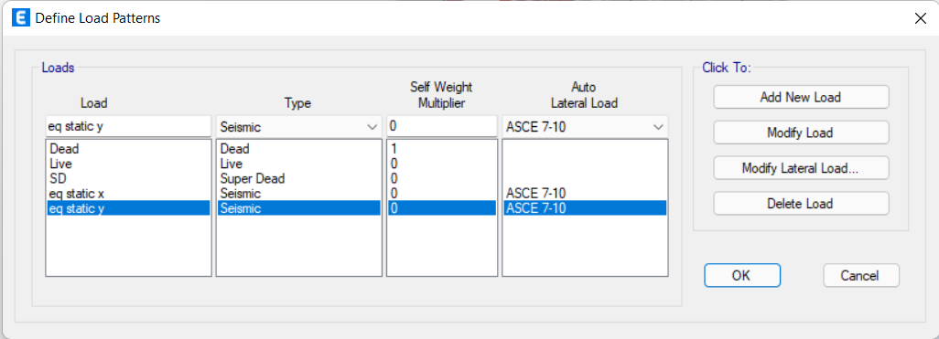
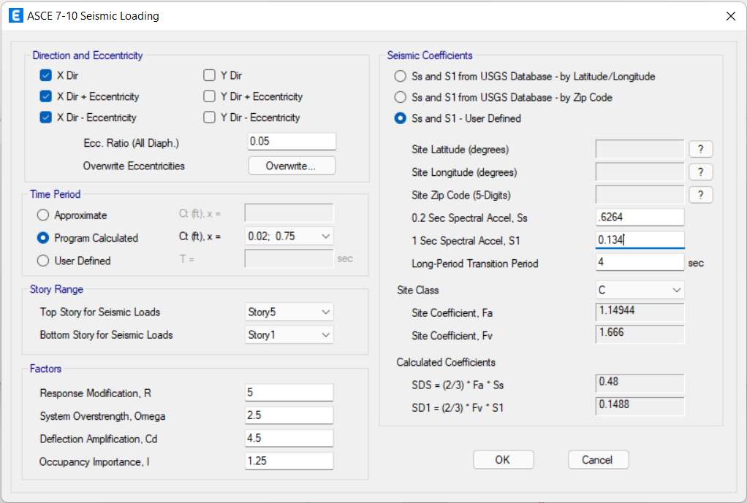
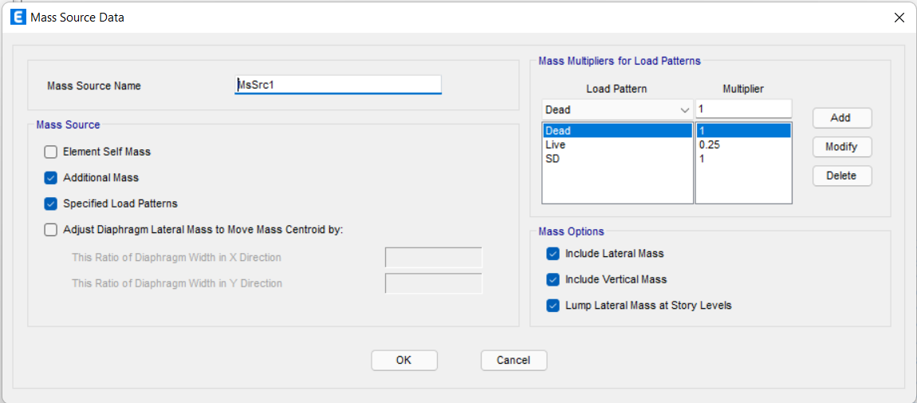
Affective seismic weight (W)
W = DL + SD + 0.25LL
= 14282.7287+ 6094.7496+0.25(6776.6608)
= 22071.643 KN
Base shear (V): V = Cs W =1920 KN
Define lateral load (equivalent static load) on ETABS:

Slide 21
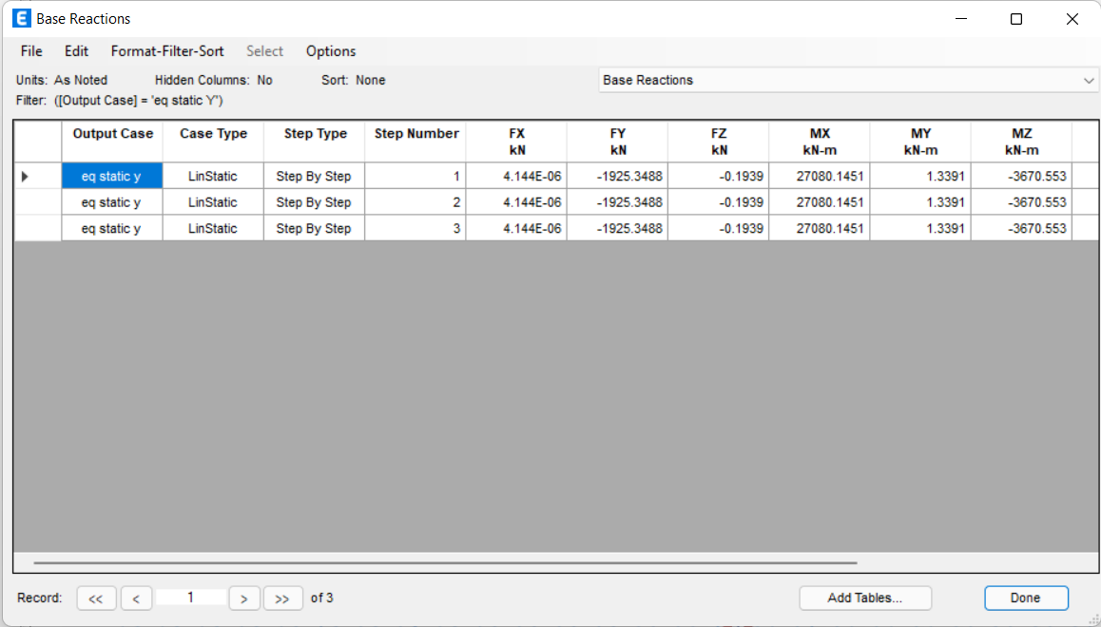
Figure: Equivalent Static shear by ETABS
V-y by hand = 1920 KN
V-y by ETABS = 1925.34 KN
Error = 0.05% < 5% so it's ok

Slide 22
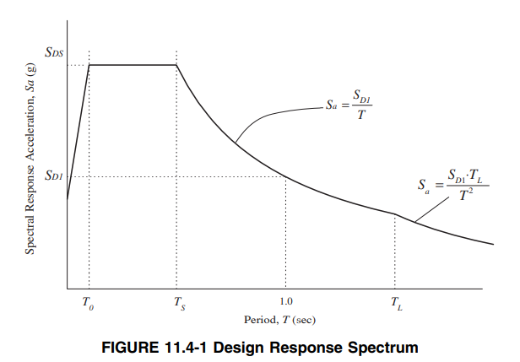
Response Spectrum Analysis by ETABS

Slide 23
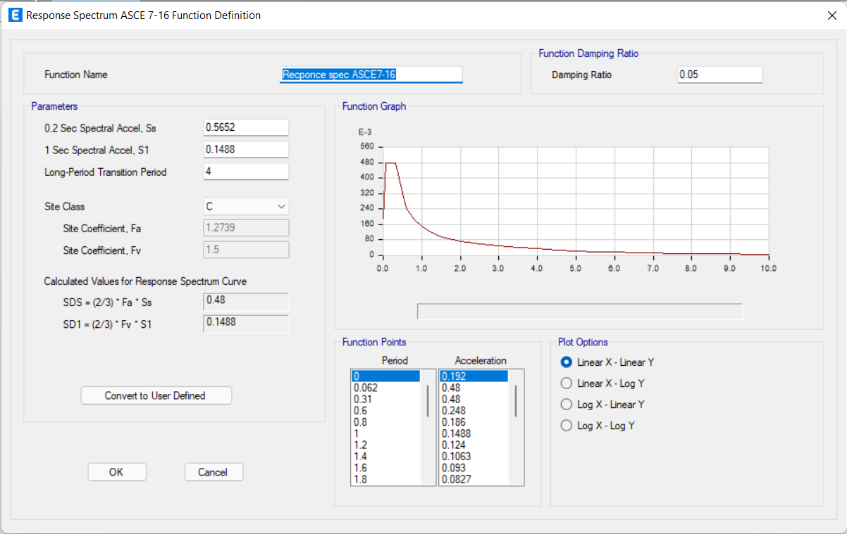
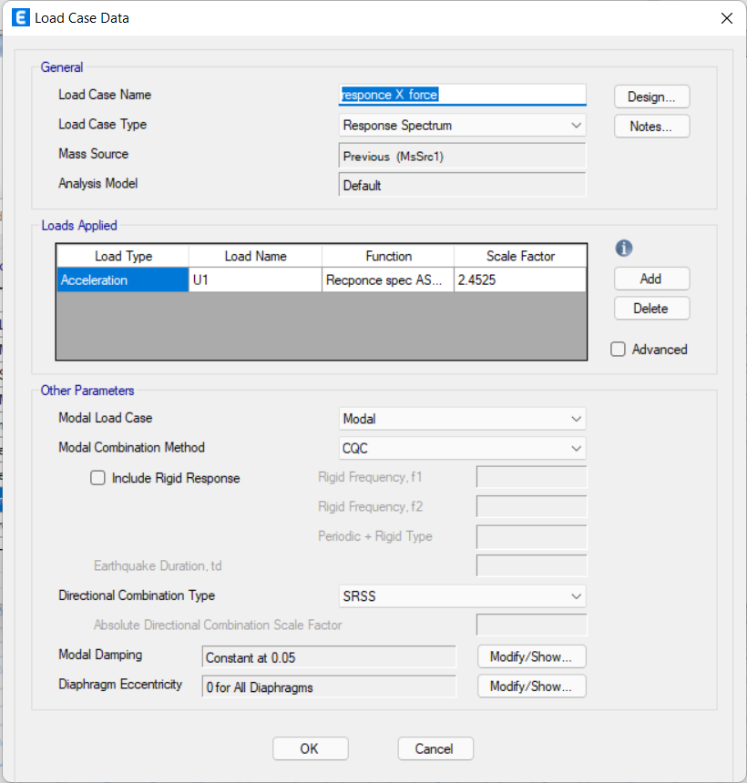
Define Response spectrum function
Define modal acceleration in X and Y
Where: scale factor = g x I /R

Slide 24
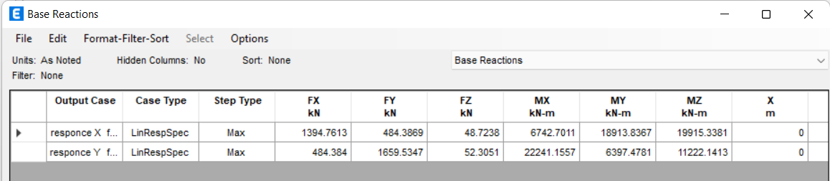
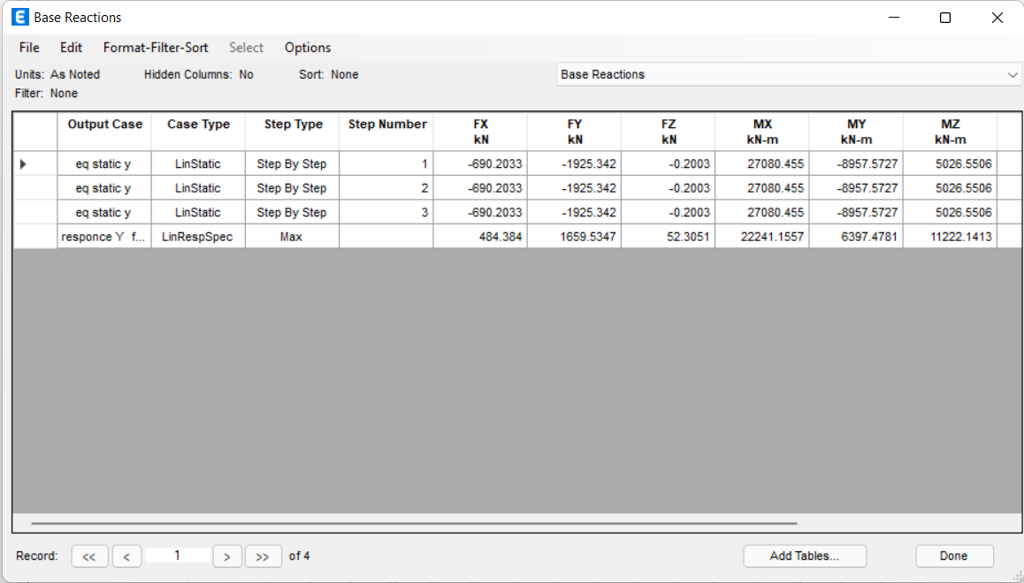
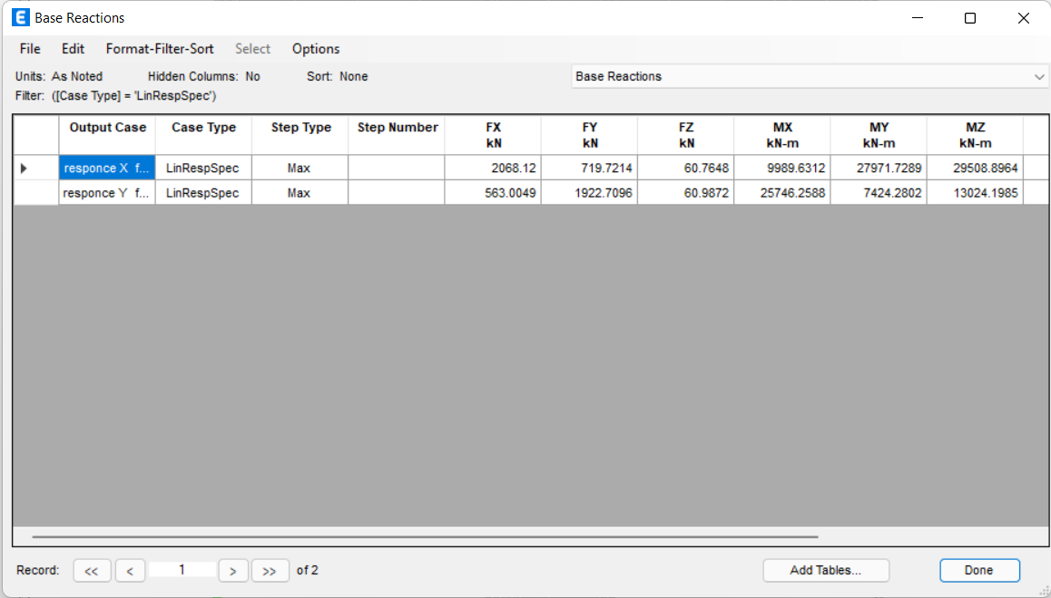
Base shear from response spectrum .

Slide 25
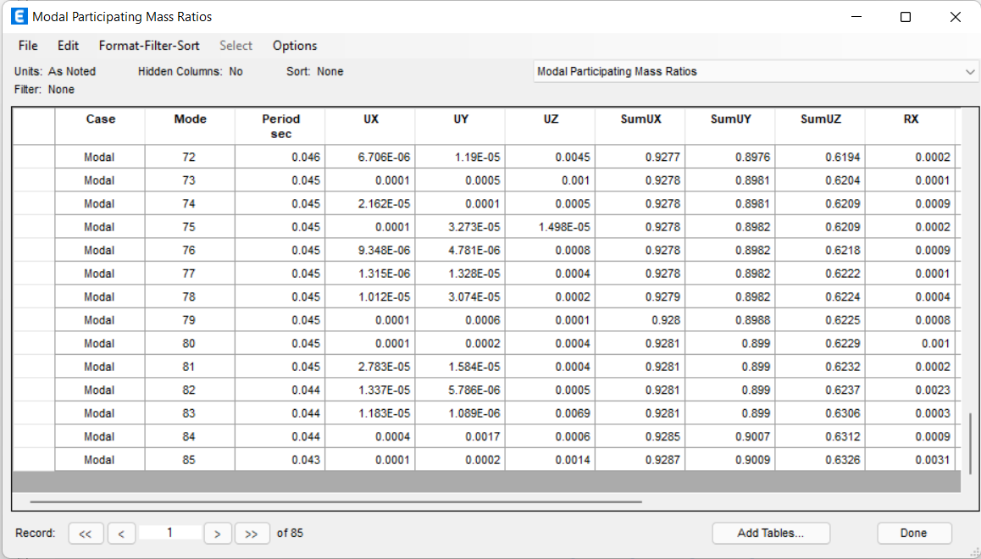
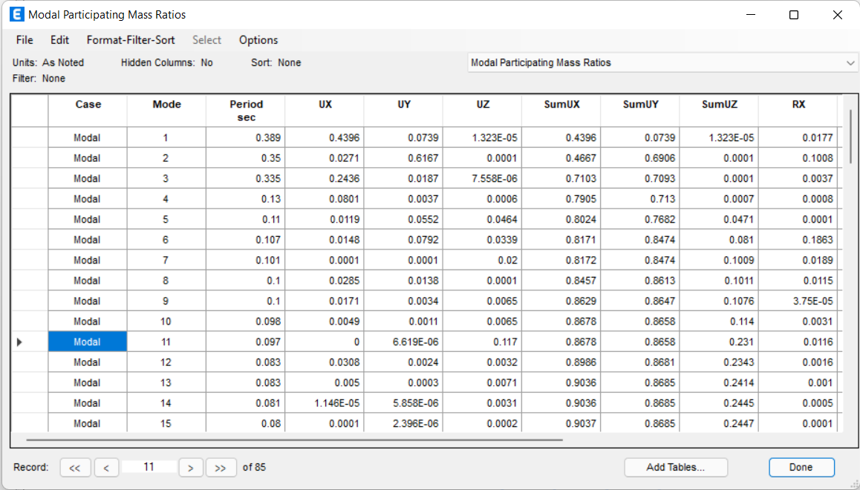
Modes and Periods
the summation of the modal participation mass ratio in X and Y more than 90% after 85 Modes

Slide 26
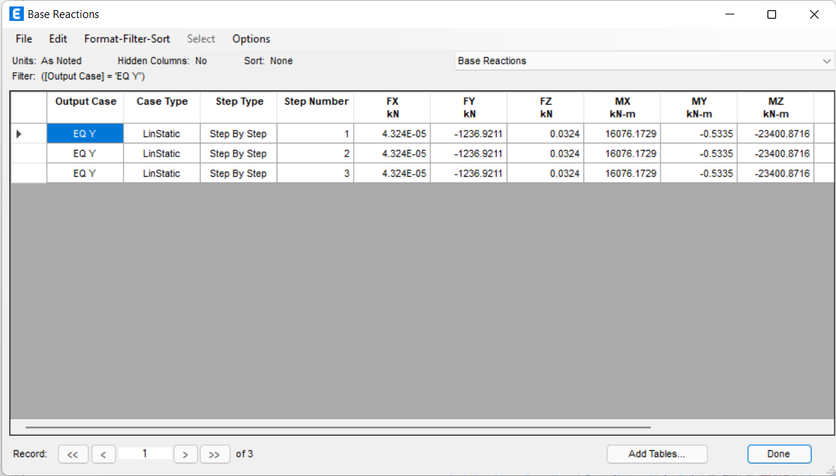
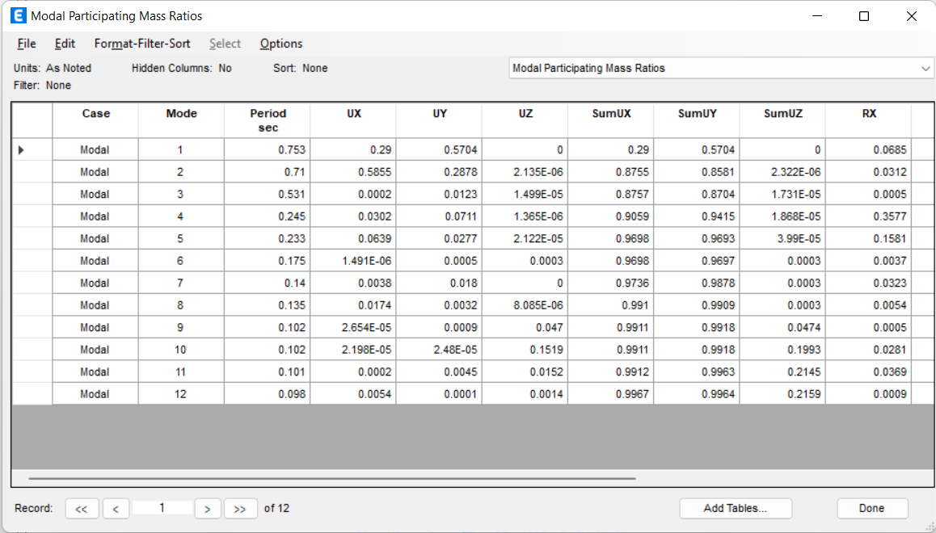
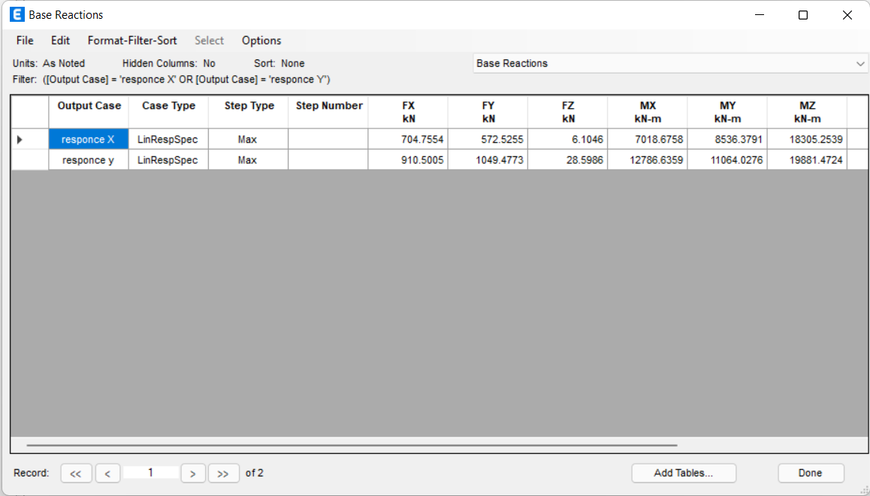
block two calculation:
Figure : Equivalent Static shear by ETABS
V-y by hand = 1255.57 KN
V-y by ETABS = 1236.92 KN
Error = 0.14% < 5% so it's ok.
Figure 5.37: Final base reaction
Modal mass participation ratios (transition in x,Y,z)

Slide 27
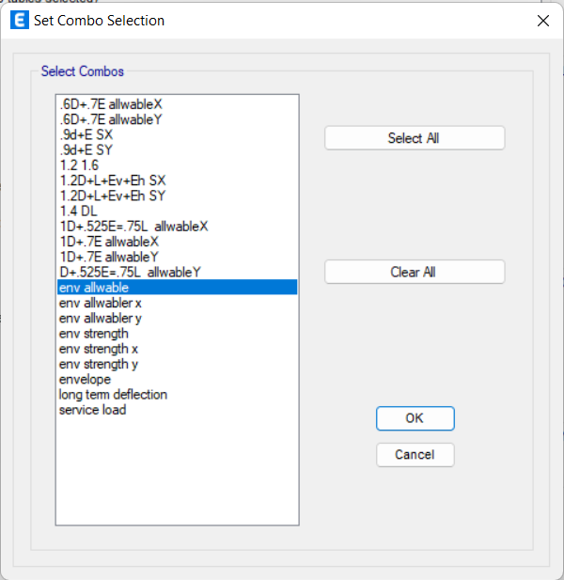
load combination with earthquake loads:
Combination for strength design:
1.4 D
1.2 D +1.6 L
1.2 D +1.0 E +1.0 L
0.9 D + 1.0 E
Combination for serviceability (allowability) design:
1.0 D
1.0 D +1.0L
1.0 D + 0.7 E
1.0 D + 0.525 E + 0.75 L
0.6 D + 0.7 E

Slide 28
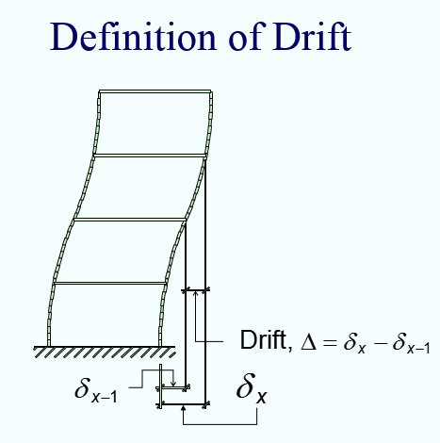
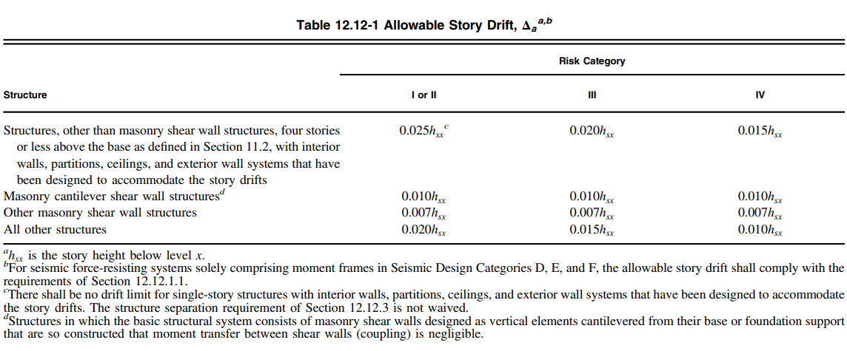
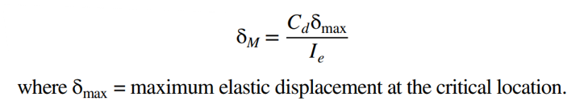
design checks :
Drift and deformations

Slide 29
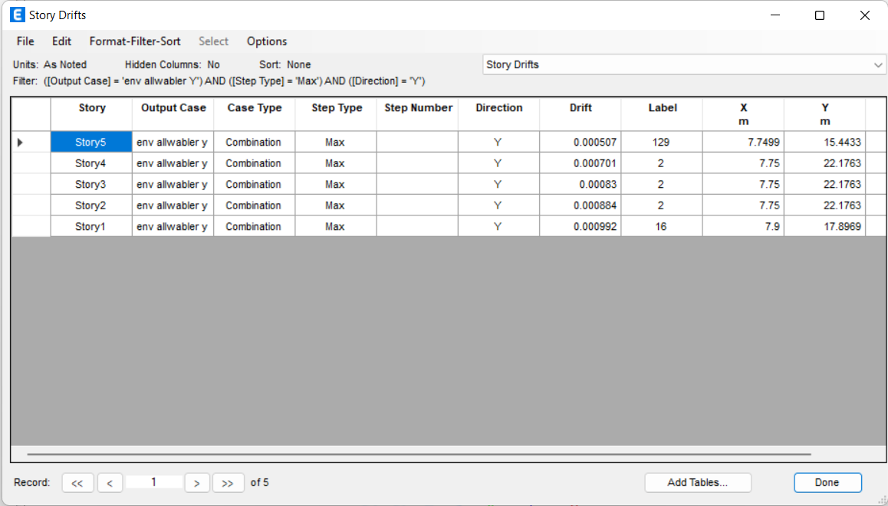
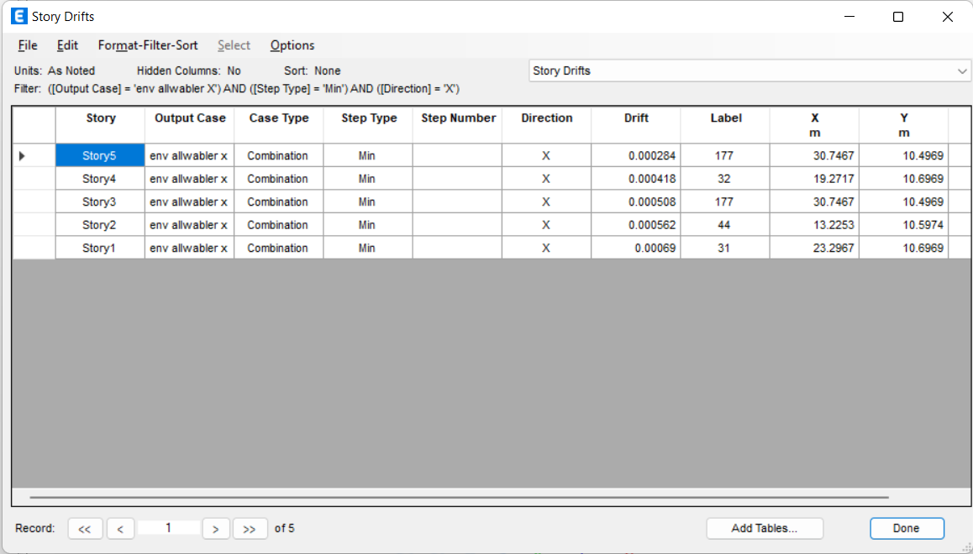
Block one drift check.
Table 5.22: Inelastic Response Displacement and story drift ration in Y
the inelastic Response displacement is ok and less than the allowable limit.

Slide 30
Block TWO drift check.
Table 5.22: Inelastic Response Displacement and story drift ration in Y
the inelastic Response displacement is ok and less than the allowable limit.

Slide 31

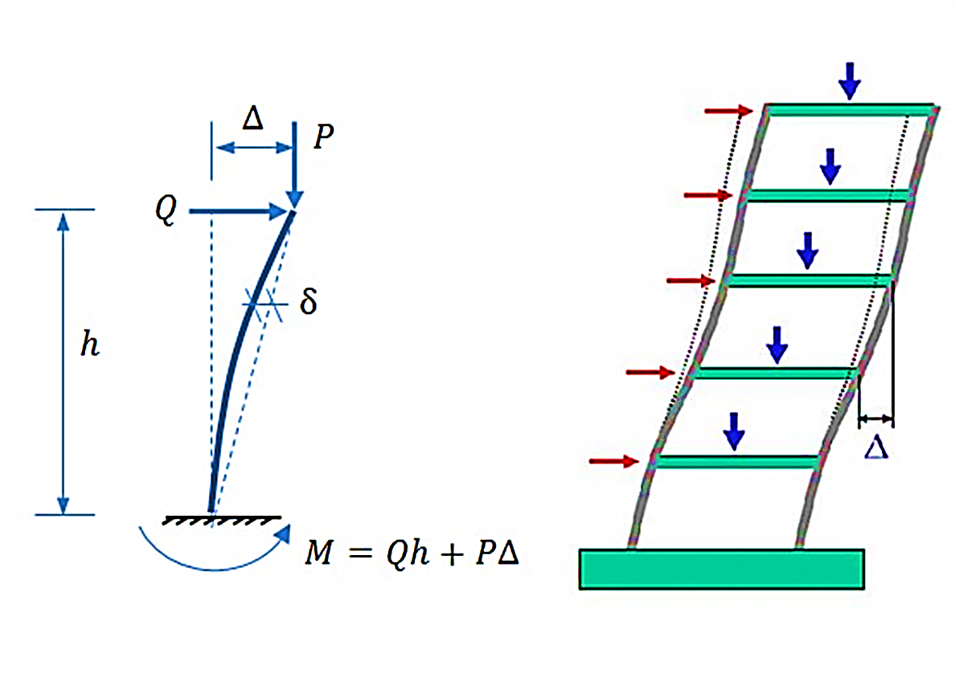

P-delta affect

Slide 32



That’s no p-delta affect in x direction, so no modification of forces on structure and the design is ok.
Table 5.23:p delta affect in X direction

Slide 33
Beam design

Slide 34


Beams in layout in ETABs :

Slide 35

Beam B1 :
Beam dimensions = 20cm width , 100cm depth ,
d= 95cm
Check if the beam behave as beam or beam column.
Beam column limit = 0.1 Fc Ag
= 1260 Kn
Axial load in beam =41.12Kn its beam not beam column
axial load on beam envelope strength combination

Slide 36






Check For moment:
manual calculations:
SD load on beam = 4.317 x 1.73 = 7.47 Kn/m
= 44.84 Kn.m
Moment =
=
From Etabs :
tributary area on beam
Error <10%
its ok!
moment on center and edge of beam from SD load

Slide 37




Design For moment:
bottom steel :
Moment=188.6KN.m
Max ultimate design strength moment on center of beam
ῤ =0.0028 . and that’s minimum than ῤmin, So
ῤ= ῤmin = 0.00333
AS= 634 mm2 = 5φ14mm on two layer
Spacing = (200-2(30)-14*3) / (3-1) = 50mm
Spacing must be > diameter of bar 1.4cm> 2.5 so its ok!

Slide 38

Top steel :
Moment=70KN.m
ῤ = .001 and that’s minimum than ῤmin, So
ῤ= ῤmin = 0.00333
AS= 634 mm2 = 5φ14mm on two layer
Spacing = (200-2(30)-14*3) / (3-1) = 50mm
Spacing must be > diameter of bar 1.4cm> 2.5 so its ok!
Max ultimate design strength moment on edge of beam

Slide 39







Design For shear:
Ultimate shear = V_{u} = 138.5KN
Vc = 167.5 Kn
Choose Ø = 10mm
use minimum shear reinforcement
0.78 =2(0.25*3.14*10²)/s
So s = 200mm = 20cm < S_{max}
So use 1 Ø10mm @ 20 cm .
S_{max}. = min. of {
= 950/2 =47.5cm

Slide 40



Design overwrite and preferences

Slide 41


Maximum axial load on all beams = 148 , so all beams behave as beam not beam column
axial load design result for Beams on block2
axial load design result for Beams on block1.

Slide 42


Results :
Area of steel in all beams in block 1

Slide 43


Area of steel in all beams in block 2

Slide 44

shear reinforcement in all beams in block 1

Slide 45

shear reinforcement in all beams in block 2

Slide 46


Slide 47
Column design

Slide 48

6.2 Column design:-
Figure 6.62: Columns plan
Sample calculations:

Slide 49

1. For column with diminutions 40*40
Figure6.63 :Column diminutions

Slide 50


Figures 6.64:for moment and axial load
From etabs by finding max load and moment
Pu=1796.2 KN
H/D =3.63 /0.4 =9.075 so ordinary
From etabs we find max load and moment

Slide 51

Pu=1796.2 KN
Case of moment in sway (unbraced) frames kLu/r <22 , will be short column else selender
r = 0.3h =0.3*0.4 = 0.12 , k=? , to find the value of K ?
I beams: IB2=0.00278 m⁴, IB3=0.01024 m⁴, I column(30*60) = 0.0054 m⁴
Ψ =0, Ψ = ∑ ^{𝑬𝑰} 𝒇𝒐𝒓 𝒄𝒐𝒍𝒖𝒎𝒏𝒔 / ∑ ^{𝑬𝑰} 𝒇𝒐𝒓 𝒃𝒆𝒂𝒎𝒔
A B
𝑳 𝑳
Then , ΨB=0.012, K= 1 (using monograph for effective length factor foe sway frames)
Figure 6.65: monograph for effective length factor foe sway frames
KLu/r = 1*3.63/0.12=30.25 >22 so it slender column
M1/M2 =-90.88/100.3161 nigative so it will be a single curvature

Slide 52
Mc =Sns*M2 , K=1 EI =1.439*10¹³ cm = 1-M1/M2 =0.96 Sns=0.96 ,
Mmin = e min * pu , emin = 0.015 +0.03*0.4 =0.027 , Mmin <100.3161 Mc=0.96*100.3161 =96.3 Kn.m
Assume M = 0.0 kN.m.(very small value)
ФPn=Pu
ФPn = Ф𝜆 (0.85 * f`c * (Ag-As) + fy * As)
As = 𝝆 Ag
= 0.02 Ag
Ag = 108.89*10³ mm² , so 40*40 is ok
ф𝑷𝒏 ₌ 𝟏𝟕𝟗𝟔.𝟐∗𝟏𝟎𝟎𝟎 _{= 1.6 Ksi}
𝒃𝒉 𝟒𝟎𝟎∗𝟒𝟎𝟎∗𝟕
ф𝑴𝒃 ₌𝟗𝟔.𝟑∗𝟏𝟎𝟎𝟎𝟎𝟎𝟎_{= 0.2 Ksi}
𝒃𝒉^{𝟐} 𝟒𝟎𝟎∗𝟒𝟎𝟎^{𝟐}∗𝟕
f`c= 28/7 = 4 Ksi fy = 420/7 = 60 Ksi

Slide 53

ɣ =^{𝟒𝟎𝟎−𝟐∗𝟒𝟎} = 0.75 , cover = 40
𝟒𝟎𝟎
→ By P-M interaction diagrams to determine 𝝆 (see Figure)
𝝆 = 0.01 , so As = 0.01 *400*400 =1600 mm² ( 8∅16)
least column dimension
16𝑑_{𝑏}
48𝑑_{𝑠}
𝑠₁ = 𝑀𝑖𝑛 {
}
S ≤ 𝟒𝟖d = 48*10 = 480
≤16 db = 16*16 = 256
≤400
→Choose the minimum spacing 250 mm
+
figure6.66 :P-M interaction diagrams
→ Use 3Φ 10 / 250 mm
Check spacing between bars
Short direction: S= ^{𝟒𝟎𝟎−𝟐(𝟒𝟎+𝟏𝟎+𝟖)} = 142 mm < 150 mm
𝟐

Slide 54


2. For column with diminutions 90*30
Figures:6.66-1 for moment and axial load
From etabs we find max load and moment
Pu=1160 KN Mu=50.5 KN.M
H/D= 3.63/0.9 = 4.0333 < 5 so intermidate
Case of moment in sway (unbraced) frames

Slide 55
kLu/r <22 , will be short column else selender
r = 0.3h =0.3*0.9 = 0.27 , k=? , to find the value of K ?
I beams: IB2=0.00278 m⁴, IB3=0.01024 m⁴, I B7= 0.0026 , I column(30*90) = 0.018225 m⁴
Ψ =0, Ψ = ∑ ^{𝑬𝑰} 𝒇𝒐𝒓 𝒄𝒐𝒍𝒖𝒎𝒏𝒔 / ∑ ^{𝑬𝑰} 𝒇𝒐𝒓 𝒃𝒆𝒂𝒎𝒔
A B
𝑳 𝑳
Then , ΨB=1.1.38 =1.4, K= 1.2 (using monograph for effective length factor foe sway frames)
KLu/r = 1.2*3.63/0.27=16.2 <22 so it short column
Assume M = 0.0 kN.m.
ФPn=Pu
ФPn = Ф𝜆 (0.85 * f`c * (Ag-As) + fy * As)
As = 𝝆 Ag
= 0.02 Ag
Ag = 70318.03 mm² , so 900*300 mm is ok

Slide 56

ф𝑷𝒏 ₌ 𝟏𝟏𝟔𝟎∗𝟏𝟎𝟎𝟎 _{= 0.6 Ksi}
𝒃𝒉 𝟑𝟎∗𝟗𝟎𝟎∗𝟕
ф𝑴𝒃 ₌𝟑𝟎∗𝟏𝟎𝟎𝟎𝟎𝟎𝟎_{= 0.05 Ksi}
𝒃𝒉^{𝟐} 𝟑𝟎𝟎∗𝟗𝟎𝟎^{𝟐}∗𝟕
f`c= 28/7 = 4 Ksi
fy = 420/7 = 60 Ksi _{ɣ =}𝟗𝟎𝟎−𝟐∗𝟒𝟎 _{= 0.9}
𝟗𝟎𝟎
→ Go to P-M interaction diagrams to determine 𝝆 (see Figure 4.2)
+
figure6.67 :P-M interaction diagrams

Slide 57
𝝆 = 0.01 so As = 0.01*900*300 = 2700 mm² , 14∅ 16
→ Use 2Φ 10 / 250 mm
Check spacing between bars
Long direction: S= ^{𝟗𝟎𝟎−𝟐(𝟒𝟎+𝟏𝟎+𝟖)} =156.8 mm>150 mm
𝟓
short direction: S= ^{∗𝟑𝟎𝟎−𝟐(𝟒𝟎+𝟏𝟎+𝟖)} = 92 mm < 150 mm
𝟐
3. For column with diminutions 60*30
H/D= 3.63/0.6 = 6.03 ordinary

Slide 58

Figures 6.68:for moment and axial load
Pu=621 KN
Mu=35.6 KN.m
Case of moment in sway (unbraced) frames kLu/r <22 , will be short column else selender
r = 0.3h =0.3*0.6 = 0.18 ,
k=? , to find the value of K ?
I beams: IB2=0.00278 m⁴, IB3=0.01024 m⁴, I column(30*60) = 0.0054 m⁴

Slide 59
Ψ =0, Ψ = ∑ ^{𝑬𝑰} 𝒇𝒐𝒓 𝒄𝒐𝒍𝒖𝒎𝒏𝒔 / ∑ ^{𝑬𝑰} 𝒇𝒐𝒓 𝒃𝒆𝒂𝒎𝒔
A B
𝑳 𝑳
Then , ΨB=1.189 =1.2 , K= 1.1 (using monograph for effective length factor foe sway frames)
KLu/r = 1.05*3.63/0.18=21.75<22 so it short column
Assume M = 0.0 kN.m.
ФPn=Pu
ФPn = Ф𝜆 (0.85 * f`c * (Ag-As) + fy * As)
As = 𝝆 Ag
= 0.02 Ag
Ag = 37644.4 mm² , so 600*300 mm is ok
ф𝑷𝒏 ₌ 𝟔𝟐𝟏∗𝟏𝟎𝟎𝟎 _{= 0.5 Ksi}
𝒃𝒉 𝟑𝟎𝟎∗𝟔𝟎𝟎∗𝟕
ф𝑴𝒃 ₌𝟑𝟓.𝟔∗𝟏𝟎𝟎𝟎𝟎𝟎𝟎_{= 0.047 Ksi}
𝒃𝒉^{𝟐} 𝟑𝟎𝟎∗𝟔𝟎𝟎^{𝟐}∗𝟕
f`c= 28/7 = 4 Ksi
fy = 420/7 = 60 Ksi _{ɣ =}𝟔𝟎𝟎−𝟐∗𝟒𝟎 _{= 0.8}
𝟔𝟎𝟎
→ By P-M interaction diagrams to determine 𝝆 (see Figure 4.2)
𝝆 = 0.01 so As = 0.01*600*300 = 1800 mm² , 10 ∅ 16

Slide 60

+
figure6.69: :P-M interaction diagrams

Slide 61
least column dimension
16𝑑_{𝑏}
48𝑑_{𝑠}
𝑠₁ = 𝑀𝑖𝑛 {
}
S ≤ 𝟒𝟖d = 48*10 = 480
≤16 db = 16*16 = 256
≤400
→Choose the minimum spacing 256 mm
→ Use 2Φ 10 / 250 mm
Check spacing between bars
Long direction: S= ^{𝟔𝟎𝟎−𝟐(𝟒𝟎+𝟏𝟎+𝟖)} =121 mm<150 mm
𝟒
short direction: S= ^{∗𝟑𝟎𝟎−𝟐(𝟒𝟎+𝟏𝟎+𝟖)} = 184 mm >150 mm
𝟏

Slide 62
4. For column with diameter 50 cm
H/D = 3.63/0.5 = 7.26 > 5 so ordinary
From etabs we find max load and moment Pu=1494 KN
Mu=73.7KN.M
Case of moment in sway (unbraced) frames kLu/r <22 , will be short column else selender
r = 0.25D =0.25*0.5 = 0.125 , k=? , to find the value of K ?
I beams: IB2=0.00278 m⁴, IB3=0.01024 m⁴, I column(cicule 0.5) = 0.00306 m⁴
Ψ =0, Ψ = ∑ ^{𝑬𝑰} 𝒇𝒐𝒓 𝒄𝒐𝒍𝒖𝒎𝒏𝒔 / ∑ ^{𝑬𝑰} 𝒇𝒐𝒓 𝒃𝒆𝒂𝒎𝒔
A B
𝑳 𝑳
Then , ΨB=1.189 =1.2 , K= 1.1 (using monograph for effective length factor foe sway frames)
KLu/r = 1.1*3.63/0.15=21.3<22 so it short column Assume M = 0.0 kN.m.
ФPn=Pu
ФPn = Ф𝜆 (0.85 * f`c * (Ag-As) + fy * As)

Slide 63
As = 𝝆 Ag
= 0.02 Ag
Ag = 73872.444 mm² , so D= 500 mm is ok
=
𝟏𝟒𝟗𝟒∗𝟏𝟎𝟎𝟎 ф𝑷𝒏
= 0.6Ksi
𝟔𝟎𝟎∗𝟔𝟎𝟎∗𝟕 𝒃𝒉
𝟑𝟓.𝟔∗𝟏𝟎𝟎𝟎𝟎𝟎𝟎 ф𝑴𝒃
= = 0.048 Ksi
𝟔𝟎𝟎∗𝟔𝟎𝟎^{𝟐}∗𝟕 𝒃𝒉^{𝟐}
f`c= 28/7 = 4 Ksi fy = 420/7 = 60 Ksi
ɣ =
𝟓𝟎𝟎−𝟐∗𝟒𝟎
= 0.9
𝟓𝟎𝟎
→ Go to P-M interaction diagrams to determine 𝝆

Slide 64

+
+
figure6.70 :P-M interaction diagrams
= 0.01 , so As = 0.01*3.14*500²/4 = 1962.5 mm² (10∅16 )𝝆

Slide 65

𝝆𝒔 = 0.45 (Ag/Ach-1) *fc/fy =0.021
S = 4As/ 𝝆𝒔DC = 4*200.96/0.021*560 = 72 <75 use ∅10/70 mm
Design performance and design ovewritcing:

Slide 66

Figere 6.71:Concrete frame design prefrences
Figure 6.72:Concrete frame design overwrites
☒ Take column C2 :-

Slide 67


Column dimensions :- 0.4m * 0.4m
f ′ = 28𝑀𝑃𝑎 , Fy=420MPa , cover = 30mm
c
Figure 6.73:
Column C2
Longitudinal reinforcement:-
Figure6.74:ETABS result for Longitudinal reinforcement:
As = 1600mm2 =8φ16 mm

Slide 68




Slide 69
Slab design

Slide 70


6.3 Slap design
Designe for moment :
Figure6.75:section in slap
Figure6.76: Ultimate M value
Mu (Top) = 90KN.m

Slide 71

=.0008 < min (.0033)
Use .0033( 2 Ø12 mm/rib )
Mu (Bottom) = 70KN.m=5.2KN.m/rib
-=.0022<min(.0033)
Use .0033( 2 Ø12 mm/rib )
Designe for shear :

Slide 72



Figure6.77: Max shear value
Total ultimate load (Vu) = 29.17 KN/𝑚²=15.17KN/rib
1
ФVc = 1.1 ∗ .75 ∗ ∗ √Fc` ∗ bw ∗ d
6
ФVc =1.1*0.75(1/6)×√28×120×(250 -30) = 19.21KN

Slide 73


Slide 74


Slide 75
Shear wall design

Slide 76

Figure : Added shear wall locations

Slide 77



Figure 6.80: ETABs result for the shear wall S.W1
f’_{c} = 28 MPa, F_{y} = 420 MPa, wall thickness = 200 mm and wall length = 5.4 m.
Check axial force:
P_{u} = P_{z} <? 0.1Ag* f’_{c}
2029KN <0.1*(0.2*5.4)*28*1000 = 3024KN
No need for axial design

Slide 78


Desgin for shear :
761.9 KN >Vu then we used the min shear reinforcement
V_{c} =
ꝭt=.0025→ Use φ12 mm @ 450 mm / Use φ10 mm @ 300 mm
ꝭl=
>2.5 then
for this wall
ꝭl=.0025 →Use φ12 mm @ 450 mm or Use φ10 mm @ 300 mm

Slide 79





.
Desgin for moment:
.03768
Figure 6.81: Shear S.W1 wall detailing
.048
< Mu
We calculate for φ14 mm @ 200 mm Mn
=4771 KN.m >Mu →ok

Slide 80


Slide 81
Footing design

Slide 82






1-Single footing design:-
P _{service} = 1358.4 KN.
P _{Ultimate} = 1796.2 KN.
Area of footing =
= 3.396 m²
=
The ultimate pressure under footing (б _{u)} =
=
= 497.5
Suppose :-
d = 350 mm.
.h = 350+ 50 = 400 mm.
Check punching Shear :
Factored punching shear strength:
V_{u, punching}⁼ (Pu-A1*qu)
= 1796.2-((.4+.35)^2*497.5)
= 1516.35 KN
ɸ V_{c, punching(min)} =1882KN > Vu………. OK.

Slide 83




-Design of wide beam shear:
V_{u} ≤ ɸ V_{c}
V_{u} = б _{u} (L–d)
= 497.5 (.75–.35)
= 198.88 KN/m
= 231.5 KN/m >Vu ok
We have 5 types of single footing in this structure
ɸ V_{c,} =
× b×d
-Design or flexure:
L1 =(1.9-0.35) / 2= .775 = L2
M_{u} =
= 140 KN.m/m.
=
.b=1000mm , d=350mm ,
ρ = 0.0036
A_{st} = ρ ×b×d = 0.0036×1000×350 = 1260 mm²/m.>Asmin(720)
(6 Ø16 mm/m) =1 Ø16 mm/15cm in both directions

Slide 84



Slide 85





2-Wall footing design:-
Section cut result:-
P _{service} = 1544KN.
P _{Ultimate} = 2030 KN.
Shear wall length =4.6m
P _{service} = (1544/4.6) =335.65KN/m.
P _{Ultimate} = (2030/4.6) =441.3 KN/m..
width of footing
=
= .84 m. take it 1m
Figure 6.84: shear wall which we design
=
The ultimate pressure under footing (б _{u)} =
= 441.3
Suppose :-
d = 170 mm.
.h = 170+ 50 = 220 mm.

Slide 86

Design of wide beam shear:
Design or flexure:
Steel in X-direction:-
V_{u} ≤ ɸ V_{c}
L = (1-.2)/2 =0..4m
V_{u} = б _{u} (L–d)
= 441.3 (0.4–0.17)
= 101.5KN/m
M_{u} =
=
= 35.3 KN.m/m.
= 112.4 KN/m >Vu ok
ɸ V_{c,} =
× b×d
.b=1000mm , d=300mm ,
But d min =300mm from IBC-Code
So we used d = dmin = 300mm.
H =350mm
ρ = 0.000123 < ρmin
A_{st} = ρmin ×b×h = 0.0018×1000×350 = 630 mm²/m.
(4 Ø14 mm/m) in X directions.
Steel in Y-direction:-
As =As min = 0.0018*1000*350 =630mm2/1m (4 Ø 14mm/m)

Slide 87
Stair design

Slide 88




Θ=tan⁻¹(
)=32
^{structural analysis:}
^{l=(3^2+1.875^2)^/5= 3.5m}
h =
Using Φ16 and cover = 20mm
Main steel
FOR +M :
ρ = 0.0061
As=1000X182X0.0061
load calculations :
W1=0.2X25X1=5 KN\m
=1093mm²
7Φ16\1m
W_{STAIR}=0.5X0.165X0.3X25=.618KN\m
W_{FINIHIMG}=1.24KN\m
Take Dead load =7 KN\m
Live load =5 KN\m
Wu= 1.2 D + 1.6 L
=16.4KN\m
FOR –M :
4Φ16\m
Shrinkage steel
ρ = ρ_{min} = .0018
As=0.0018X1000X200
=360 mm²
5Φ10\m
Check shear
استراحة الدرج
ΦVc=.75*(1\6) *λ
*bw*d
Wu= 15.5 KN\m²
W_{FINISHING} =1.24 KN\m²
Take Dead load = 6.24 KN\m²
Live load =5 KN\m²
W_{CONCRETE}= 0.17X25 = 5 KN\m²
*1000 *180*1000=120KN
ΦVc=.75*(1\6) *1

Slide 89


Slide 90
Retaining wall design

Slide 91

Wall thickness = 30 cm
Wall footing thickness = 40cm
Wall footing width = 100cm
Height of basement wall =Height of story = 3.65 m
Weight on soil = Wu = 1.2 x ((0.1 * 25 )+(4.13)) +1.6 x (4.8) = 15Kn/m²
K_{O} = 1-sin37 = 0.4
Stem modal and soil pressure :
δ₁ = .4 x 15 = 6kn/m²
δ₂ = .4 x ( 15 + 3.65*20) = 35.5 Kn/m²
Figure 6.86: basement retaining wall preliminary dimensions.

Slide 92





Reaction from slap (horizontal reaction) = 19.17 kn
Ry = (3.55/2)*(17.9) = 31.8 kn/m
check bearing capacity
M_{over turning} =
reactions.
define load
on sap
Over turning safety factor = 0.9
It must increase width of footing to be 1.5 m .

Slide 93

After make it 1.5 m :
Mr= 201.6 sum weight = 120.675Kn
e_{r} = 23.3 / 120.675 = 0.19 m > (B/6 =.25)
can ignore eccentricity .

Slide 94




Design for shear :
Vu = 1.6 x 56.6 = 90.6Kn
shear force on basement retaining wall
Design for moment :
vertical reinforcement:
moment force on basement retaining wall
Mu = 1.6 x 35.5 = 56.8Kn.m
ῤ = 0.00248 < ῤmin
take ῤ= ῤmin =0.0025
As = 750 mm² (5Ф14 / meter )
Horizontally reinforcement :
As=750 (7Ф12 / meter ) take it 4 Ф12/m for each face .

Slide 95


Slide 96

لُيَ ۆلُزملُآئيَ آلُشُرٍفَ آلُگبيَرٍ ۆآلُمقآم آلُڌيَ يَضآہيَ آلُنجٍۆم آن نہدِيَيَ مشُرٍۆعٍ تخـرٍجٍنآ آلُﮯ آقصآنآ آلُجٍرٍيَحٍ , لُلُۆطُن آلُنآزف,لُآرٍۆآحٍ آلُشُہدِآء ,لُلُمقآۆميَن تحٍت آيَ سمآء ۆفَۆق آيَ آرٍض ,لُلُبنآدِق آلُملُطُخـة بدِمآء آلُيَہۆدِ, آلُﮯ آبآئنآ نبرٍآس آضآء لُنآ آلُحٍيَآة
ۆہم گ آلُشُمس آڌآ آشُرٍقت خـجٍلُت منہآ آلُگۆآگب
ۆآمہآتنآ آلُحٍضن آلُدِآفَئ آلُآتيَ لُم يَترٍگننآ يَۆمآ
, ۆخـتآمآً آلُمرٍبيَة آلُفَآضلُة آلُدِگتۆرٍة صآحٍبة آلُفَضلُ عٍلُيَنآ بعٍدِ آلُلُہ تعٍآلُﮯ ہندِ طُبيَلُة .
ۆآلُسلُآم عٍلُيَگم ۆرٍحٍمة آلُلُہ

