Slide 1
Smart Bag
Prepared by :
Shayma Owais.
Sabreen Qadommi.
Supervisor :
Dr. Alaa Almasri

Slide 2
Outline
What is Smart Bag?
Motivation
Components
Features of our project
Flowchart
Constrains
Future Work
Demo

Slide 3
What is Smart Bag?
Smart Bag is a vehicle that follow you .
Consist two parts:
control the system automatically.
control the system by your mobile.

Slide 4
Motivation
We wondered before selecting a project idea.
We tried to provide a simple, smart and secure system.

Slide 5
Components:

Slide 6
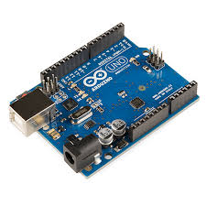
Arduino Uno Microcontroller

Slide 7
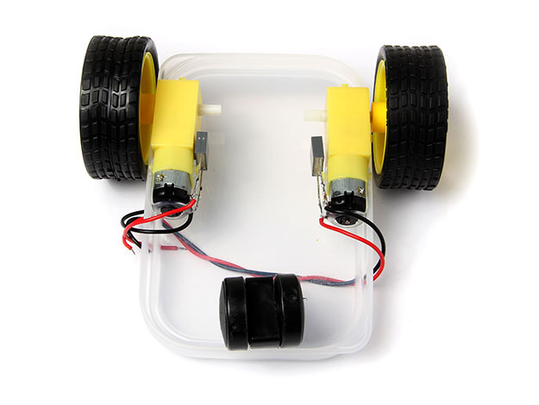
Two wheels robotic car and
Motors.

Slide 8
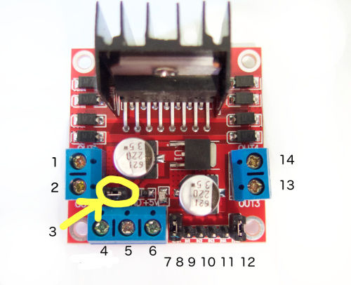
H-bridge module

Slide 9
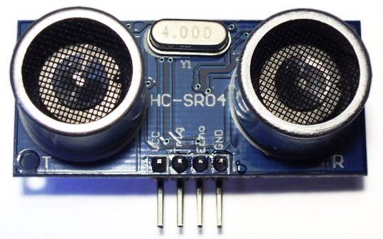
Ultrasonic Sensor

Slide 10
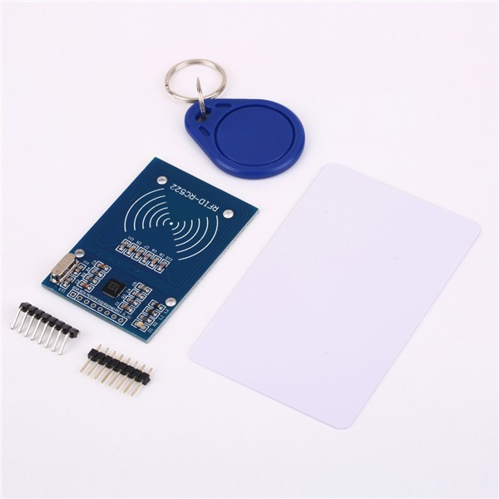
RFID

Slide 11
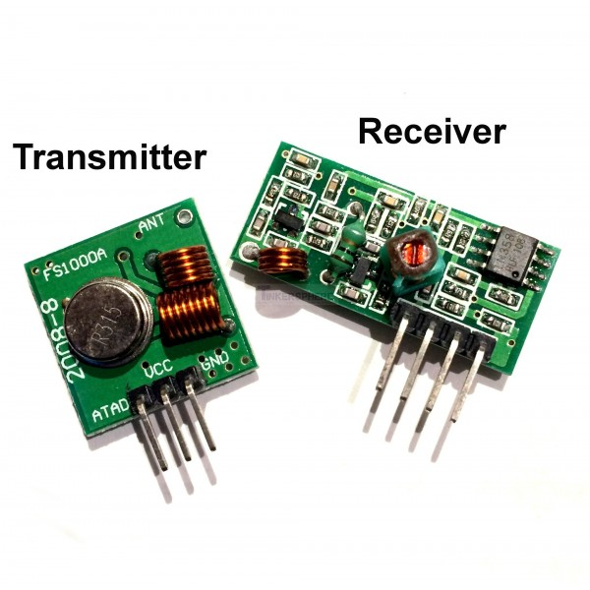
RF transmitter and receiver

Slide 12
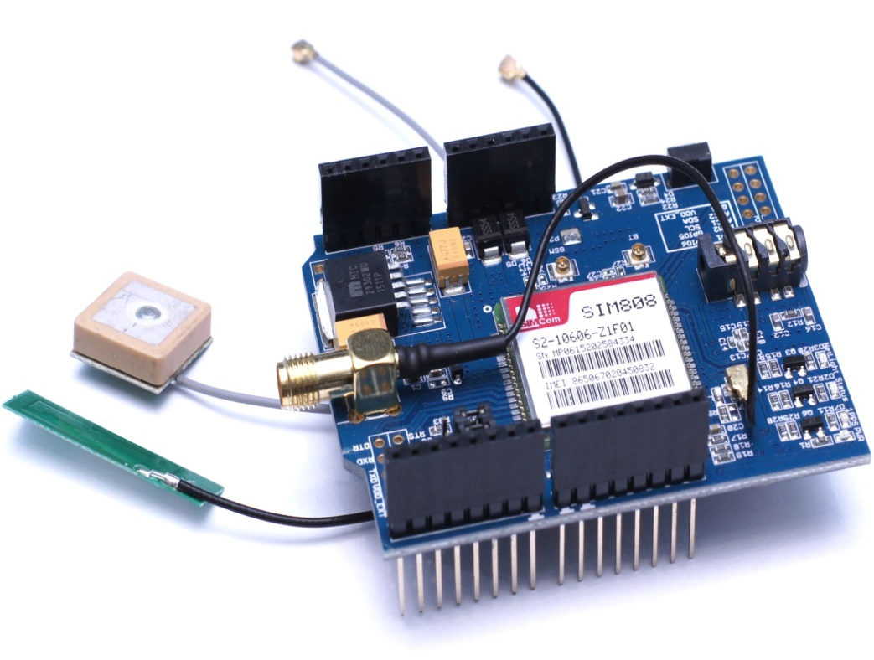
GPS

Slide 13
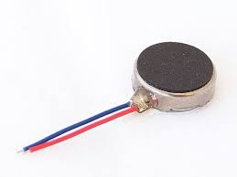
Motor vibration

Slide 14
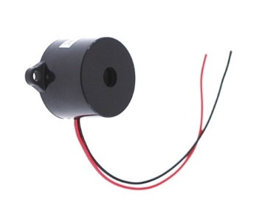
Buzzer

Slide 15
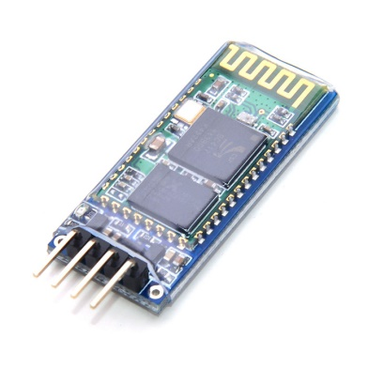
Bluetooth H005

Slide 16
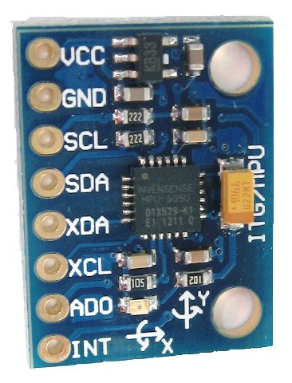
MPU6050

Slide 17
Features of our project:
The design is flexible and can be easily reusable.
Smart: the movement of bag is done automatically.
Safety: if there is an alarm system is used.
User friendly

Slide 18
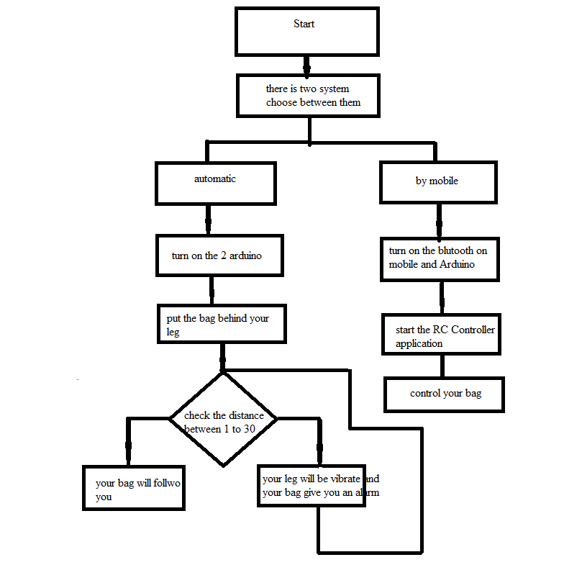
Flow Chart

Slide 19


Constraints
Choosing the idea of the project
Components constraints
Hardware implementation

Slide 20
Future Work
We will try to develop our project to have more features such as:
To be applicable on many aspects of life.
Add more features to make it more reliable and secure.

Slide 21
Demo
Play

Slide 22


