Slide 1

CONTENT AND ACTIVITY BASED FRIENDS SUGGESTION IN AN ANNOTATION SYSTEM
Jana Taha
Ramah Hawash
Supervised by: Dr. Ahmed Awad
An-Najah National University | 2024

Slide 2
2
AGENDA
  Introduction
  Annotations Similarity: Algorithims
  Problem & solution
  Elite Users
  Conclusion & Future Works
  system Architecture
  Experimental Tests
  demo
  system technologies
  Learning Outcomes
An-Najah National University | 2024

Slide 3
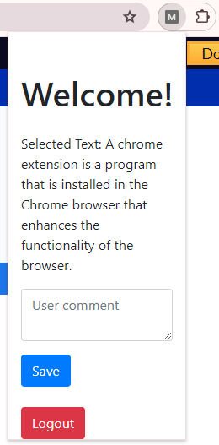
3
INTRODUCTION
what is Annotation System ?
An annotation system is a tool or method used to add notes, comments, or explanations to a document or piece of data.
Our Annotation System:
  Able to create online annotations.
  Proposes friends according to:
    Annotations similarity (Cosine, Euclidean, Dot product).
    Subjects Elites.
An-Najah National University | 2024
Google Chrome Extension

Slide 4
4
PROBLEM & SOLUTION
  Huge number of users (different interests)
  How to know which users related to ones thoughts?
An-Najah National University | 2024
  Suggest the most related users (Annotaion Similarity, Elite Users)

Slide 5
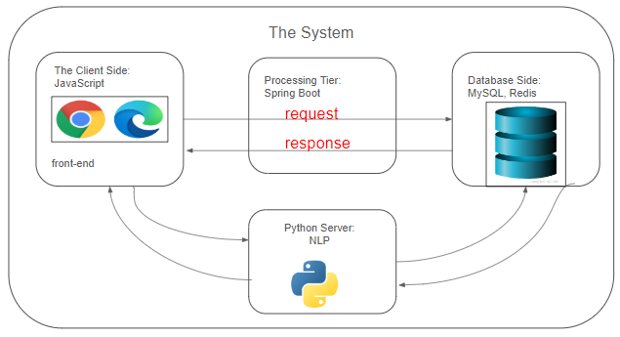
5
SYSTEM ARCHITECTURE
An-Najah National University | 2024

Slide 6

FRONT-END TECHNOLOGIES
6

Slide 7

BACK-END TECHNOLOGIES
7

Slide 8
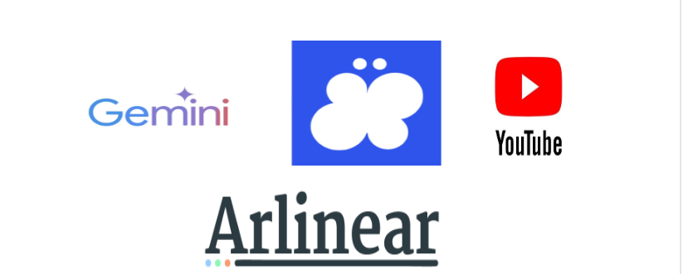
External Resources
8

Slide 9

CI/CD and IDE
9

Slide 10

DATABASE
10

Slide 11
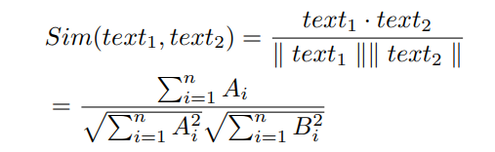

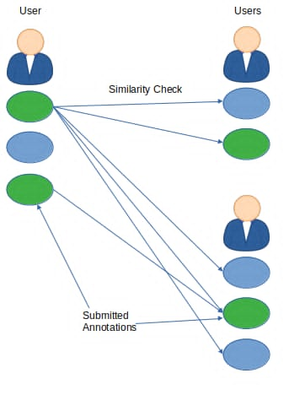

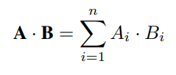
11
ANNOTATIONS SIMILARITY: ALGORITHIMS
Cosine Similarity
Euclidean distance Similarity
An-Najah NAtional University | 2024
Dot Product Similarity

Slide 12
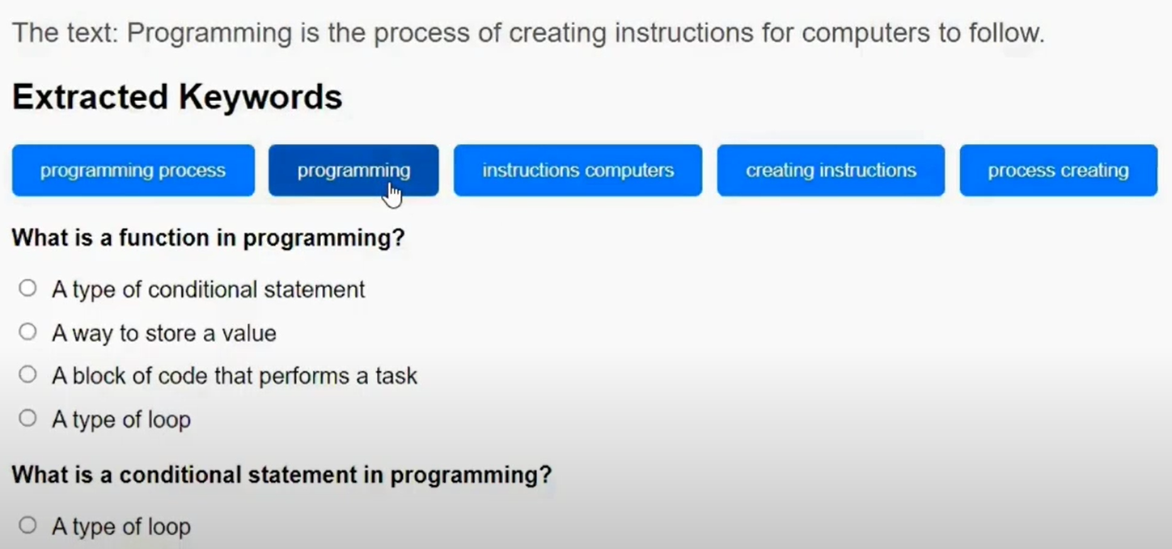
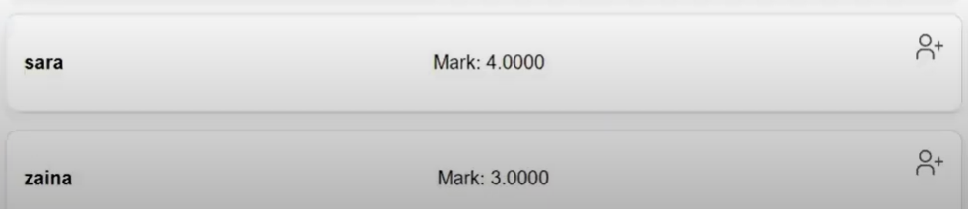
ELITE USERS
12
Doing Quizzes
upon term selection
Top Users

Slide 13
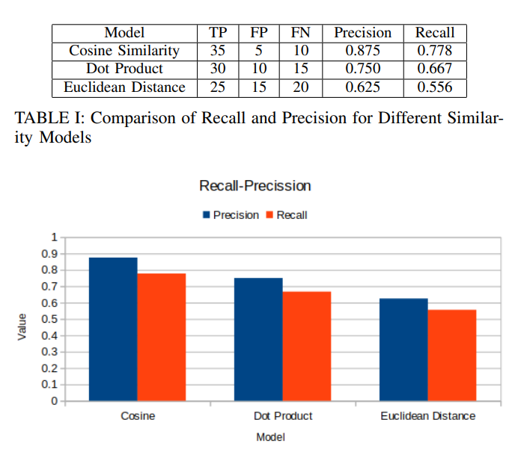
EXPERIMENTAL TESTS
13

Slide 14
14
LEARNING OUTCOMES
Learning
  Using new technologies
  Studying similarity measures
An-Najah National University | 2024
Teamwork
  Integrating code.
  Managing Tasks

Slide 15
15
CONCLUSION & FUTURE WORKS
  Cosine Similarity outperforms others.
  Elite Users proposing.
  Involve social media in sharing annotations.
  Advanced annotations search.
An-Najah National University | 2024

Slide 16
16
CONFERENCE
The work is submitted to 3ICT2024 IEEE Conference in Bahrain
#31 (157104440)
An-Najah National University | 2024

Slide 17
17
DEMO
click here
An-Najah National University | 2024

Slide 18
THANK YOU

