Slide 1
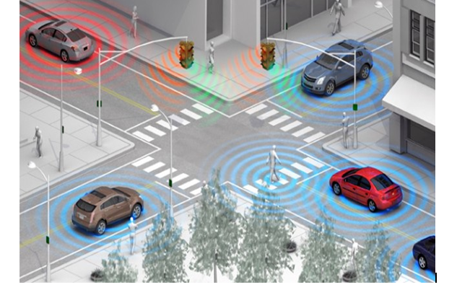
Intelligent Transportation System
I.T.S

Slide 2
Submitted by:
Ruba Abed.Alkhater
Lana Jawad
Waad Abu Hasheesh
Somayah Jarara’
Supervisor: Dr.Saed Tarapiah

Slide 3
Introduction
With the increase in number of drivers and cars,this let to the congestion of the streets and increase of accidents, so we need to make greater regulation of the system of transportation around the world and developed it so, in our project we proposed the idea of intelligent transportation system that reduces these negative effects and makes life easier.

Slide 4
system overview
The project will depend on WiFi ESP Technology, RFID and some sensor.
we put cards on each side of street that each one have Unique ID.
the readers reads and sends it to arduino by SPI to determine the location of the car.
after send this data from Arduino to the WIFI ESP
( represent aclient) by Serial.
then happen connection between two WIFI ESP ( client & access point) by protocol IEEE 802.11g.
after the second (Arduino) receive this data from WIFI ESP ( access point ) by Serial to controls the traffics light.

Slide 5

Literature Review
Some techniques can be used in this project:
RFID tagging:
We use it in this project ,because it’s more appropriate than other technique.

Slide 6

GPS(Global Positionng System):
We can use it in this project, but it’s cost high and accurately high ranges.

Slide 7
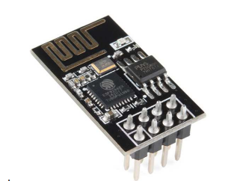
WIFI ESP (8266-01 Module) :
A PCB-Trace antenna and an external 1MB flash chip. It is not breaking out every GPIO pins – just 2 (GPIO0 & 2), It can broadcast more than 100 meters, It is very small module, the damnations of it is 14.3 mm x 24.8 mm. The following figure shows the module:

Slide 8
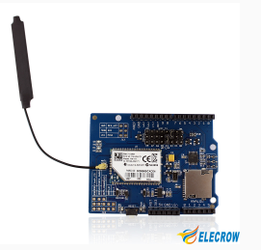
Wifi SHEILD :
This WiFi Shield connects your Arduino or Crowduino to the internet wirelessly.
We can use it in this project, but it’s cost high.

Slide 9
System Main Components
Hardware Components:
RFID
uses electromagnetic fields to automatically identify and track tags attached to objects. The tags contain electronically stored information. Passive tags collect energy from a nearby RFID reader's interrogating radio waves.
Where the second and third pin is used for movement forward and backward. And the fourth and fifth pin to determine the movement of rotation right or left.

Slide 10
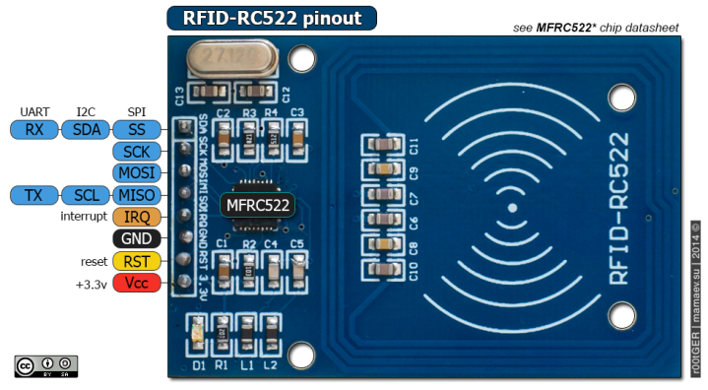

Slide 11
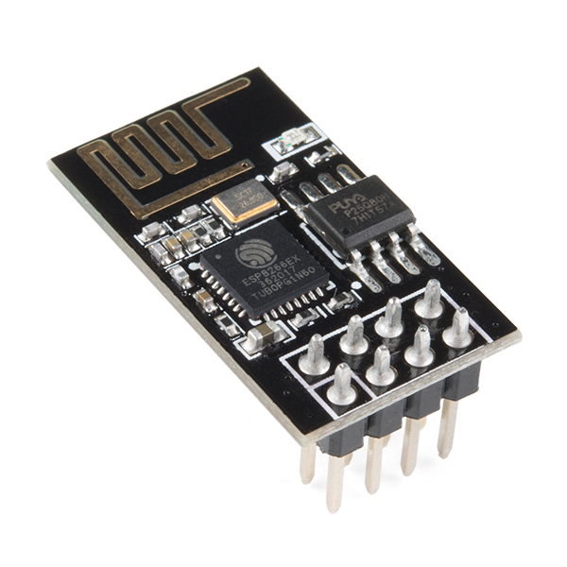
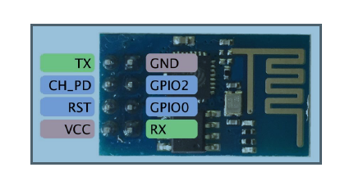
ESP8266-01 Module
It has 8 pins I/O, it is connected to 3.3v using Arduino.

Slide 12
Adapter
It is device used to down the voltage from 5 volts to 3.3 volts.
We use it to connect WIFI ESP with Arduino because WIFI turn on3.3 V and Arduino make 5V.

Slide 13
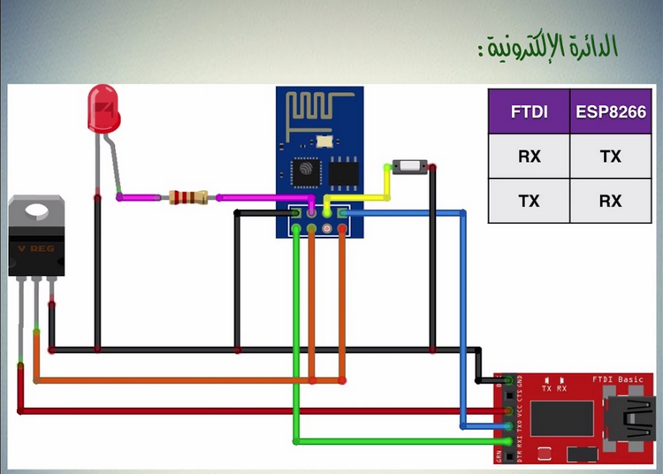

Slide 14
Software Components and Programming Language
Arduino code.

Slide 15
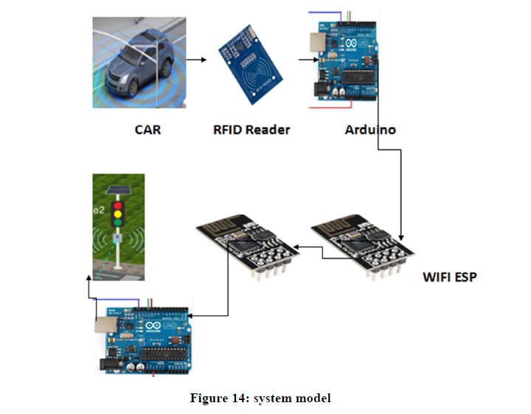
System model

Slide 16
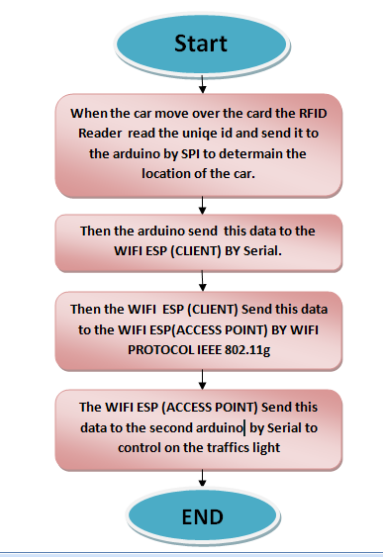
Flow chart for all system

Slide 17
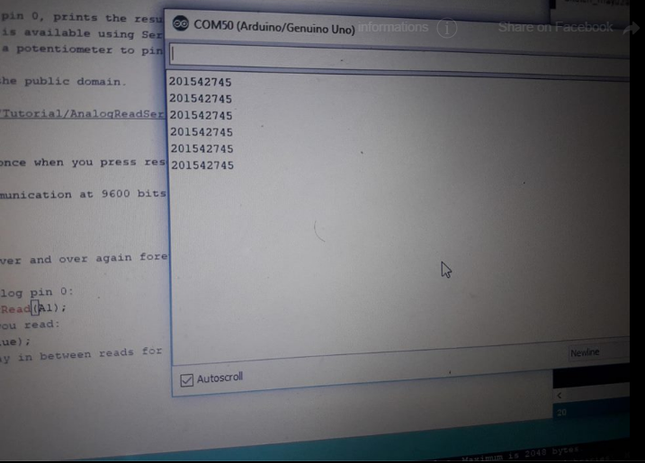
results
we managed to read the UID of the cards to determine the location of the car.
THE RESULTS ON ARDUINO SERIAL

Slide 18
feasibility study
1-Arduino:35$
2-Wi-Fi-tag (ESP8266): 11 $.
3- led’s:3$
4-RFID :11$.
5-car : 20$ .
6-adapter:7$
7-buttery:2$

Slide 19
Thank You

