Slide 1

An-Najah National University
Engineering College
Civil Engineering Department
Project title :
Management of stormwater for a portion of Faisal street “Nablus” by StormCAD
Prepared by:
Azzam Husain As'ous
Ahmad Abed-Alrahman
Abed-Alrahman Masimi
Supervisor : Dr. Mohammad N. Almasri

Slide 2
Introduction
The natural situation is to have rainfall. If this rain falls on the roofs and reached the streets, it becomes runoff.
If this runoff does not have a drainage network, it will lead to many serious problems. So it is necessary to end this problem and to develop solutions.

Slide 3
Objectives
To quantify the maximum stormwater flow rate for the study area
To hydraulically simulate the existing stormwater collection system
To develop management options that suit study area from engineering point view .
To evaluate the effectiveness of the proposed management options in solving stormwater problems using StormCAD .

Slide 4
The Study area
The study area that was chosen is located in the north-eastern part of the City of Nablus and is very close to the City Center. The problem of stormwater appears extensively and exists clearly in Faisal Street.
Faisal Street is of great importance for the main traffic, since it connects the east and west of the City and is an arterial street and is considered essential. It passes through the City Center and thus considered to have an economic importance.

Slide 5
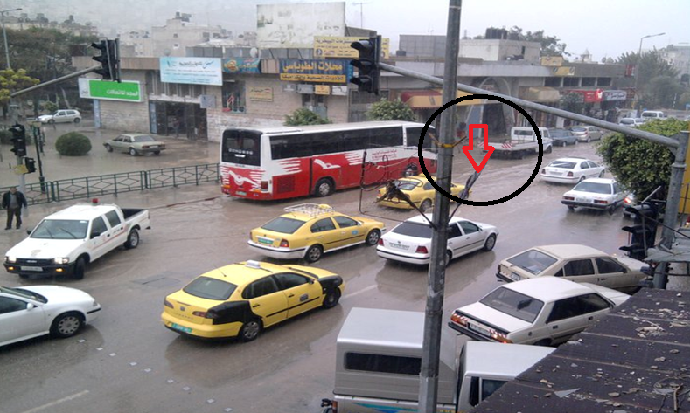
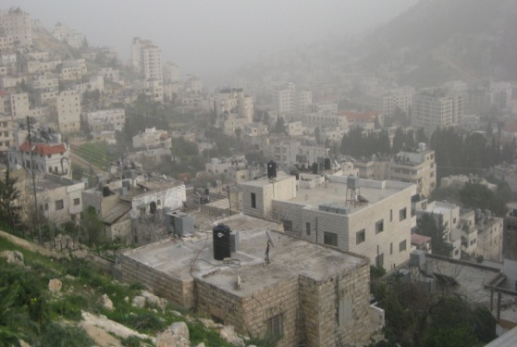
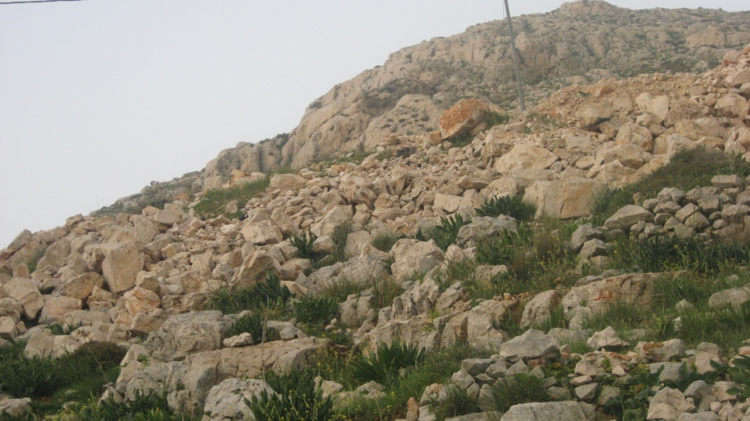
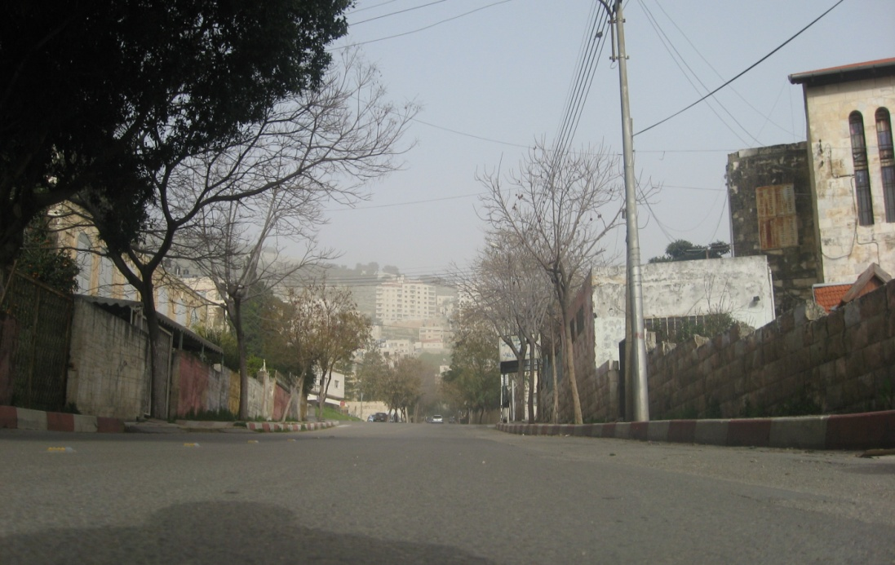
Study area
Contribution area
Residential
rocky area
Faisal street
Pavement

Slide 6
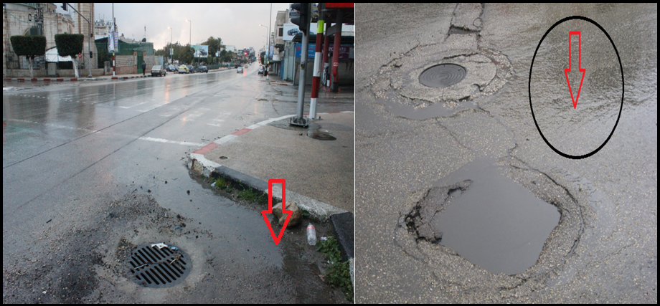
Existing problems
1- problem in water drainage

Slide 7
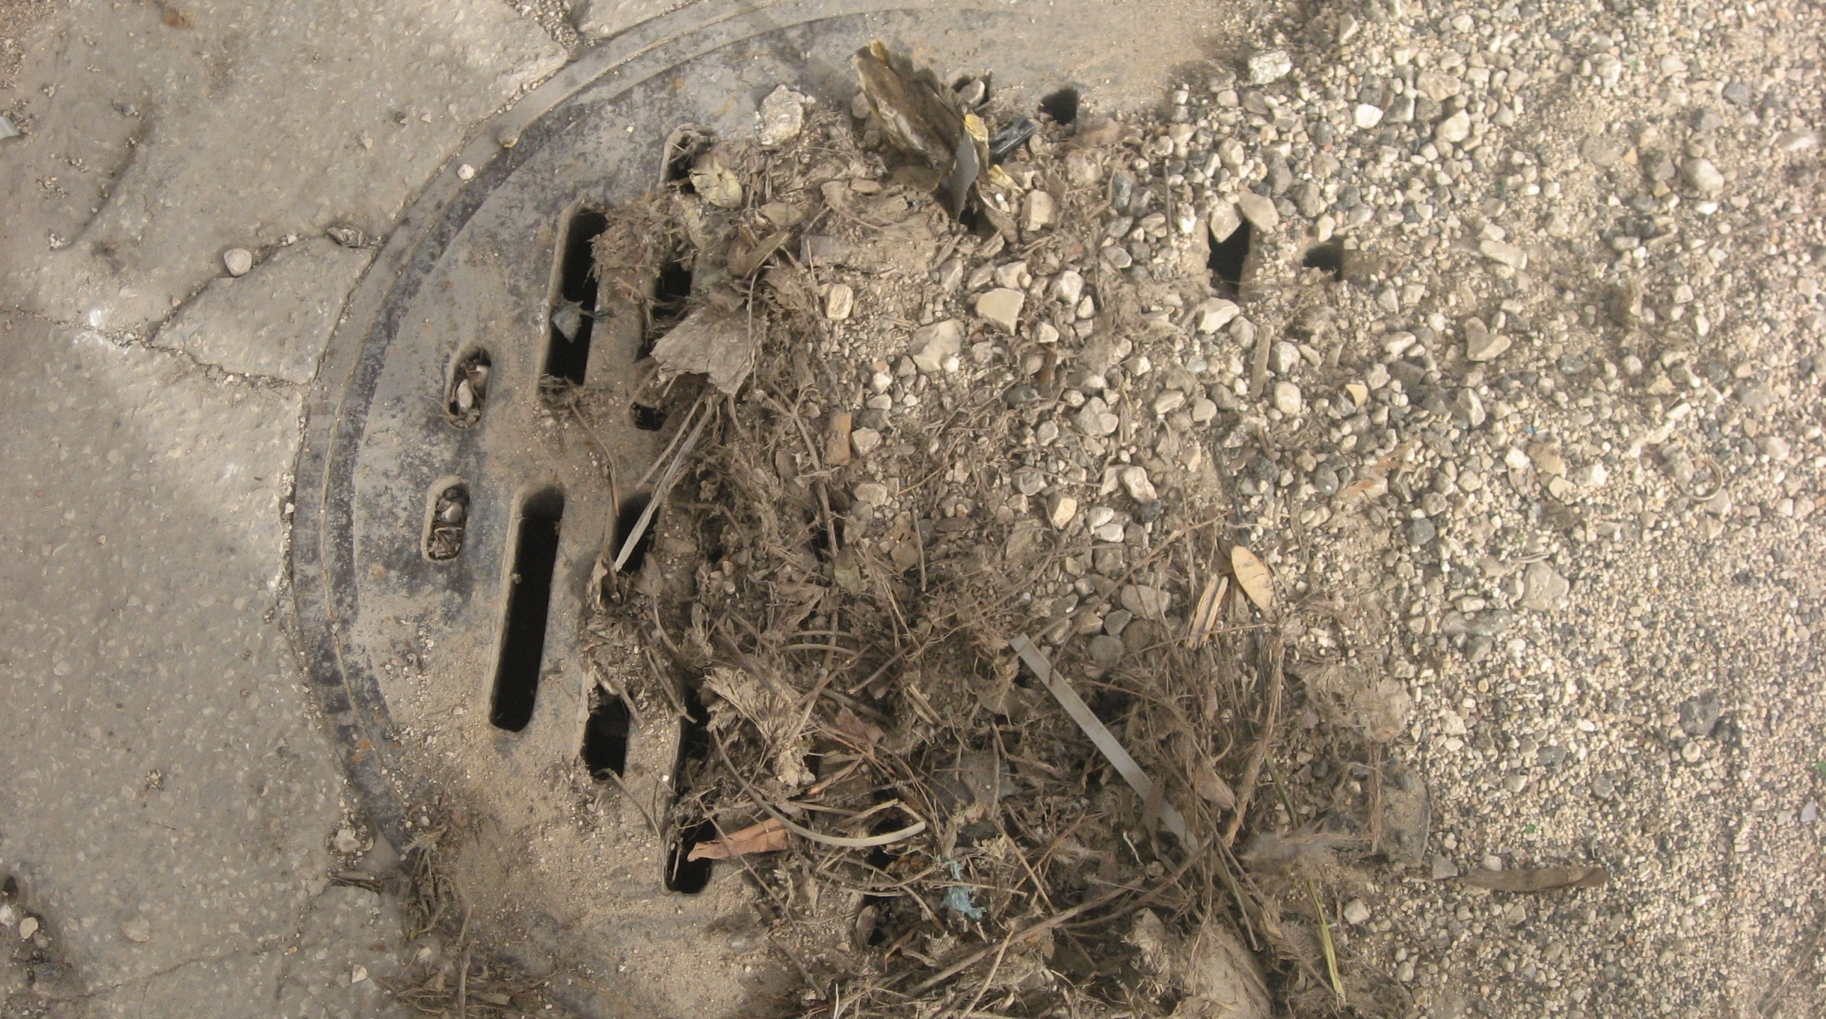
2- No Activities for Maintenance and/or Cleaning

Slide 8
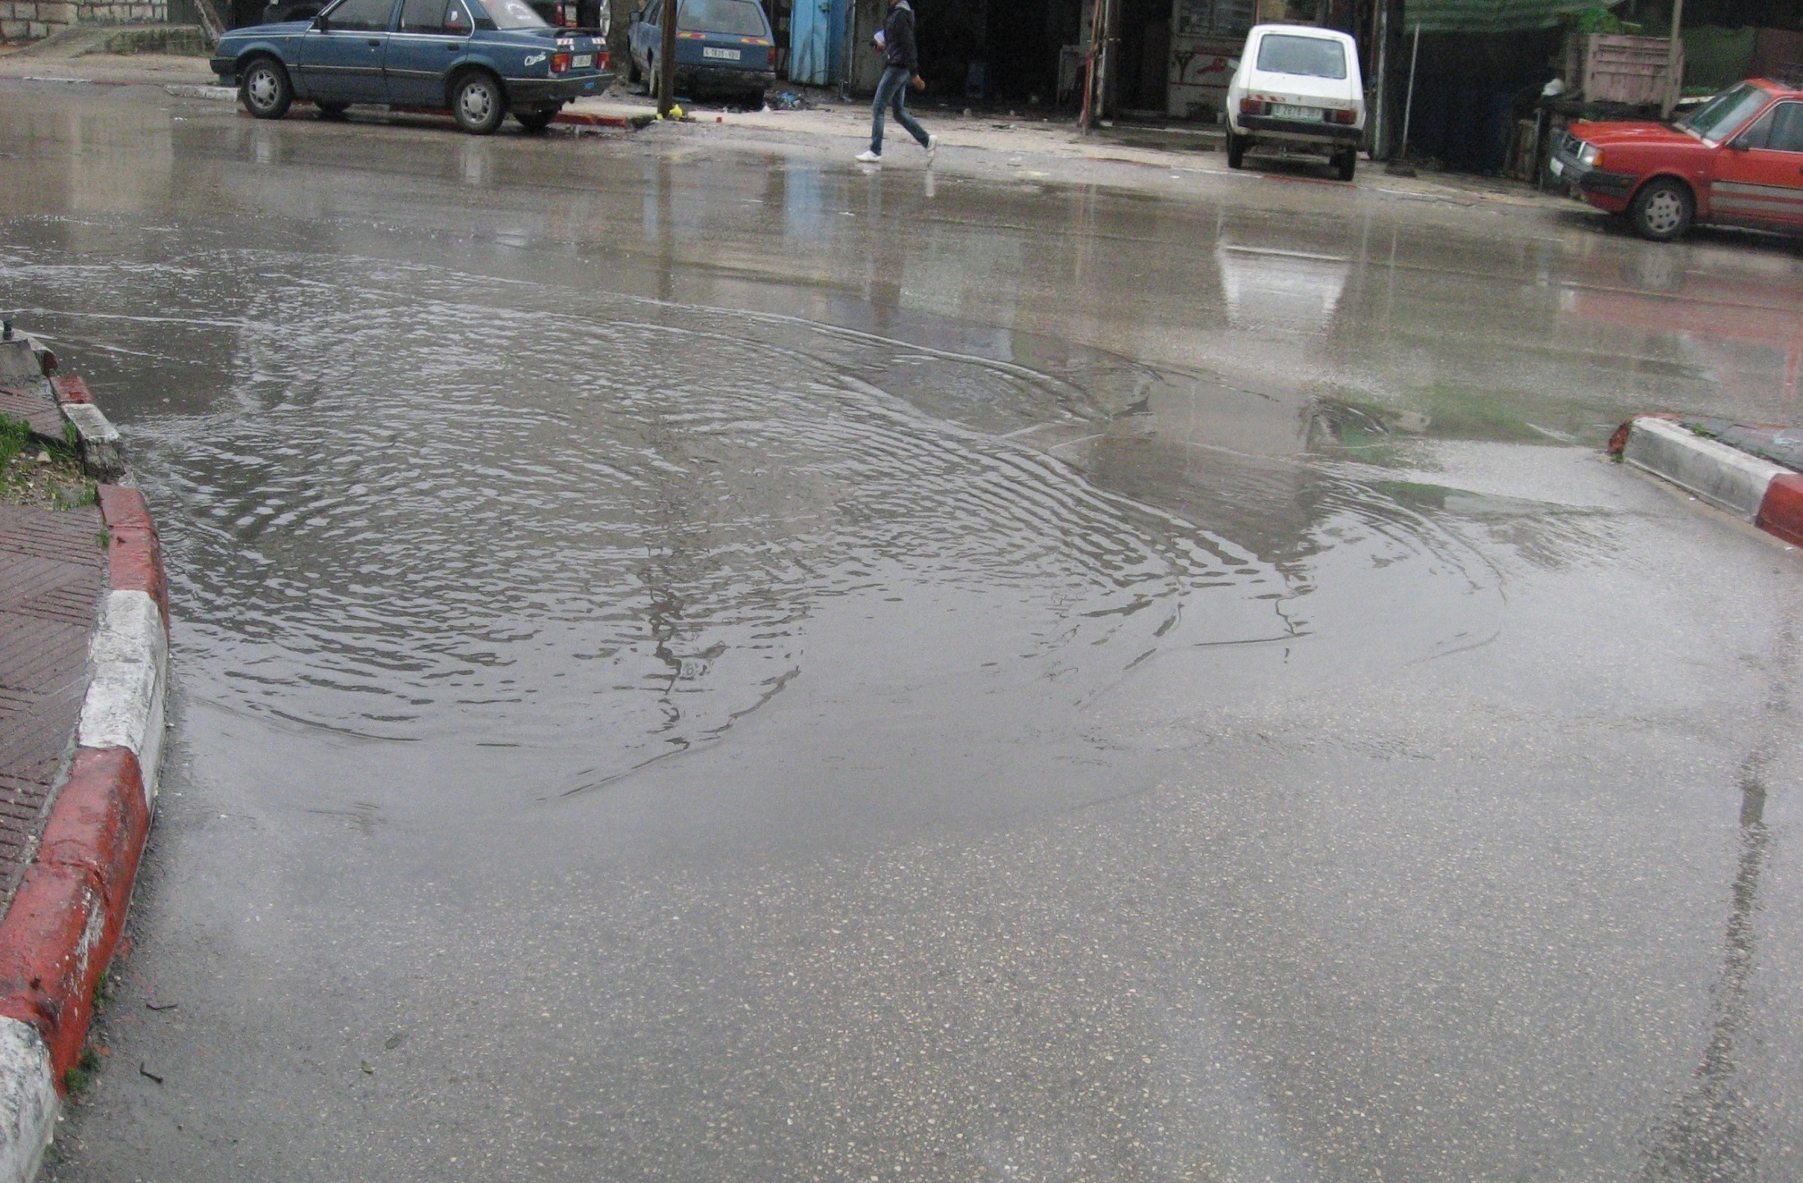
The result

Slide 9
3- In sufficient number of catch basins: the current number of catch basin can not handle with amount of stormwater.
4- pipe size: exist pipe size ( 20 in ) very small to accommodate the amount of stormwater.

Slide 10
Methodology
Understanding the problem
Selection of the study area
Data collection
Development of StormCAD model
Propose a set of solutions to the problem
Validation of solutions
Conclusions and Recommendations

Slide 11

System analysis
1- Hydraulics of stormwater collection system
a) Rational method
Q= CIA
b) Manning equation

Slide 12
2- StormCAD
Inlets
Catchments
Conduits

Slide 13
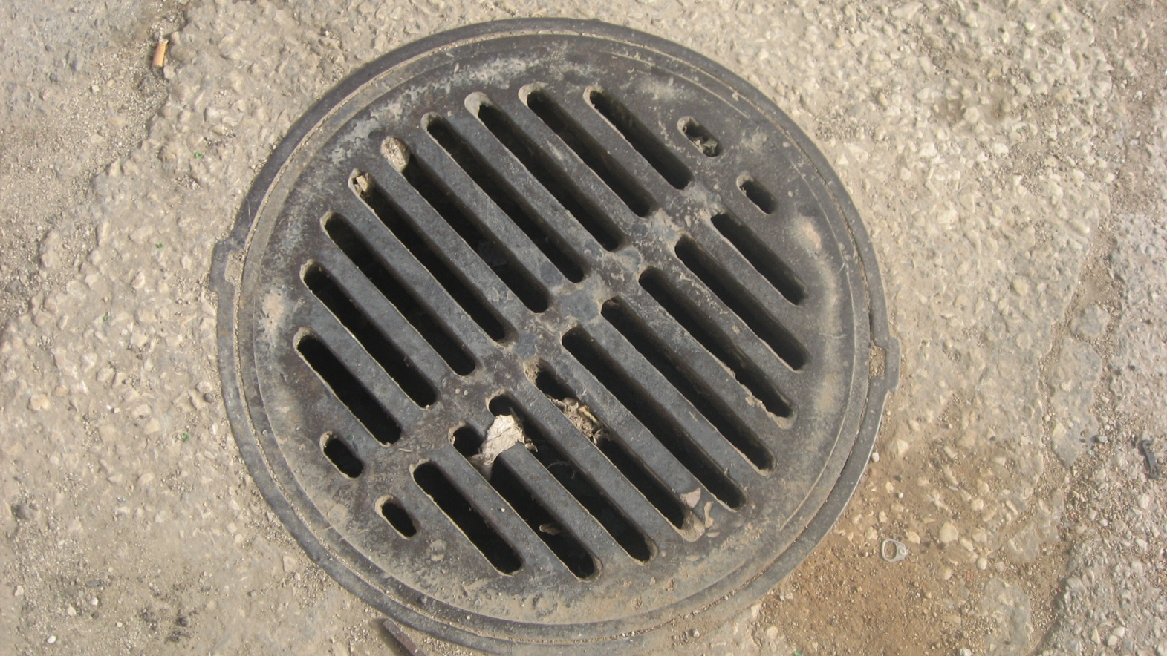
Inlet
Inlets are structures that convey storm water from the surface into a drainage system.

Slide 14
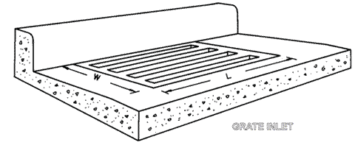
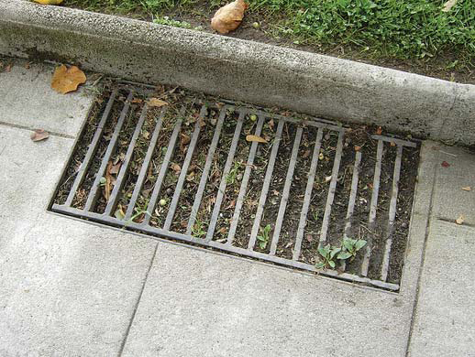
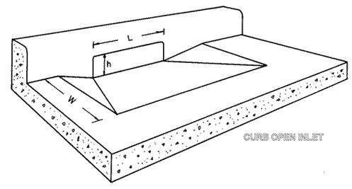
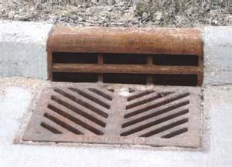
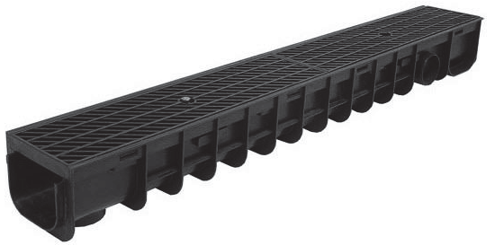
Inlet type
Grate
Combination
slotted

Slide 15
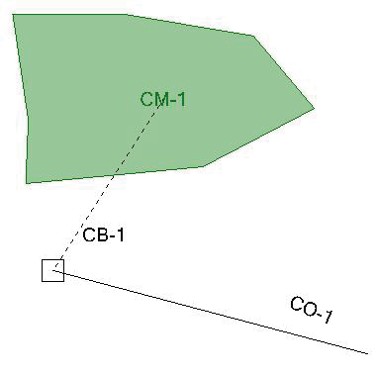
Catchment
Associated with each catch basin there is catchment over which rainfall becomes storm water .
Key include
Area , runoff, time concentration

Slide 16
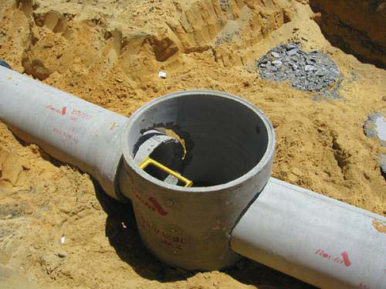
Conduit
Diameter
Length
Slope
Material
Number of pipe

Slide 17
Model calibration
1- After understanding every parameter that the program need we started the process of calibration
2- Match between the real case and the model output
3- Alter certain parameters of the model and run the model and extract the results

Slide 18
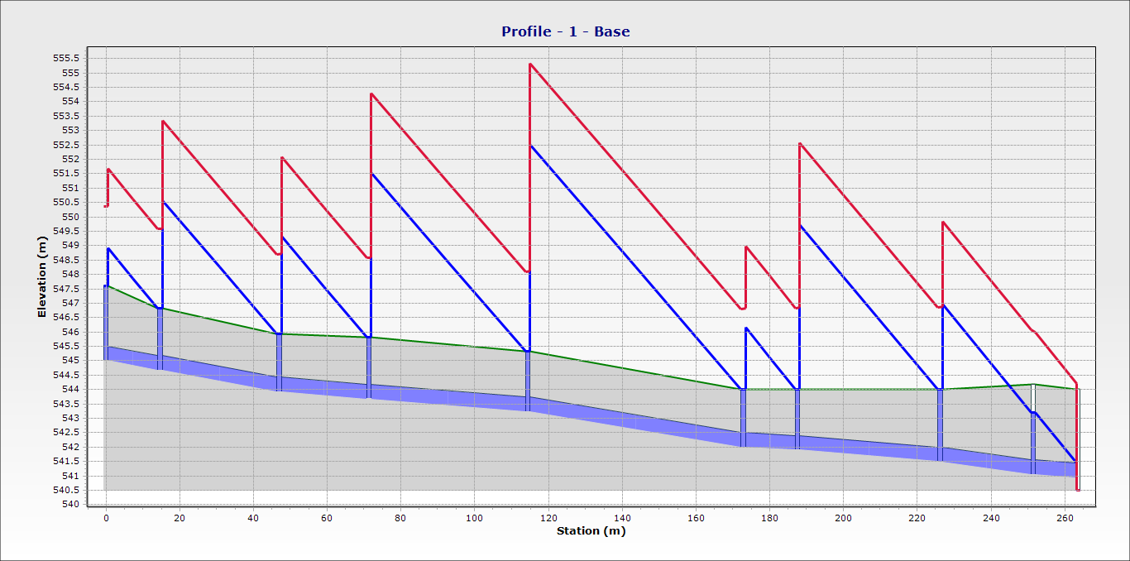
First shot
The profile that was extracted

Slide 19
The profile that appeared does not make sense for the real case that seen in the study area.
So more understanding of the parameters that have effective impact on model output
The most parameter that have effective impact
Runoff coefficient( C )

Slide 20
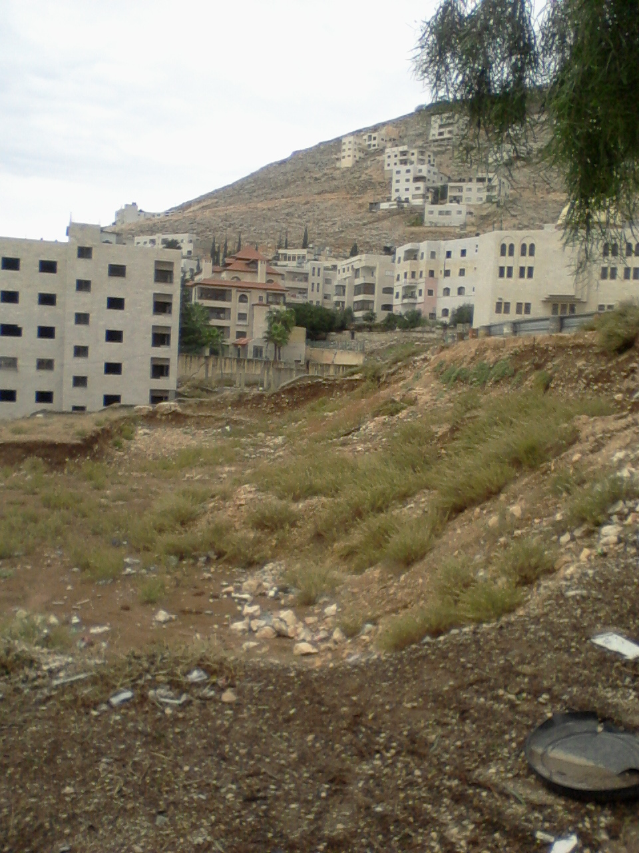
When finding that the value of C must be low we revisited the study area and found that there are few depressions that impact the generation of stormwater

Slide 21
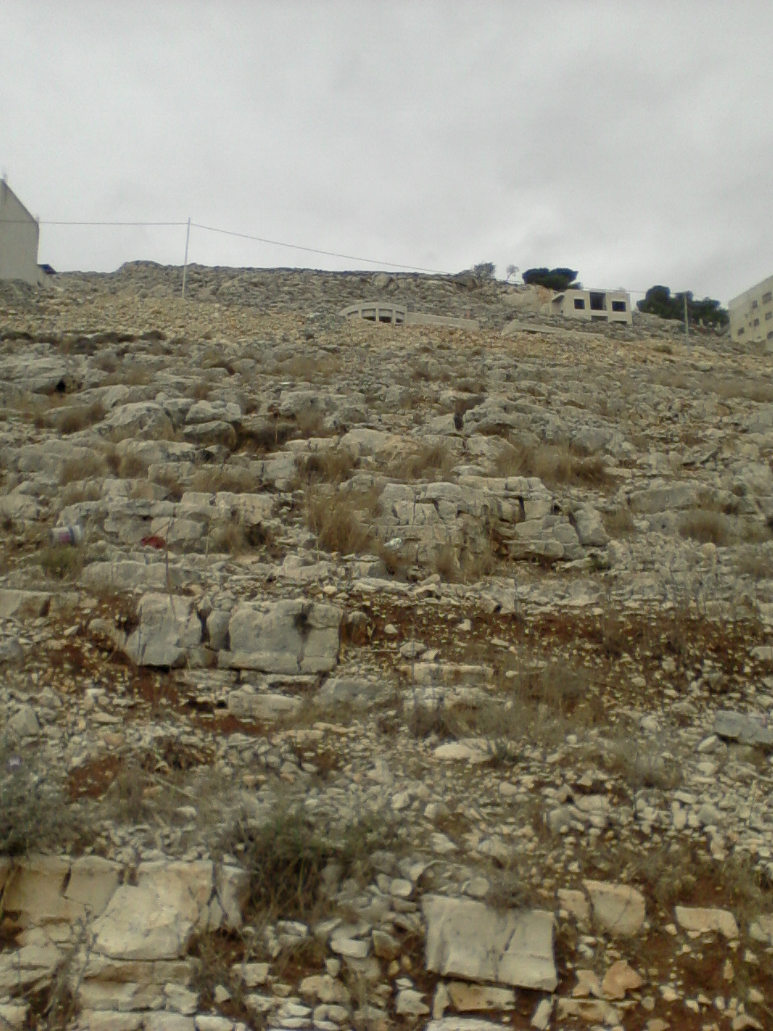
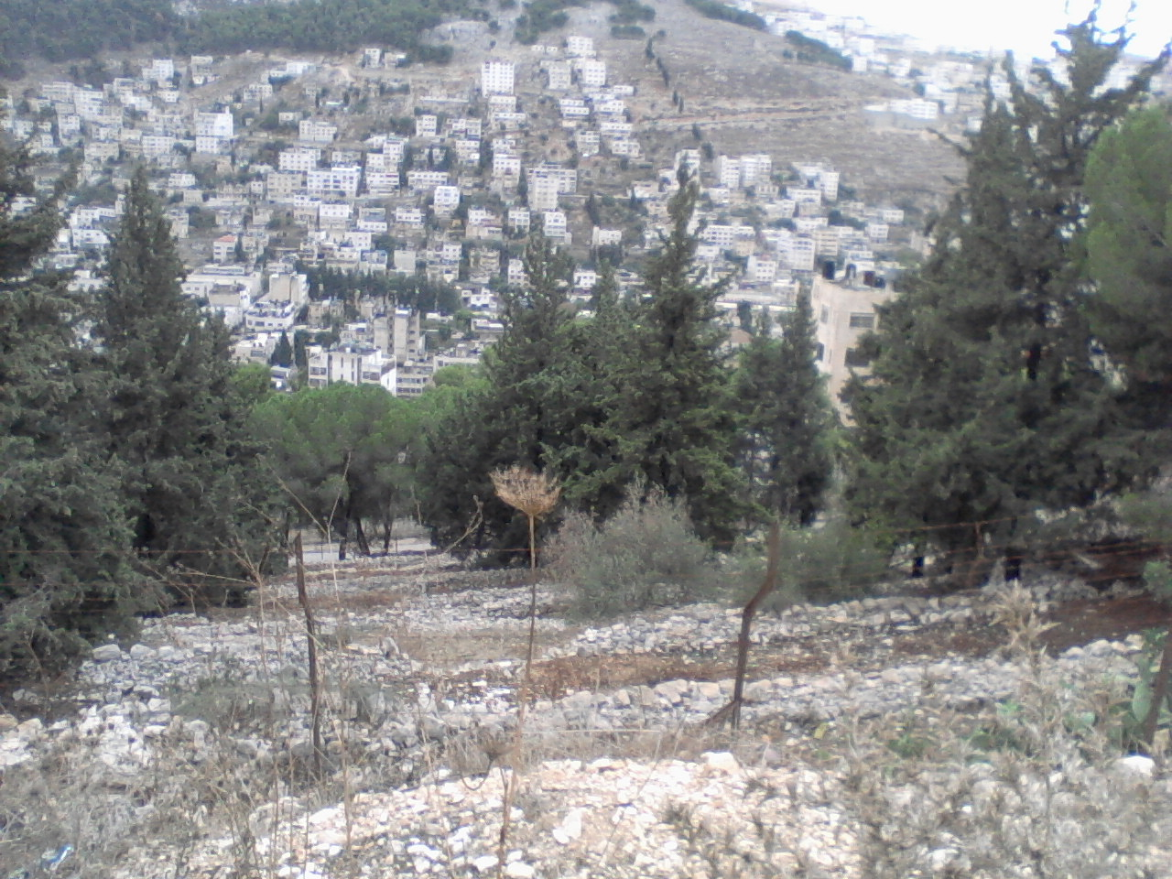
In addition, the rocks of the study area are oriented in away that obstructs the stormwater

Slide 22
3- output exist situation
Profile
Velocity
Flow rate and relation with pipe capacity

Slide 23
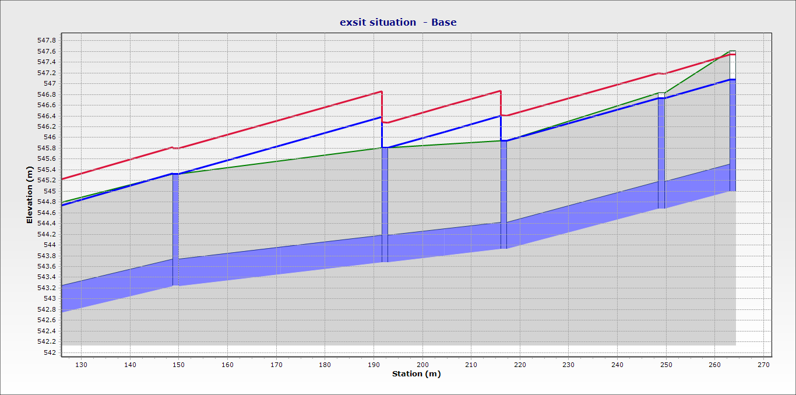
Profile

Slide 24
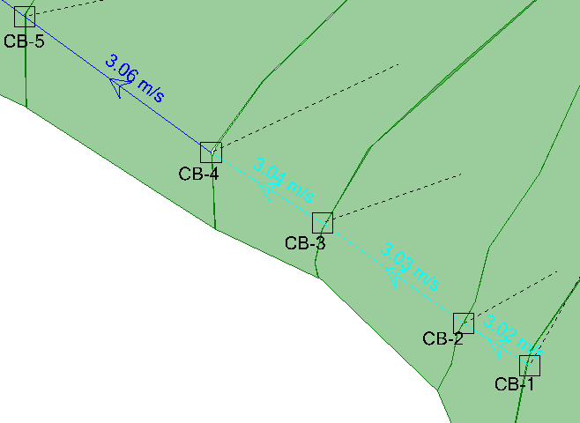
Velocity

Slide 25
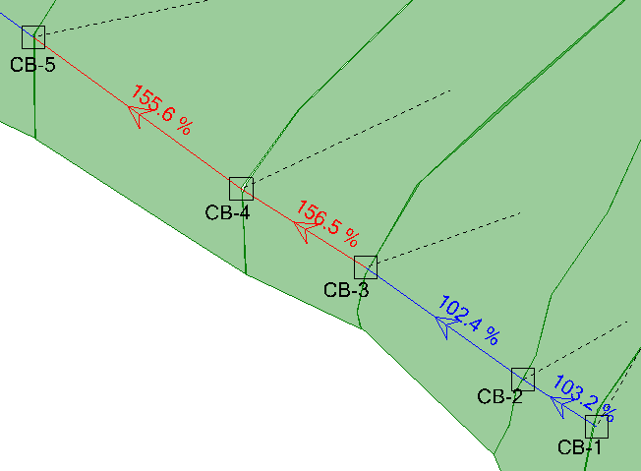
Flow rate and relation with pipe capacity

Slide 26
Management options
Option 1
the purpose of this option is to suggest an increase in the flow capacity of the pipe by changing the diameter

Slide 27
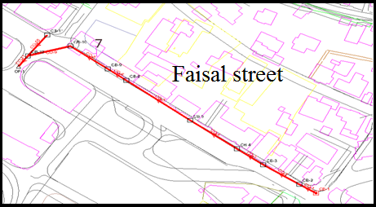
Main pipe line

Slide 28
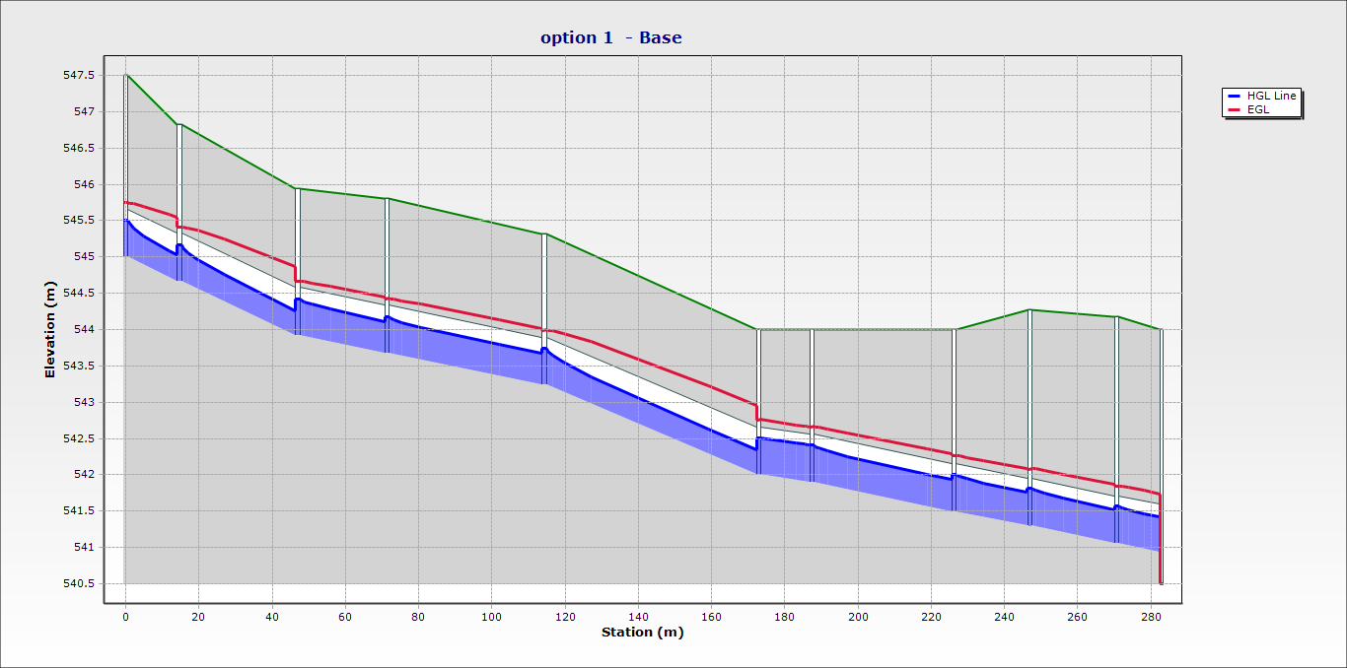
Profile after applying option 1

Slide 29
Management options
Option 2
the idea of this proposed option is to prevent a part of this huge amount of stormwater from entering the system by changing the direction of part the stormwater at a specific location

Slide 30
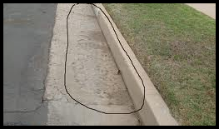
How ???
By changing the slope of the street and making a gutter at the street curb
adding a slotted inlet in the street to catch the stormwater and drain through a subsurface pipe

Slide 31
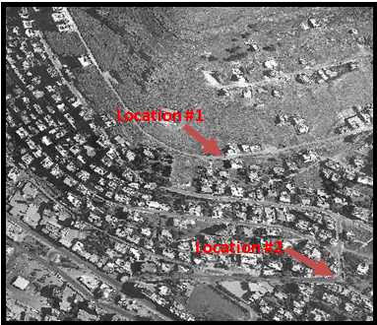
Two locations under this management option were specified.

Slide 32
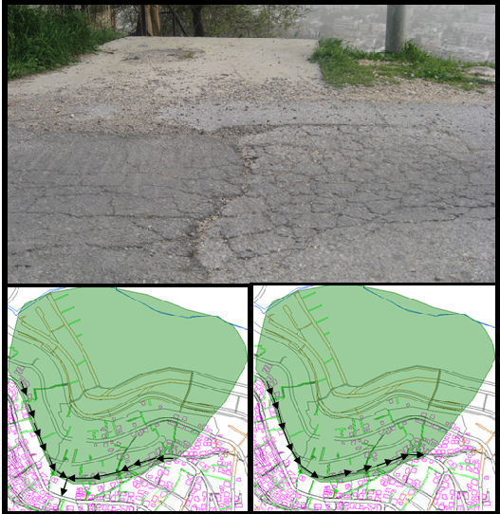
Location 1
Change the direction of the water that accumulate from the shaded area.

Slide 33
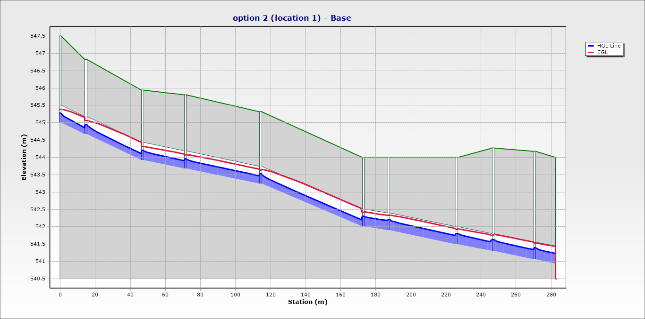
profile after applying option 2 location # 1

Slide 34
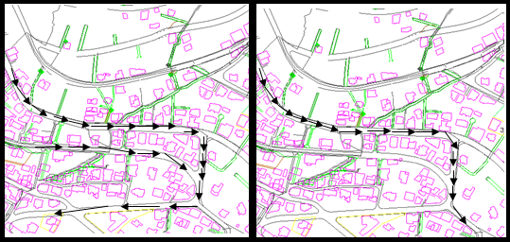
Location 2
Change the percent of the stormwater that accumulates in the street into another area to decrease the amount of flow

Slide 35
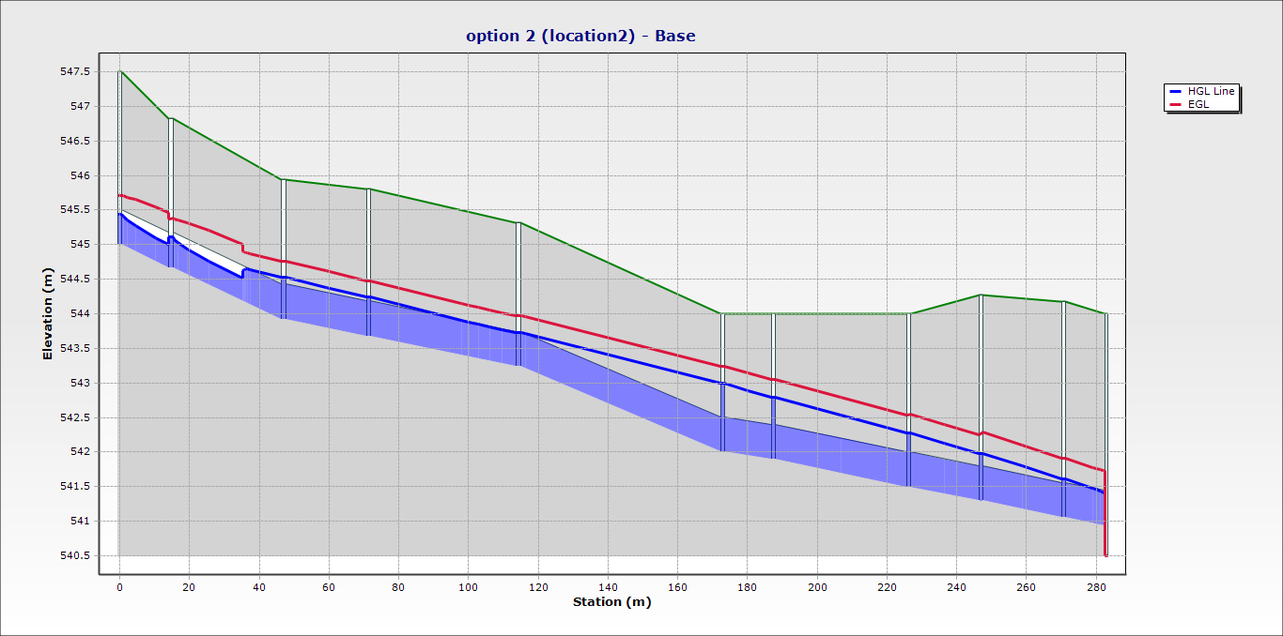
profile that occurs after applied the diverge on the location #2

Slide 36
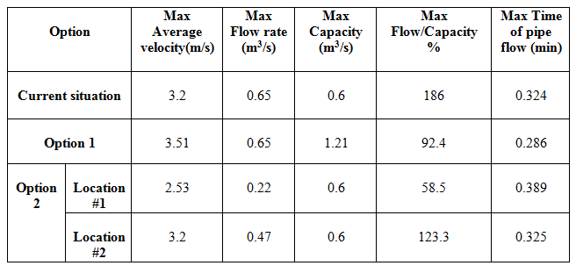
Table summarizes the maximum characteristics for the current situation, option 1, and option 2

Slide 37
Conclusions and Recommendations
The use of a sewer with a diameter of 20 inches is not effective in combined stormwater and sewer collection systems for the study area.
Time of concentration (t_{c}) and rational coefficient (C) have a significant impact on the maximum rate of stormwater.

Slide 38
The management of stormwater problem in the study area must be part of an overall integrated management plan. This plan must consider a larger area compared to our study area. So solving the problems in our study area will be in the expense of creating new problems to nearby areas.

Slide 39
Recommendations
Nablus Municipality should consider the development of an integrated management plan for stormwater for larger areas in order to effectively solve such a problem.
Change the diameter of the sewer in the network from 20 to 26 inches in order to solve the existing problems.

Slide 40
Diversion of a percent of stormwater at the specific locations to decrease the amount of the stormwater that enters the network.
Make a full maintenance for all network elements and change the damaged ones. This should be carried out prior to the winter season.

Slide 41


