Slide 1

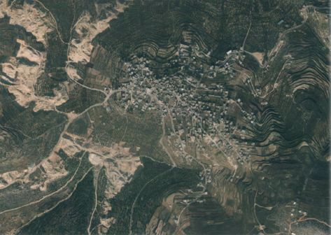
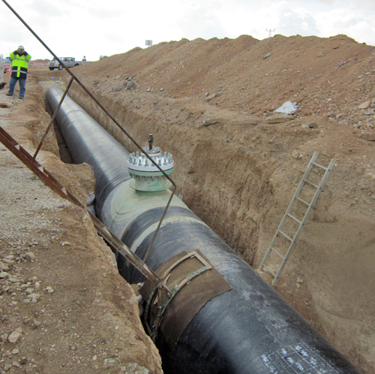
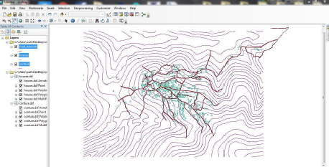
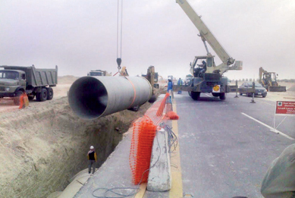

Slide 2

Objectives
Study area
Data collected
Methodology
Results
Cost estimates
Conclusion and recommendations

Slide 3


Significance of the work
Not enough quantity of water There is no WWCN

Slide 4
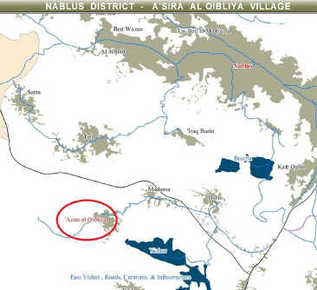
Study Area
Location
Total area of the village is about 480 donums
The average elevation is 480 m above mean sea level.

Slide 5
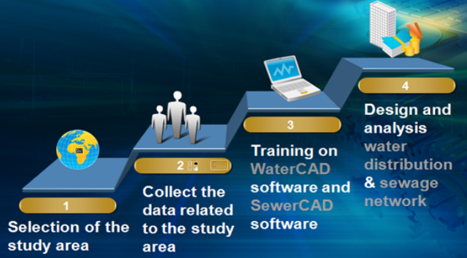
Methodology

Slide 6
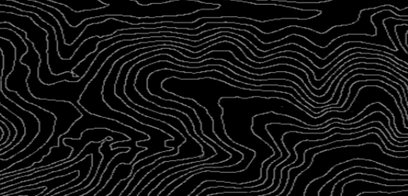
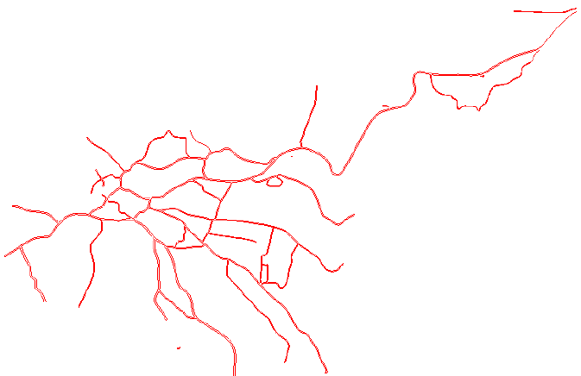
Data Collected
Topographic contour map
Road Network

Slide 7
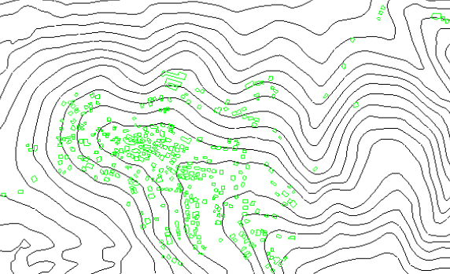
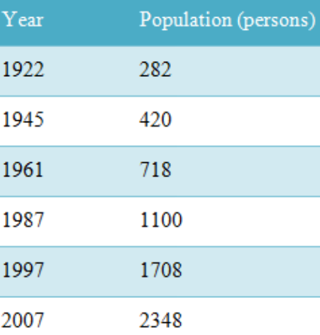
Data Collected
Distribution of houses
Population number

Slide 8
Water distribution network system
Our based design period is n=30 years.
Assume that consumption per capita is equal 120L/d.
Assume maximum hourly factor is equal 3.
Calculate the growth rate “r” and population number after design period (30 years).
Pn = P(1+r)^n
P(2007) = P(1997) (1+r)^n ➔2348 = 1708(1+r)^10 ➔ so, r=0.0323
P(2044) = P(2007) (1+r)^n ➔ P(2044) = 2348(1+0.0323)^37 ➔ P(2044)=7613 Capita.

Slide 9

Water distribution network system
Number of peple in 1 house
= number of people in 2044/number of houses in 2014
= 7613 / 368 ➔ = 21 Capita per house
Avg. consumption per house per day
= 21*120 L/capita.day ➔ = 2520 L/d
Demand in each node
Number of houses * (average consumption per house by max. hourly factor{2520*3=7560}).

Slide 10

Equation Used
WaterCAD programme use Hazen-William equation to design and analysis the network .
.

Slide 11
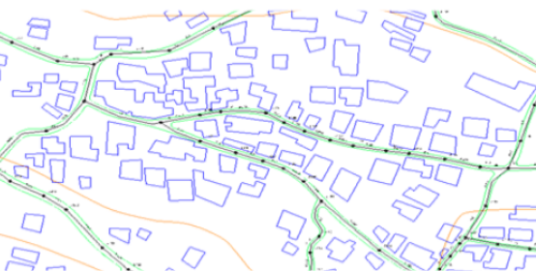
Design steps
Assign the nodes
Assign pipes between nodes with the suitable diameters
Insert node’s elevation by trex tool.
Insert the demand of nodes to the waterCAD.
Run the model

Slide 12

Design Criteria
The pressure (20-100) m H2O
➔ The velocity (0.2-3 )m/s.

Slide 13
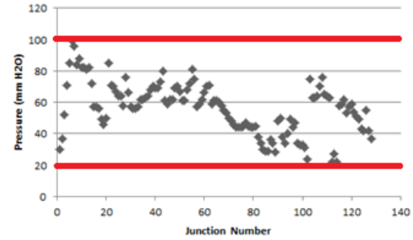
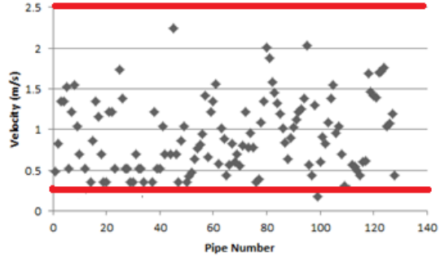
Results
The existing network velocities and pressure are given in the following figures:

Slide 14
Wastewater collection system
Our based design period is n=30 years.
Assume that consumption per capita is equal 120L/d.
Assume maximum hourly factor is equal 4.
Assume wastewater/water is 80% and infiltration rate is equal 20%.
Calculate the growth rate “r” and population number after design period (30 years).
P(2007) = P(1997) (1+r)^n ➔2348 = 1708(1+r)^10 ➔ so, r=0.0323
P(2045) = P(2007) (1+r)^n ➔ P(2045) = 2348(1+0.0323)^38 ➔ P(2045)=7858 Capita.
So, waste water per capita is (120×0.8×4 + 120×0.8×0.2) = 403.2 L/c-d.

Slide 15
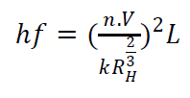
Equation Used
Manning equation that we have used in SewerCAD
.

Slide 16
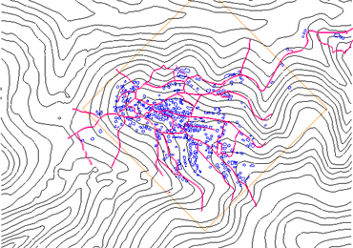
Design steps
1- Collect data needed for design
2- Add data to SewerCAD software.

Slide 17
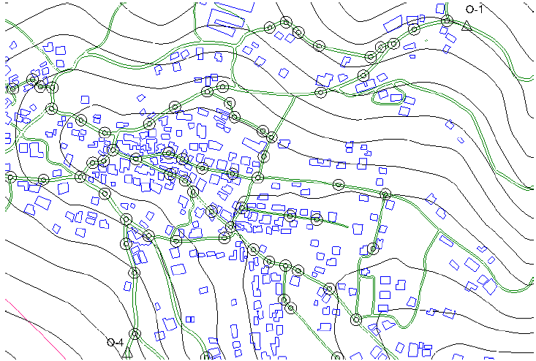
Design steps
3- Distribution manholes and outfalls

Slide 18
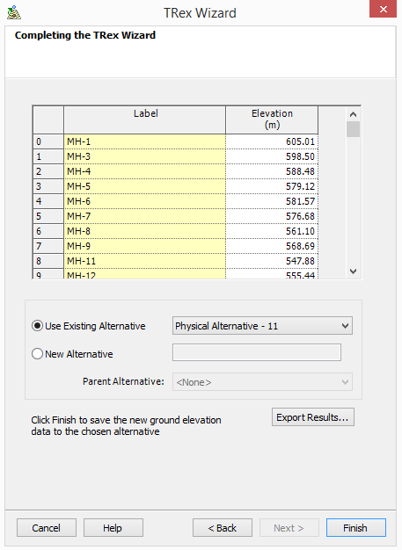
Design steps
4- Extracrt the elevation of manholes and outfalls by trex tool

Slide 19
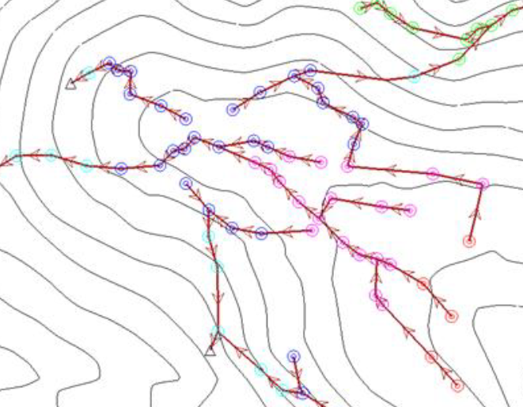
Design steps
5- Tracing conduits between manholes

Slide 20
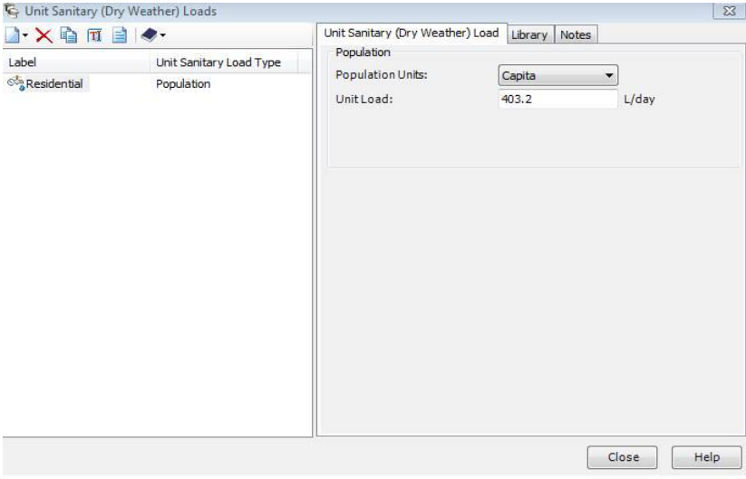
Design steps
6- Insert unit sanitary load (based population) into SewerCAD

Slide 21
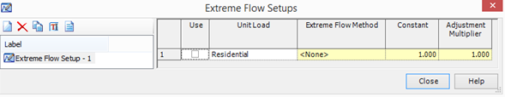
Design steps
7- Define extreme flow setup

Slide 22
Design steps
8- Determine the served area for each manhole by used archydro tools, then assign load design for each manhole by model builder tool
Population density =𝑃𝑜𝑝𝑢𝑙𝑎𝑡𝑖𝑜𝑛/study area
=7858/558607.28 = 0.014 capita/m2 .
Population served by manhole = served area × Population density .

Slide 23
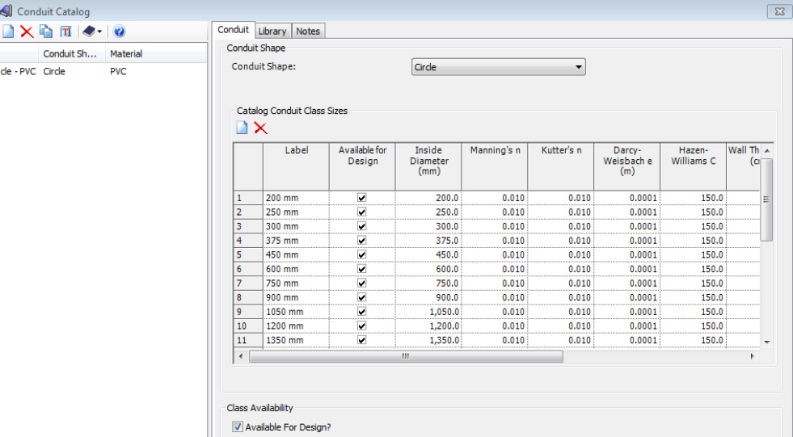
Design steps
9- Import conduit diameter from the library

Slide 24
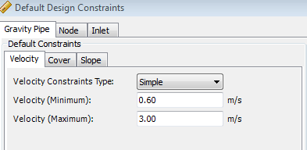
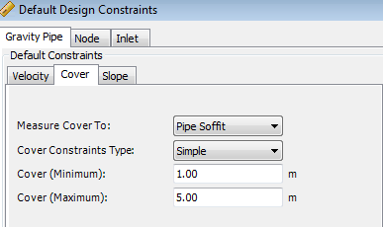
Design steps
10- Define design constrains

Slide 25
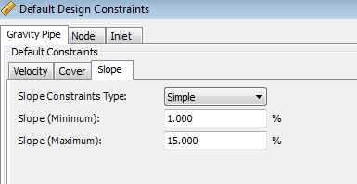
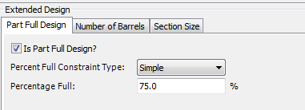

Design steps
Then, Run The Model

Slide 26

Design Criteria
➔Cover: (1-5) m
Slope (1-15)%
➔Velocity (0.6-3 ) m/s

Slide 27
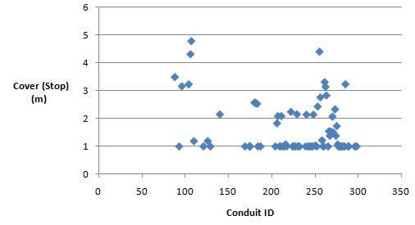
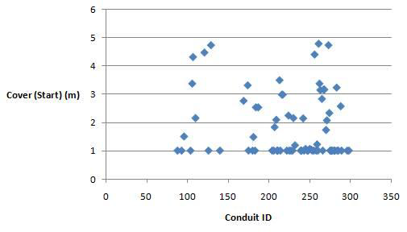
Result
The existing network Covers are given in the following figures:

Slide 28
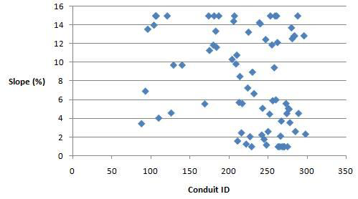
Result
The existing network Slopes are given in the following figure:

Slide 29
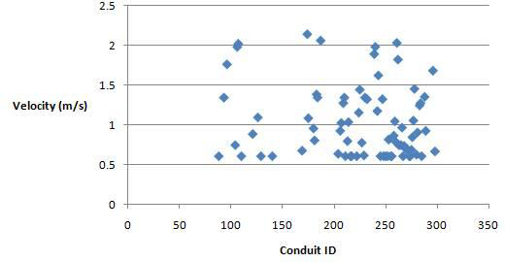
Result
The existing network Velocities are given in the following figure:

Slide 30
Cost Estimates
For water distribution network:
The total cost equal $671116.64 and it is equal $107.05 per unit length.
For wastewater collection network:
The total equal $474454.4 and it is equal $137.66 per unit length.

Slide 31
Conclusions
For water distribution network (WDN):
● The selected design period is applicable and serviceable.
● As we notice, if we decrease the diameter of the pipe the velocity increase and the pressure increase.
● To reduce the pressure we use one pressure reducing valve, which controls the high pressure.
●No pump was used in the network because we put the reservoir in the highest elevation in the village and so the water travels along pipes under the influence of gravity.

Slide 32
Conclusions
For wastewater collection network (WWCN):
● The selected design period is applicable and serviceable.
● We note that the values of velocity are within the allowable range (0.6-3) m/s.
●We note that the values of slope are within the allowable range (1-15) %.
●There is no need to use drop manholes because all values of cover are within the allowable range (1-5) m.

Slide 33
Recommendations
● To construct the wastewater collection network because of the problems caused by cesspits on the environment and groundwater, In addition to seepage problems and expenses.
● To make wastewater treatment plan (WWTP) to avoid the pollution of the environment caused by the wastewater.
● We recommend the municipality of Asira al-Qibliya to consider this proposal to construct the network.

Slide 34


