Slide 1

Hardware Graduation Project :
Face Recognition
“one type of security systems”
Supervised by:
Dr. Raed Al Qadi.
Prepared by:
Isra`a Hinnawi.
Ala`a Abu Odeh.
Notes:
هون بنحط صورةوجه يكون 3d
من النت

Slide 2
Outlines:
Introduction
Hardware
Tools And Software Libraries
Algorithm
Progress
Problems
Future Work

Slide 3
Introduction..
Security, authentication and speed are one of the most requirements in this life, and the importance of these concepts are increased among the time in all fields.
So, we choose a project that concerned with these concepts.
AND IT IS …

Slide 4
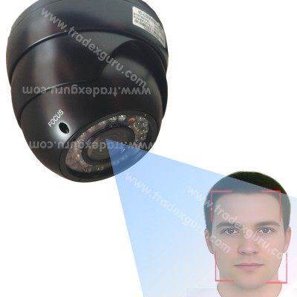
Introduction..
Allow an authorized person and prevent unauthorized person from passing an electronic gate using Face Recognition.

Slide 5
Why Face Recognition ?
  There exist several biometric systems such as signature, finger prints, voice, hand geometry and ear geometry.
  Among these systems, facial recognition appears to be one of the most universal, collectible, and accessible systems.

Slide 6
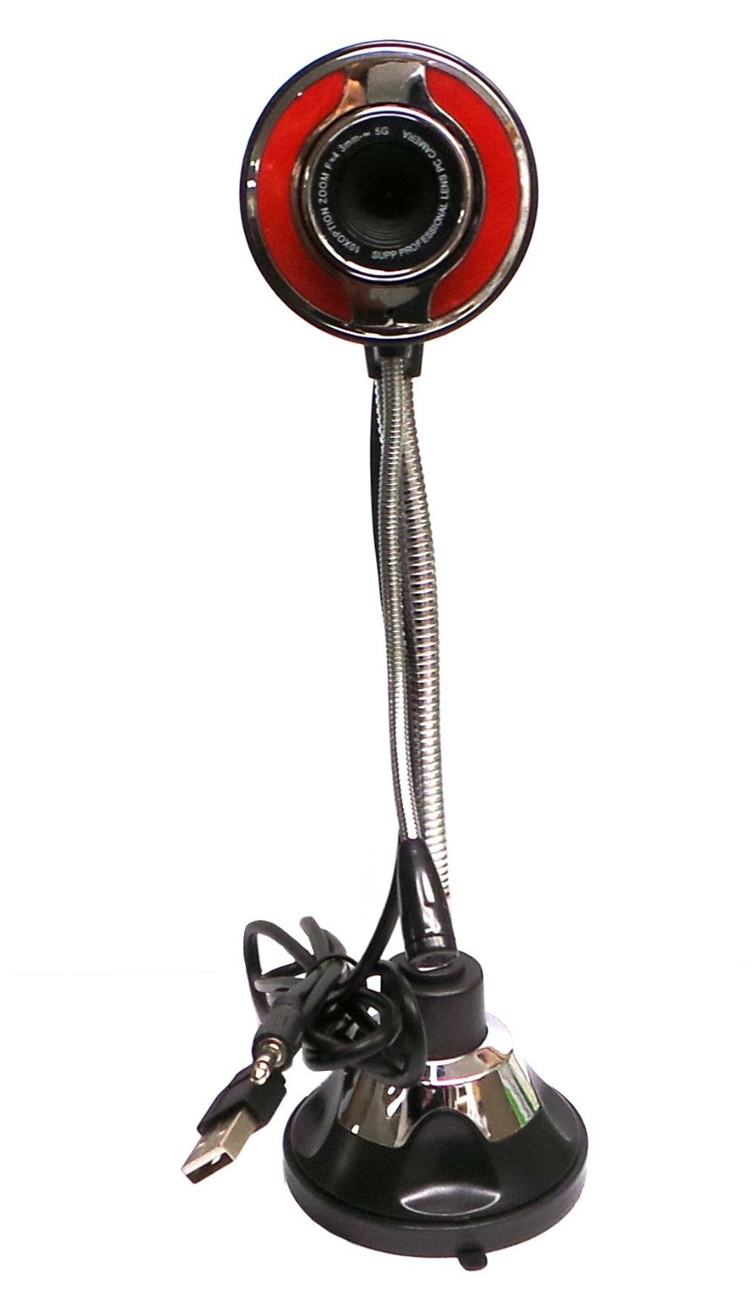
Hardware…
User Controller Side
Camera
To capture images .

Slide 7
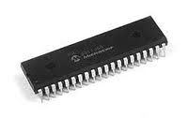
Hardware…
User Controller Side
Pic18f4620
To control the electronic gate.
To send/receive feedback from the BeagleBoard-XM.

Slide 8
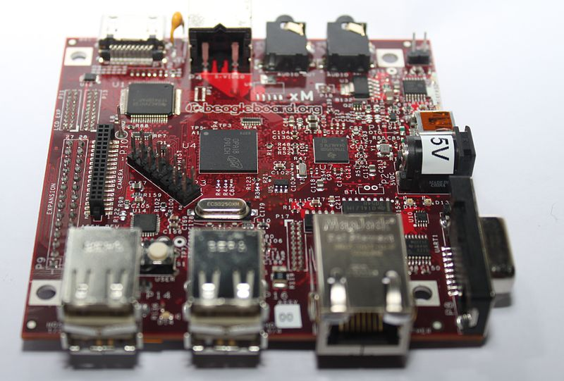
Hardware…
Main Controller Side
TheBeagleBoard-XM
Linking all the components of the system.
responsible for processing and issuing commands
Notes:
Itʼs a low power PC on board that is designed to be used as an educational board.
1 GH Super-Scalar ARM Cortex-A8 processor.

Slide 9
Hardware…
Main Controller Side
TheBeagleBoard-XM
Linking all the components of the system:
Ethernet Port.
4 USB Ports.
RS232.
HDMI Port.
Micro SD Card.
etc…

Slide 10
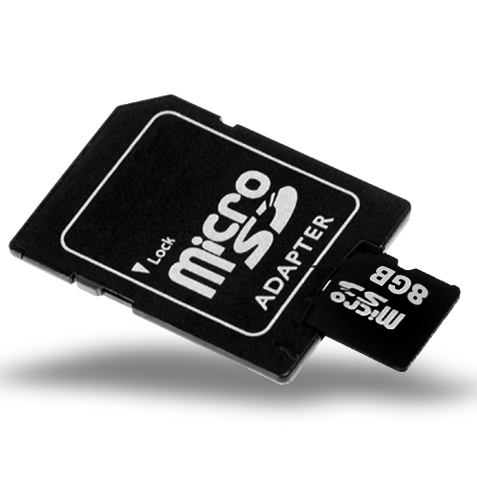
Hardware…
System Controller Side
SD Card (8GB)
4 GB microSD supplied with the BeagleBoard-xM and loaded with The Angstrom Distribution.
But 8 GB microSD for Ubuntu and OpenCV compiled.
Notes:
3lashan ubuntu kter t2eel lazm n7ke 3n mowasafat o saye2at ubuntu

Slide 11
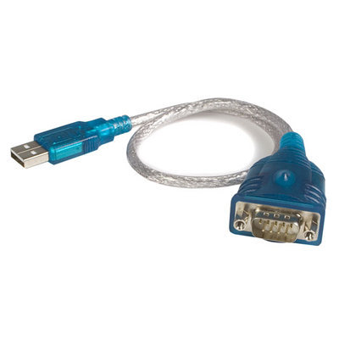
Hardware…
System Controller Side
USB to RS232 cable
USB to RS232 converter used for connection between BeagleBoard and PIC.
Notes:
3lashan ubuntu kter t2eel lazm n7ke 3n mowasafat o saye2at ubuntu

Slide 12
Tools And Software Libraries
PIC C Compiler:
In the user controller side in order to write the C code for PIC18F4620 microcontroller and produce the hex file.
OpenCV Library:
we have used it since it have a useful image processing classes as face recognizer class.
Serialib Library:
we used it to send and receive from PIC to BeagleBoaed.
Ubuntu:
We used linux ubuntu operating system because it is a good and suitable for BeagleBoard to work with OpenCV.

Slide 13
Operating System
You need to format the SD card to have 2 partitions. The first is a FAT partition marked with a boot flag and the second is an EXT3 ( Linux ) journal partition to hold the root file system.
We get the image(tar.gz) of angstrom and additional packages that we need, then extract the files to copy it to SD-card boot and angstrom partitions.
Then plug card into BeagleBoard and booting the system using Hyper terminal.

Slide 14
Operating System
The same thing done for Ubuntu.
We found that Ubuntu has slow or low performance compared with Angstrom.
Also Ubuntu has a lot of support for drivers , devices and detect the driver automatically unlike Angstrom that has less support for derivers. And need to find a driver for USB cam.

Slide 15
Algorithm :
Face recognition algorithms
There are many Face recognition algorithms we chose fisher algorithm (supported in OpenCV library, good accuracy level ).
Challenge
face recognition is easy for human but complex for computer

Slide 16
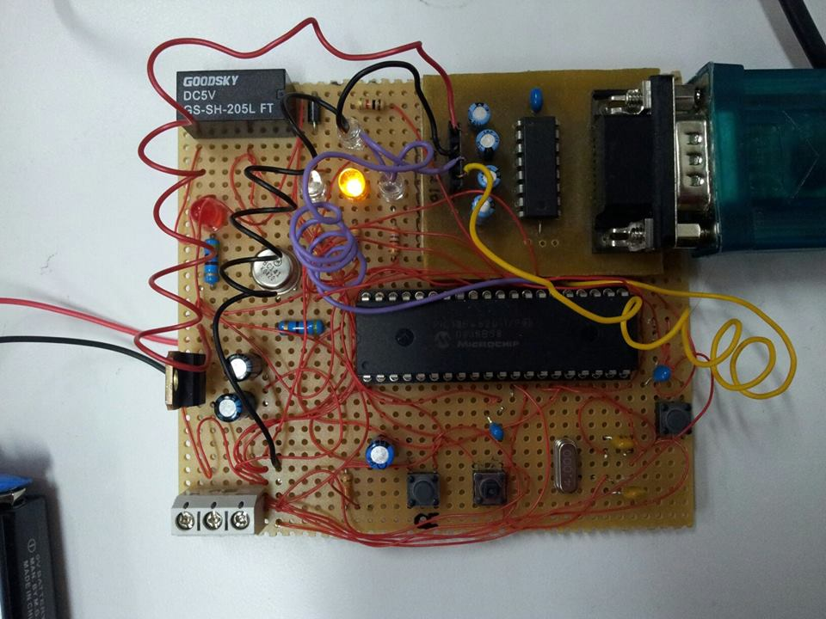
Progress..System Flow
1. PIC (User Controller side) waiting for capture button to be pressed
Notes:
هون نضيف صورة سيركت البيك ونحط دائرة واضحة على ال capture button

Slide 17
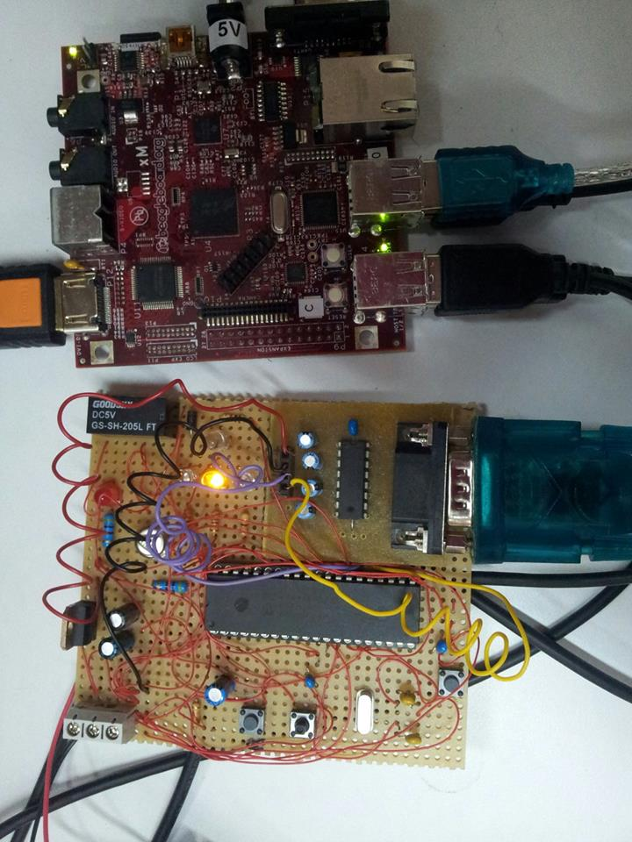
Progress..System Flow
2. If pressed PIC send command to beagleBoard through serial port indicating that push button pressed
Notes:
هوون نحط صورة البيك والبيجل بورد وبينهم الوصلة
usb to serial
ويكون مبين انو ال button مكبوس

Slide 18
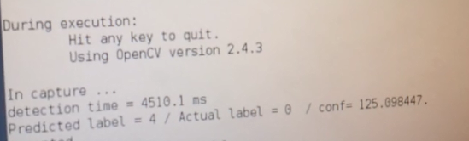
Progress..System Flow
3. When beagleboard receive the command the camera capture the image .
Notes:
هون صورة الكاميرا وهي بتصور
اي وجه

Slide 19
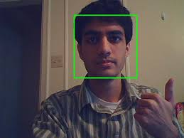
Progress..System Flow
4. The beagleboard applying face detection algorithm on the captured picture then crop the detected face and applying face recognition algorithm on it

Slide 20
Progress..System Flow
5. The algorithm compare the detected face with a pre-stored faces images for the authenticated users

Slide 21
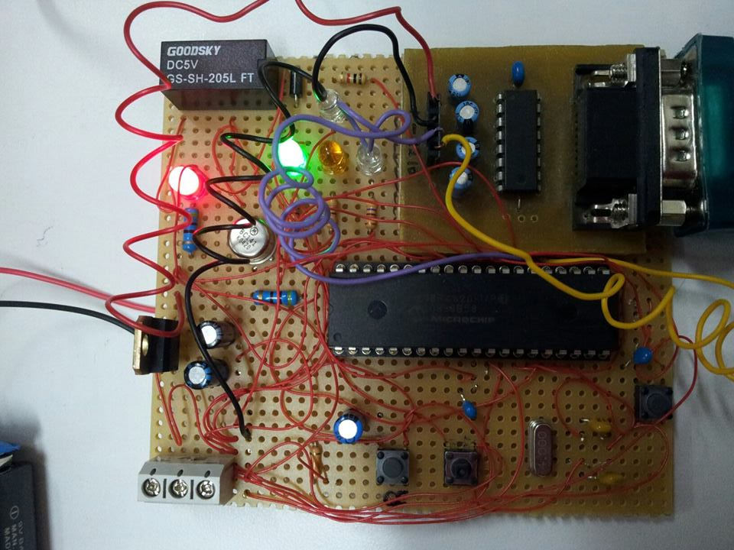
Progress.. System Flow
If the recognition succeed it will send command to the PIC which will turn on green led switch on the relay that will open the door lock.
Notes:
هون بنحط كل نقطة بسلايد وبنضيف صورة البيك لما يكون المصباح الاخضر ضاوي مع الاحمر
وع النقطة التانية لما يكون الاحمر ضاوي

Slide 22
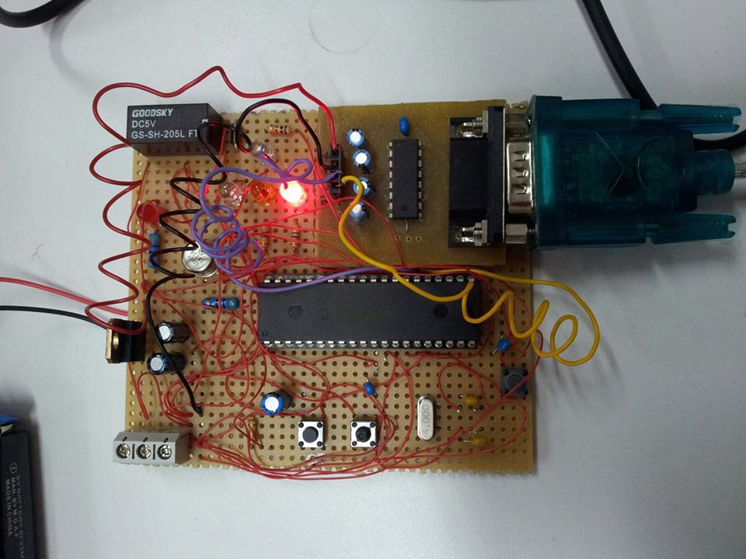
Progress.. System Flow
If the recognition failed it will send command to the PIC which will turn on red led indicating that captured face belong to unauthorized person.

Slide 23
Problems..
First the problem of dealing with XM-Beagleboard, since we don’t have a good experience to deal with it.
Also we had multiple problem with the version of the angstrom operating system , with installing the needed packages and compiling the codes.
Sometimes PIC was not receiving any data using RS232 to RS232 serial cable because we didn’t know the exactly port. The problem was solved by checking all the ports or by using USB port .

Slide 24
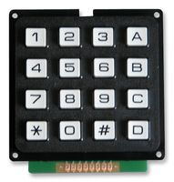
Future Work..
As a future work for our project, we plain to let you to store your own image to be acceptable for the system by adding Keypad and store button ,that this button will be available just if the password is correct (password for store the image).

Slide 25
Thank You

