Slide 1
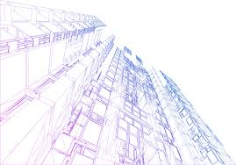
Quantity Surveying and Cost Estimate to the Ministry of Local Government in Nablus
BY:
Aya Mezyed
Ahmad Yasen
Lana Sharif
Under supervision of : Dr. Reema Nassar

Slide 3
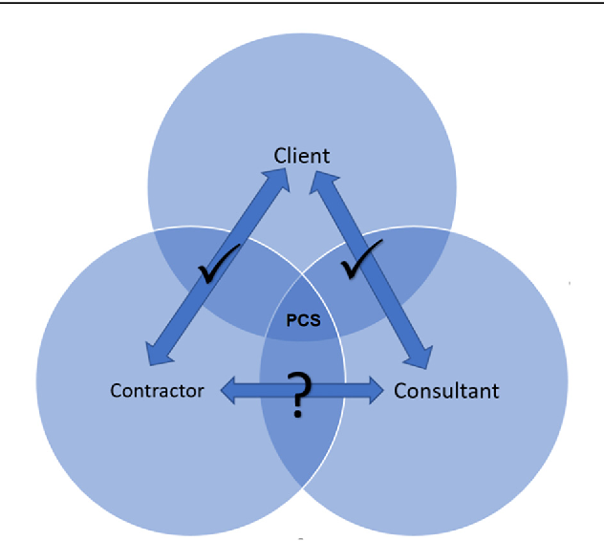
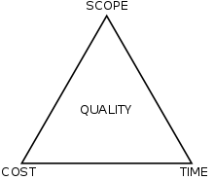
Project construction:
Project parties: Project constraints

Slide 4
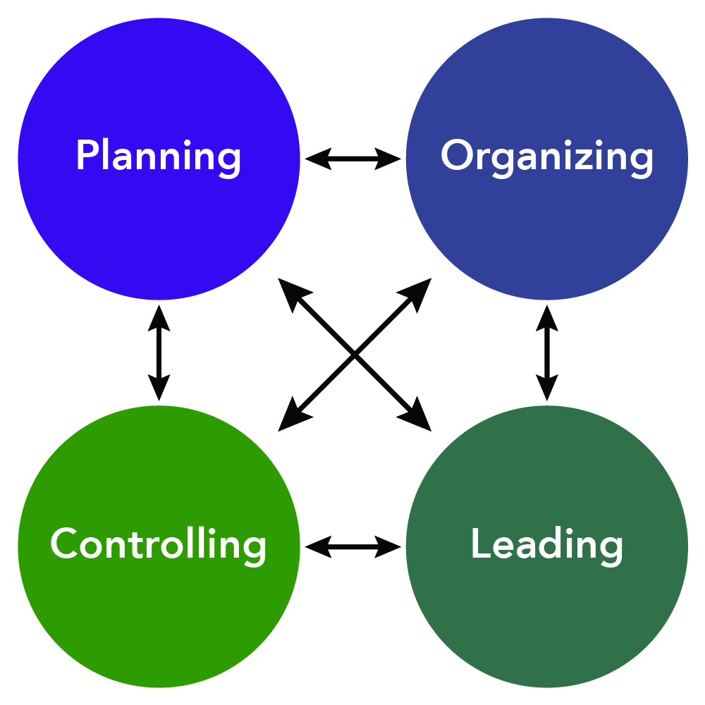
Project management
Management functions:

Slide 5
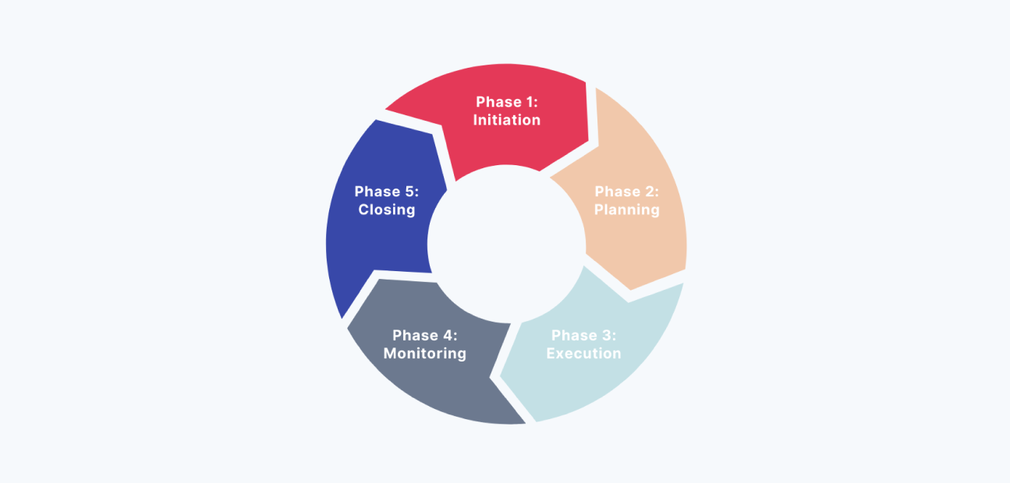
Project life cycle :

Slide 6
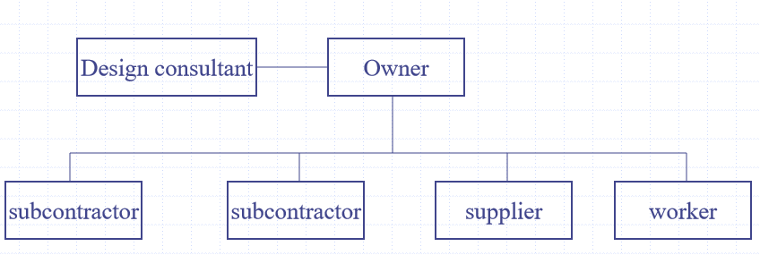
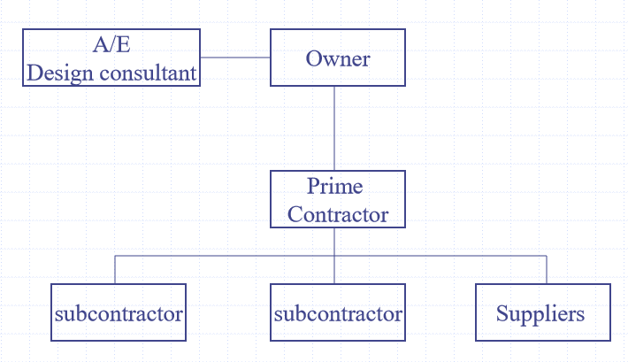
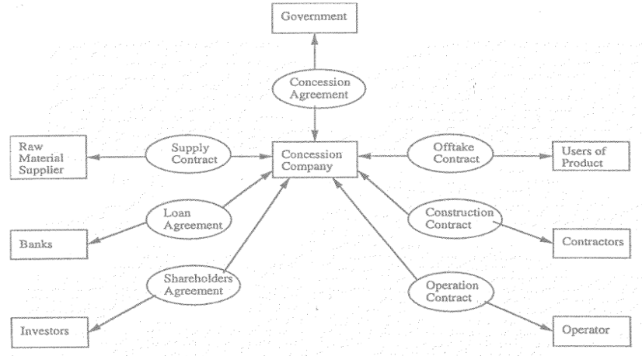
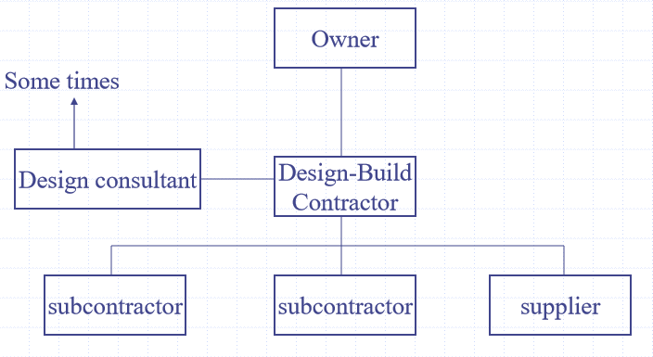
Project Delivery Systems :
Traditional (design-bid- build): Self-performance (Force account):
Design- build (Turnkey): Build operate transfer:

Slide 7
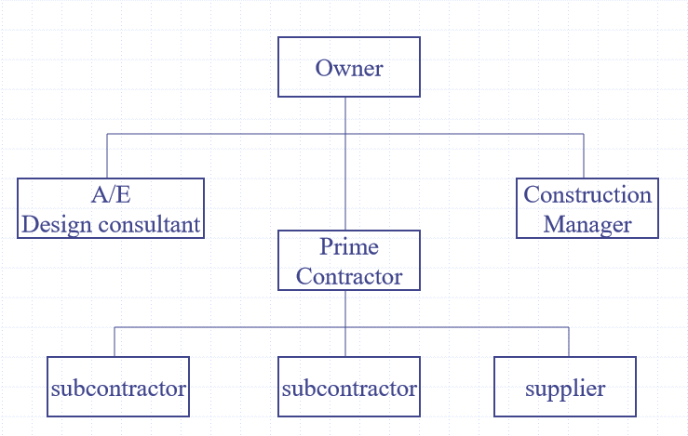
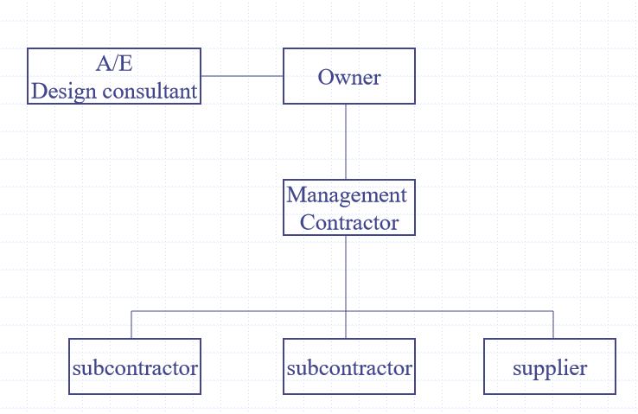
Professional Construction Management
Professional Construction Management
Construction management (Agent): Management Contracting (CM @ risk)

Slide 8
Construction contracts:
1. Lump sum
2. Unit price
3. Negotiated Cost plus Fee Contract
4. Guaranteed Maximum Price Contract:

Slide 9
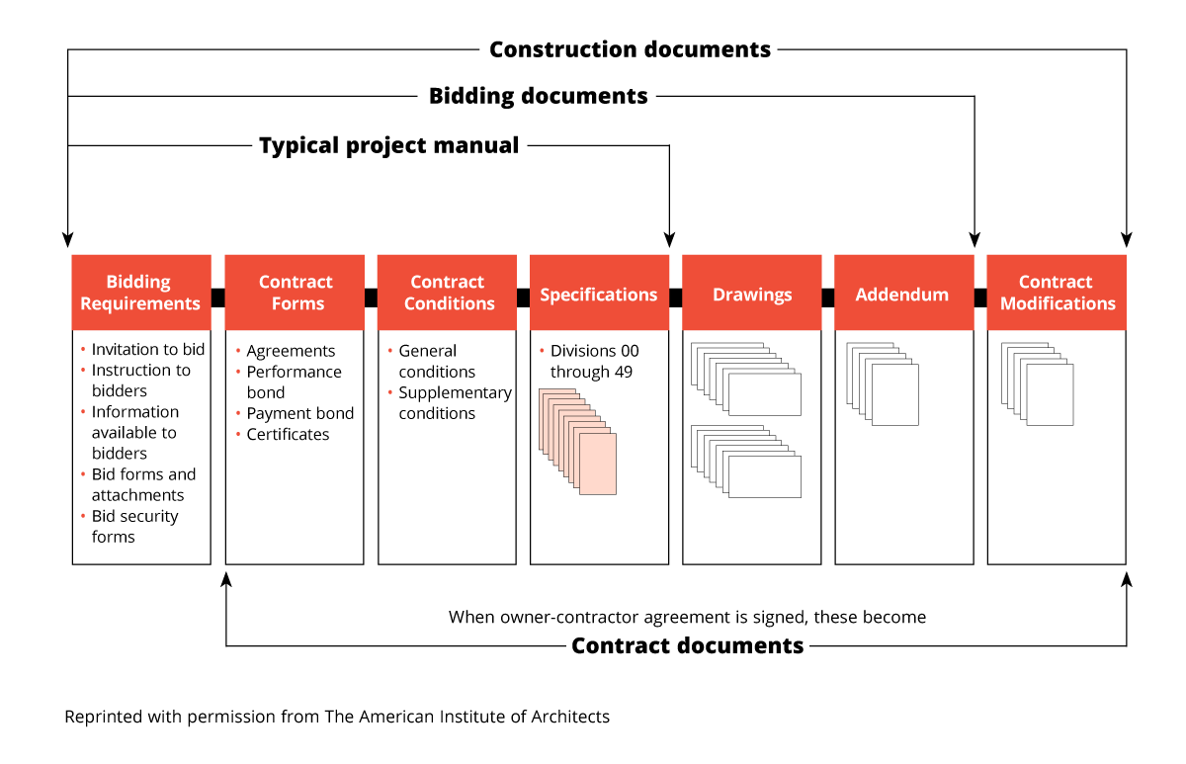
Construction Documents :

Slide 10
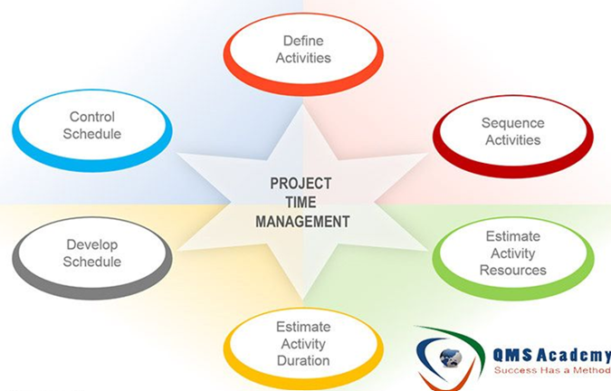
Time management

Slide 11
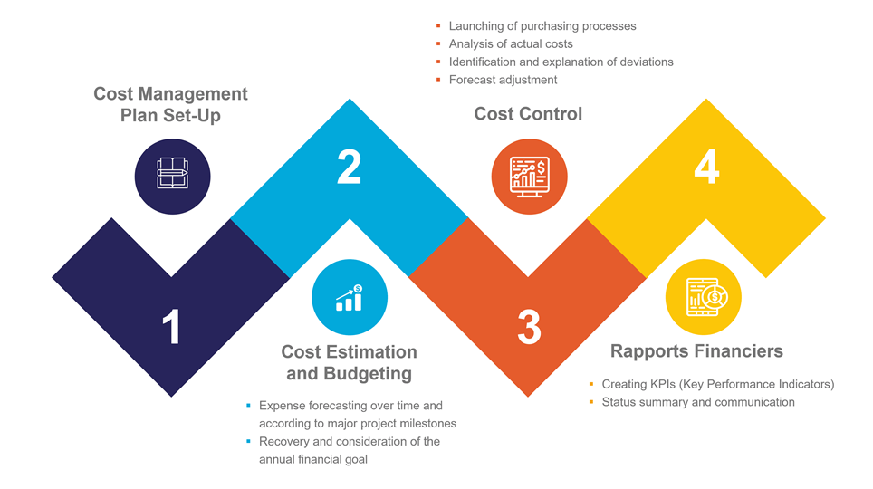
Cost management

Slide 12
Types of construction activities
1. Production activity
2. Procurement activity
3. Management activity

Slide 13
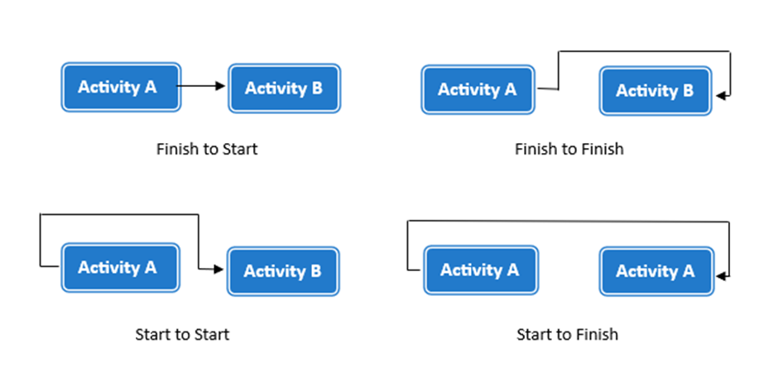
Activities relationships

Slide 14
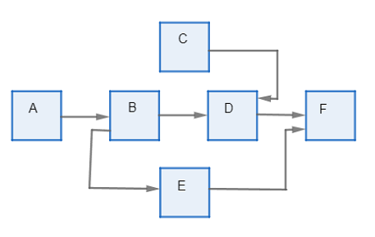
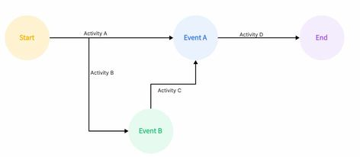
Critical path method
Arrow Diagramming Method Precedence Diagramming Method

Slide 15
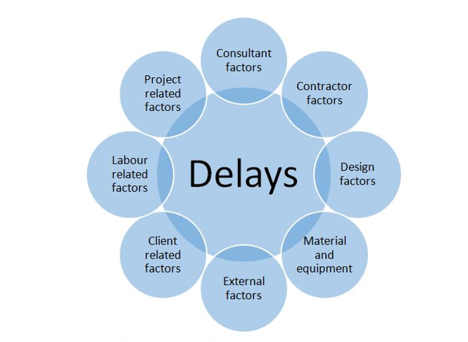
Delay

Slide 16
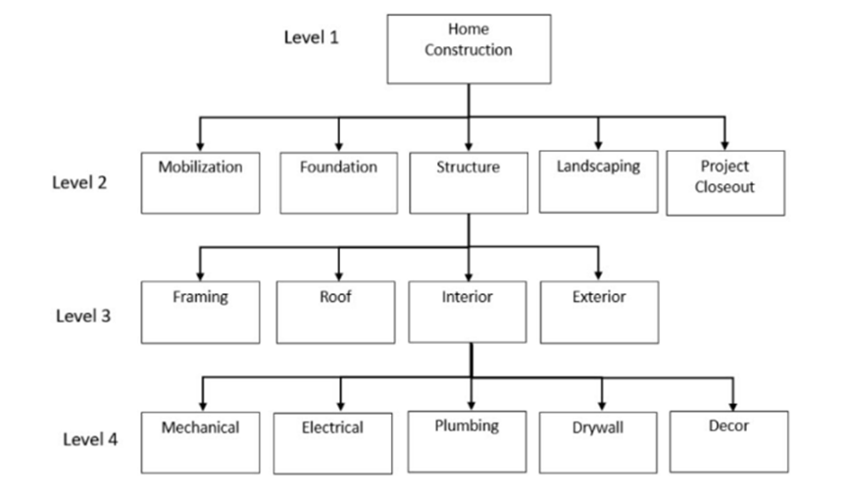
Work breakdown structure

Slide 17


Quantity surveying
"It deals with estimating and managing the costs of a construction project“
It takes into account each material, resource and equipment needed in every property development project.
Quantity surveyors work out the estimated cost at the start of the project, and continue to keep watch on the costs as the project progresses.

Slide 18
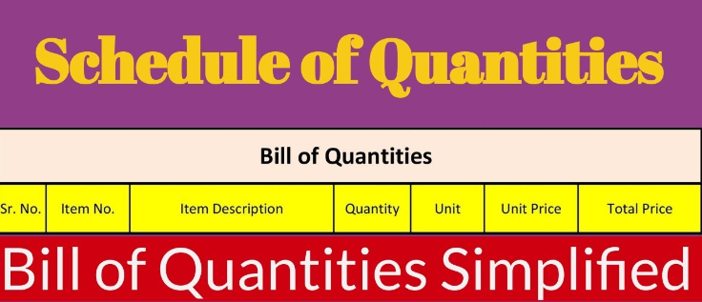
Bill of quantity (BOQ)

Slide 19
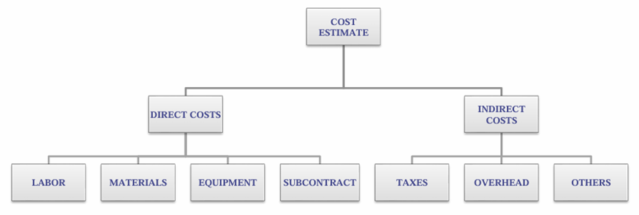
Cost Estimate

Slide 20
Methodology :
How will we work?
Collect the necessary data and charts
Create a 3D model of the project using the Revit program and calculate quantities through it
Create a project timeline using Primavera

Slide 21

Revit

Slide 22

Primavera

Slide 23


