Slide 1

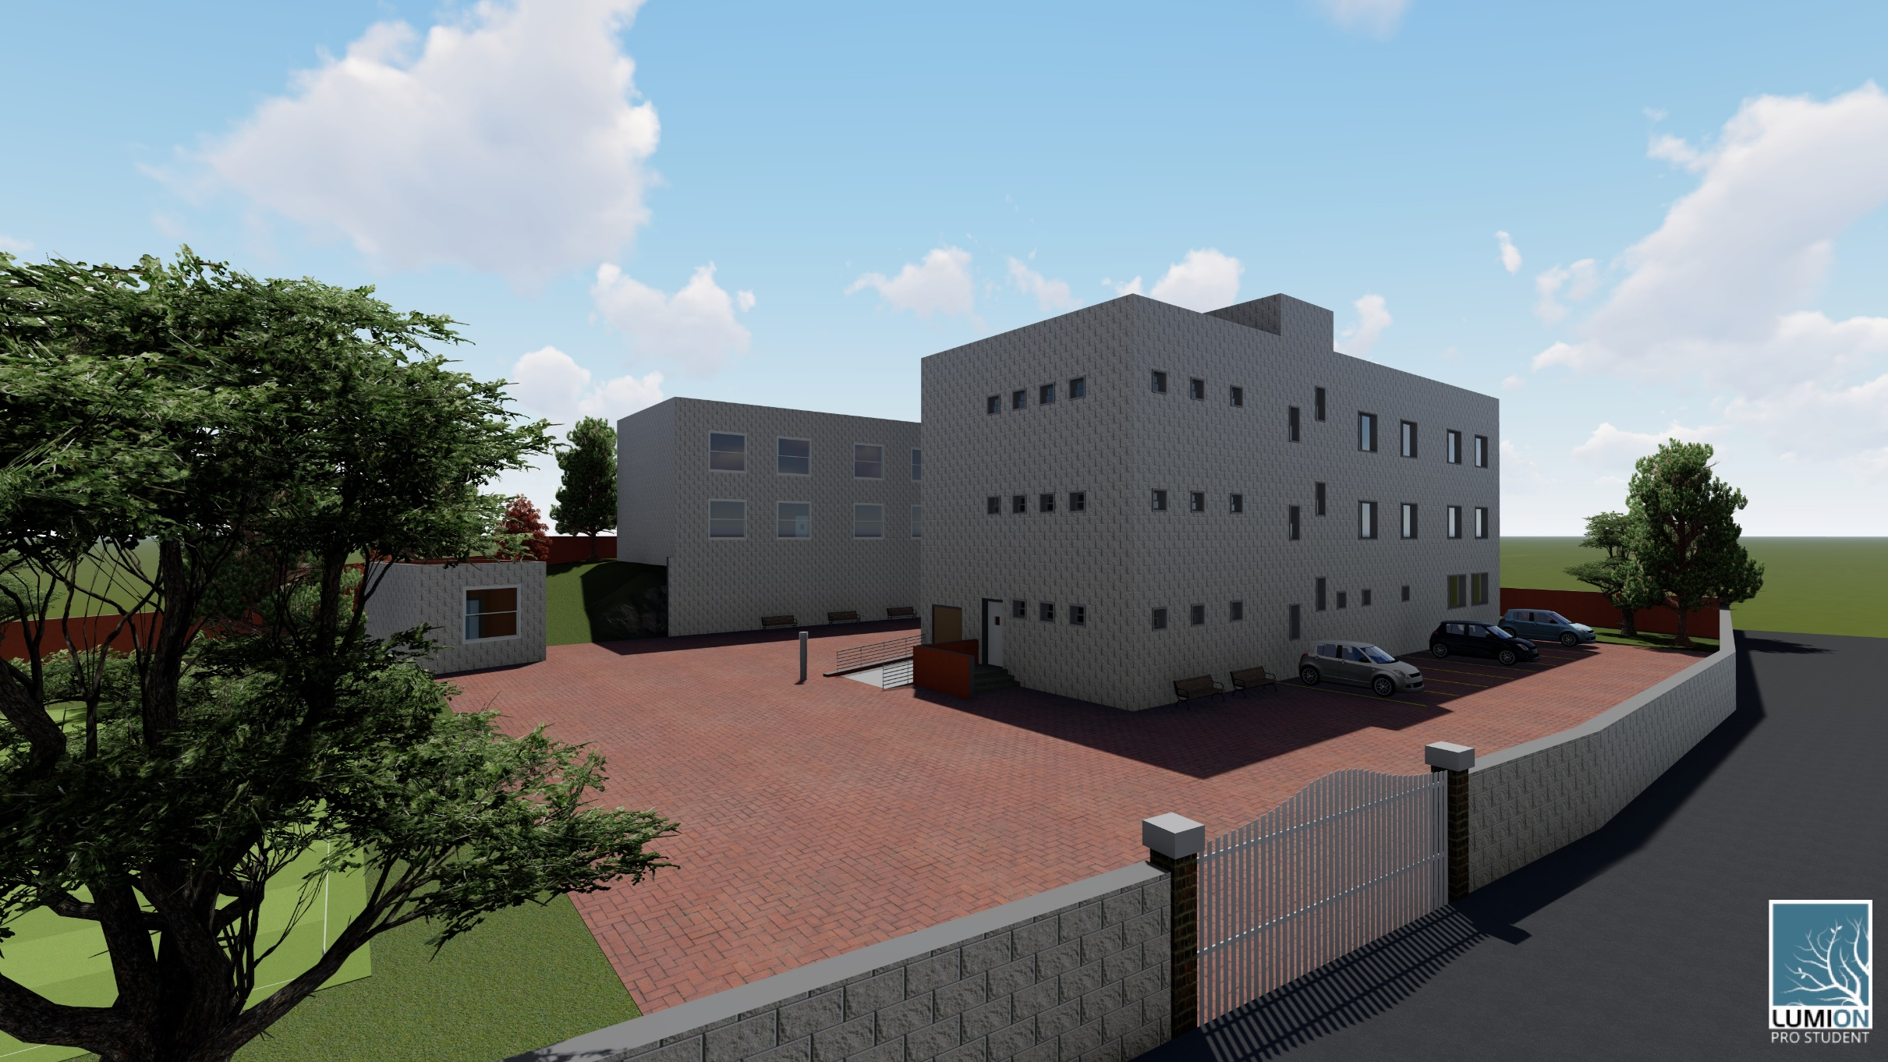
Graduation project II
Design of an Eco-friendly school
With a geothermal system
1
Supervisor:
Dr. Mutasim Babaa
Prepared by:
Ala’a Qadah
Fakhria Nabulsi
Tala Zyoud
20-5-2019

Slide 2
Outline
Introduction (Design Challenge)
Site Analysis
Architectural Design
Environmental design
Structural Design
Electrical Design
Mechanical Design
Safety Design
Quantity Surveying

Slide 3
Design Challenge
Suitable environmental design to be used in the public schools.
Not exceeding the budget of the ministry of education.
New ministry of education’s limitations of using PV solar cells in schools.
Limited building areas.
Limited schools geometries.

Slide 4
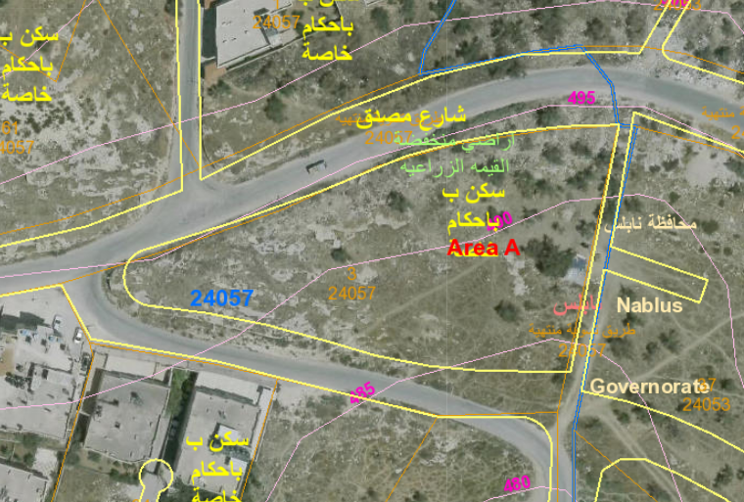
Site analysis
Nablus near Al-Ma’ajeen area.
Total area of the Land= 3675.2 m².
lies on two wide streets.
latitude of 32°13′15″ north.
longitude of 35°15′15″ east.

Slide 5
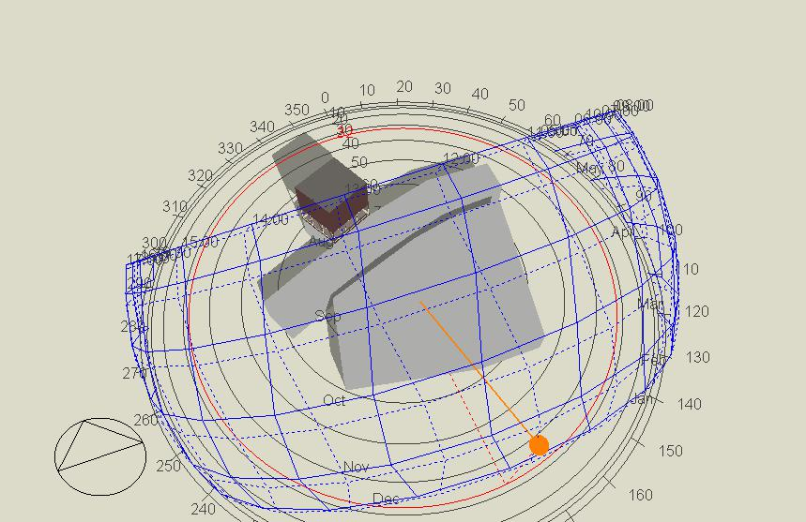
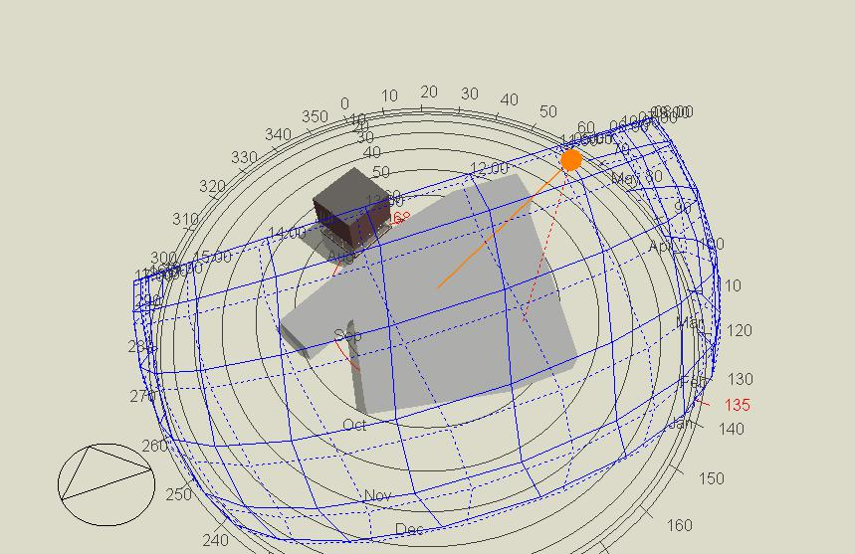
Over shadowing on the land
summer season
winter season

Slide 6
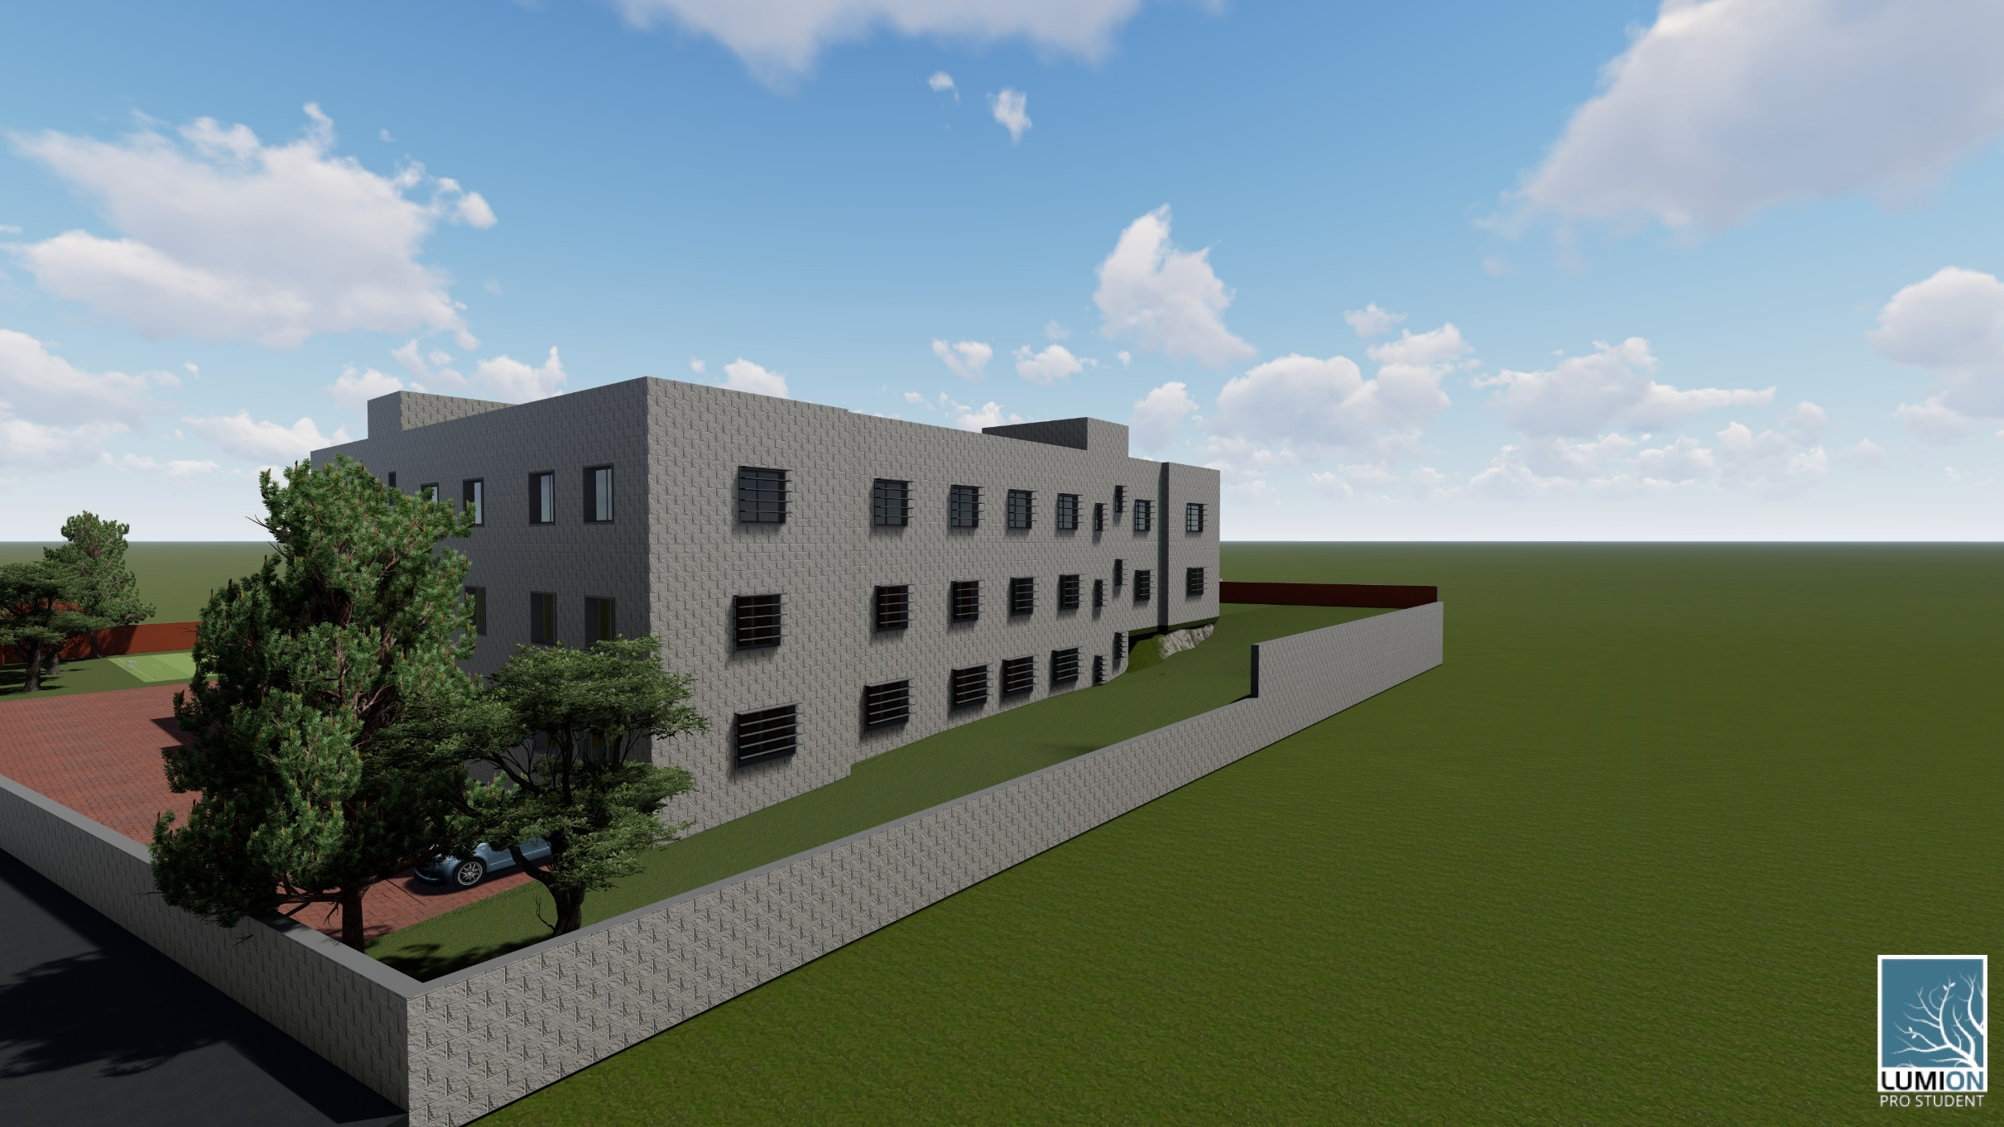
Architectural Challenge
Using the natural slope as much as possible to reduce the total amount of cut and fill needed, which leads to an organic design.
Which led to have the school on two levels as will be clear in the plans.
Organic Design.

Slide 7
Architectural plans

Slide 8
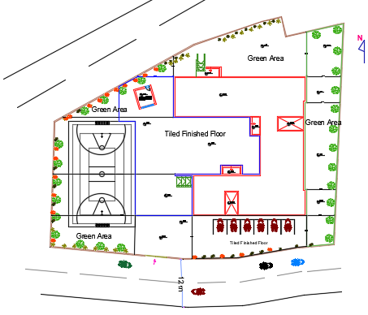
Site Plan
Building area = 2080 m².
J-shaped.
Tow entrances.
Three Floors (467 m² for the GF and 810 m² for both FF & SF).

Slide 9
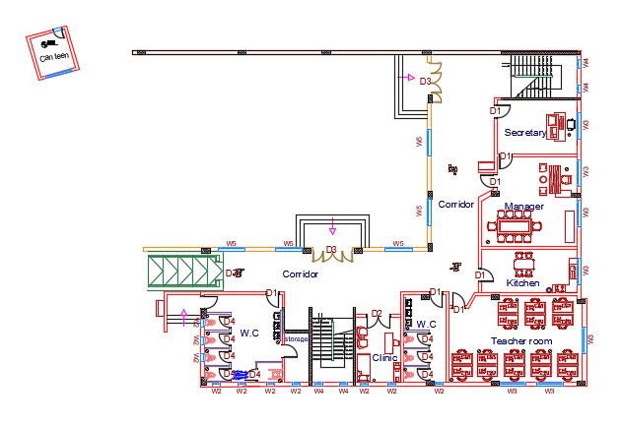
Ground Floor
Total Area: 467 m² .

Slide 10
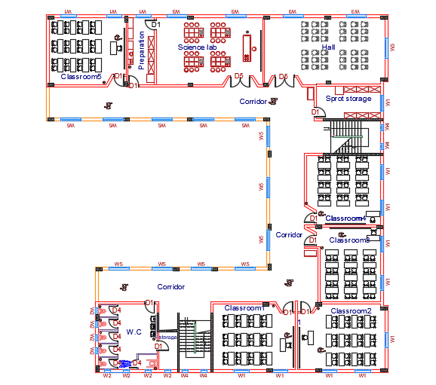
First Floor
Total Area: 810 m² .

Slide 11
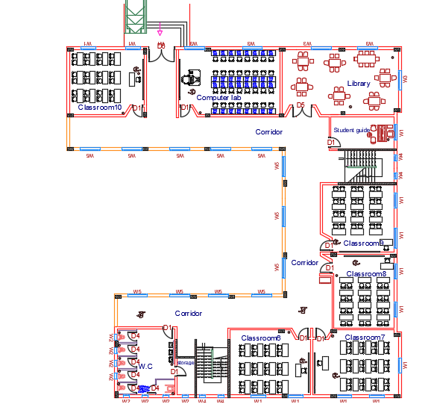
Second Floor
Total Area: 810 m² .

Slide 12
Elevations

Slide 13
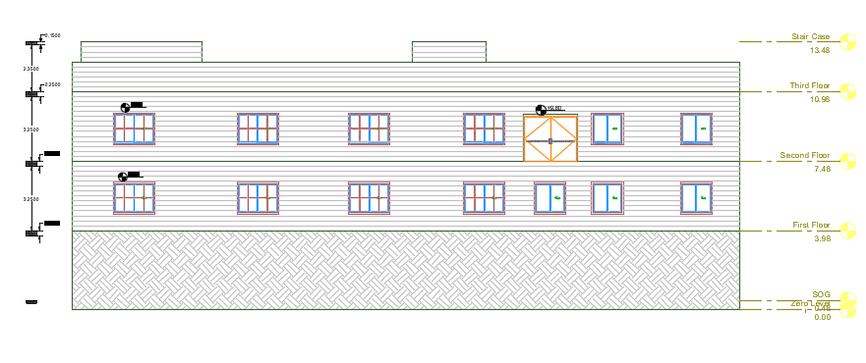
Northern Elevation

Slide 14
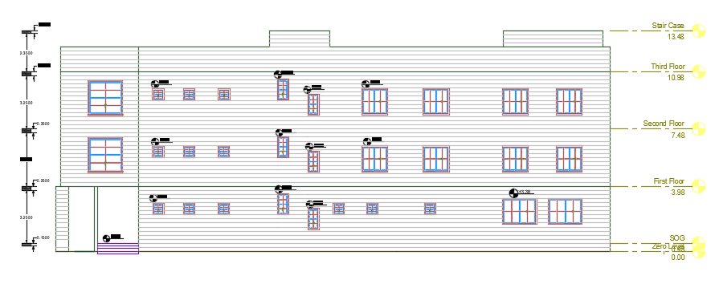
Southern Elevation

Slide 15
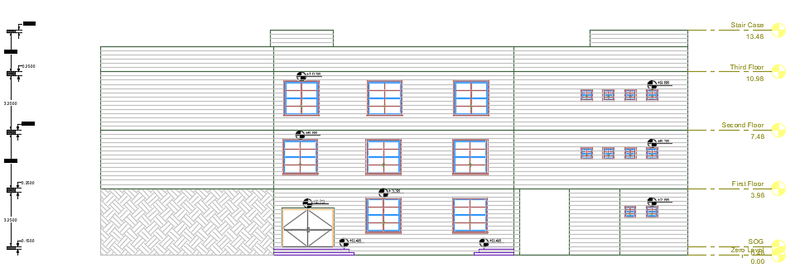
Western Elevation

Slide 16
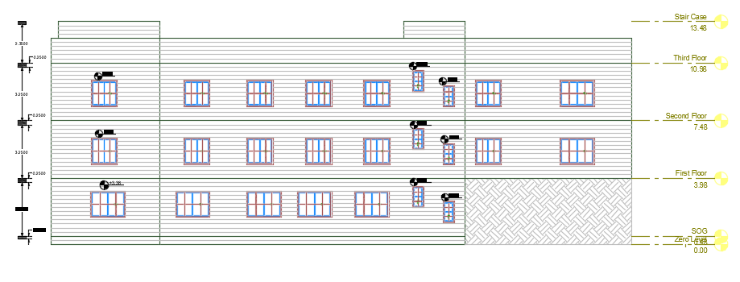
Eastern Elevation

Slide 17
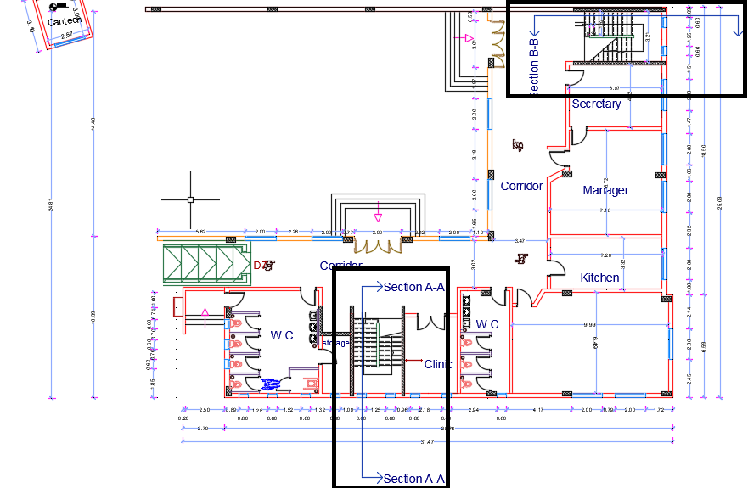
Sections

Slide 18
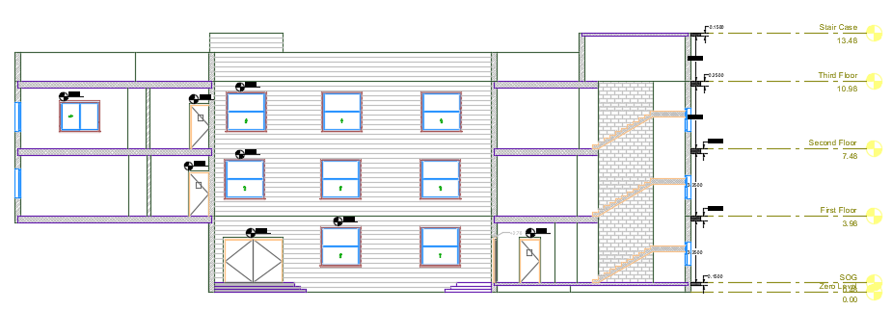
Section A-A

Slide 19
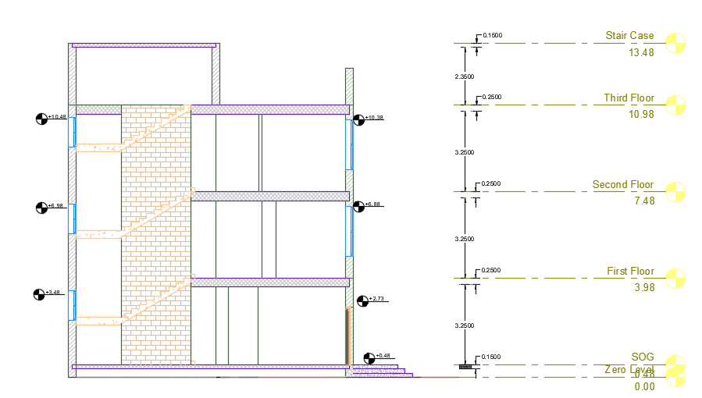
Section B-B

Slide 20
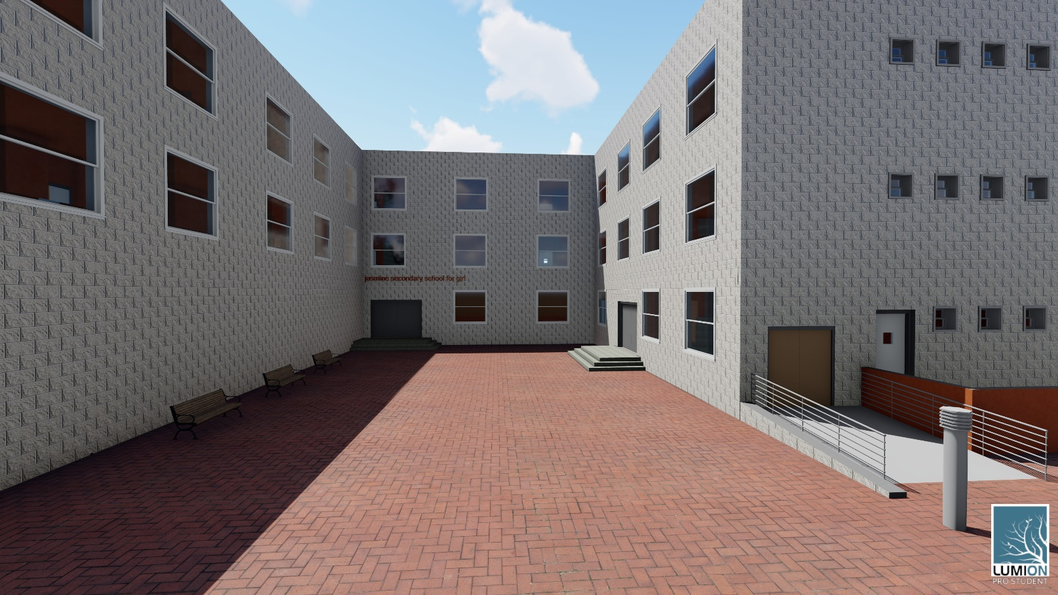
3D Render

Slide 21
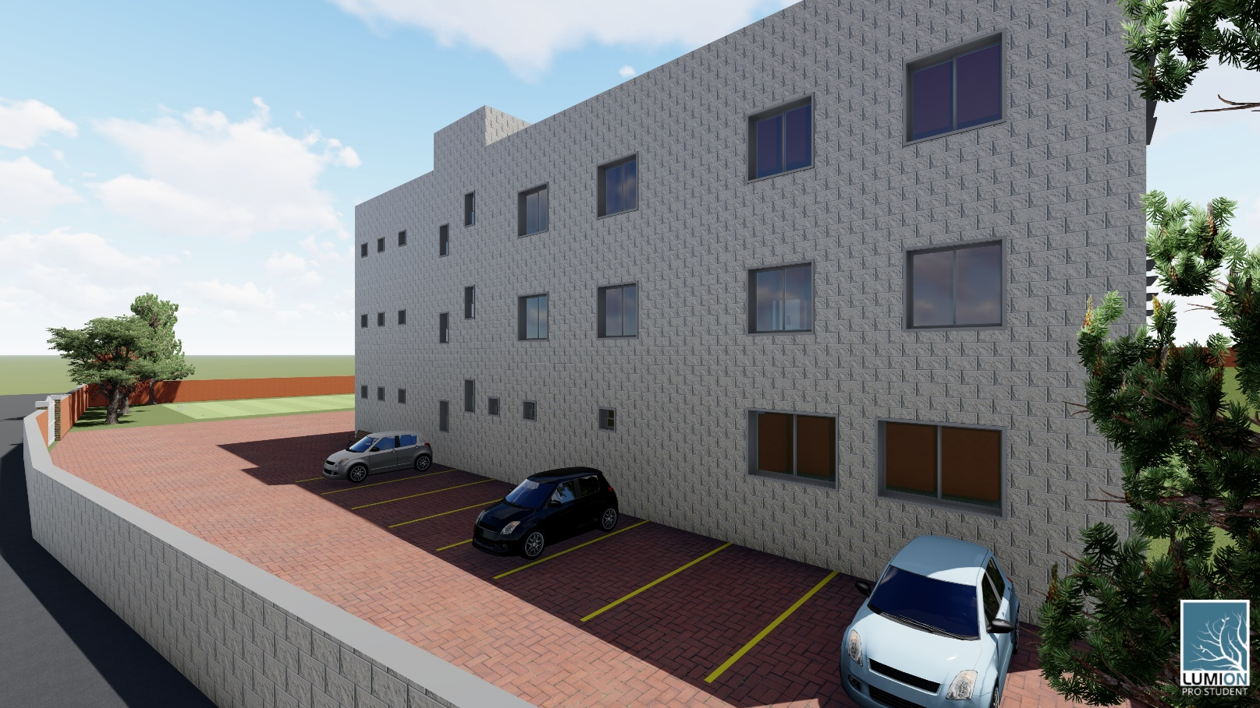

Slide 22
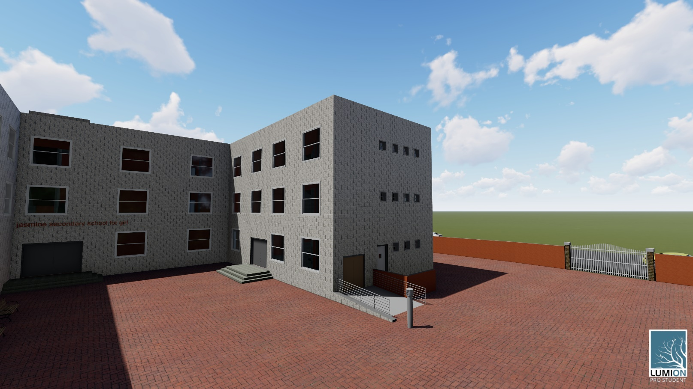

Slide 23
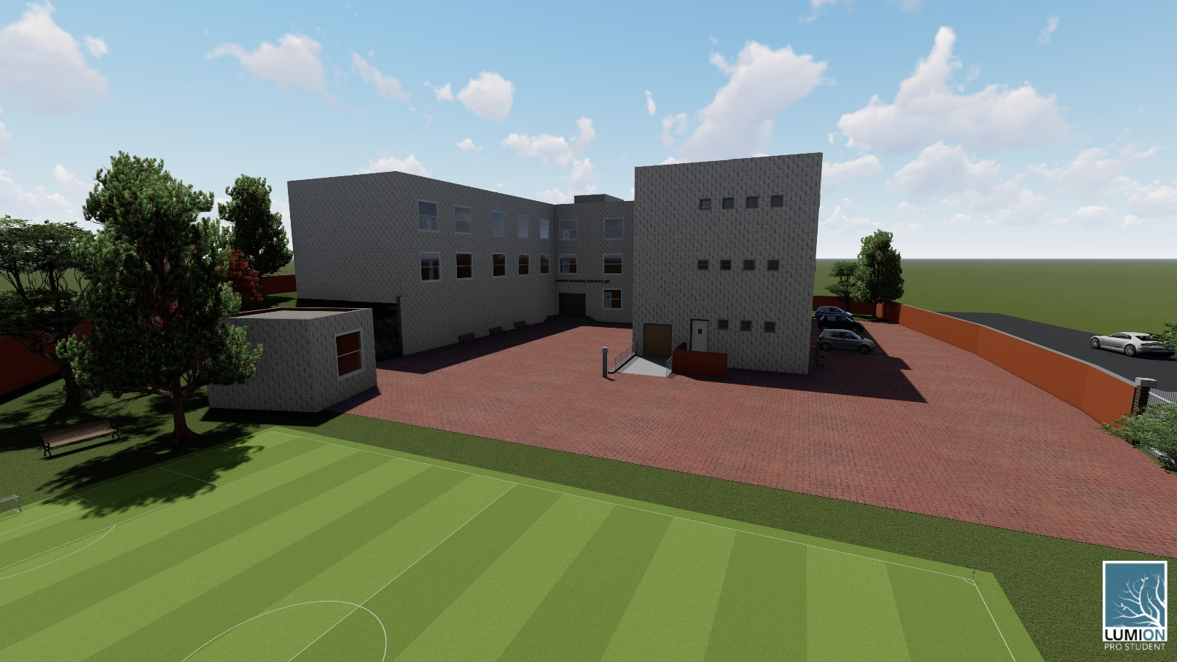

Slide 24
Environmental Design

Slide 25
Acoustical system
Standard values of RT60
Space | Standard value of RT60
Classroom | ≤ 0.6
Library | 0.8-1
Manager room | 0.7-1.3
Clinic | 0.4-0.7

Slide 26
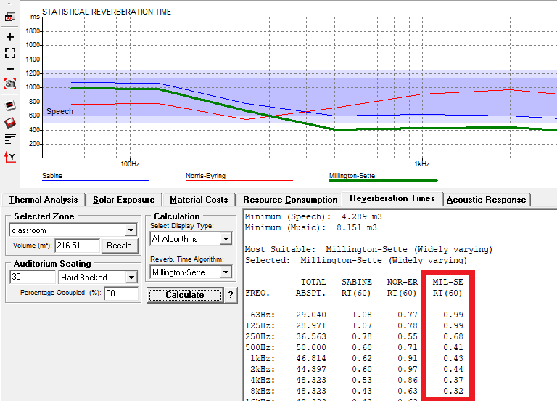
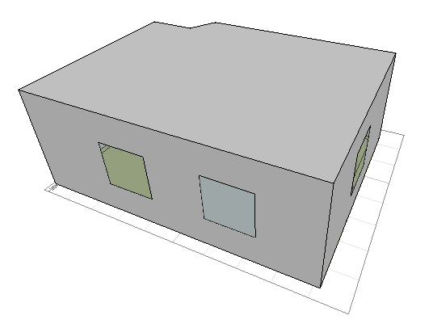
Reverberation time (RT60)
Classroom

Slide 27
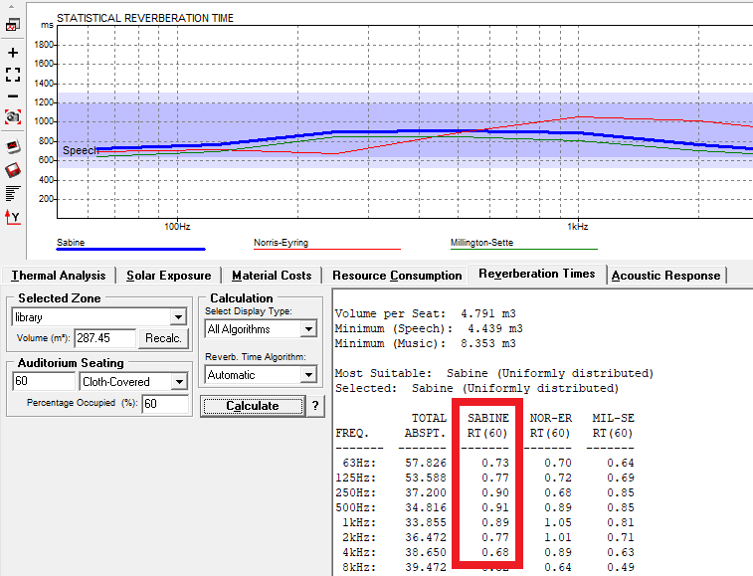
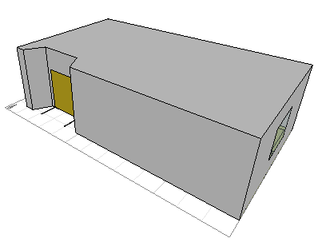
Reverberation time (RT60)
Library

Slide 28
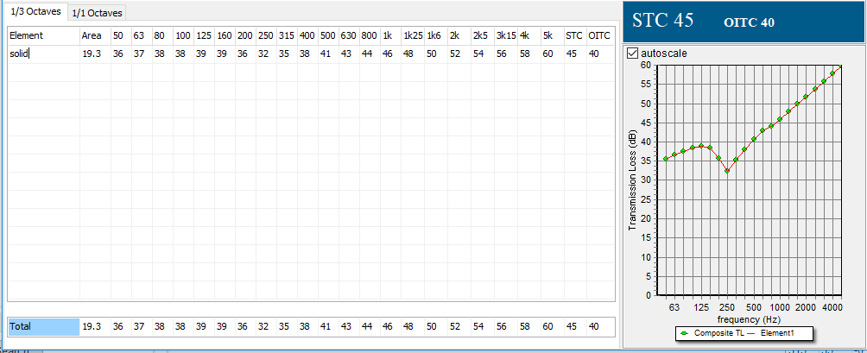
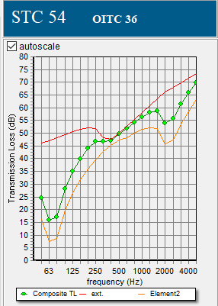
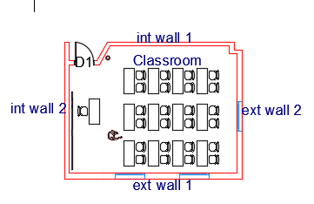
Sound Transmission Loss (STC)
Classroom
Internal wall 1
External wall 2

Slide 29
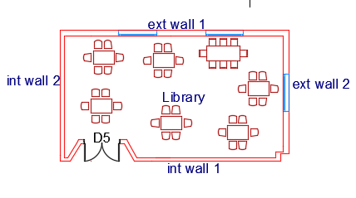
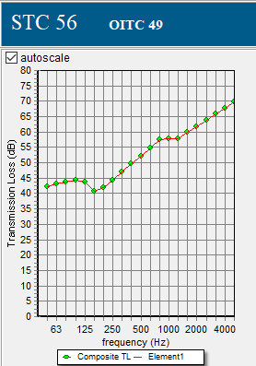
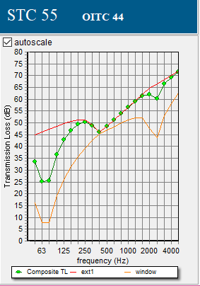
Sound Transmission Loss (STC)
Library
Internal wall 1
External wall 2

Slide 30
Sound Transmission Loss (STC)
Standard and actual values of STC
Function | Standard dB | Actual dB | Comply / Not comply
classroom wall | 45 | 55,45 | Comply
Library wall | 45 | 56,55 | Comply
Manager room wall | 45 | 55,55 | Comply

Slide 31
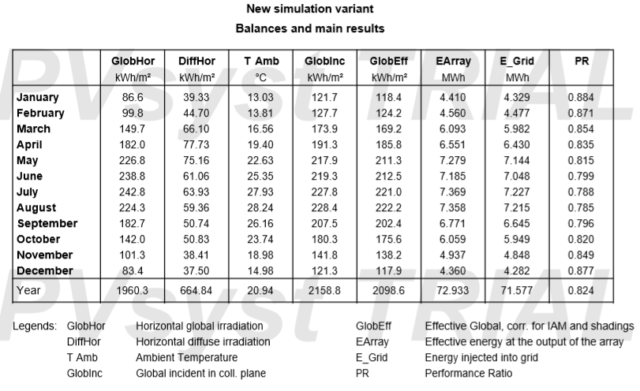
Solar Photovoltaic System Design (PV_{syst})
Total Energy for building= 260900 Wh/day= 260.9 kWh/day.

Slide 32
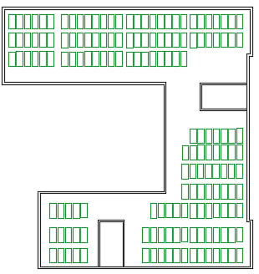
Solar Photovoltaic System Design (PV_{syst})
Output from PVsyst:
Number of modules = 161 modules.
Number of inverters = 4 inverters.
System productivity = 60% of building needs.

Slide 33
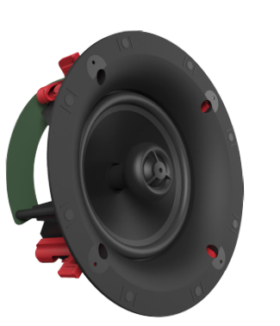
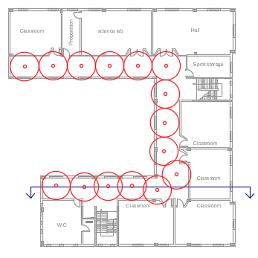
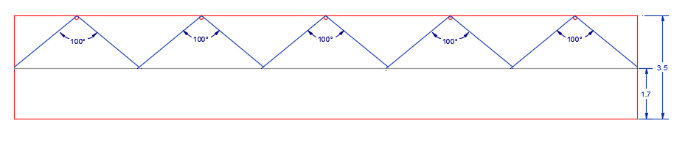
Distribution of speakers in corridors
Layout for the corridor of first floor
Vertical section of the speakers

Slide 34
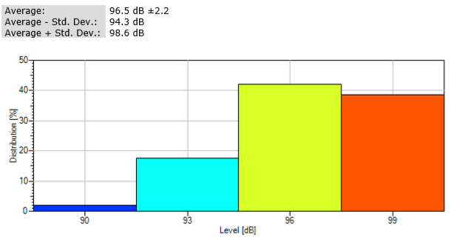
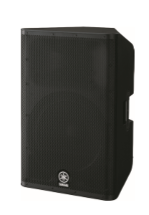
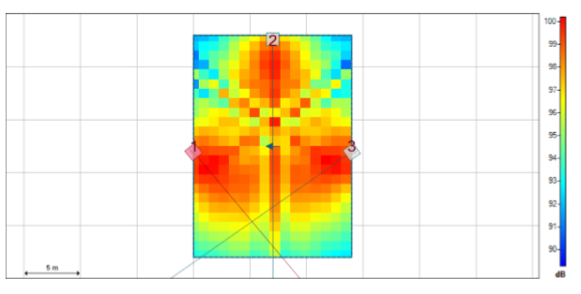
Acoustical system for the school yards

Slide 35
Geothermal System

Slide 36
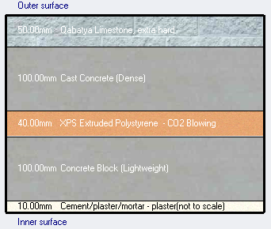
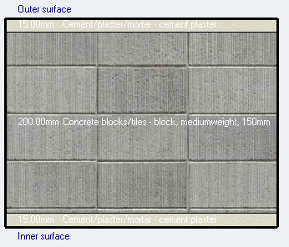
Materials used
External walls layers and their thicknesses.
Internal partitions layers and their thicknesses.

Slide 37
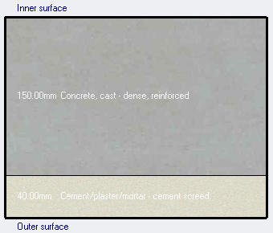
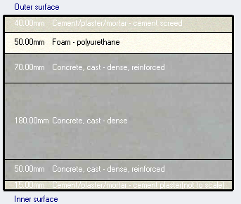
Floor layers and their thicknesses.
Roof levels and their thicknesses.

Slide 38
U- Values for the construction elements
Construction element | U-value (W/m².k)
External wall | 0.502
Internal partition | 1.78
External floor | 3.1
Roof | 0.466

Slide 39
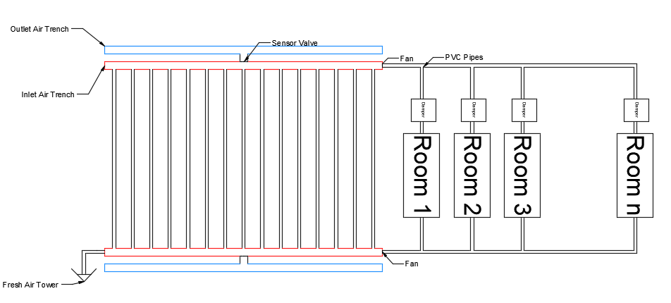
Geothermal System
” The earth tube heat exchanger (ETHE) is a device that transfers the heat from ambient air to deeper layers of soil and vice versa”.

Slide 40
Geothermal system components
Dampers in Spaces.
Complicated net of 8“ PVC horizontal and vertical pipes.
FAN.
Ardweno Controlled sensor.
Elbows.
Filters.
Fresh Air Inlet Tower.

Slide 41
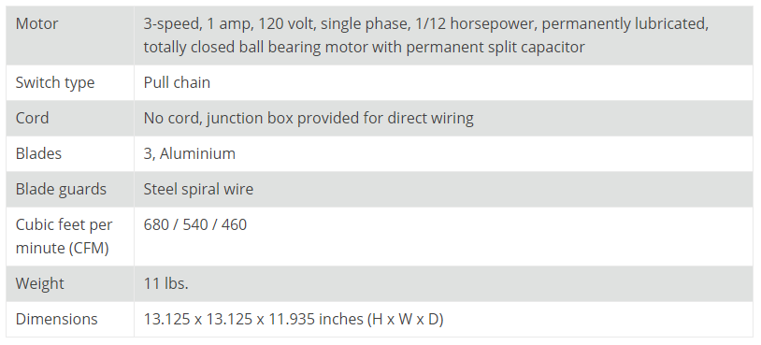
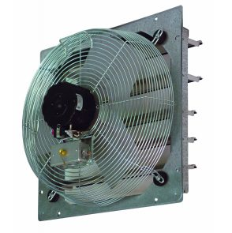
TPI Corporation CE10-DS Direct Drive Exhaust Fan

Slide 42
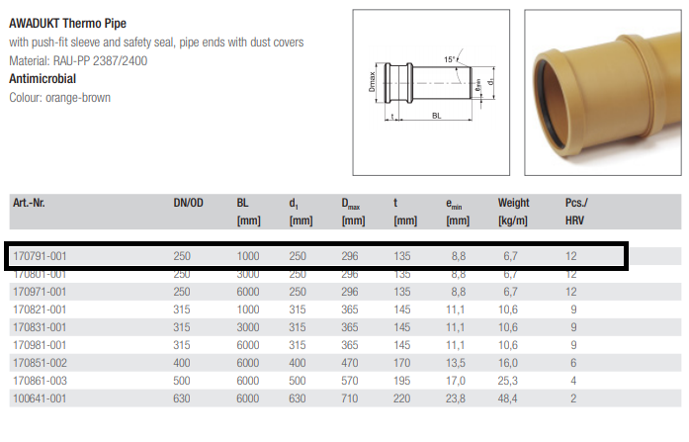
PVC Pipes

Slide 43
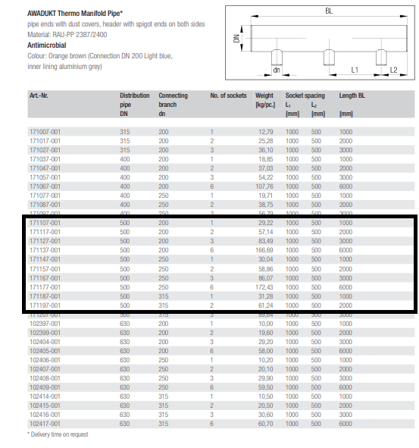
Main PVC Trench

Slide 44
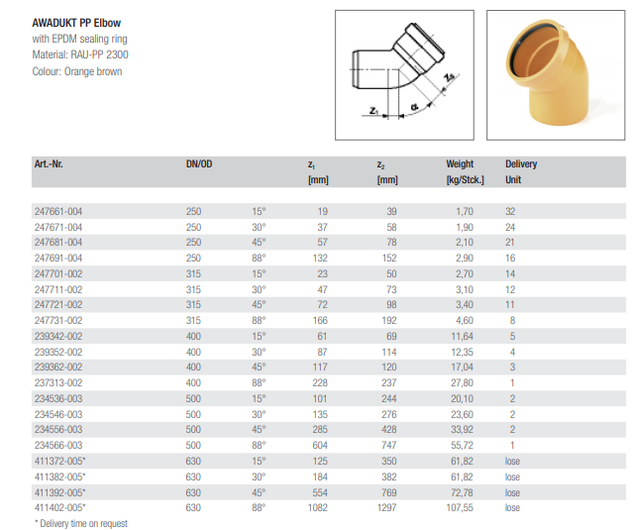
Elbows

Slide 45
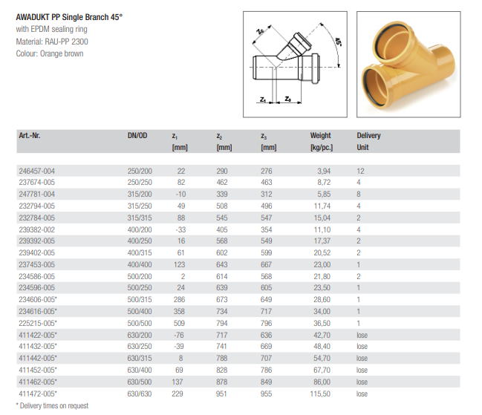

Slide 46
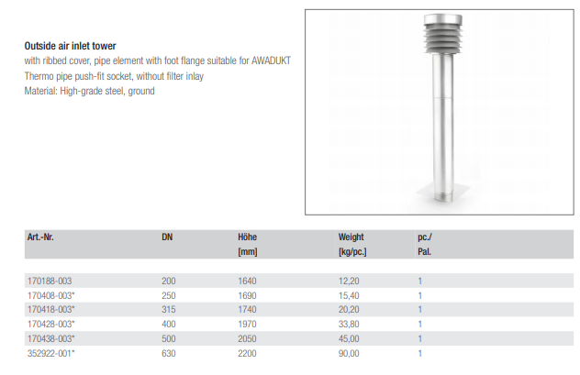
Inlet Air Tower

Slide 47

Filters

Slide 48
Pipes Distribution

Slide 49

Pipes distribution in the GF

Slide 50

Pipes distribution in the FF

Slide 51

Pipes distribution in the SF

Slide 52


Thermal Simulation Results
Thermal Simulation was done using the Design Builder program.
NOTE: The total using hours of the building is 8600 hours.

Slide 53


Slide 54
Structural Design

Slide 55
Codes and Standards:
ACI -318-14 for reinforced concrete elements.
UBC -97 for design of seismic load and loads combinations.
For the design of the structure and its elements ETABS , SAFE , SAP and hand calculations were used .
Materials used:
    Concrete strength, f’c = 24 MPa and 28 MPa.
    Steel yielding strength fy = 420 MPa.
    Bearing capacity for soil = 2.5 kg/cm².
Design Loads:
    Live load = 5 KN/m².
    Super imposed dead load = 4 KN/m².

Slide 56

Seismic design data:
City of building : Nablus.
Seismic zone factor Z=0.2
Ca=0.24
Cv=0.32
I =1.5
R =5.5
Seismic hazard map for building codes.

Slide 57

Modeling on ETABS:

Slide 58
Sections dimensions:
Structural element | Dimensions (cm)
Slabs | 30
Beams | 30×50
Columns | C1 : 30×40 C2 : 30×60 C3 : 35×60
Footings | F1 : 180×170 F2 : 200×180 F3 : 250×220 F4 : 190×160

Slide 59


Slabs system:
Two-way U-boot voided slabs with a thickness of 30cm were used.

Slide 60


Beams system:
Drop beams are used.

Slide 61

Beams reinforcement:

Slide 62


Columns system:

Slide 63


Footings system:
Single footings with a depth of 50cm were used.

Slide 64


Footings’ reinforcement:
Section in basement wall footing
Section in F2

Slide 65

Shear walls reinforcement:

Slide 66

Stair reinforcement:

Slide 67


Water tank:
Top view
Section in water tank

Slide 68
Electrical Design

Slide 69
Artificial lighting system design
actual lux | Target lux | Function | actual lux | Target lux | Function
252 | 100 | corridor | 563 | 300 | Class room
235 | 200 | Sport storage | 584 | 500 | Library
570 | 500 | secretary | 400 | 200 | Hall
508 | 500 | Manager room | 533 | 300 | Computer room
531 | 500 | kitchen | 586 | 500 | Science lab
589 | 500 | Teacher room | 321 | 300 | Student guide
330 | 300 | Clinic | 210 | 100 | WC

Slide 70

Artificial lighting system design
Class room

Slide 71


Artificial lighting system design
DIALUX class room calculations
Luminaire specification

Slide 72

Artificial lighting system design
Computer room

Slide 73


Artificial lighting system design
DIALUX computer room calculations
Luminaire specifications

Slide 74
Artificial lighting system design
DIALUX computer room calculations
Luminaire specifications

Slide 75

Artificial lighting system design
Lighting Arrangement in first floor

Slide 76
Sockets Design
Sockets number and calculation in first floor
Room | No. | No of sockets | Socket Current | Special socket | Special socket current | Total current | Voltage | Diversity Factor | Watt
Class room | 5 | 7 | 2 | 0 | 10 | 70 | 220 | 0.2 | 3080
Science lab | 1 | 16 | 2 | 4 | 10 | 72 | 220 | 0.2 | 3168
Hall | 1 | 8 | 2 | 0 | 10 | 16 | 220 | 0.2 | 704
Sport storage | 1 | 2 | 2 | 0 | 10 | 4 | 220 | 0.2 | 176
Storage | 1 | 2 | 2 | 0 | 10 | 4 | 220 | 0.2 | 176
WC | 1 | 2 | 2 | 0 | 10 | 4 | 220 | 0.2 | 176
Stair | 2 | 2 | 2 | 0 | 10 | 8 | 220 | 0.2 | 352
Corridor | 1 | 10 | 2 | 0 | 10 | 20 | 220 | 0.2 | 880

Slide 77

Sockets Design
Sockets arrangement in first floor

Slide 78
Mechanical Design
Water Supply system.
Drainage System.
Rain Water Management.

Slide 79

Water Supply system
Pipes Distribution on GF

Slide 80

Water Supply system
Pipes Distribution on FF

Slide 81

Water Supply system
Pipes Distribution on SF

Slide 82

Drainage System
Pipes Distribution on GF

Slide 83

Drainage System
Pipes Distribution on FF

Slide 84

Drainage System
Pipes Distribution on SF

Slide 85

Rain Water Management

Slide 86
Safety Design

Slide 87

Fire protection in ground floor

Slide 88


Fire protection in first floor
Fire protection in second floor

Slide 89

Escape route plan for ground floor

Slide 90


Escape route plan for first floor
Escape route plan for second floor

Slide 91
Quantity Surveying

Slide 92
Final BOQ of the project:
Aspect | Total cost (NIS)
Architectural | 814,044
Structural | 2,017,322
Electrical | 89,299
Mechanical | 12,549
Environmental | 61,460
Total building area = 2080 m².
Total cost of the project = 2,994,675 NIS.
Unit cost of the project = 1,440 NIS/m².

Slide 93
Thank you..

