Slide 1

Wearable Robotic Exoskeleton
Supervisor : Dr. Bashir Nouri
By: Ahmed Innab & Ahmed Ghannam

Slide 2
PRESENTATION OUTLINE
Overview of Project
Kinematic Analysis
Main components
Proportional Myoelectric Control
Control System
Power Unit
Conclusion

Slide 3
INTRODUCTION

Slide 4
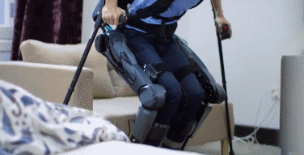
OVERVIEW OF PROJECT
Robotic exoskeleton that can assist walking of elderly people and people with disabilities using EMG-based control.

Slide 5
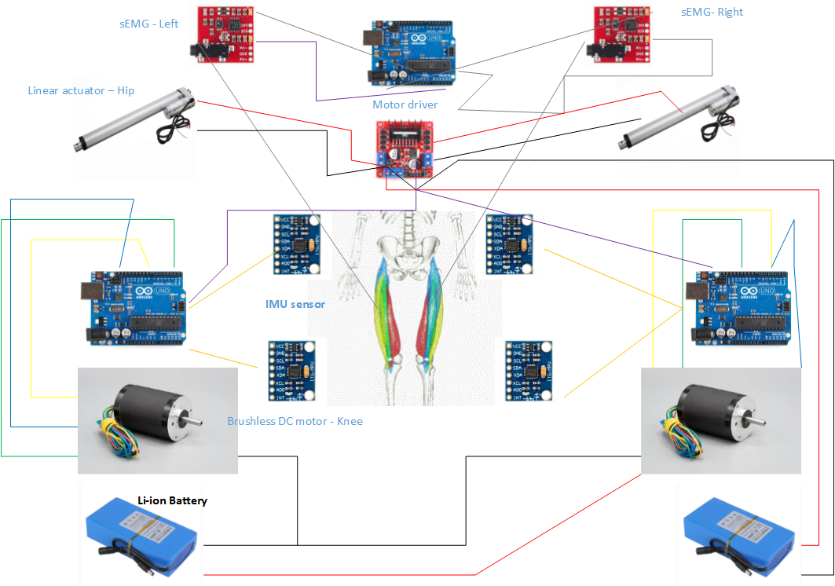
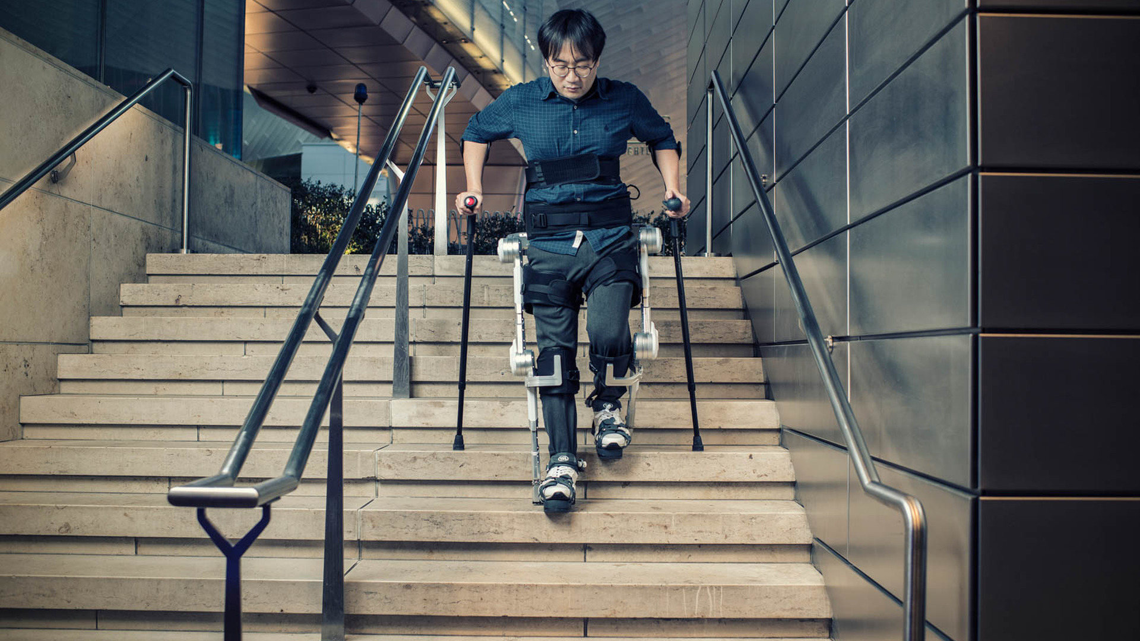
OVERVIEW OF PROJECT

Slide 6
OVERVIEW OF PROJECT
The function of this exoskeleton is performed by the following steps :
Detecting Electromyography signals from muscles.
Depending on pre -set values the exoskeleton can be activated or deactivated.
If the right part was activated, the exoskeleton will complete gait cycle until receiving the deactivation value, then it will stop and return to standing up position.

Slide 7
Kinematic Analysis
The exoskeleton of this project is six Degree of freedom ( DOF ).
Since both robotics and human biomechanics are applied to exoskeletons, the following methods can be used to analyze this exoskeleton :
6 DOF - Open kinematic chain ( one Manipulator ).
Two Manipulators.

Slide 8
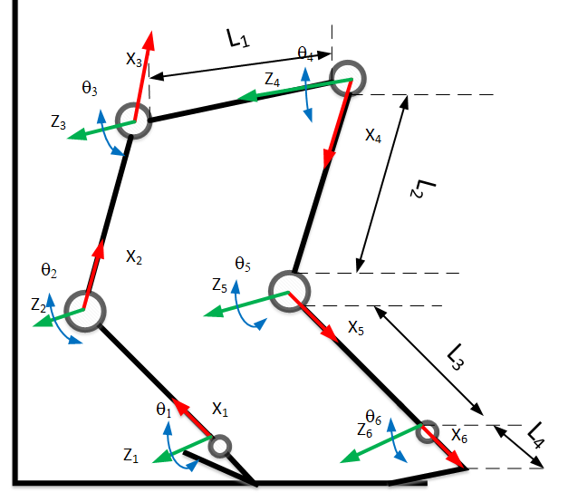
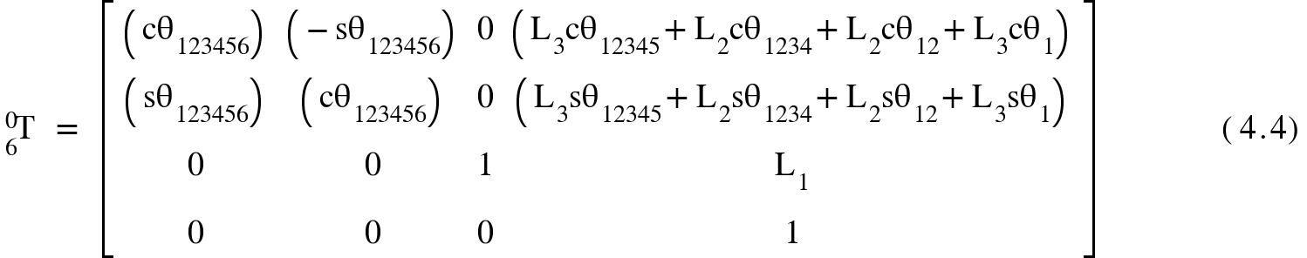
6 DOF - Open Kinematic Chain ( One Manipulator )
The exoskeleton can be seen as one manipulator with 6 joints, while assuming that the right/left is the End-effector. The following figure shows the kinematic model of the exoskeleton :
From this model, transformations ( position &
Orientation) of each joint can be obtained

Slide 9
Torques analysis
The analysis of torques at each joint is one of the most important aspects in the design of exoskeleton, it helps selecting the right actuators, Also it explains the amount of torque that will be produced for the exoskeleton in addition to that generates from human muscles, the total torque is varying with respect to different applications of exoskeletons.

Slide 10
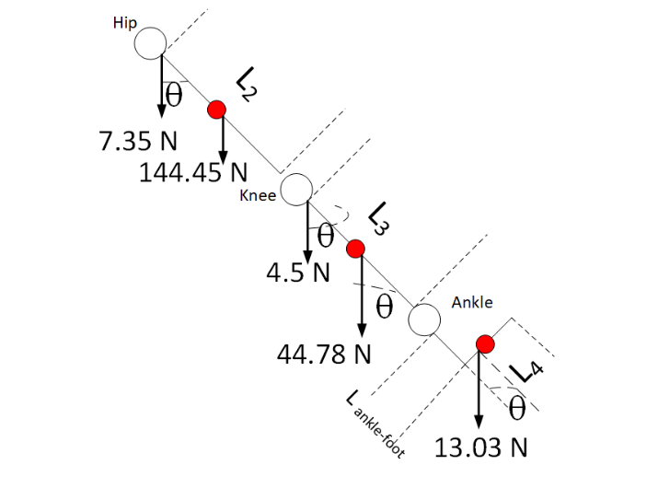
Torque Analysis

Slide 11
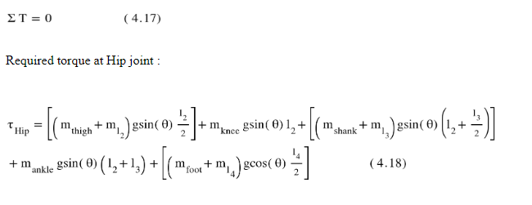


Slide 12
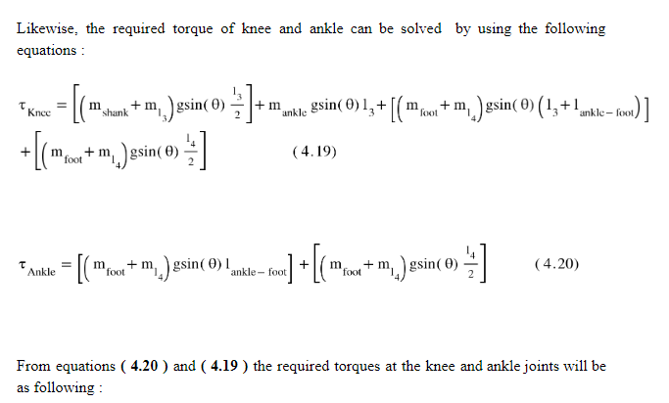


Slide 13
Main Components

Slide 14
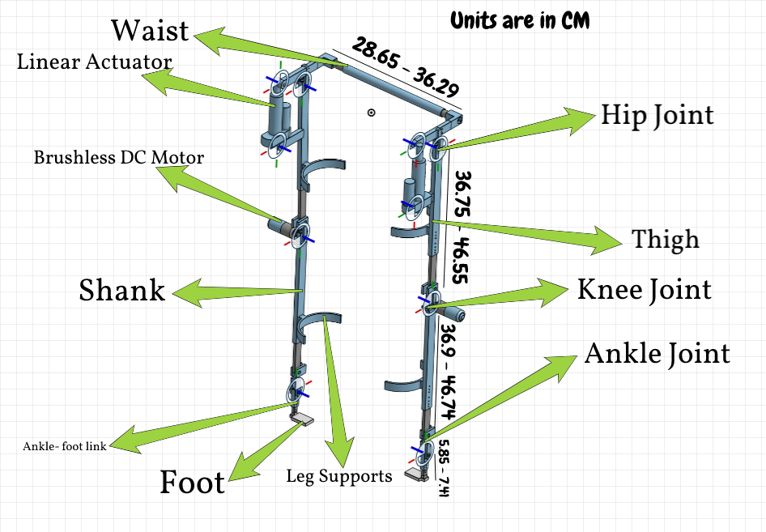
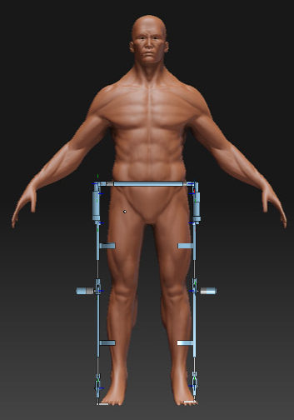
Mechanical Design

Slide 15
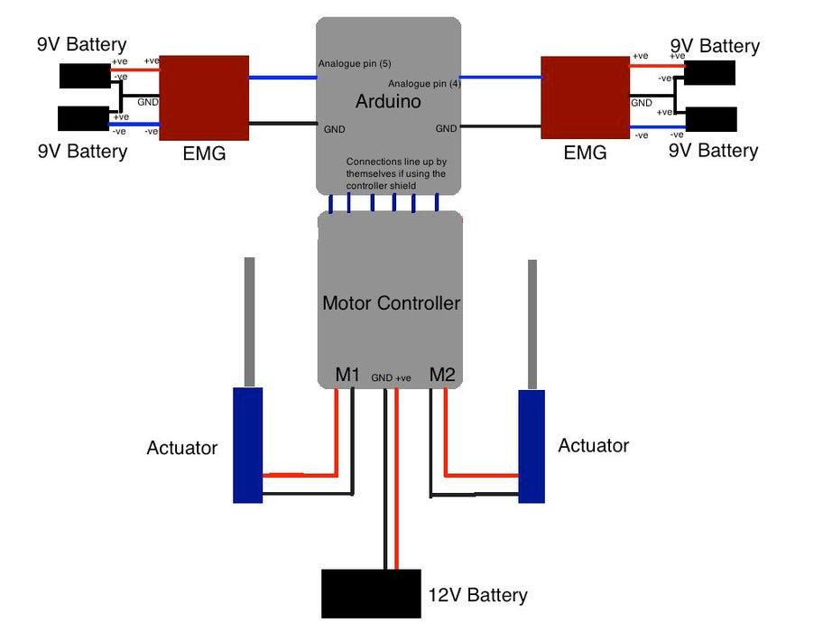
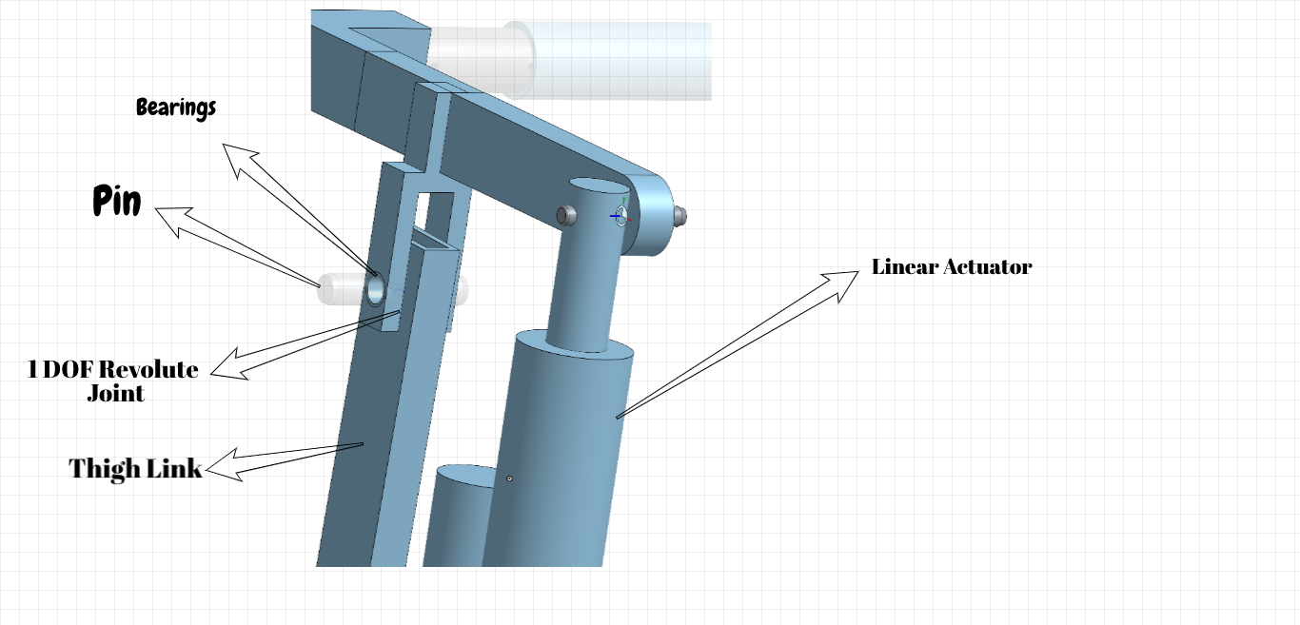
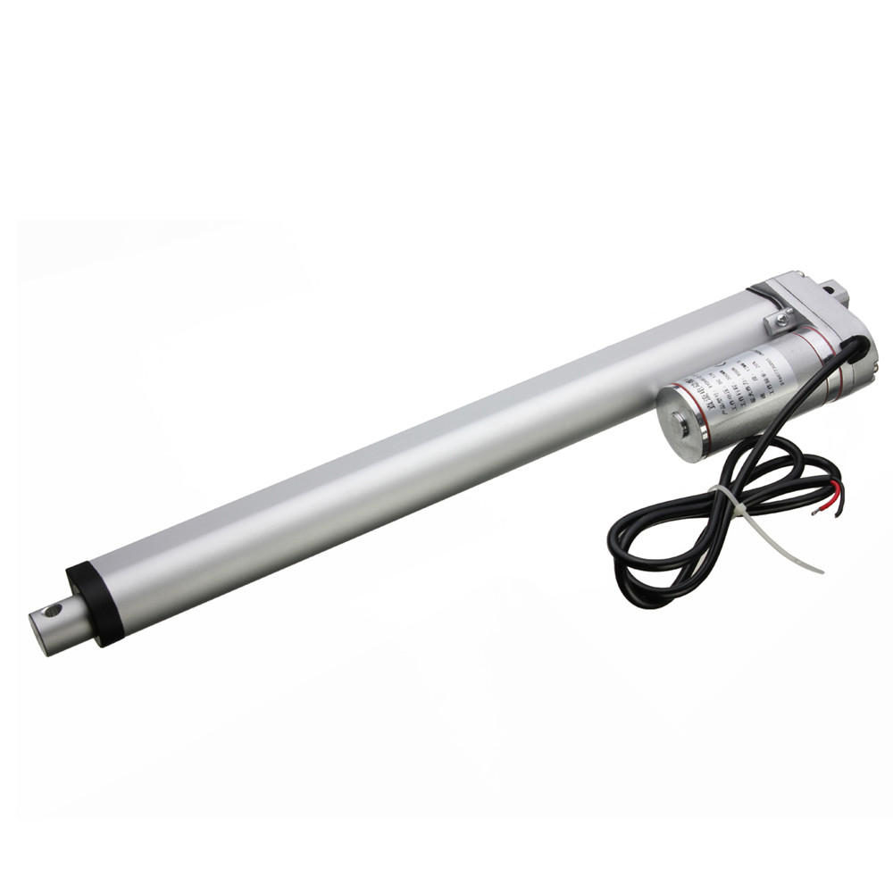
Hip Joint
The hip joint of this exoskeleton is 1 DOF and allows flexion/extension motion, it is actuated by Linear actuator with 500 N Force.

Slide 16
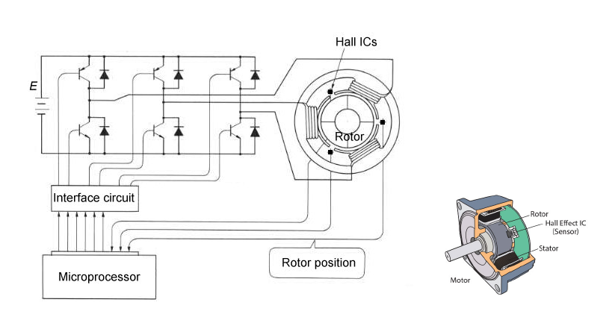
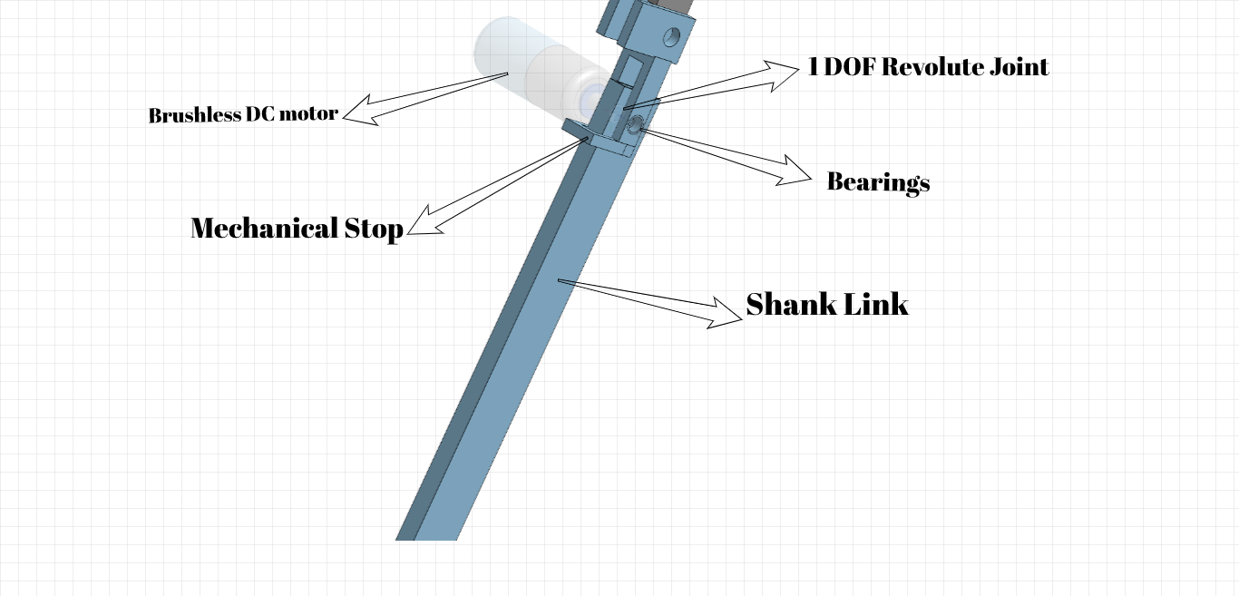
Knee Joint
The knee joint of this exoskeleton is one DOF joint actuated by Brushless DC motor ( controlled using Pulse Width Modulation ( PWM ).

Slide 17
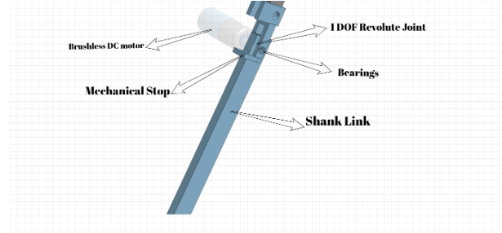
The ankle joint and foot

Slide 18
The ankle joint and foot
Ankle consists of one degree of freedom revolute joint, that moves passively.
The foot plays an important role in supporting the weight of the body and in locomotion.

Slide 19
Mechanical Stops
Can be used to prevent unnecessary motion and provide safety to User. The most important use is to allow knee locking and unlocking and limiting joint angles.

Slide 20
Proportional Myoelectric Control

Slide 21
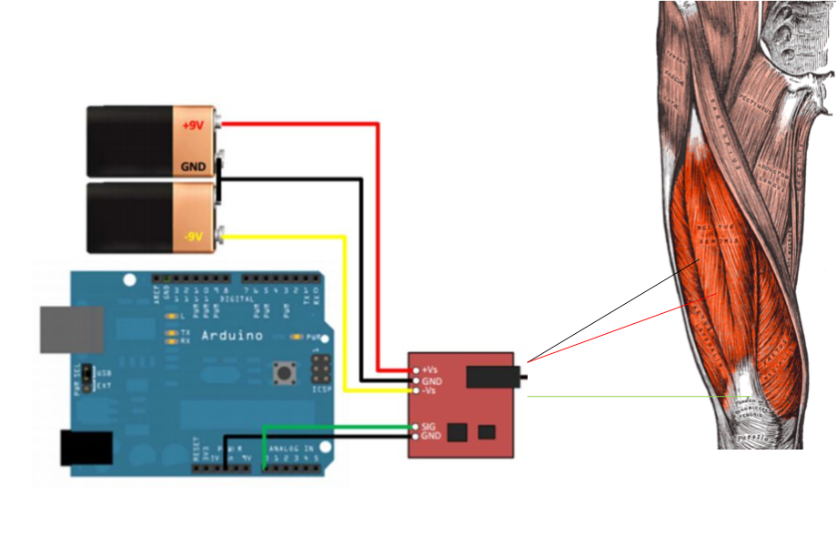
Surface Electromyography Sensor
sEMG sensors are used to detect electromyography signals generated by muscles of quadriceps in both right and left legs. It consist of differential amplifier and surface electrodes.

Slide 22
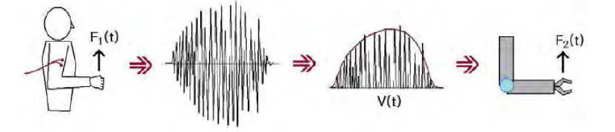
sEMG-based Control
Activate joint actuator in response to the activation of human muscles.
That can be performed by detecting sEMG signals using sEMG sensor.

Slide 23
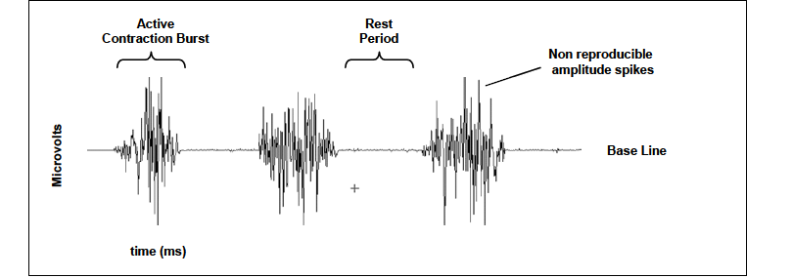
RAW EMG signal

Slide 24
Processing of sEMG signal
Before the use of sEMG signals in proportional myoelectric control, raw EMG signal must be processed by the following steps :
Filtration and amplification : eliminate noises and amplify small signals.
Setting base to zero : removing offset
Full Wave Rectification : rectify all signals to produce only positive values.
Smoothing : Using moving average (ARV ) or Root mean square ( RMS).

Slide 25
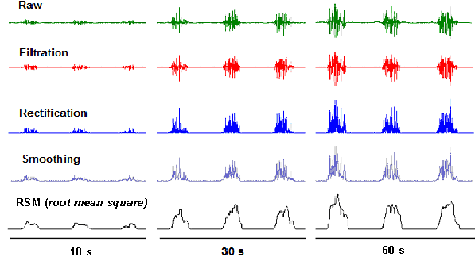
Processing of sEMG signals

Slide 26
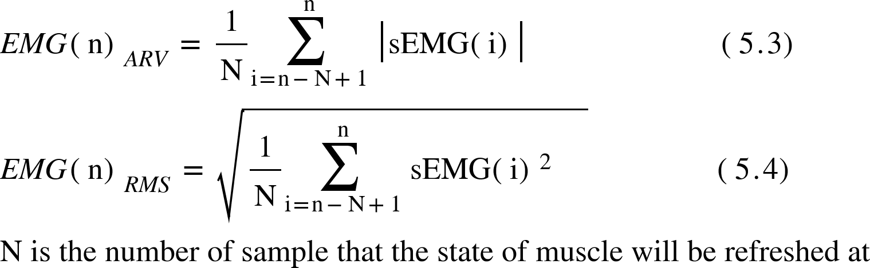
Processing of sEMG signals

Slide 27
Processing of sEMG signals
Setting Activation Threshold :
After completing the previous steps, the threshold can be implemented, which will be used to activate actuators in response to the activation of muscles, that can allow the proportional myoelectric control.
Setting maximum voluntary contraction ( MVC) : should be adjustable, so it can be detected depending on the comfortability of the user, so the user gives a strong comfortable muscle activation for 5 sec,. Activation threshold is equal to a constant percentage of MVC.

Slide 28
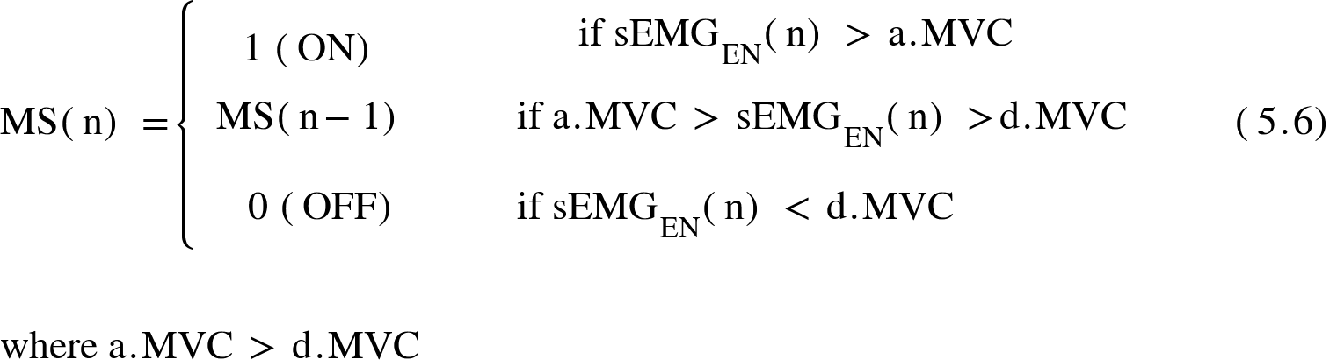
Processing of sEMG signals
Double threshold :

Slide 29
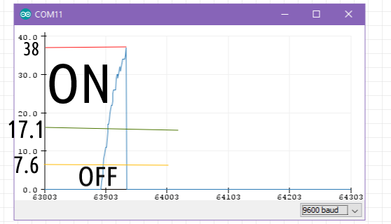
Processing of sEMG signal

Slide 30
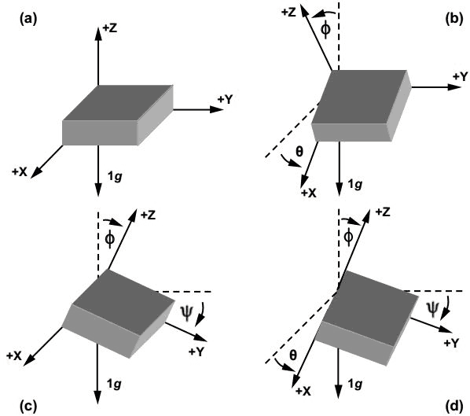
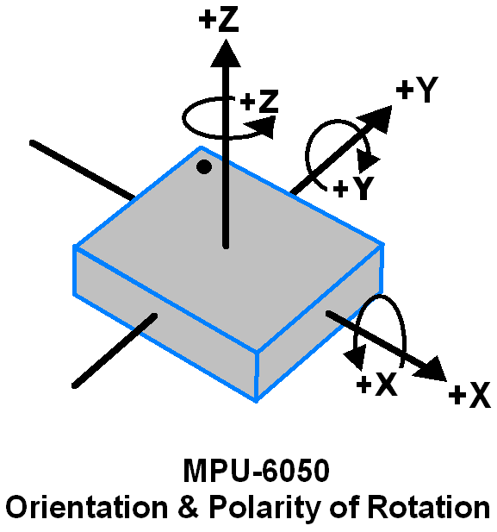
Inertial Measurement Unit (IMU)
Inertial Measurement Unit sensors ( IMU ) can be used to detect both angles and angular velocities, since it contains six axises, three of them are used for accelerometer and the other are used for gyroscope.

Slide 31
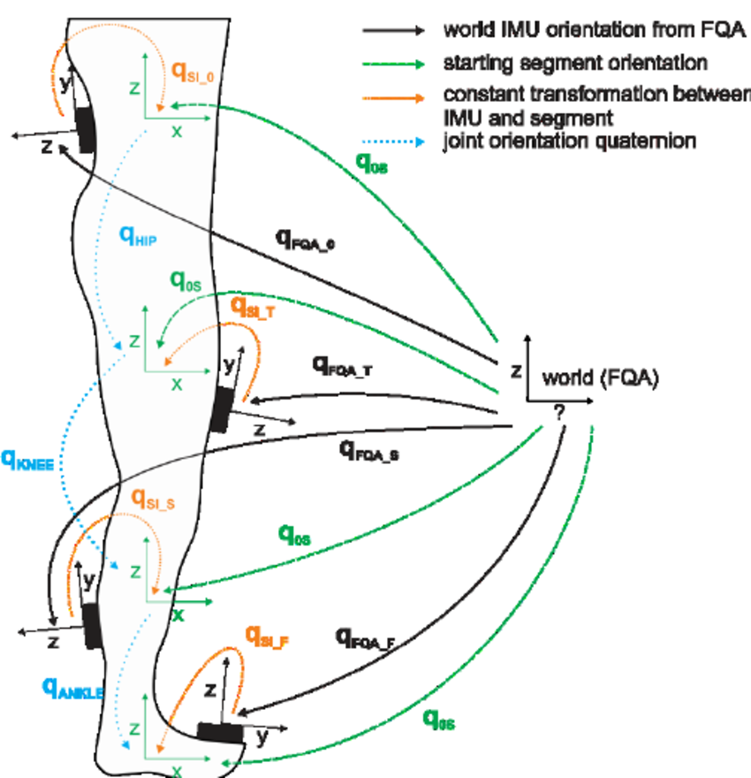
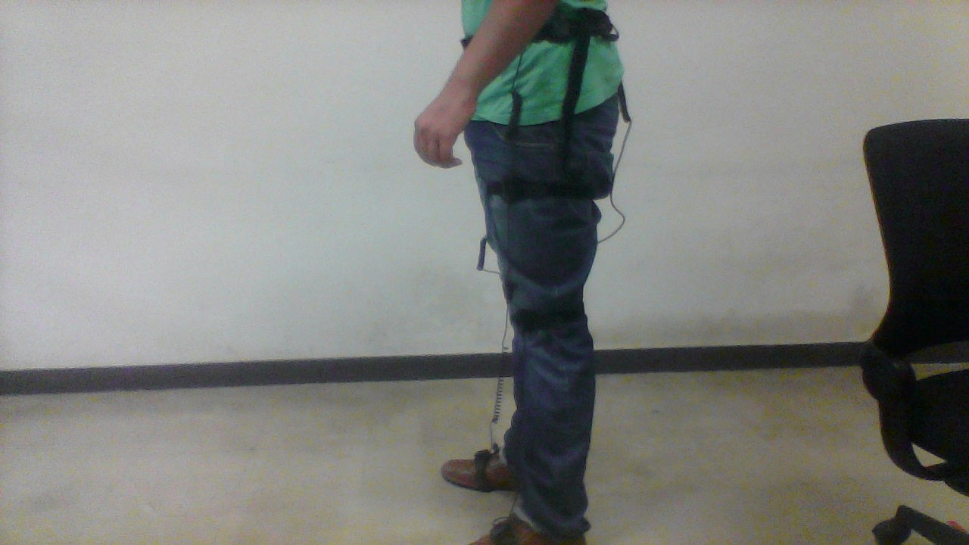
Inertial Measurement Unit (IMU)
Joint angles can be obtained by using IMU to measure the angle after and before activation.
when sEMG signal is detected and muscles are activated, the actuator will operate until the joint angle is equal to the desired angle, in response the other joint actuators will operate to complete the gait phase.

Slide 32
Control system

Slide 33
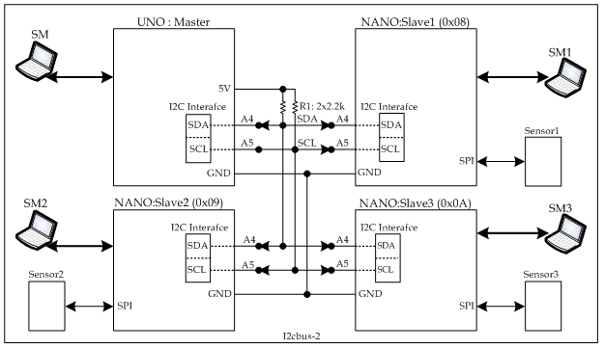
ESP8266- based Microcontroller
Wifi- based Microcontroller.
Allows the use of Wifi technologies.
Using master - slave control through I2C,SPI,Wifi and Bluetooth ( connecting two or more microcontrollers ).
More PWM pins and more communications pins.

Slide 34
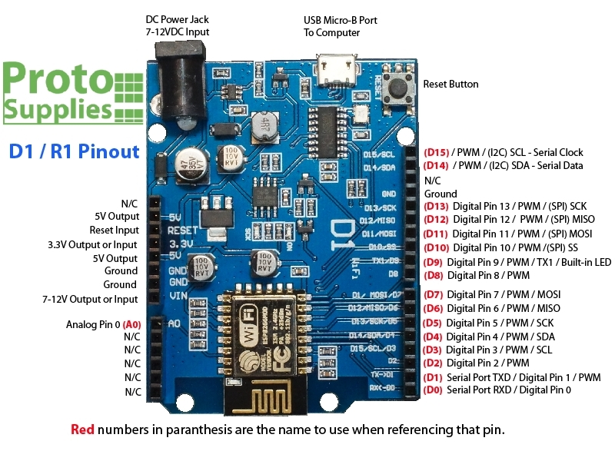
ESP8266-based Microcontroller

Slide 35
ESP8266-based Microcontroller
Microcontroller ( 1 ) : Master controller. Getting sEMG signal and control other slave controllers based on the value of signal. Right and Left sEMG sensor will be connected to this controller.
Microcontroller ( 2 ) : Slave controller ( Right ). Controlling the right knee and hip actuators and getting information from IMU sensors attached on the right thigh and shank.
Microcontroller ( 3 ) : Slave controller ( Left ). Controlling Left knee and hip actuators and getting information from IMU sensors attached on the left thigh and shank.

Slide 36
Power Unit
Lithium- ion ( Li-ion ) battery is a good choice, since it is a rechargeable battery, lighter than conventional batteries, high energy density, the rate of discharge is lower than other conventional batteries. The selection of suitable Lithium - ion battery depends on Three main criterias :
Voltage.
Capacity.
Discharging Current.

Slide 37
Power Unit
Using two 12v lithium ion ( Li-ion ), 2.5 A discharging current and 20 AH capacity.
Running time = 20+20 / 5 = 40/ 5 = 8 hours
Each battery will power one part ( right/left )
Microcontrollers and sEMG sensors are powered by separate 9v batteries.

Slide 38
Conclusion
Orthotic Exoskeleton can be used to assist walking of people, EMG signals can be used to control this orthotic robot.
Actuators can be activated depending on the activation of muscles.
Mechanical system must be safe, comfort and compatible with human kinematics.

Slide 39

Thank You

