Slide 1
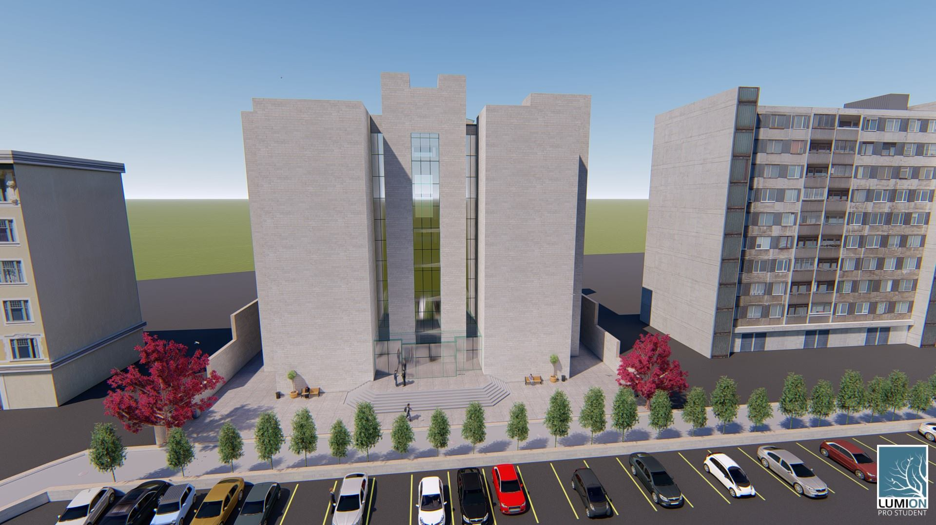
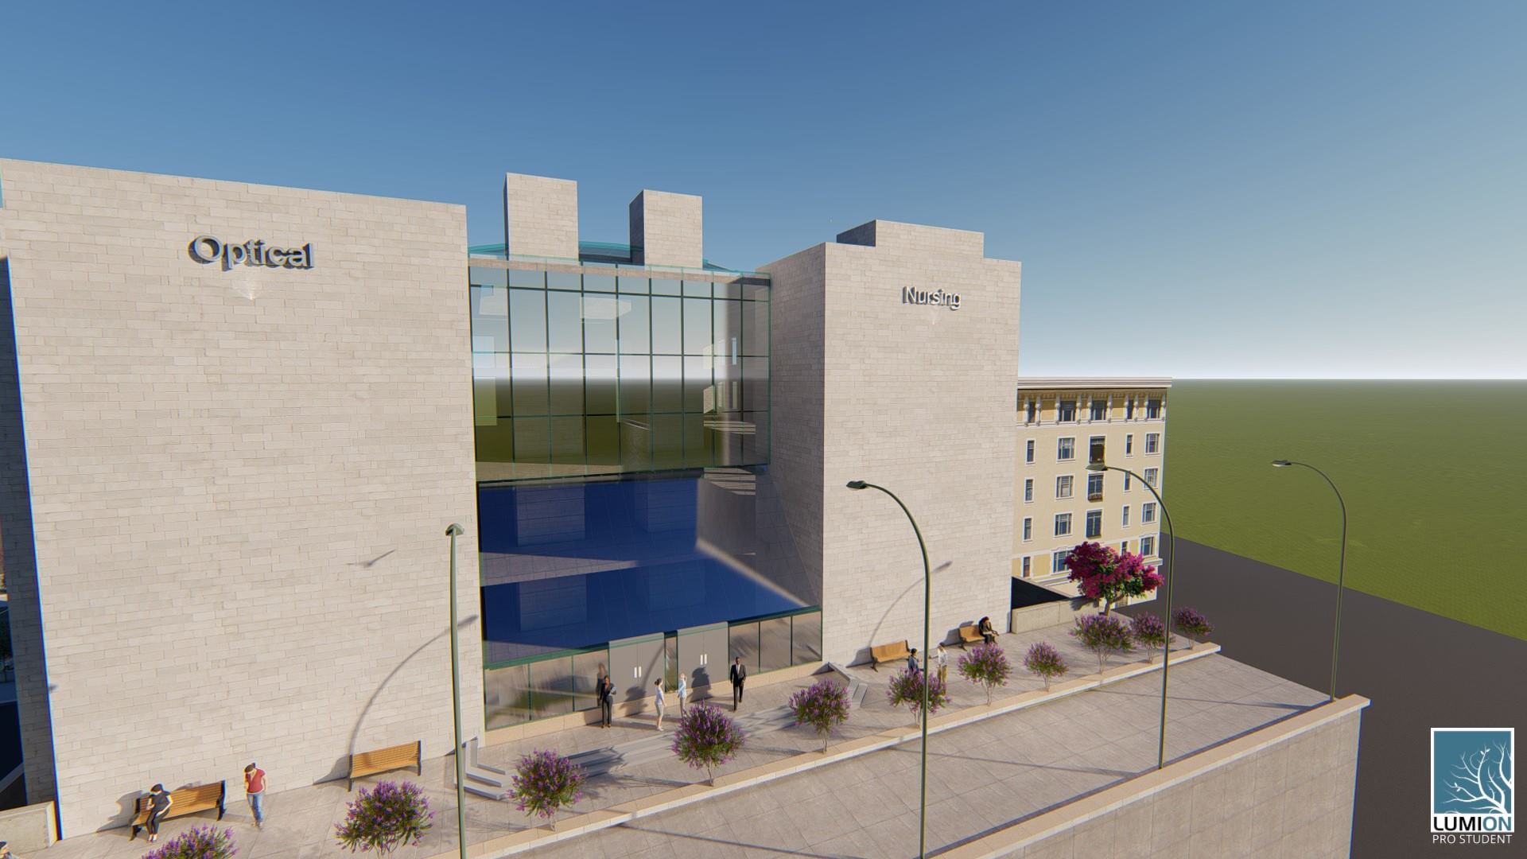
Redesign the Optical and Nursing College

Slide 2
Outline
Overview
Architectural Design
Environmental Design
Structural Design
Electro-Mechanical Design
Cost estimation

Slide 3
OVERVIEW
Last semester
  Checks
  Results
This semester
  Redesign according to Standard .

Slide 4
Environmental and Architectural Design

Slide 5
Architectural design
C:\Users\Meme Saleh\Downloads\ض.mp4

Slide 6
Architectural design
Spaces areas and numbers
Functions between facilities
Openings

Slide 7
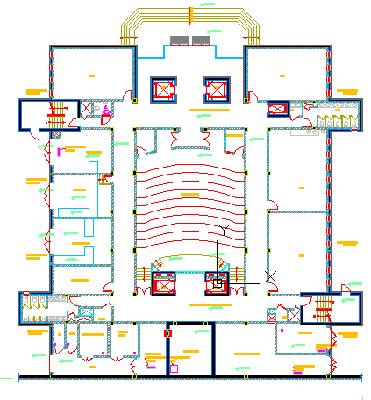
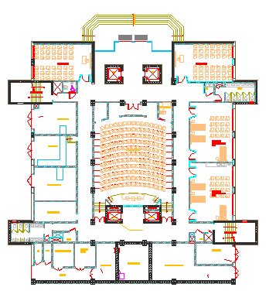
Existing Basement three
Designed Basement three

Slide 8
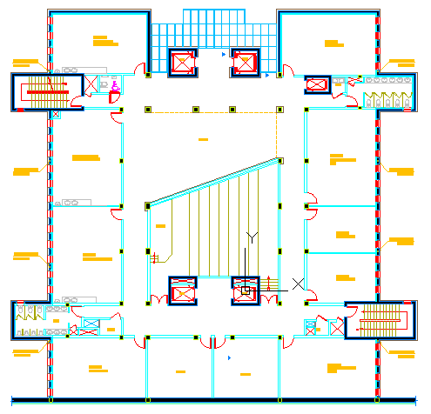
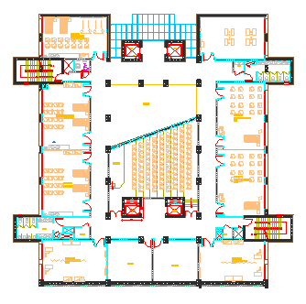
Existing Basement two
Designed Basement two

Slide 9
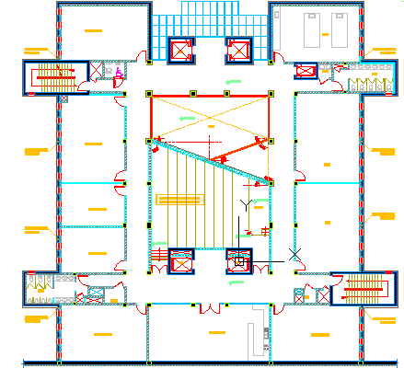
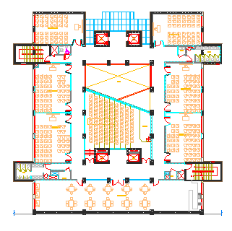
Existing Basement one
Designed Basement one

Slide 10
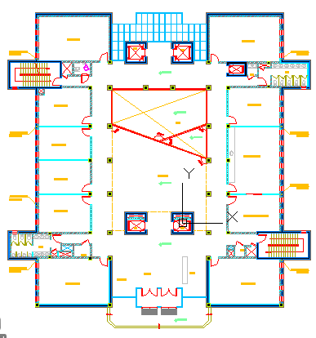
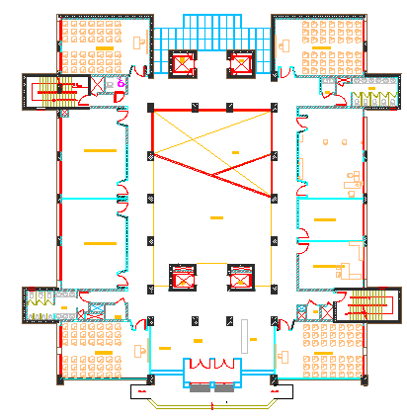
Existing Ground Floor
Designed Ground Floor

Slide 11
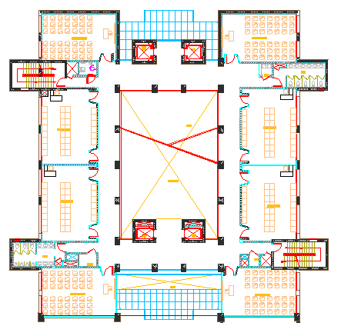
Designed First Floor

Slide 12
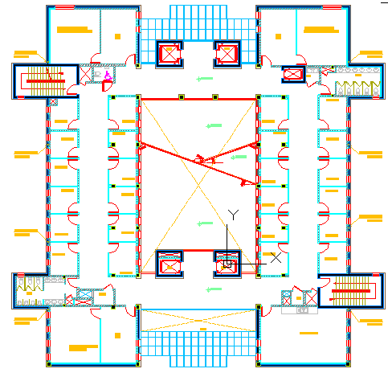
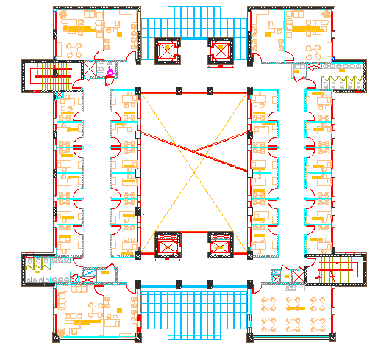
Existing Second Floor
Designed Second Floor

Slide 13
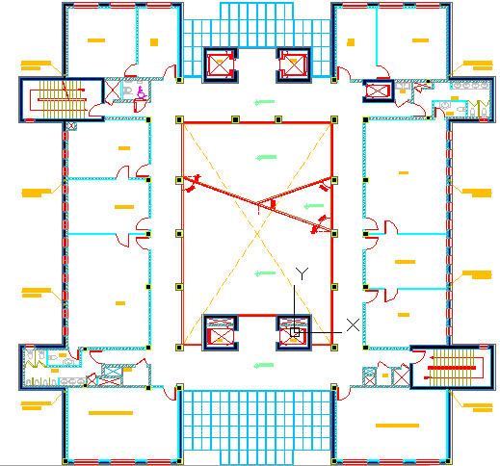
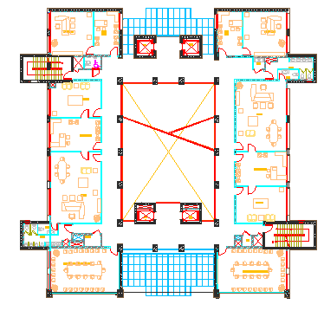
Existing Third Floor
Designed Third Floor

Slide 14
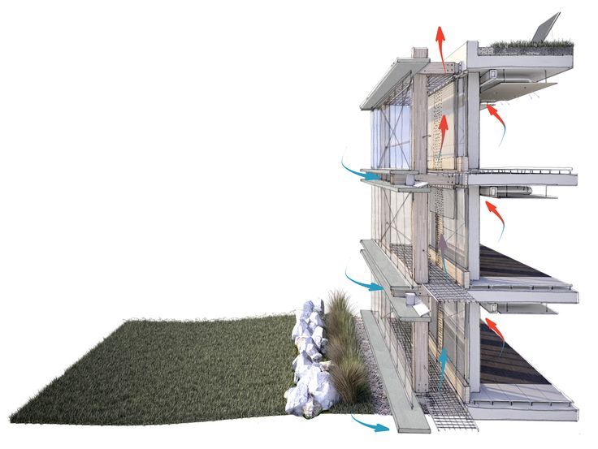
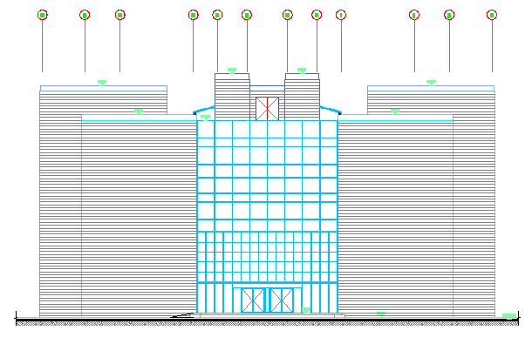
Environmental design
Passive aspects
Double-skinned wall

Slide 15
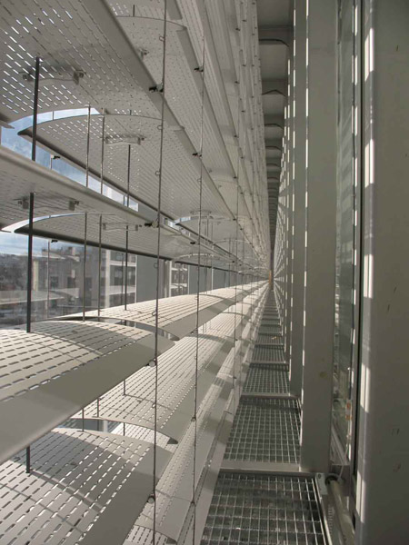
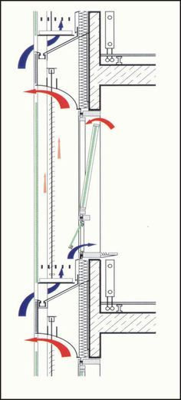
Environmental design
Double-skinned wall

Slide 16
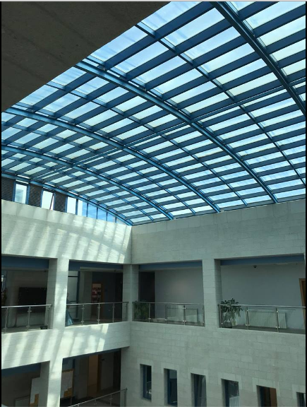
Environmental design
Passive aspects
Sky light

Slide 17
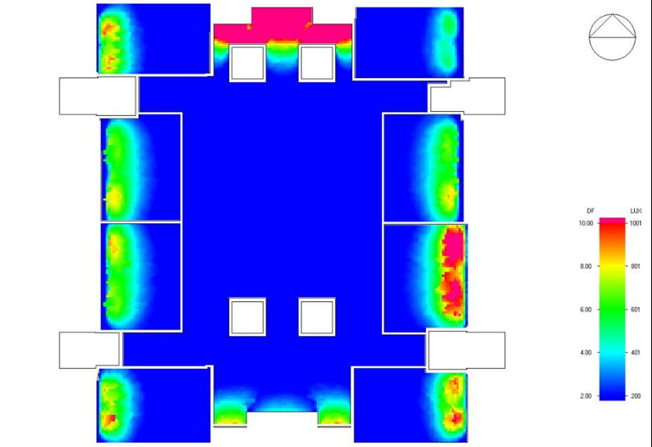
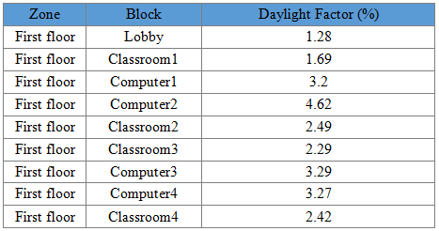
Daylight Factor

Slide 18
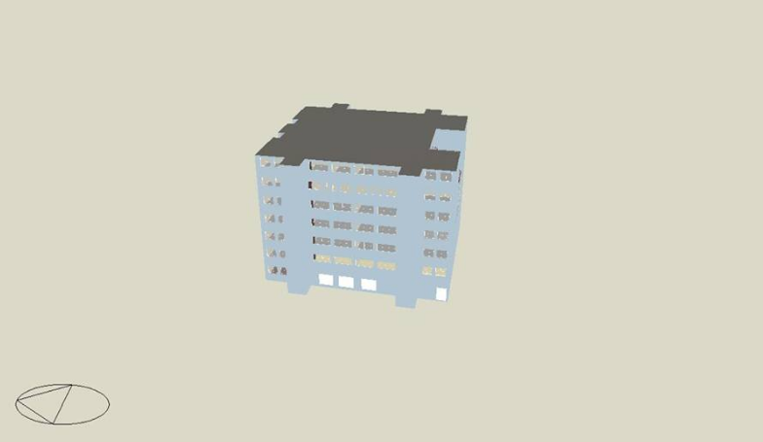
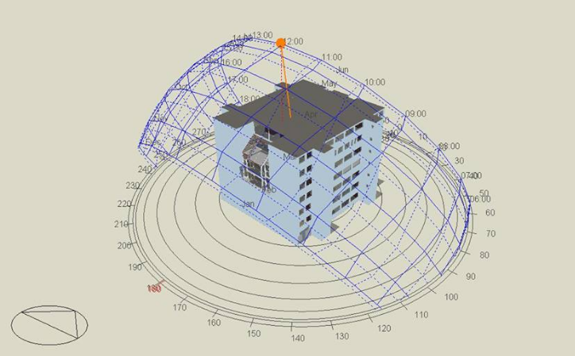
Thermal Design

Slide 19

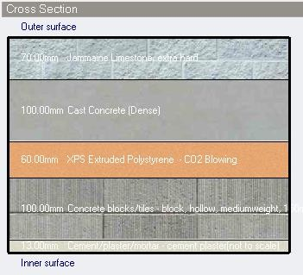
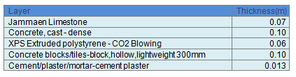
External wall
U-value = 0.452 W/m2.k

Slide 20
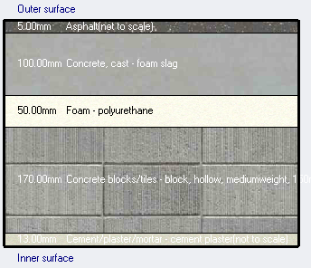
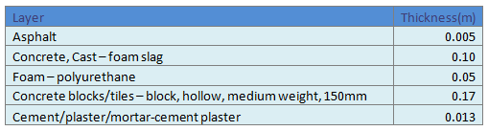
Flat roof
U-value = 0.381 W/m2.k

Slide 21


Design Capacity and Energy per total building area

Slide 22
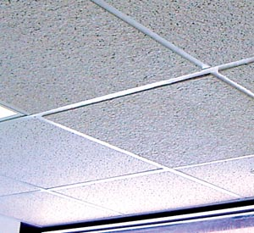

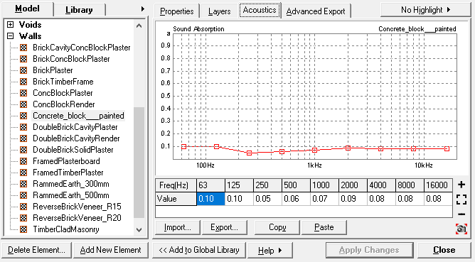
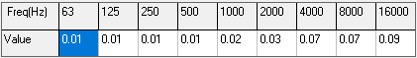
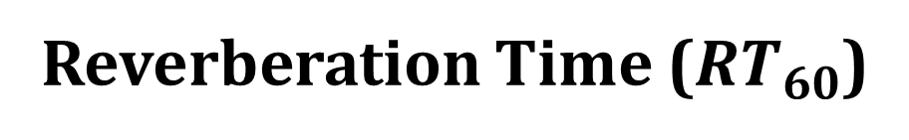
Environmental design
Acoustics
Reverberation Time ($RT_{60}$)
Used absorptive material
Acoustical ceiling tiles
Concrete block painted
Concrete slabs tiles-on ground
27

Slide 23
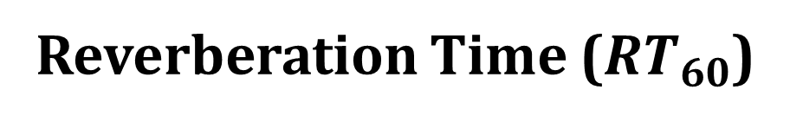
Environmental design
Acoustics
Reverberation Time ($RT_{60}$)
Classroom
0.5-0.8
 | SABINE
FREQUENCIES | RT(60)
63Hz: | 0.85
125Hz: | 0.86
250Hz: | 0.74
500Hz: | 0.57
1kHz: | 0.52
2kHz: | 0.49
4kHz: | 0.48
8kHz: | 0.45
16kHz: | 0.45
27

Slide 24
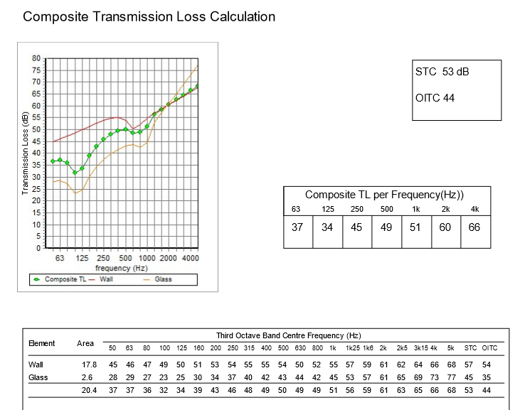
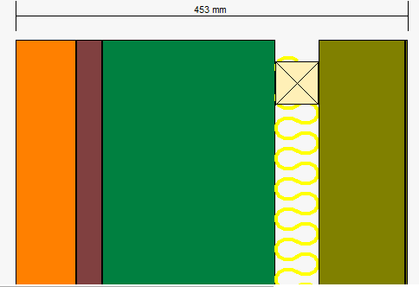
Environmental design
Acoustics
STC and IIC
External wall
stone=5cm
Morter=3cm
P.Concrete=20
Polystrene=5cm
Bloch=10cm
Plater=2cm
Paint=0.3cm
TL composite =53 dB
28

Slide 25
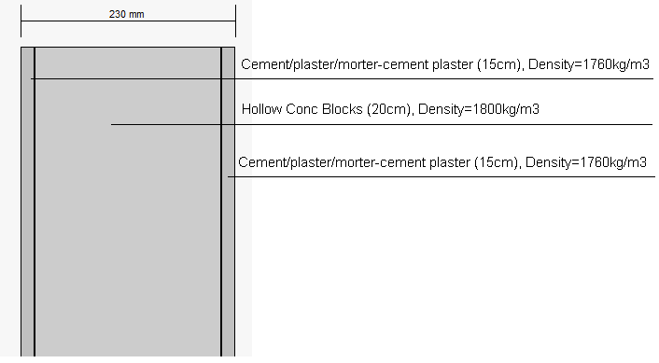
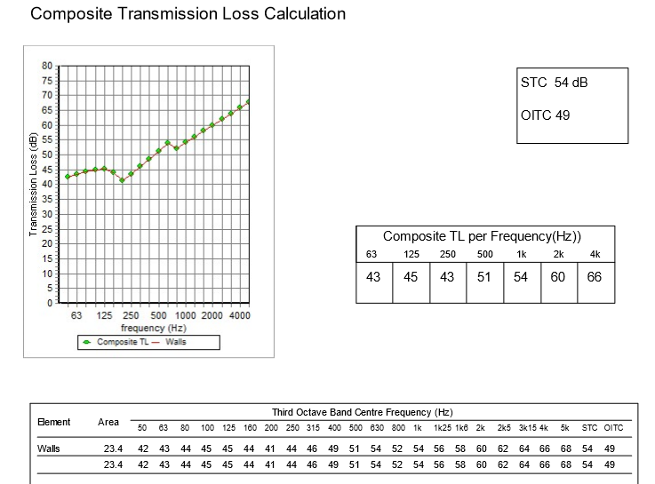
Environmental design
Acoustics
TL composite =53 dB
STC and IIC
Internal wall
Plaster=1.5cm
Block=20cm
Plater=1.5cm
28

Slide 26
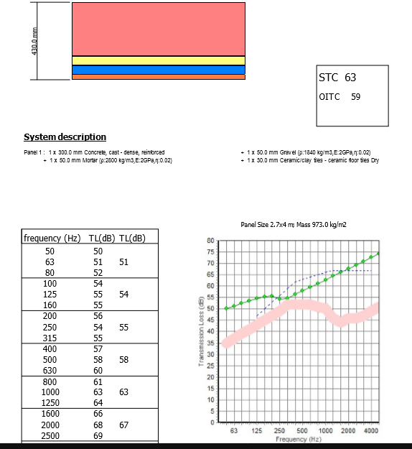
Environmental design
Acoustics
STC and IIC
Ceiling
P.Concrete=20 cm
Polystrene=5cm
Plater=2cm
Paint=0.3cm
28

Slide 27


Environmental design
Acoustics
Articulation Loss of Consonants ($AL_{conson.}\%$)
For classroom = 8.5 %
29

Slide 28
Structural Design
33

Slide 29
Structural Design
Codes
(ACI 318-14) for RC Structures Design
(UBC 97) for Earthquake Loads
(ASCE 7 2010) for loads computations
34

Slide 30
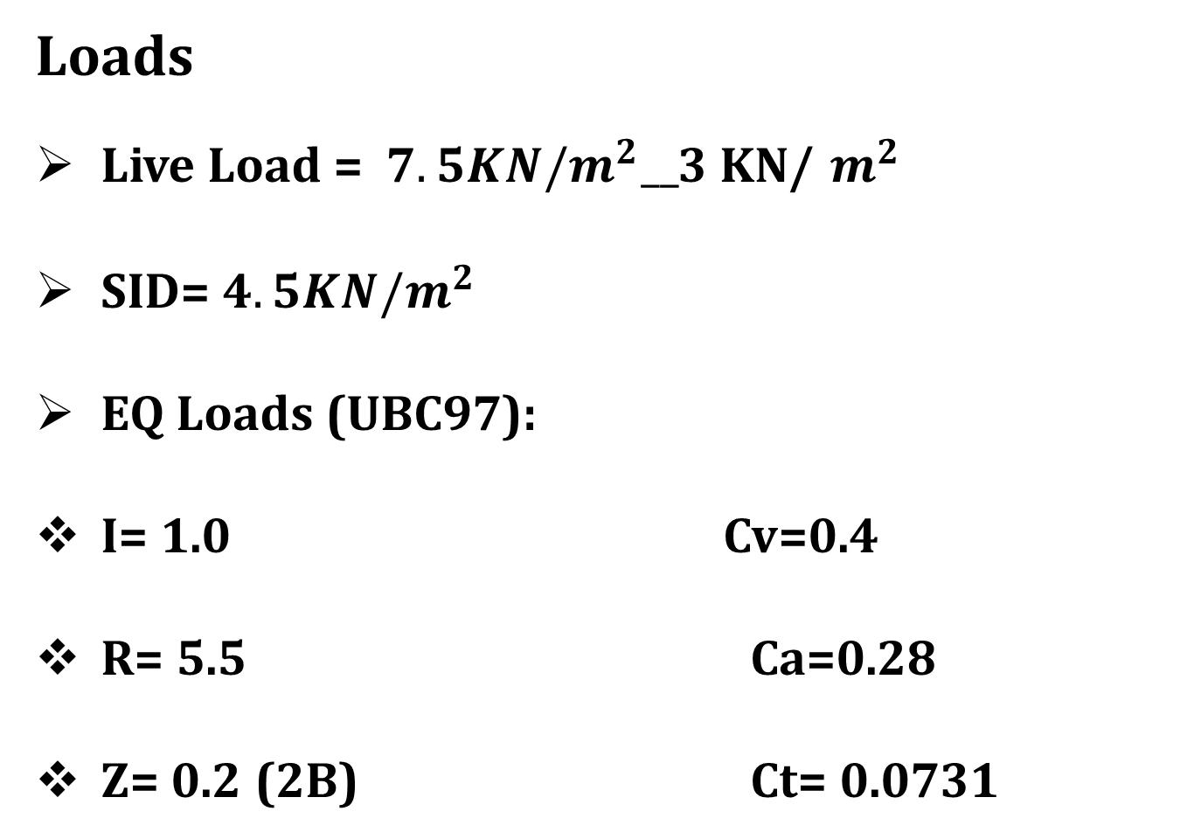
Structural Design
Loads
Live Load = $7.5KN/m^{2}__$3 KN/$m^{2}$
SID= $4.5KN/m^{2}$
EQ Loads (UBC97):
I= 1.0 Cv=0.4
R= 5.5 Ca=0.28
Z= 0.2 (2B) Ct= 0.0731
35

Slide 31

Structural Design
Material
Concrete B350
Steel Fy = 420MPa
Final Design Sections
Slabs thickness 0.2 m
Columns(rectangular) (0.9$×$0.6m),(0.9$×$0.35 m)
,(0.35$×$ 0.35m)
Beams (0.6$×$0.5)m
Walls thicknesses 0.2 m
Structural system
One way solid slab
36

Slide 32
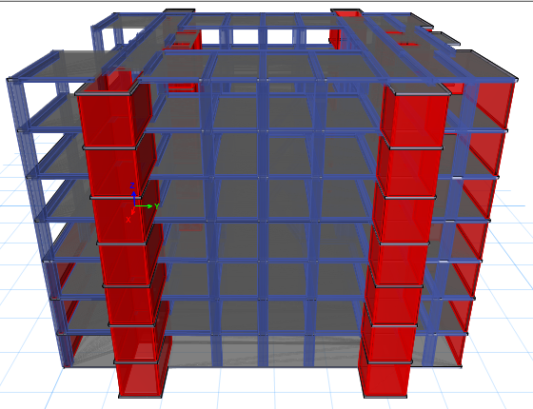
Structural Design
3D model
37

Slide 33
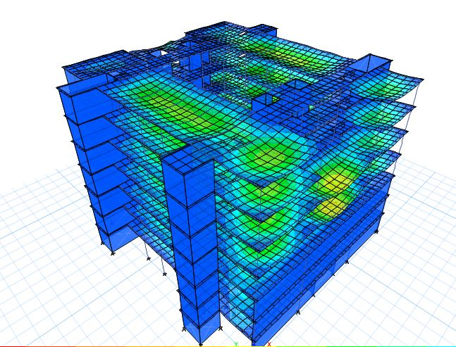
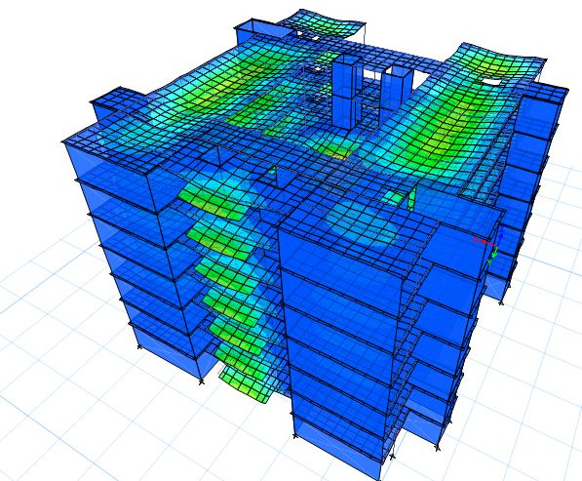
Structural Design
Compatibility Check
38

Slide 34
Structural Design
Equilibrium Check
Load | Manual calculations (KN) | Calculations from ETABS (KN) | Difference (%)
Dead load | 89 769.75 | 89 594.4 | 0.19
Live load | 43069.8 | 42 413 | 1.5
Superimposed dead load | 37 314.67 | 38 172 | 2.2
Element | Hand calculations | Calculations from ETABS | Difference (%)
Column 3 | 3351.6 KN.m | 3288 KN.m | 1.93
Beam 2 | 643. 7 KN.m | 637. 97KN.m | 0.70
Slab | 250 KN | 218 KN | 12.80
Internal Forces Check
39

Slide 35
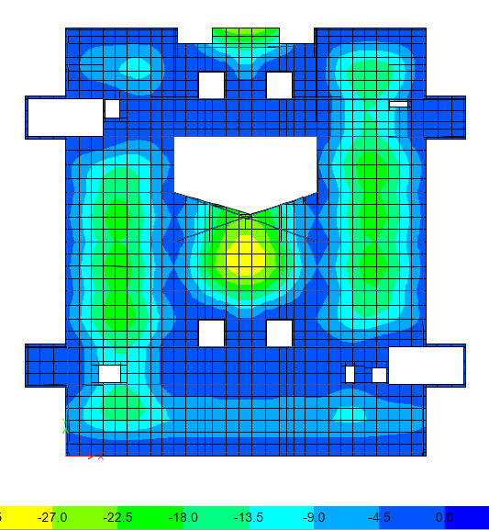
Structural Design
Deflection
Limit = 6200/240
= 25.83 mm
(According to
ACI 318-11)
40

Slide 36
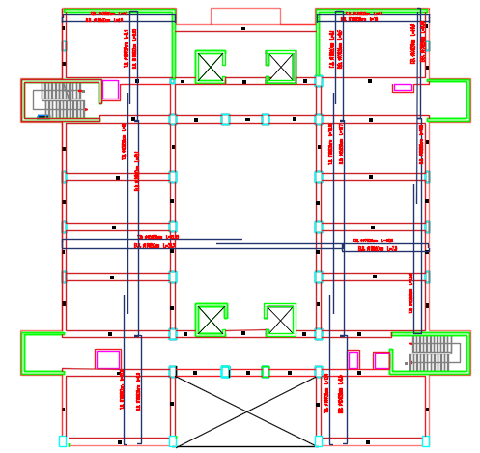
Structural Design
Slab:
One -Way Solid Slab
41

Slide 37
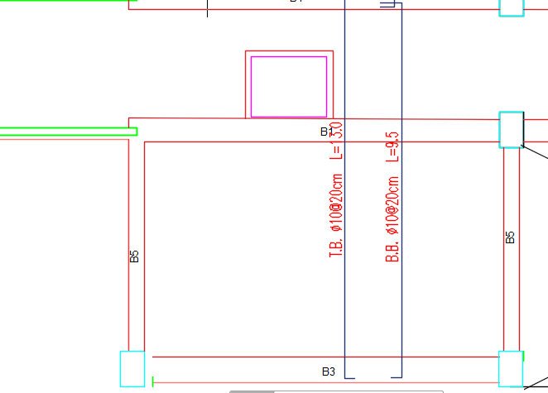
Structural Design
Slab:
One-Way Solid Slab
41

Slide 38
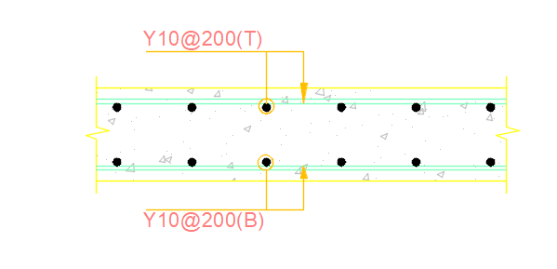
Structural Design
Slab:
One-Way Solid Slab
41

Slide 39
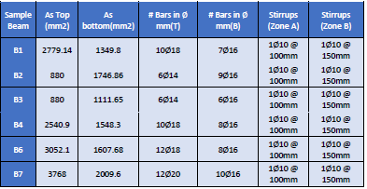
Structural Design
Beam Design
42

Slide 40
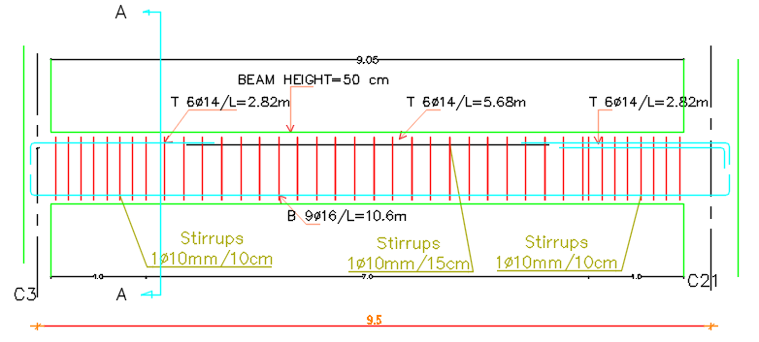
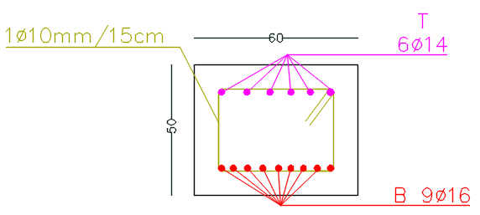

Structural Design
Beam Design
42

Slide 41


Structural Design
Columns
C30
43

Slide 42

Structural Design
Column Design C30
43

Slide 43

Structural Design
Footing Design
44

Slide 44
Structural Design
Footing number | columns | Dim.(mm) |  |  | reinforcement for short direction | reinforement for long direction
 |  | L | B | H
F1 | C(2,3,4,7,8,9,11,12,13,16,17,18,25,26,27,28,30) | 3 | 2.5 | 0.7 | 11Ø25 /150mm | 13Ø25 /150mm
F2 | C(24,23,19,20) | 3.7 | 2.7 | 0.8 | 18Ø25 /150mm | 25Ø25 /150mm
F3 | C(21,22) | 4 | 3 | 0.87 | 20Ø25 /150mm | 27Ø25 /150mm
F4 | C(15,14,10,6,5,1) | 2.5 | 1.2 | 0.45 | 8Ø25 /150mm | 17Ø25 /150mm
Footing Design
45

Slide 45


Structural Design
Footing Design
Section in footing (F1)
Plan of footing (F1)
45

Slide 46


Structural Design
Shear wall & wall footing Design
46

Slide 47


Structural Design
Water Tank Design
47

Slide 48

Structural Design
Stair Design
48

Slide 49
Electro-Mechanical Design

Slide 50


Electrical Design
Lighting Design
Classroom and laboratory
The average illuminance is 324lx
The uniformity is 0.42
The unified glare rating is 16.1 and 15.

Slide 51


Electrical Design
Secretary room
The average illuminance is 646lx
The uniformity is 0.64
The unified glare rating is less than 10

Slide 52


Electrical Design
Office Room
The average illuminance is 614lx
The uniformity is 0.63
The unified glare rating is 15.1

Slide 53

Electrical Design
Socket system

Slide 54

Mechanical Design
    Drainage System

Slide 55

Mechanical Design
    Drainage System

Slide 56

Mechanical Design
Water supply system

Slide 57

Mechanical Design
Elevator system

Slide 58


Mechanical Design
Required number N' = 4.
Car capacity = 2500lb.
Car speed =350fpm.
Car passenger Capacity P = 13.

Slide 59

Mechanical Design
HVAC system

Slide 60
Mechanical Design
Fire Fighting Design
Fire alarm system
Firefighting system
Emergency Lighting

Slide 61

Mechanical Design
Fire alarm system

Slide 62

Mechanical Design
Firefighting system

Slide 63

Mechanical Design
Emergency Lighting

Slide 64
Cost Estimate

Slide 65
Cost Estimate
Project Works
construction works Cost(NIS) | 5766910.1
Finishing Works Cost(NIS) | 5053751
Mechanical Works Cost(NIS) | 2942545
Electrical Works Cost(NIS) | 841615
Total Cost(NIS) | 14604821.1

