Slide 1

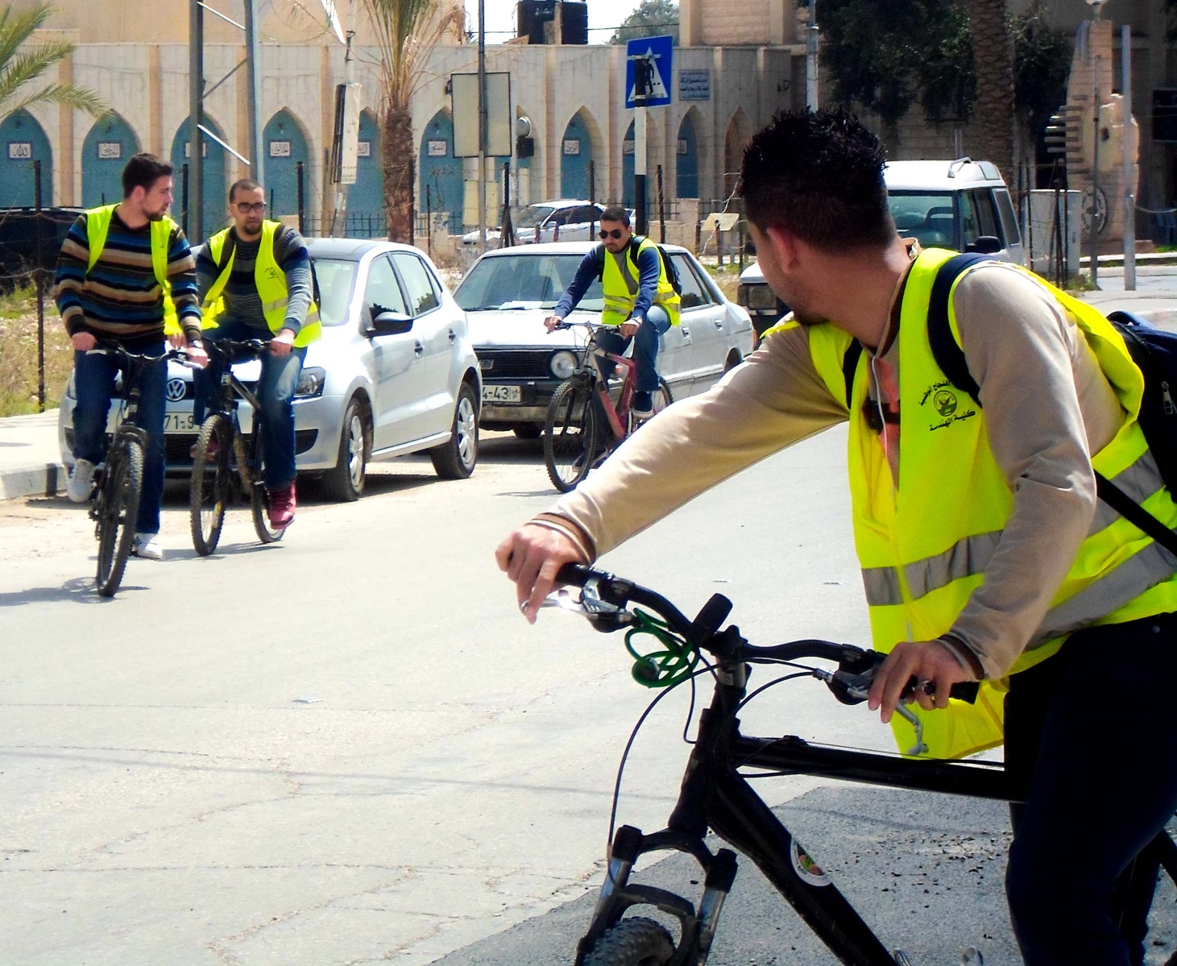
First Bicycle Network in Palestine
An-Najah National University
Engineering & IT Faculty
Civil Engineering Department
Prepared By:
Amro Al-Wawi
Anas Najeh’
Bayan El-Hout
Omar Al-Sahili
Supervised By:
Prof. Sameer Abu-Eisheh

Slide 2



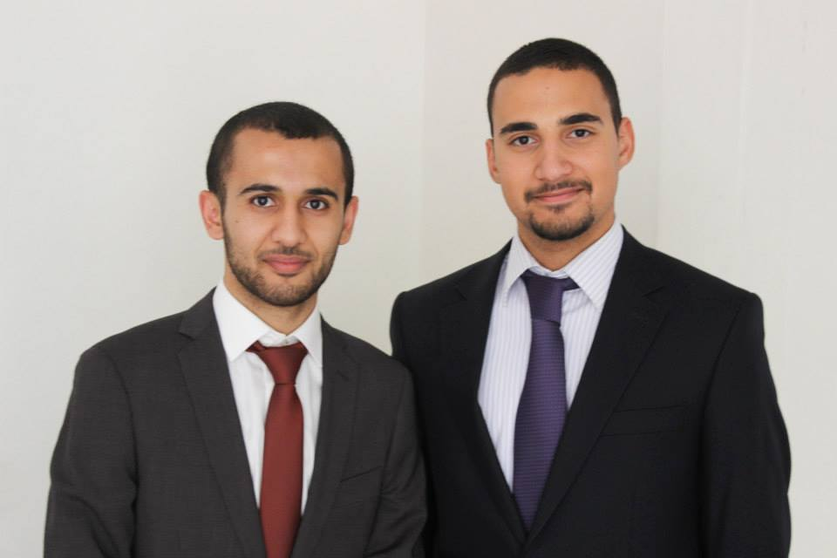
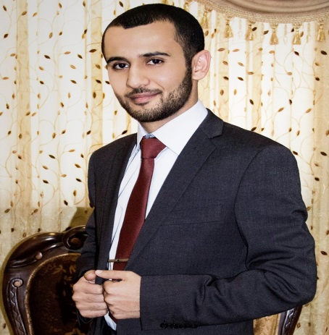
Report Outline
Introduction
Design Criteria
Objectives
Final Design
Final Design
EIA
Anas Naje’
Bayan El-Hout
Data Analysis
Methodology
Final Design
Specifying
Study
EIA
Data Collection
Conclusion
Cost
Omar Al-Sahili
Amro Al-Wawi

Slide 3

INTRODUCTION
General Background
Importance of the Project
Problem Definition

Slide 4

OBJECTIVES
Specifying the existing conditions
for Jericho city’s network
Performing the required studies and analysis
Designing the Network

Slide 5

METHODOLOGY
Data
Analysis
Final Design
Design criteria
Data
Collection
Specifying Study Area
Potential impacts

Slide 6

Specifying Study
Area

Slide 7
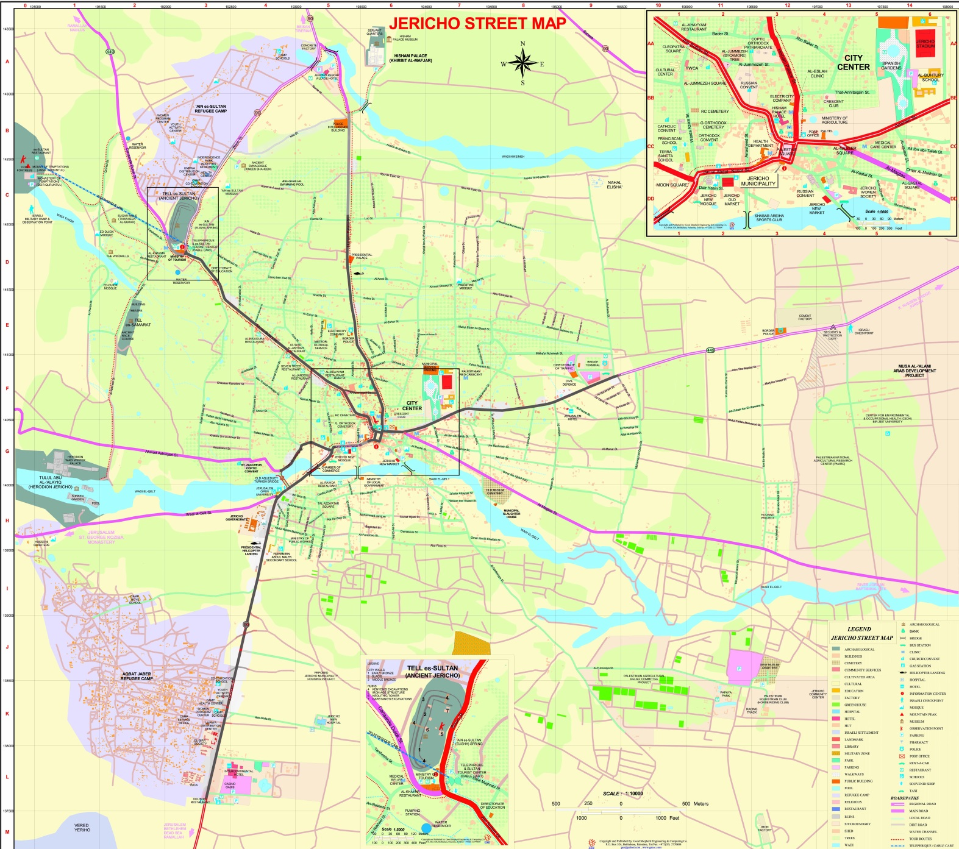
Jericho City Map
Nile St.
Al-Istiqlal Uni. St.
Tal Es-Sultan St.
Jummezeh St.
Amman St.
Terra Santa St.
City Center
AlQuds St.

Slide 8

Specifying Questionnaire Sample

Slide 9
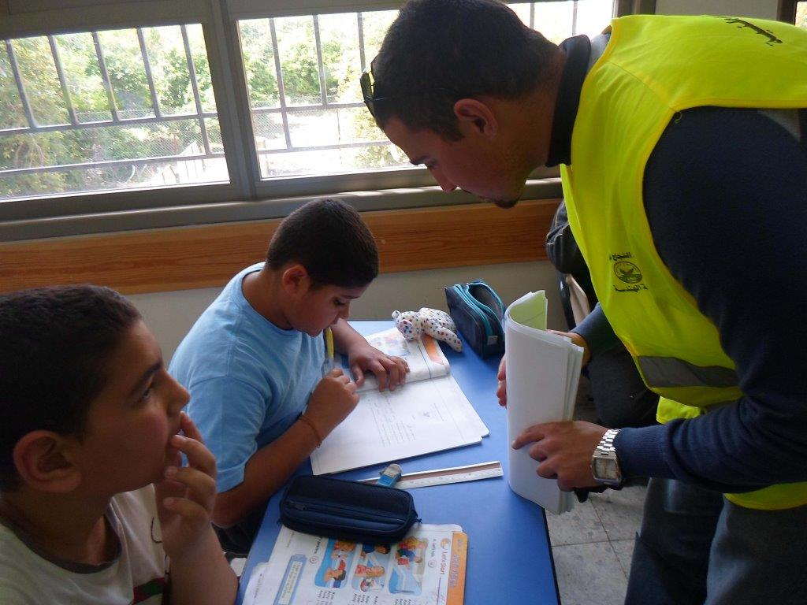
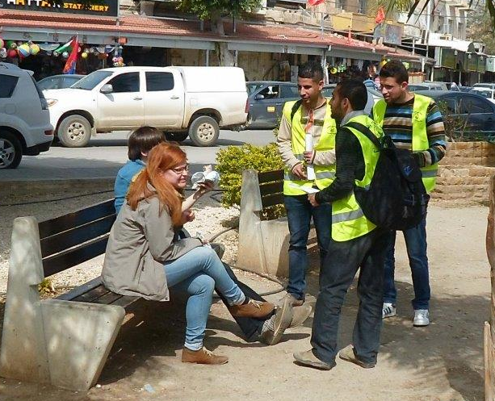
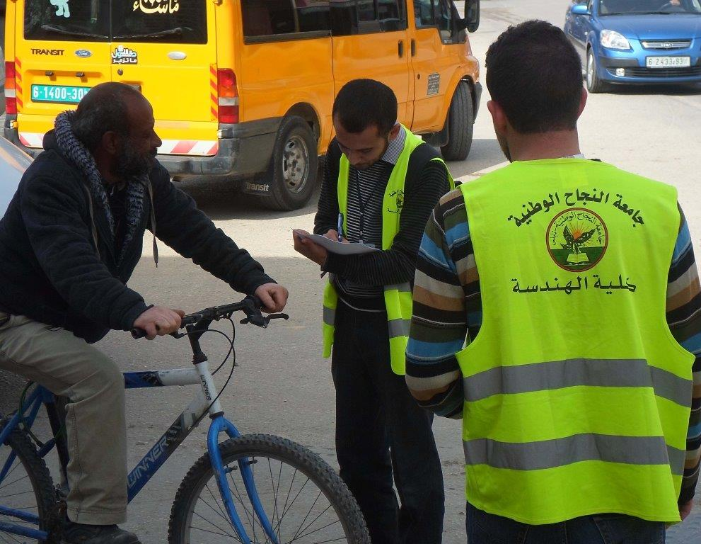
Specifying Questionnaire Sample
School Students
Tourists
Local citizens

Slide 10


DATA COLLECTION
Inventory study
Vehicle & bicycle counts
Pedestrians counts
Questionnaires

Slide 11

DATA ANALYSIS
Ques.
Traffic
Traffic
School Students
Local Citizens
Tourists
Vehicles
Bicycles
Pedestrians
Vehicles
Bicycles
Pedestrians

Slide 12

Traffic Analysis
Amman Street
Facility Type | Multilane-highway |  | Bicycle Lane |  | Pedestrian
Direction | EB | WB | EB | WB | EB | WB
Parameter | (D) 4.0 | 2.9 | 23(S) | 23 | 9.56 | 9.56
LOS | A | A | A | A | C | C
Al-Quds Street
Facility Type | Multilane-highway |  | Bicycle Lane |  | Pedestrian
Direction | NB | SB | EB | WB | EB | WB
Parameter | (D) 3.5 | 2.3 | 18(S) | 18 | 5.86 | 5.86
LOS | A | A | B | B | C | C
Al-Istiqlal Uni. Street
Facility Type | Multilane-highway |  | Bicycle Lane |  | Pedestrian
Direction | NB | SB | EB | WB | EB | WB
Parameter | (D) 1.2 | 1.6 | 22(S) | 22 | 3.03(Vp) | 3.03
LOS | A | A | B | B | C | C

Slide 13
Traffic Analysis
Tal Al-Sultan Street
Facility Type | Multilane-highway |  | Bicycle Lane |  | Pedestrian
Direction | WB | EB | EB | WB | EB | WB
Parameter | (D) 2.4 | (D) 2.5 | - | - | 1.67 (Vp) | 1.67
LOS | A | A | - | - | C | C

Slide 14

Questionnaire Analysis

Slide 15

DESIGN CRITERIA
D. Vehicle
Design
Criteria
Intersection D.
D. Speed
Signs
Elements of D.
Marking

Slide 16

Design Criteria
Design Vehicle
Standard Bicycle
Design Speed
Pav. Level Terrain 24 km/h

Slide 17
Design Criteria
Elements of Design
On Road Facilities
Shared Used Path

Slide 18
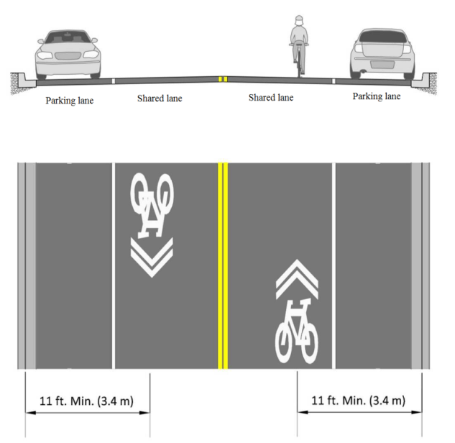
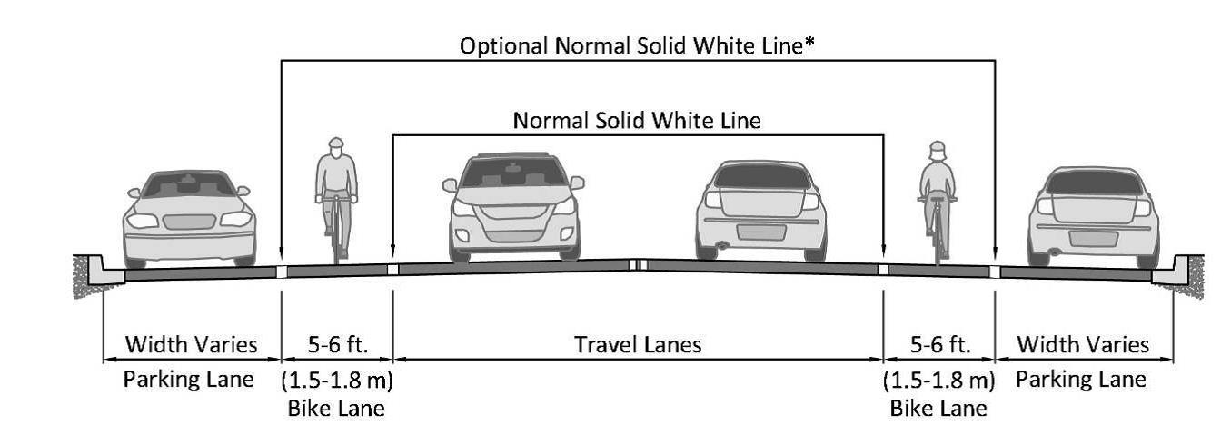
Design Criteria
Shared Lane
On Road Facilities
Bicycle Lane

Slide 19
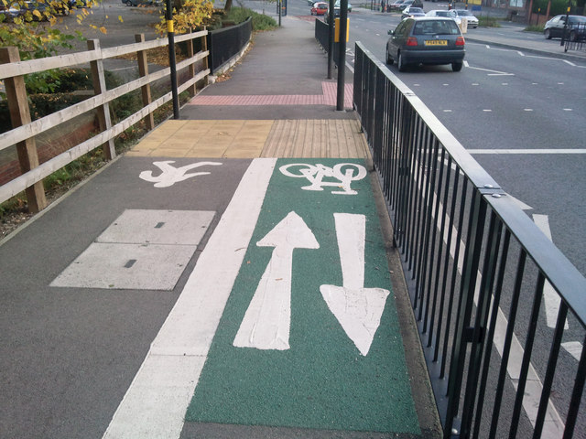
Design Criteria
Shared Use Path

Slide 20

Final Design

Slide 21

City Center Area Map

Slide 22
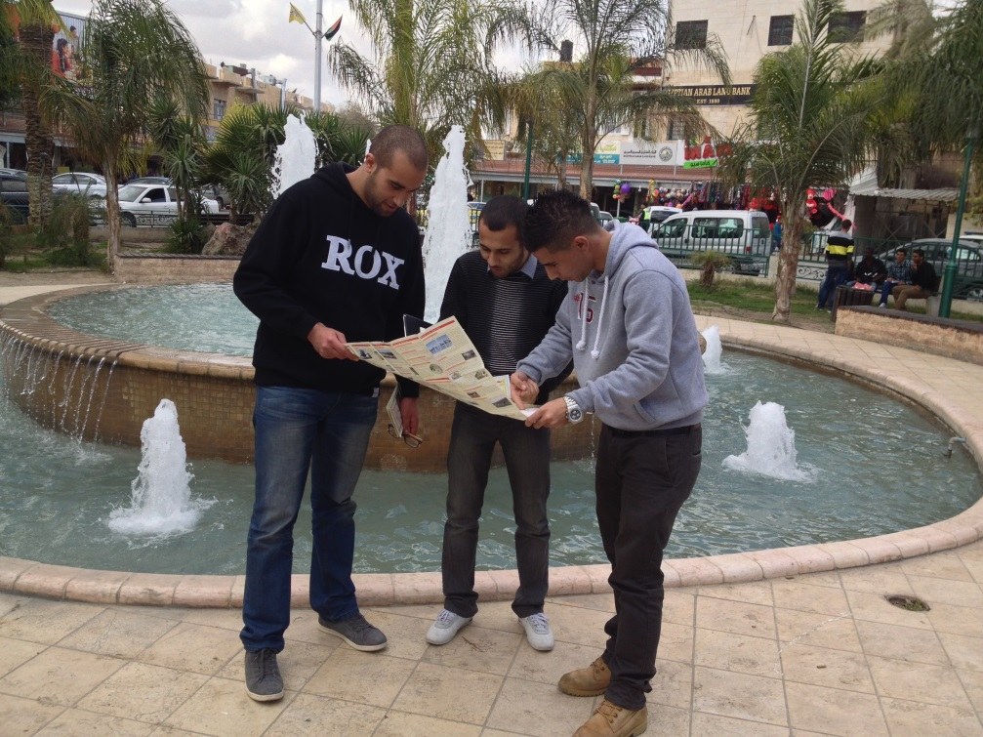
City Center Area
ellipse roundabout 30m x 40m
2 lanes - 4 m per lane
Parking
Bicycle lanes

Slide 23
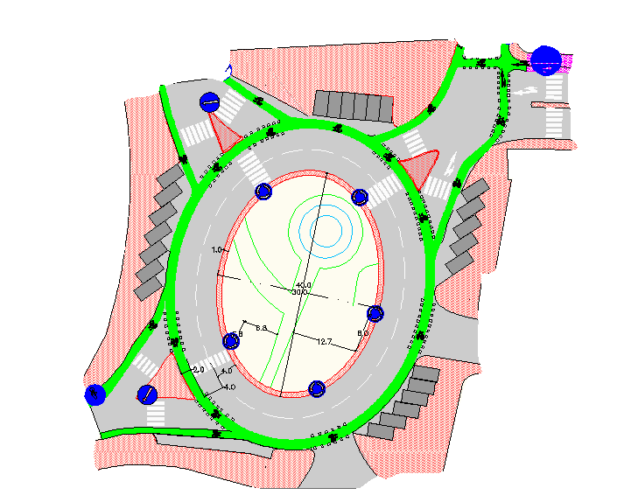
City Center Area Design
Before
After

Slide 24
Amman Street Map
Amman St.

Slide 25
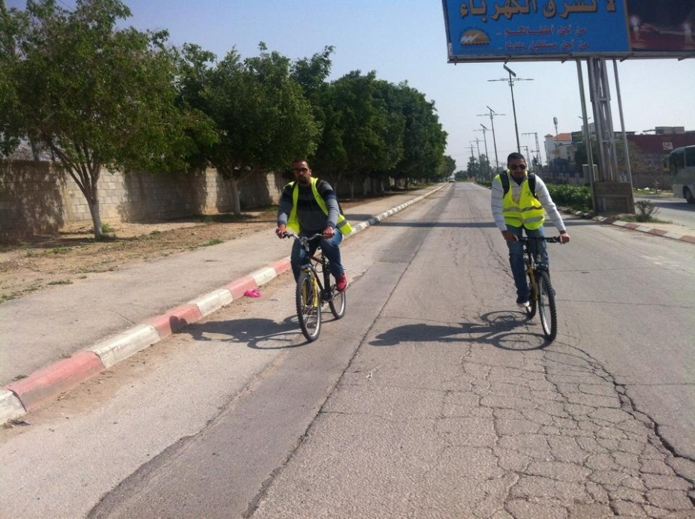
Amman Street
Sec # | Type of Facility | width of facility | WB Lane | median | EB Lane | EB parking | S SW | ROW
1 | SUP | 3.5 | 6 | 1 | 4.0* | 2.1 | 1.4* | (18)*
2 | SUP | 3.5 | 6 | 1 | 6 | 2.1 | 1.4 | 20
3 | SUP | 3.5 | 7.5 | 4.5 | 7.5 | NP | 3.0 | 26

Slide 26
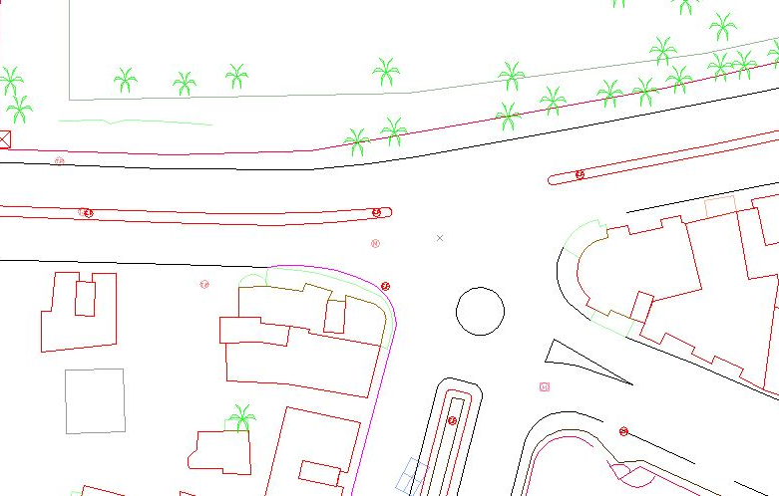
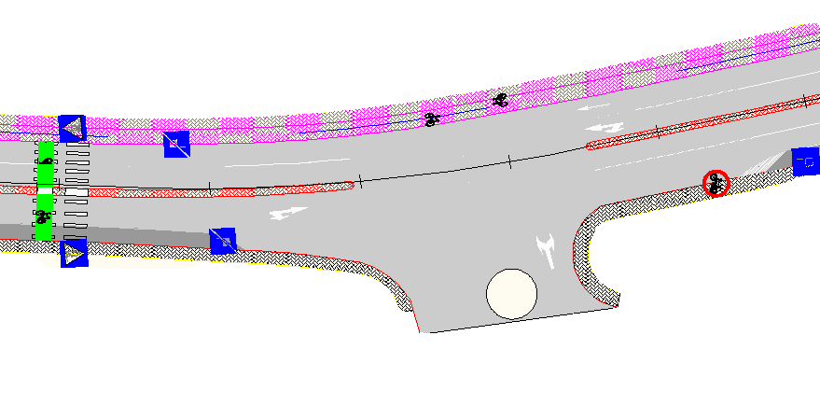
Amman Street Design

Slide 27
Al-Istiqlal Uni. Street Map
Al-Istiqlal Uni. St.
Amman St.

Slide 28
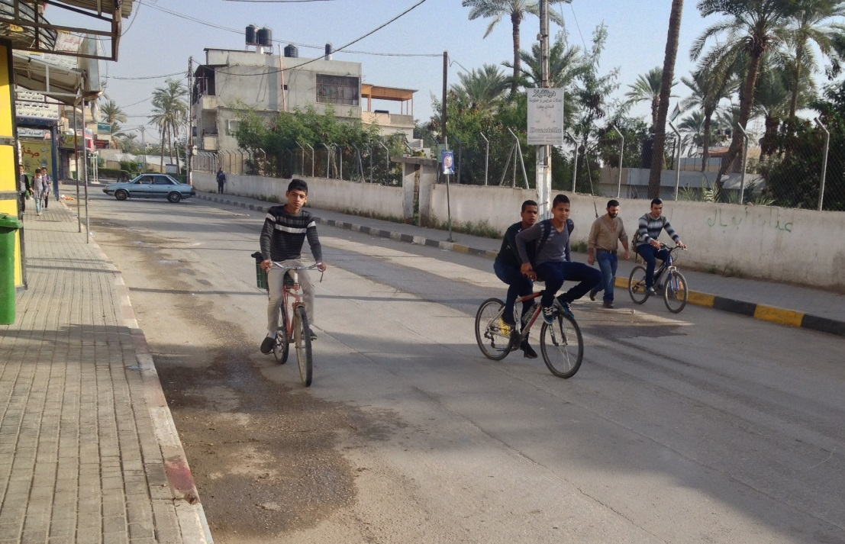
Al-Istiqlal Uni. Street
Sec # | Facility | E-SW | NB Park | NB BL | NB Lane | SB Lane | SB BL | SB Park | W-SW | ROW
1 | Bicycle L | 1.5 | NP | 1.5 | 3.0 | 3.0 | 1.5 | NP | 1.5 | 12
2 | Bicycle L | 1.5 | NP | 1.5 | 3.9 | - | 1.5 | 2.1 | 1.5 | 12
3 | Bicycle L | 1.5 | NP | 1.5 | 3.0 | 3.0 | 1.5 | NP | 1.5 | 12
4 | Bicycle L | 1.4 | 2.1 | 1.5 | 3.0 | 3.0 | 1.5 | NP | 1.5 | 14

Slide 29
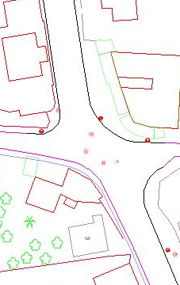
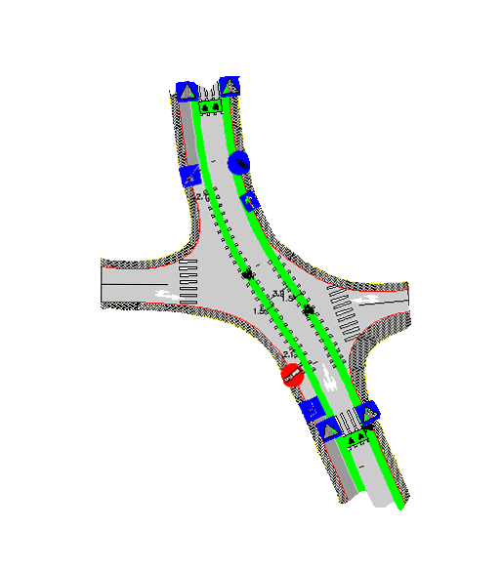
Al-Istiqlal Uni. Street Design

Slide 30
Tal Es-Sultan Street Map
Al-Istiqlal Uni. St.
Tal Es-Sultan St.
Amman St.

Slide 31
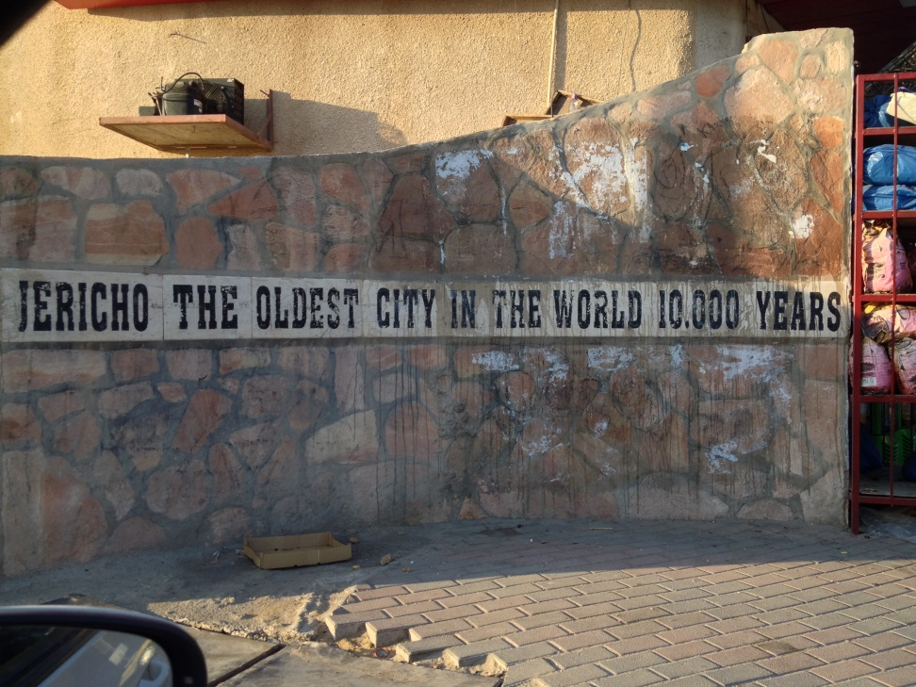
Tal Es-Sultan Street
Before Traffic Light
Sec# | Type of Facility | E SW | NB P. | NB BL | NB Lane | SB Lane | SB BL | SB P. | W SW | ROW
1 | BL | 3.0 | 2.1 | 1.5 | 3.3 | 3.3 | 1.5 | 2.1 | 3.0 | 20
After Traffic Light
Sec # | Type of Facility | E SW | NB BL | NB P. | NB Lane | SB Lane | SB P. | SB BL | W SW | ROW
2 | BL | 2.5 | 1.5+0.3 | 2.1 | 3.6 | 3.6 | 2.1 | 1.5+0.3 | 2.5 | 20

Slide 32
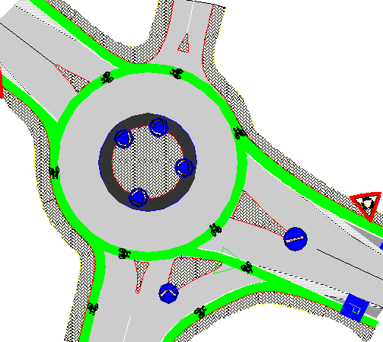
Tal Es-Sultan Street Design
Notes:
Check notes

Slide 33
Al-Quds Street Map
Al-Istiqlal Uni. St.
Tal Es-Sultan St.
Amman St.
AlQuds St.
Abdl Nasir St.

Slide 34
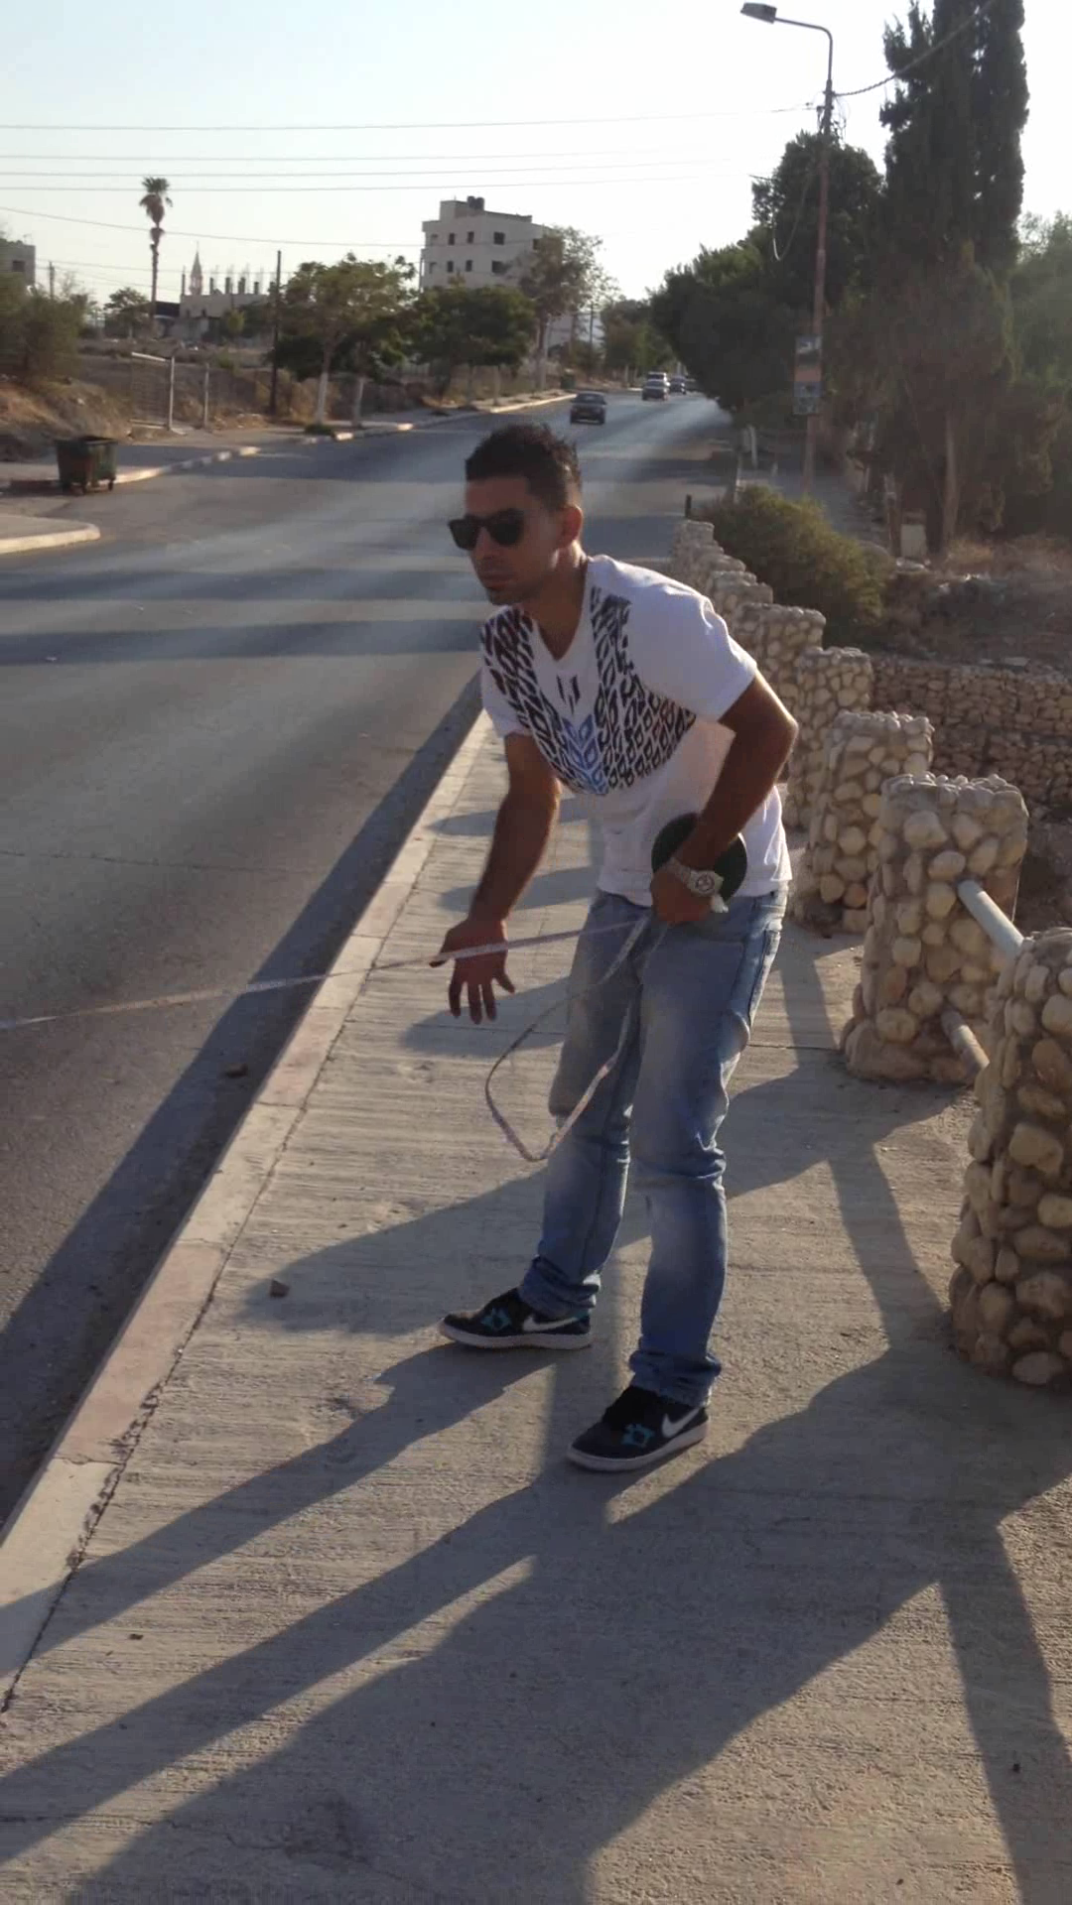
Al-Quds Street
Jamal Abdl Nasir Street
Al-Quds Street
Sec # | Type of Facility | N SW | EB Park | EB bicycle lane | EB-Lane | WB-Lane | WB bicycle lane | WB Park | S SW | ROW
1 | Bicycle Lane | 3 | 2.1 | 1.5+ 0.1 | 3.3 | 3.3 | 1.5+0.1 | 2.1 | 3 | 20
Sec # | Type of Facility | W SW | SB Bicycle lane | SB Lanes | NB Lanes | NB Bicycle lane | E SW | ROW
2- Bef. Bridge | bicycle lane | 1.7 | 1.5 + 0.2 | 6.6 | 6.6 | 1.5+0.2 | 1.7 | 20
3- at Bridge | Bicycle lane | 1.0 | 1.2 | 3.3 | 3.3 | 1.2 | 1.0 | 11
4- after Bridge | Bicycle lane | 1.7 | 1.5 +0.2 | 6.6 | 6.6 | 1.5 +0.2 | 1.7 | 20

Slide 35
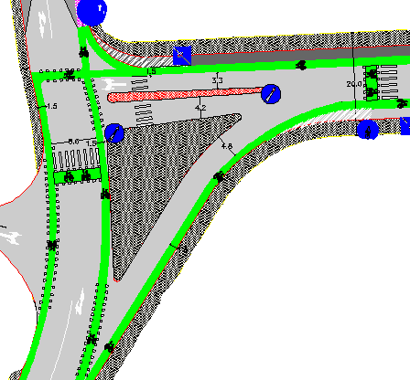
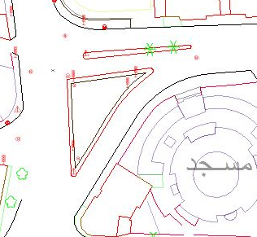
Al-Quds Street Intersection Design

Slide 36
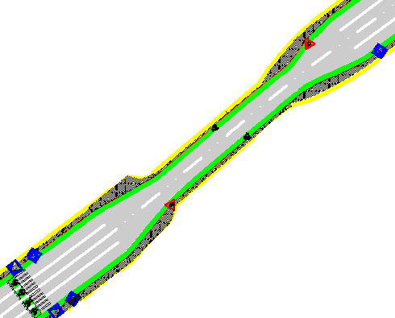
Al-Quds Street Design

Slide 37
Terra Santa Street Map
Al-Istiqlal Uni. St.
Tal Es-Sultan St.
Amman St.
Terra Santa St.
AlQuds St.

Slide 38
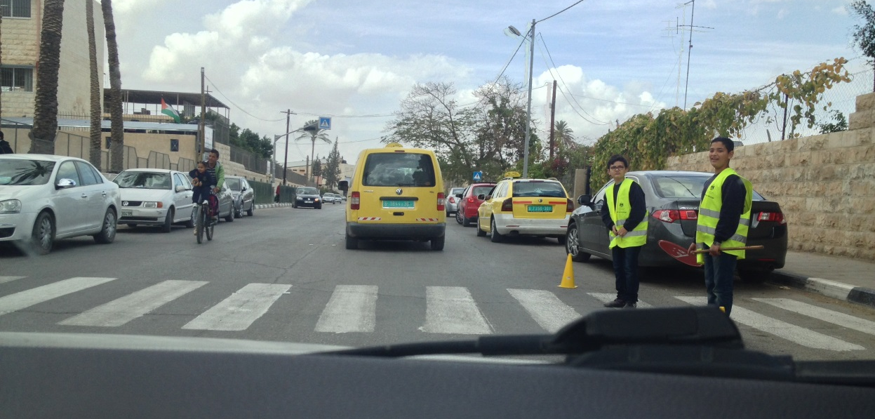
Terra Santa Street
Section # | Type of Facility | Shared Use Path | NB park | NB Lane | SB Lane | SB Park | W SW | ROW
1 | Shared use Path | 3.8 | 2.1 | 3.0 | 3.0 | 2.1 | 2.0 | 16
Section # | Type of facility | E SW | NB BL | NB Lane | SB Lane | SB BL | SB park | W SW | ROW
2 | bicycle lane | 2.0 | 1.5+0.1 | 3.3 | 3.3 | 1.5+0.1 | 2.1 | 2.1 | 16

Slide 39
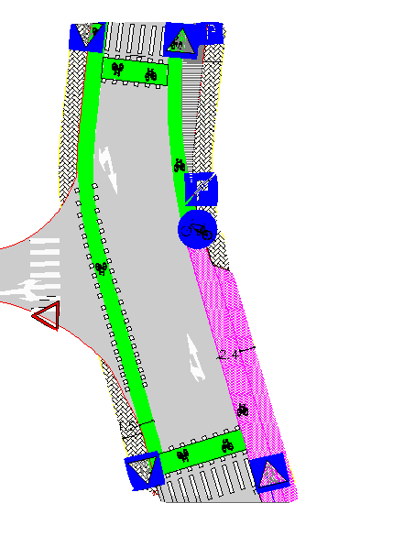
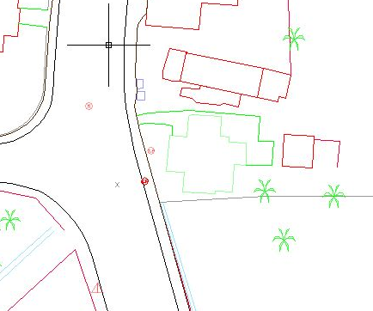
Terra Santa Street Design

Slide 40
The Final Network Map
Nile St.
Al-Istiqlal Uni. St.
Tal Es-Sultan St.
Jummezeh St.
Amman St.
Terra Santa St.
AlQuds St.

Slide 41
The Final Network Summary
Summary Road Network Lengths
No. | Street | Length(m) | Facility
1 | Jamal Abdl Nasir Street | 275 | Bicycle lanes
2 | Al-Quds Street | 875 | Bicycle lanes
2 | Terra Santa Street | 460 | Shared Use Path + Bicycle lanes
3 | Tal Es-Sultan Street | 3785 | Bicycle lanes
4 | Amman Street | 3170 | Shared Use Path
5 | Al-Istiqlal Uni. Street | 2435 | Bicycle lanes
Total Length = 12 km

Slide 42

Environmental and Social Aspects
Scoping
Baseline Conditions
Monitoring and Auditing
Environmental & Social Statement
Mitigation Measures
Social and Environmental
Impacts

Slide 43
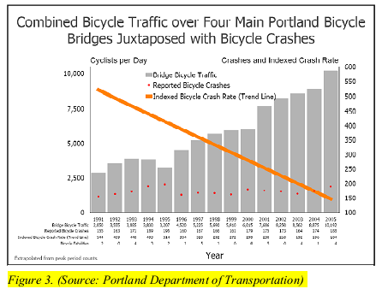
Environmental and Social Aspects
Social Impacts - Higher potential of accidents
Source: Portland Department of Transportation(2005)

Slide 44
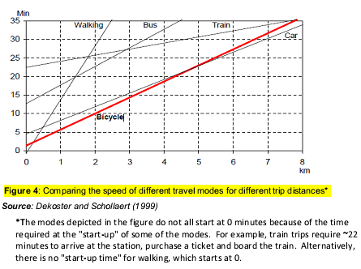
Environmental and Social Aspects
Social Impacts – Longer Travel Time

Slide 45
Action | Impact | Value | Mitigation measure | Responsibility
Construction
Road construction | Traffic delay | -1 | Work Off peak | contractor
 | noise | -3 | Through day time | contractor
 | dust | -2 | Use water and cover trucks | contractor
 | Construction Waste | -2 | Disposal plan to remove waste | Contractor and municipality
 | Pedestrian discomfort and harassment | -4 | Preamble radio programs and signs | Media and police
Road marking | Traffic delay | -3 | Preparing alternative routes | Police
 | Odor for workers | -1 | Wearing masks | Contractor
Operation
More Bicycles usage | Conflict between modes | -2 | Preparation for vehicle and bicycle drivers | Police and media
 | Higher potential of accidents | -1 | Preparation for vehicle and bicycle drivers | Media and organizations
 | Better health | +3 | - | -
 | More attractive mean of transportation | +2 | Enhancing agricultural
 | Tourism encouragement | +4 | Tour programs | Tourism center
Less numbers of cars | Reduce emissions | +2 | illustrating of results | Media
 | Less noise | +2 | - | -
 | Reduce fuel consumption | +4 | Illustrating the results | Media
 | Save money | +4 | Illustrating the total | Media
 | Slower traveling | -1 | Giving advantages for cyclists in movement | Police and Ministry
Different mean of transportation | New businesses in the city | +3 | Ease of establishment | Municipality
 | More guides required | +2 | Tourism interest | Municipality

Slide 46

Project Total Cost
Summary Roads Network
No. | Item | Activity Performed | Cost ($)
1 | Total of Preliminaries | Mobilization | 15,000
2 | Total of Earth Works | Excavation, Remove of obstructs | 16,450
3 | Total of Sub Base and Base Course | Sub-Base, Base Coarse | 68,650
4 | Total of Bituminous Construction | Prime Coat, Binder | 120,135
5 | Total of Miscellaneous Works | Curbstone, Painting, Blocks | 438,265
 | Total Cost = 658,500 $

Slide 47

SUMMARY
and
CONCLUSIONS

Slide 48

Any Questions ?

