Slide 1
Design and control of DC / DC Buck Converter used as a Battery charger with maximum power extraction from photovoltaic array
Ahmad Qaneer
Abdullah Hassiba

Slide 2
Contents
Methodology
Abstract
P-V & I –V characteristics.
Block Diagram
Electrical Circuit
Matlab Simulation
Maximum Power Point
COMPONENTS USED IN PROJECTS
OPERATION STATES OF THE CHARGER

Slide 3
Methodology
First step: We designed a solar cell model .
The second step: we enter the voltage that we extracted from the solar cell into the buck converter to reduce the voltage to the voltage of the battery that we will charge
The third step: in order to maintain the maximum power of the solar cell,
we measure the voltage and current of the solar cell at every moment
and treat it using (P&O algorithm),
where it controls the voltage that feeds the battery by controlling the duty cycle,
In order for the buck converter to give us the appropriate voltage and current to charge the battery .

Slide 4
Abstract
In our project we used DC-DC buck converter to extract the maximum power that solar panels .
and maintain this value and use it to charge the battery .
the power generated by the solar panels is variable (solar radiation and the temperature ).
using a specific PV module.
we designed the DC-DC buck converter and selected the battery .
We extracted the maximum power by using p&o algorithim .

Slide 5
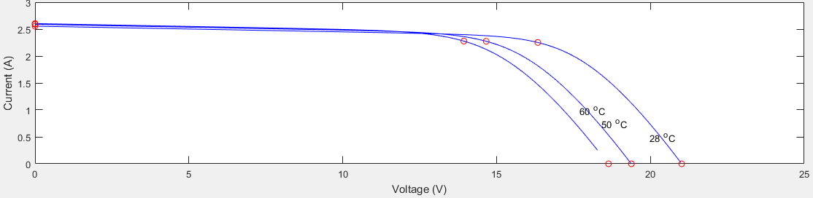
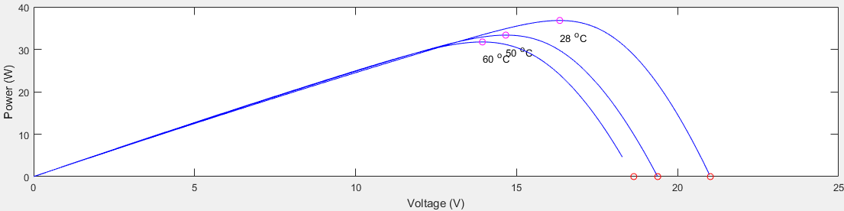
P-V & I –V characteristic of the PV module for different temperature level and fixed irradiation(1000W/m2) .

Slide 6
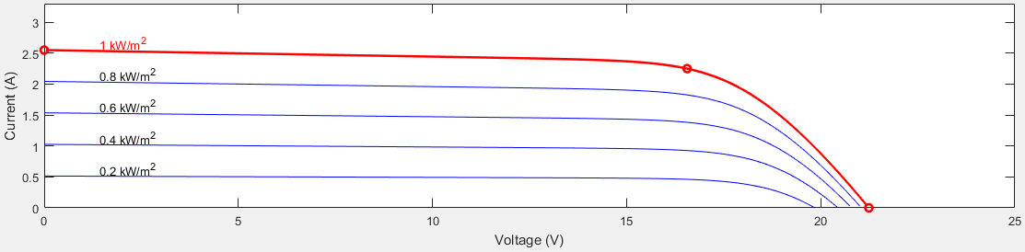
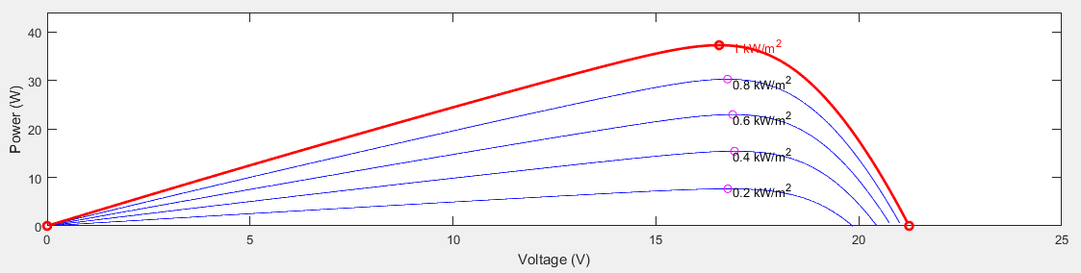
I-V & P –V characteristic of the PV module for different irradiation level and fixed temperature (25 c) .

Slide 7
Block Diagram

Slide 8
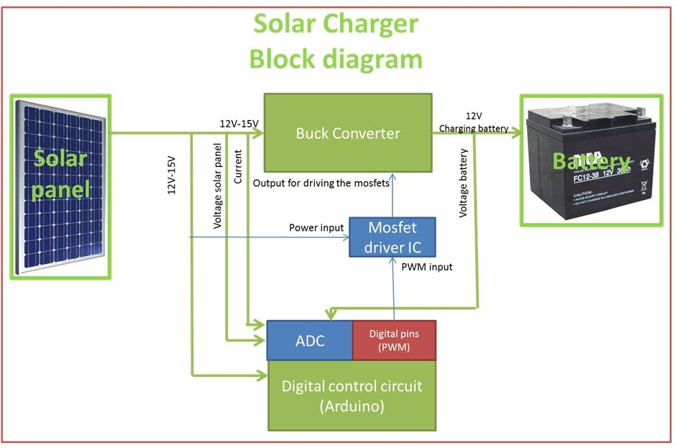

Slide 9
Electrical Circuit

Slide 10
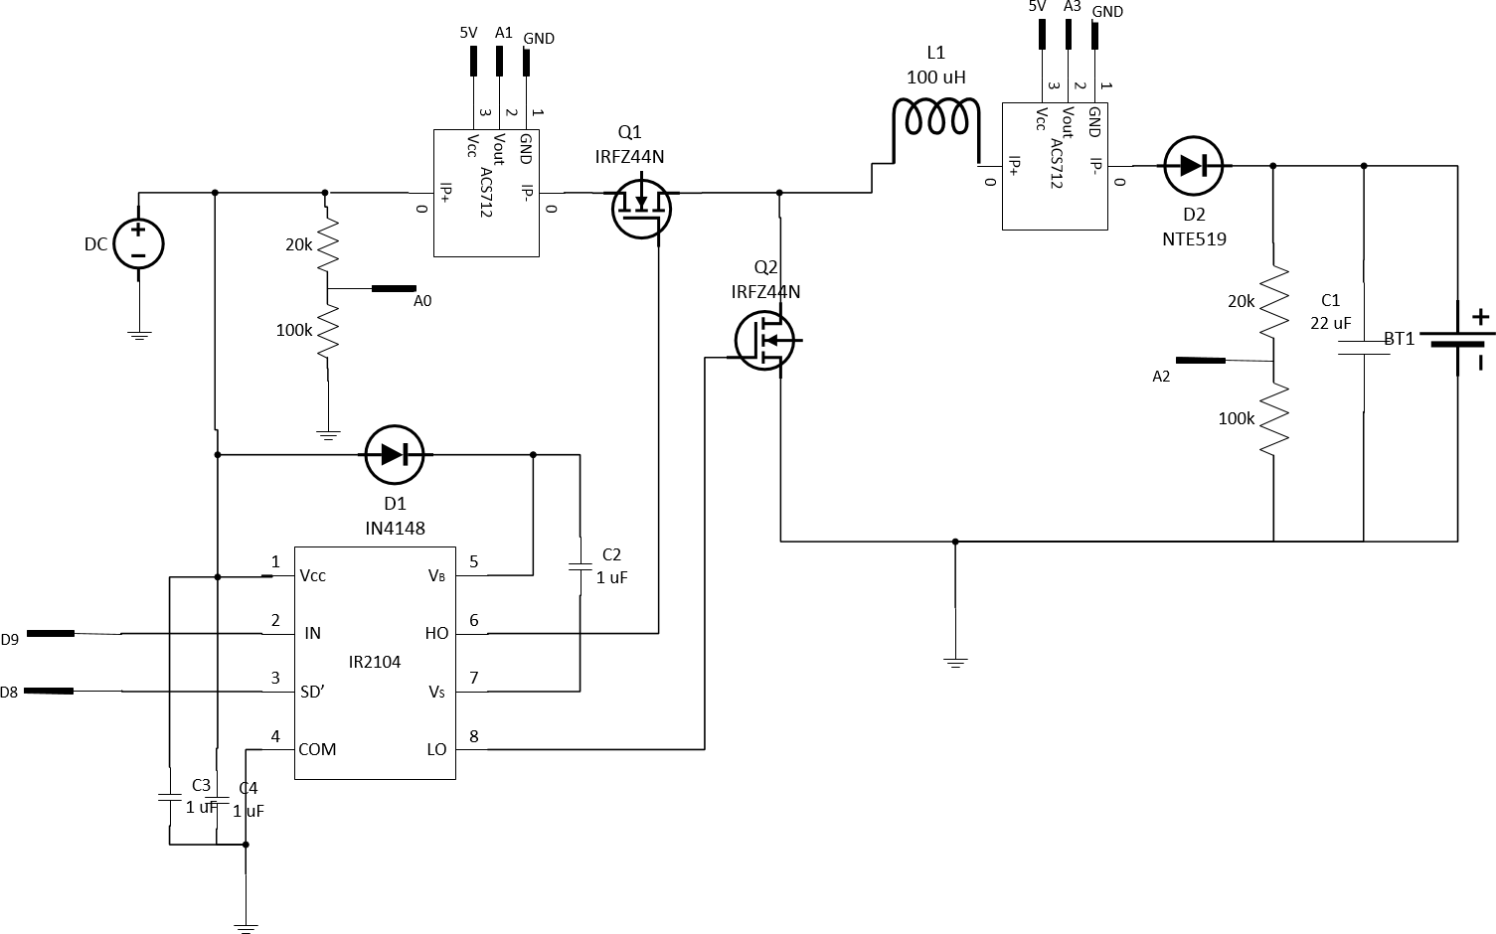

Slide 11
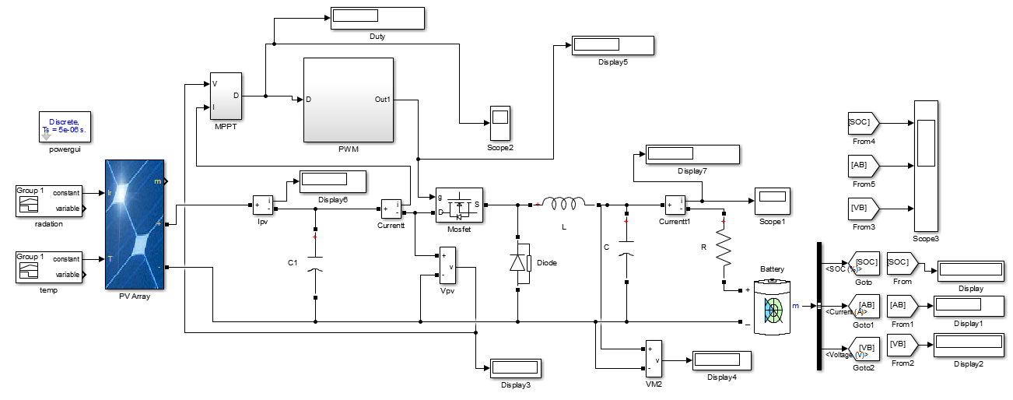
Matlab Simulation of Battery Charging Using Solar Power with MPPT and buck converter

Slide 12
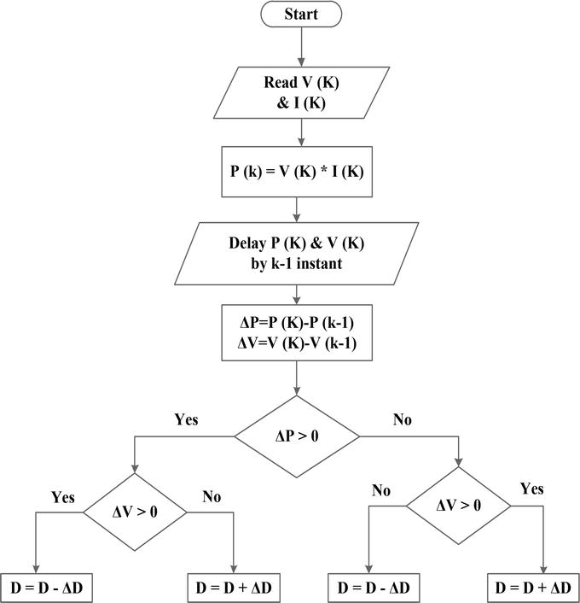
Perturb & Observe MPPT Flow Chart

Slide 13
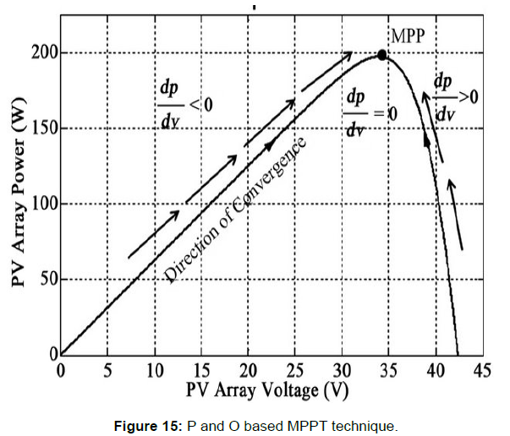
Maximum Power Point at Vmpp & Impp

Slide 14

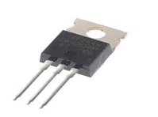

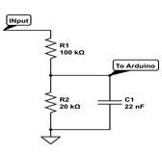

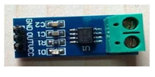
COMPONENTS USED IN PROJECTS
ARDUINO UNO
IRFZ44N MOSFET
Capacitor
Voltage Sensor
Grove-RGB backlight LCD
Current Sensor

Slide 15
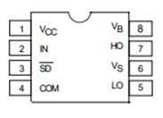


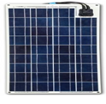
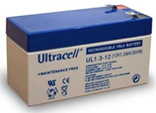
IR2104 (gate driver)
toroidal inductor
NTE519 Diod
37W solar panel
Battery

Slide 16
OPERATION STATES OF THE CHARGER
Bulk: The bulk state is the most crucial state of the charger This is the state where the MPPT algorithm p&o is placed and at this mode .
Absorption: When the battery reaches the bulk charge set voltage, the PWM begins to hold the voltage constant.
Float : The float state is to prevent overvoltage to the battery .

Slide 17
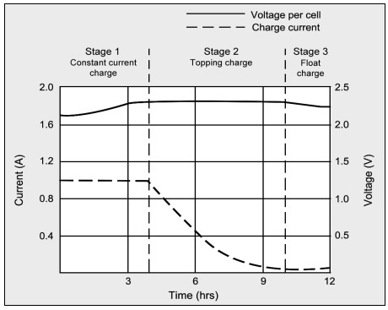
OPERATION STATES OF THE CHARGER

