Slide 1
Smart Energy Meter
Prepared by: Bahaa Snouber
Khalid Mona
Mohammad Shayeb
Supervisor: Dr. Omar Al-Tamimi

Slide 2
OUTLINE
Smart Meter
Advantage and Disadvantage
How it works ?
Smart Meter Circuit
Advanced Metering Infrastructure (AMI)
Results
Problems and Notes
Conclusion

Slide 3
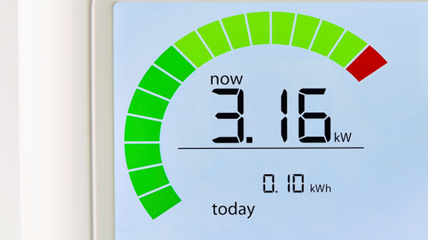
Smart Meter
Called Advance Metering infrastructure (AMI) meter.
Two way digital communications between customer and utility and vise versa.
To monitor and record the energy consumption at real time, record the power outage at consumer’s homes and allowed providers to switch electricity on and off.
More secure against theft.
More accurate.

Slide 4
Advantage and Disadvantage
Advantages:
    Provide supplier with real time data.
    No need to read meters manually.
    Help consumers to reduce their consumption.
    Help the utility to improve the services.
Disadvantage:
  Need large memory to storage meters’ data.
  Difficult to convince consumers of the new meter.

Slide 5
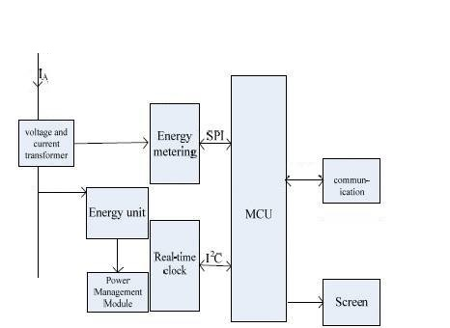
How it works?

Slide 6
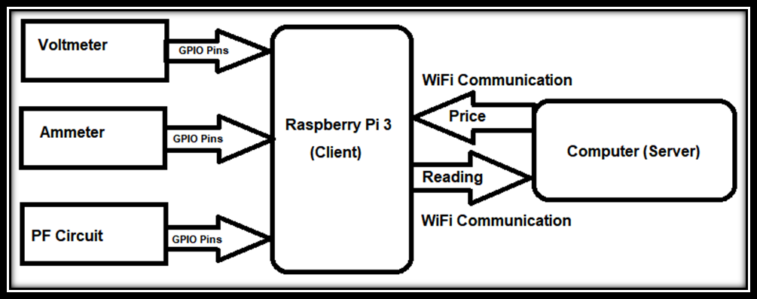
Smart Meter Circuit

Slide 7
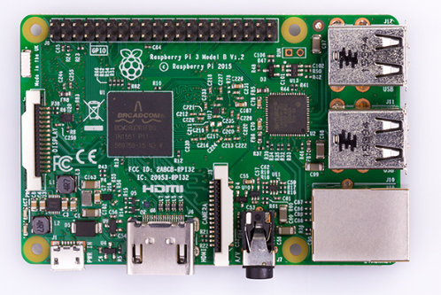
Raspberry Pi 3
The Raspberry Pi 3 is the third generation Raspberry Pi.. Compared to the Raspberry Pi 2 it has:
A 1.2GHz 64-bit quad-core ARMv8 CPU
802.11n Wireless LAN
Bluetooth 4.1
Bluetooth Low Energy (BLE)
Like the Pi 2, it also has:
1GB RAM
4 USB ports
40 GPIO pins
Full HDMI port
Ethernet port
Audio jack and composite video
Camera interface (CSI)
Display interface (DSI)
Micro SD card slot
Video Core IV 3D graphics core

Slide 8
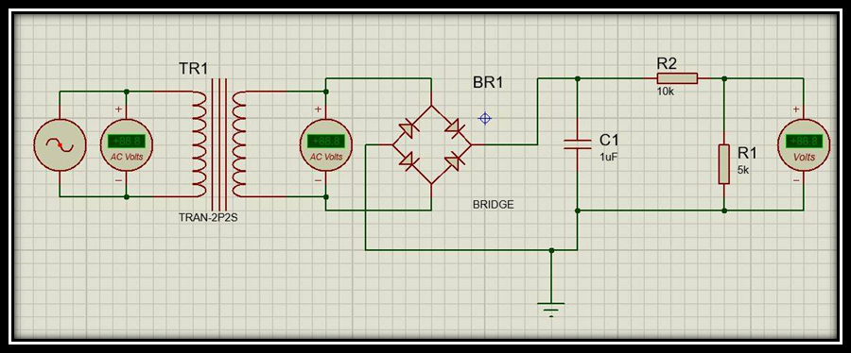
Smart Meter Circuit
Voltage Circuit

Slide 9
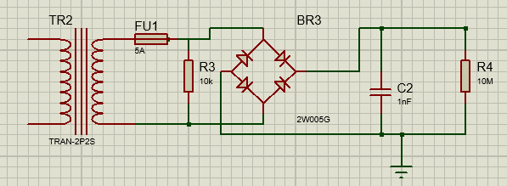
Smart Meter Circuit
Current Circuit

Slide 10
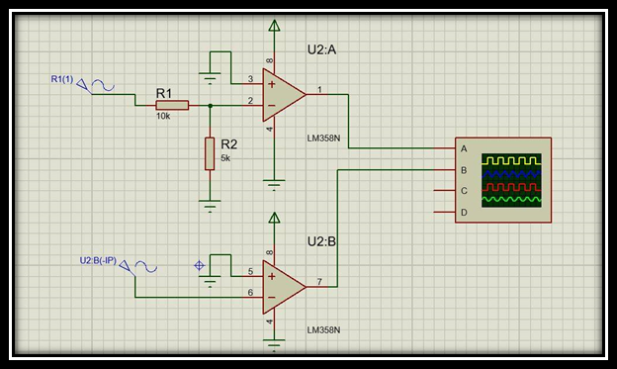
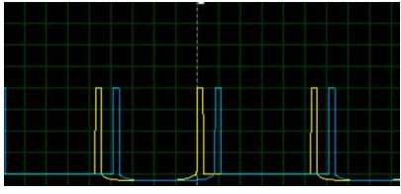
Smart Meter Circuit
Power Factor Circuit

Slide 11
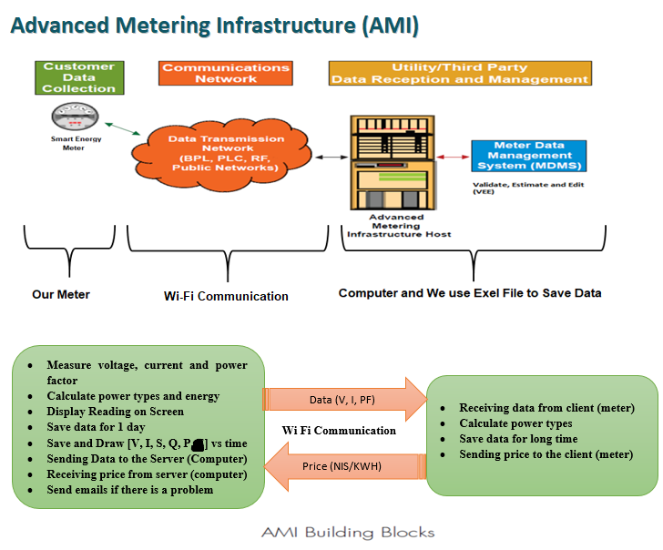

Slide 12
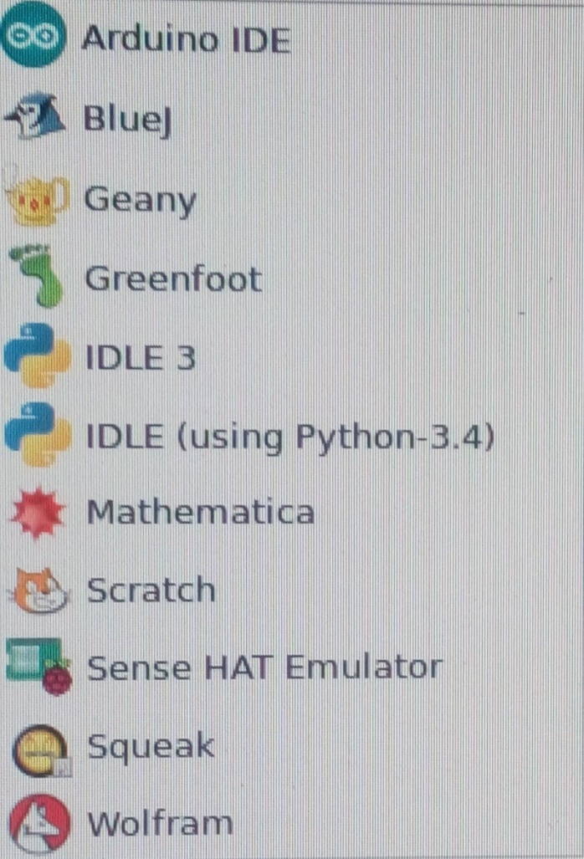

Project Codes
Python is a widely used high-level programming language for general
-purpose programming
Python is an easy to learn programming language.
You can use it to create web apps, games, even a search engine.

Slide 13
Results
Voltage
Real Voltage | Time | Measure Voltage
228 V | 3:00 PM | 225 V
232 V | 9:00 PM | 229 V
237 V | 3:00 AM | 235 V
200 V | - | 198 V
100 V | - | 99 V

Slide 14
Results
Current
Power | Real Current | Measure Current
1000 W | 5.34 A | 5.66 A
1200 W | 6.4 A | 7.4 A
2000 W | 10.7 A | 12A
2200W | 11.76 A | 11.7 A
3200 W | 17.1 A | 16 A

Slide 15
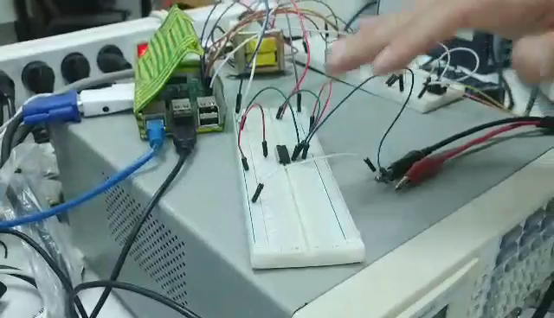
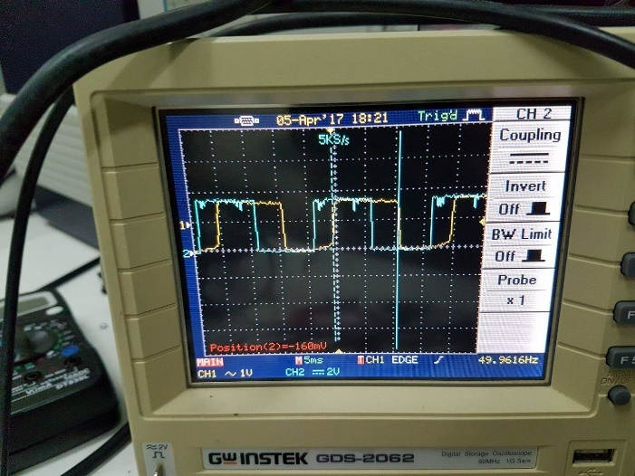
Results
Power Factor
Real PF | Measure PF
1 | 0.988 lag
0.8 lag | 0.87 lag

Slide 16
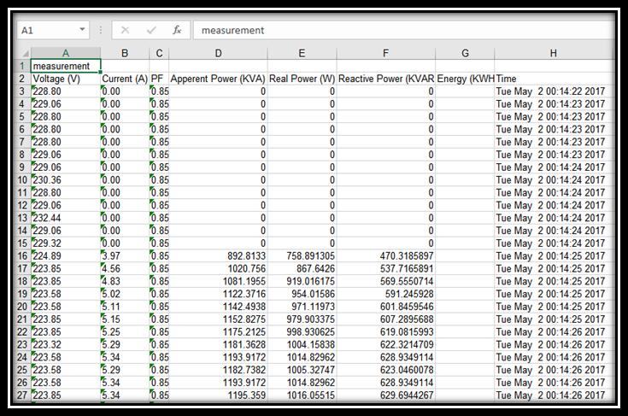
Results
Save date

Slide 17
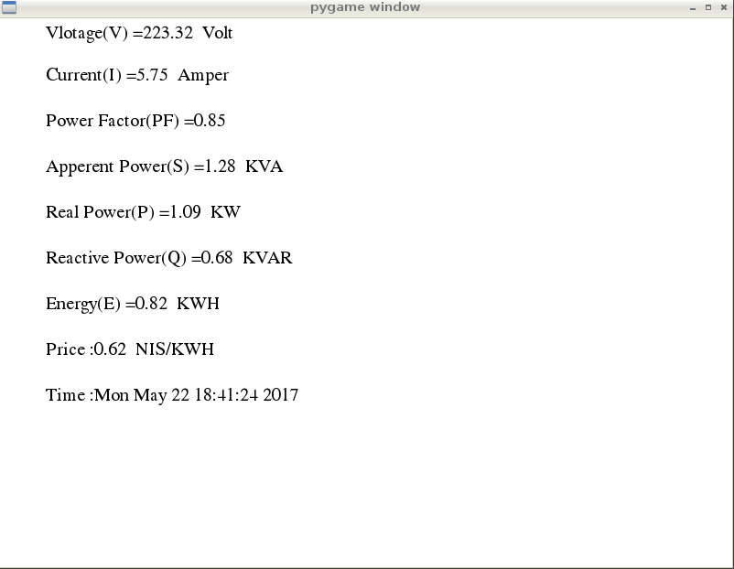
Results
Screen

Slide 18
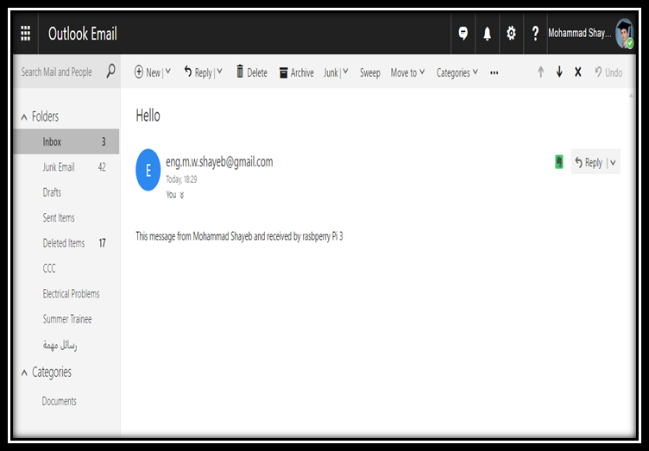

Results
Email and Clock

Slide 19
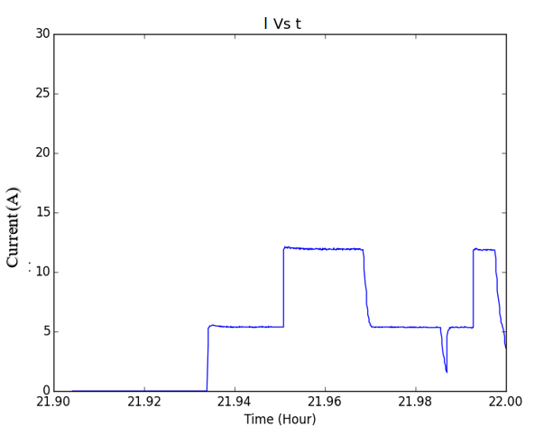
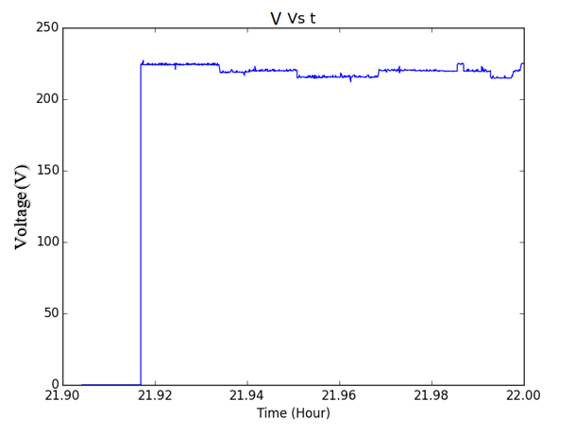
Results
Graphic

Slide 20
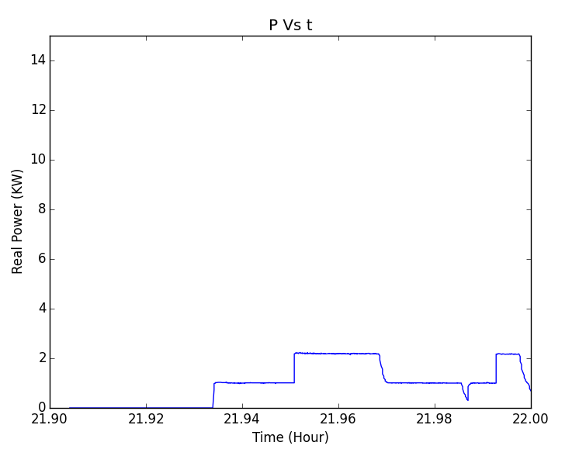
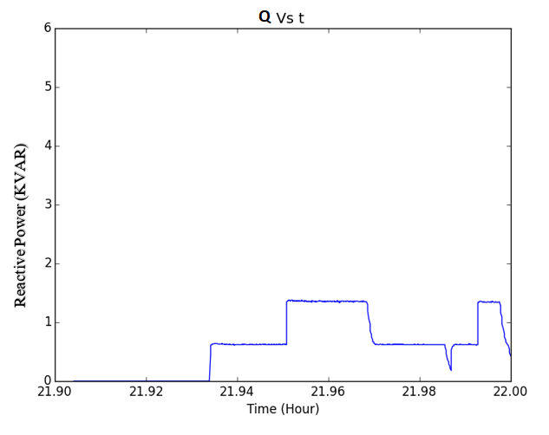
Results
Graphic

Slide 21
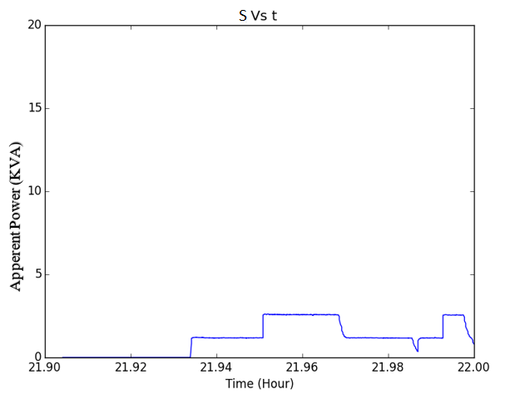
Results
Graphic

Slide 22
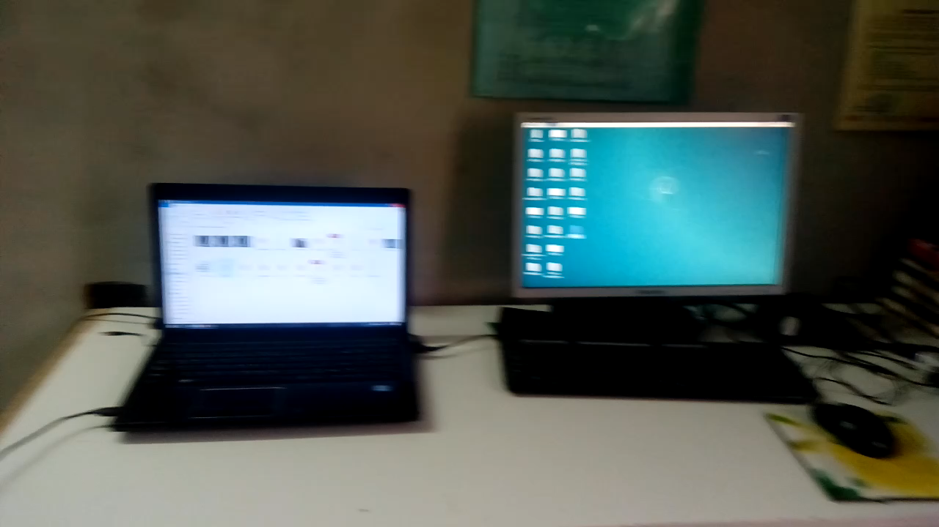
Results
Communication

Slide 23
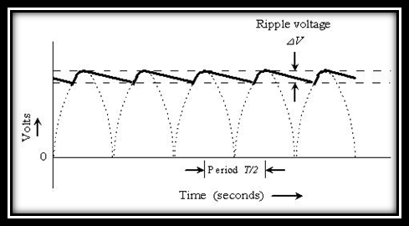
Problems and Notes
Solved Problems
  The difference between real and measured voltages = 10 V
  Sending data takes long time
  We couldn't able to draw figure instantaneously
  The meter measured current for long time after turn off the load
Problems not solved
  Measured Power factor succeed by using Arduino and oscilloscope but fails by raspberry pi 3
  We have noise
Notes
  When we turn on the load, the voltage decrease.

Slide 24
Conclusions
In the case of using Wi-Fi for sending data, we recommend to use the parallel way instead of series also using HTTPs protocol instead of TCP/IP because it's more safe.
Power Line Communication (PLC) is better and faster than Wi-Fi , so we recommended.
The project can be improve by adding GSM or joined API service which provided by the telecommunications company to send SMS to customers instead of e-mails.

Slide 25


