Slide 1

An-Najah National University
Faculty of Engineering
Civil Engineering Department
جامعة النجاح الوطنية
كلية الهندسة وتكنولوجيا المعلومات
Graduation Project (2)
Structural Analysis and Design of Commercial Complex in
Haifa–Palestine
By:
Abdullah Ma’moon Al-Refa’i
Ahmad Adel Salameh
Mohammad Amer Hamad
Mohammad Ismail Ibrahim
Rawan Mofeed Rabaya
Under supervision of: Ibrahim Arman.

Slide 2

Al-Tajamo’ Commercial Building

Slide 3
Outline project:
1
General Description
2
Preliminary Design
3
Three-dimensional analysis and design.

Slide 4
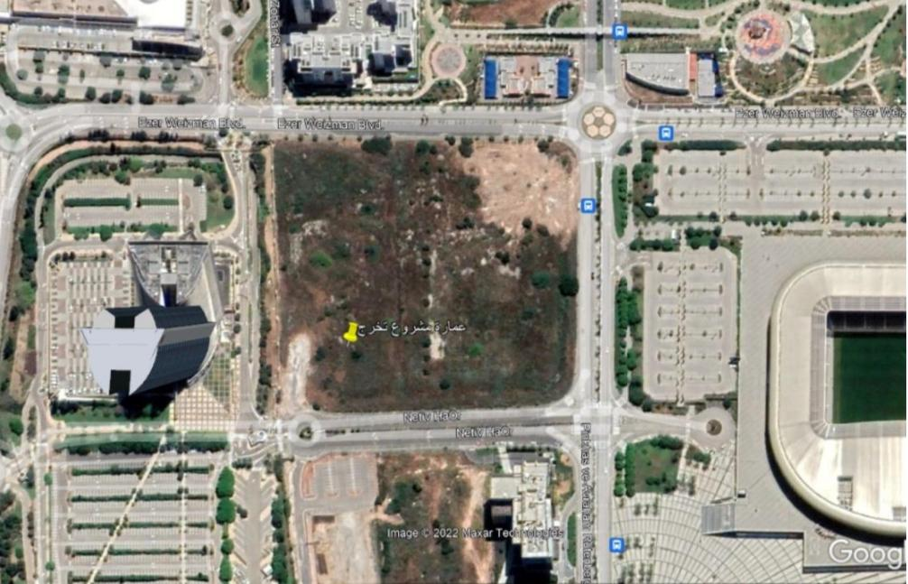
General Description:
Site Location:

Slide 5
Project plans:

Slide 6
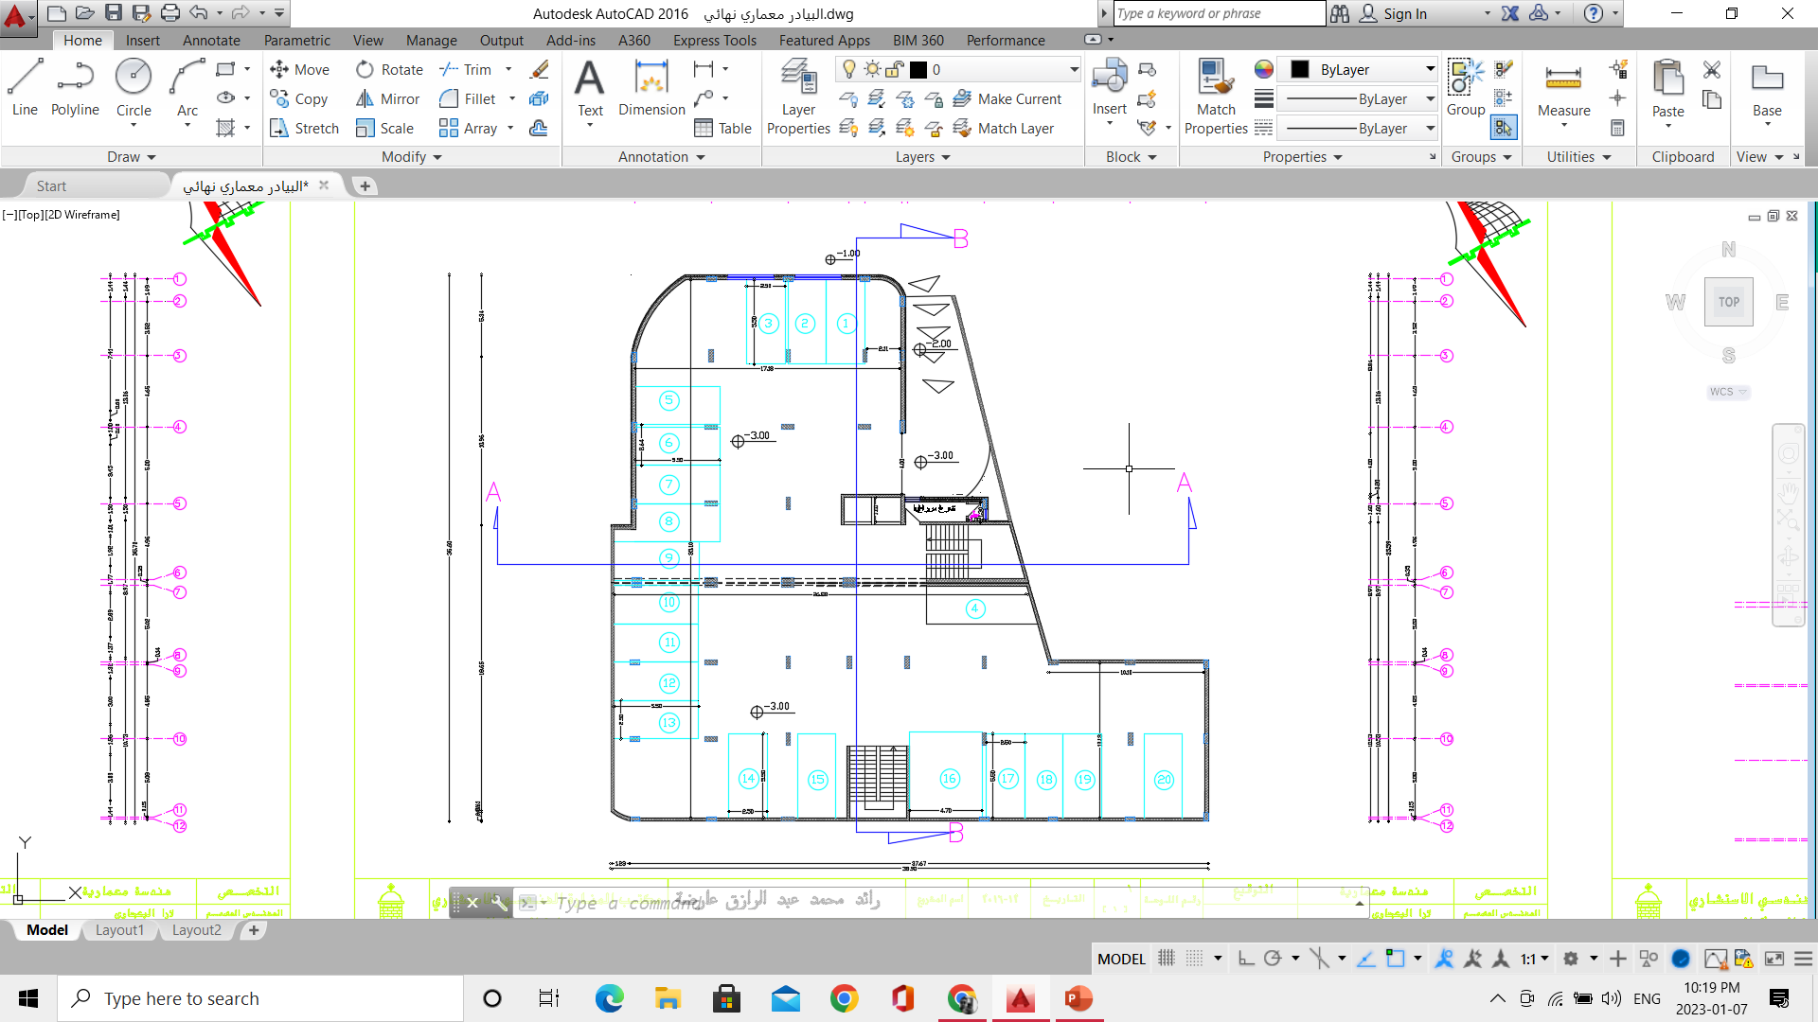
Garage

Slide 7
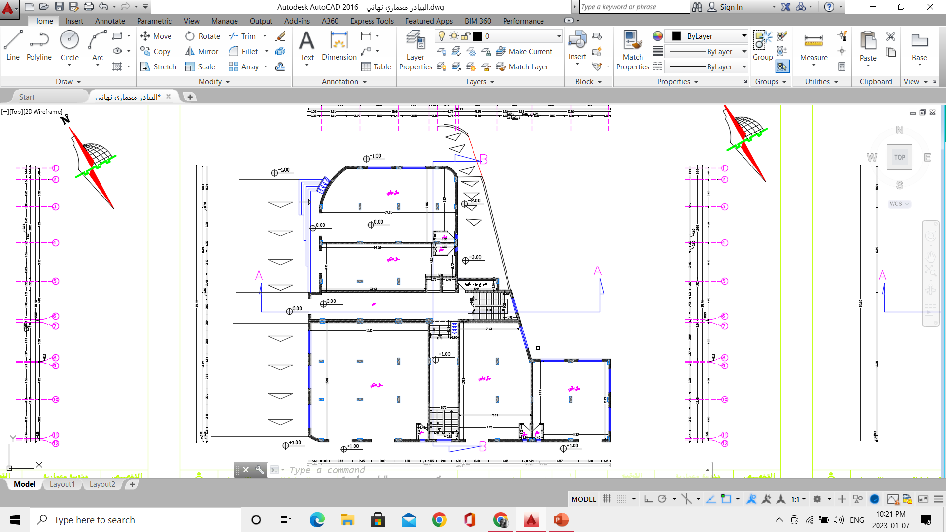
Commercial

Slide 8
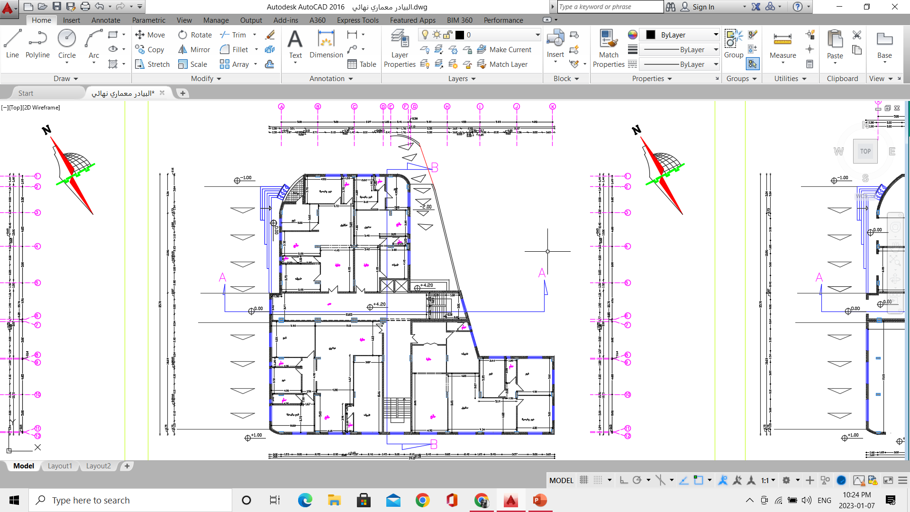
Apartments

Slide 9
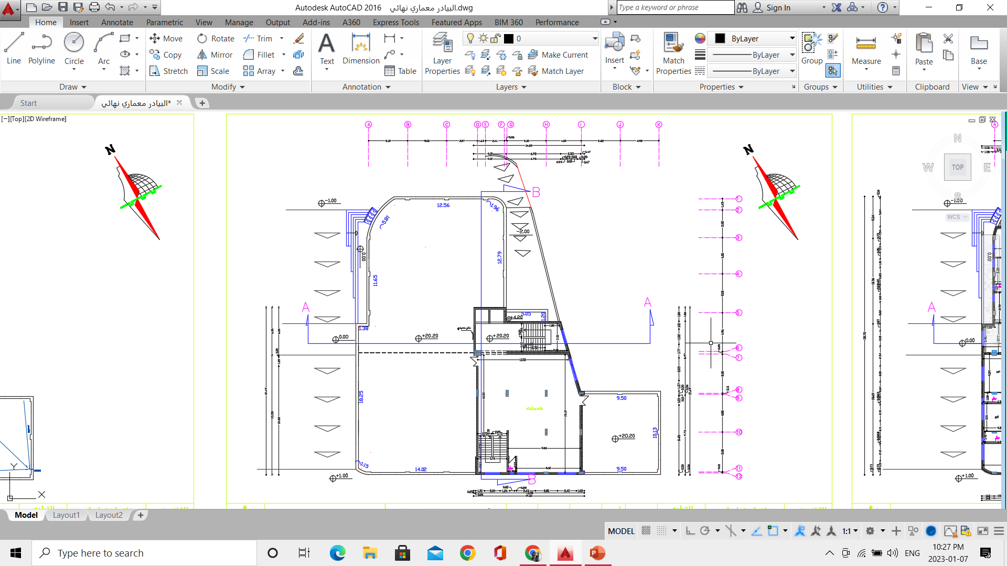
Services

Slide 10
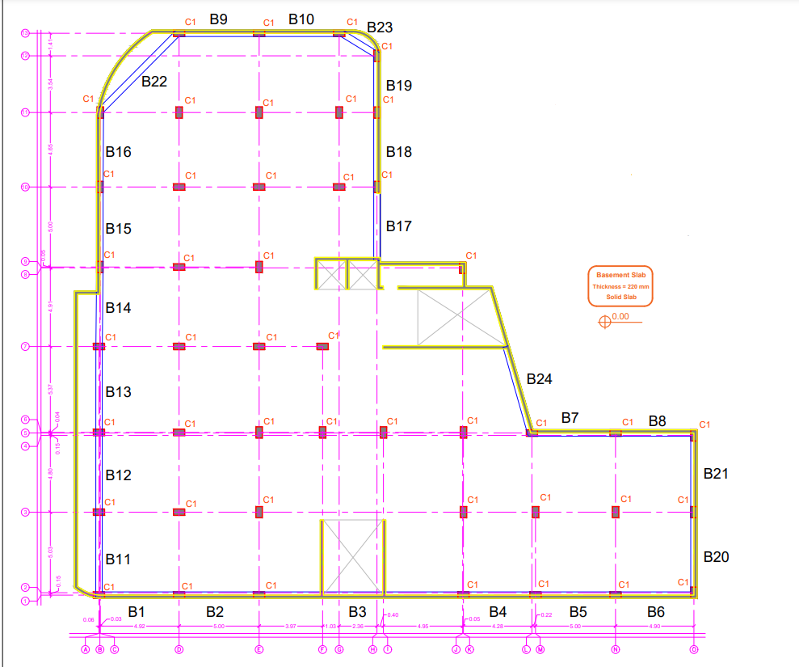
Project Plans:
Basement Slab Layout

Slide 11
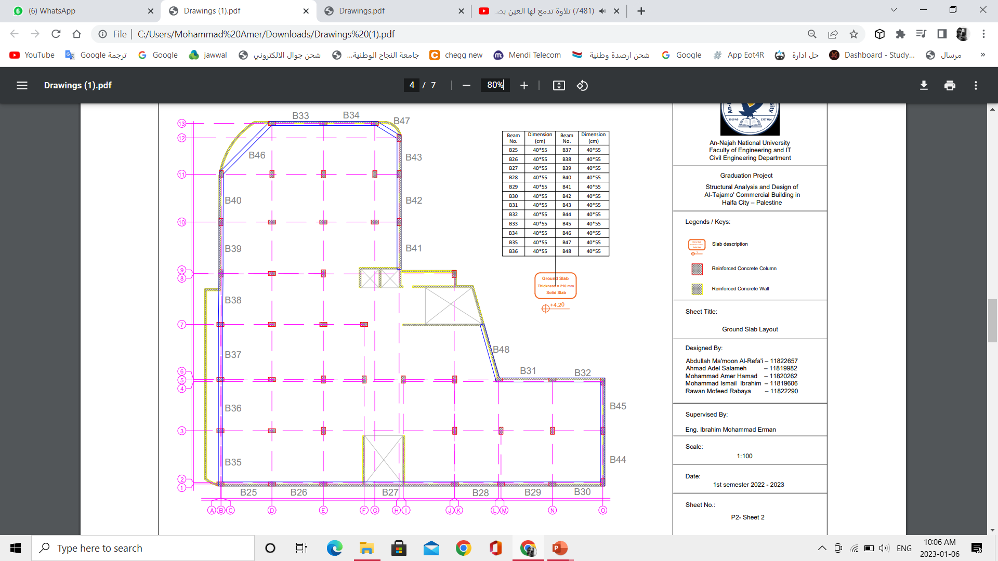
Ground Slab Layout

Slide 12
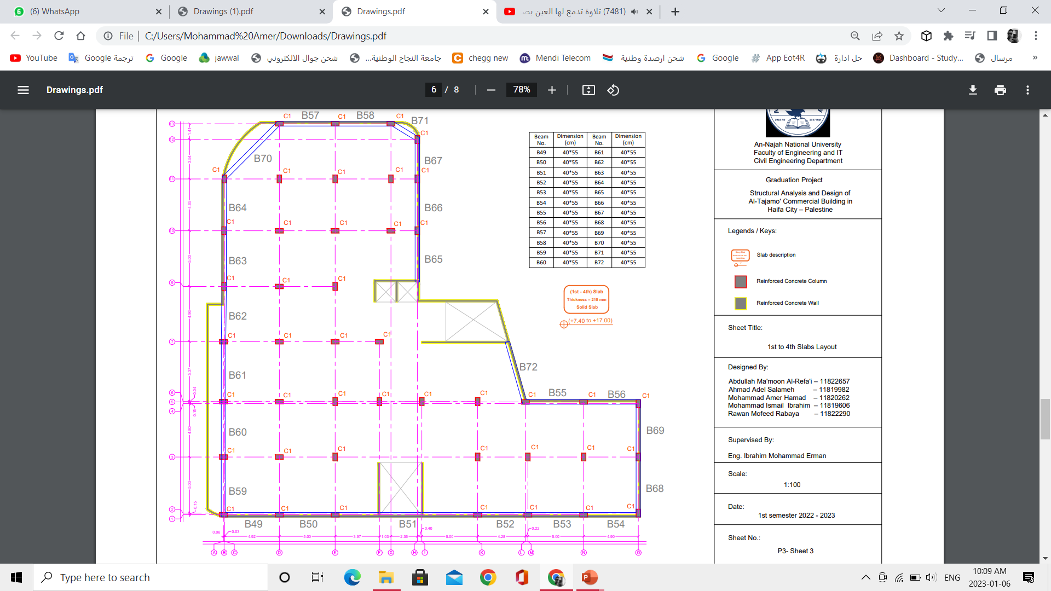
1st to 4th Slabs Layout

Slide 13

5th Slab Layout

Slide 14
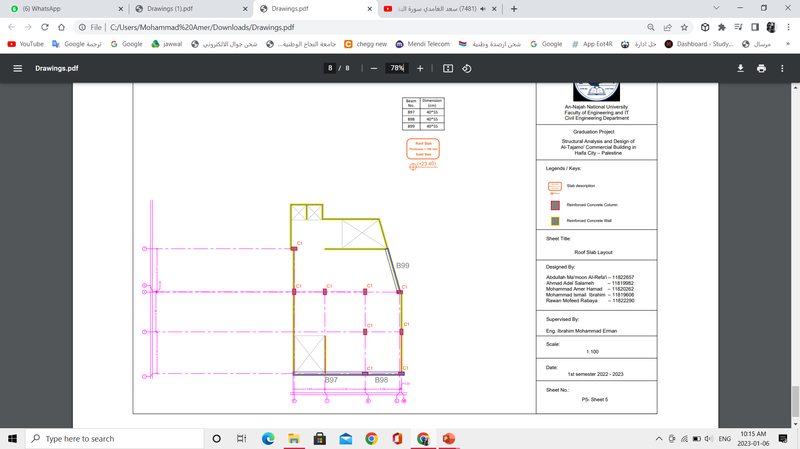
Roof Slab Layout

Slide 15
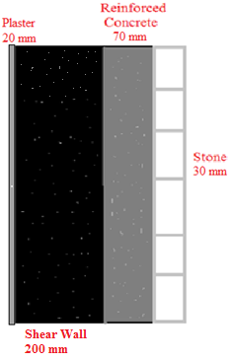
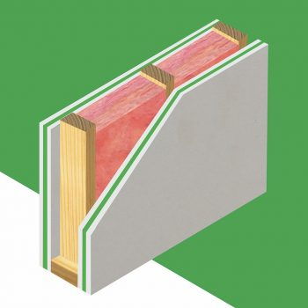
An inside brief about the project:
The building includes interior walls which are 10 cm and 20 cm in thickness and are made of gypsum and wood, the staircase and elevator walls are 20 cm thick and will be constructed as shear wall, and the exterior walls are shear walls of 30 cm thick and made of three layers 20 cm shear wall, 7 cm reinforced concrete and 3 cm stone, with some openings, which are windows for the building.

Slide 16
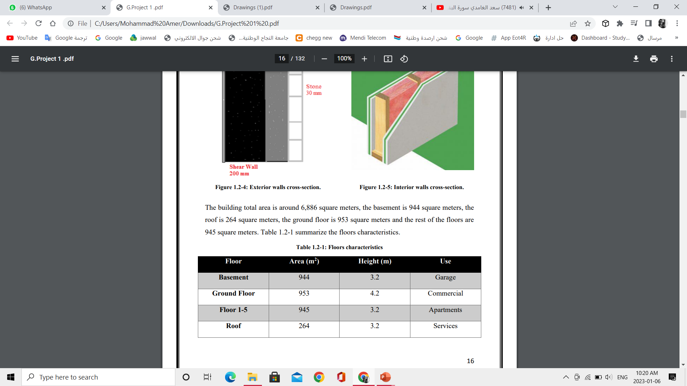
Height and Area for each floor:
The building is full height = 27 m

Slide 17
Codes and Standards:
1
ACI-318M-19: which was used in the design of structural elements (Static design).
2
ASCE-7-22 Minimum Design Loads and Associated Criteria for Buildings: which was used in the design of the earthquake in the building.
3
Jordan Loads and Forces Code: Which was used for the loads connected to the rain and snow.
4
AASHTO: This code was used to identify some of the materials.

Slide 18
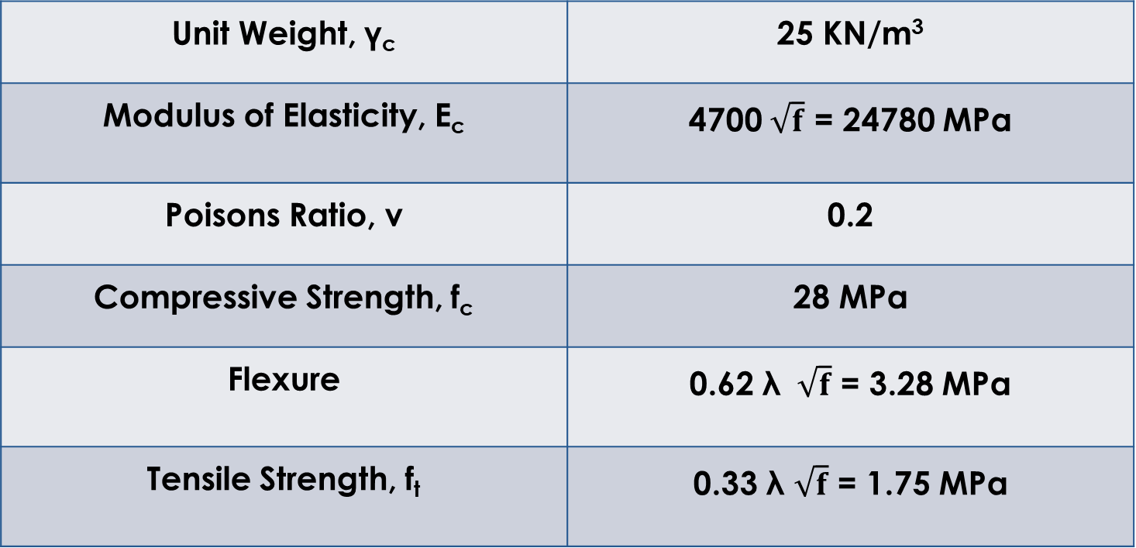
Construction Materials:
1- Structural Elements.
Unit Weight, γ_{c} | 25 KN/m³
Modulus of Elasticity, E_{c} | 4700 $\sqrt{f}$ = 24780 MPa
Poisons Ratio, v | 0.2
Compressive Strength, f_{c} | 28 MPa
Flexure | 0.62 λ $\sqrt{f}$ = 3.28 MPa
Tensile Strength, f_{t} | 0.33 λ $\sqrt{f}$ = 1.75 MPa

Slide 19
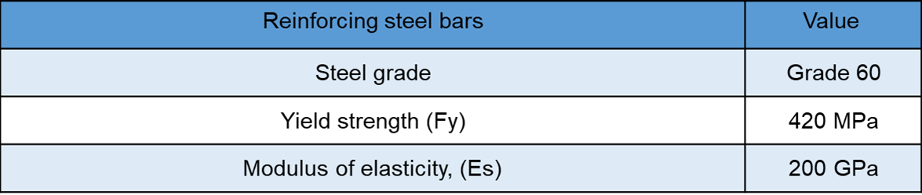
Reinforcing Steel:

Slide 20
Material | Unit Weight KN/m³
Gypsum | 8.08
Stone | 26
Tiles | 27
Cement Mortar | 23
Sand | 17
Aggregate filling | 17
Concrete | 25
Glass | 26
Wood | 6.6

Slide 21
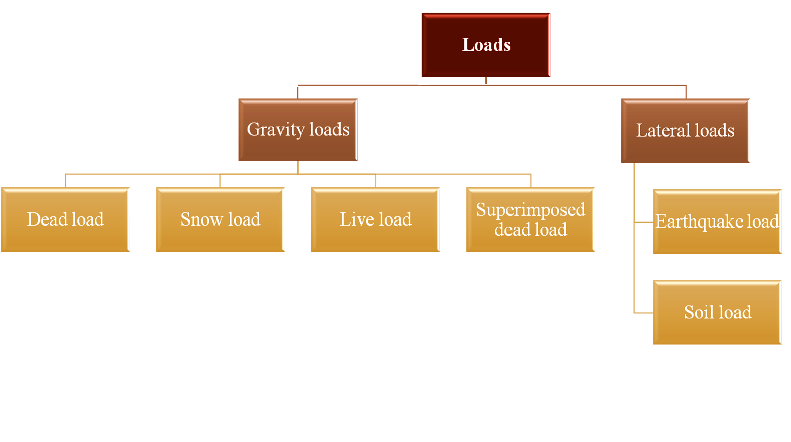
LOADS

Slide 22
A(GRAVITY LOADS:
1( Dead load: self weigh of the structure
Floor | Uses for | Live Load
Basement | Garages for Passenger vehicles only | 3 KN/m²
Ground Floor | Storage warehouses, Light | 6 KN/m²
First to Fifth Floors | Residential, Private rooms and corridors serving. Public rooms and corridors serving them. Balcony | 2 KN/m² 5 KN/m² 5 KN/m²
Roof | inactive | 1 KN/m²
2( Live load: According to ASCE 7-22 Code
3) Snow Load:
The snow load will be ignored in the model.

Slide 23
A(GRAVITY LOADS:
3- Superimposed dead load at Slab:
Finishing materials weight
SD from partitions
Floor | Total SD
Ground Floor | 4 KN/m²
First Floor | 4 KN/m²
Second Floor | 4 KN/m²
Third Floor | 4 KN/m²
fourth floor | 4 KN/m²
Fifth Floor | 4 KN/m²
Roof Floor | 2.5 KN/m²

Slide 24
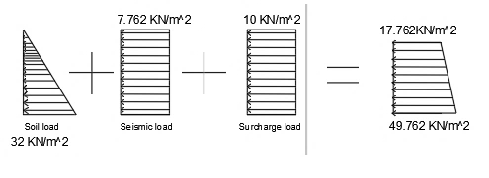
B(Lateral LOADS:
1- Earth pressure (Soil load):
* Soil pressure = y *K0*h =32 KN /m2
* Earth pressure caused by seismic force =ΔP = 0.4× Kh ×Ɣtotal ×Z= 7.762 KN /m2
* The surcharge load = 10 KN/m2

Slide 25
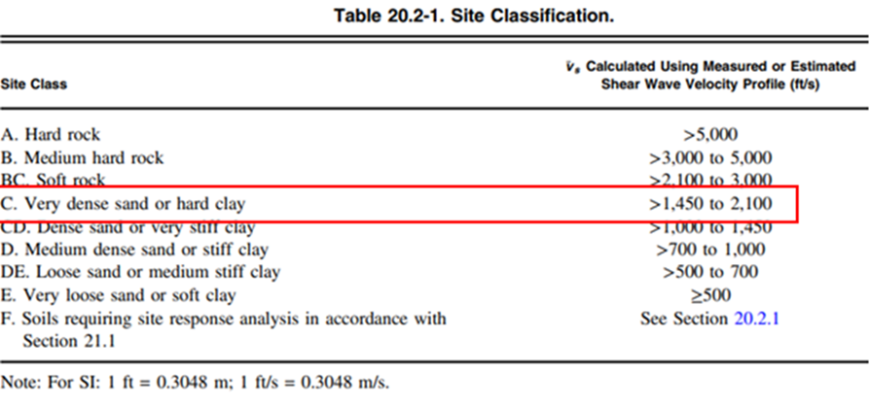
2- Seismic loads
According to ASCE 7-22 code to seismic analysis for this structure:
1-Mapped acceleration parameters Ss&S1:
  From Palestine seismic map:
  Ss= 0.67
  S1 = 0.13
2- Site class: Site classification is C

Slide 26
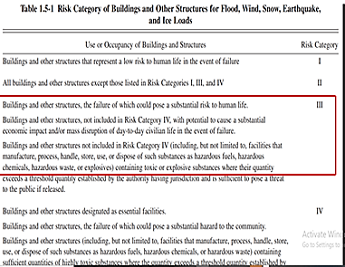
3- Risk category:
risk category of the building is III

Slide 27
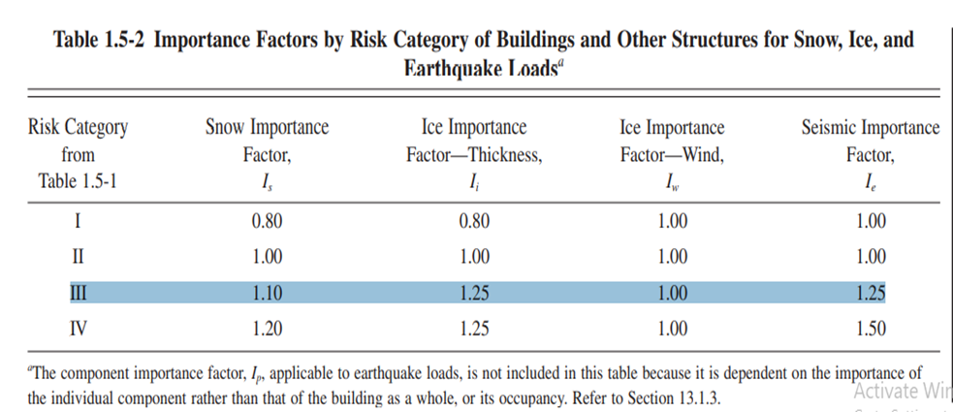
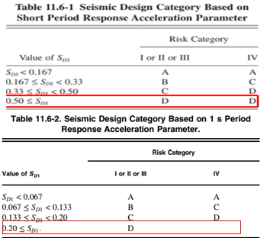
4- Seismic Design Category : D
5- Importance factor : Ie = 1.25

Slide 28
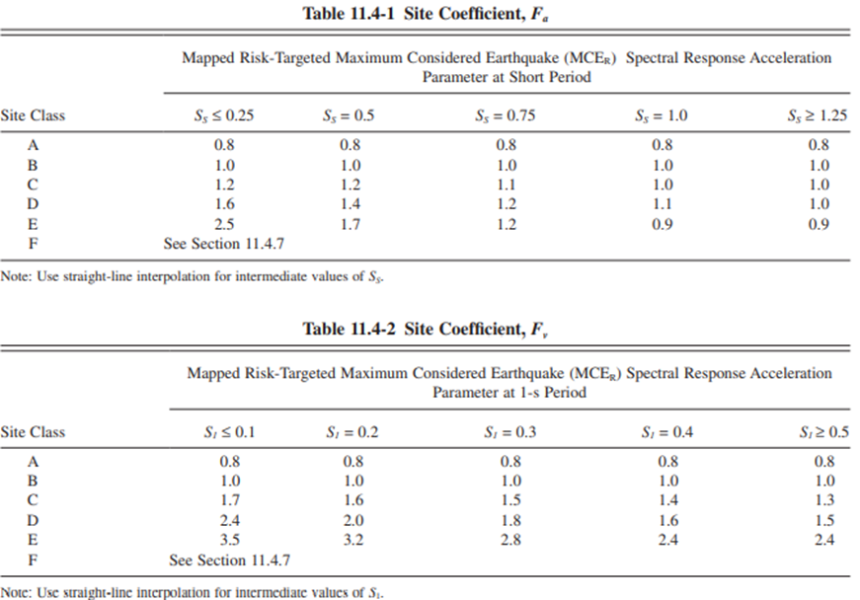
6- Site coefficients: The values of Fa 1.132= and Fv =1.67

Slide 29
*The maximum considered earthquake Spectral Response Acceleration Parameters SMS and SM1 :
          SMS=Fa * Ss= 1.104 * 0.74 = 0.817
          SM1= Fv * S1 = 1.65 * 0.15 = 0.2475
*Design spectral acceleration )SDS & SD1(
          SDS = SMS = 0.817
          SD1 = SM1 = 0.2475

Slide 30
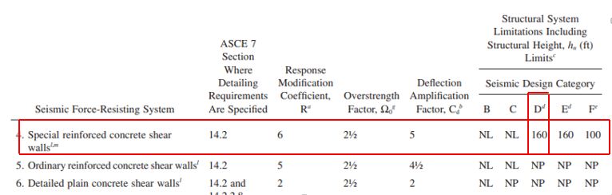
7- Type of the lateral forces resisting system:
building frame system: special shear walls
Response modification factor= 6
Overstrength factor Ω = 2.5
Deflection Amplification Factor = 5

Slide 31
8- Seismic Base Shear
V = Cs W
Cs= 0.158
W= D+SD+0.3SL

Slide 32
CHAPTER 2: Preliminary Design.
1) Slab structural system.
2)Preliminary slab thickness.
3)Preliminary dimensions of Beams .
4)Preliminary dimensions of columns and walls.

Slide 33
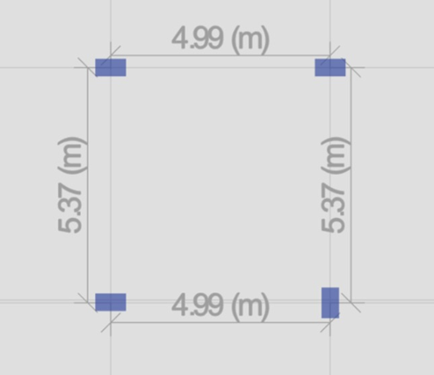
General Notes about dimension
1) The slab structural system used in this building is a two-way flat plate solid slab.
2) preliminary dimensions were be chosen according to ACI 318-19
3) Use the longest span for calculation
4) For Column dimension,
assuming ρ = 0.02 → A_{s} = 0.02 A_{g}

Slide 34
Preliminary dimensions of the structural elements
Structural element | Preliminary dimensions
Slab | Thickness = 180mm
Walls | Thickness = 200mm
columns | b = 300 mm & h = 700 mm
Beams | b = 300 mm & h = 300 mm

Slide 35
Final dimensions of the structural elements
Structural element | Final dimensions
Slab | Thickness =(180,210,220)mm
Walls | Thickness = (300, 220 ,200)mm
columns | b = 400 mm & h = 700 mm
Beams | b = 400 mm & h = 550 mm

Slide 36


Modeling Programs
AutoCAD
ETABS

Slide 37
Modeling Programs
AutoCAD
1) Drawing Plans.
2) Drawing Detailed Sections.
3) Illustrate Shop Drawing.

Slide 38
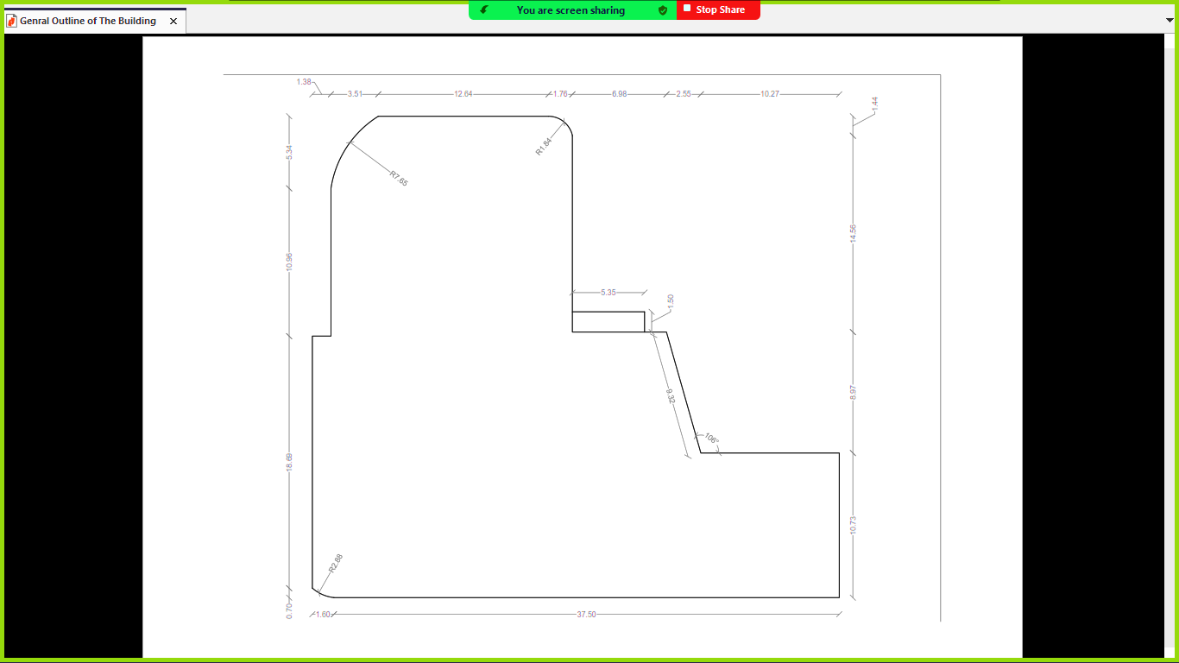
AutoCAD (Outline)

Slide 39
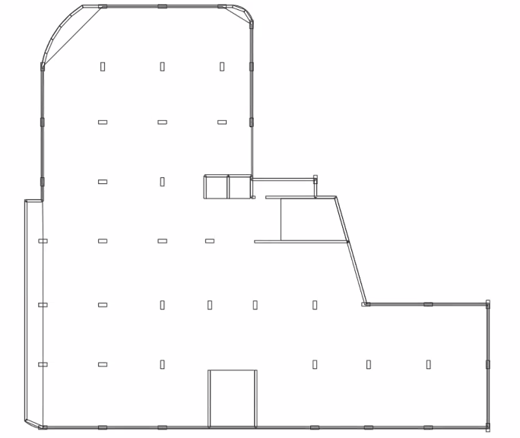
AutoCAD (Structural Plan)

Slide 40
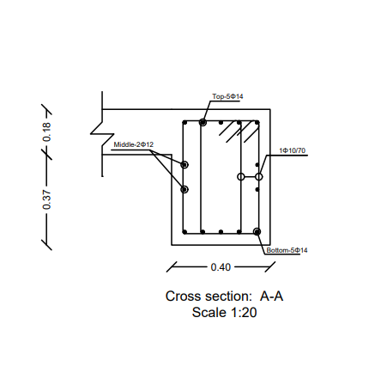
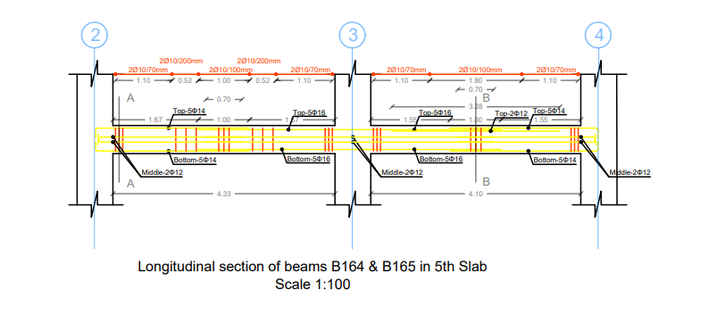
AutoCAD (Detailed Section)

Slide 41
Modeling Programs
ETABS
1) Modeling Structures.
2) Analyzing structures.
3) Design Structures

Slide 42
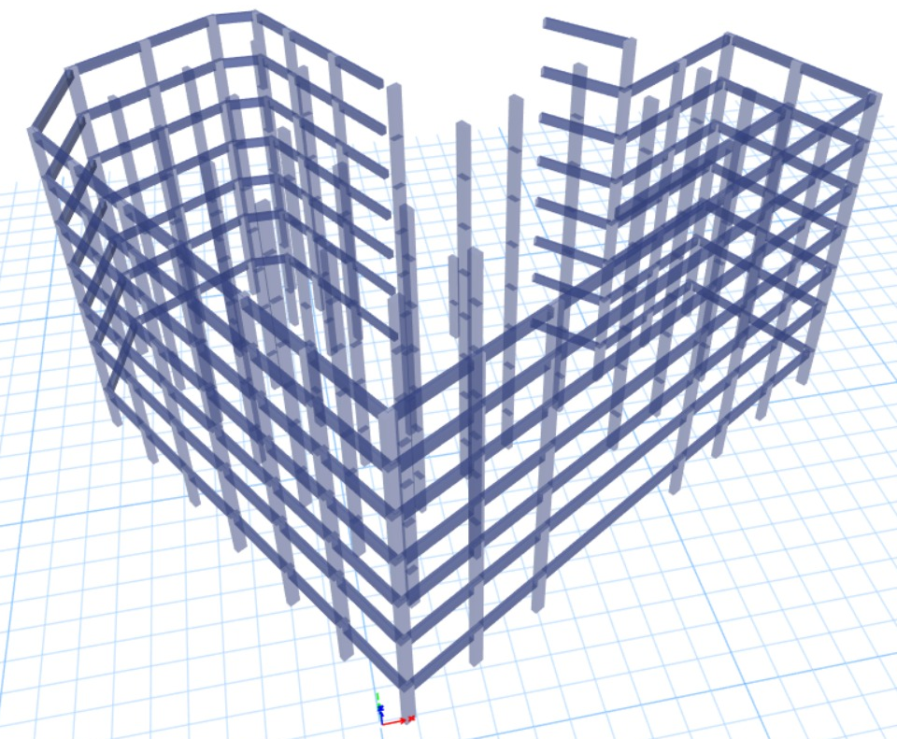
ETABS (3D Frame)

Slide 43
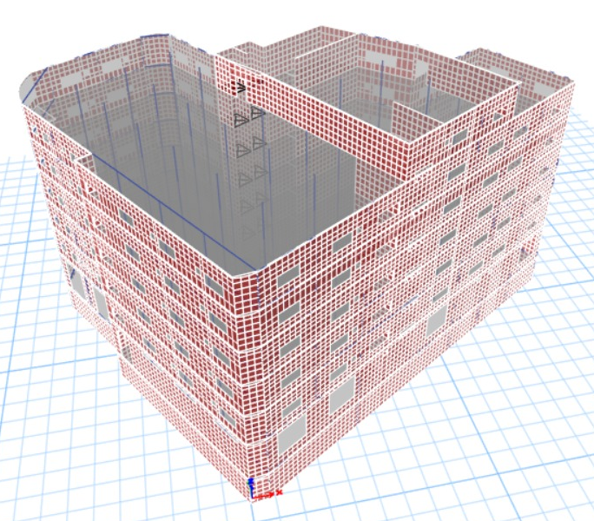
ETABS (3D Model)

Slide 44
Lateral Load Definition
There are two main natural event that must be considered during the design of such a building:
Earthquakes
Winds

Slide 45

Cause of Earthquake
The random movements of the tectonic plates are the main natural cause of the earthquake

Slide 46
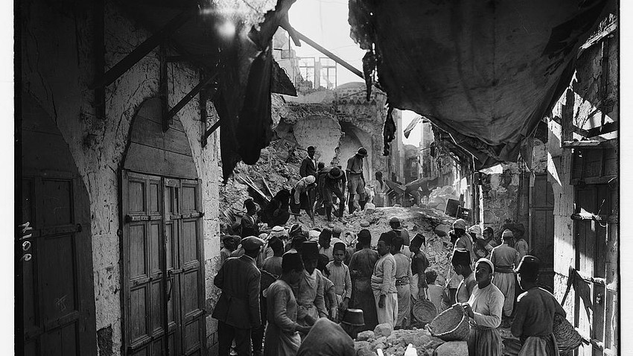
History of Earthquake in Palestine
In 1927, a strong earthquake hit Nablus with a volume of 6.2 on the Richter scale which last for a duration of 90 secs.

Slide 47
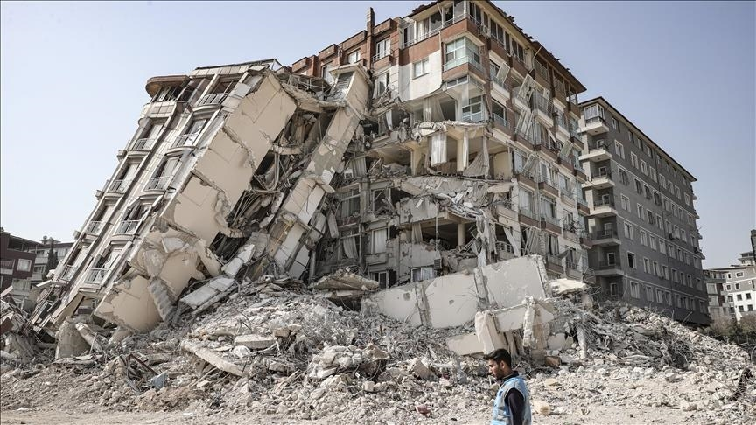
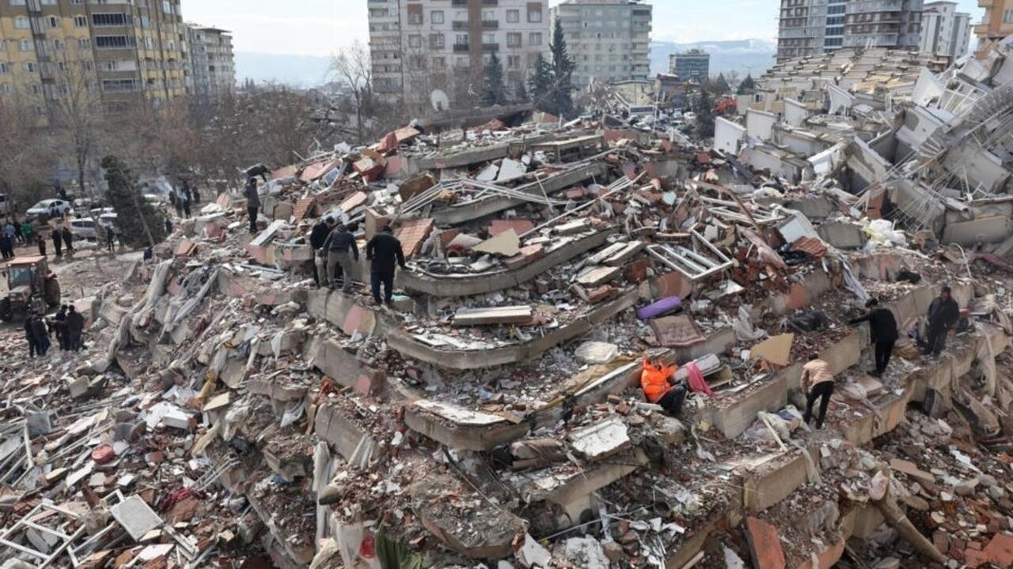
Tragedy of Earthquakes

Slide 48
Provisions By the ASCE 7-22 Code
The design earthquake has a probability of exceedance of 2% every 50 years.
That means every the 2500 years, an earthquake large than the design earthquake will occur.

Slide 49
Seismic Modeling Methods
Equivalent Static Method (Static).
Response Spectrum Method (Dynamic).
Time History Method (Dynamic).

Slide 50
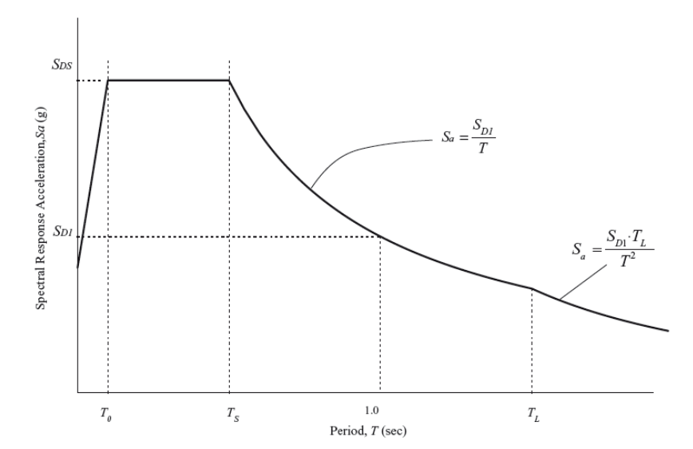
Equivalent Static Method
The main idea is to replace the dynamic forces to a static forces based on Newton’s second law. (F = a*m)

Slide 51
Response Spectrum Method
It perform multiple Equivalent Static Method in each mode of the structure and combined them in the end as one force.

Slide 52
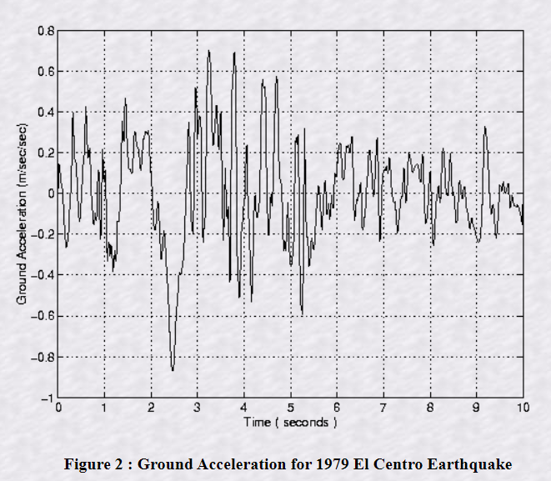
Time History Method
This applies the dynamic forces on the building as a function of time during the earthquake.

Slide 53
Structural Irregularity
There are two types of Structural Irregularities:
Horizontal Structural Irregularity
Vertical Structural Irregularity

Slide 54
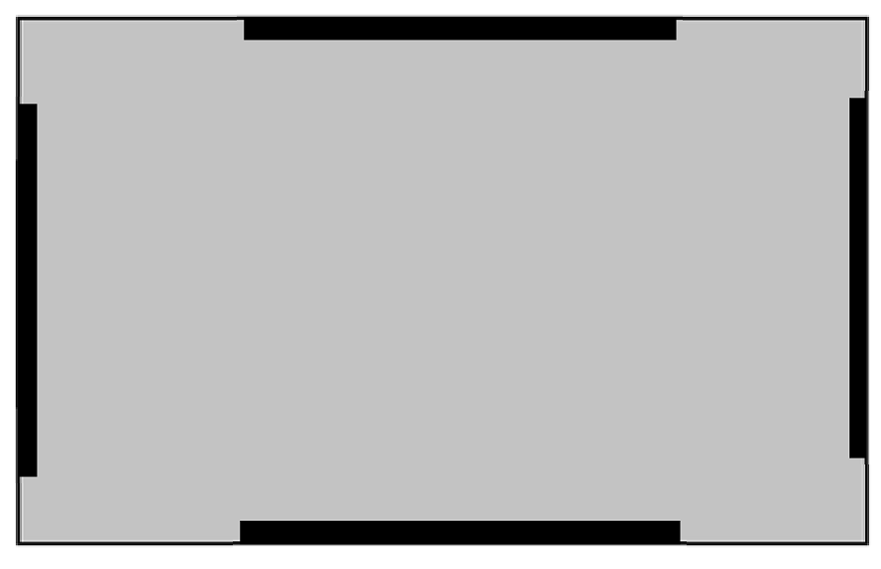
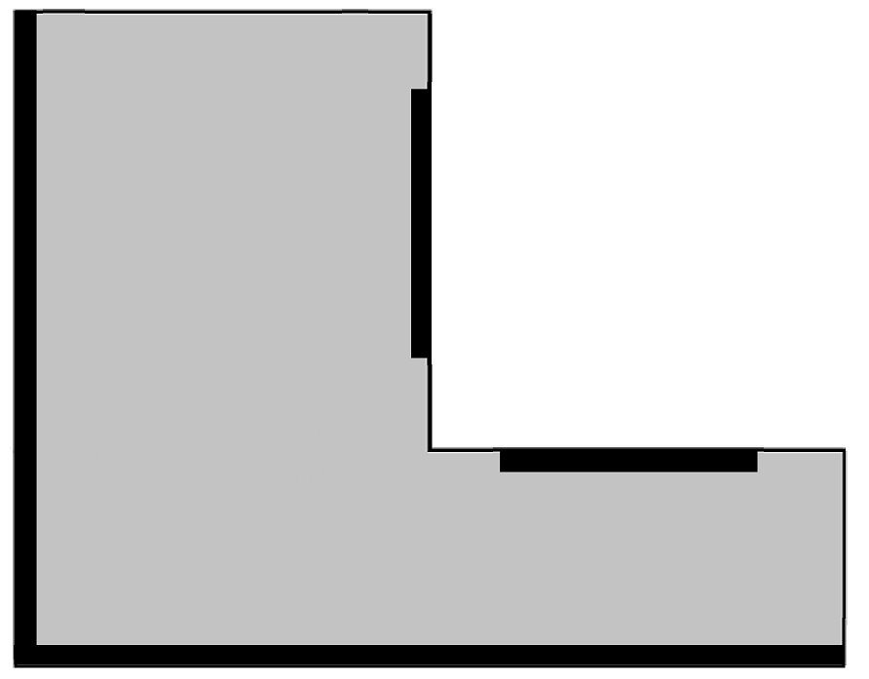
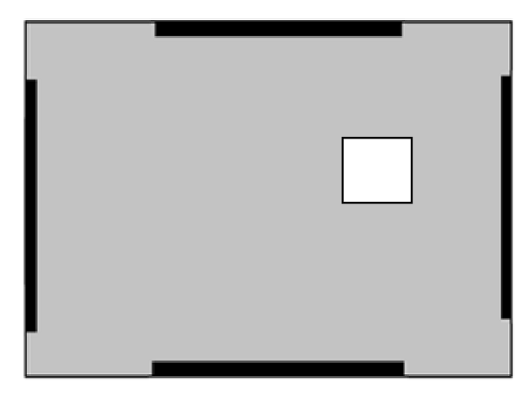
Horizontal Structural Irregularity

Slide 55
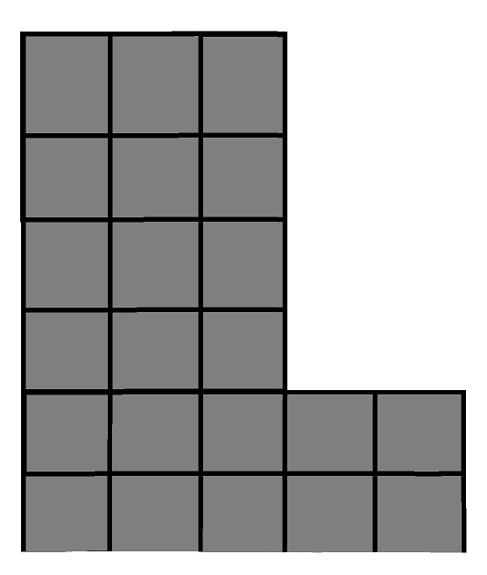
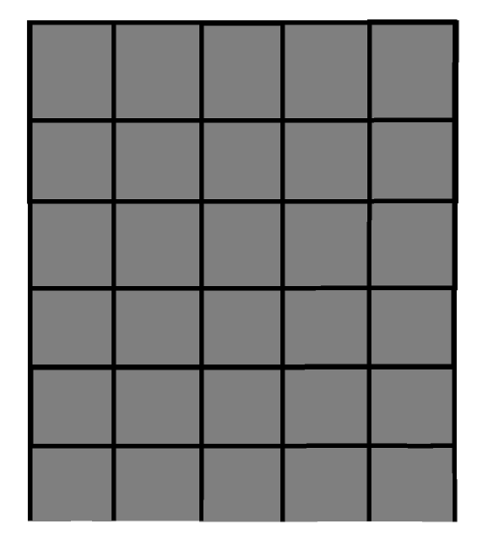
Vertical Structural Irregularity

Slide 56
Seismic Checks
1- Base shear check
2- Story drift check
3- P-delta check
4- Type of Lateral-resisting system

Slide 57
Designs of Structural Elements
Steel Reinforcement is used for multiple reasons:
1- To support the concrete with resisting the tension forces mainly
and compression forces.
2- To prevent shrinkage of concrete.
3- To make the concrete a ductile material.

Slide 58
Designs of Structural Elements
1- Beams
2- Columns
3- Walls (Piers and Spandrels)
4- Foundations
5- Slabs (Diaphragms and Collectors)
6- Stairs

Slide 59
Design of Beams

Slide 60
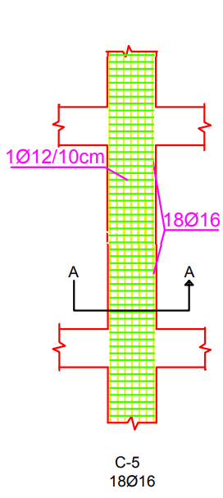
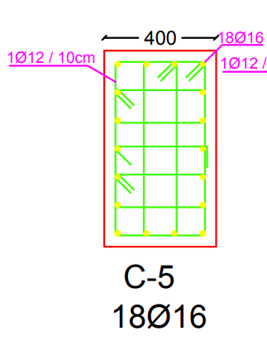
Design of Column

Slide 61
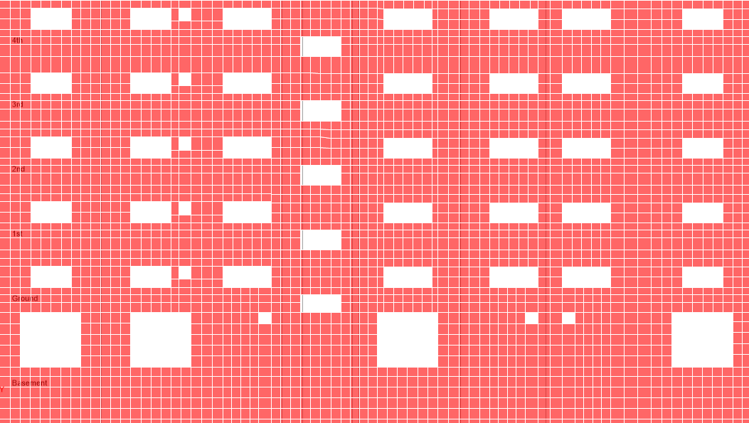
  Design of Walls
We have two sections on the wall, the first pier and the second spandrel.

Slide 62
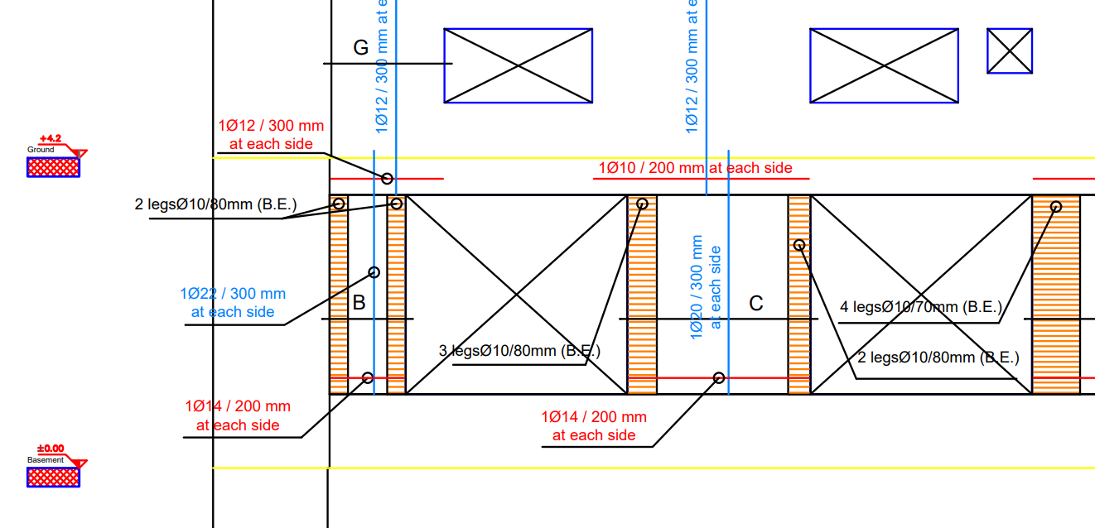
  Design of Walls
Pier Sample

Slide 63
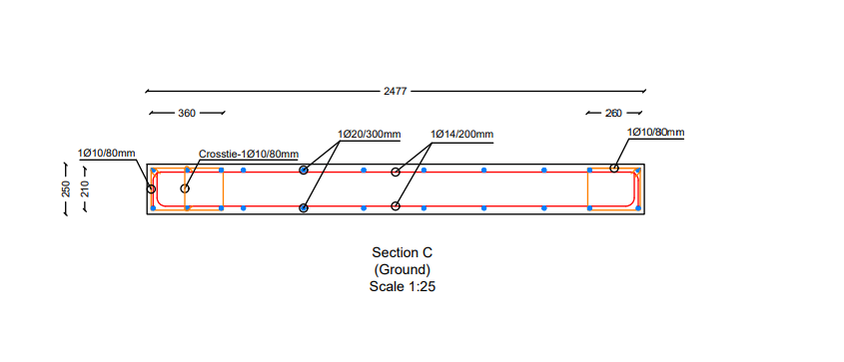
Design of Walls
Pier Sample

Slide 64
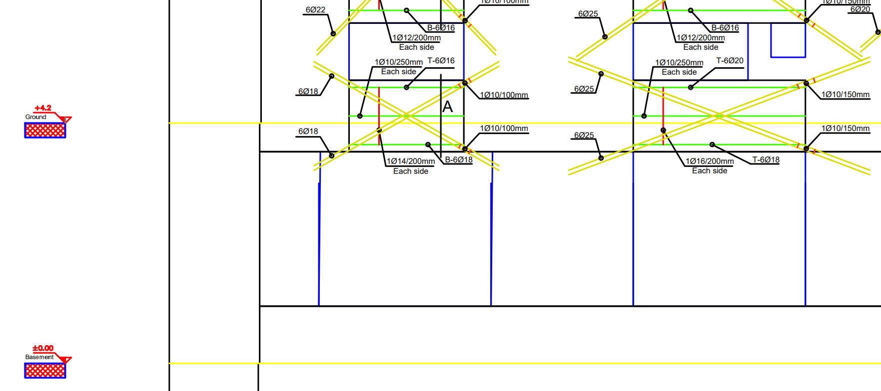
Design of Walls
Spandrel sample

Slide 65
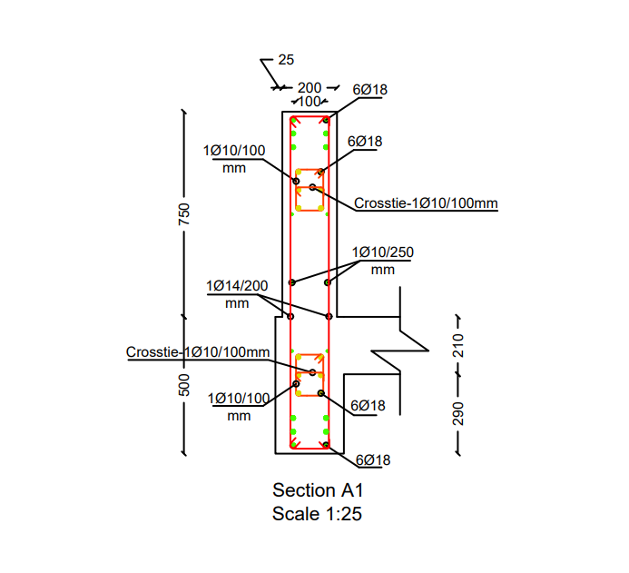
Design of Walls
Spandrel sample

Slide 66
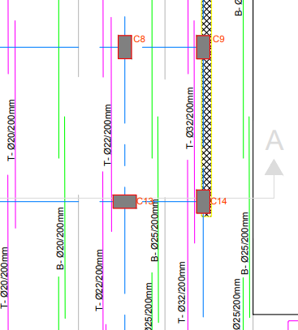
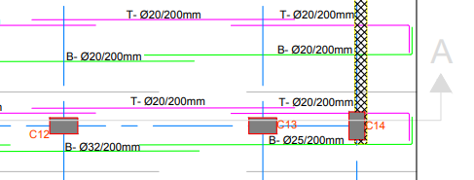
Design of footing
The base is the most important structural element responsible for bearing all the forces of the building.
Its thickness was 80 cm.

Slide 67
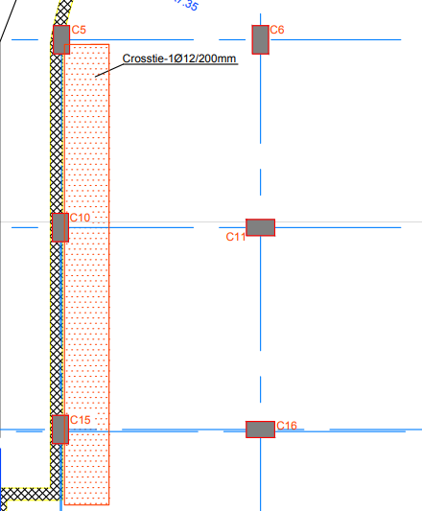
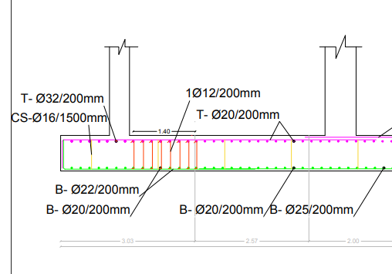
Design of footing

Slide 68

Design of Stairs
The staircase is an important element in the structural elements that connect from one floor to another.

Slide 69


Design of Stairs

Slide 70

Design of Slabs
all slabs have ratios less than 0.9 for punching shear. OK

Slide 71
Design of Slabs
No. Floor | Bottom steel in direction 1 | Top steel in direction 1 | Bottom steel in direction 2 | Top steel in direction 2
Basement | ∅ 12 / 250 mm. | ∅ 12 / 250 mm. | ∅ 12 / 250 mm. | ∅ 12 / 250 mm.
Ground | ∅ 12 / 250 mm. | ∅ 12 / 250 mm. | ∅ 12 / 250 mm. | ∅ 12 / 250 mm.
1st | ∅ 12 / 250 mm. | ∅ 12 / 250 mm. | ∅ 12 / 250 mm. | ∅ 12 / 250 mm.
2nd | ∅ 12 / 250 mm. | ∅ 12 / 250 mm. | ∅ 12 / 250 mm. | ∅ 12 / 250 mm.
3rd | ∅ 12 / 250 mm. | ∅ 12 / 250 mm. | ∅ 12 / 250 mm. | ∅ 12 / 250 mm.
4th | ∅ 12 / 250 mm. | ∅ 12 / 250 mm. | ∅ 12 / 250 mm. | ∅ 12 / 250 mm.
5th | ∅ 10 / 200 mm. | ∅ 10 / 200 mm. | ∅ 10 / 200 mm. | ∅ 10 / 200 mm.
Roof | ∅ 10 / 200 mm. | ∅ 10 / 200 mm. | ∅ 10 / 200 mm. | ∅ 10 / 200 mm.

Slide 72

Design of Slabs

Slide 73

Design of Slabs

Slide 74

Diaphragms and Collectors
Diaphragms It works like a depth of beam with very great depth
.
Collectors They are reinforced in some areas and are usually along the shear wall

Slide 75

Non-structural elements
Examples on the non-structural elements:
Stones
Gypsum and wood partitions
Aluminum and glass curtains
Doors and windows

Slide 76
شكراً لحسن استماعكم و دمتم لنا ذخراً نفتخر بكم دائماً

