Slide 1
Architectural Aspect
PROJECT 2
1
Redesigned
Ground floor:
First & second floor:
Basement floor:
Toilets have a different location from ground floor and that will create a mechanical design problem in future, so to avoid these from happening we must put them in the same place.
Improvements that we make to the building. It can contain + 30 car and that cover all school needed for car parking.
Administration offices need to organized.
Class number and area dose not matching with class in the above story and that
mean the school can’t include all this number of pupils for the next years.
Grade one have an extra number of class than the grade two, and I don’t want this.
No need for two lobbies and two kitchens.
Useless area in the corridor .
The first floor escape stair has a bad door orientation.

Slide 2
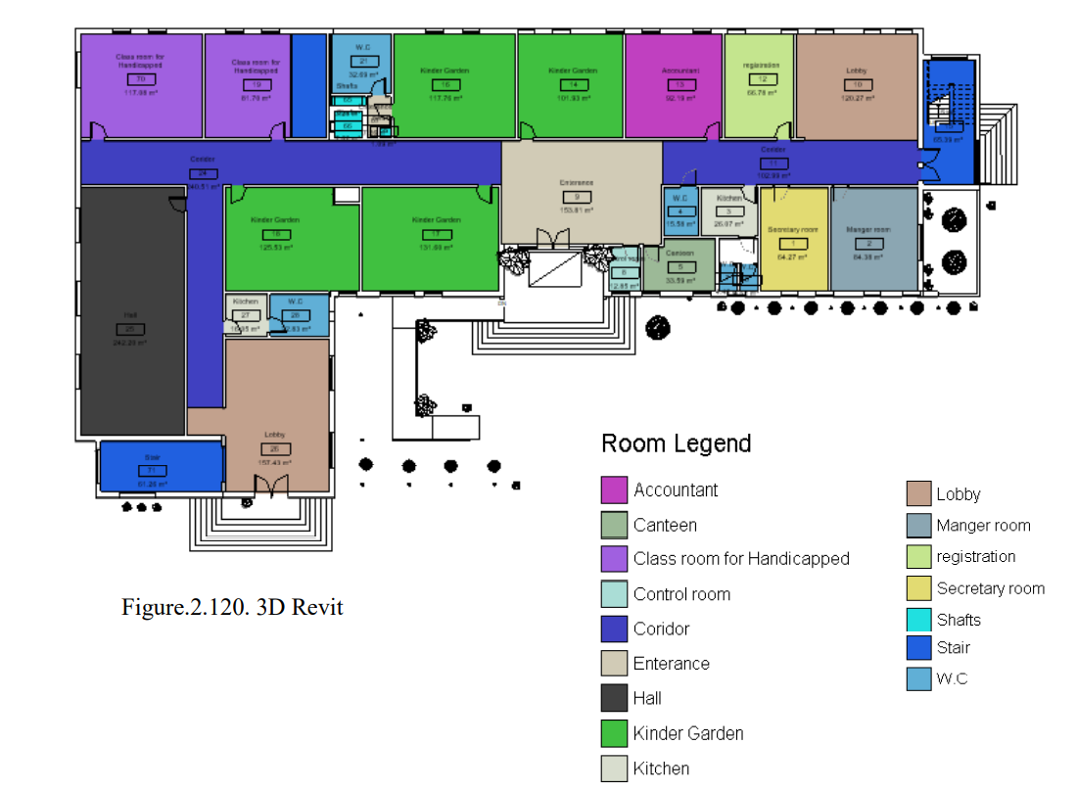
PROJECT 2
2
The ground floor before re-design:

Slide 3
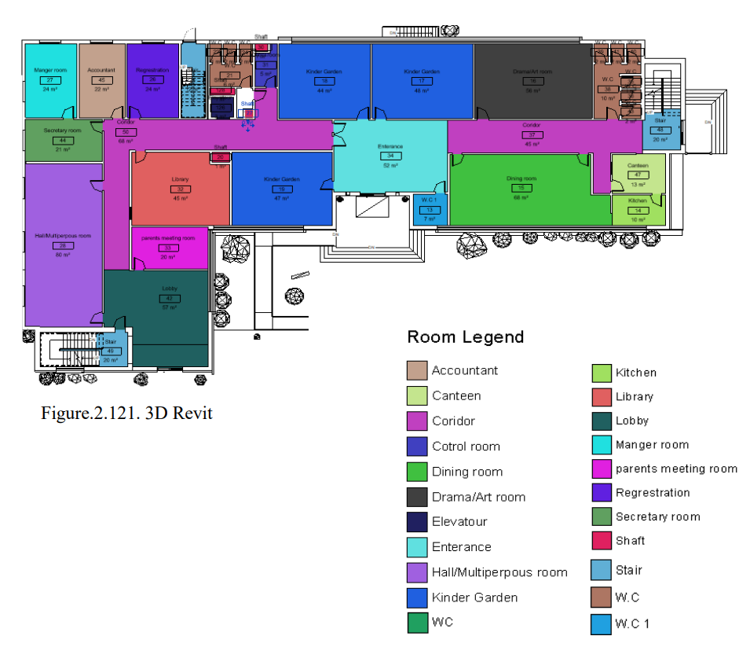
The ground floor after re-design:

Slide 4
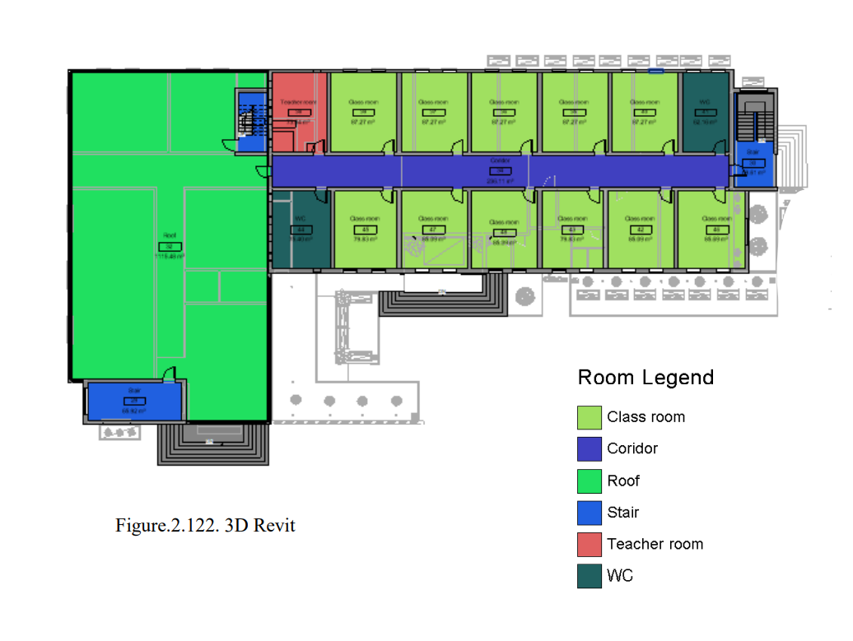
PROJECT 2
4
The first floor before re-design:

Slide 5
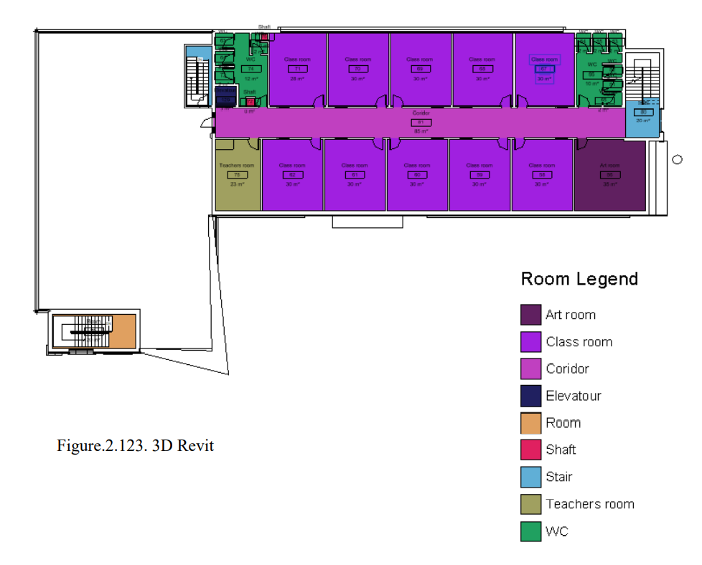
The first floor after re-design:

Slide 6
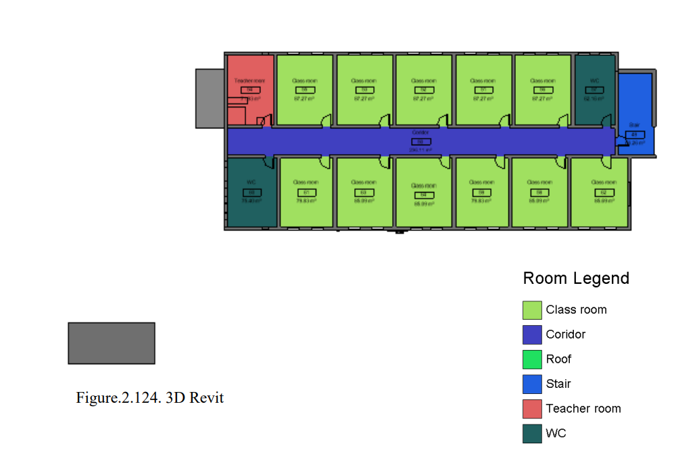
PROJECT 2
6
The second floor before re-design:

Slide 7
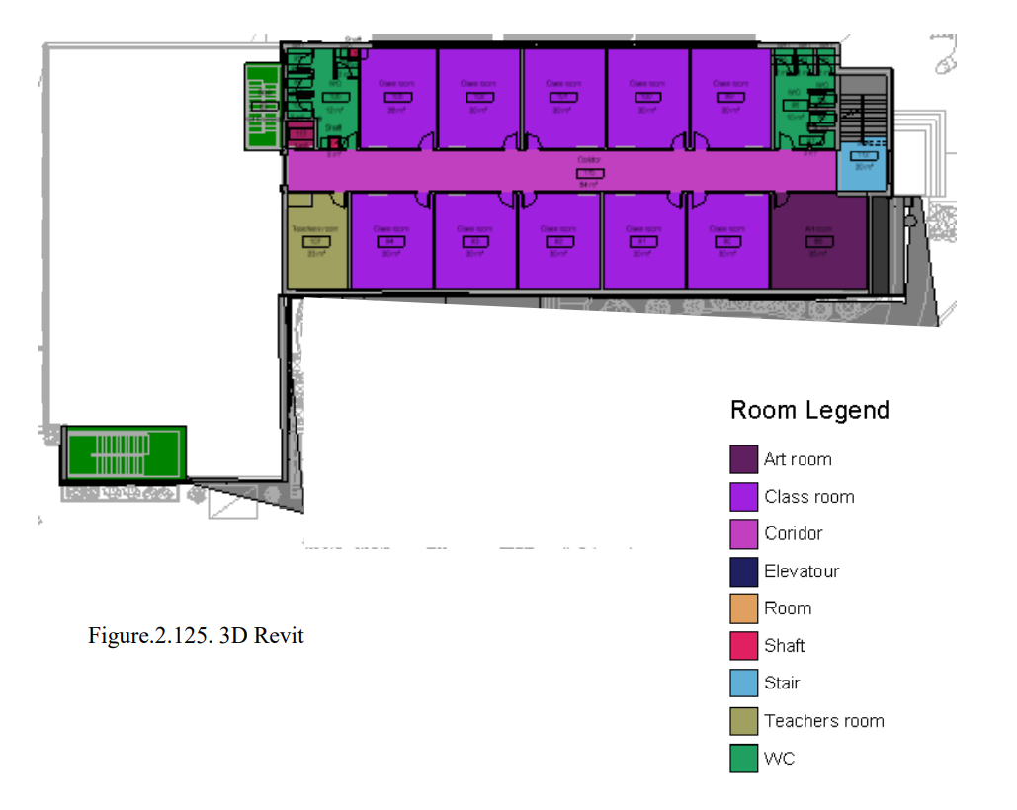
The second floor after re-design:

Slide 8
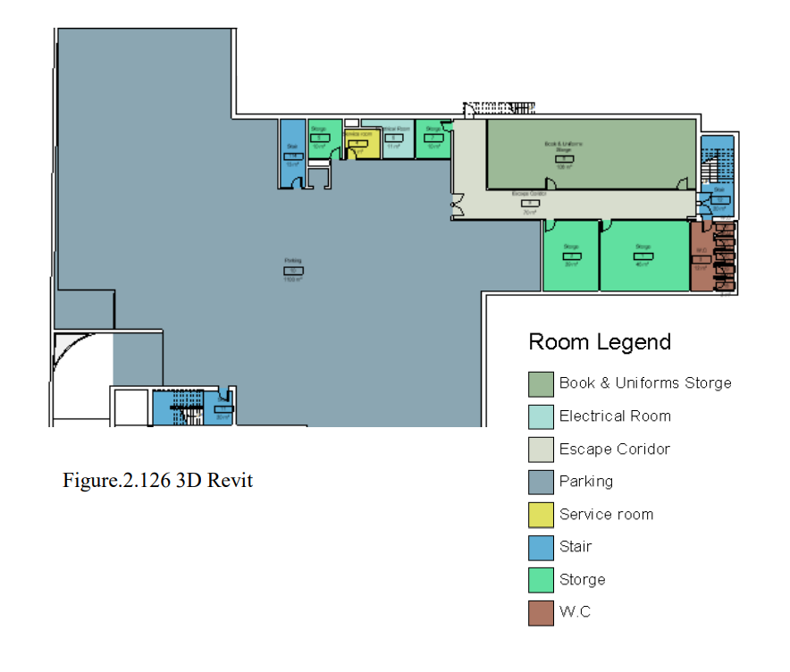
Basement Floor – As a modifier

Slide 9

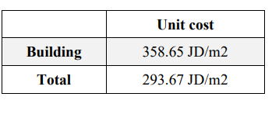
Total budgeted cost equal (without landscape) 1,242,786.37 JD.
Land area = 4727 m2.
Building area = 3466 m2
Total budgeted cost equal (building with landscape) 1,388,193.87 JD.
Cost Estimate
Areas

Slide 10
Presentation – Graduation Project 2
Work done by: Lana Al-Hasan
Architectural and environmental Aspects
Pv system
HVAC system
Cost estimation and quantity surveying – for Architectural work

Slide 11
3. Architectural & Environmental Aspects
Architectural- Case study
Architectural- 3D model design
Architectural- Landscape design
Environmental- Site analysis
Environmental- Shadowing and solar gain
Environmental- Daylight factor
Environmental- Heating and cooling loads
Environmental- Modification

Slide 12
Architectural Aspects

Slide 13
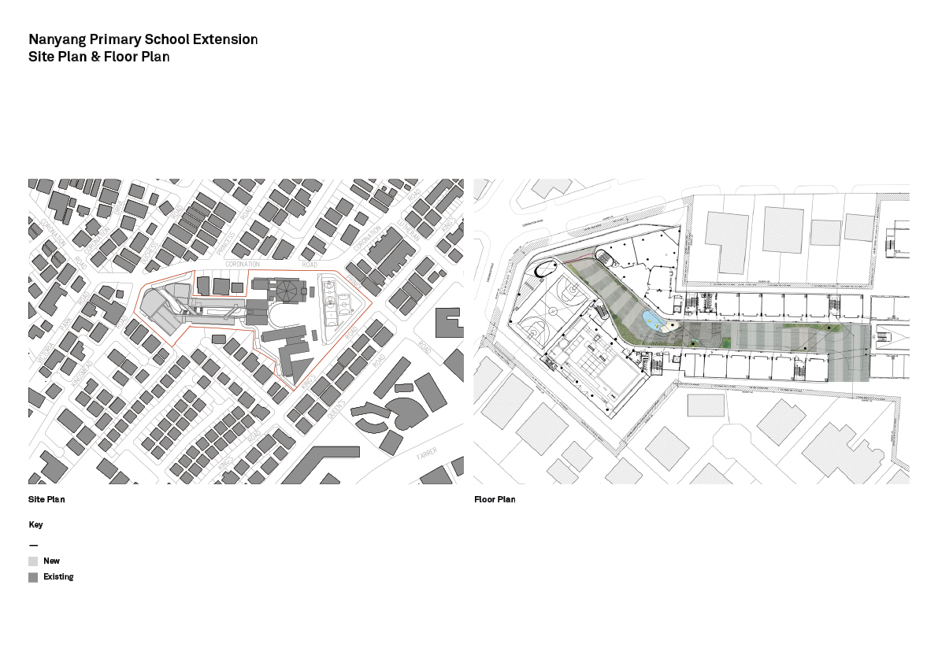
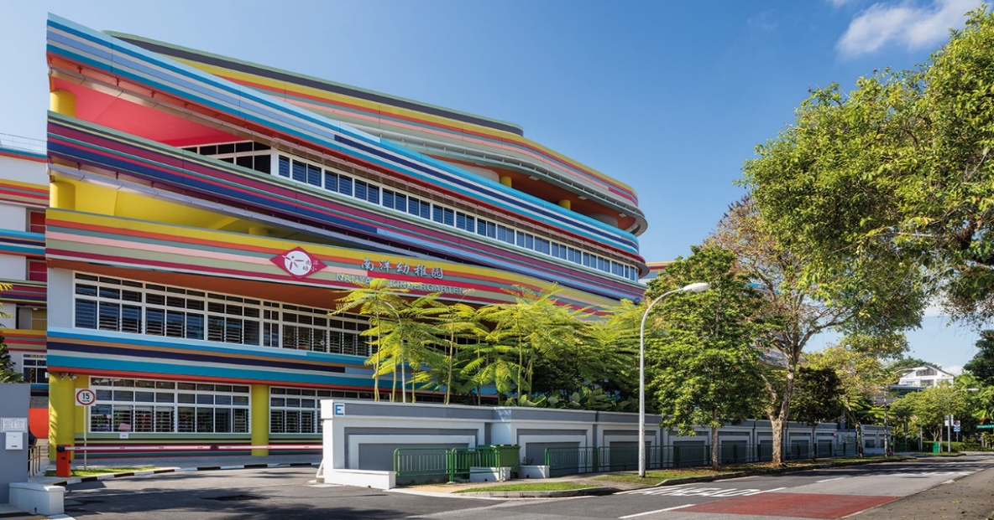
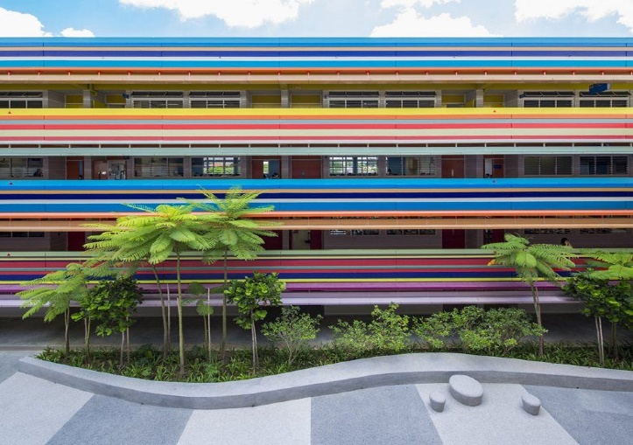
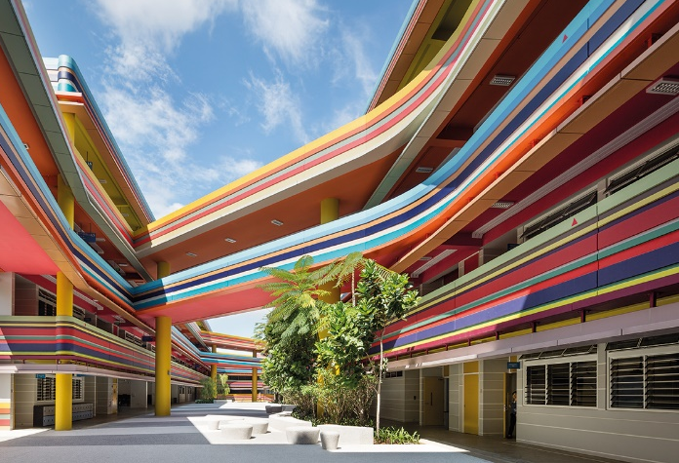
1.1 Case study analysis
Figure.1.01. Surrounding buildings
Figure.1.03 North elevation
Figure.1.02. Site plan
Figure.1.04 Shot from outdoor
Figure.1.05 Shot from outdoor

Slide 14
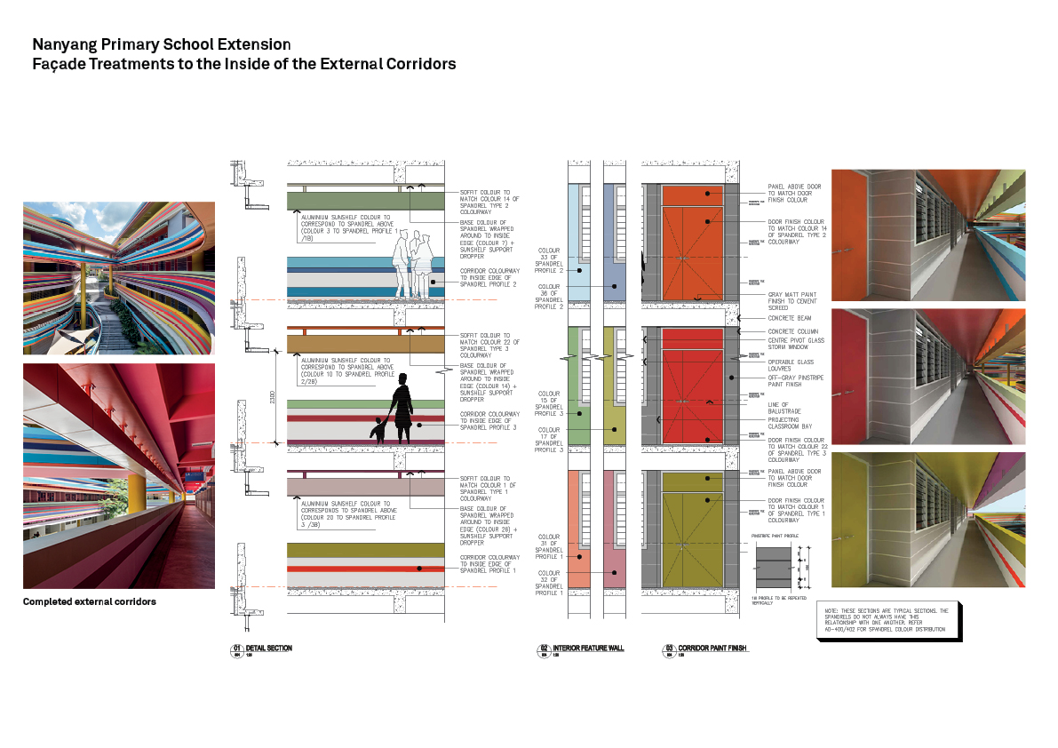
Figure.1.09 Section - material
Figure.1.06 Section - doors
Figure.1.07 Shot from indoor
Figure.1.08 Shot from indoor

Slide 15
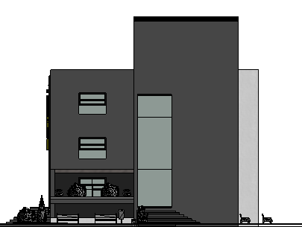
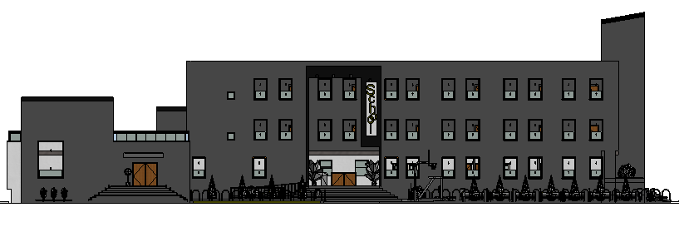
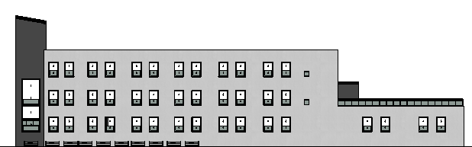
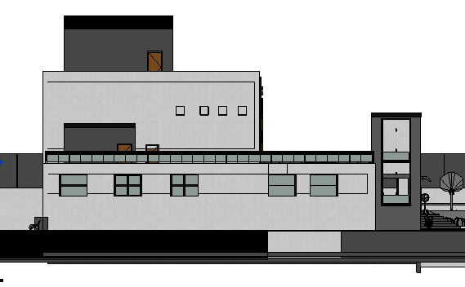
1.2 Building model
2D - Before modifier - Elevations
Figure.1.10. North - Elevation
Figure.1.12. West - Elevation
Figure.1.11 South - Elevation
Figure.1.13. East - Elevation

Slide 16
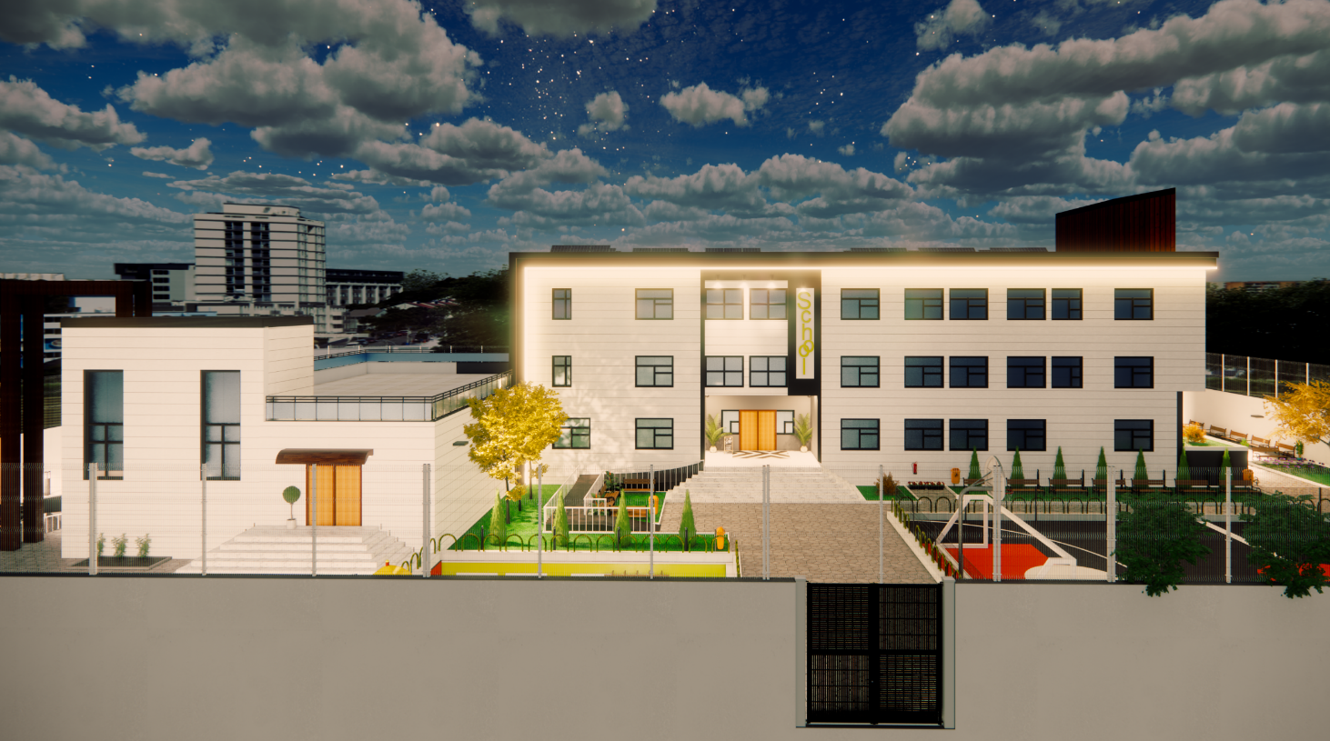
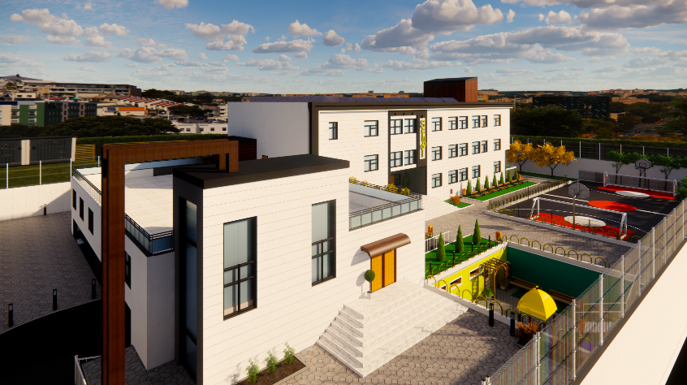
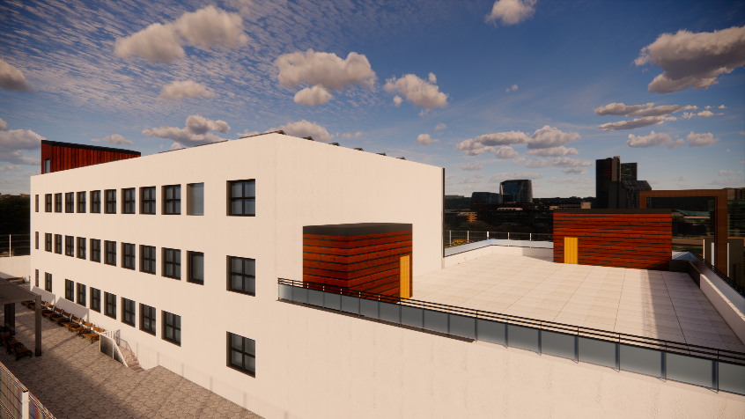
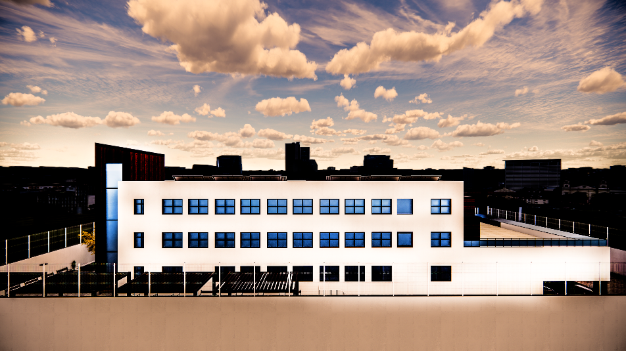
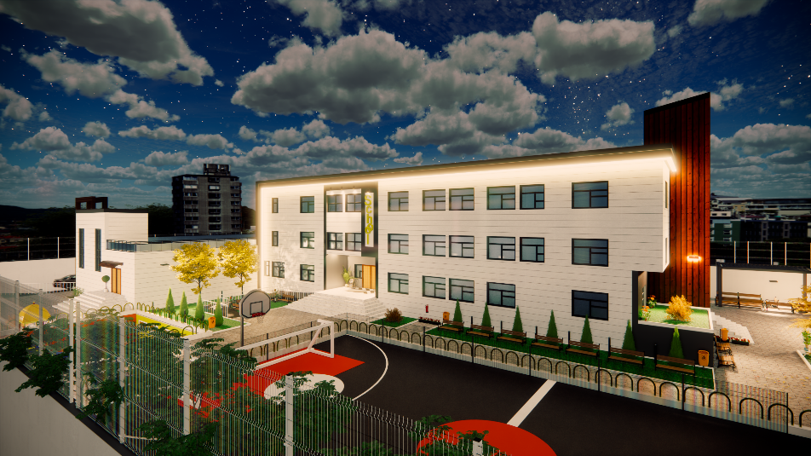
3D - Before Modifiers

Slide 17
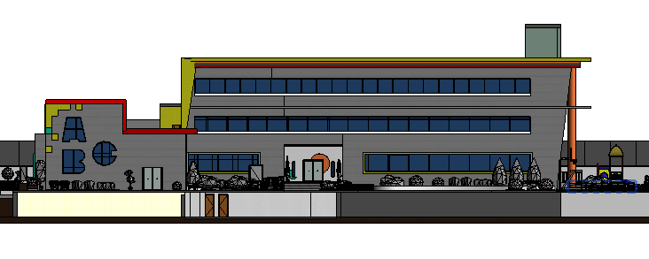
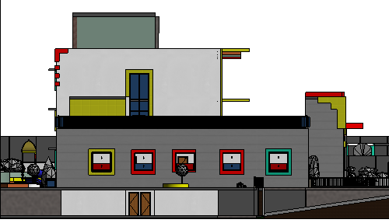
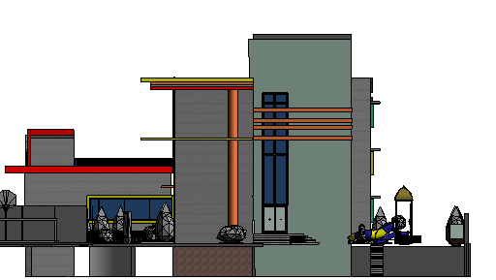
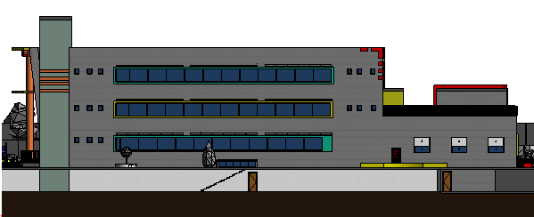
2D - After modifiers, Elevations
Figure.1.14. North - Elevation
Figure.1.16. West - Elevation
Figure.1.15. South - Elevation
Figure.1.17. East - Elevation

Slide 18
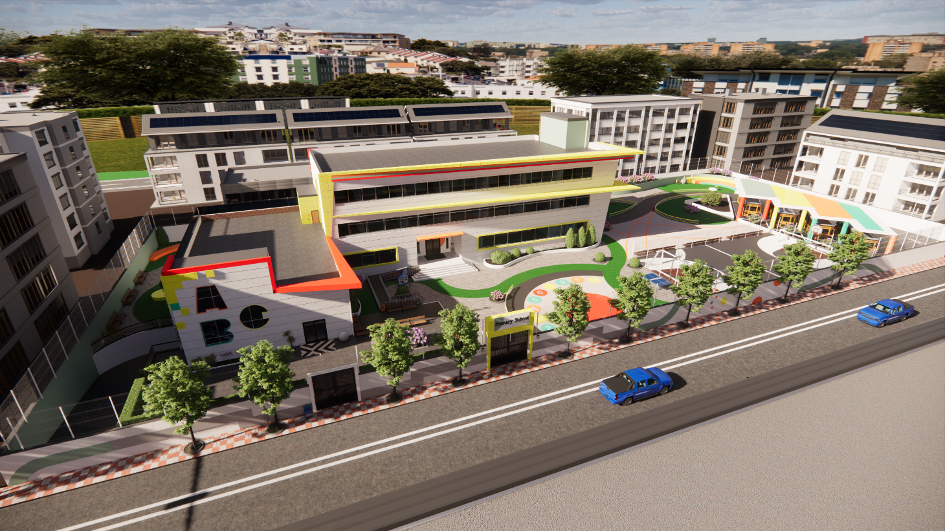
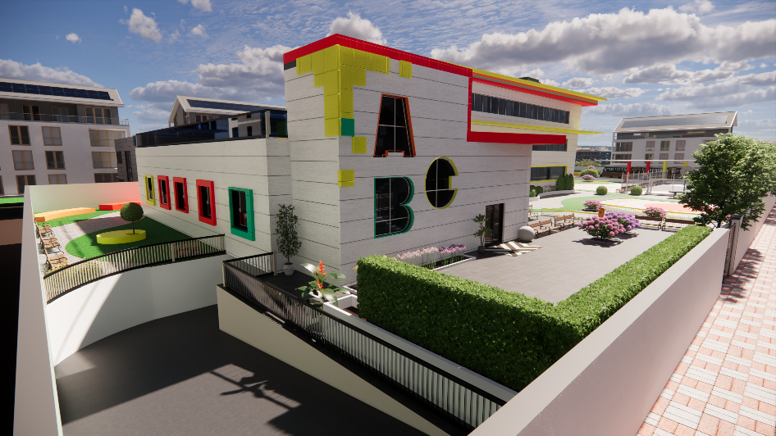
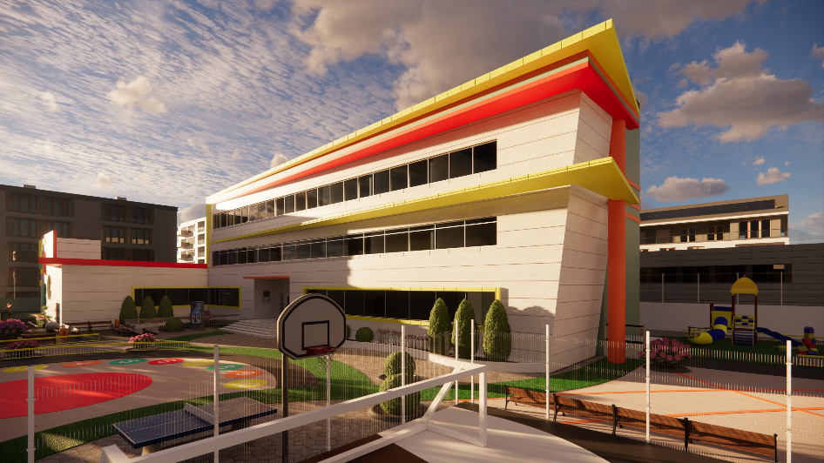
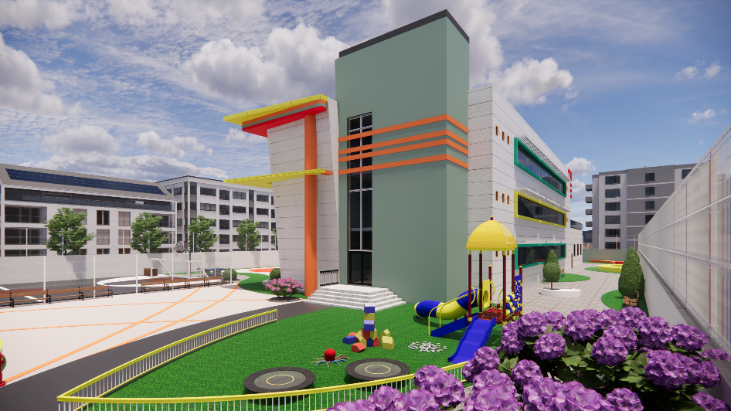
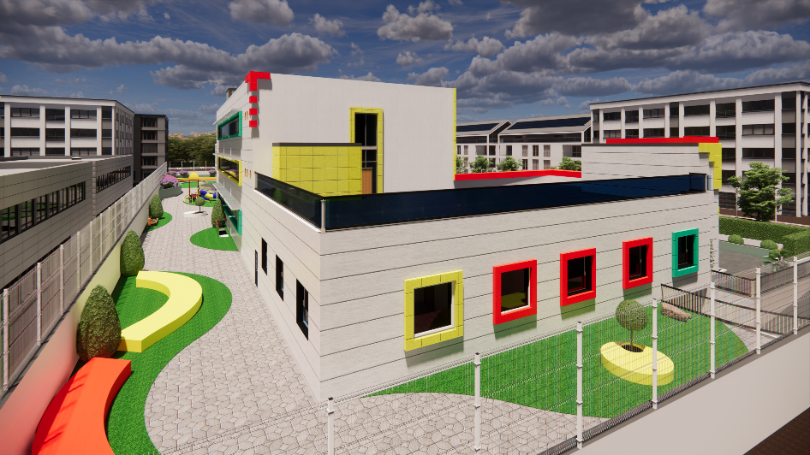
3D - After Modifiers

Slide 19
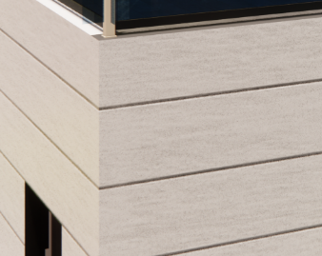

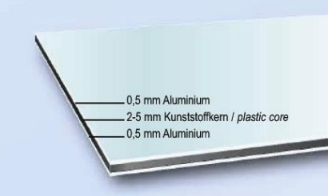
Materials Used for- After case
Smoothed artificial stone
Thickness: 5 cm
Glazing system
Thickness: 6 mm – each layer
Double low e glass
Alucobond
Thickness: 3 mm
With aluminum cantilever frame
Green paint - exterior
Thickness: 1 mm
Tirol ™ Altra-teraco
Painted concrete
Aluminum lovers

Slide 20
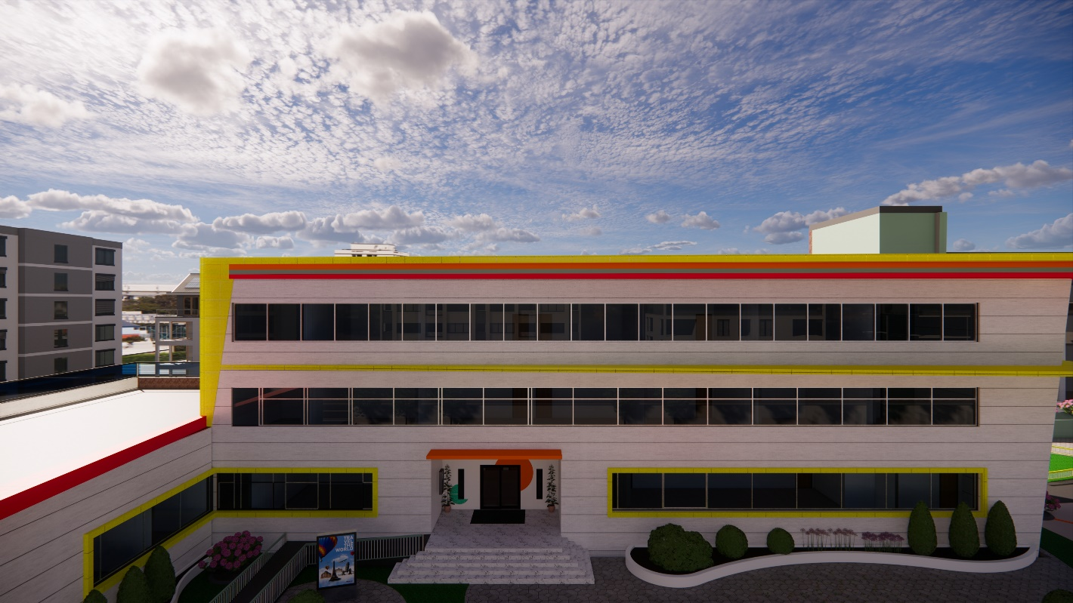
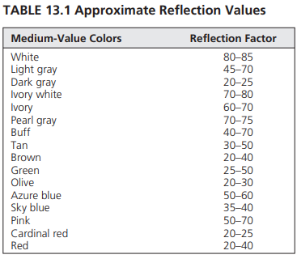
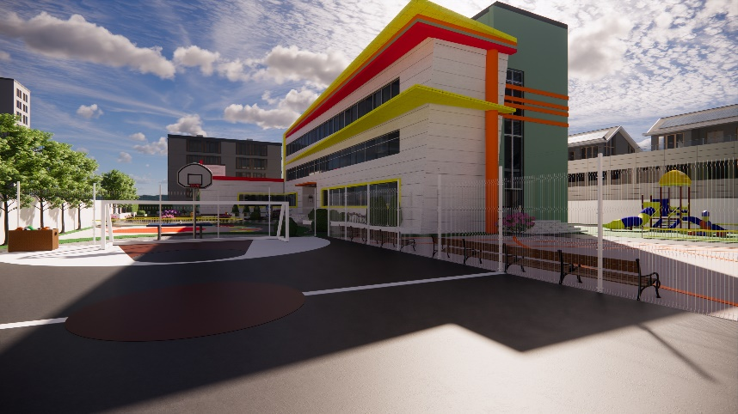
Why using these colors ?

Slide 21

1.3 Landscape – Before

Slide 22
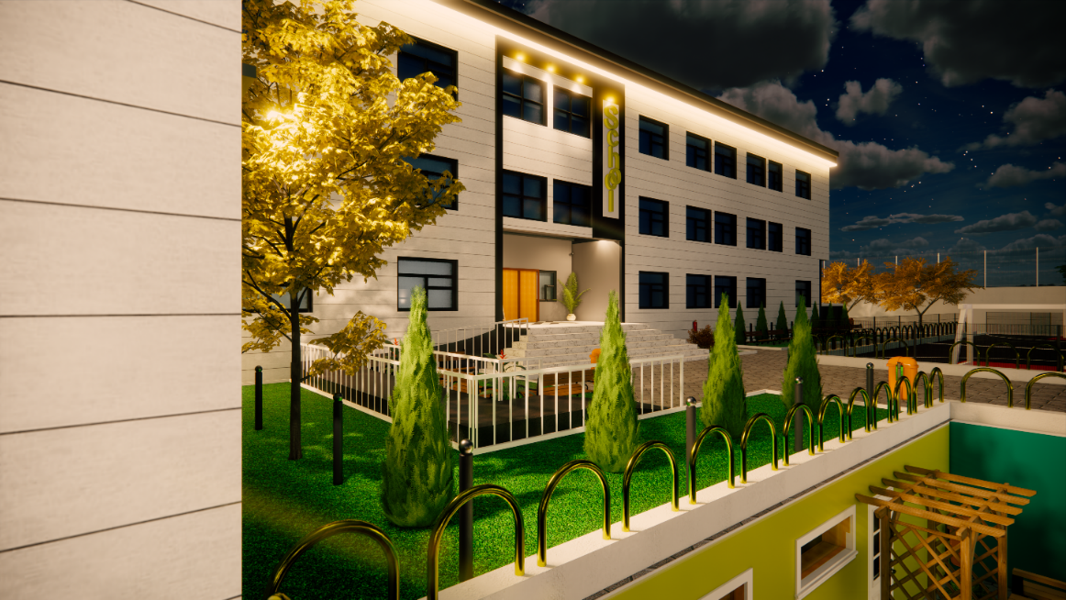
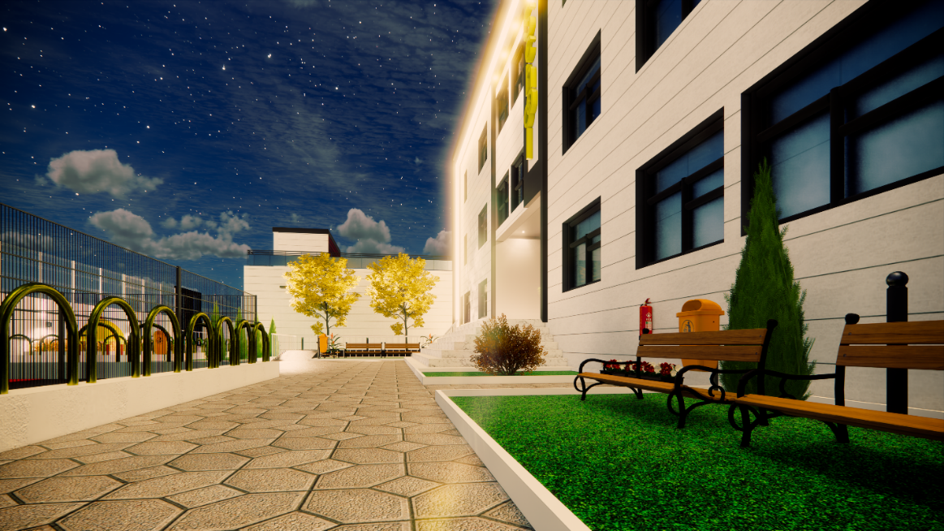
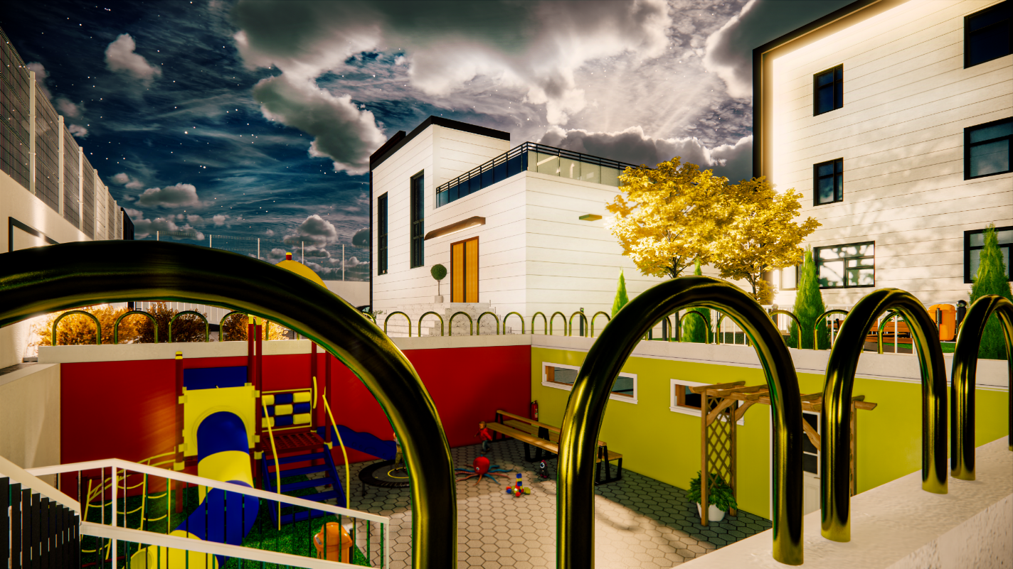

Slide 23
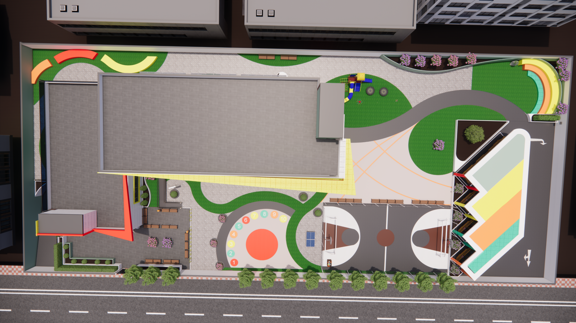
Landscape – After

Slide 24
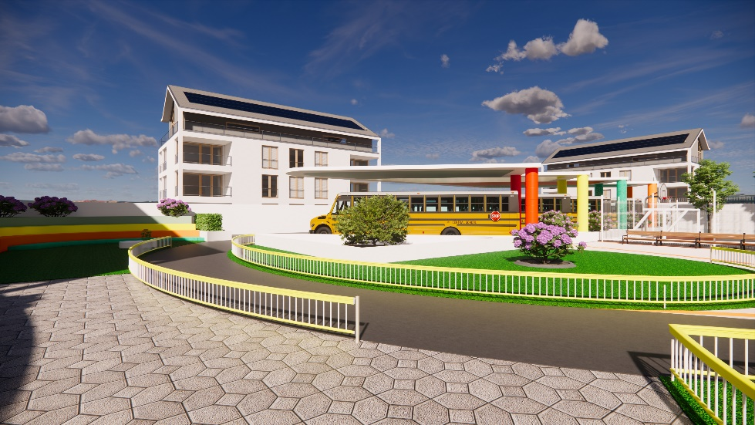
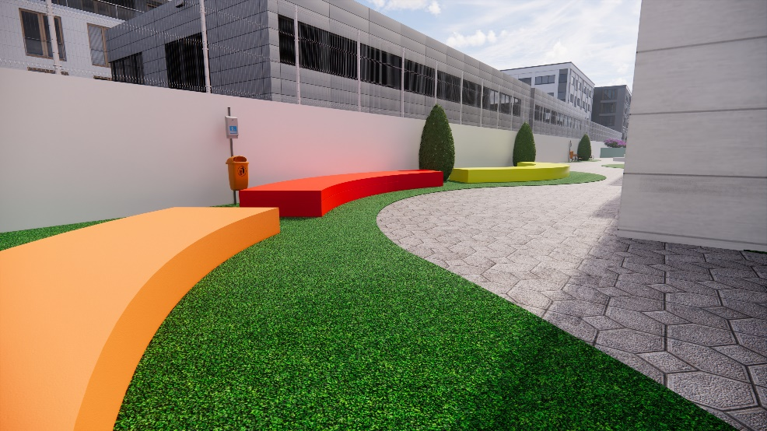
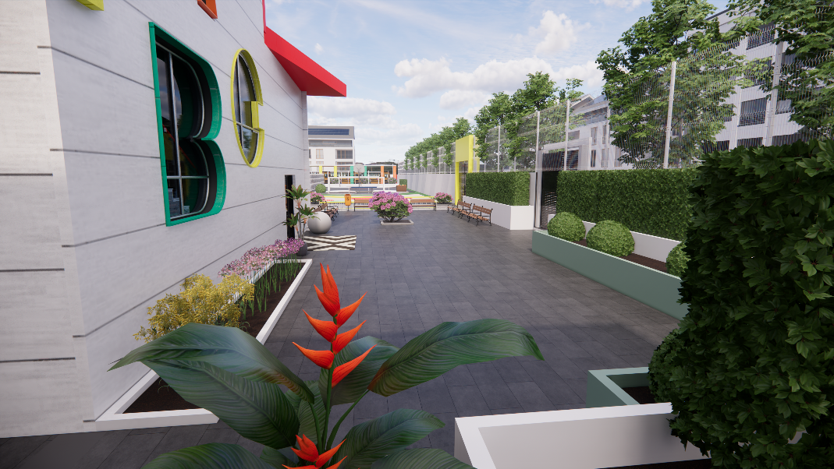
Materials Used for Landscape
Painted concrete as a floor & seats
Cement tiles
Ceramic landscape tiles
Gross
Flowers block – boundary

Slide 25
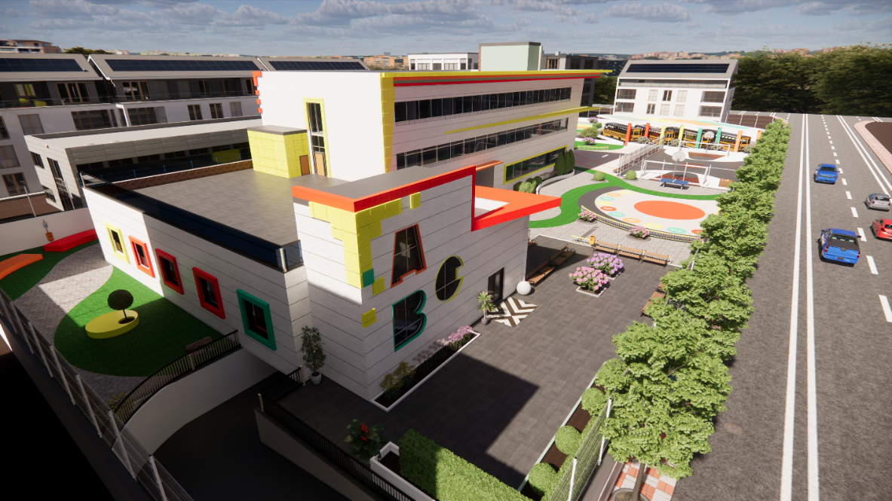
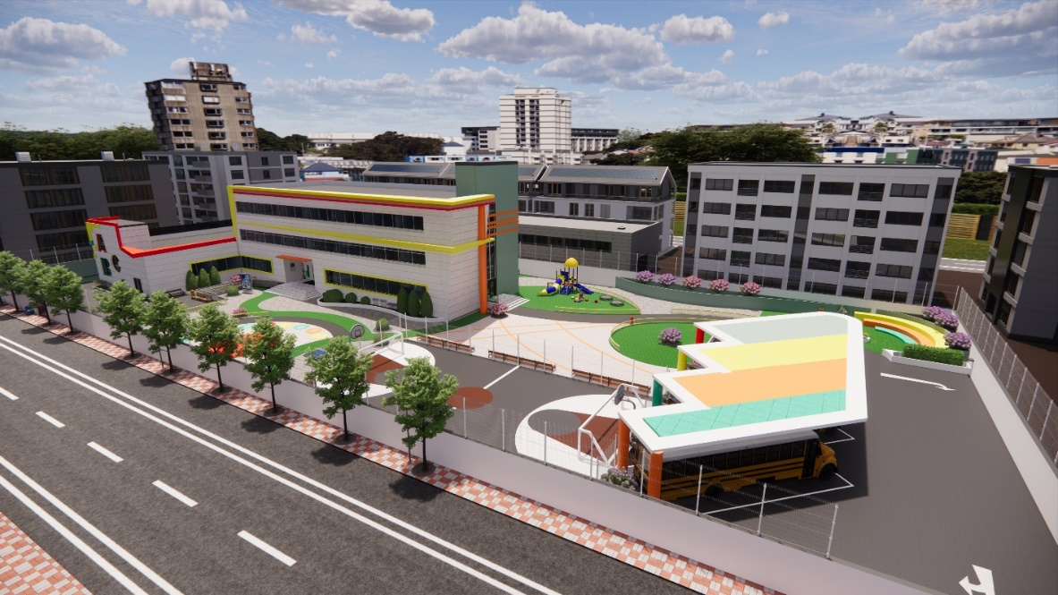
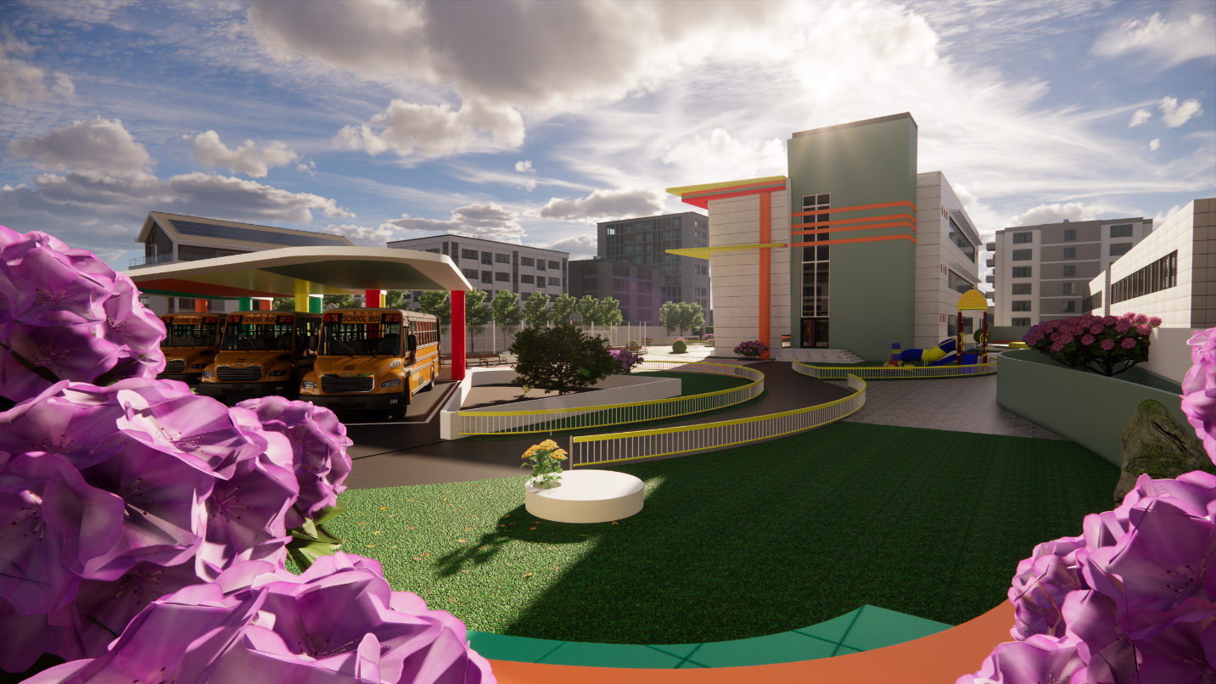

Slide 26
Environmental Aspects

Slide 27
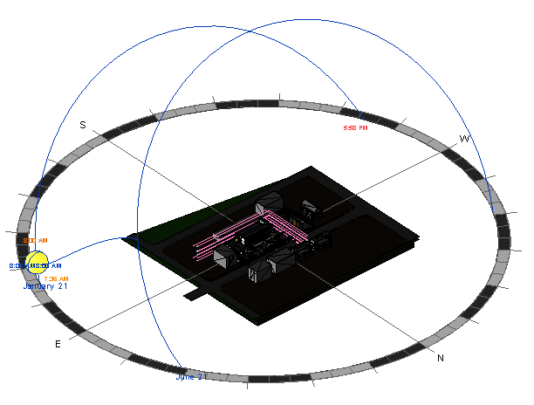
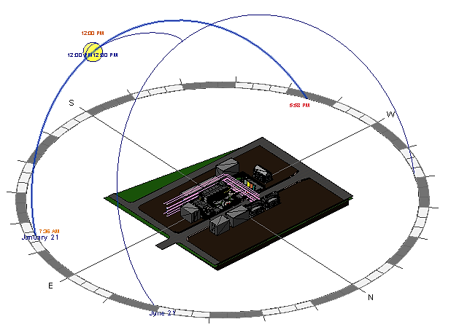
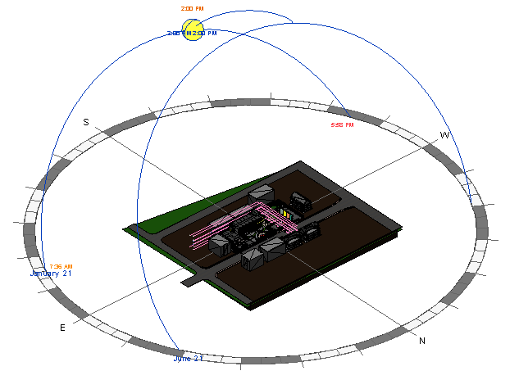
2.1 Site analysis
8 am – for both winter and summer
12 pm– for both winter and summer
2 pm– for both winter and summer

Slide 28
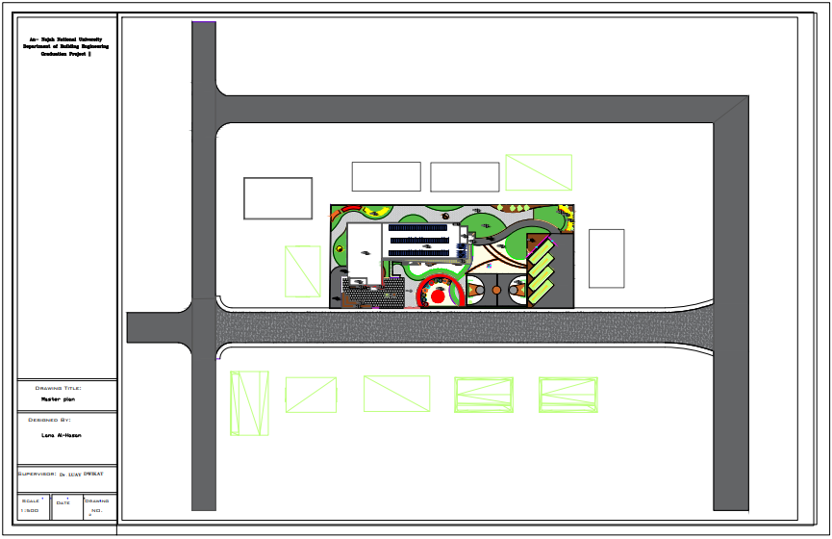
S
E
W
N
N

Slide 29





2.2 Shadowing and solar gain
21.1
12 pm
Figure.2.42. South – East, Elevation
Figure.2.37. North – East, Elevation
Figure.2.43. South – West, Elevation
Figure.2.38. North – West, Elevation

Slide 30




21.6
Figure.2.29. North – East, Elevation
Figure.2.31. South – East, Elevation
12 pm
Figure.2.30.North – West, Elevation
Figure.2.32. South – West, Elevation

Slide 31
Season | Time | Shadowing effect
 |  | South-west elevation | North-east elevation | South-east Elevation | North-west elevation
Winter | 8:00 am | 1.01 | 0.48 | 0.89 | 0.44
 | 12:00 Pm | 1.18 | 0.84 | 1.02 | 0.71
 | 2:00 Pm
summer | 8:00 am
 | 12:00 Pm
 | 2:00 Pm

Slide 32









Solar heat gain
Winter 21.1
North-West
North-East,
Roof

Slide 33






South-East
South-West

Slide 34








Summer 21.6
North-West
North-East,
Roof

Slide 35






South-East
South-West

Slide 36

Season | Time | Solar heat gain(KWh/m²)
 |  | South-west elevation | North-east elevation | South-east Elevation | North-west elevation | Roof
Winter | 8:00Am-2:00 Pm | 1.01 | 0.48 | 0.89 | 0.44 | 1.13
summer | 8:00Am-2:00 Pm | 1.18 | 0.84 | 1.02 | 0.71 | 3.89

Slide 37



Before - modification
Net Site Energy = 163.46 KWh/m2
Heating Load = 265.80 Kw
Cooling Load = 315.50 Kw
Heating Load = 265.80 Kw
Cooling Load = 315.50 Kw

Slide 38
2.3 Environmental modification
1.
Change the school function design & HVAC system.
2.
3.
4.
5.
Applying shading system and revel only.
Wall insulation only.
Roof insulation only.
Windows glass treated only.
6.
Inside Curtin louvers with medium reflectivity only.
7
Photovoltaics system used only.

Slide 39



Before modification
Change school function and HVAC system.
Net Site Energy = 122.71 KWh/m2
Heating Load = 207.49 Kw
Cooling Load = 328.35 Kw

Slide 40


Applying shading system and revel only.
Net Site Energy = 112.93 KWh/m2
Heating Load = 199.33 Kw
Cooling Load = 319.37 Kw
Wall insulation only.
Net Site Energy = 103.40 KWh/m2
Heating Load = 170.1 Kw
Cooling Load = 267.46 Kw

Slide 41


Roof Insulation only.
Net Site Energy = 108.03 KWh/m2
Heating Load = 183.82 Kw
Cooling Load = 286.84 Kw
Inside curtain louvers with medium reflectivity only.
Net Site Energy = 110.98 KWh/m2
Heating Load = 191.08 Kw
Cooling Load = 303.10 Kw

Slide 42


Glazing treated only.
Net Site Energy = 105.69 KWh/m2
Heating Load = 176.35 Kw
Cooling Load = 307.65 Kw
Photovoltaics.
Net Site Energy = 83.84 KWh/m2
Heating Load = 199.4 Kw
Cooling Load = 296 Kw

Slide 43




After all modifications
Net Site Energy = 45.92 KWh/m2
Heating Load = 75.13 Kw
Cooling Load = 149.90 Kw

Slide 44


Detailing
Walls detailing
Roof detailing

Slide 45






Glazing system
Shading system
Dbl LoE Spec Sel Clr 6mm/13mm Arg
Long-wide alucobond cantilever
Aluminum cantilever
Horizontal louvers
30 cm revel With 20 cm frame window

Slide 46

Thermal comfort
Annual comfort is in the range of 0.1 to -0.1

Slide 47

monthly comfort is in the range of 0.5 to -0.5,

Slide 48

finally that daily comfort is in the range of 1 to -0.5.

Slide 49

2.4 Daylight factor
Standard
(according to the mechanical and electrical equipment book N 40).
1.5 % * 9000 (the solar radiation reached from sun) = 135 lux
2.5 % * 9000 (the solar radiation reached from sun) = 225lux
Teaching spaces, art room, library and offices need nearly: 300 -350 lux (3.90 % : DF)
Corridors and stair case need nearly: 100 lux with white floor tiles and wall paints
Entrances: 200 lux

Slide 50





2.2 Daylight factor – Before
GF
FF
3D Mass by Revit
SF

Slide 51







Daylight factor – After
GF
3D Mass
FF
BF
SF

Slide 52











Slide 53
2.5 Heating and Cooling Loads
Heating load
 | Zone | Design Capacity (kW) | Heating load (W/m2) | Total heating load (KW)
Ground Floor | Entrance | 2.02 | 39.840 | 62.646
Ground Floor | Kg-3 | 2.21 | 45.059 | 70.851
Ground Floor | Library | 1.83 | 39.933 | 62.792
Ground Floor | Corridor 2 | 1.5 | 23.374 | 36.754
Ground Floor | Multi-purpose room | 4.41 | 55.772 | 87.697
Ground Floor | Dining room | 6.61 | 102.513 | 161.193
Ground Floor | Secretary room | 0.7 | 34.965 | 54.979
Ground Floor | Food preparation area | 0.93 | 30.760 | 48.368
Ground Floor | Wc's | 0.62 | 27.249 | 42.847
Ground Floor | Art room | 1.64 | 29.023 | 45.636
Ground Floor | Kg-2 | 1.76 | 36.746 | 57.780
Ground Floor | Kg-1 | 2.28 | 52.688 | 82.847
Ground Floor | Wc's 1 | 0.48 | 16.076 | 25.278
Ground Floor | Accountant room | 0.81 | 32.964 | 51.833
Ground Floor | Regression | 0.77 | 34.588 | 54.387
Ground Floor | Manger room | 1.13 | 45.697 | 71.855
Ground Floor | Lobby | 3.82 | 63.333 | 99.587
Ground Floor | Parents meeting room | 1.26 | 57.399 | 90.255

Slide 54
 | Zone | Design Capacity (kW) | Heating load (W/m2) | Total heating load (KW)
First Floor | WC's | 0.56 | 22.735 | 35.749
First Floor | Wc's | 0.65 | 23.403 | 36.800
First Floor | Class9 | 1.42 | 50.480 | 79.375
First Floor | Class8 | 1.34 | 44.122 | 69.378
First Floor | Class7 | 1.6 | 52.000 | 81.766
First Floor | Class6 | 1.17 | 38.272 | 60.180
First Floor | Class5 | 1.57 | 53.445 | 84.038
First Floor | Class4 | 1.19 | 40.384 | 63.501
First Floor | Art room | 1.61 | 47.297 | 74.370
First Floor | Class3 | 1.57 | 53.843 | 84.663
First Floor | Class2 | 1.24 | 41.161 | 64.722
First Floor | Class1 | 1.53 | 53.419 | 83.996
First Floor | Teachers room | 1.83 | 34.906 | 54.887
 | Zone | Design Capacity (kW) | Heating load (W/m2) | Total heating load (KW)
Second Floor | Wc | 0.86 | 35.154 | 55.277
second Floor | Teachers room | 2.43 | 46.344 | 72.872
second Floor | Class9 | 1.82 | 62.679 | 98.557
second Floor | Class8 | 1.91 | 63.646 | 100.079
second Floor | Class7 | 1.79 | 61.553 | 96.787
second Floor | Class6 | 1.85 | 62.203 | 97.810
second Floor | Art room | 1.95 | 57.410 | 90.272
second Floor | Wc's | 1.15 | 43.218 | 67.957
second Floor | Class5 | 1.69 | 57.630 | 90.619
second Floor | Class4 | 1.83 | 58.409 | 91.844
second Floor | Class3 | 1.91 | 61.109 | 96.089
second Floor | Class2 | 1.94 | 62.985 | 99.038
second Floor | Class1 | 1.94 | 63.078 | 99.185

Slide 55
Cooling load
 | Zone | Design Capacity (kW) | Total Cooling Load (kW) | Design Cooling (W/m2)
Ground Floor | Entrance | 2.65 | 2.3 | 52.2
Ground Floor | Kg-3 | 1.53 | 1.33 | 31.2
Ground Floor | Library | 3.27 | 2.85 | 71.5
Ground Floor | Corridor 2 | 4 | 3.48 | 62.2
Ground Floor | Multipurpose room | 3.77 | 3.28 | 47.6
Ground Floor | Dining room | 1.45 | 1.26 | 22.5
Ground Floor | Secretary room | 2.4 | 2.09 | 120.5
Ground Floor | Food preparation area | 4.95 | 4.3 | 164.1
Ground Floor | Wc's | 1.09 | 0.95 | 47.9
Ground Floor | Art room | 4.92 | 4.28 | 87
Ground Floor | Kg-2 | 5.79 | 5.04 | 120.7
Ground Floor | Kg-1 | 5.41 | 4.7 | 125.2
Ground Floor | Wc's 1 | 2.14 | 1.86 | 72.2
Ground Floor | Accountant room | 1.54 | 1.34 | 62.5
Ground Floor | Regression | 1.4 | 1.22 | 63.1
Ground Floor | Manger room | 2.56 | 2.22 | 103.2
Ground Floor | Lobby | 5.52 | 4.8 | 91.4
Ground Floor | Parents meeting room | 0.96 | 0.84 | 43.8

Slide 56
 | Zone | Design Capacity (kW) | Total Cooling Load (kW) | Design Cooling (W/m2)
First Floor | WC's | 1.88 | 1.63 | 75.8
First Floor | Wc's | 1.83 | 1.59 | 65.5
First Floor | Class9 | 3.05 | 2.65 | 108.2
First Floor | Class8 | 2.87 | 2.5 | 94.9
First Floor | Class7 | 2.77 | 2.41 | 90.1
First Floor | Class6 | 3.5 | 3.05 | 114.6
First Floor | Class5 | 2.99 | 2.6 | 101.6
First Floor | Class4 | 5.49 | 4.78 | 185.8
First Floor | Art room | 4.73 | 4.11 | 139.2
First Floor | Class3 | 3.71 | 3.23 | 126.9
First Floor | Class2 | 4.09 | 3.55 | 135.3
First Floor | Class1 | 5.1 | 4.43 | 178.3
First Floor | Teachers room | 2.35 | 2.04 | 44.7
 | Zone | Design Capacity (kW) | Total Cooling Load (kW) | Design Cooling (W/m2)
second Floor | Wc | 2.57 | 2.23 | 105.3
second Floor | Teachers room | 3.99 | 3.47 | 76.3
second Floor | Class9 | 4.57 | 3.98 | 157.2
second Floor | Class8 | 3.94 | 3.43 | 131.5
second Floor | Class7 | 3.94 | 3.42 | 135.3
second Floor | Class6 | 4.6 | 4 | 155.1
second Floor | Art room | 4.65 | 4.04 | 136.9
second Floor | Wc's | 3.76 | 3.27 | 141.5
second Floor | Class5 | 3.7 | 3.21 | 126
second Floor | Class4 | 3.47 | 3.02 | 110.8
second Floor | Class3 | 3.55 | 3.09 | 113.9
second Floor | Class2 | 3.54 | 3.08 | 115
second Floor | Class1 | 3.91 | 3.4 | 127.1
Table 2.36 Heating and Cooling Load (KW)

Slide 58
Structural Analysis
:General Information
Design code:
American Concrete Institute ACI 2014 for design.
Uniform Building Code (UBC 97) is adopted the code in Earthquake Analysis.
Materials
Concrete.
f´c = 32 Mpa for columns, walls and footings
f´c = 24 Mpa for slabs and beams
Reinforcement steel (Fy = 420 Mpa)

Slide 59
Structural Analysis
General Information:
Loads
Live Load= 5 KN/m²
Superimposed dead load = 4 KN/m²
Dead load=5.74 KN / m².
External wall Load =20 KN /m.
One-way and two-way of 32cm-thickness ribbed slab will be used in this project according to every panel dimension.

Slide 60

Structural Analysis
Seismic analysis:
Seismic zone : 2A with (Z = 0.15)
Soil profile : SC
Acceleration-dependent seismic coefficients Ca=0.15.
Velocity-dependent seismic coefficients Cv= 0.25.
Importance factor I=1.
Force reduction factor R=5.5

Slide 61

Checks
Compatibility check
Equilibrium check
Internal Forces check
Deflection check
Period check
Base shear check
Drift check
All checks OK

Slide 62


Slab Structural System
One way ribbed and two way ribbed
Thickness 32cm
Hidden beams and drop beams.

Slide 63

Basement Slab

Slide 64

Slab

Slide 65

Replicated Slab

Slide 66

Moment design
use ${2∅12}/{rib}$ as bottom steel in X-direction. $M_{11}^{+}=17.36 {KN.m}/m=9.54 {KN.m}/{rib}$
use ${2∅16}/{rib}$ as top steel in X-direction.
$M_{11}^{−}=74.00 {KN.m}/m=40.70 {KN.m}/{rib}$
Shear design
ᴓVc>Vu

Slide 67

Beam System

Slide 68

Beam Detailing

Slide 69

Column

Slide 70

Column Detailing

Slide 71


Column Detailing

Slide 72

Shear Wall Design

Slide 73

Shear Wall Design

Slide 74

Footing & Tie Beam

Slide 75

Footing

Slide 76

Footings Reinforcement

Slide 77

Footings Detailing

Slide 78

Footings Detailing

Slide 79

Footings Detailing

Slide 80

Footings Detailing

Slide 81

Wall Footings Detailing

Slide 82

Tie beams desing

Slide 83

Tie beams Detailing

Slide 84

stair Detailing

Slide 85

Design of water tank
Volume= 550 m³

Slide 86


water tank Detailing

Slide 87

Design beams of water tank

Slide 88

water tank Detailing

Slide 89

Chapter 4 : Electro-Mechanical
This chapter of the project includes all the details and requirements related to the electrical and mechanical aspect; they are:

Slide 90
4.1 Artificial lighting design
artificial lighting design factor
Illuminance (lux)
Uniformity
Glare

Slide 91




Types of luminaires
rooms
storage rooms
parking
Bathroom

Slide 92

luminaires distribution
ground floor

Slide 93

First floor
second floor

Slide 94

basement floor

Slide 95


3D Views
Parents meeting room
kindergarten room

Slide 96



library
dining room
parking

Slide 97
power Design 4.2
Components of the electrical system
weirs
sockets
distrbution board
circuit breakers
load lighting and power

Slide 98


distribution of the main and branch distribution boards
position of the main distribution boards (basement)

Slide 99


The lighting power and electrical load Calculation
Basement
ground floor

Slide 100

first floor

Slide 101

The electrical load of elevators and HVAC

Slide 102
4.3Acoustic design
There are two considerations
Architectural side
Electro- acoustic side
The spaces that were designed acoustically in the faculty
Classroom
Multipurpose hall
Art \ music room

Slide 103



Multipurpose hall

Slide 104




Slide 105


Art/ music room

Slide 106


Classroom

Slide 107


4.4 Fire alarm and Firefighting systems
Evacuation ways:
Evacuation routes on the first floor
Evacuation routes on the first floor

Slide 108




Fire alarm systems

Slide 109


distribution of Fire Hose Cabinet (ground floor)

Slide 110


sprinklers system:
The selection of sprinkler

Slide 111



Slide 112


4.5 Water supply
Ground floor
first floor

Slide 113


4.6 Drainage system
Ground floor
first floor

Slide 114


4.7storm water tank
Rainwater plane for the roofs of school

Slide 115


4.8 Vertical transportation
Elevator selection

Slide 116
PV system & HVAC system
PV system used
PV system simulation – pv sys & rescreen
PV system cash flow
HVAC system used
HVAC system steps in calculating

Slide 117
Photovoltaics system

Slide 118


1.1 Pv system used
We used a pv panels on the building roof.
79 photovoltaics panel shall be used, each on produce 345 wp
Monocrystalline silicon with 24% cell efficiency and 14-17.5 % module efficiency
Dimension: (L=1.95 m, W=0.95 m, D=0.04m)
By Landscape – distribution way we need 79 panel, by Portrait we need 68 panel.
Orientation: South with fixation angle of 35 degree (as winter semester needed angle)
The goal is not producing the maximum, it’s how to selected the orient and fixation angle that will produce energy during all the solar hour-year.

Slide 119

79 panel each one produces 345 wp, all of them= 27.26 kwp
Assume that every day there is 8 hours’ solar radiation gain from sun in Jordan
27.26 kwp * 8 hr = 218.04 kwp/day
218.04 kwp/day * 365 day = 79,584.6 kwp
Assume that 20% dropped: from the year – the sky will be partially/totally clouded and fro the inverter efficiency and maintenance
79,584.6 kwp * 80 % = 63,667.68 kwp / yearly

Slide 120



1.2 Pv system- pv sys. and Rest screen
Pv sys
Produced Energy 58.89 MWh/year
Performance ratio 74%

Slide 121


Ret Screen

Slide 122



Ret Screen – Financial visibility

Slide 123
HVAC system

Slide 124
HVAC VRF system,
The following information have been collecting from Design Builder simulation summary:
Relative humidity is between (30-50) %
21° in winter and 24° in summer
Total cooling capacity = 130.36 kw
Total heating capacity = 75.13 kw
Using these steps:
Design capacity, total load and volumetric flow rate
Diffusers needed for each space
Fresh air
Fan coil unit
Ducted sizes

Slide 125
Design capacity, total load and volumetric flow rate
 | Zone | Design Capacity (kW) | Heating load (W/m2) | Total heating load (KW) | Mass Flow rate (Kg/s) | Volume Flow rate (m3/s)
G.F | Entrance | 2.02 | 39.840 | 62.646 | 0.25 | 0.205
G.F | Kg-3 | 2.21 | 45.059 | 70.851 | 0.27 | 0.224
G.F | Library | 1.83 | 39.933 | 62.792 | 0.22 | 0.186
G.F | Corridor 2 | 1.5 | 23.374 | 36.754 | 0.18 | 0.152
G.F | Multipurpose room | 4.41 | 55.772 | 87.697 | 0.54 | 0.447
G.F | Dining room | 6.61 | 102.513 | 161.193 | 0.81 | 0.671
G.F | Secretary room | 0.7 | 34.965 | 54.979 | 0.09 | 0.071
G.F | Food preparation | 0.93 | 30.760 | 48.368 | 0.11 | 0.094
G.F | Wc's | 0.62 | 27.249 | 42.847 | 0.08 | 0.063
G.F | Art room | 1.64 | 29.023 | 45.636 | 0.20 | 0.166
G.F | Kg-2 | 1.76 | 36.746 | 57.780 | 0.21 | 0.179
G.F | Kg-1 | 2.28 | 52.688 | 82.847 | 0.28 | 0.231
G.F | Wc's 1 | 0.48 | 16.076 | 25.278 | 0.06 | 0.049
G.F | Accountant room | 0.81 | 32.964 | 51.833 | 0.10 | 0.082
G.F | Regrestration | 0.77 | 34.588 | 54.387 | 0.09 | 0.078
G.F | Manger room | 1.13 | 45.697 | 71.855 | 0.14 | 0.115
G.F | Lobby | 3.82 | 63.333 | 99.587 | 0.47 | 0.388
G.F | Parents meeting room | 1.26 | 57.399 | 90.255 | 0.15 | 0.128

Slide 126
Diffusers needed for each space
 | Zone | Design Flow rate m3/s | Space Flow rate m3/s | # diffuser | # diffuser
G.F | Entrance | 0.167 | 0.205 | 1.23 | 2.00
G.F | Corridor 2 | 0.167 | 0.152 | 0.91 | 1.00
G.F | Lobby | 0.189 | 0.388 | 2.05 | 2.00
G.F | Library | 0.150 | 0.186 | 1.24 | 2.00
G.F | Multipurpose room | 0.306 | 0.447 | 1.46 | 2.00
G.F | Dining room | 0.333 | 0.671 | 2.01 | 2.00
G.F | Parents meeting room | 0.136 | 0.128 | 0.94 | 1.00
G.F | Food preparation area | 0.147 | 0.094 | 0.64 | 1.00
G.F | Art room | 0.150 | 0.166 | 1.11 | 2.00
G.F | Kg-1 | 0.153 | 0.231 | 1.51 | 2.00
G.F | Kg-2 | 0.150 | 0.179 | 1.19 | 2.00
G.F | Kg-3 | 0.153 | 0.224 | 1.47 | 2.00
G.F | Wc | 0.142 | 0.049 | 0.35 | 1.00
G.F | Wc | 0.142 | 0.063 | 0.44 | 1.00
G.F | Secretary room | 0.142 | 0.071 | 0.50 | 1.00
G.F | Accountant room | 0.142 | 0.082 | 0.58 | 1.00
G.F | Regrestration | 0.142 | 0.078 | 0.55 | 1.00
G.F | Manger room | 0.142 | 0.115 | 0.81 | 1.00

Slide 127
Fresh air
 | Zone | Fresh air/person(L/s) | #of students | Fresh air/person(L/s)
G.F | Library | 5.000 | 30.000 | 150.000
G.F | Multipurpose room | 5.000 | 40.000 | 200.000
G.F | Dining room | 5.000 | 40.000 | 200.000
G.F | Parents meeting room | 8.000 | 20.000 | 160.000
G.F | Food preparation area | 8.000 | 2.000 | 16.000
G.F | Art room | 5.000 | 20.000 | 100.000
G.F | Kg-1 | 5.000 | 25.000 | 125.000
G.F | Kg-2 | 5.000 | 25.000 | 125.000
G.F | Kg-3 | 5.000 | 25.000 | 125.000
G.F | Wc | 5.000 | 6.000 | 30.000
G.F | Wc | 8.000 | 6.000 | 48.000
G.F | Secretary room | 8.000 | 1.000 | 8.000
G.F | Accountant room | 8.000 | 1.000 | 8.000
G.F | Regrestration | 8.000 | 1.000 | 8.000
G.F | Manger room | 8.000 | 1.000 | 8.000

Slide 128
Fan coil unit
 | Zone | Design Flow rate m3/s | Space Flow rate m3/s | #Fan coil unit | #Fan coil unit
G.F | Entrance | 0.185 | 0.205 | 1.11 | 1.00
G.F | Corridor 2 | 0.185 | 0.152 | 0.82 | 1.00
G.F | Lobby | 0.185 | 0.388 | 2.10 | 2.00
G.F | Library | 0.185 | 0.186 | 1.01 | 1.00
G.F | Multipurpose room | 0.185 | 0.447 | 2.42 | 3.00
G.F | Dining room | 0.185 | 0.671 | 3.63 | 4.00
G.F | Parents meeting room | 0.185 | 0.128 | 0.69 | 1.00
G.F | Food preparation area | 0.185 | 0.094 | 0.51 | 1.00
G.F | Art room | 0.185 | 0.166 | 0.90 | 1.00
G.F | Kg-1 | 0.185 | 0.231 | 1.25 | 1.00
G.F | Kg-2 | 0.185 | 0.179 | 0.97 | 1.00
G.F | Kg-3 | 0.185 | 0.224 | 1.21 | 1.00
G.F | Wc | 0.185 | 0.049 | 0.27 | 1.00
G.F | Wc | 0.185 | 0.063 | 0.34 | 1.00
G.F | Secretary room | 0.185 | 0.071 | 0.38 | 1.00
G.F | Accountant room | 0.185 | 0.082 | 0.44 | 1.00
G.F | Regrestration | 0.185 | 0.078 | 0.42 | 1.00
G.F | Manger room | 0.185 | 0.115 | 0.62 | 1.00

Slide 129
Ducted sizes
Duct | Volumetric flow rate (L/s) | ΔP/EL | Velocity (m/s) | Duct size (mm * mm) | D (mm)
Main | 726 | 0.61 | 5.3 | (400*1050) | 500
B1 | 475 | 0.61 | 4.11 | (450*1550) | 600
B1 | 200 | 0.61 | 2.89 | (270*1135) | 600
B3 | 235 | 0.61 | 2.89 | (270*1135) | 600

