Slide 1
Omnspector
Omni Environment Inspector
Prepared by:
Noor Sadaqa & Alia Tuqan
Supervised by:
Dr. Suleiman Abu Kharmeh

Slide 2
Outlines
Main features
Tools
Project structure
Constraints
Future work
Conclusion

Slide 3
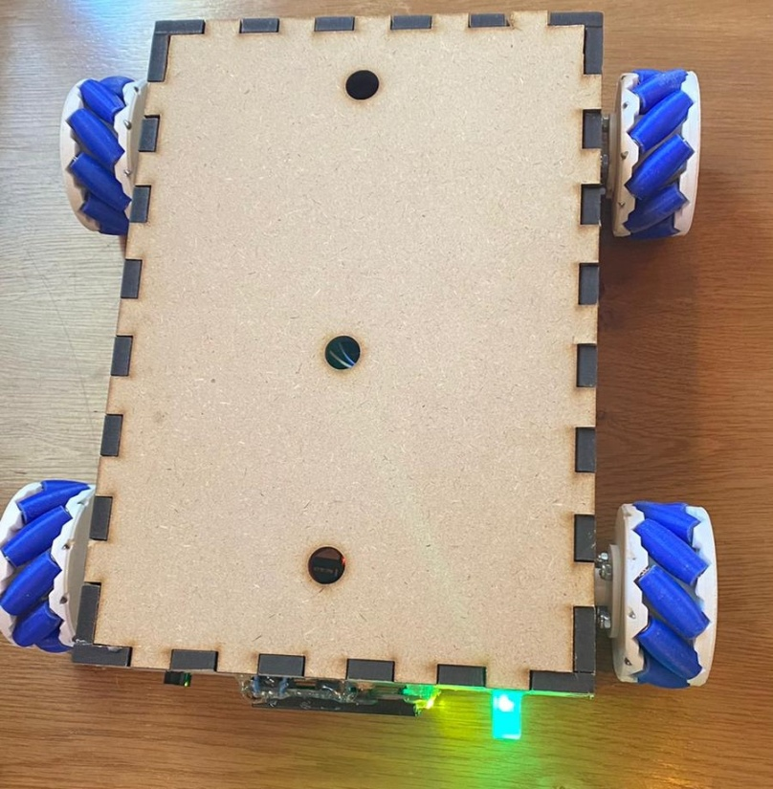
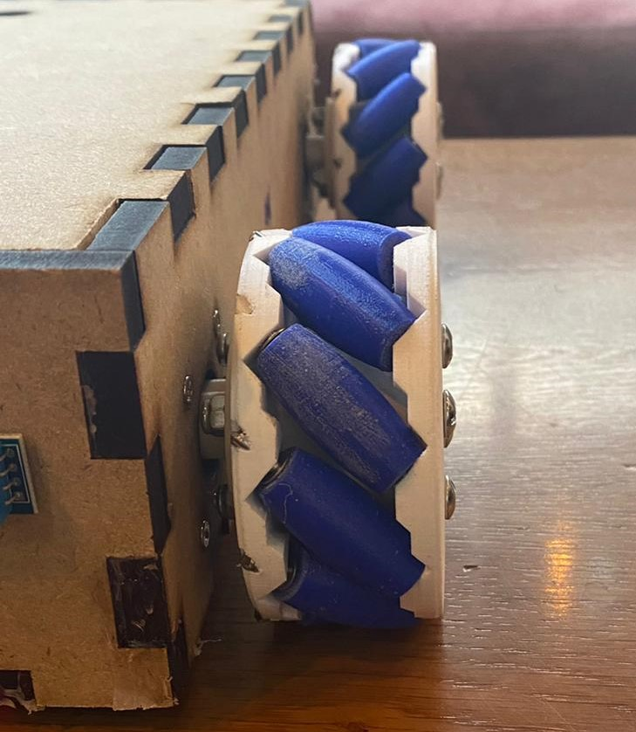
Main features
Omnspector is a robot with special 3D printed wheels that enable it to move in all directions.

Slide 4
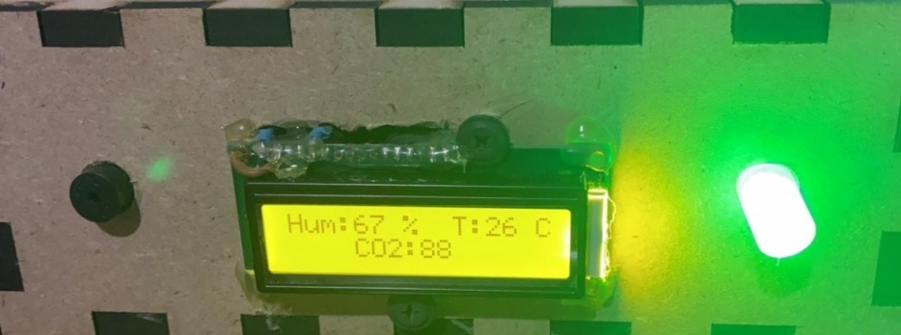


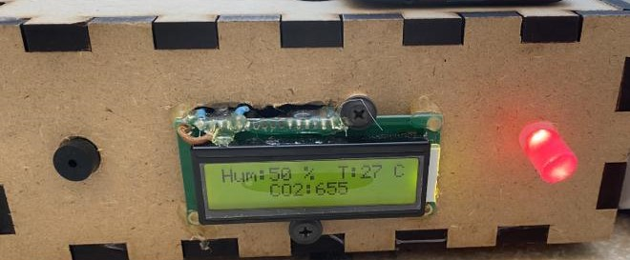
Main features
Measure the gas concentration, temperature, humidity and indicate if there is a danger.

Slide 5
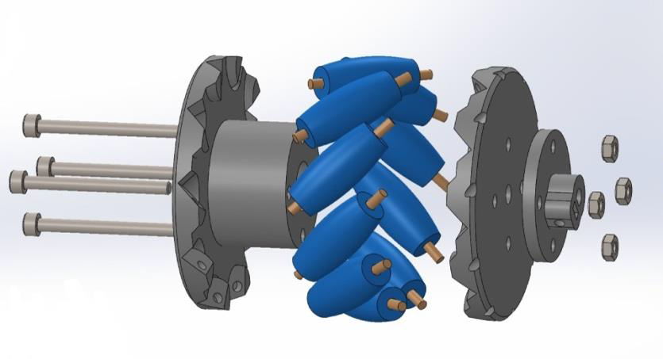

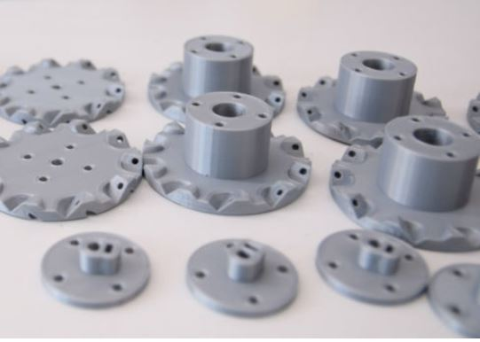
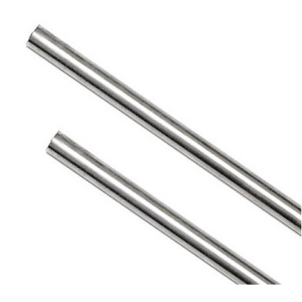
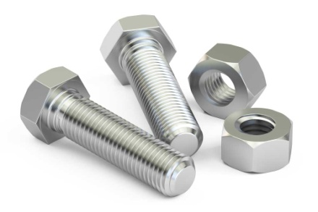
Tools
3D printed wheels
Bolts and nuts
3D printed Rollers
3D printed circumference
Rods

Slide 6
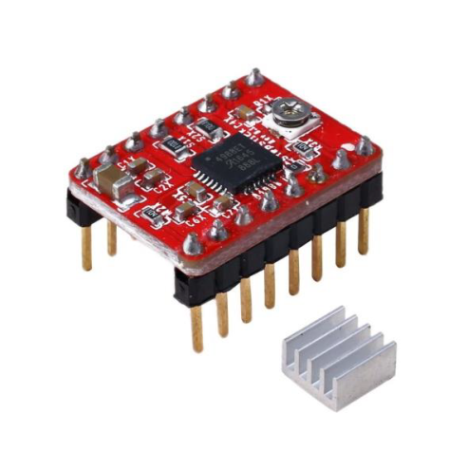
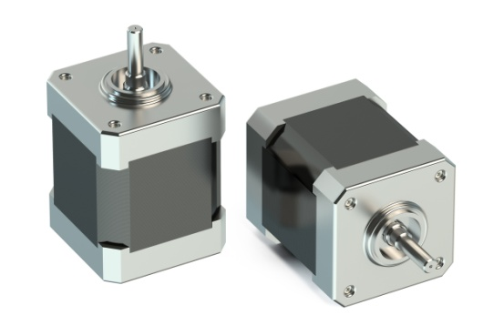
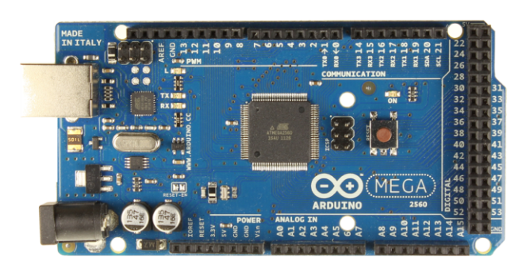
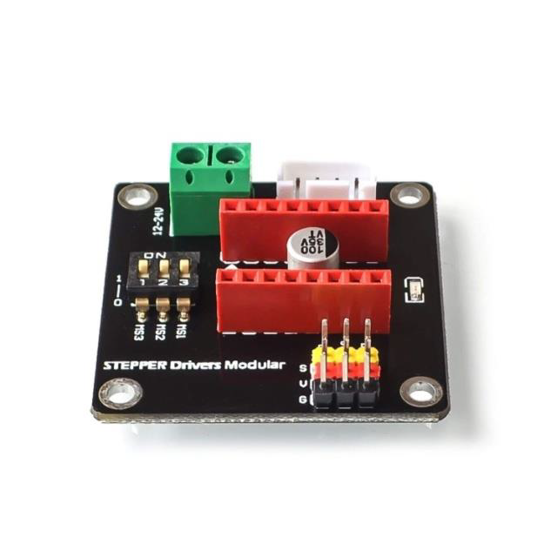
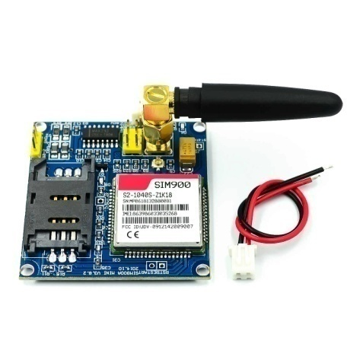
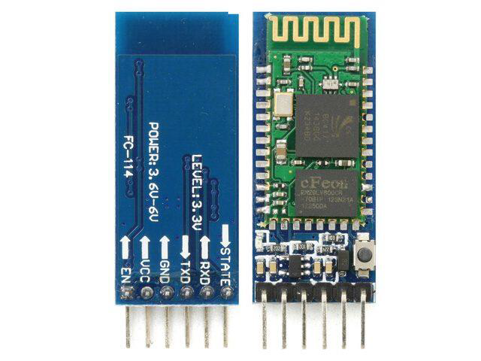
Tools
Arduino Mega
Stepper Motors
Stepper Motor Driver
Bluetooth Module (HC-06)
Stepper Motor Expansion Board
Sim900 gsm module

Slide 7
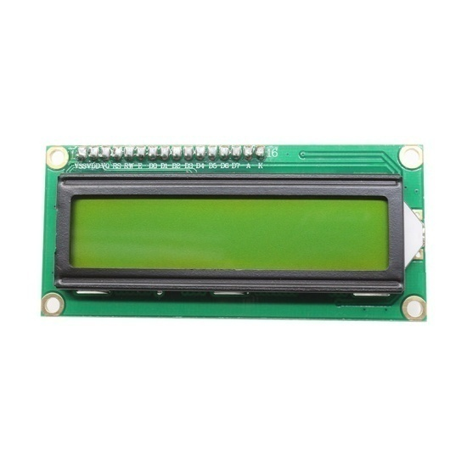
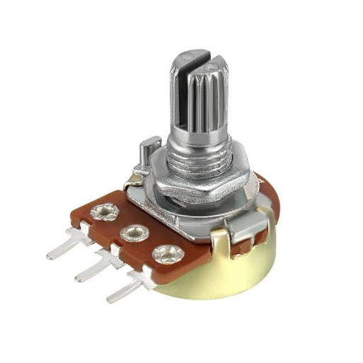
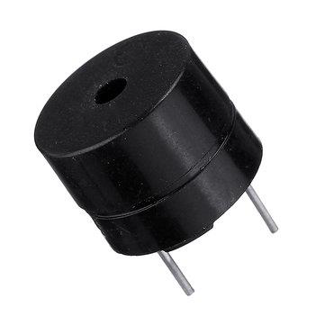
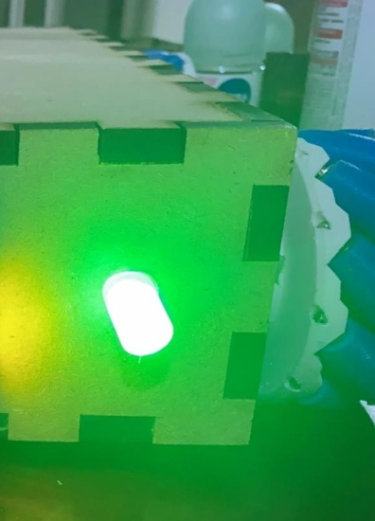
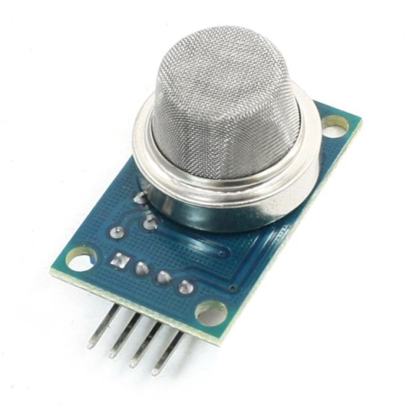
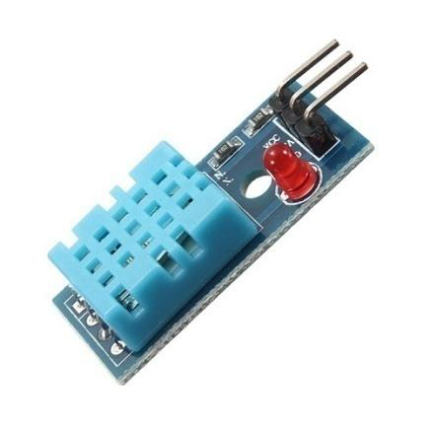
Tools
LCD
Variable resistor
Buzzer
DHT11 sensor
MQ gas sensor
LED

Slide 8
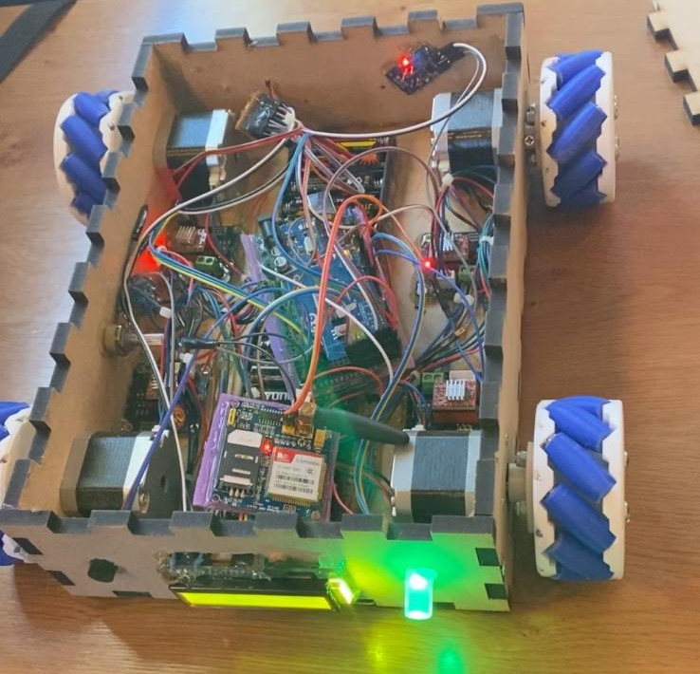
Project Structure
The structure of our project is divided into three phases which are mechanical part, electrical part and software part.

Slide 9
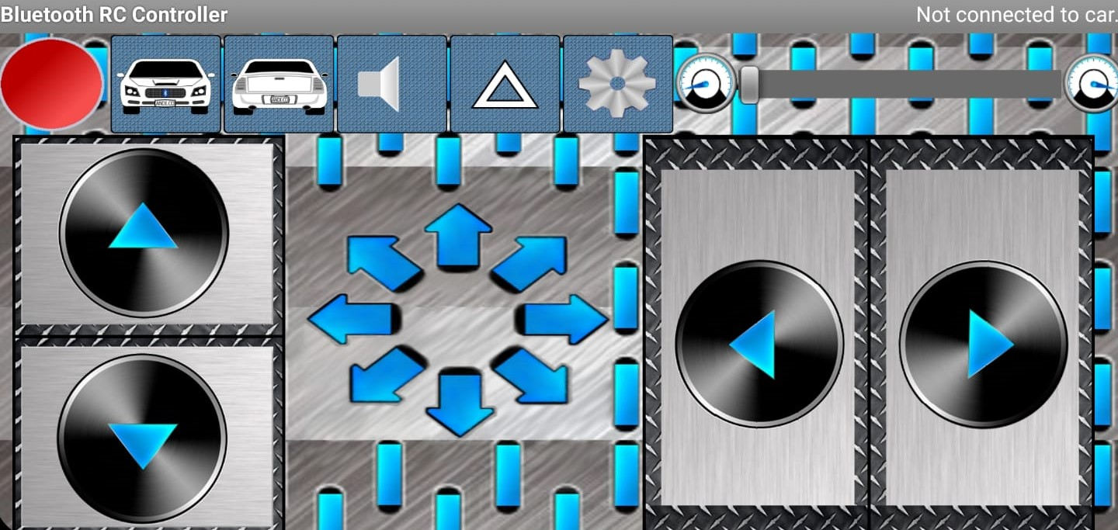
Project Structure
In software part we use Bluetooth RC Controller application to control robot movement.

Slide 10
Constraints
Mechanical part
Difficulties to find the desired threaded rods with fixed diameter.
Controlling speed of stepper motors.
3D printed wheels couldn’t move on every type of floor.

Slide 11
Future work
Providing image processing and an arm for moving goods from the desired source to the desired destination.
Adding some more advanced sensors.
Apply the idea on ambulance cars to help in not getting stuck in traffic.

Slide 12
Conclusion
In our project, we designed an Arduino-controlled robot that mainly focuses on keeping an eye on air conditions and hazardous situations and moves freely without being an obstacle and make it hard for workers to stumble and it also can move in any direction.

Slide 13
Thank You

