Slide 1
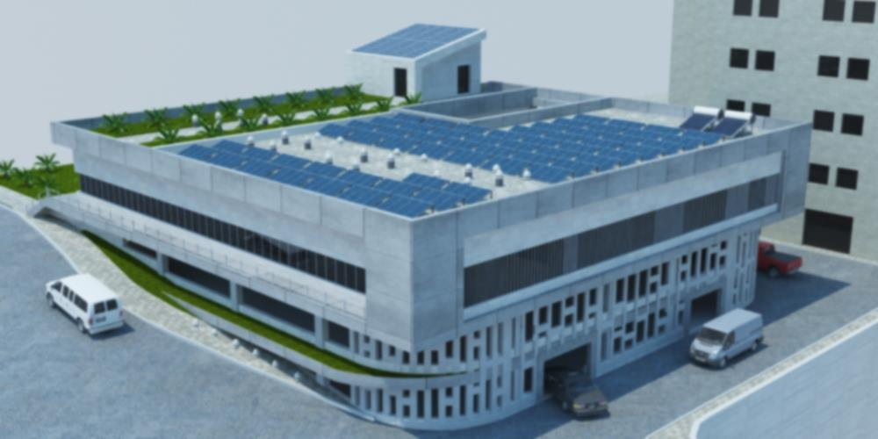
Green parking
Graduation Project 2
Prepared by:
Saja M. Sawafta
Ayat daher
Ameera mousa
Maisa sawafta
Supervisor : Dr. Muhannad Haj Hussien

Slide 2
Outline:
Introduction
Structural Design
Environmental Design
Mechanical Design
Architectural Design
Electrical Design

Slide 3
Introduction and objectives
1. Prepare and finalize the architectural design considering all other aspects of design.
2. Conduct an environmentally friendly structure as much as possible.
3. The design will respect the recommended value and standard for the different aspects
4. Solve most common problems in the existing parking.
5. Design a bridge to connect our parking to the engineering faculty.
6. Well integration for our proposed parking in the university campus

Slide 4
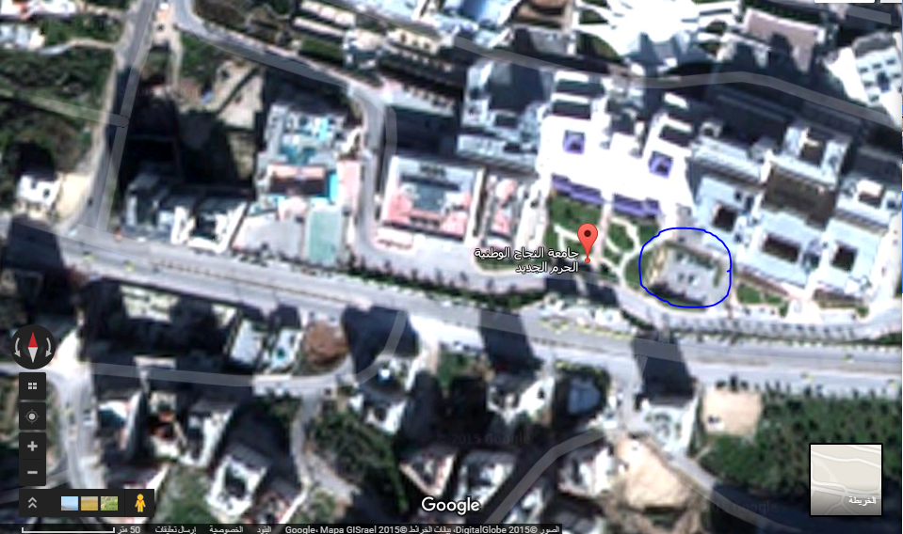
Site location:
Location: Site is located to the southern-west of Nablus city, the area of the site is 724m²

Slide 5
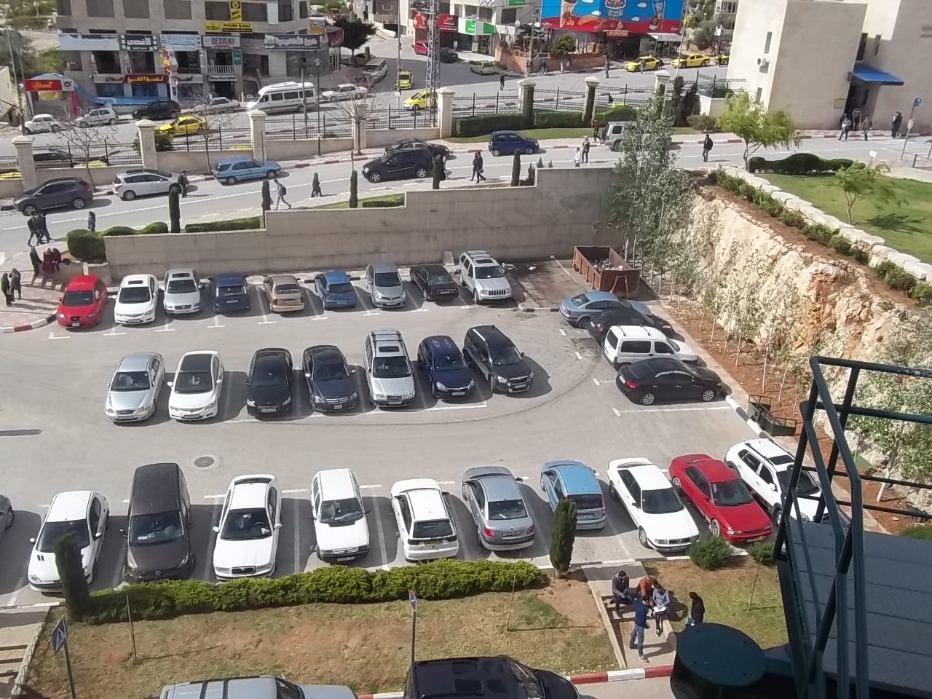
Site location:

Slide 6
Site advantages:
1- Easily access for cars.
2- The slope of the land is moderate.
3- No surroundings of high building that prevent sun and wind.

Slide 7
Architectural Design

Slide 8
project
Parking
4 floors
B2 , B1 , Gf , F1
Offices and drawing room
1 floor
F2

Slide 9
Parking level Programming
Item | number | dimensions | Total Estimated Area (m2)
Car | 100 | 5.5*2.5 | 1375
Elevators | 2 | 3*2.5 | 15 *4 = 60
Staircase | 1 | 2.5*5.5 | 13.75* 4 = 55
Ramps | The percentage 46 % |  | 2011.1
Total estimated area |  |  | 3501

Slide 10
Offices level Programming
Item | number | dimensions | Estimated total Area (m²)
Class room | 5 | 10*13.5 & 7.5*13.5 7*13.5 & 7.1*13.5 7*13.5 | 531.8
Offices (Privet) | 4 | 2.4 *4.2 | 40.32
Offices (General) | 1 | 3.36*5.58 | 18.7
W.Cs | 2 | 3.9*4.9 &5.3*7.6 | 59.39
Circulation and corridors. | Percentage = 21% |  | 228.3
Total estimated area |  |  | 878.51

Slide 11
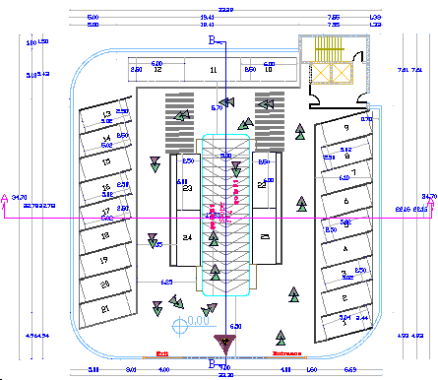
Parking plan

Slide 12
Vertical transportation
Stairs: The parking has one staircase which could be used by both students and employees.
Elevators: We use two elevators for both doctors and student.
Ramps: After trying different scenarios with different types of ramps, we find that type B is the very appropriate type from the circulation, movement and size capacity. This ramp is designed for two way traffic movements with slope17%.

Slide 13
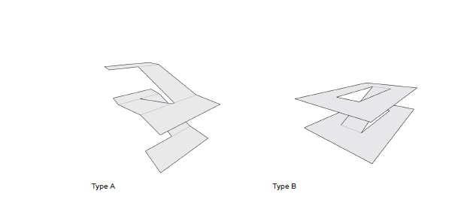
type B ramp

Slide 14
parking layout

Slide 15
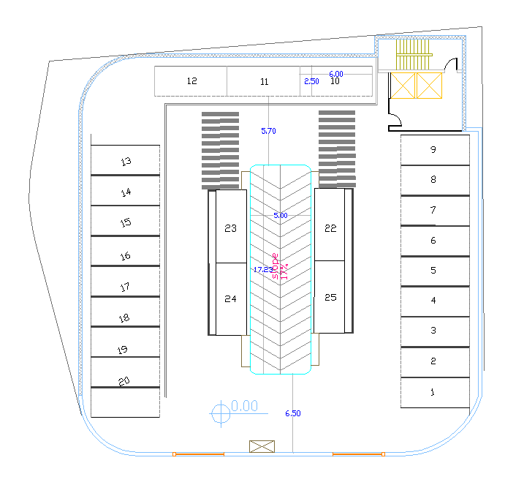
Perpendicular (90 degree)

Slide 16
Angled 75 Degree

Slide 17
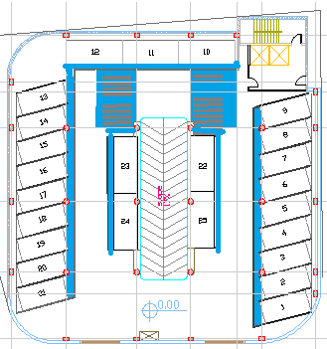
Parking specification
1- Access and exit for pedestrian

Slide 18

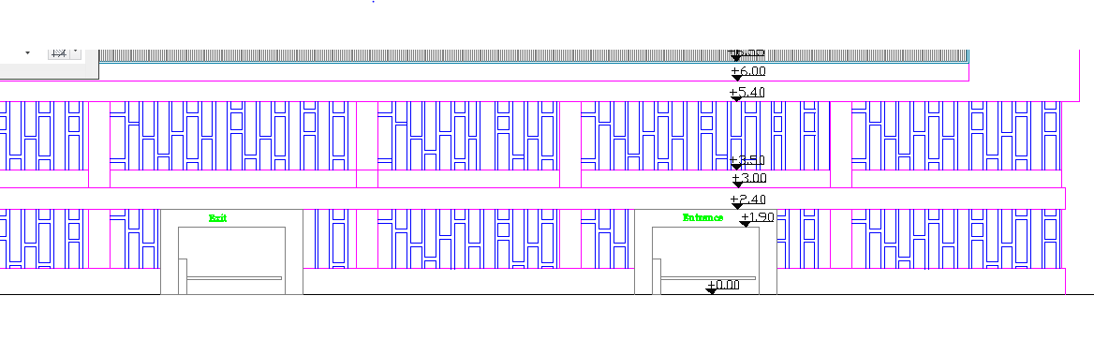

Slide 19
Parking dimensions
Standard dimensions of vehicles :-
Type of vehicles | dimensions
Car | 2.4 meters x 4.8 meters
Light Vans | 2.4 meters x 5.5 meters
Articulated Vehicles | 3.5 meters

Slide 20
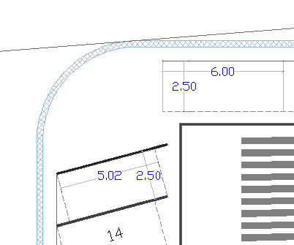
We used this 2.5 *5.5 m for each car park with 75 angled and 2.5*6 with angled 90 degree

Slide 21
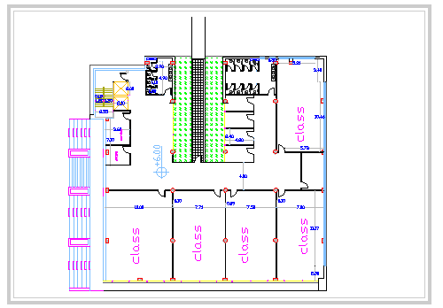
offices and drawing classes level plan

Slide 22
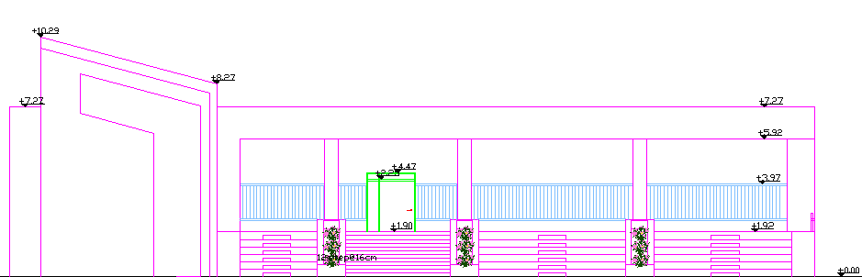
Elevations
west elevation

Slide 23
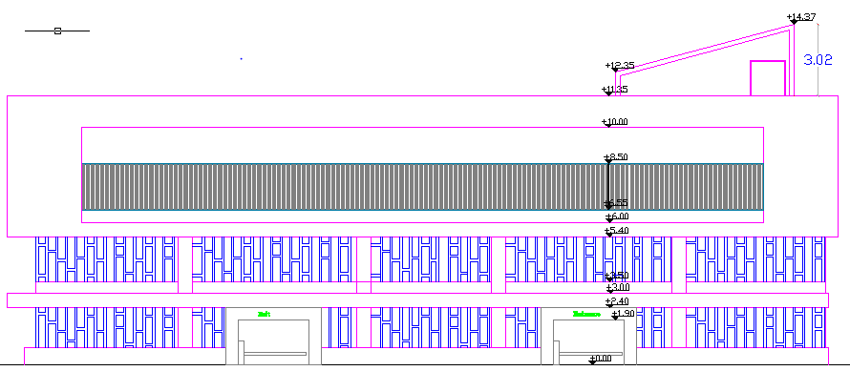
east elevation

Slide 24
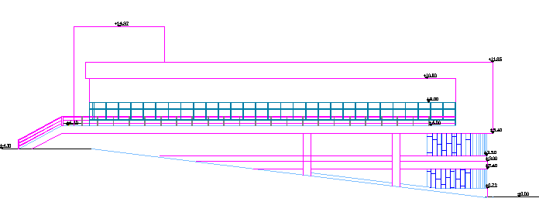
South elevation

Slide 25
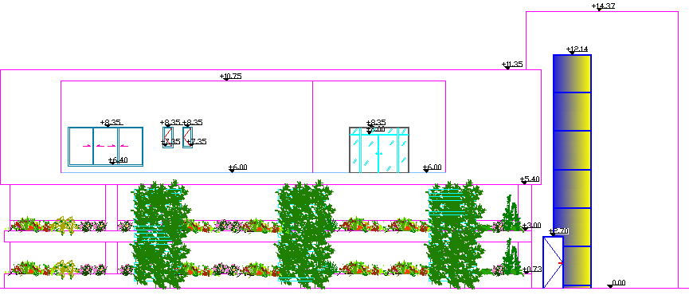
North Elevation

Slide 26
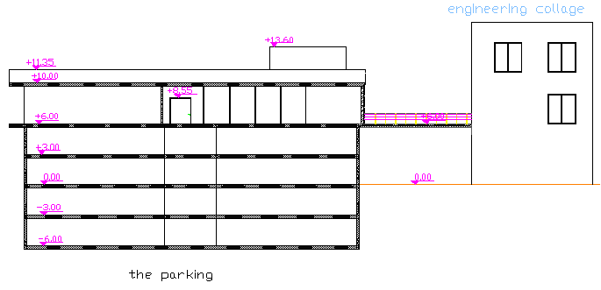
Sections
section A-A

Slide 27
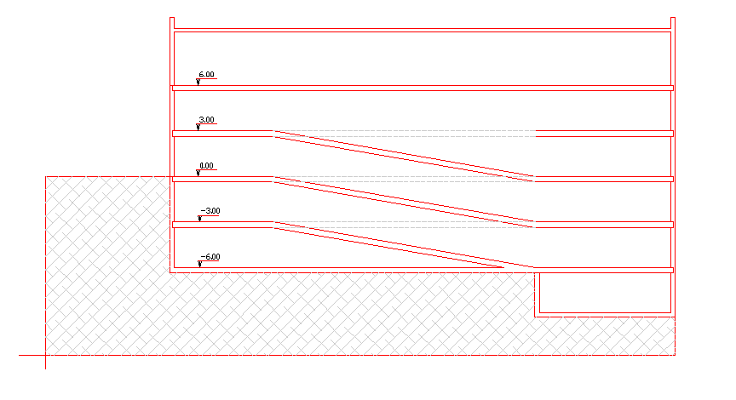
section B-B

Slide 28
Three dimension views

Slide 29
south –east elevation

Slide 30
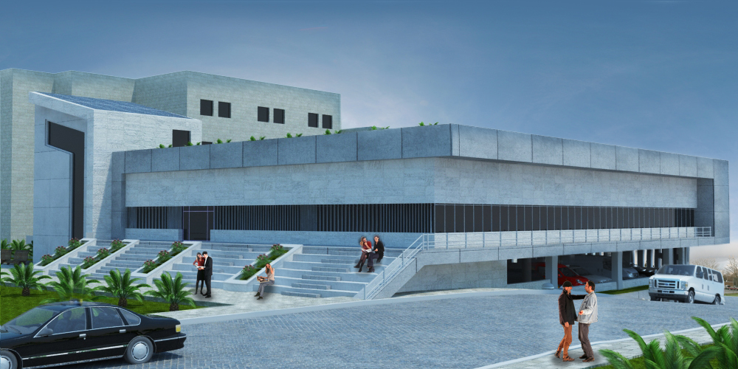
west-south elevation

Slide 31
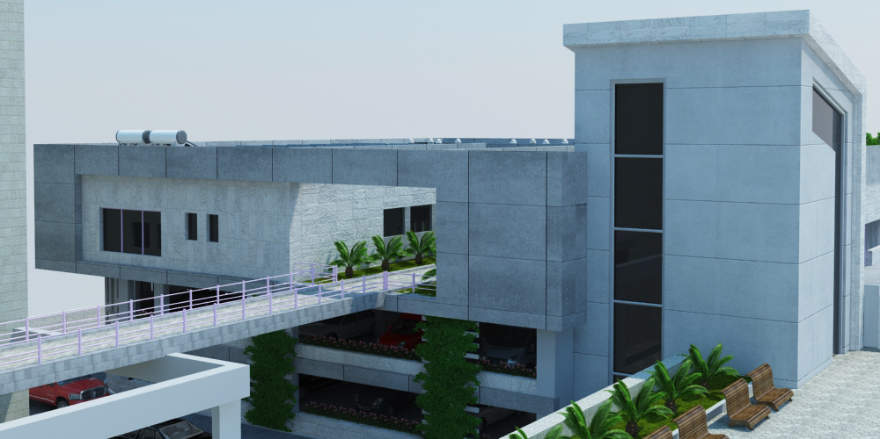
north elevation

Slide 32
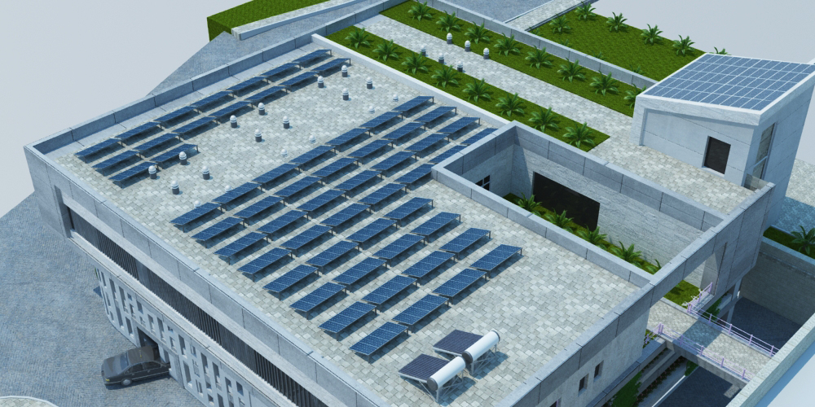
roof shot

Slide 33
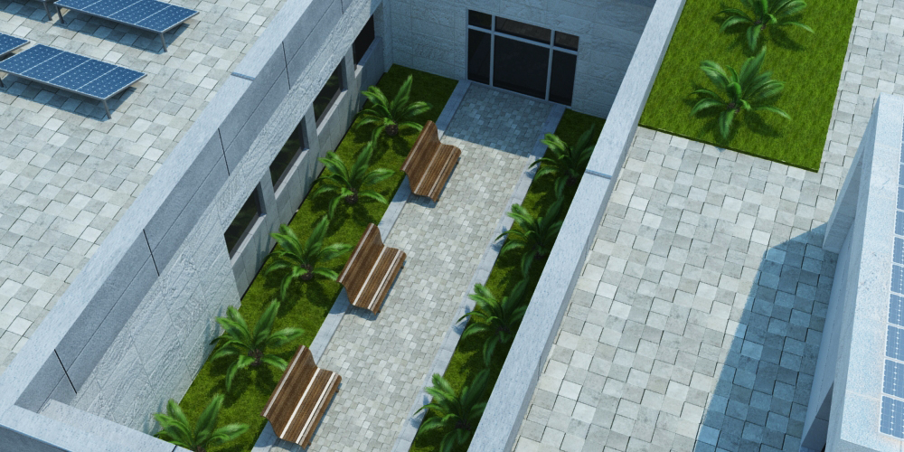
Garden- offices level shot

Slide 34
Structural Design

Slide 35
Structural Design:
Design Codes:
ACI -318-08 (American Concrete Institution) for reinforced concrete structural design.
UBC-97 (Uniform Building Code) for earthquake load computations.

Slide 36
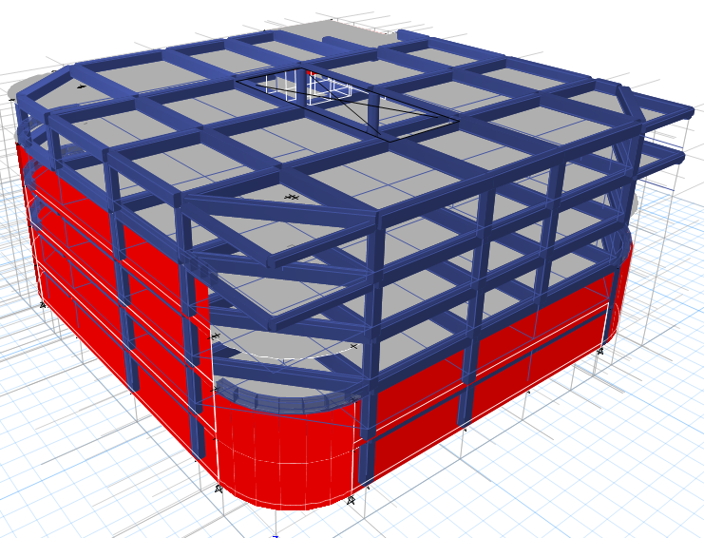
Structural Design:
Building Description:

Slide 37
Structural Design:
Material :
concrete
Reinforcement steel
Property | Value
Compressive strength of concrete, (f’c)
Modulus of elasticity, (Ec)
Unit weight of plain concrete,
Unit weight of reinforced concrete,
Property | Value
Yield strength (fy)
Modulus of elasticity, (Ec)

Slide 38
Structural Design:
Types of loads:
Type of load | Load KN/m²
Live load | 4 KN/m²
Super imposed dead load | 3 KN/m²

Slide 39
Structural Design:
Structural System:
The system of the slab is two way slab(35 cm thickness) with Drop beams 65 cm

Slide 40
Structural Design:
ETABS model:

Slide 41
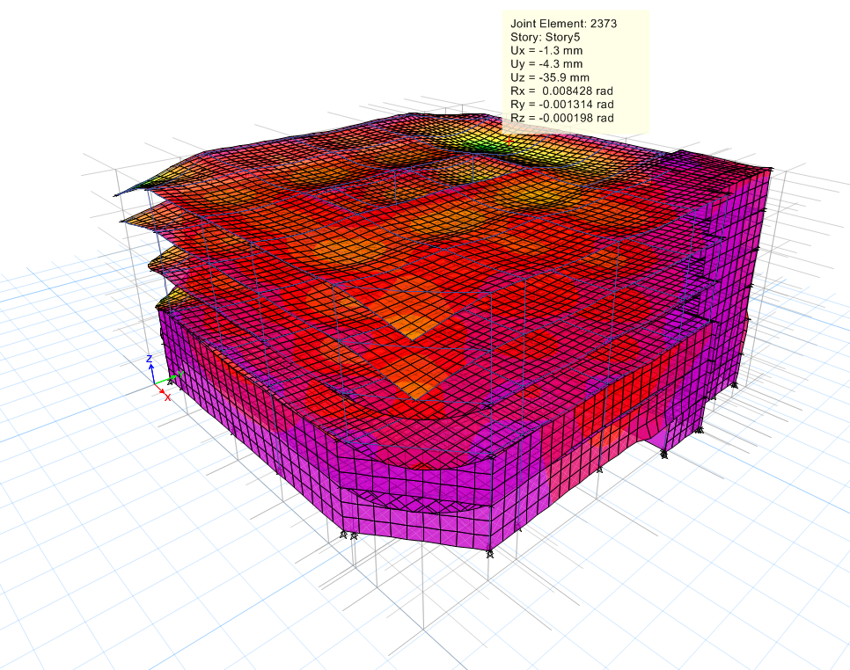
Structural Design:
Compatibility check

Slide 42
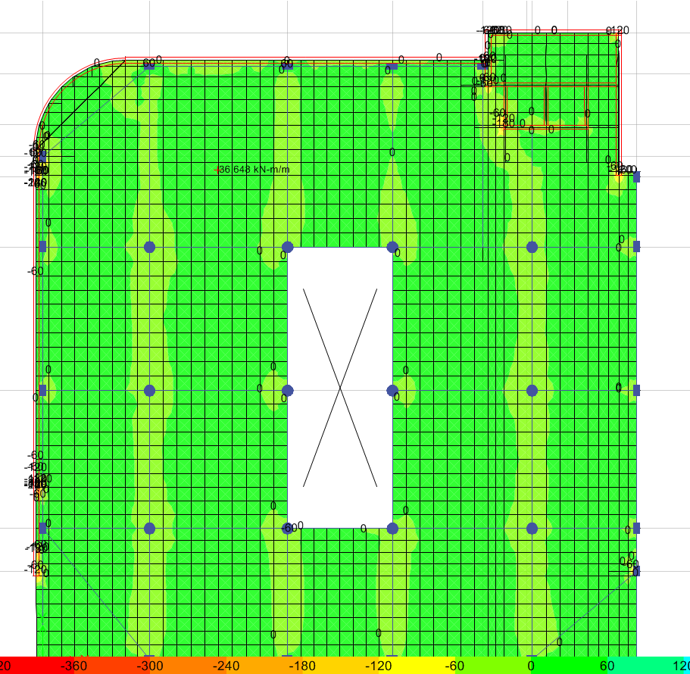
Structural Design:
Deflection check:

Slide 43
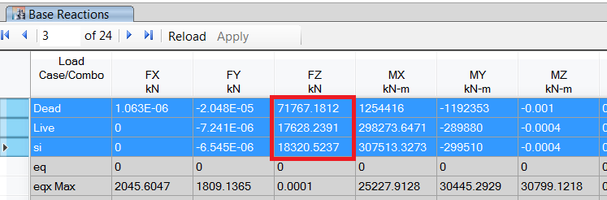
Structural Design:
Equilibrium check:
Load type | Hand results KN | SAP results KN | Difference %
Dead | 74977 | 71767.2 | 4.28%
Super imposed | 18345 | 18320.5 | 0.13%
Live | 18169.13 | 17628.2 | 2.98%

Slide 44
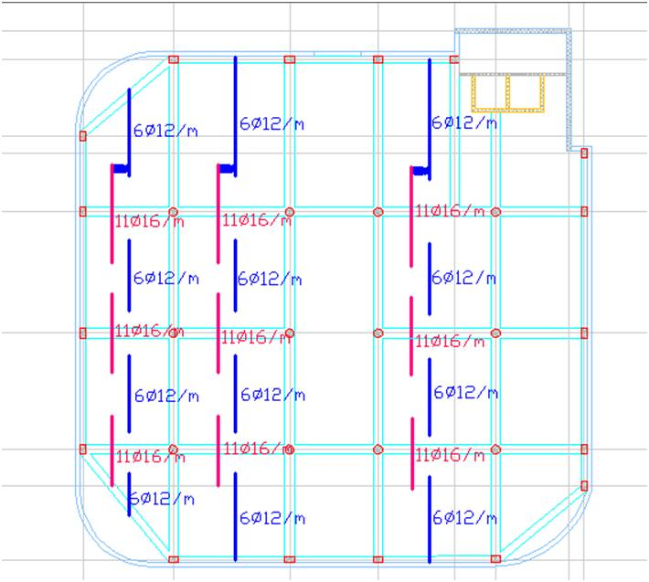
Structural Design:
Slab reinforcement

Slide 45
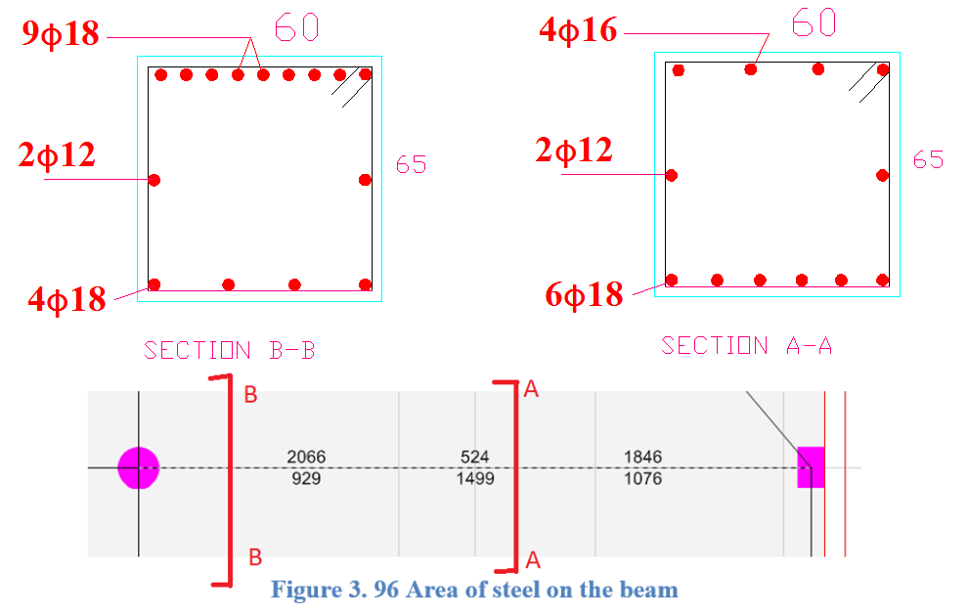
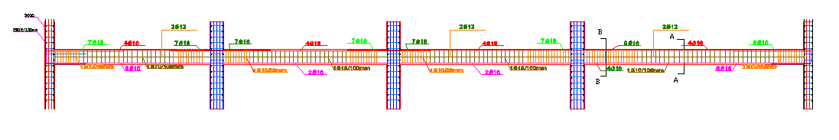
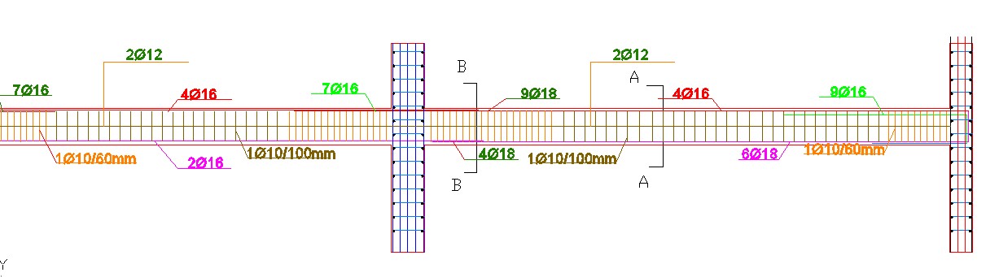
Structural Design:
Beam reinforcement

Slide 46
Column grouping
Group number | Section dimension (m) | Column number | Axial force rang (kN)
1 | 600X400 | C1,C5, C6, C28,C29 | Less than 1000
2 | 600X400 | C2,C3, C12, C24 | 1000-1999
3 | 600X400 | C4,C7,C13, C18, C19,C26, C27 | 2000-2999
4 | 600X400 | C25 | 3000-3999
5 | 600 | C9,C15,C16 | 3000-3999
6 | 700 | C21, C22 | 4000-5000
7 | 800 | C8,C10, C11,C14,C17,C20, C23 | 6000-7000

Slide 47
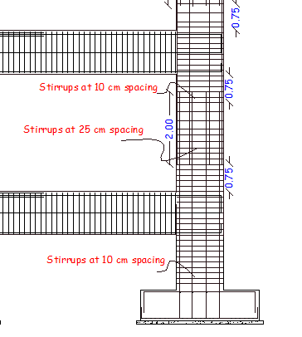
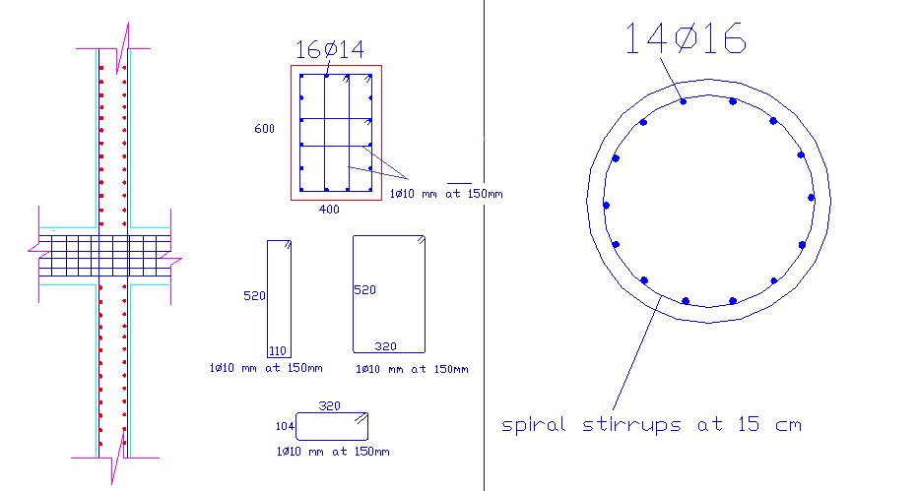
Structural Design:
Column reinforcement

Slide 48
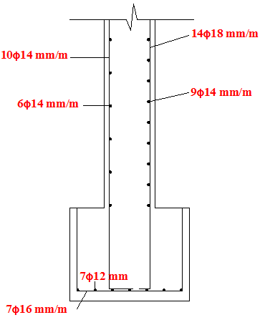
Structural Design:
shear wall reinforcement

Slide 49
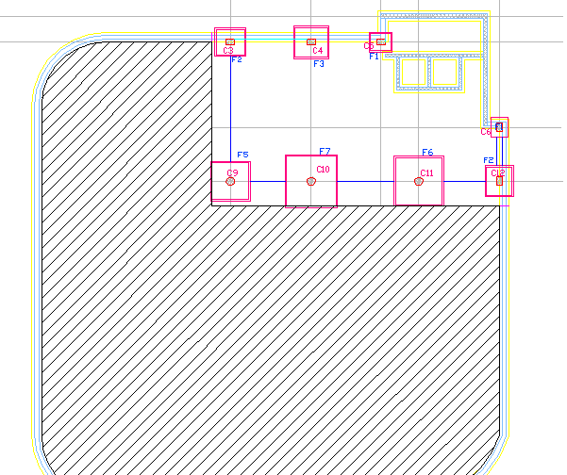
Structural Design:
Footing layout

Slide 50
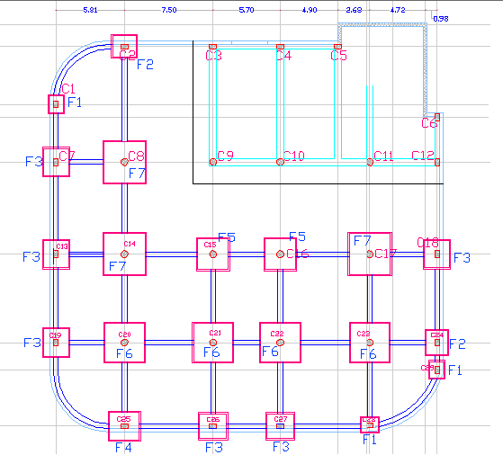

Slide 51
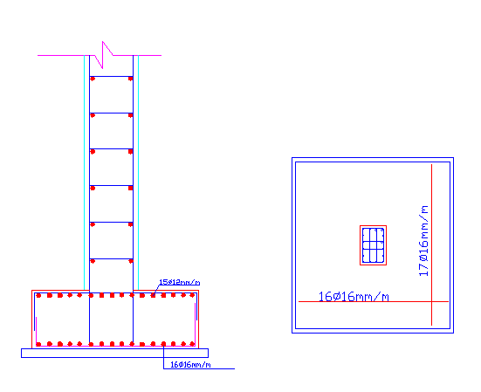
Structural Design:
Footing reinforcement

Slide 52
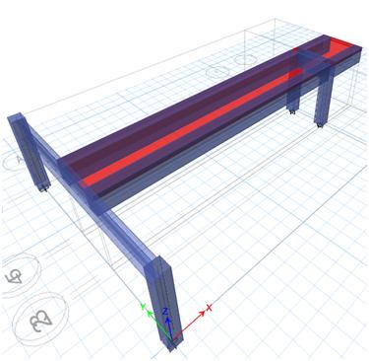
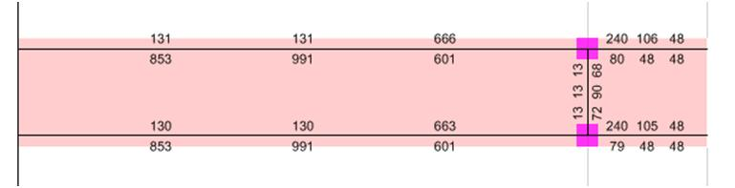
Structural Design:
bridge reinforcement

Slide 53
Environmental Design

Slide 54
Design Environmental
1. Solar analysis
2. Solar shading
3. Thermal insulation
4. Acoustical design
5. Heating and cooling
6. Daylight

Slide 55
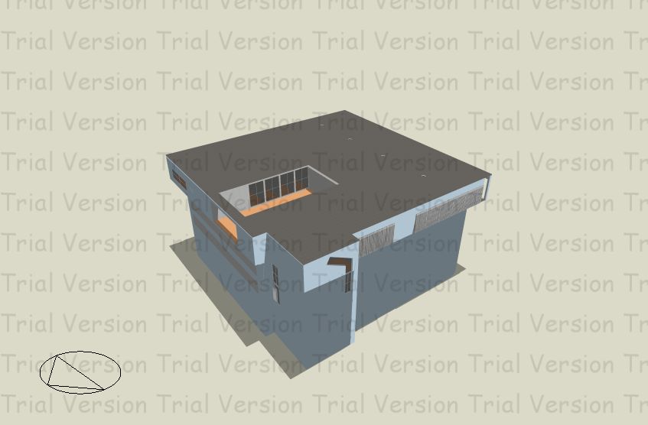
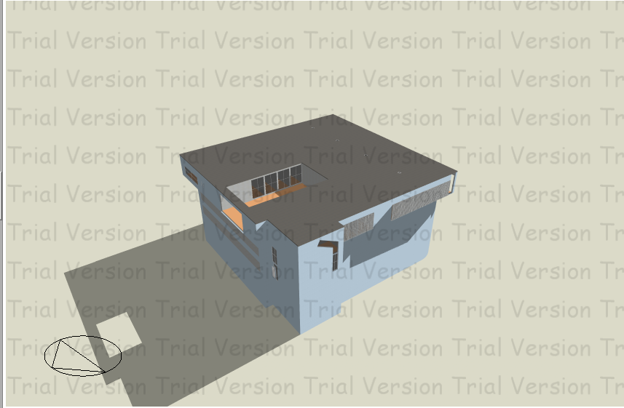
Design Environmental solar analysis
shadow in our building on 21-6 at 12:00 pm in
shadow in our building on 21-12 at 12:00 pm in
Summer day
Winter day

Slide 56
Design Environmental
Solar Shading
As we know the sun is concentrated on the east elevation in the morning so the heating gain is huge.
Solution:
Using vertical louvers to prevent sun exposure, in order to reduce heat gain..

Slide 57
Design Environmental
Thermal Insulation:
The goal: The achieved thermal coefficient U for all new and air-conditioned buildings should be not more than the U-value of the specified code
Value of thermal coefficient
U value (W/m2.k) | outer structure element of the building | number
0.5 | The external wall | 1
0.39 | Exposed horizontal roof | 2
0.39 | Exposed leaning roof | 3
2.46 | External window | 4

Slide 58
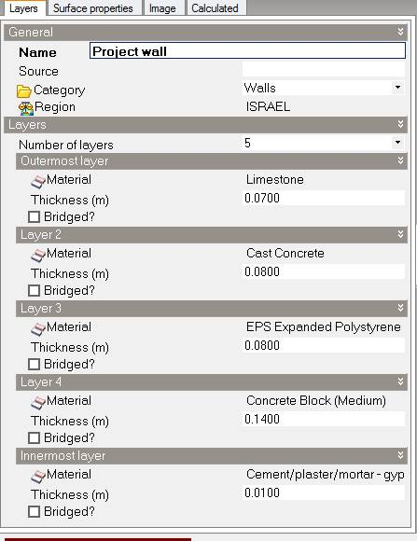
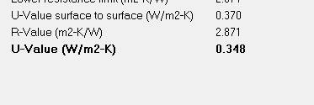
Design Environmental
Thermal Insulation:
Exterior wall
U value from design builder
U = 0.34 > 0.5 ok

Slide 59
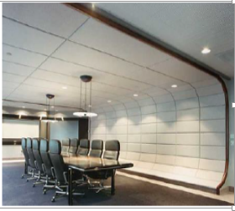
Acoustical Design:
The goal of acoustical design is to reduce of unwanted noise, which is referred to as noise control.
According to specifications of the offices, the required RT60 is ( 0.6– 0.8) s
RT60=2.12 s
After modification
RT60=0.62 s

Slide 60
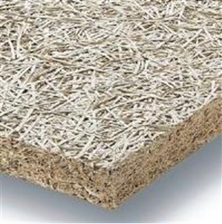
RT for parking floor is also very high and need to modify it by using an absorption material such as Heraklith C.
it is a fire resistance, acoustic performance, ease of installation, and attractive appearance for underground garages

Slide 61
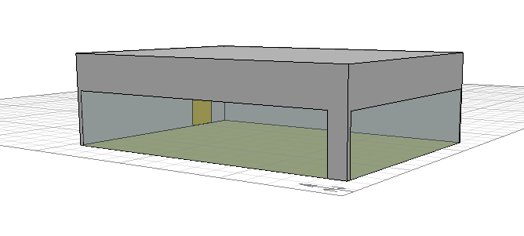
STC Calculations:
For inner wall ( between the classroom):
For external wall (for classroom 1)
-STC for classroom must be >42
STC=43
Required STC level (50-55)
STC=54

Slide 62
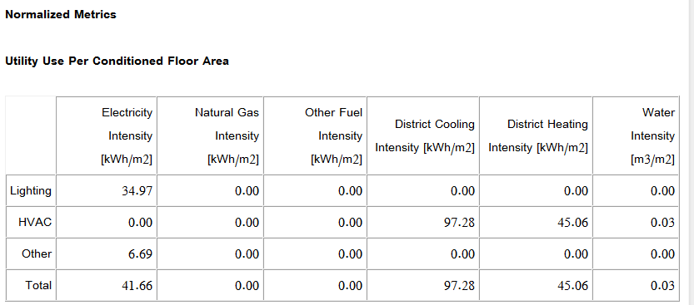
Heating and cooling:
cooling capacity=97KW/m2
heating capacity=45KW/m2

Slide 63
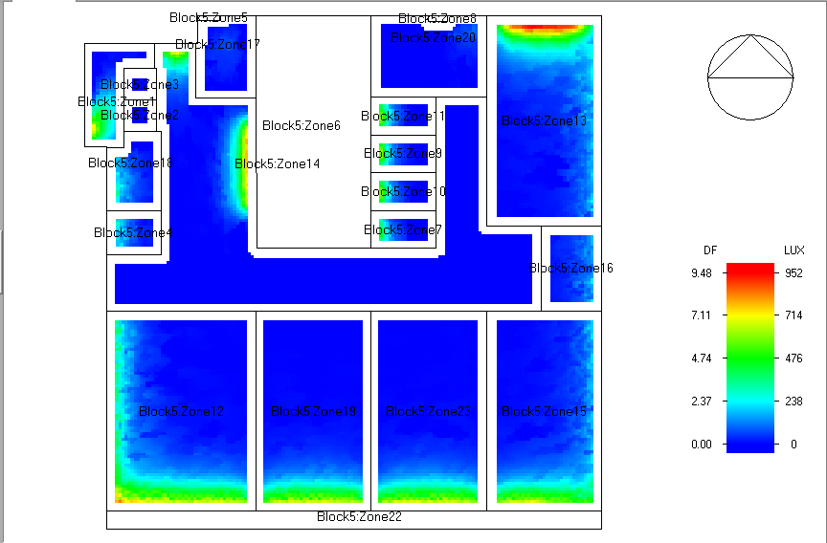
Daylight
Daylight Factor = 0.726

Slide 64
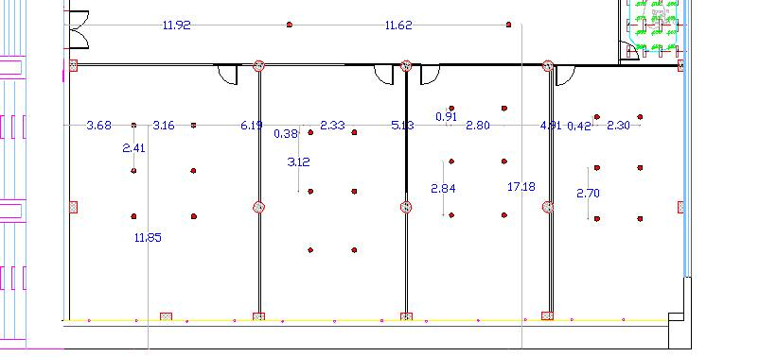
Daylight
We notice that the daylight factor is less than required so we solved this problem by using skylight tubes in class rooms and parking floors
Required Lux of the classrooms and offices is 500 lux so we need 6 skylight tubes and we distribute as a grid.

Slide 65
Mechanical Design

Slide 66
Mechanical Design
Mechanical design involves many aspects including :
      Water Supply System.
      Drainage Water System.
      HVAC system.
      Fire fighting & emergency exits.

Slide 67
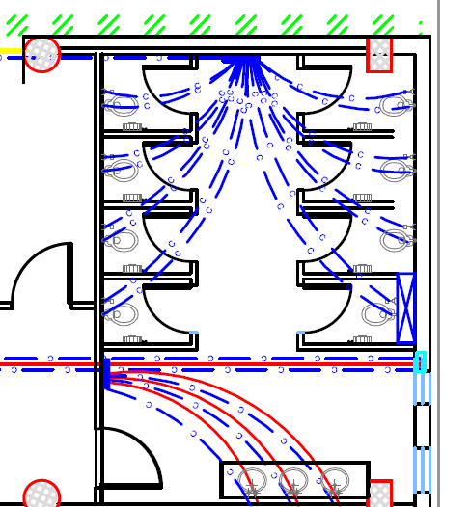
Water Supply System

Slide 68
Mechanical Design
Drainage system
      Black water: W.CS
      Grey water: Lavatory.
Pipe size for W.CS=4”
Pipe size for Lavatory = 2’’.

Slide 69
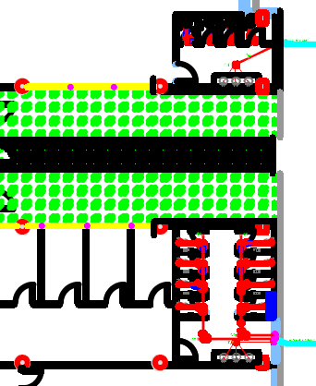
Mechanical Design
Drainage system for the offices floor

Slide 70
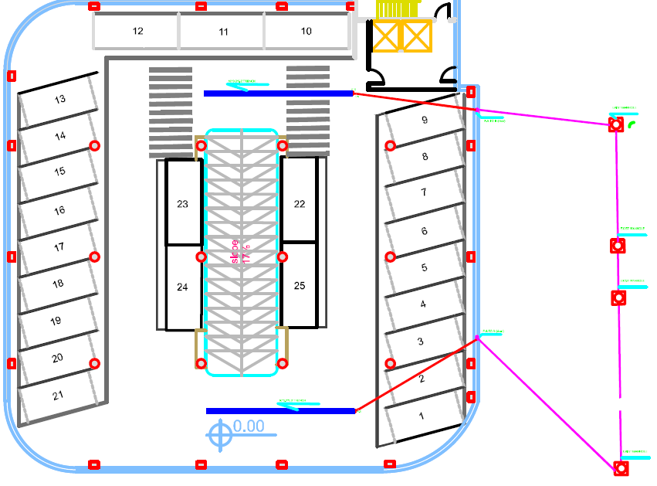
Drainage system for the parking floors

Slide 71
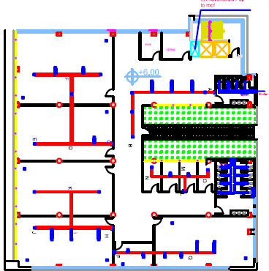
HVAC system

Slide 72

Ventilation system

Slide 73


Fire System and Safety
Sprinkler fire system

Slide 74


Fire system
Dry powder Portable Fire Extinguisher(in labs)

Slide 75

Fire System and Safety
Fire-hose-system

Slide 76
Electrical Design

Slide 77
Lighting
Indoor lighting
1- Offices and class rooms floor :
We used LED for corridors , bathrooms and classrooms

Slide 78

lamp type used in class rooms

Slide 79


lamp type used in storage areas and corridors

Slide 80

lamp type used in bathrooms

Slide 81


lamp type used in offices

Slide 82

2- parking : we used florescent lamp in the parking floors

Slide 83
lighting requirements
U0 | Glare rating | Lux (avg) | Type of area
0.6 | 19 | 500 | Drawing room
0.4 | 28 | 100 | Circulation and corridors
0.4 | 25 | 300 | Ramps during the day | indoor Car park
0.4 | 25 | 100 | Parking areas
0.4 | 25 | 300 | bathroom
0.6 | 19 | 500 | Offices

Slide 84
Dialux –values

Slide 85




1- class rooms :

Slide 86



2- corridor

Slide 87



3-bathrooms

Slide 88




4- offices

Slide 89




5- parking

Slide 90

Elevators

Slide 91

Occupancy sensors

Slide 92

sensors plan

Slide 93
electrical loads
Load (KW.h) | Electrical equipment
22.4 | elevators
0.05 | sensors
197.581 | light
0.4 | electrical gate
35 | LCD projectors
85.32 | Electricity Socket
61.536 | fan coil unit
402.287 | Total load

Slide 94

Solar cells
8045.74 KWh/month | Total demand /month
5470 KWh/ month | From solar cells avg. value
67.9 % | Percentage

Slide 95

Parking -Lamp distribution

Slide 96

Offices -Lamp distribution

Slide 97

offices -socket distribution

Slide 98



Slide 99


Slide 100


