Slide 1
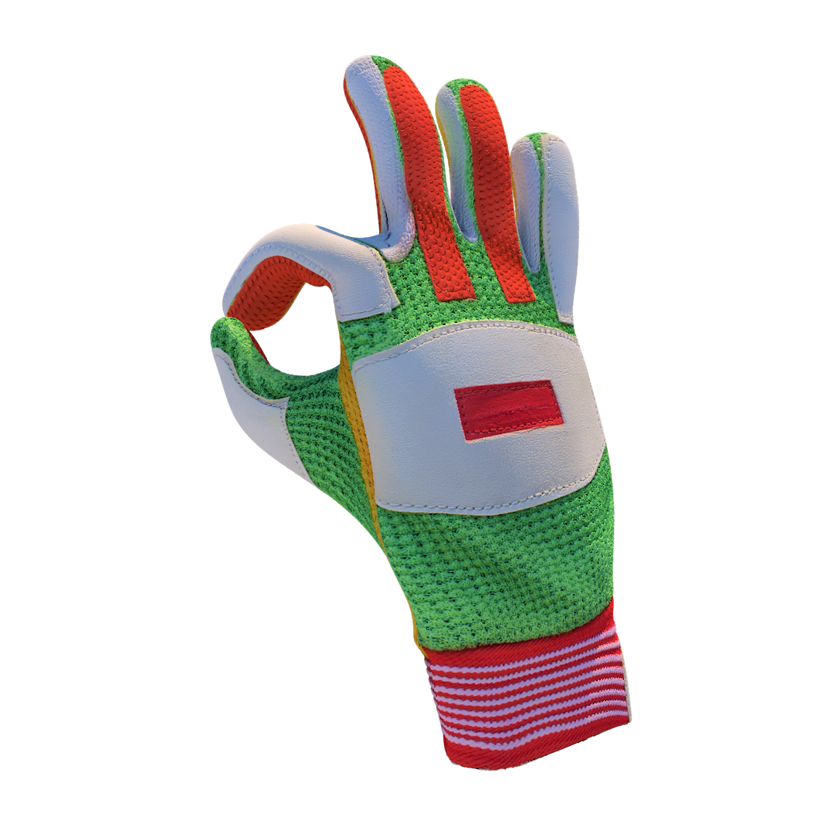
Handy
Supervisors:
Ashraf Armoush
By :
Emad Aghbar
Mohammad Abdalraziq

Slide 2
Outline:
Motivation
What is Handy
How it works
Technical choices
implementation
Challenges
Constraints
Future work

Slide 3
Motivations:
Controlling presentation limits movement.
User has two choices:
  Sacrifice Full control in the sake of free movement
  Get full control but loose free movement
Presentation screen is not interactive enough.
Traditional solutions don’t give satisfying controls.

Slide 4
Handy
Is a smart glove
Gives remote controlling capabilities over PC.
  Control PC using simple hand gestures.
Converts projector screen into a sudo-touch screen
Fun and more interactive presentation experience

Slide 5
How Does it work …
Hand Gestures
  By only moving your hand, you can control screen.
  Simple hand gestures translated to computer commands.

Slide 6
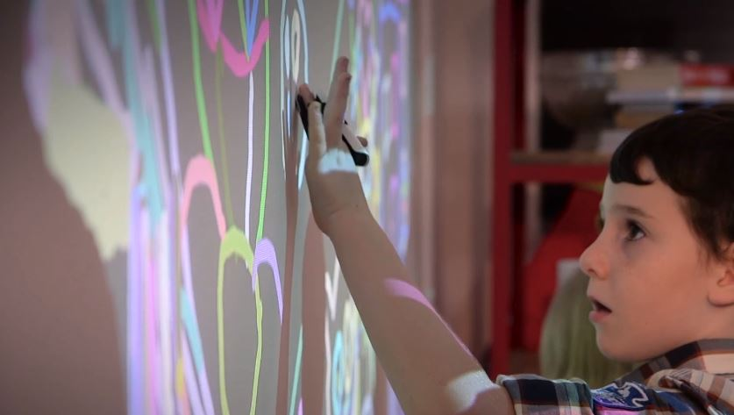
How Does it work …
Sudo touch screen
  Turning projecting surface into a touch screen

Slide 7
Technical choices
Hardware:
  Reading hand gestures :
    Reading fingers
    Hand motion
  Creating touch surface :
    Wiimote and IR camera
    IR LED signals

Slide 8
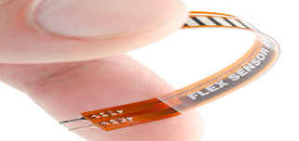
Reading hand gestures
Flex Sensors:
A variable resistor
  Placed on each finger
  Used to read fingers status
  Translated to commands via Arduino code

Slide 9
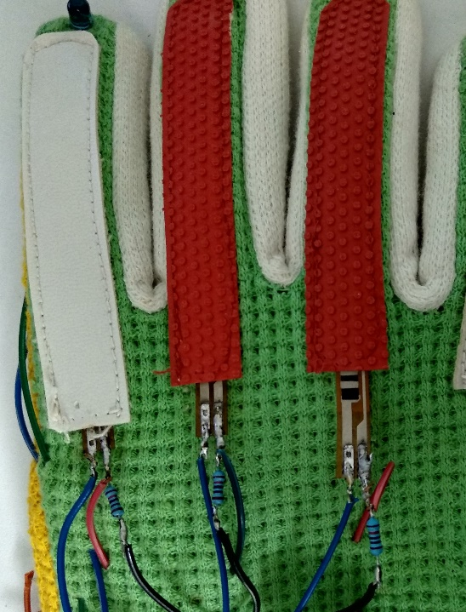
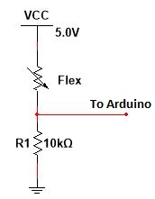
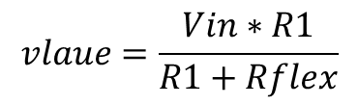
Flex implementation:
Connection :
$$vlaue=\frac{Vin∗R1}{R1+Rflex}$$

Slide 10
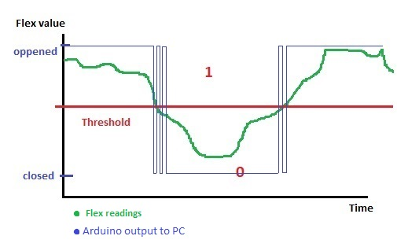
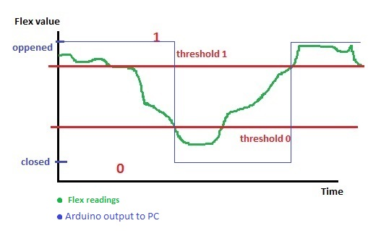
Flex implementation:
Thresholds & readings :
Distorted signals Smooth signals

Slide 11
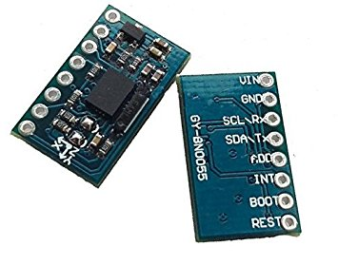
Reading hand gestures
Motion sensor – BNO055:
  Contains gyroscope
  Installed on top of glove
  Reads 3-axis motion angles of the hand
  Angles reading converted to commands via Arduino Nano

Slide 12
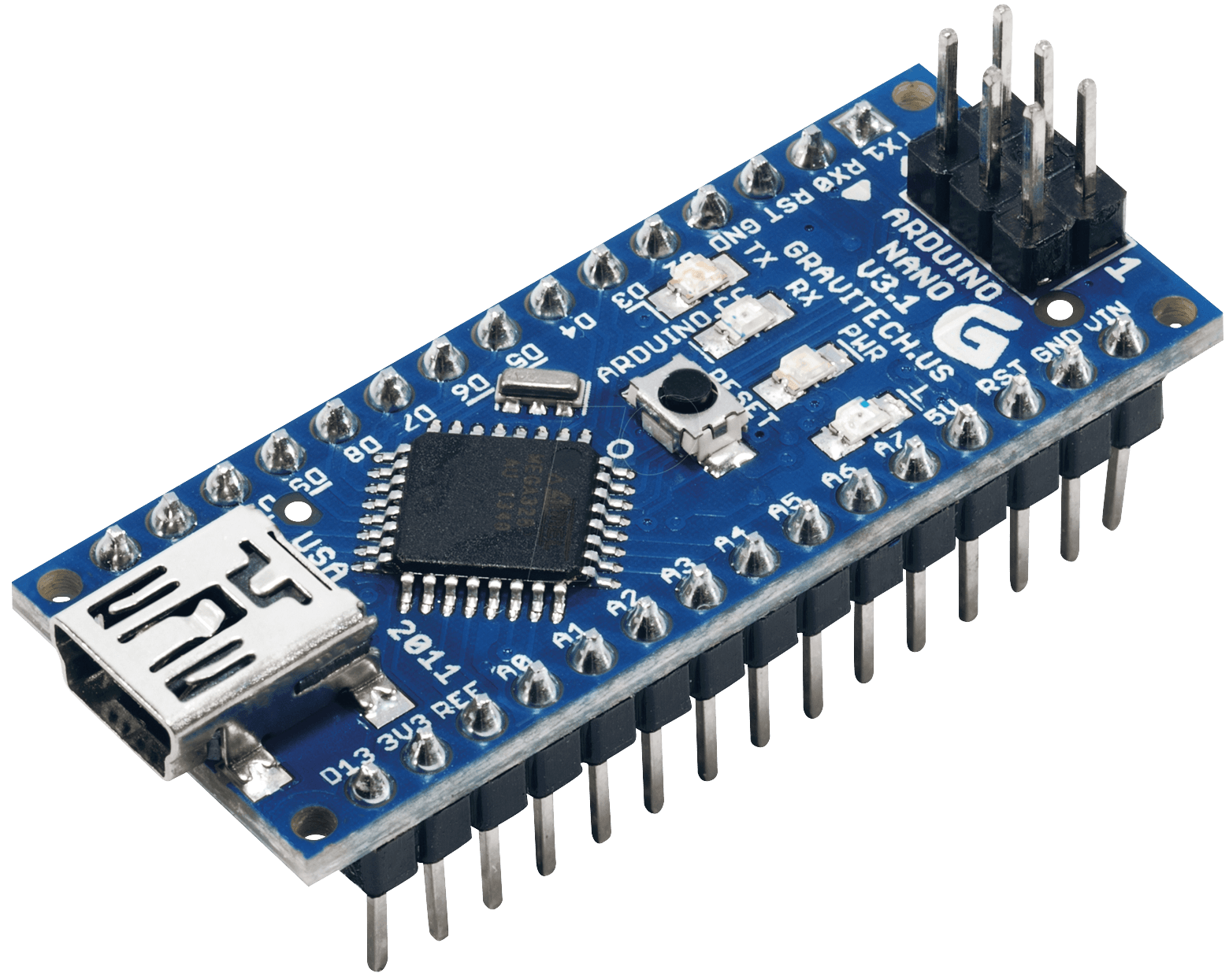
Glove – PC connection :
Arduino Nano :
  Main brain of the project
  Reads sensors data and processes them
  Handles connection between glove and PC

Slide 13
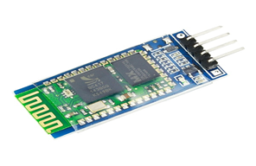
Glove – PC connection :
Bluetooth:
  Connects glove to PC .
  Exchange commands and data between them.
  Cheaper and consumes low power compared to Wi-Fi .
  more consistent than IR .
  Gives suitable connection distance .

Slide 14
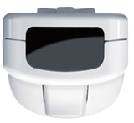
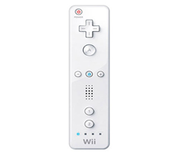
Creating touch surface
  Wiimote and IR camera
    is a controller for Wii .
    Has so many capabilities .
    We are interested only in Bluetooth connection and IR camera .

Slide 15
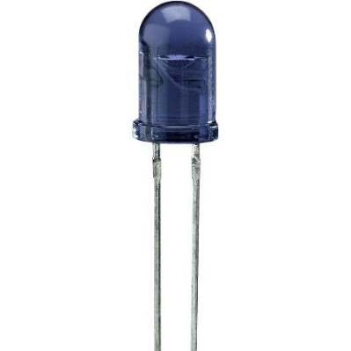
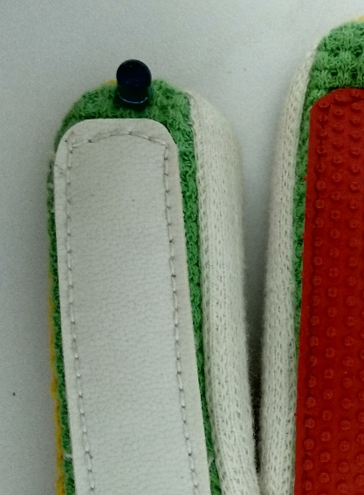
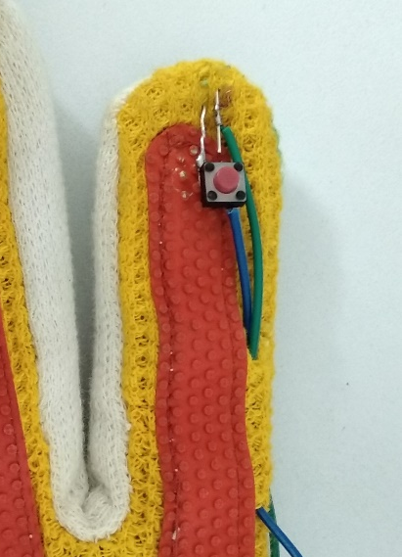
Creating touch surface
  IR LED signals
    IR LED and push Button installed in the index figure.
    Used to emit IR signals to be detected by IR Wiimote camera .
    Signals are translated to touch commands on screen using smoothBoard software .

Slide 16
Technical choices
Glove Software:
  Arduino code
    Processes and exchanges data with PC .
  Driver Software
    JAVA language was used to write driver Software for glove data.
    Driver reads data from Bluetooth and converts it to PC commands .

Slide 17
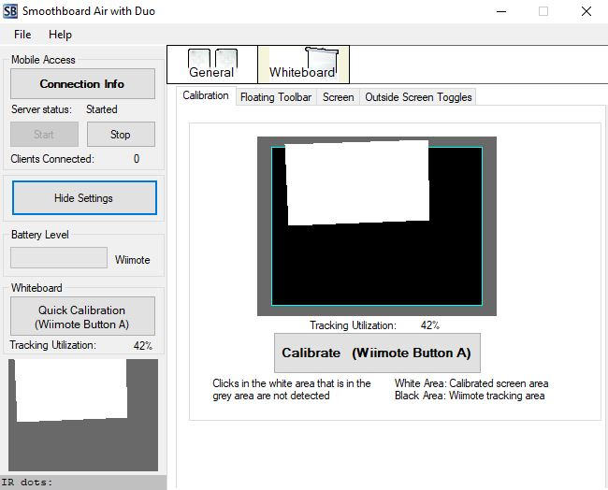
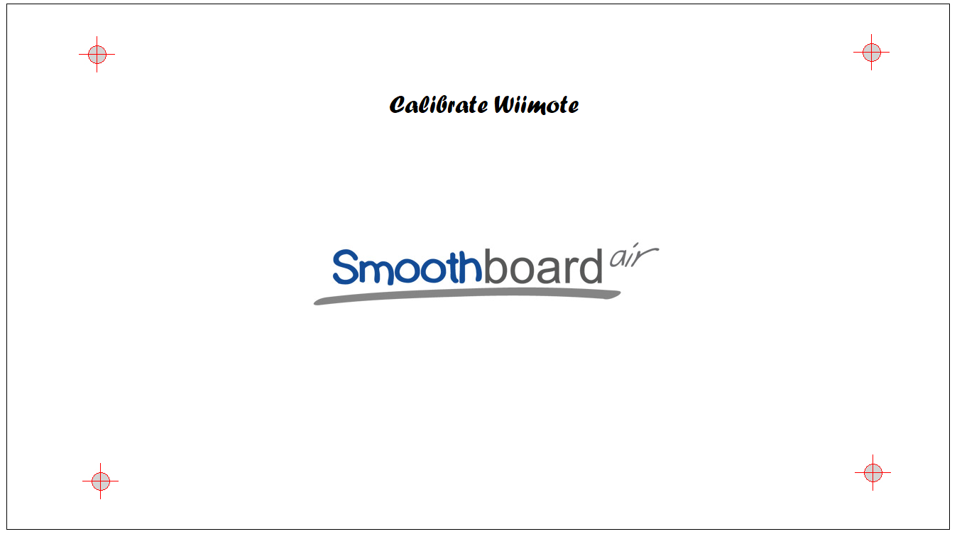
Technical choices
Touch screen Software:
  SmoothBoard software .
    Connects PC to the Wiimote via Bluetooth.
    Calibrates screen with the Wiimote IR camera.
    Converts IR signals to touch commands

Slide 18
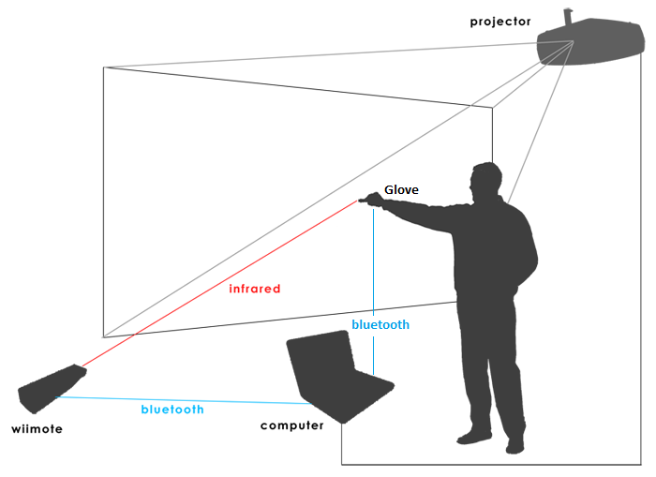
Full Connections :

Slide 19
Challenges
Coming up with consistent design.
Reflecting sensors data smoothly on screen
Turning surface to touch screen :
  Image processing
  IR signals

Slide 20
Constraints:
design for the glove and the parts on it
Some parts availability

Slide 21
Future work
Data mining.
Adapt other social websites events.
Improve owner capabilities on dashboard

Slide 22
Demo

Slide 23

Thanks
احنا مش

