Slide 1
Self-service pharmacy
Supervisor :
Dr. Hikmat Darawsheh
Prepared by :
Yazan Abu Alhayja
Ibrahim Abdelhadi

Slide 2
Table of contents
01
02
04
05
03
Introduction
Main Aim & Objective
Methodology
06
Mechanism
Limitations
Future Work

Slide 3

01
Introduction

Slide 4

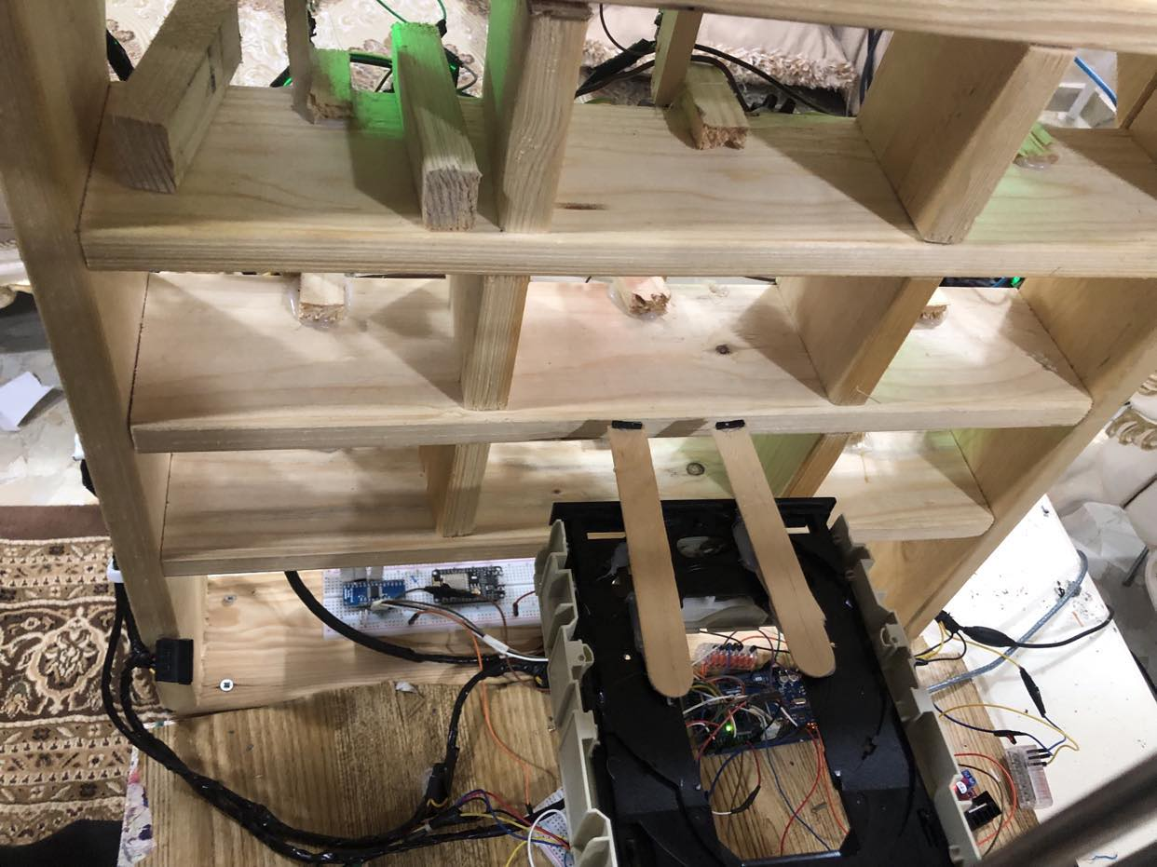
Introduction
faster and easier
uses a lever mechanism to move medications from Individual cells

Slide 5

Where did our idea come from?

Slide 6
02
Main Aims & Objective

Slide 7
Aims
Cut down waiting times for medicine retrieval.
Ensure the self-service pharmacy is open around the clock.
Utilize technology to minimize medication dispensing errors, prioritizing safety.
Efficiency
24/7 Accessibility
Error Reduction
User-Friendly Design
Implement an easy-to-use system

Slide 8
Guarantee the confidentiality of personal and health information through robust security measures.
Reduce paper usage and ensure energy-efficient machines for an environmentally friendly approach.
Privacy and Security
Environmental Responsibility
Positive Impact
Strive to bring about a substantial positive change in the medicine retrieval process, benefiting both customers and pharmacists.

Slide 9

Methodology
03
1
Design and Planning

Slide 10
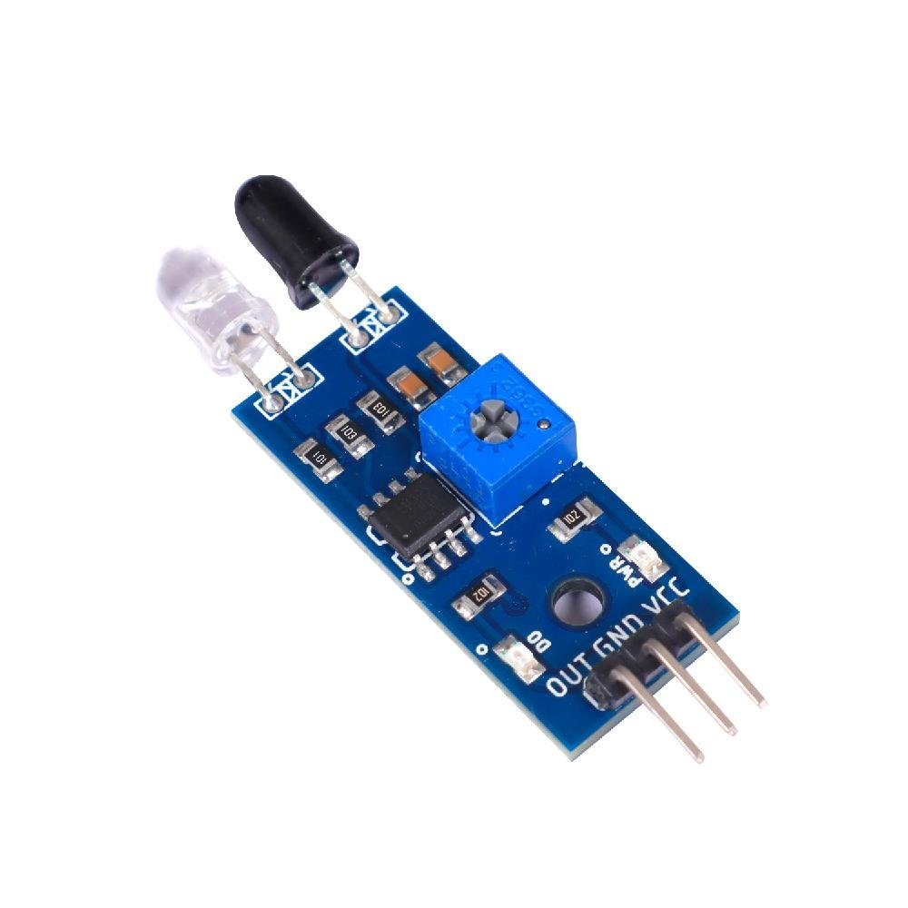
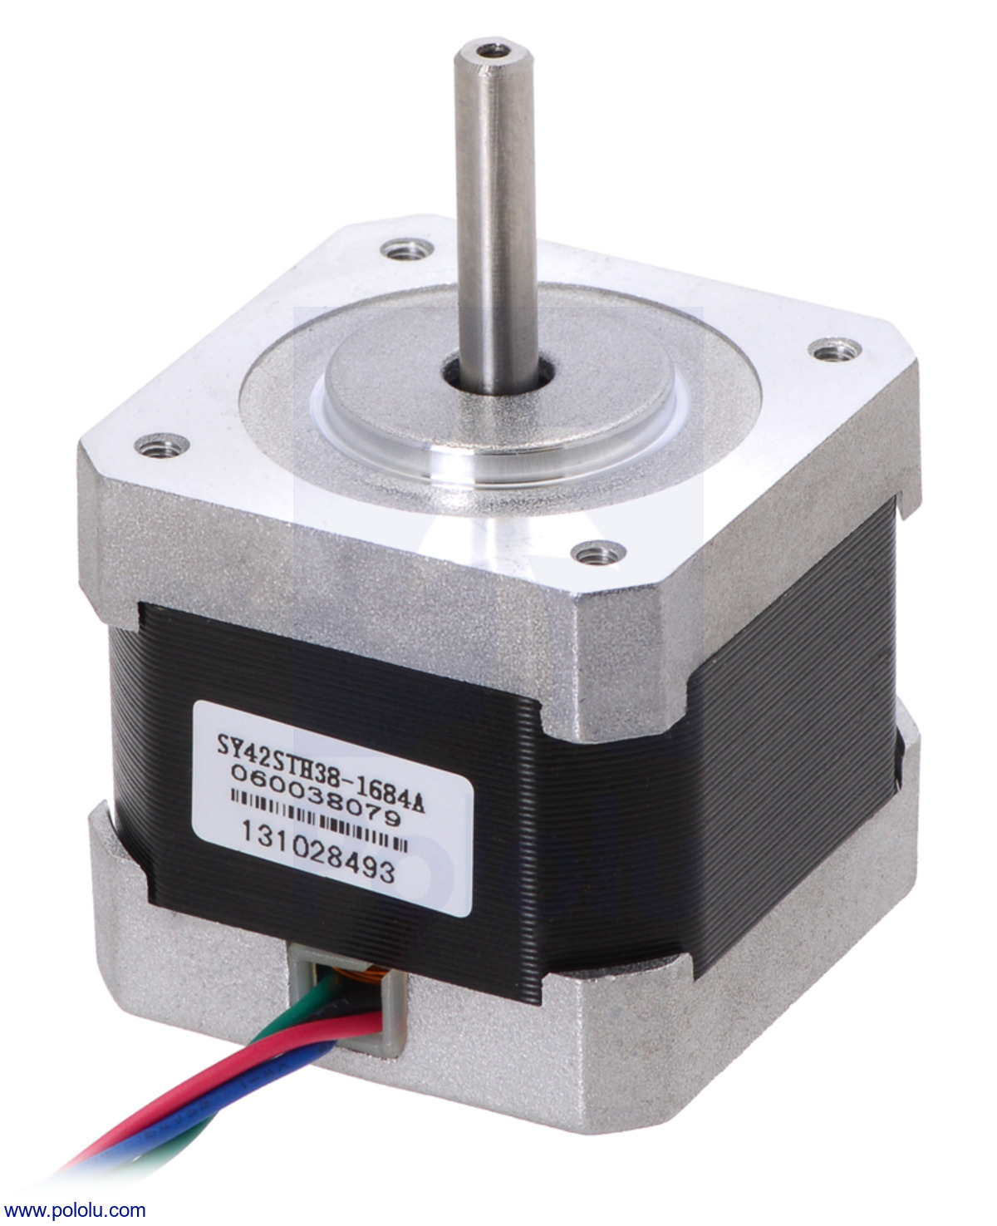
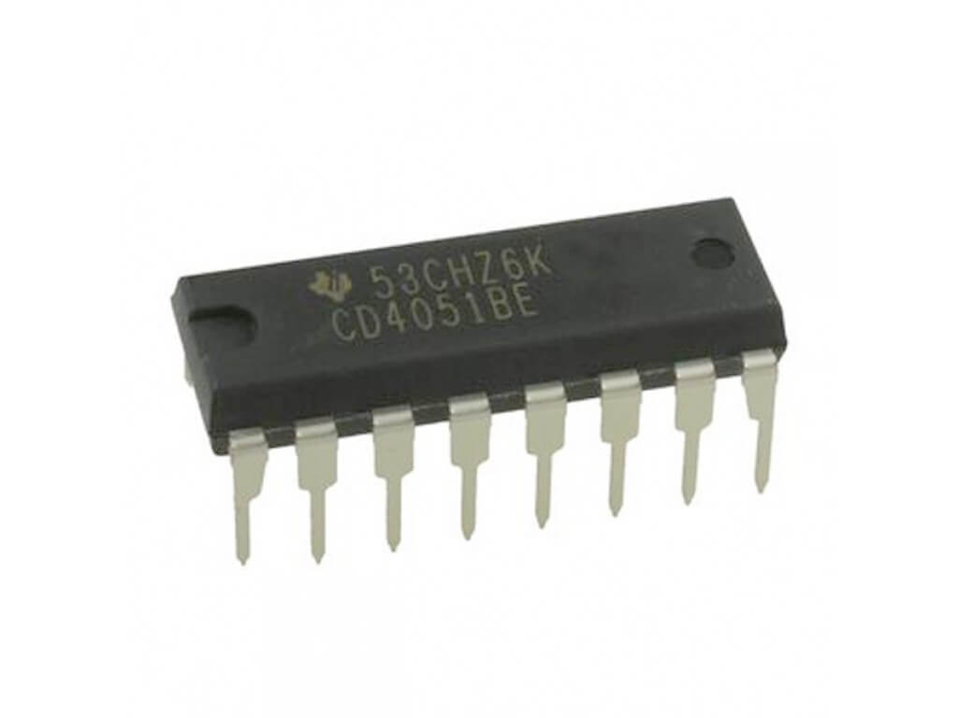
2
Hardware components
Multiplexer (MUX)
IR Sensors
Stepper motor

Slide 11
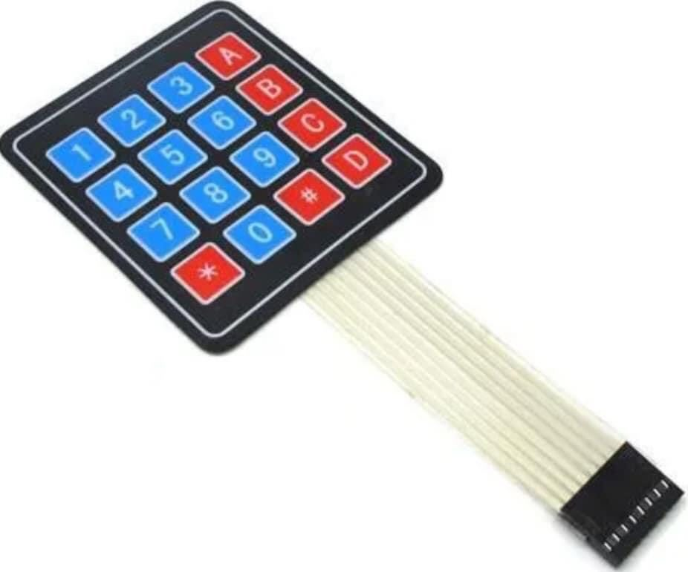
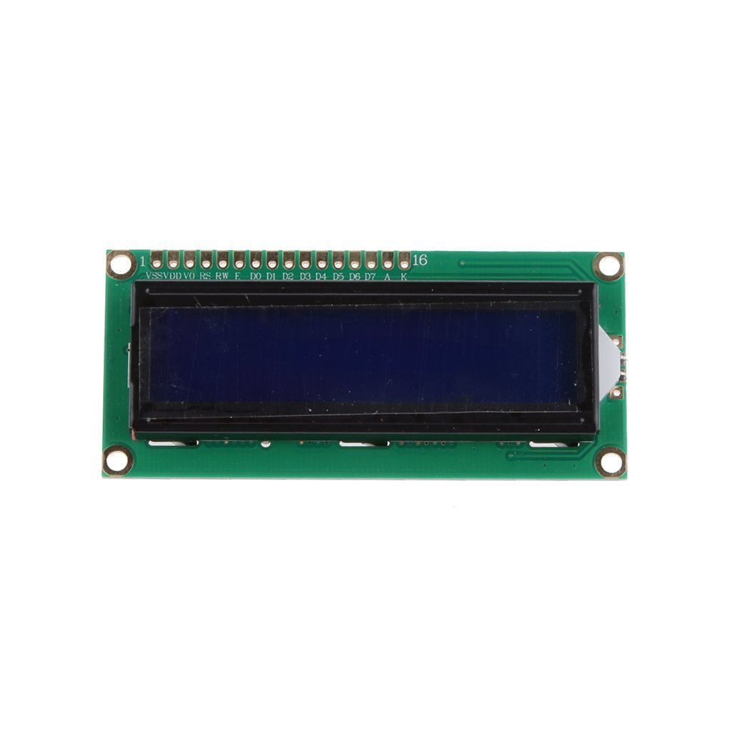
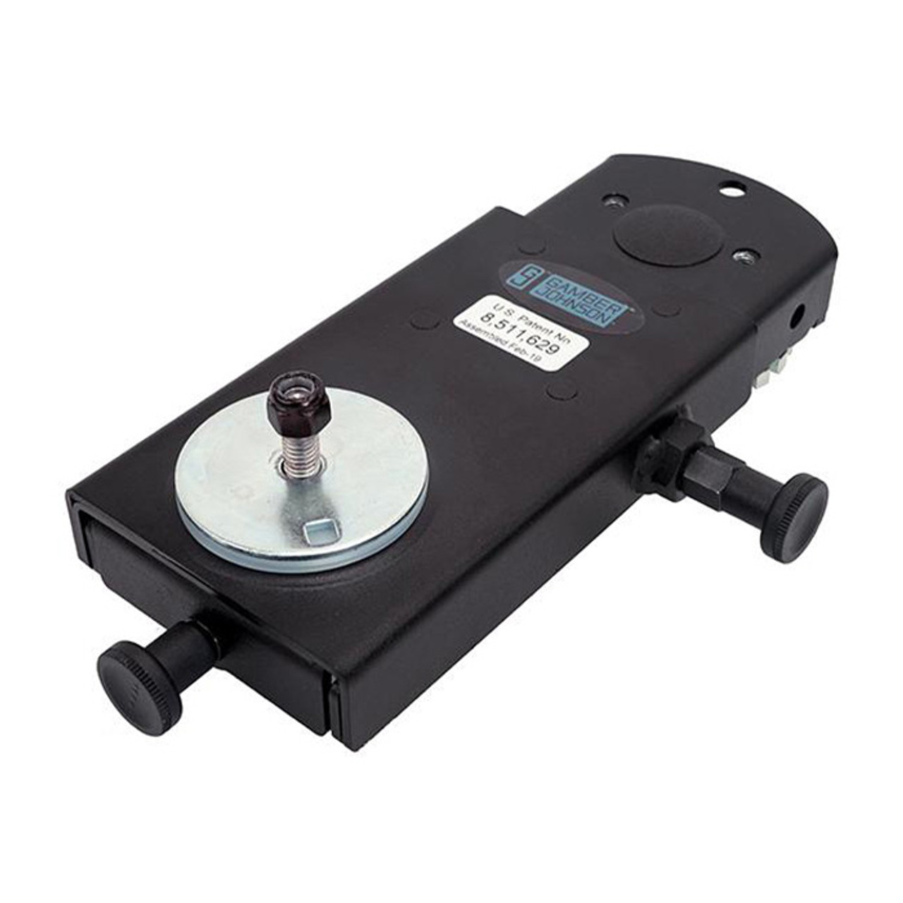
Keypad
LCD screen
Sliding arm

Slide 12
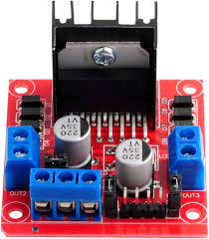
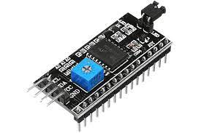
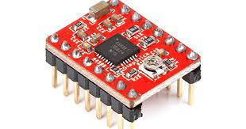
I2C
Driver A4988
H- Bridge

Slide 13
3
Software
The project was built using Arduino IDE
1-set the arm at the origin point code
2-keypad & LCD code
3-sensors code
4-motion code (x-y-z axis)

Slide 14
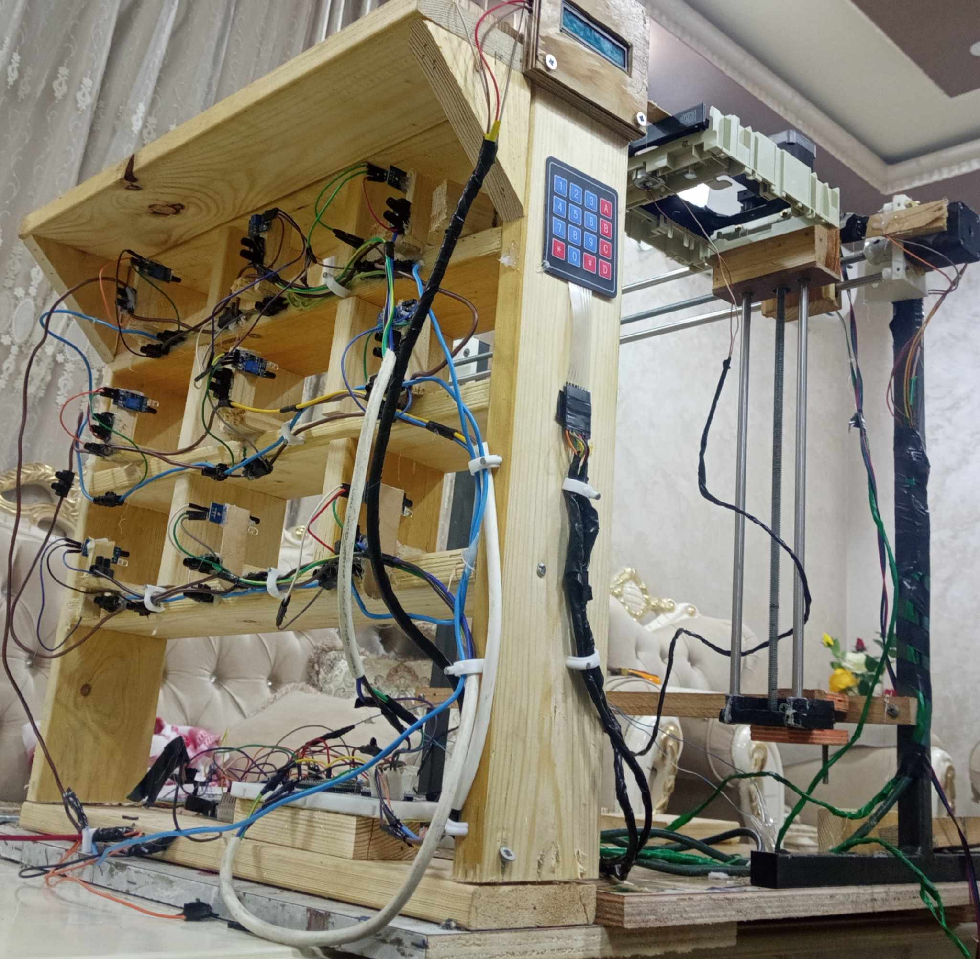

Slide 15
04
The Mechanism

Slide 16
Mechanism of Action
Request Medication
User Interaction
Users initiate the process by interacting with our system through the KEYPAD and LCD, providing information about their medication or symptoms.
Through a brief conversation with the system, users receive guidance, and the system identifies the correct medication for them.

Slide 17
Mechanism of Action
Lever System Activation
Medication Retrieval
Utilizing the lever mechanism, the system picks up the identified medication and administers it to the user at a conveniently located point.
The lever system is then activated, precisely navigating to the specific cell containing the correct medication.

Slide 18
05
Limitations

Slide 19
06
Future Work

Slide 20

Thanks!

