Slide 1


Faculty of Engineering & Information Technology
Department of Civil Engineer
Graduation Project II
Design the Foundations of The American School
Prepared By:
Omar Alsayeh
Ali Fares
Iyad Mohammed
Abdallah Yaseen
Under supervision of : Dr. Mohammed Ghazal

Slide 2

Outlines:
Introduction
Design
Conclusion

Slide 3
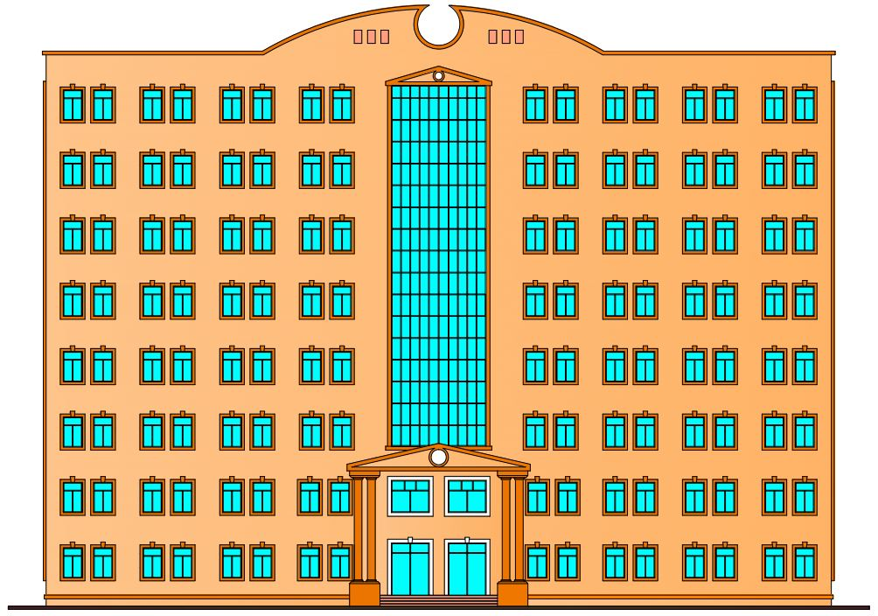
Introduction
The Project:
The project contains’ an Eight floors with total building area (4613 m²), the first floor used for administrative Offices and the remaining floors are used as educational classes and activity halls.

Slide 4
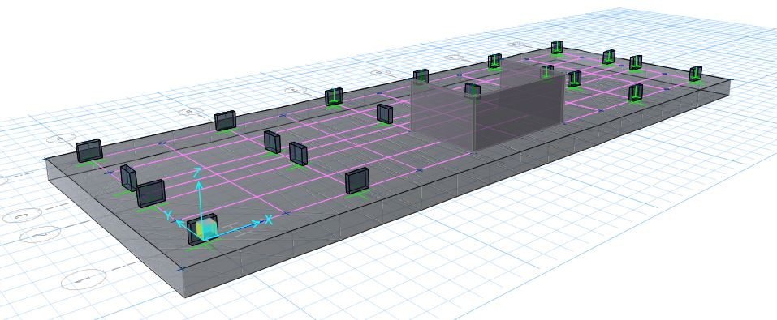
Introduction
We designed the foundations for the building (school) consisting of eight floors. At first, we designed Isolated Footing , but because of the heavy dead loads and the heavy live loads on the building because it is a school building, as a result, the Isolated Footing overlap in some of them, so we chose the Mat Foundation design instead of the Piles Foundation due to the high cost .

Slide 5
Design:
To ensure the safety of the mat foundation, we need to make THREE Check:
1- Check Deformed Shape ( settlement )
2- Check Soil Pressure
3- Check Punching

Slide 6
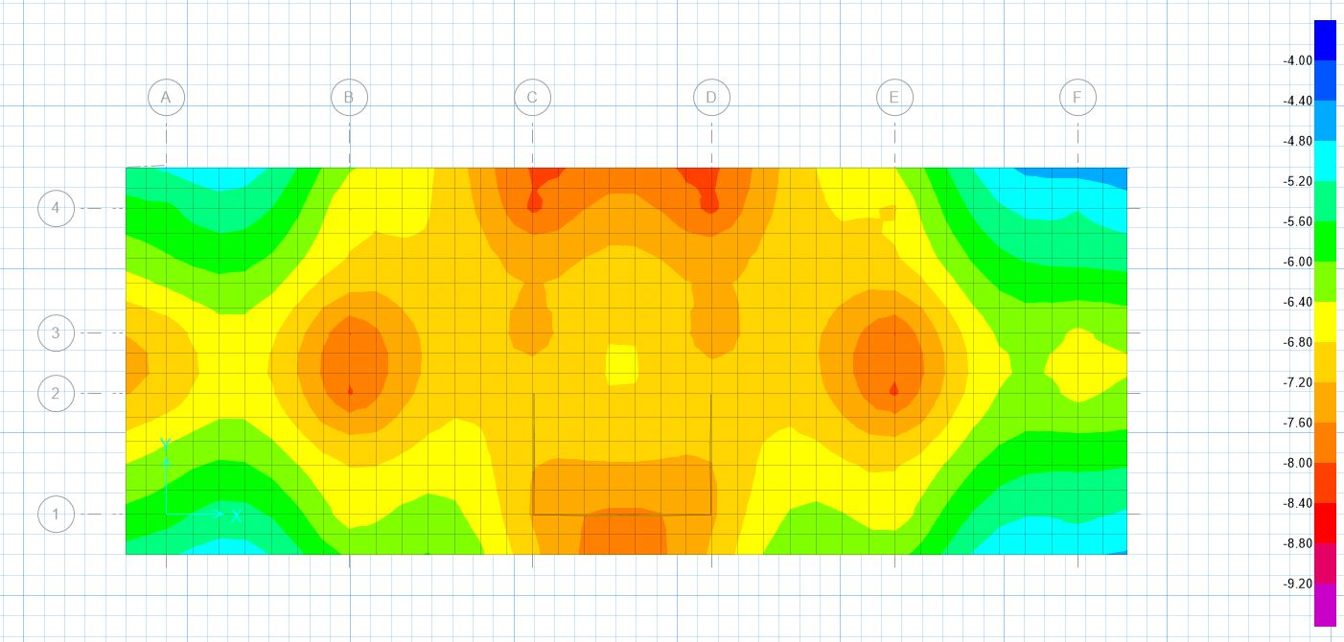
Design:
[ Max = -4.58 mm, Min = -8.86 mm] < 50 mm

Slide 7
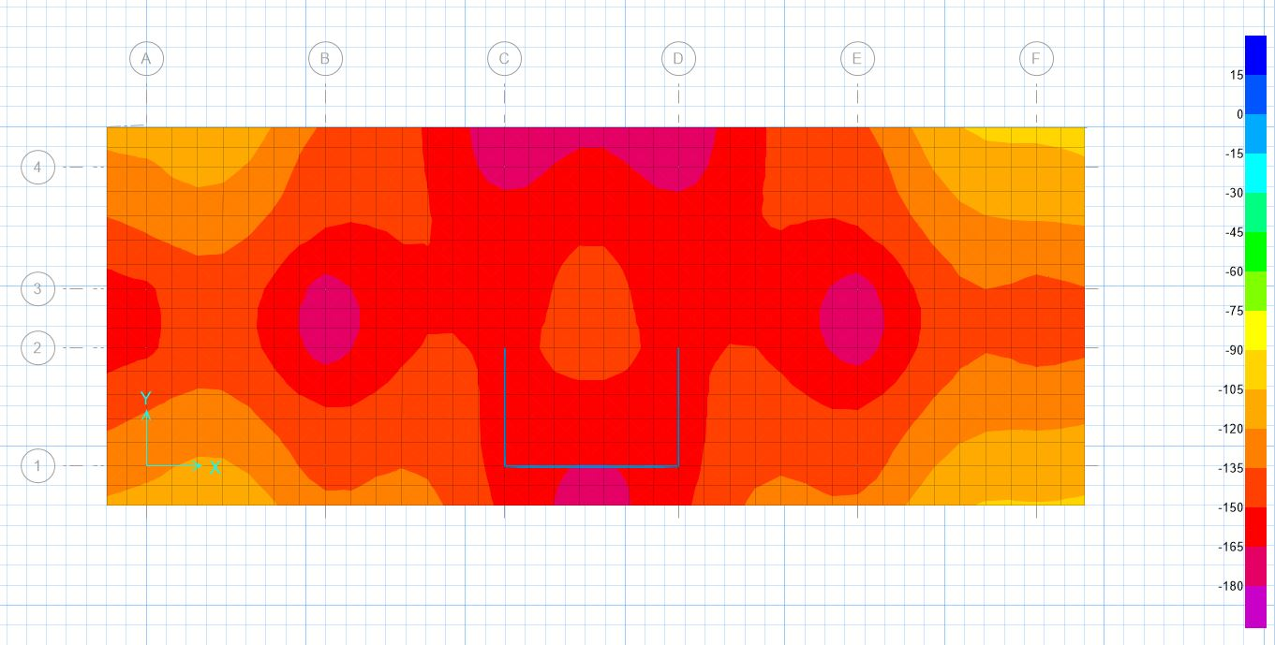
Design:
Max = 175.47 KN/m < 180 KN/m

Slide 8
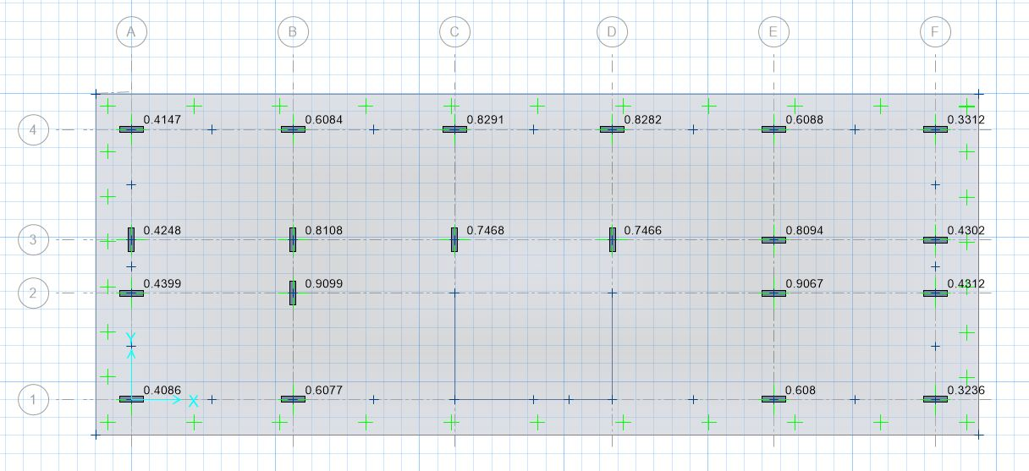
Design:
Maximum value for punching 0.9099 < 1 → O.K

Slide 9
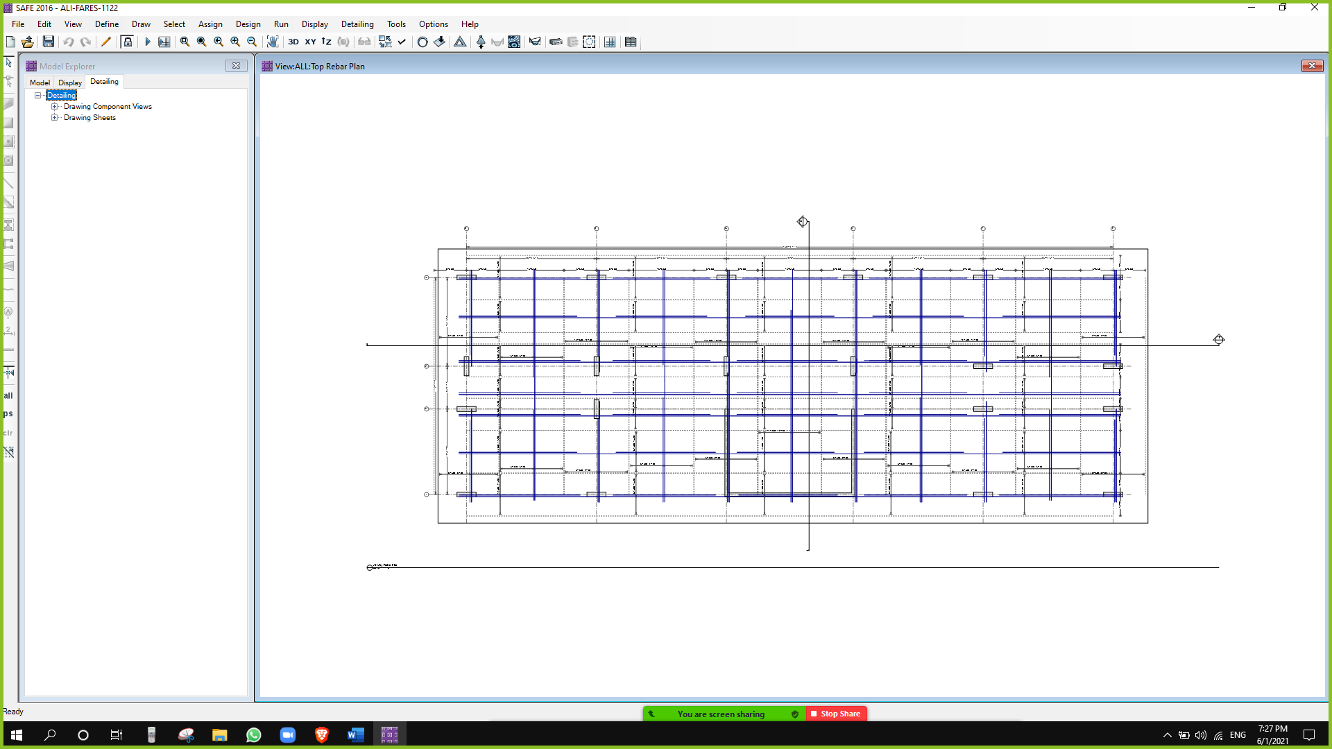
Design:
Use Top bar for direction 1 & 2 → 5 Φ18/m and Extra Bar

Slide 10
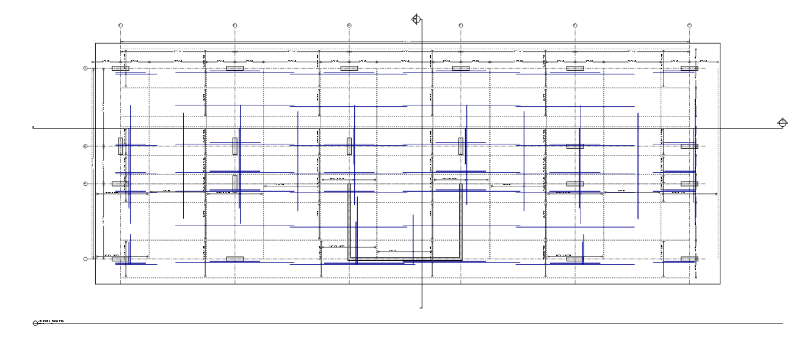
Design:
Use Bottom bar for direction 1 & 2 → 5 Φ26/m and Extra Bar

Slide 11
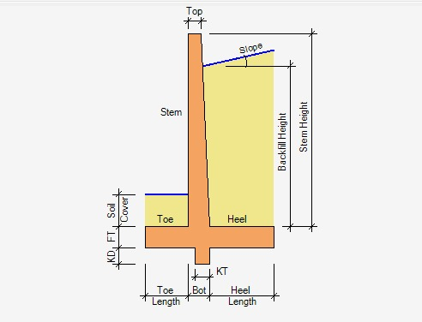
Design:
Designing a retaining wall We used the ASDIP RETAIN program : Retiring Wall Dimension:
Stem Height = 4.60 m
Stem Thickness Top = 30.50 cm
Stem Thickness Top = 60.00 cm
Footing Thickness = 50.80 cm
Toe Length = 1.25 m
Heel Length = 1.25 m
Soil Cover at Toe = 0.60 m
Backfill Hight = 3.7 m
Backfill Slop Angle = 0.0 deg
Shear Key Depth = 30.50 cm

Slide 12
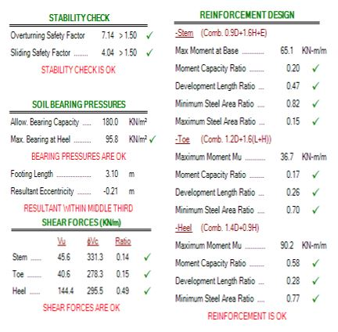
Design:
We need to do the following Checks :

Slide 13
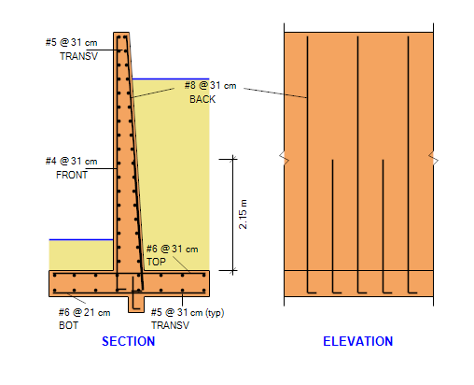
Design:

Slide 14
Conclusion:
The site address is Section (B/A + (1/15)), Basin No. 1, behind Rafidia Hospital, southwestern of Nablus City.
The total size of the land is about 2454 m², where the project occupies only 618 m²
The building contains’ Eight floors with total building area 4613 m²
The soil inspection report for the ground, Qall = 5% x 62 = 3.1 Kg / cm², but we used 1.8 kg / cm²
-
During our design of the isolated footing, it was found that they are overlapping, due to the heavy load that falls on it. Therefore, we designed a mat foundation with a thickness of 1300 mm on the SAFE program. Therefore, we did not need the piles, so that the mat was sufficient to load the building. And we designed a retaining wall from the side of the severe inclination of the earth on the ASDIP RETAIN program .

Slide 15


