Slide 1
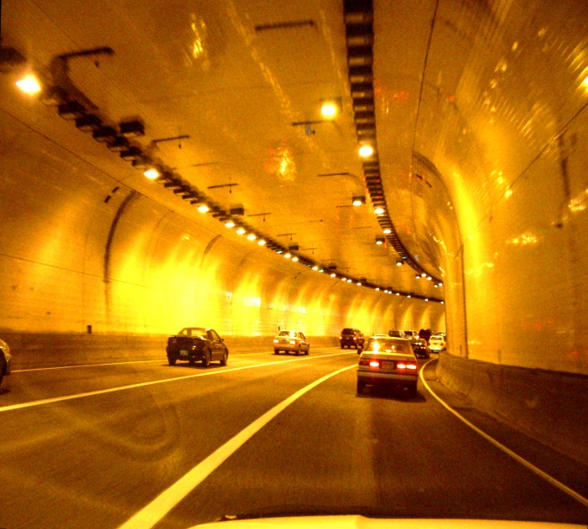
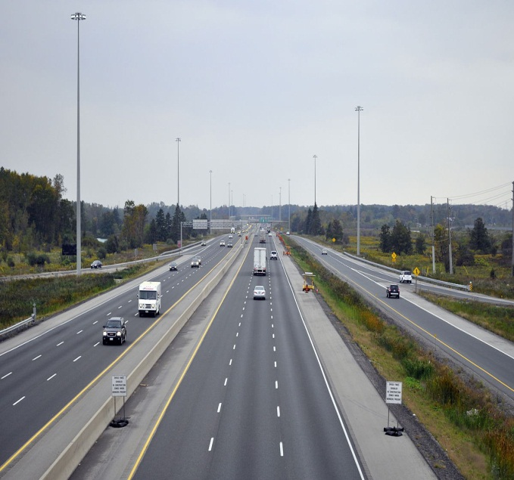


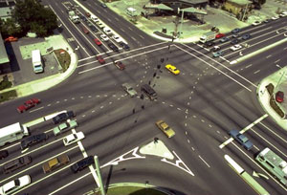
Supervised by : Dr.Khaled Al-Sahili Prepared by : Ethar Aqel - Saja Yameen Khaireya Soqia
Graduation Project
Traffic Management of Rafedia Main Corridor

Slide 2
Introduction
Corridor management is defined as the coordination of the individual network operations between adjacent facilities that creates an interconnected system capable of cross-network travel management.
The focus of this project is to study and analyze Rafedia Corridor (Urban Arterial Highway).

Slide 3
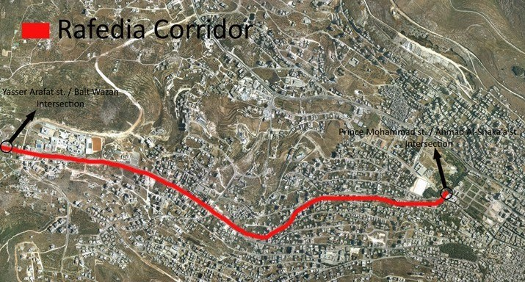

Slide 4
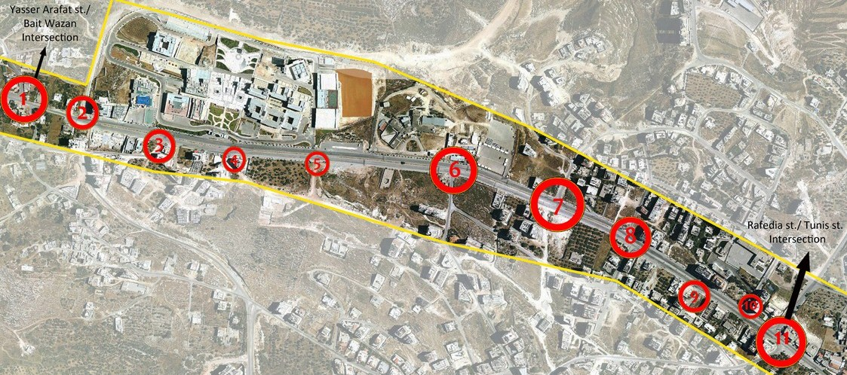
Multilane Part

Slide 5
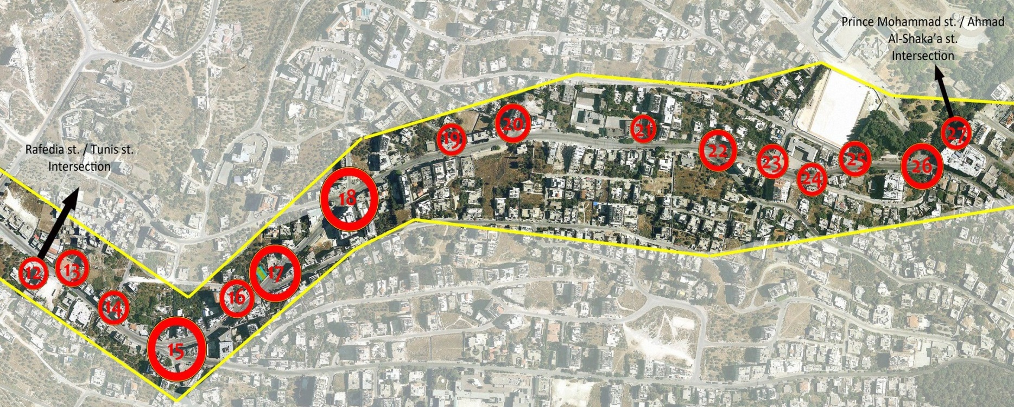
Two Lane Part

Slide 6
Methodology
Data Collected
Data Analysis
Problem Definition
Improvements
Simulating Existing Conditions
Recommendations
Conclusions

Slide 7
Geometric Data
Maps
6
Traffic Volumes
1
5
Data Collected
2
4
Parking
3
Crashes
Control Devices

Slide 8
Traffic Analysis
Geometric Analysis
6
LOS Analysis using HCS
1
5
Data Analysis
2
LOS Analysis using Synchro
4
3
Crash Analysis
Parking Analysis

Slide 9
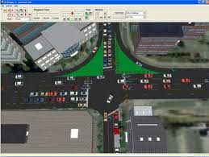
Simulating Existing Conditions
Rafedia Corridor and some adjacent streets were analyzed as one network using Synchro 7 program.
Depending on HCM 2000 & ICU 2003

Slide 10
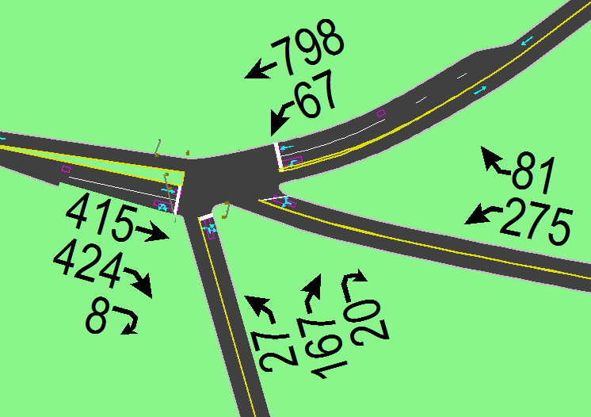
Rafedia st. / Omar Ibn Al-Khatab st.
LOS : F

Slide 11
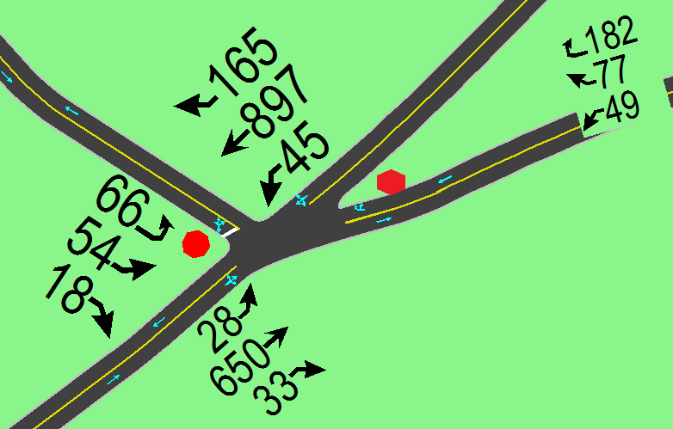
Al-Kfair st. / Road 15
LOS : G

Slide 12
Quantifying the Problems
Parking
LOS
Delay
Accidents
Geometry
186.2 sec
Omar Ibn Al-Khatab
88.6 sec
Qadri Tuqan
106-175 crash

Slide 13
Evaluation of Traffic Conditions at Major Intersections
LOS | Name of Intersection
F | Rafedia st. / Omar Ibn Al-Khatab st.
G | Al-Kfair st. / Road 15
H | Al-Kfair st. / Al-Muraij st.
E | Al-Kfair st. / Qadri Tuqan st.

Slide 14
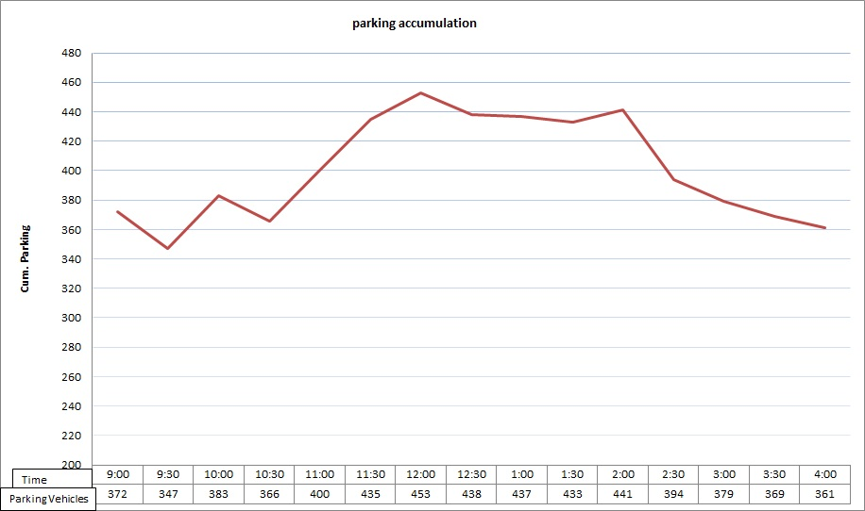
12:00PM , 453 veh

Slide 15
Improvements
Alternative One
Alternative Two
The Best Alternative
Alternative Three

Slide 16
Alternative One
Intersection Name | Intersectrion No.
Rafedia st. / Tunis st. | 11
Rafedia st. / Omar Ibn Al-Khatab st. | 15
Al-Kfair st. / Road 15 | 17
Al-Kfair st. / Akram Zu’aiter st. | 1
Al-Kfair st. / Al-Muraij st. | 20
Al-Kfair st. / Qadri Tuqan st. | 22
Prince Mohammad st. / Ahmad Al-Ska’a st. | 27

Slide 17
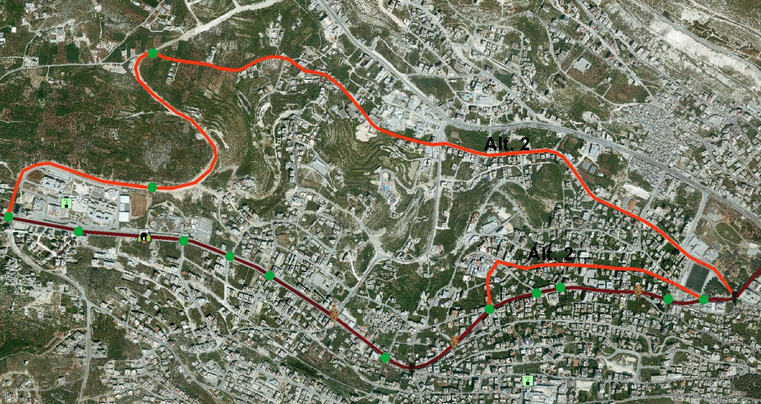
Alternative Two

Slide 18
Consequences of Alternative Two
20 % of public transportation was subtracted along the whole Corridor .
10% of public transportation was subtracted along the Corridor from Al-Kfair Street / Soccer Field Street intersection to Al-Kfair Street / Akram Zu'aiter Street intersection.
Prevent the parking in front of the main gate of new campus of An-Najah National University and converts it to the back gate of the university.

Slide 19
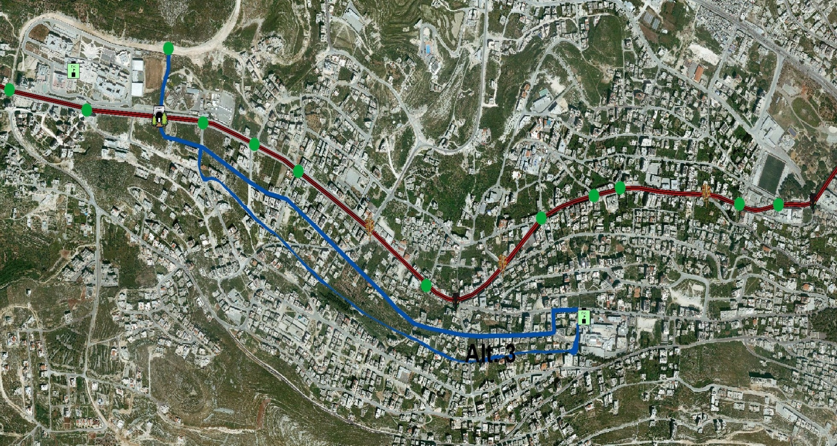
Alternative Three

Slide 20
Consequences of Alternative Three
20 % of public transportation was subtracted along the Rafedia Corridor from Rafedia Street / Omar Ibn Alkhatab Street intersection to the end of Yasser Arafat Street.
Prevent the parking in front of the main gate of new campus of An-Najah National University and converts it to the back gate of the university.

Slide 21
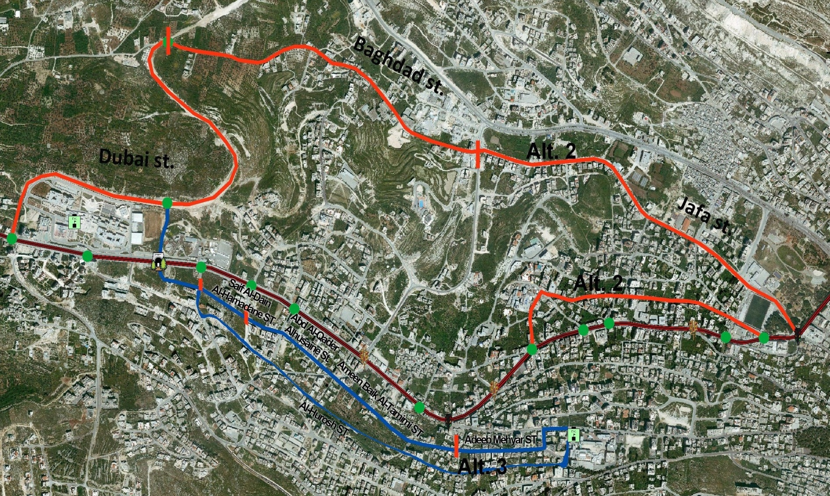
The Best Alternative

Slide 22
Results of Best Alternative
Reduction of demand.
Acceptable LOS.
Reduction of Delay.
Smooth Movement.
Increase number of lanes at critical intersections.

Slide 23
Conclusions & Recommendations
Install proper traffic control devices.
Install traffic signals on the recommended intersections
Regulate on-street parking along Rafedia Corridor & prevent the parking on some recommended locations.
Improve geometric design & pavement marking along Rafedia Corridor.

Slide 24
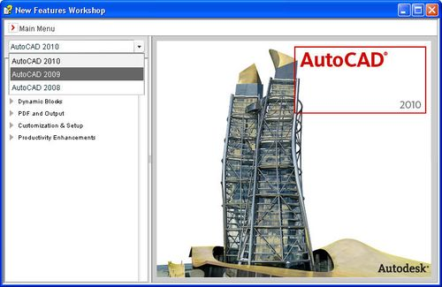
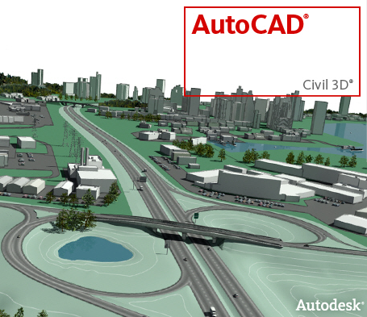

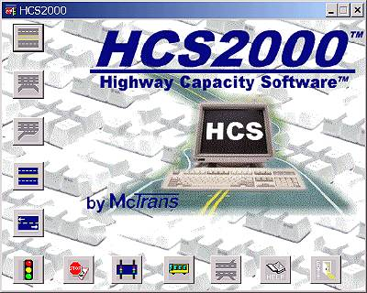



Slide 25


