Slide 1
Graduation Project (2)
Operations Improvement For
Al-Andalus Factory
An-Najah National University
Faculty of Engineering and Information Technology
Industrial Engineering Department
Supervisor Name:
Eng. Suleiman Daifi
Group Members:
Abbas Jibrel
Karim Risha
Manar Khalil
Tala kayed

Slide 2
Outline
Introduction.
Project Description.
Methodology and Data collection.
Our work.
Conclusion.
Recommendations.

Slide 3
Introduction
Al-Andalus factory was established in 1992.
They started with manufacturing shoes but in 1997 they switched to producing plastic bags.
It is a small family business with 16 employees including the manager.

Slide 4
Project Description
Al-Andalus faces many problems due to the absence of integrated operation systems, material handling system, factory layout and management system
In this project some tools were used as facility layout, methods engineering and lean manufacturing to support Al-Andalus Company to improve the operation.

Slide 5
Constraints
Gathering accurate data and information.
Lack of information about the market demand.
Weakness of the top management in applying suitable principles in managing and operating the factory.

Slide 6
Methodology
Data Collection and Analysis.
Literature Review.
Develop Systems.
Supervise the implementation of the developed systems and tools.
Reporting.

Slide 7
Data collection
A toolkit was used for assessing the current situation of the factory.
The tool consists of seven areas which are: Inventory management, maintenance, quality control, material handling, safety, facility layout and Material management.

Slide 8
Toolkit results
The figure shows these priority areas with their percentage in details:
Figure 1:Result of the Assessment

Slide 9
Current Situation
The next video shows the current situation of the factory.

Slide 10
Our work
Facility Layout.
Warehouse Management.
Organizational Structure.
Production Planning and Order Fulfilment.
Maintenance System.

Slide 11
1.Facility Layout
Current Layout:
  Long cycle time & material handling time.
  Many obstacles that obstruct the workers.
  No emergency exits.
  Many unused areas.

Slide 12
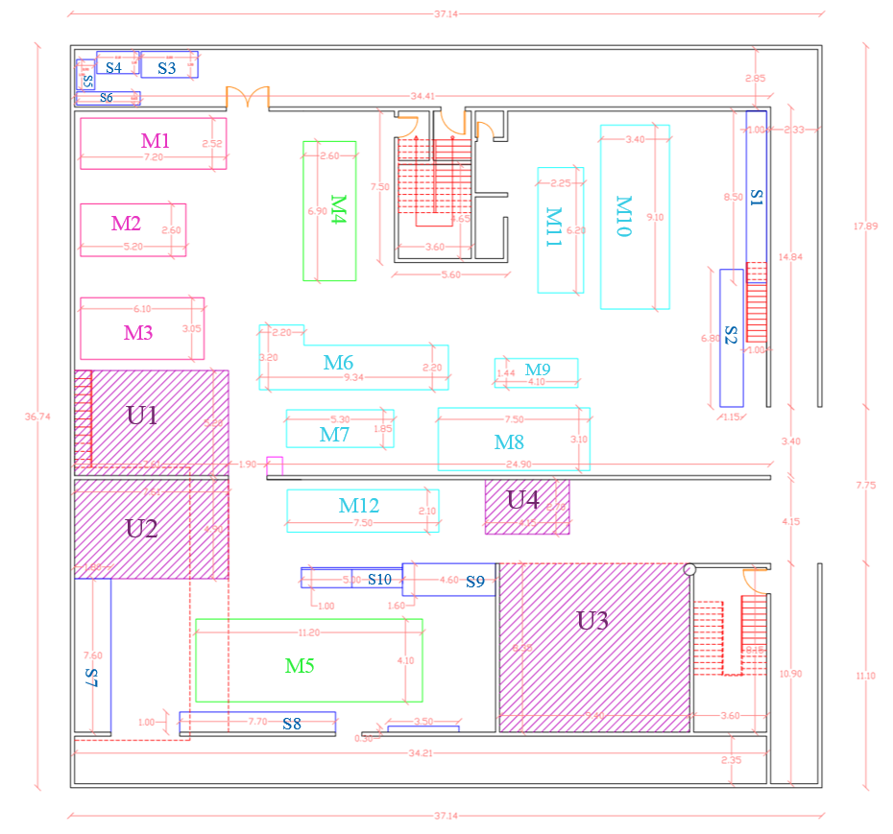
Current Layout
The following figure shows the current layout in the factory:
Figure 2: The current Layout in the factory

Slide 13
Layout Improvement
Factor | Current layout | First suggested | Second suggested | Third suggested | Fourth suggested
Extra free space | 98.33 | 103.75 | 126 | 130 | 192.124
Less distance travelled | 1102.13 | 1066.17 | 979.9 | 883.851 | 818.067
Extra inventory space | 118.85 | 206.877 | 146.484 | 196.777 | 182.757
Safety exits | 0 | 0 | 0 | 1 | 2
Table 1: Calculations for four layouts

Slide 14
Layout Improvement
Factor | Weight | Current layout |  | First suggested |  | Second suggested |  | Third suggested |  | Fourth suggested
 |  | Score | Weighted Score | Score | Weighted Score | Score | Weighted Score | Score | Weighted Score | Score | Weighted Score
Extra free space | 40% | 5.11 | 2.044 | 5.4 | 2.16 | 6.55 | 2.62 | 6.8 | 2.72 | 10 | 4
Less distance travelled | 20% | 7.4 | 1.48 | 7.7 | 1.54 | 8.3 | 1.66 | 9.3 | 1.86 | 10 | 2
Extra inventory space | 30% | 5.7 | 1.73 | 10 | 3 | 7 | 2.1 | 9.5 | 2.85 | 8.8 | 2.64
Safety exits | 10% | 0 | 0 | 0 | 0 | 0 | 0 | 5 | 0.5 | 10 | 1
Total |  | 5.254 |  | 6.7 |  | 6.38 |  | 7.93 |  | 9.64
Table 2: Scores & weight for layouts

Slide 15
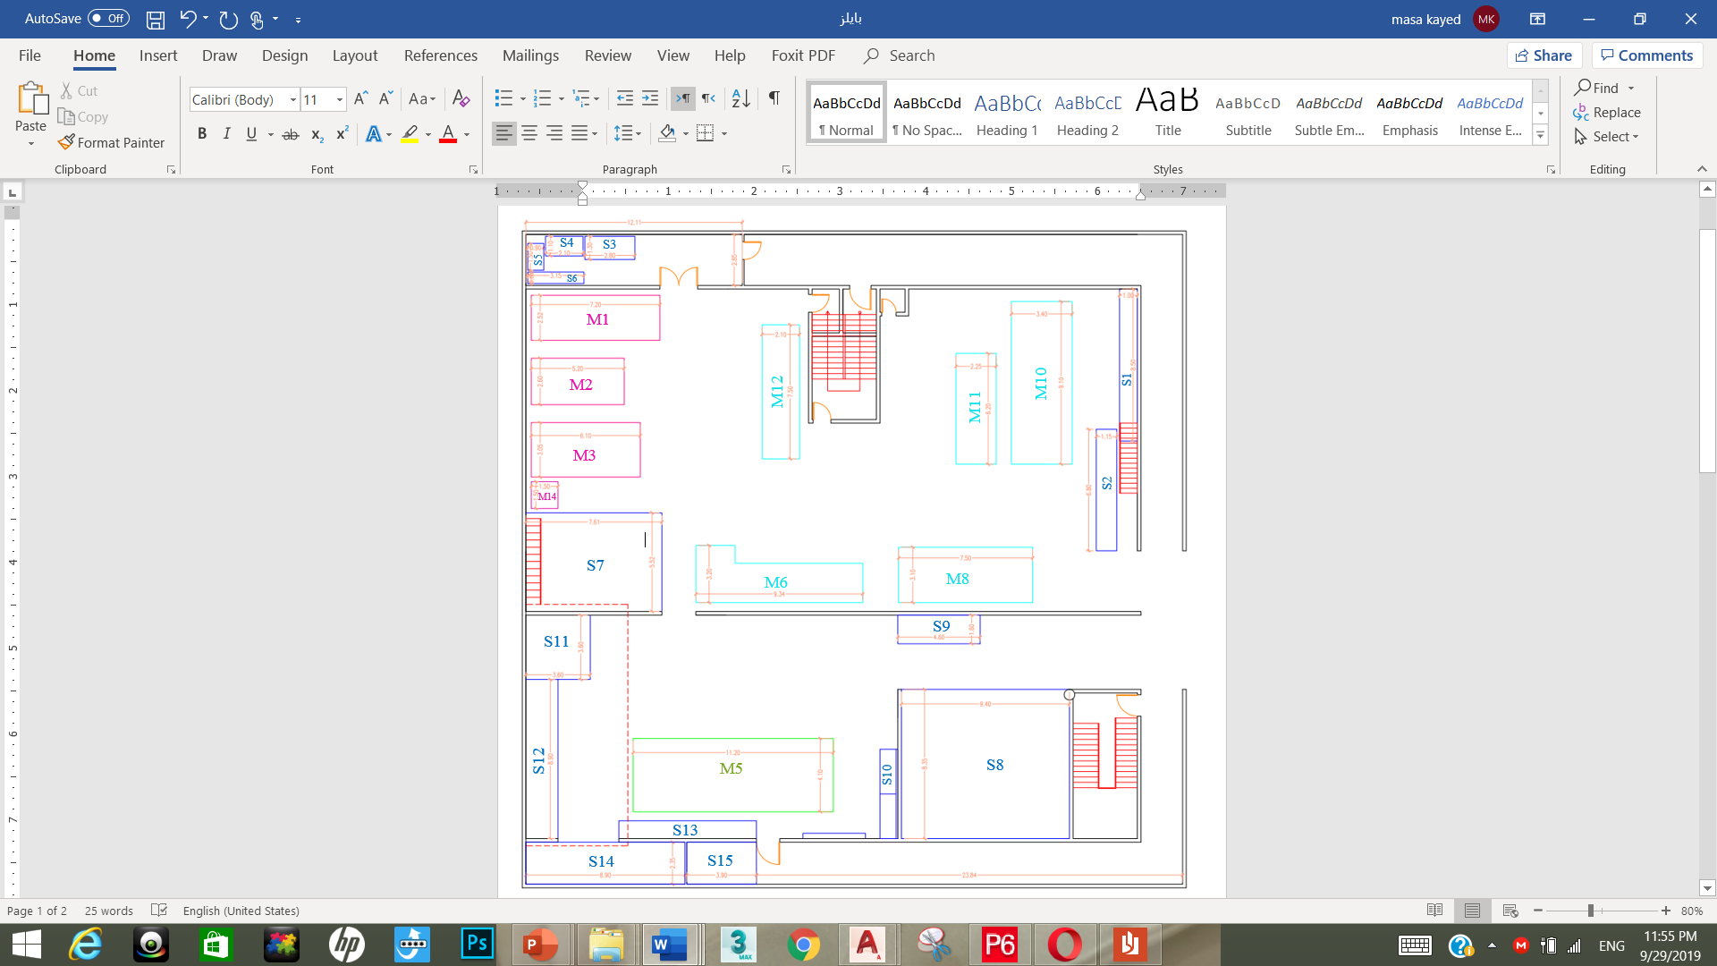
Layout Improvement
Figure 3: Fourth suggested layout

Slide 16
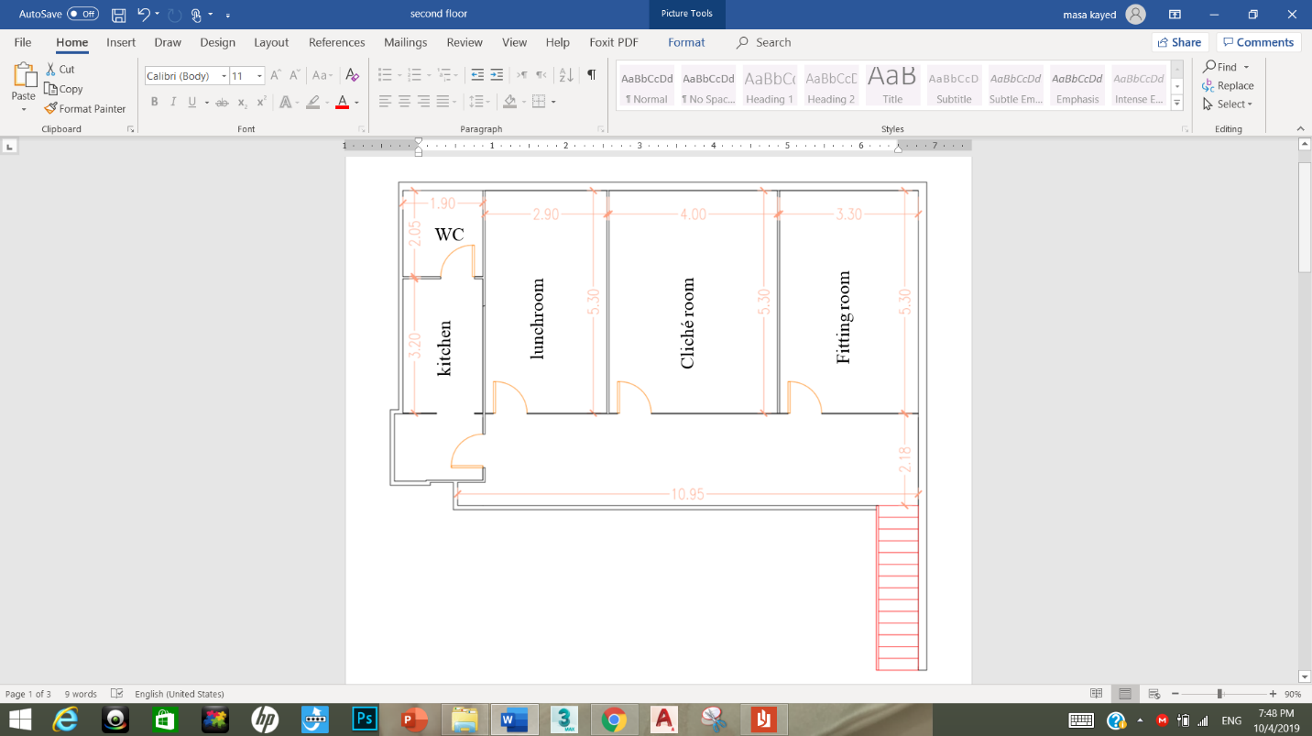
Layout Improvement
Figure 4: Second floor layout 1

Slide 17
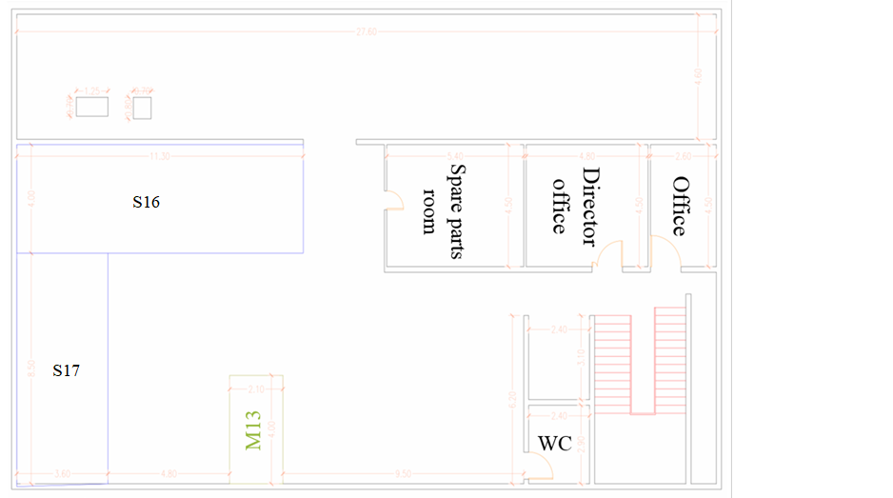
Layout Improvement
Figure 5: Second floor layout 2

Slide 18
2.Warehouse Management
Current status of Warehouse in the factory:
  Many areas not being using.
  The raw material, work- in-process and finished products are put together with no order.
  Raw material is placed between machines.

Slide 19
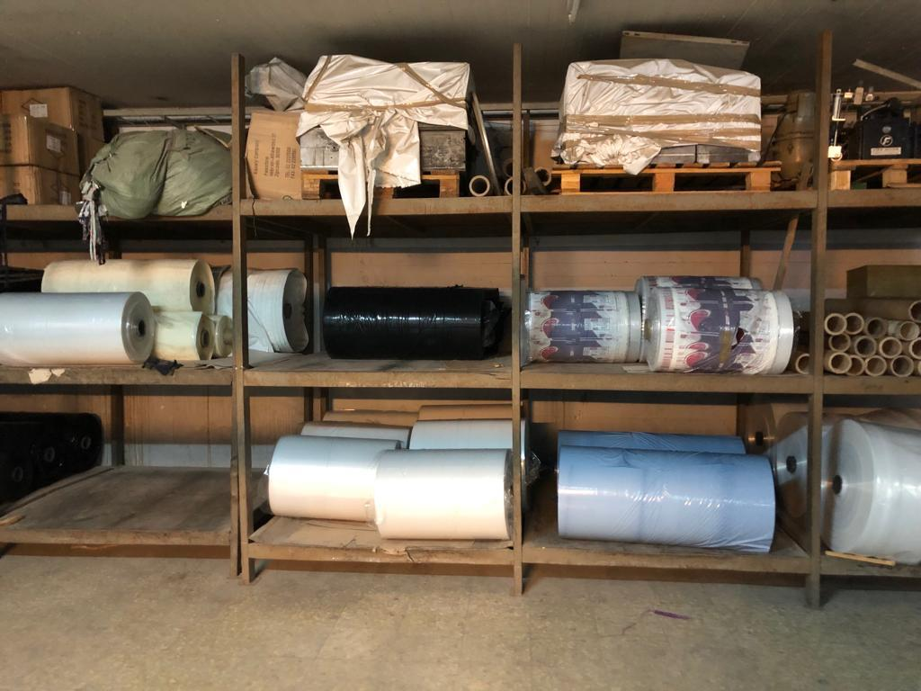
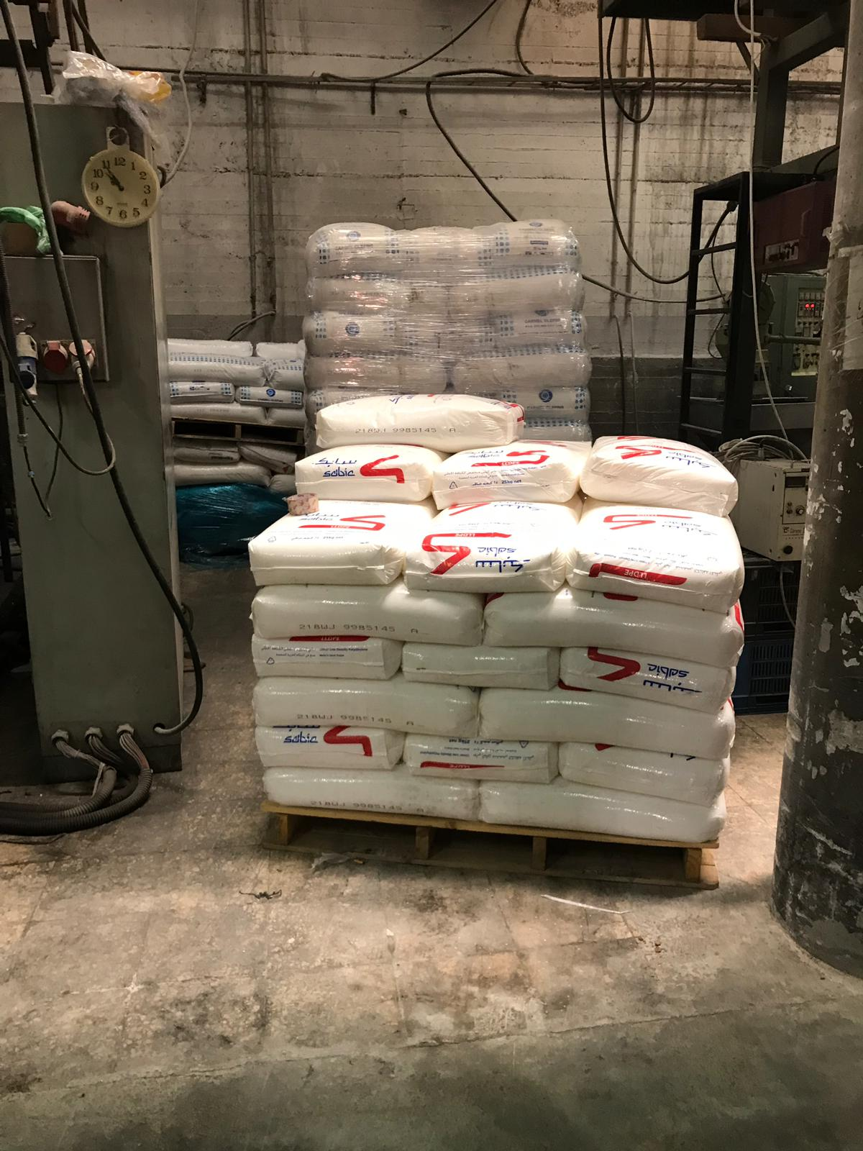
Current Situation
Figure6: Work-in-process store
Figure7: Raw materials between machines

Slide 20
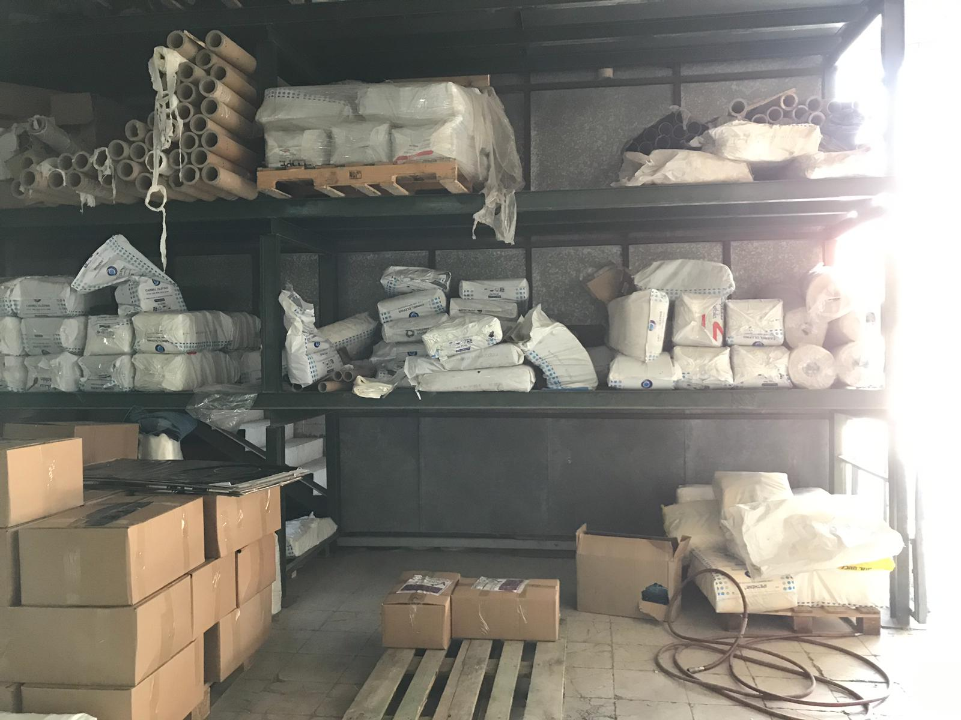
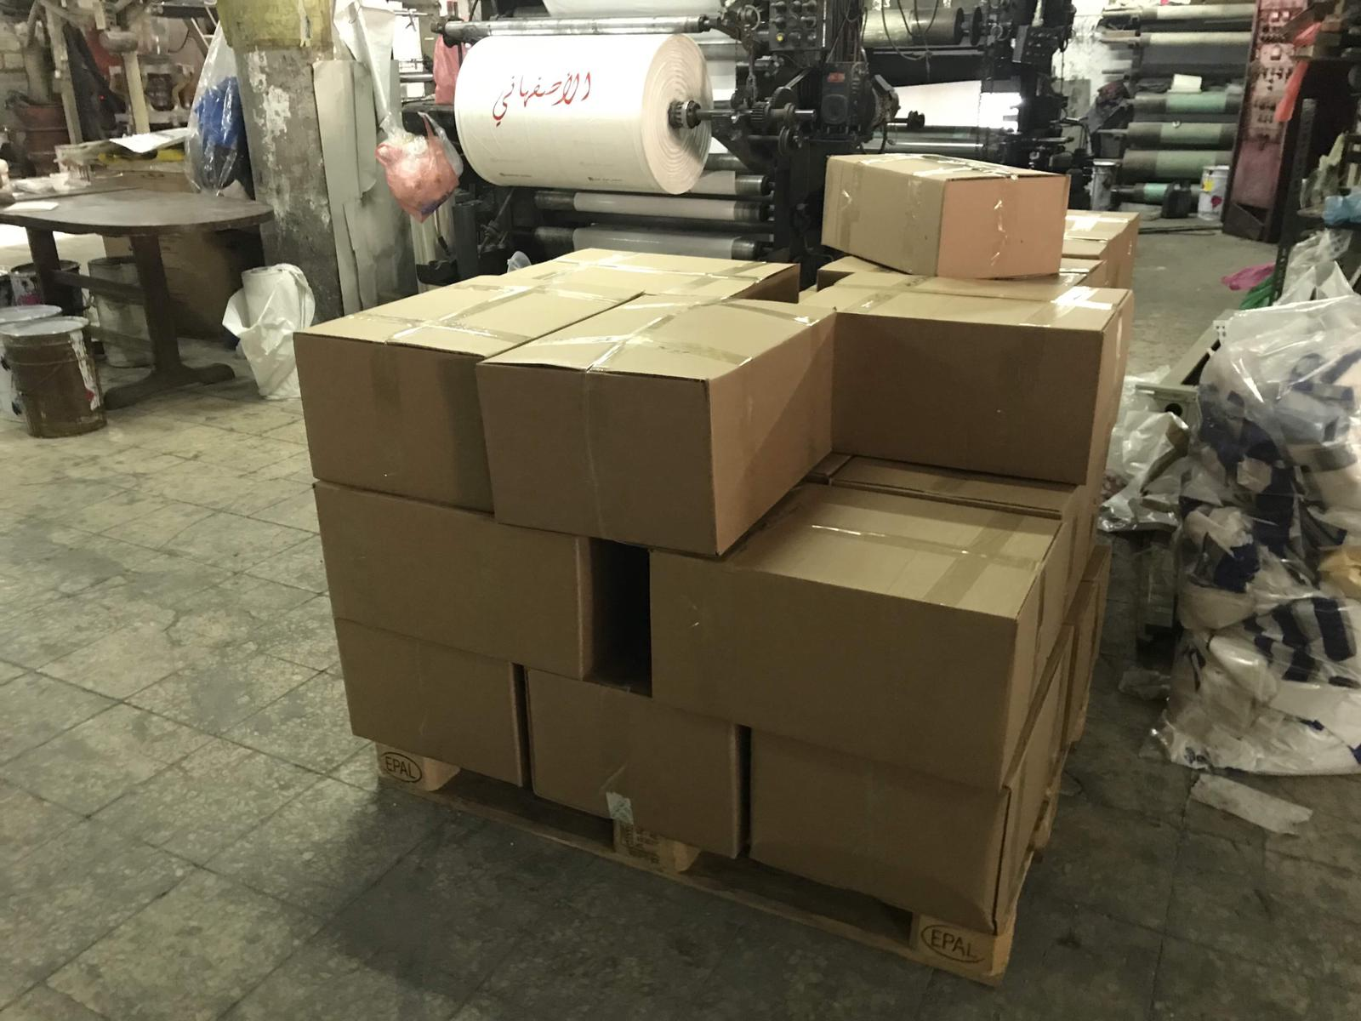
Current Situation
Figure8: Raw material, work-in-process finished product
Figure9: Packaged products

Slide 21
Warehouse Improvement
Classification :
  Location of Warehouses.
  Storing mechanism.
  Signs.
  Safety.
Inventory Management:
  ROP.
  SS.
Warehouse:
  SOP.

Slide 22
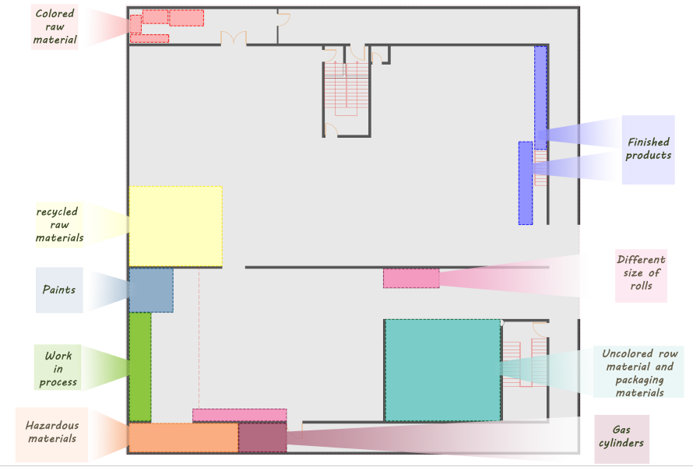
Warehouse Classification
The next figures show the suggested location of warehouses
Figure 10: Location of warehouses 1

Slide 23
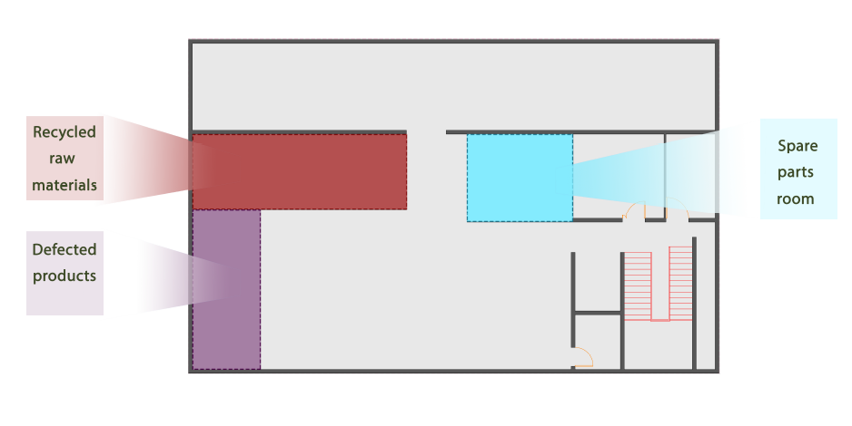
Warehouse Classification
Figure 11: Location of warehouses 2

Slide 24
Inventory Management
In this section, Reorder Point and safety stock were calculated depending on demand data.
Product Unpainted Plastic rolls | Month 2019 | Demand (tons) | LDPE (tons) | LLDPE (tons)
 | January | 10.55 | 8.757 | 1.794
 | February | 8.20 | 6.806 | 1.394
 | March | 9.44 | 7.835 | 1.605
 | April | 11.60 | 9.628 | 1.972
 | May | 12.20 | 10.126 | 2.074
 | June | 9.952 | 8.260 | 1.692
 | July | 12.685 | 10.529 | 2.156
 | August | 13.810 | 11.462 | 2.348
 | September | 15.971 | 13.256 | 2.715
 | October | 12.267 | 10.182 | 2.085
 | November | 10.675 | 8.860 | 1.815
Table 3: Materials Demand for year 2019 (Unpainted Rolls)

Slide 25
Inventory Management
Constraints:
lead time is constant = 2 days
demand is variable.
Safety Stock (S.S) for LLDPE = 𝑍𝜎𝑑𝐿𝑇
Safety Stock (S.S) = 1.28 * 0.623 * √ 2/26 = 0.22 tons.
Reorder Point (ROP) for LLDPE = Average daily usage * L.T + S.S
Reorder Point (ROP) = 3.720/26 * 2 + 0.22= 0.506 tons.

Slide 26
3. Maintenance System
Current status of Maintenance :
  The factory suffers from a poor maintenance system.
  There is no preventive maintenance.
  Interruption of production by frequent breakdowns.

Slide 27
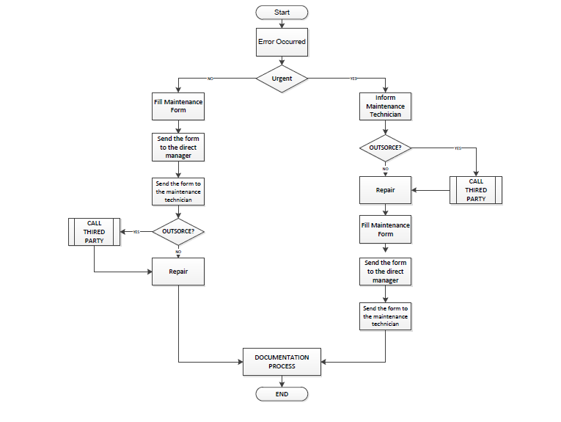
Improved Maintenance System
This part of the project aims at constructing a maintenance system at Al-Andalus Factory.
Figure 12: Corrective maintenance flow chart

Slide 28
3. Maintenance System
SOPs and Forms were developed to organize and manage all maintenance operations whether preventive maintenance or corrective maintenance.

Slide 29
4. Organizational Structure
Al-Andalus suffers from lacking a clear organizational structure.
The next figure shows the proposed organizational structure of the factory

Slide 30
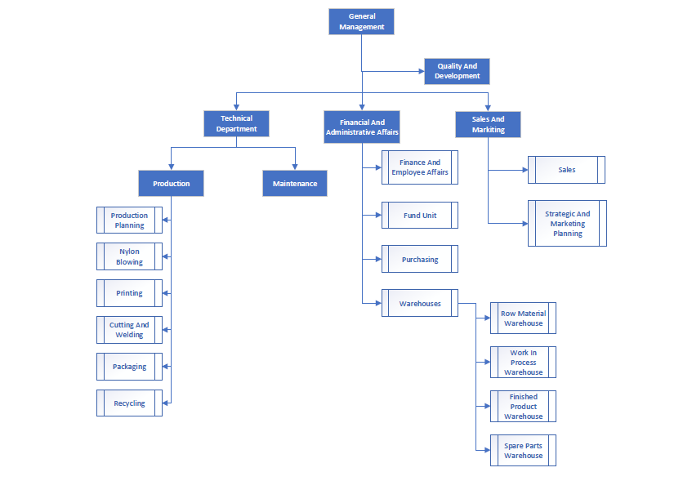
Figure 13: Proposed Organizational Structure

Slide 31
5.Production Planning and Order Fulfilment
Current status of production management:
  The factory Doesn’t use any scientific methods to organize their production operations.
  They work randomly.
  There is no work plan, no goals set for operating purposes,
  There is a high volume of backlog orders because of bad time management system.
The following flowchart shows the sequence of activities for manufacturing plastic bags after applying after applying the enhancement:

Slide 32
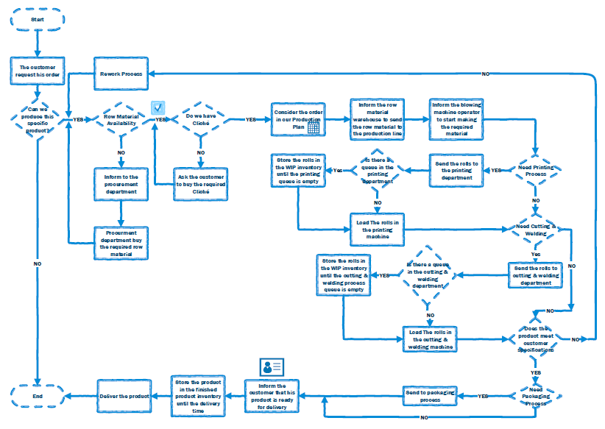
Figure 14: Enhanced Flow chart

Slide 33
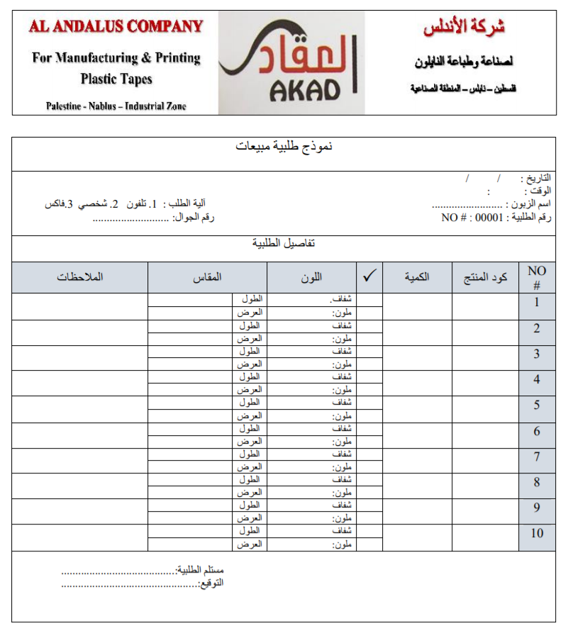
5.Production Planning and Order Fulfilment
Sales Order Form

Slide 34
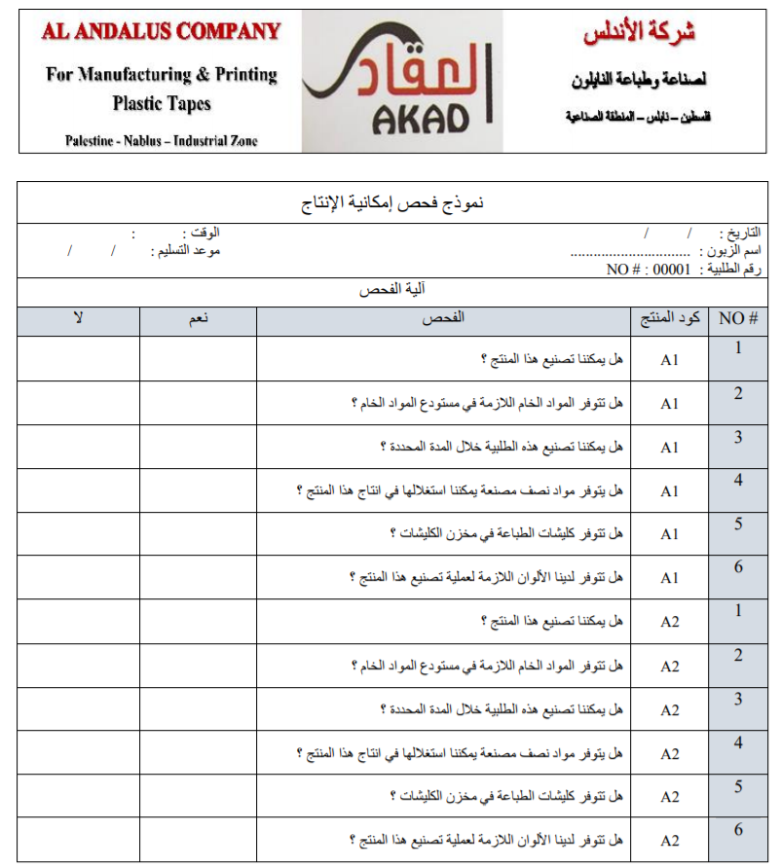
5.Production Planning and Order Fulfilment
Production possibility
Testing form.

Slide 35
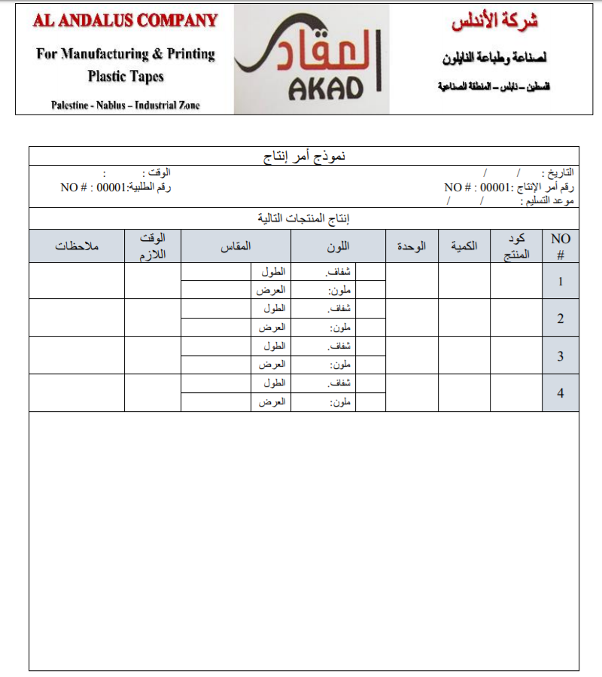
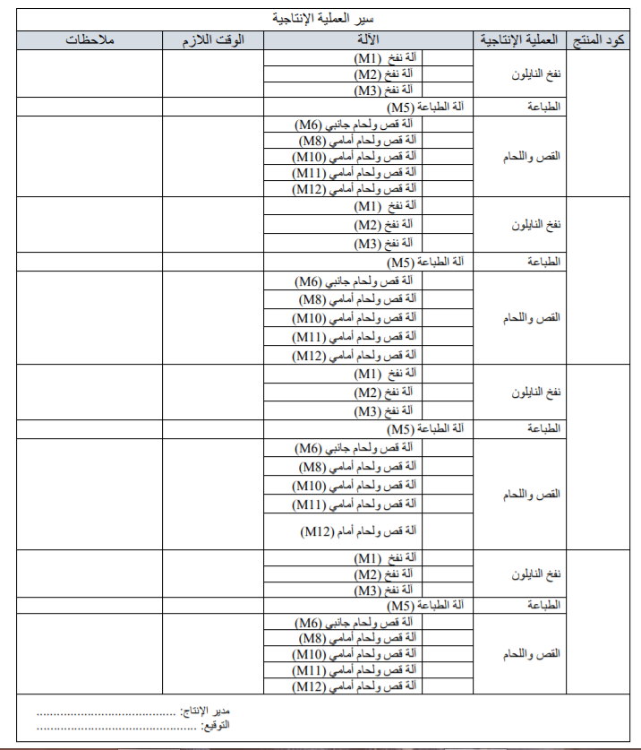
5.Production Planning and Order Fulfilment
Production
Order Form

Slide 36
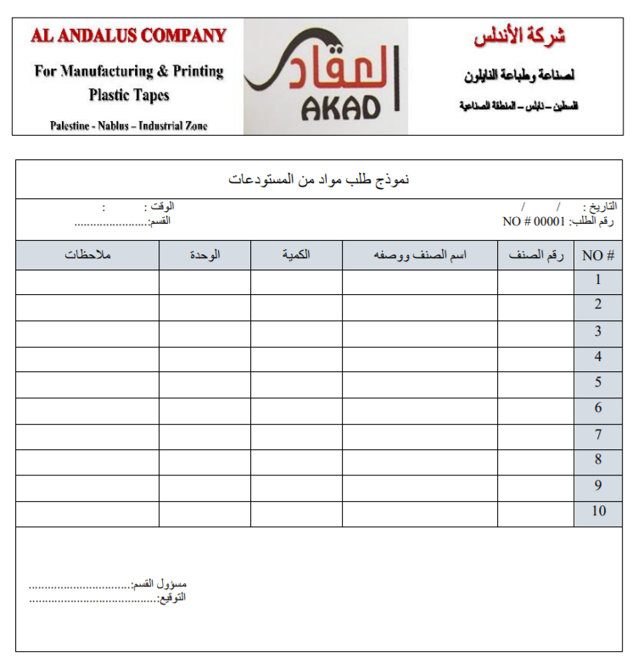
5.Production Planning and Order Fulfilment
Materials ordering form

Slide 37
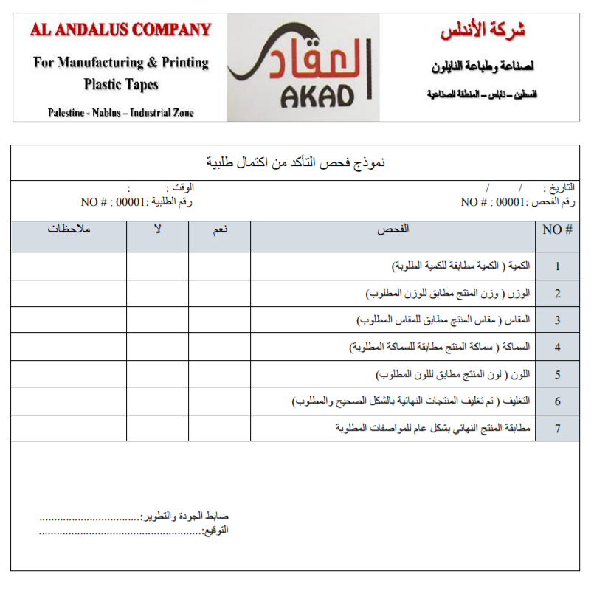
5.Production Planning and Order Fulfilment
Quality Assurance form

Slide 38
Future Situation
The next video shows the future situation of the factory.

Slide 39
Conclusion
A new layout was designed.
A maintenance system was built.
Standard operating procedures (SOPs) for maintenance and warehouse systems were created.
A clear organizational structure was established.

Slide 40
Recommendations
It is recommended to implement the deliverables from this project, in addition:
Prepare the remaining SOPs that have not been discussed in this project.
Continue research and development on procedures and forms.
Commitment to safety regulations.
Utilize the free space by buying new machines and installing them in that area.

Slide 41


