Slide 1
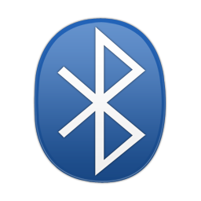
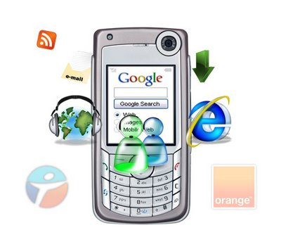
Browsing Internet Via Bluetooth
BMB
_{Bluetooth Mobile Browser}
Lubna Y. Dwaikat
Hind A.H. Wadi

Slide 2
Introduction
Using Mobile in Internet browsing become widely used , most of the time it’s done using WAP.
WAP needs payment , usually high cost.
Regular DSL is available and much cheaper.
Bluetooth become widely used in PCs , laptops and mobiles.

Slide 3
Introduction
Why don’t we use Bluetooth to browse Internet !
Let’s Browse Internet via Bluetooth.
Let’s implement Bluetooth Mobile Browser (B.M.B)

Slide 4
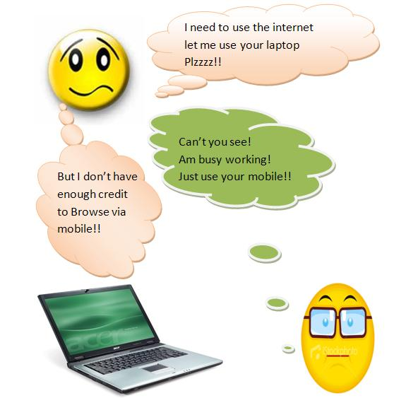
Before B.M.B

Slide 5
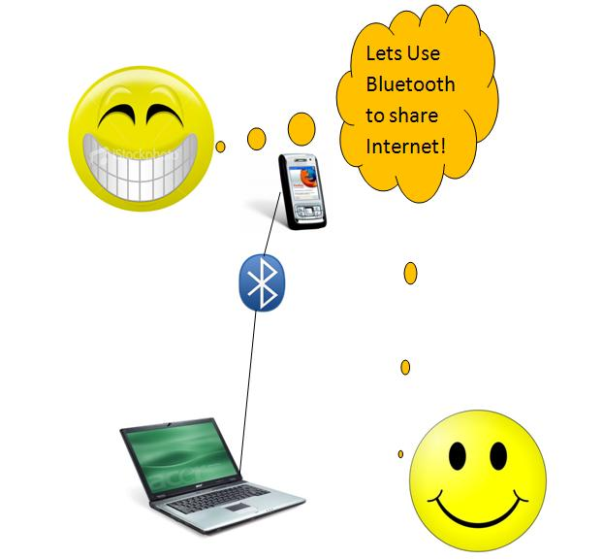
With B.M.B

Slide 6
Bluetooth mobile browse (B.M.B)
How to implement?
Needs to programs:
*Desktop application to work as server
*Mobile application (Browser) to work as client

Slide 7
B.M.B … how to implement
First Idea :
Let’s use the mobile browser .
oooops!!!
API problem
Notes:
Even if we overcome it … our applcation will work only on certain series

Slide 8
B.M.B … how to implement
Since we can not use the existing mobile browser
let’s find out an open source mobile browser
Big challenge !
but after long search we found
“ JCellBrowser “
Best alternatives !

Slide 9
B.M.B … how to implement
Client (Mobile) Application:
*Use the open source mobile browser we found.
* Understand how it works (oooh !! )
* Remove anything related to HTTP Connection
* Add a bluetooth connection , use it to:
- send a request
- accept the response

Slide 10
B.M.B … how to implement
Server (Desktop) Application:
*Connect the computer to the mobile via Bluetooth.
* Accept a request from mobile device.
* Handle the request.
* Send the response back to the mobile

Slide 11
B.M.B … Flow Chart

Slide 12
Server starts
Client starts
Keep listening
Send a connection request via Bluetooth
Receive the connection request
Connected to server,
Bluetooth channel is opened
Wait for Http Request
Send an Http Request
Handle Request
Wait the response
Send Response
parse the response , view it in the browser
Server Disconnect
Client Disconnect
Bluetooth channel is closed

Slide 13
Need a Protocol !
Http connection : opened when needed , accept response then closed.
While in Bluetooth connection :It’s always On.
Protocol to tell :
when the data starts
when it ends
what’s it’s length

Slide 14
Need a Protocol !
Http connection : uses two methods get and post
Bluetooth connection :Need to simulate HTTP.
Protocol to differentiate between get request and post request

Slide 15
Challenges
How to send the request, and how to redirect the response to mobile.
Images.
Logging In

Slide 16
Technologies , building tools
Bluetooth
Serial Communication
J2me
C#.net
Notes:
Esh el ashya2 elly mne7tagHa la 7atta yeshteghel el barnameg? …bt 3nd server o 3nd client, mobile yed3am j2me

Slide 17
Security
Https
Bluetooth
Application

Slide 18
Limitations
Limited speed , the data is sent serially .
The Open S. Mobile browser we found

Slide 19
To be done
Serve More than one client

