Slide 1

Redesign Of Integrated Car showroom
Prepared By :
Basheer Ibrahim
Emad Sokkar
Mutaz Dawood
Sameh Abu Aishih
Supervisor:
Eng. Fadi Fatayer

Slide 2
Outline
Site location
Architectural Design
Environmental Design
Structural Design
Mechanical Design
Safety Design
Electrical Design
BOQ

Slide 3
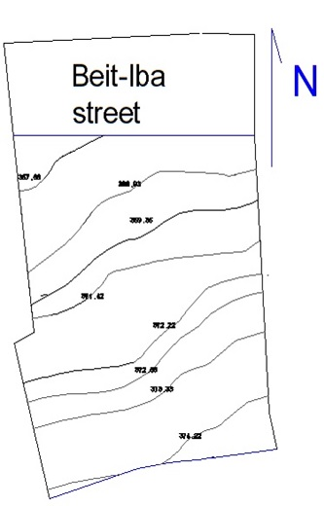
Site Information
The site is located at Nablus city, Beit- Iba Street. slight slope.
The land has an area = 7936.2m^{2.}

Slide 4
Outline
Architectural Design
Comparison between suggested and final plan
Site plan
Circulation and entrances
Elevations
Sections

Slide 5
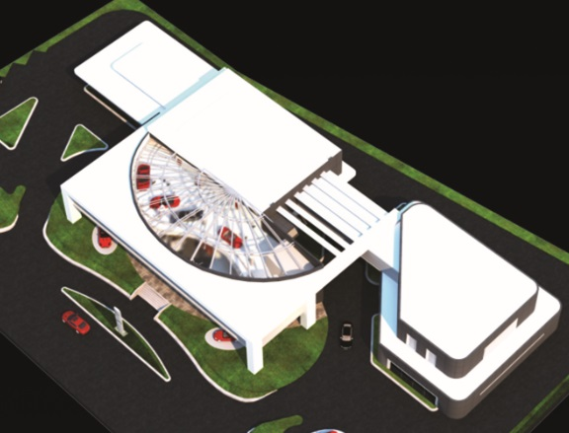
The suggested design for our project is one of a student work of the third year of architectural department.
During our project we modified the
selected design (redesign the model)
In order to be suitable for the
selected site in Nablus city.

Slide 6
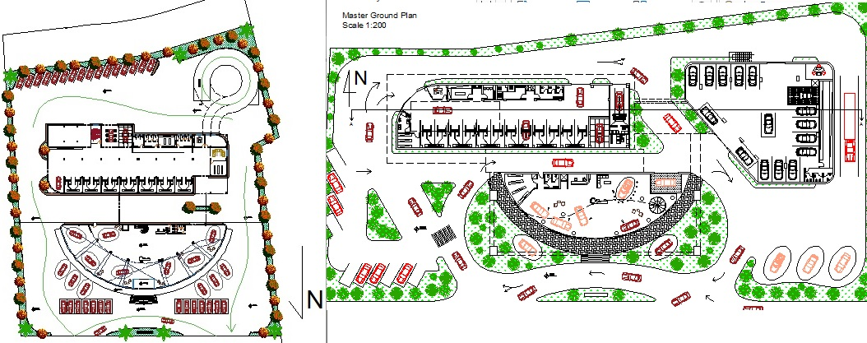
Comparison between suggested &final Design

Slide 7
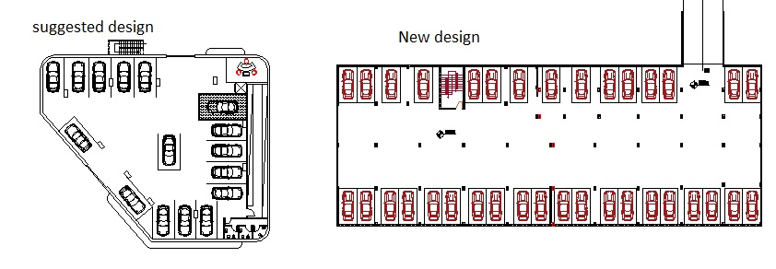
Cars storage

Slide 8
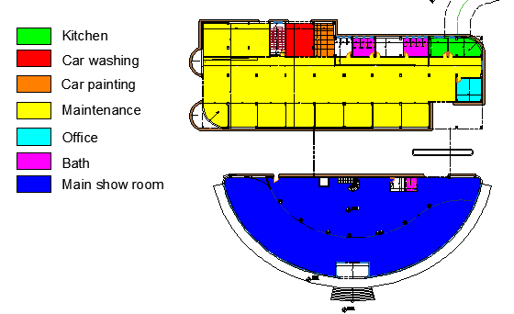
Ground Floor
Total Area = 1550m²

Slide 9
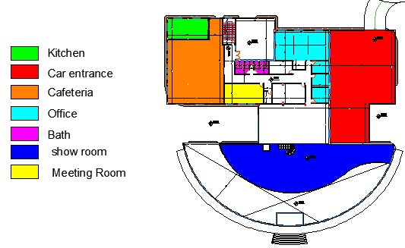
First Floor
Total Area = 1630 m²

Slide 10
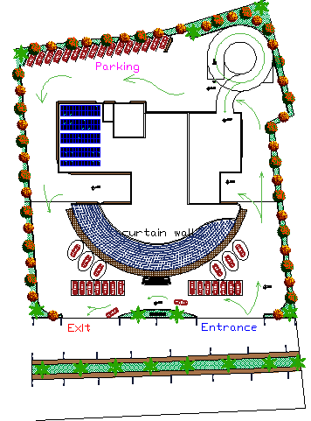
Site plan
Circulation &entrance
Area total=7936 m²

Slide 11
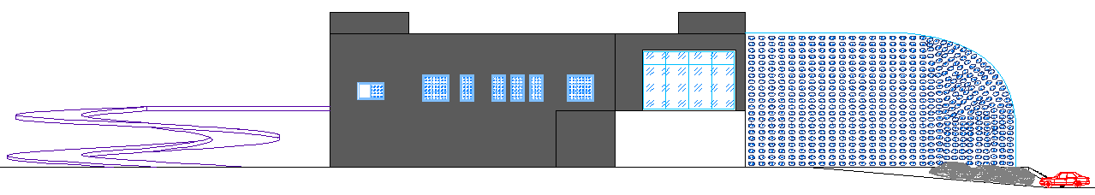
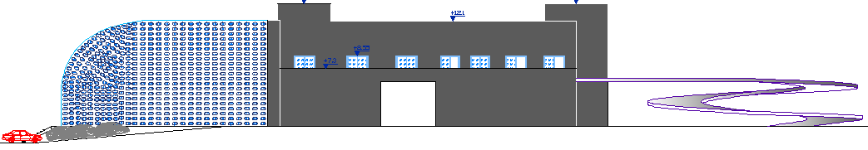
East & west Elevation
East elevation
West elevation

Slide 12
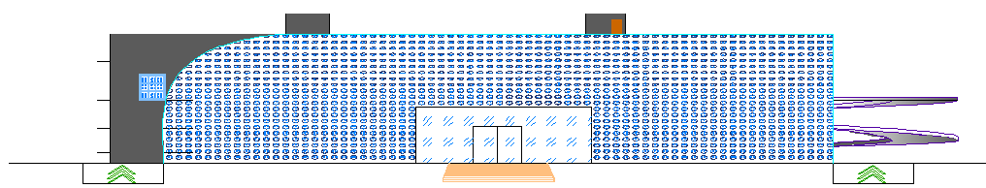
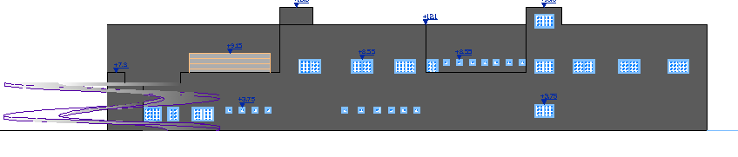
North & south Elevation
South elevation
South elevation

Slide 13
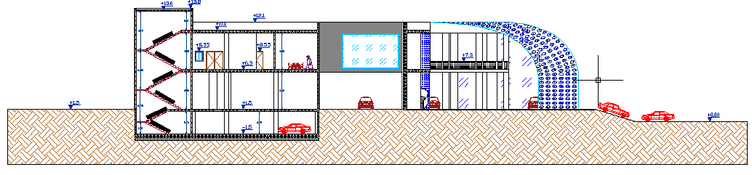
section A-A

Slide 14
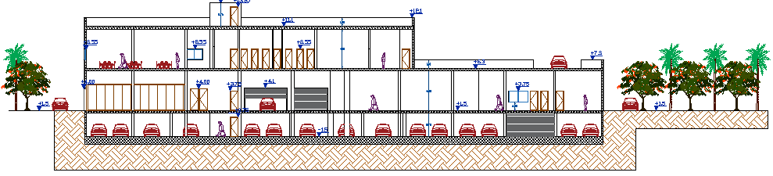
section B-B

Slide 15
Outline
Environmental Design
Shading Design
Daylight factor
Thermal analysis
Acoustical design
Photovoltaic cells

Slide 16
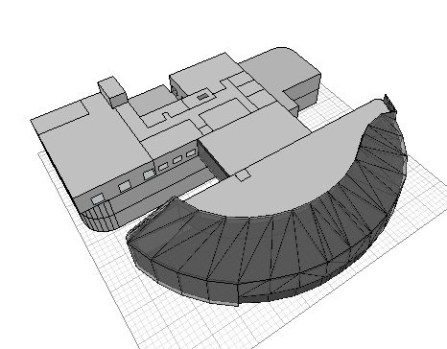
Building in ecotect

Slide 17
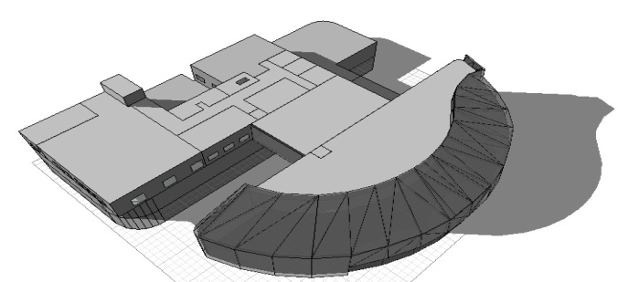
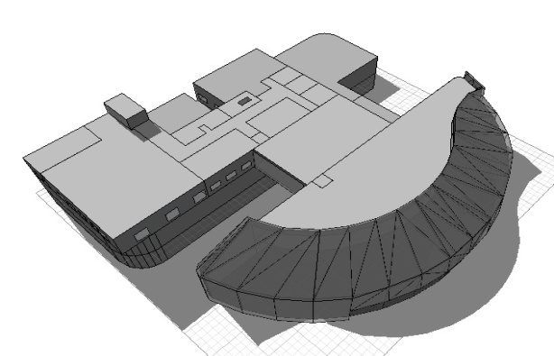
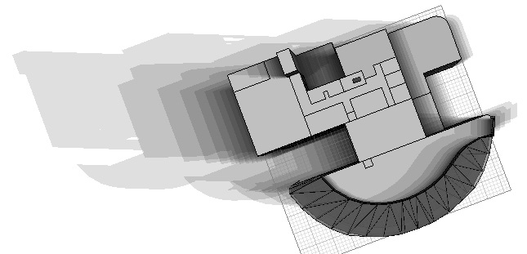
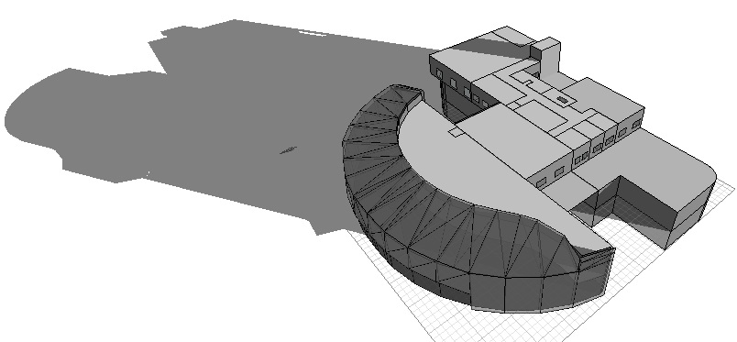
Shading at 21June
At 9:00 AM
At 12:00 PM
shadow range for the building from 8:00 am to 18:00 pm every half hour.
At 4:00 PM

Slide 18
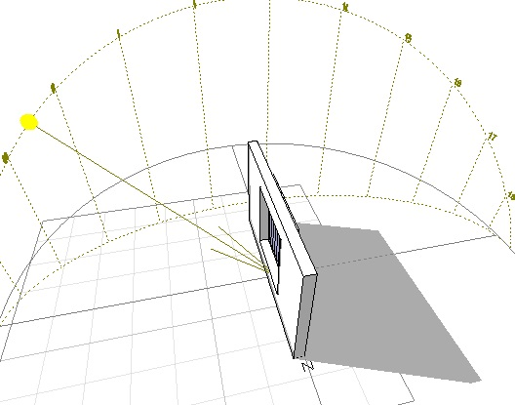
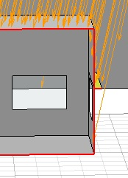
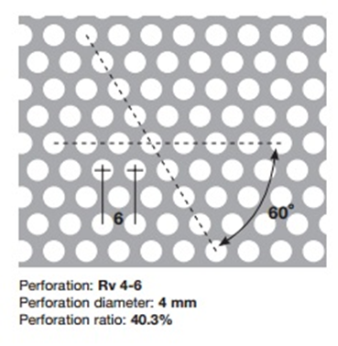
West and East
Showroom
South
12vertical Adjustable
Louvers - 30 cm
perforated panel perforation ratio of 40.3%
Fixed cantilever – 29 cm.

Slide 19
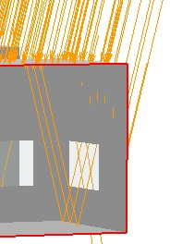
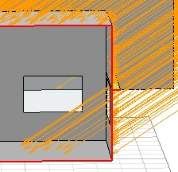
General Office shading - South
After shading in winter
Before shading
After shading in summer

Slide 20
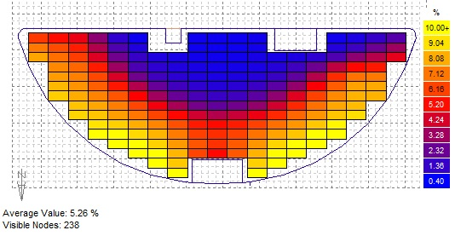
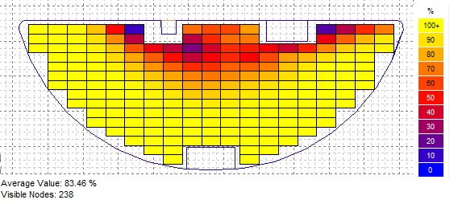
Daylight factor
GF of showroom
Daylight factor in = 5.26%
Autonomy =83.46%

Slide 21
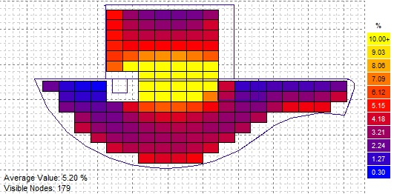
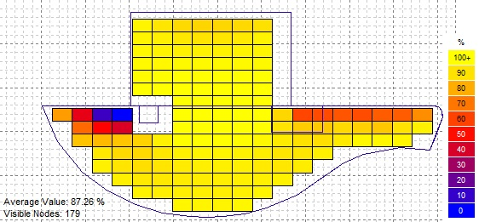
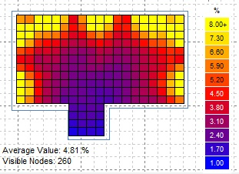
Daylight factor in F.F of showroom= 5.20%
Autonomy =87.26%
Autonomy =91.56%
Daylight factor in General office = 4.81%

Slide 22
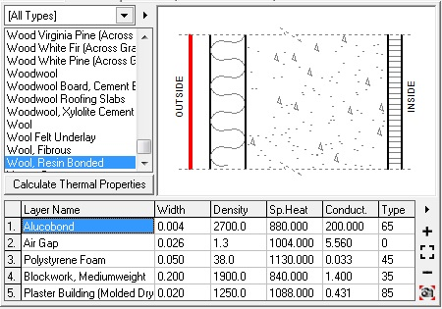
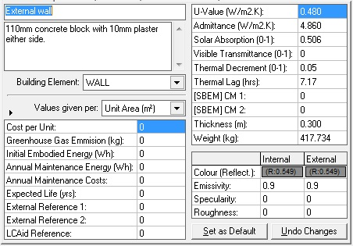
Materials :
External wall of U = 0.48 W/m2.K

Slide 23
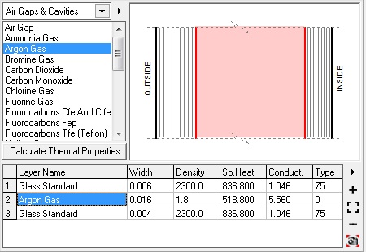
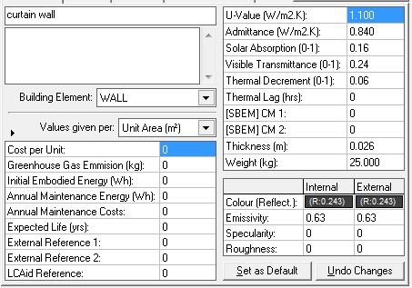
Curtain wall of U = 1.1 W/m2.K
(6mm Stop Sol- 16mm Argon – 4 mm planibel)

Slide 24
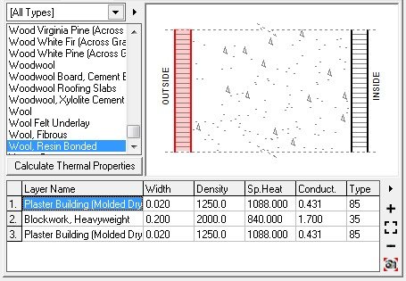
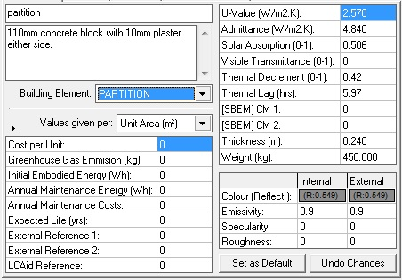
Internal wall of U = 2.57 W/m2.K

Slide 25
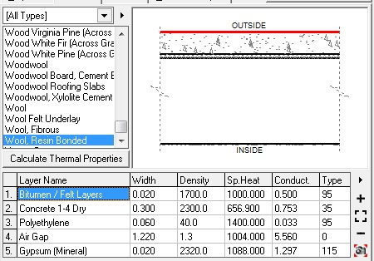
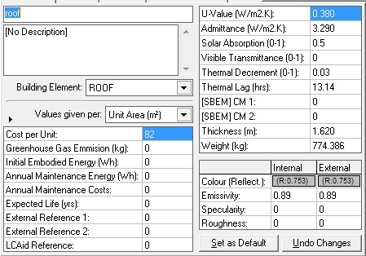
Materials :
Roof of U = 0.38 W/m2.K

Slide 26
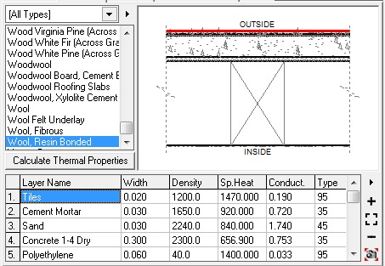
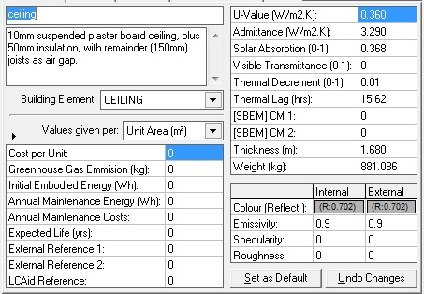
Ceiling of U = 0.36 W/m2.K

Slide 27
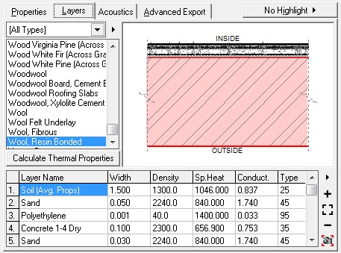
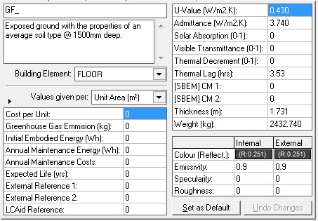
Ground Floor of U = 0.43 W/m2.K

Slide 28
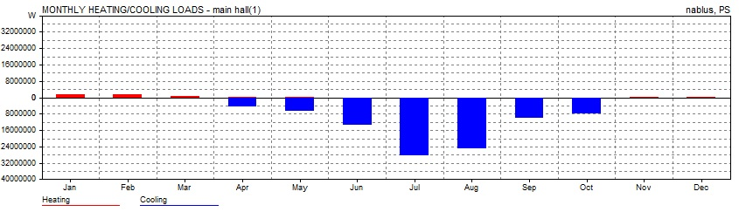
Heating/cooling loads in showroom
Max Heating: 31950 W at 13:00 on 18th January
Max Cooling: 193054W at 12:00 PM on 31th July

Slide 29
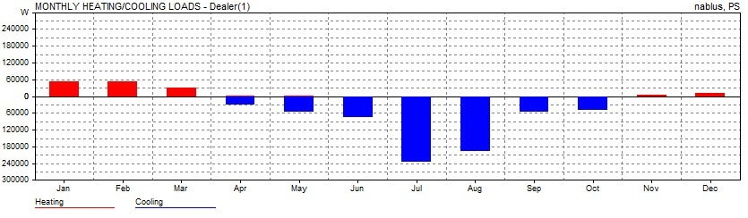
Heating/cooling loads in Dealer office
Max Heating: 925 W at 11:00 on 19th January.
Max Cooling: 1797 W at 14:00 on 23rd July.

Slide 30
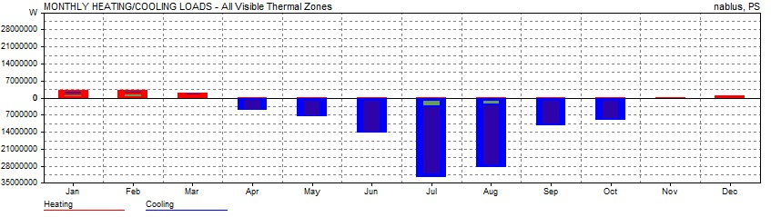
Heating/cooling loads for all building
Max Heating: 54092 W at 13:00 on 18th January.
Max Cooling: 229175 W at 12:00 on 31st July.

Slide 31
Reverberation Time RT60 in showroom
The optimum reverberation time for showroom is (1-1.4)sec ,
We used tow perforated false ceiling with different absorption coefficient for ground and first floor to optimize RT60

Slide 32


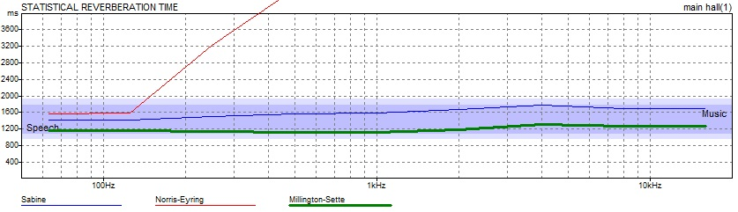
Absorption coefficient for ground floor ceiling
Absorption coefficient for first floor ceiling.
Reverberation time inside showroom after improving.

Slide 33


RT₆₀ before any improvement
RT₆₀ after applying the improvements

Slide 34
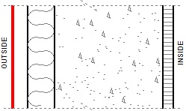
STC Values:
Layers | STC (dB)
20cm Hollow Block (medium) | +48
Insulation in air gap | +3
Plaster to one sides | +2
Total | 53
STC for ceiling =84 db.
STC for external wall =53 db.

Slide 35
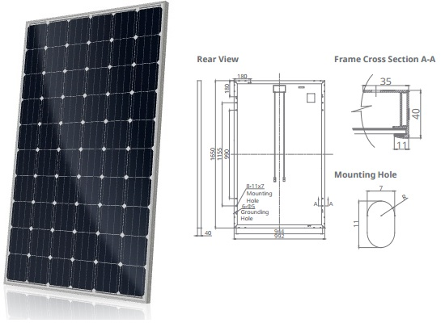
Photovoltaic
we use photovoltaic cells of type CS6K obtained from Canadian solar manufacture with nominal power of 270 W

Slide 36
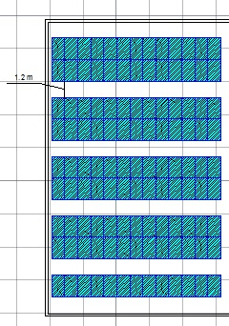
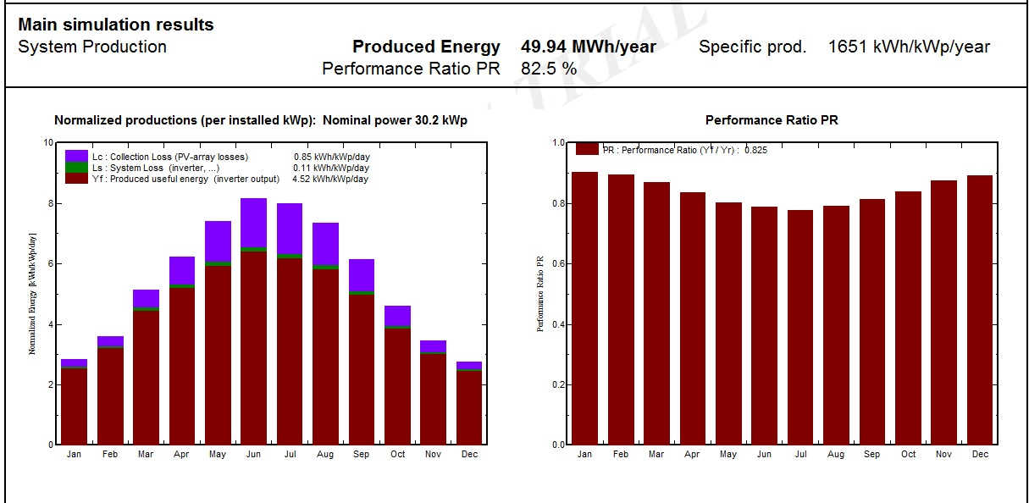
Photovoltaic
Simulation of horizontal portrait instillation
Produced energy=49.94 MWh/year
Performance ratio=82.5%
Horizontal portrait installation

Slide 37
Outline
Structural Design
Design cods
Design Data
Structural Elements
Etabs Result
Detailing

Slide 38
The structural systems
Two structural systems were used in the project:
Concrete Structure.
Truss Steel structure

Slide 39
Design Codes
The American Concrete Institute code (ACI 318-11).
The seismic design according to UBC-97.
The analysis and design were done using SAP2000, and ETABS 2015 programs.

Slide 40
Design Data
1. Concrete compressive strength
f’c =24 MPa for slabs and footings.
f’c =28 MPa for shear walls, columns and beams.
2.Yielding strength of steel
The yield strength of steel Fy= 420MPa
3. Bearing capacity of soil
the bearing capacity of soil = 150KN/m2

Slide 41
Structural Systems concrete structure
Sold slab “Car exhibition Building”
Thickness :
Solid slab = 30 cm

Slide 42
Structural Elements concrete structure:
Beams
Shear wall
Columns
Slabs
Footing
Stairs

Slide 43
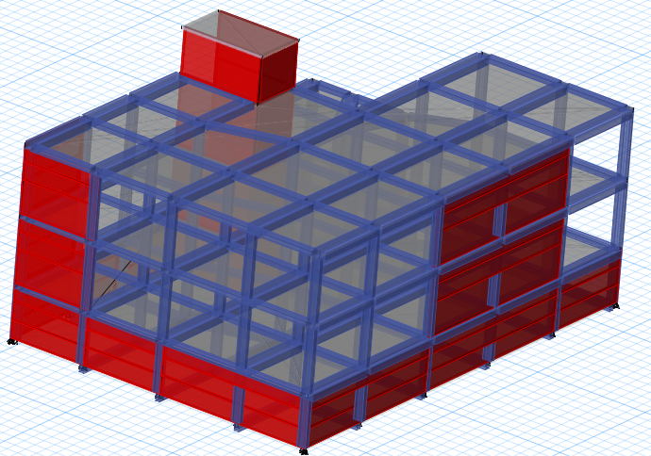
3D Modeling ETABS 2015

Slide 44
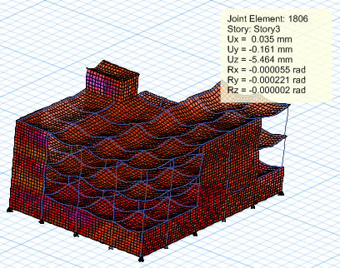

Checks ETABS 2015
Compatibility & Deflection Check:

Slide 45

Checks ETABS 2015
Equilibrium Check

Slide 46

Seismic Design Response Spectrum
Base shear reaction:
W= 45802 KN , Include D.L+S.D+0.25LL
UBC-97
I = 1
R= 5.5
Ca= 0.280
Cv= 0.40
T = 0.324 sec

Slide 47


Slab Reinforcement

Slide 48

Footing Reinforcement

Slide 49

Footing Reinforcement

Slide 50


Stairs Reinforcement

Slide 51


Shear wall Reinforcement

Slide 52
Steel truss structure
Materials Design Data:
A36 steel with yielding strength (F_{y}) = 250 Mpa and ultimate strength (F_{u}) = 400 Mpa
Concrete with Fc' = 24 Mpa
Metal sheet with weight of 75 kg/m²
E70xx welding material, with strength F =480 Mpa.

Slide 53
Loads
Values | Loads type
2 KN/m² | live
.75 KN/m² | SID
2 KN/m² | Snow
.25KN/m² | Wind load

Slide 54

2D – Model

Slide 55

Compatibility check for truss

Slide 56

Sections used in truss
We used HSS for all group in truss:

Slide 57


Connection Design
Dimension of gust plate:

Slide 58
Outline
Mechanical Design
Water supply system
Drainage system
HVAC

Slide 59
Water consumption
Functions | Gal.per day | Water consumption
Washing cars | 100-150 | 150
Employees | 12 | 12
Maintenance | 5-10 | 10
No Private bath (per persons) | 50 | 1000
Additional kitchen requirements | 10 | 20
showers | 600 | 600
Total building of water demand = 1792 g/ day

Slide 60

a water tank of 33 m3

Slide 61

Total FU’s | Collector
92 | In maintenance
100 | In show room in GF
28 | In show room in FF
Meter of 3.00 in
vertical of 3 in
Horizontal of 2.5 in
branch of 2.00 in

Slide 62


Drainage system for Ground Floor

Slide 63


Roof and Storm water Drainage

Slide 64

HVAC Design
The used HVAC system is VRF system

Slide 65

We need 4 outdoor units of Mitsubishi type with 69KW (235400BTU/h) Cooling capacity.
Out door unit

Slide 66


We used fan coils to receive natural air, supply air and to distribute the air through the Diffusers slot diffuser:

Slide 67

Diffusers distribution:

Slide 68

Main Duct sizing :
V’=1.98 m3/s , V=6m/s , (Δ𝑝/𝐸𝐿)=0.59 Pa/m

Slide 69
Outline
Safety Design
Circulation
Fire Fighting System
Safety signs

Slide 70


circulation movement and door exit

Slide 71

Fire Fighting System
Sprinkler distribution In showroom.

Slide 72


Fire Fighting System
Hose and extinguishers cabinet
Fire alarm device

Slide 73


Safety signs
Emergency exit signs.
Don’t use the elevator in case of fire or earthquakes

Slide 74
Outline
Site location
Architectural Design
Environmental Design
Structural Design
Mechanical Design
Socket distribution
Safety Design
Lighting distribution
Electrical Design
Dialux
BOQ

Slide 75


Distribution of Sockets

Slide 76
Outline
Site location
Architectural Design
Environmental Design
Structural Design
Mechanical Design
Socket distribution
Safety Design
Lighting distribution
Electrical Design
Dialux
BOQ

Slide 77

Results calculations from dialux evo for showrooms
For showroom in ground floor (lx=1146>1000,Uo=0.66~0.70 and UGR=14<19)

Slide 78

Results calculations from dialux evo for showrooms
For showroom in first floor (lx=1176>1000,Uo=0.68~0.70 and UGR=15<19)

Slide 79






Type of lighting units used in showrooms
Unit type | Quantity | Specifications | Total
Philips Lighting DN570B PSED-E 1xLED40S/830 F 1xLED40S/830 | 115 in showroom 1 184 in showroom 2 | Light output ratio: 100% Lamp luminous flux: 4200 lm Luminaire Luminous Flux: 4200 lm Power: 38.0 W Light yield: 110.5 lm/W Colour temperature: 3000 K Color rendering index: 100 | 299
Philips Lighting 4ME450 P-WB 1xSON250W +9ME100 R GC D450 | 45 combined between showroom 1&2 | Light output ratio: 78.98% Lamp luminous flux: 27000 lm Luminaire Luminous Flux: 21324 lm Power: 276.0 W Light yield: 77.3 lm/W Colour temperature: 3000 K Color rendering index: 100 | 45
Philips Lighting MCS501 1xCDM-TEV35W EB 12_930 | 10 in showroom1 11 in showroom 2 | Light output ratio: 67.84% Lamp luminous flux: 4300 lm Luminaire Luminous Flux: 2917 lm Power: 43.0 W Light yield: 67.8 lm/W Colour temperature: 3000 K Color rendering index: 100 | 21

Slide 80


Distribution of Lighting
Showroom in first floor
Show room in GF

Slide 81


Artificial Lighting from Dialux.evoProgram
Show room rendering

Slide 82


Artificial Lighting Dialux Program

Slide 83




Sound reinforcement system
We used two types of loud speakers which is obtained from Yamaha company.

Slide 84

Distribution of loudspeaker for ground floor of showroom.

Slide 85

Distribution of loudspeaker, Sprinkler, Diffusers and lighting units togother.

Slide 86
Outline
BOQ

Slide 87
Bill of Quantities
Total cost of project= 4047462 $
Cost for the project with land price per m²= 1185 $/m²

Slide 88
Thanks for your listening

