Slide 1
RoboMealMate
Innovating Restaurant Service Hospitality with AI (Artificial Intelligence)

Slide 2

Idea

Slide 3
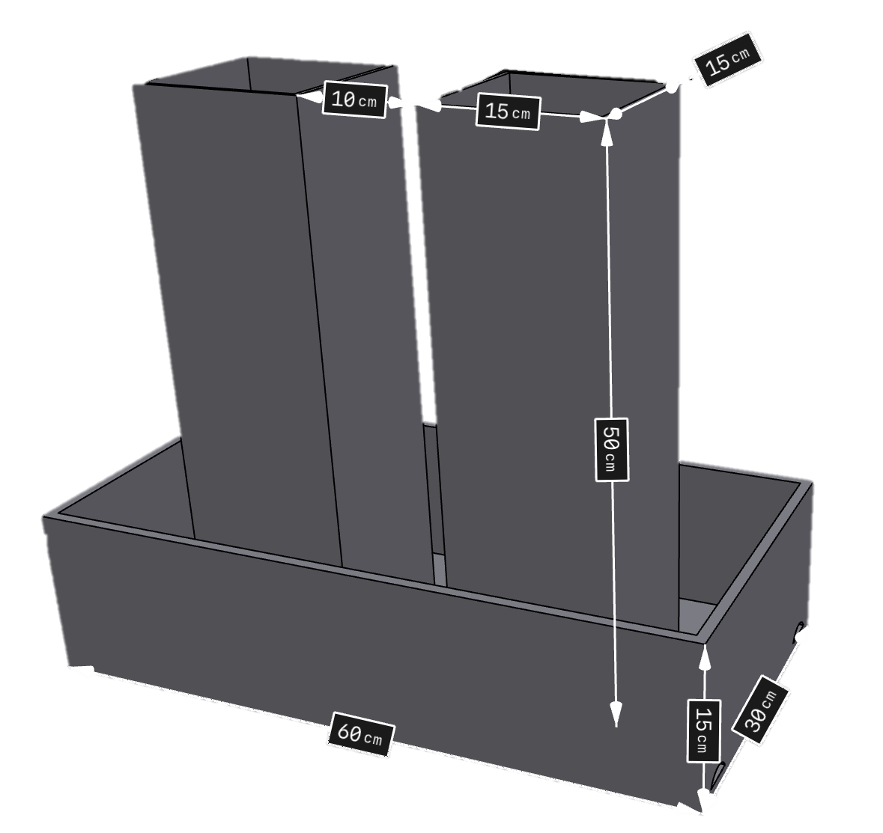
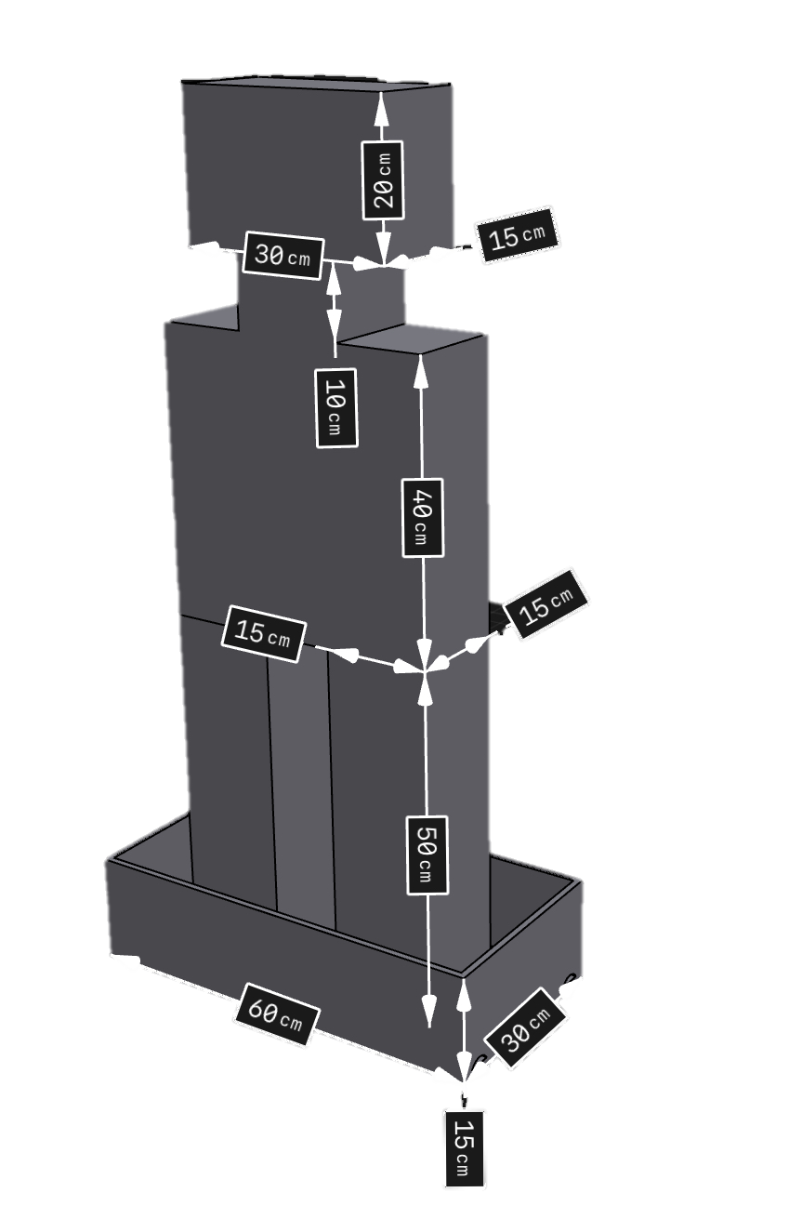
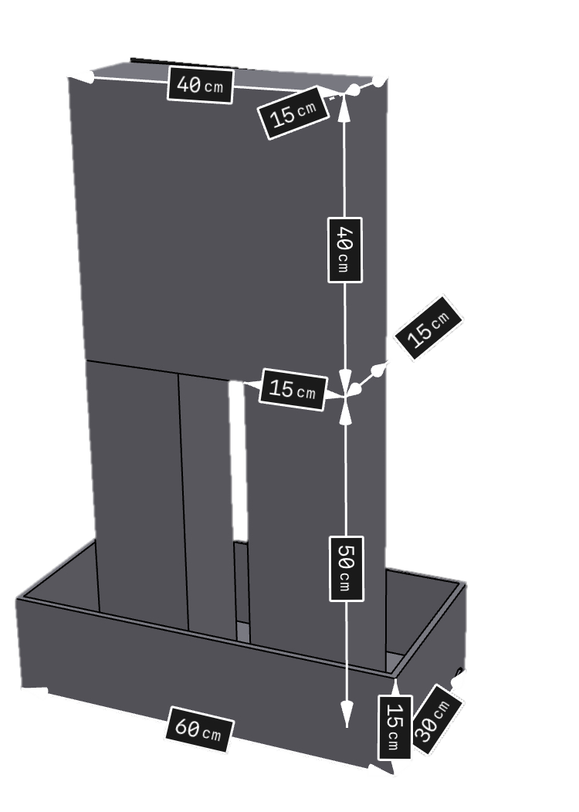
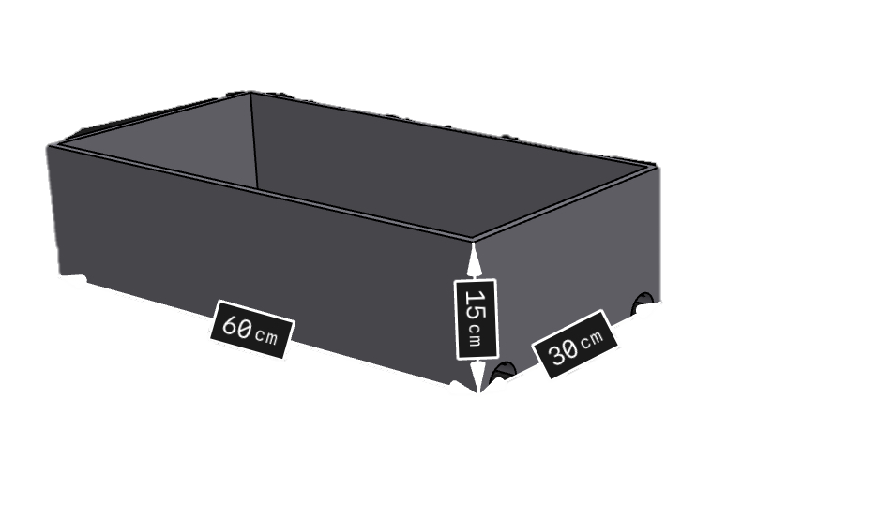
Design
Feet
Body
Head
Base

Slide 4
Hardware
Software

Slide 5
Hardware

Slide 6
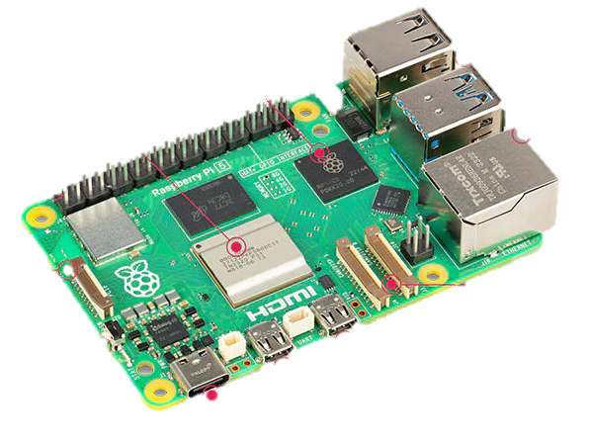
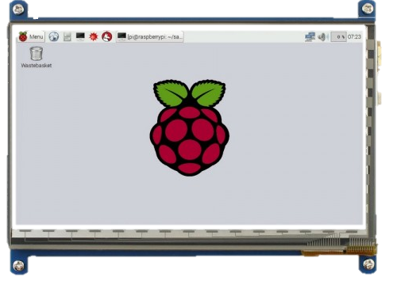
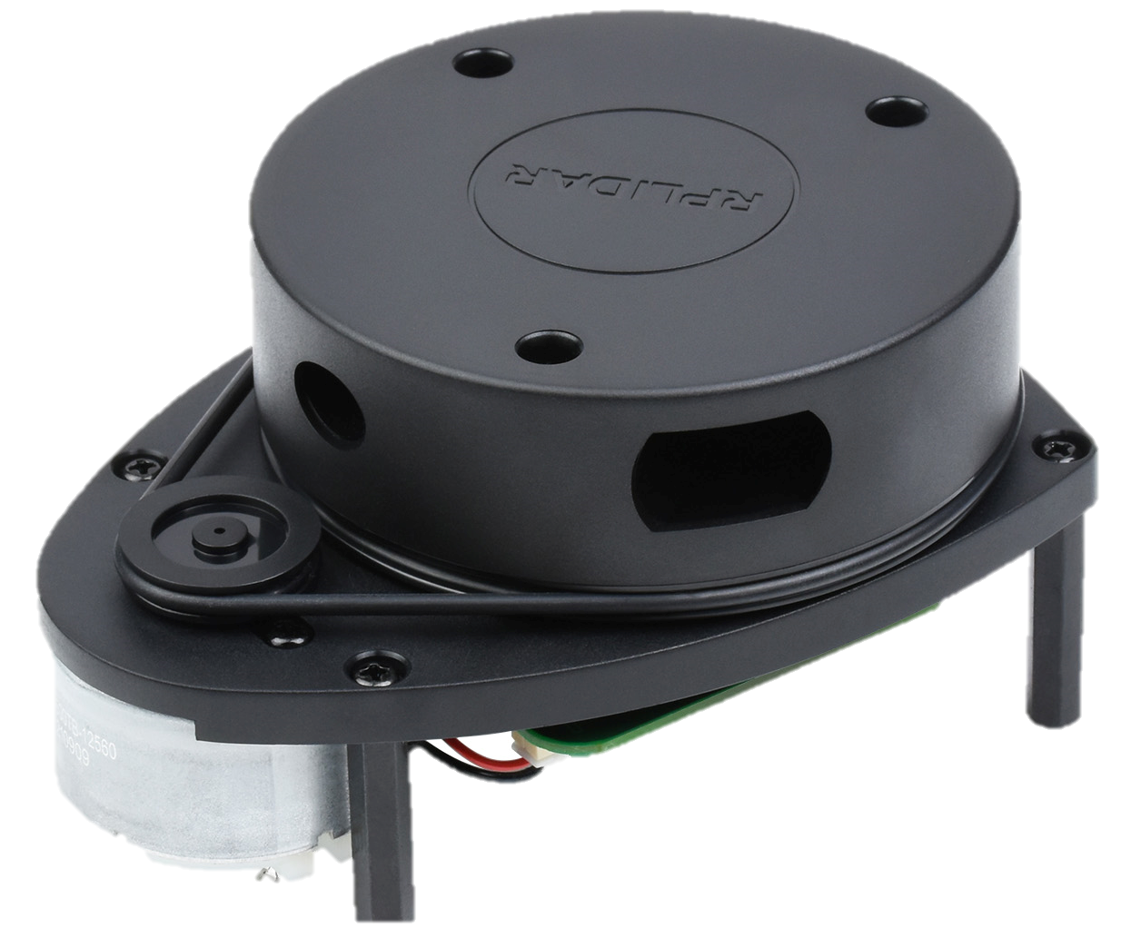
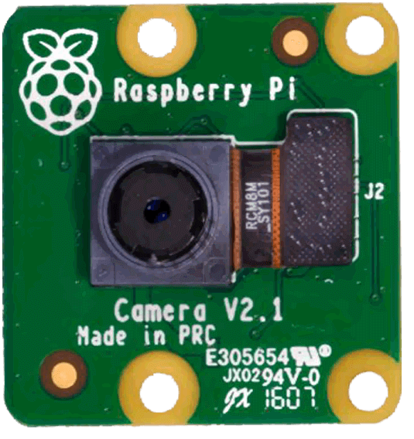
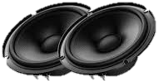
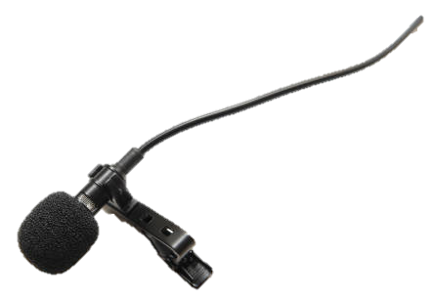
Hardware components
High-level control and its components
Raspberry pi 4
LCD Screen
Lidar
Camera
Speakers
Microphone

Slide 7
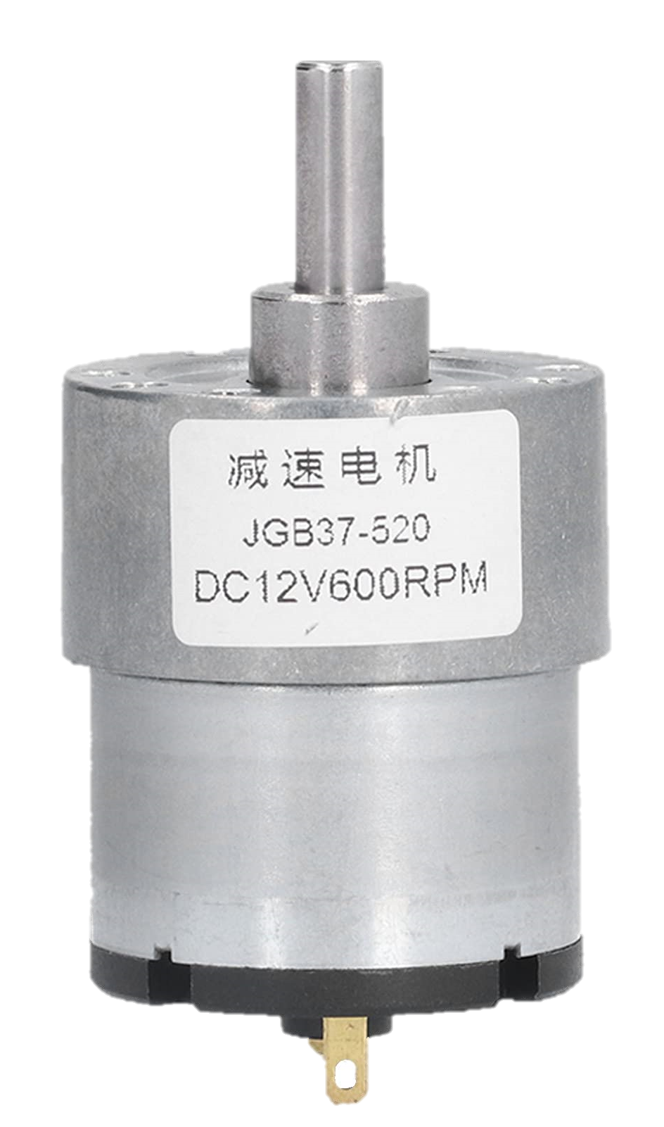
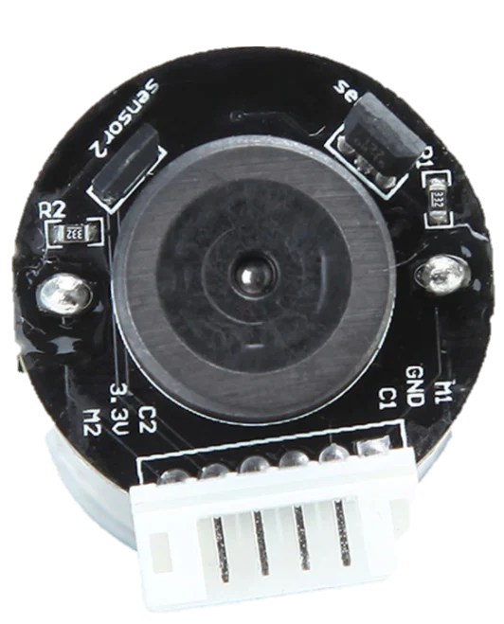
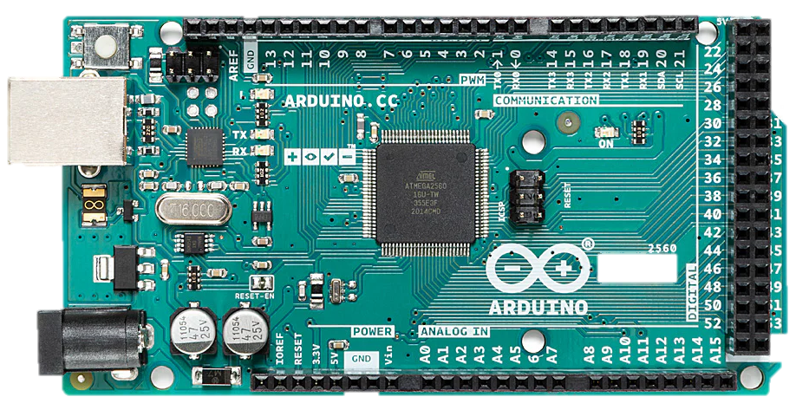
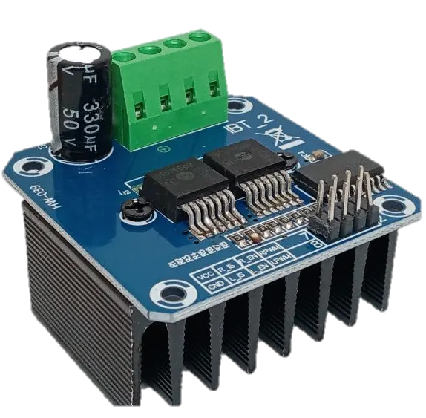
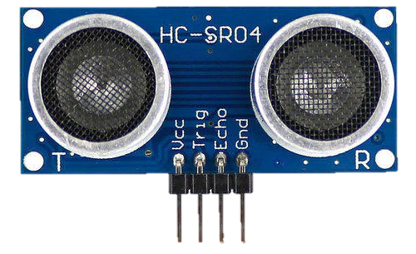
Low-level control and its components
Arduino Mega
DC motors
Encoders
IBT 2 motor drivers
Ultrasonic sensors

Slide 8

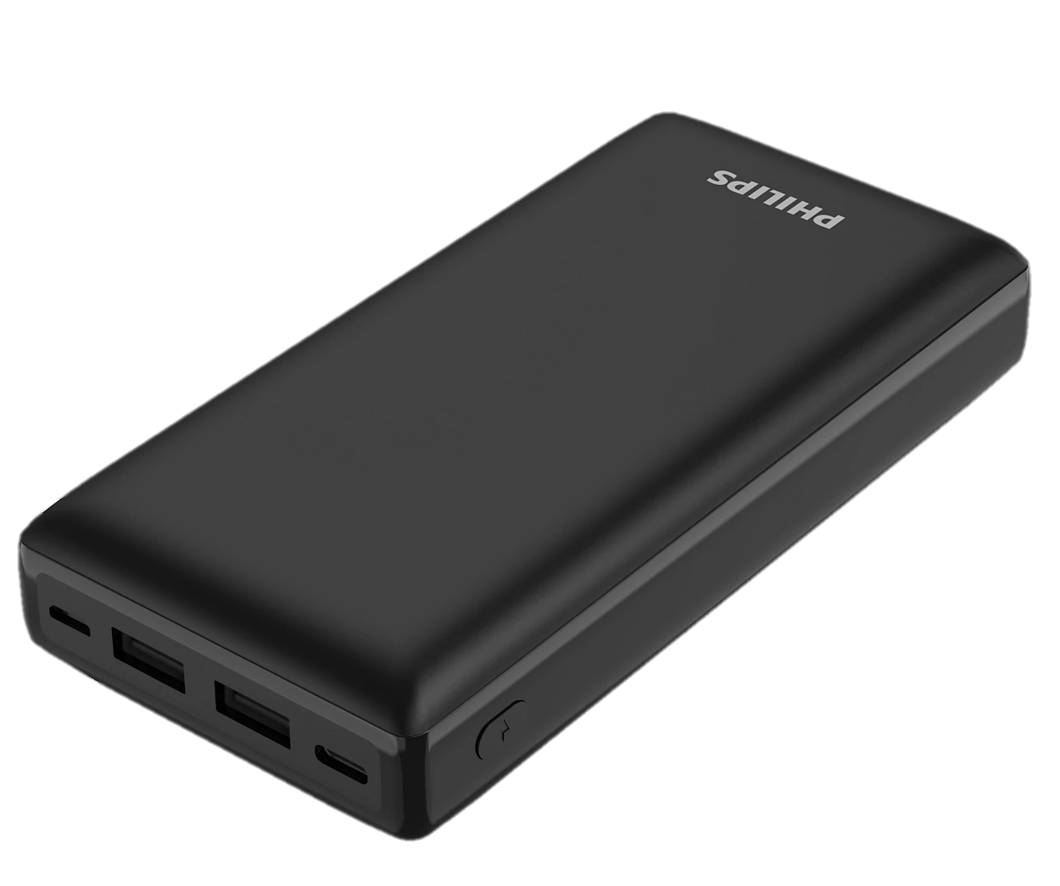
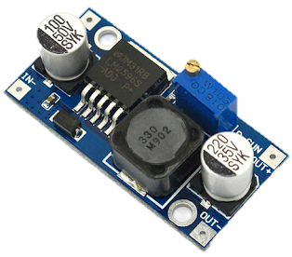
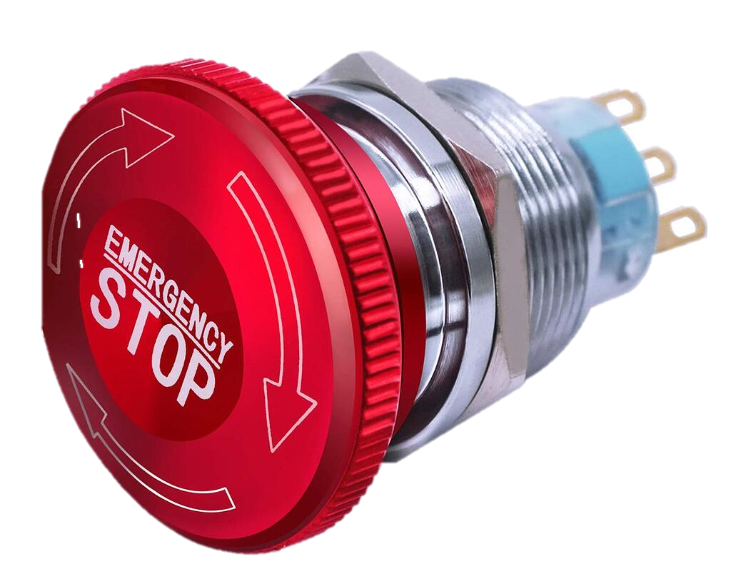
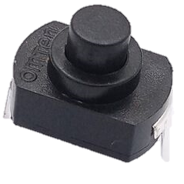
Power supply and buttons
12V 9A battery
Power Bank
DC-DC buck converter
ON/OFF buttons
Emergency Button

Slide 9
Software

Slide 10





ROS (Robot Operating System)

Slide 11
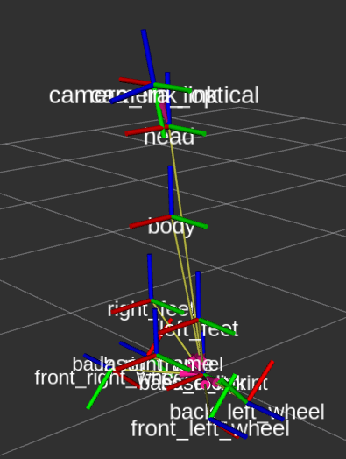
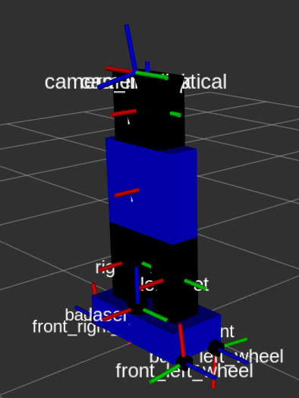
URDF (Unified Robot Description Format)

Slide 12
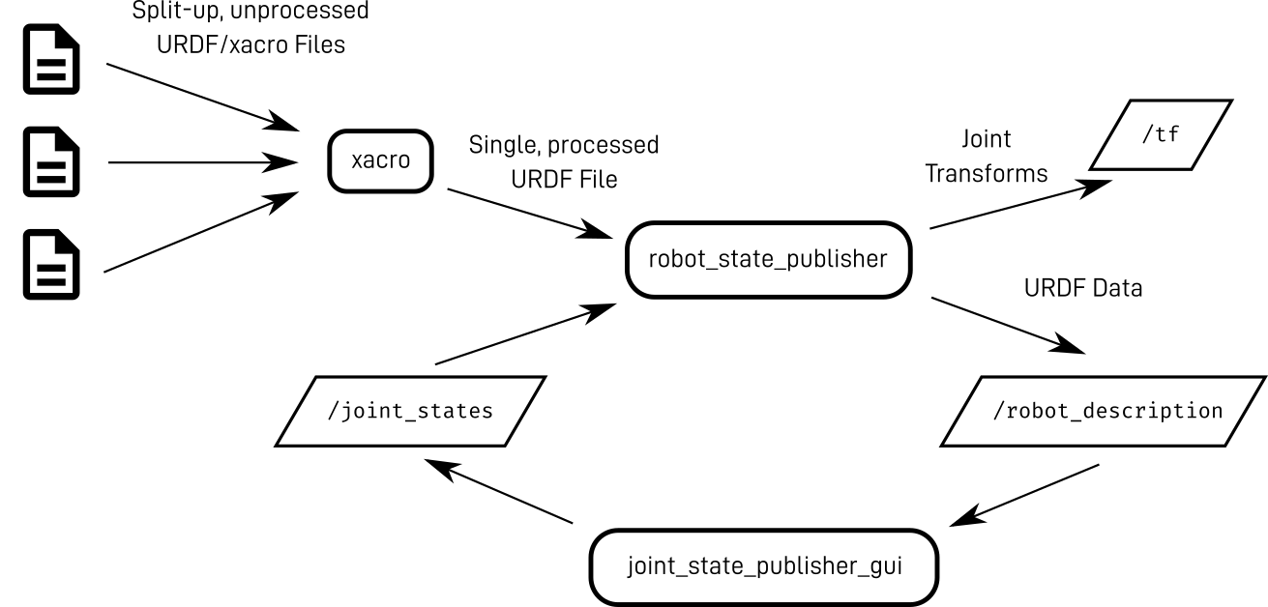

Slide 13

Simulation
GAZEBO

Slide 14
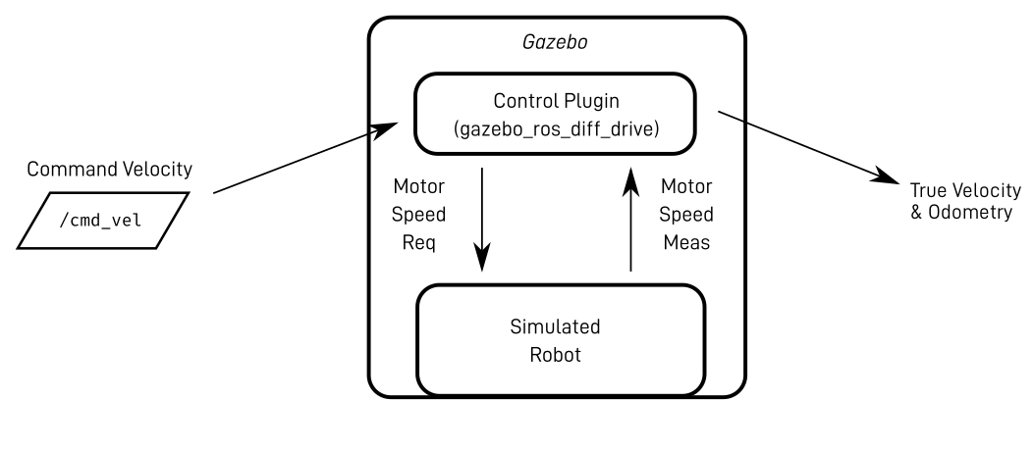

Slide 15
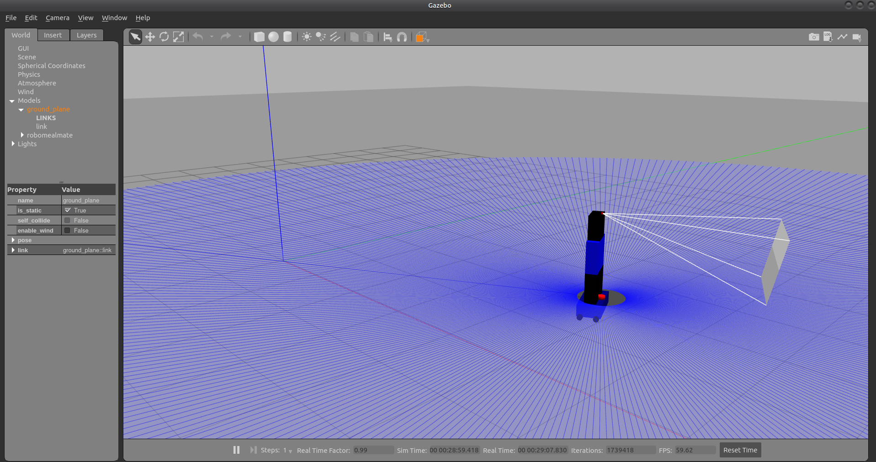

Slide 16

SLAM
(Simultaneous Localization and Mapping)

Slide 17
SLAM Toolbox
Lidar driver
scan
SLAM Toolbox
map

Slide 18
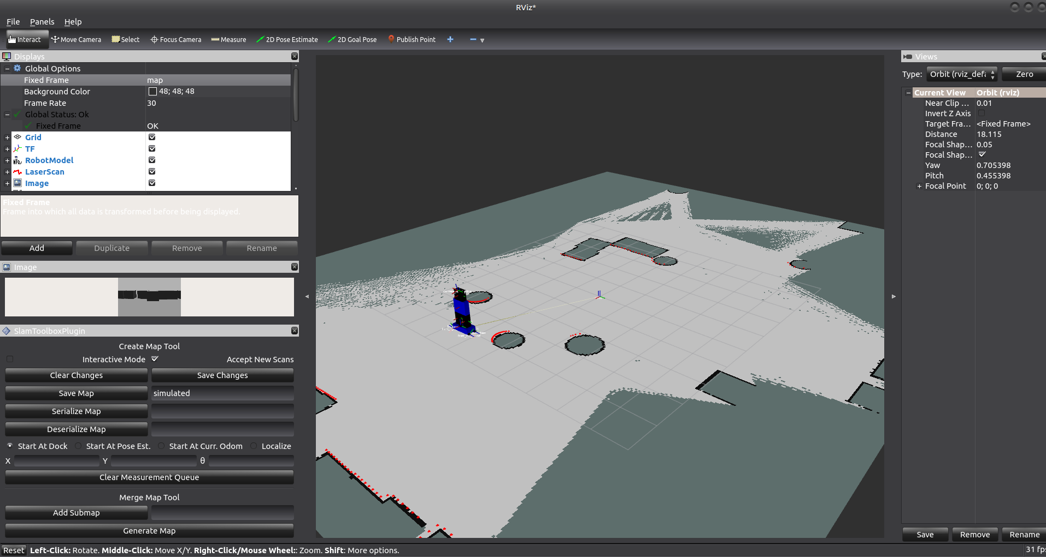

Slide 19

Navigation
(Nav 2)

Slide 20
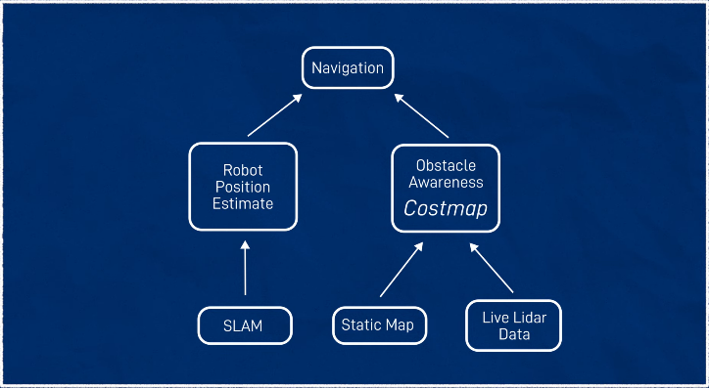

Slide 21
NAV 2
Goal Position
Local
Cost Maps
server
/map
Planner Server
Global
Local plan
cmd_vel
Controller server
plan

Slide 22
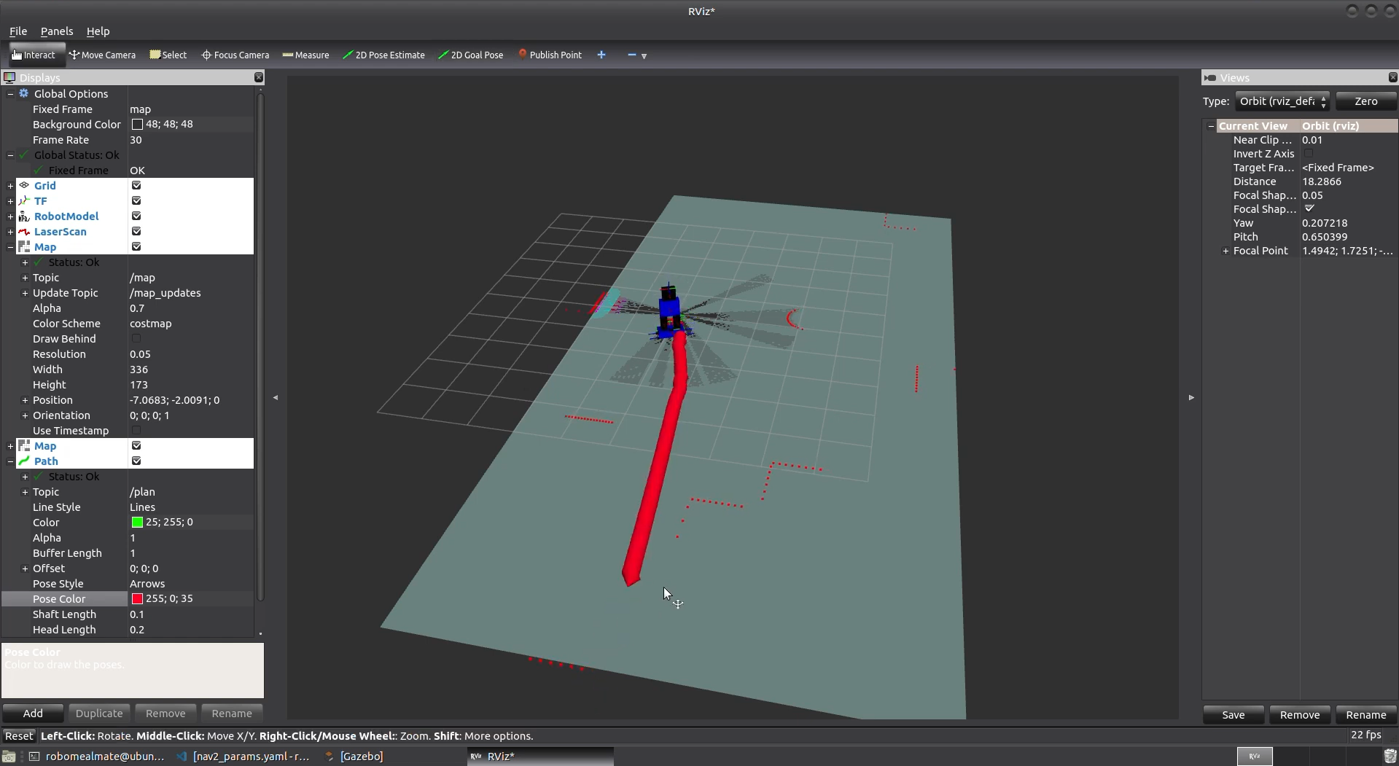

Slide 23
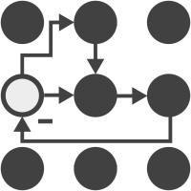
Control
ROS Control

Slide 24
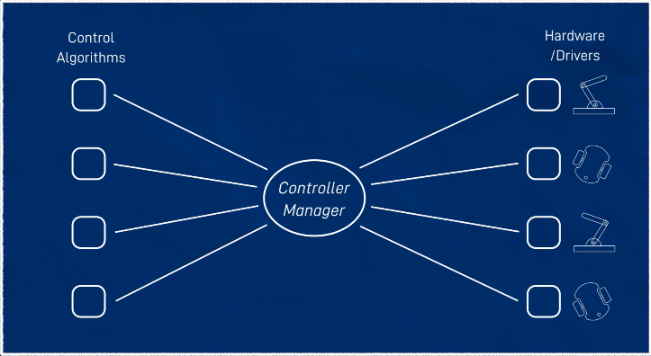

Slide 25
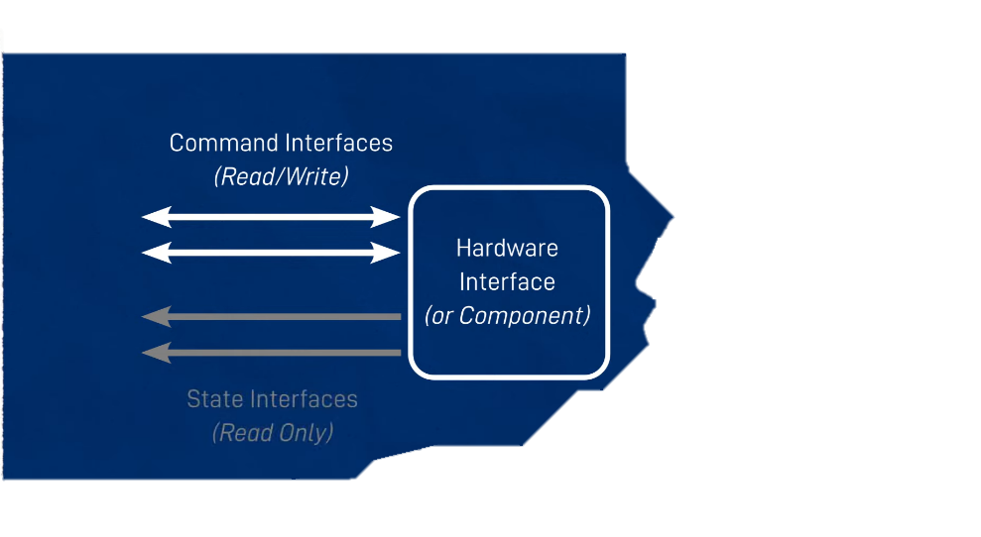

Slide 26
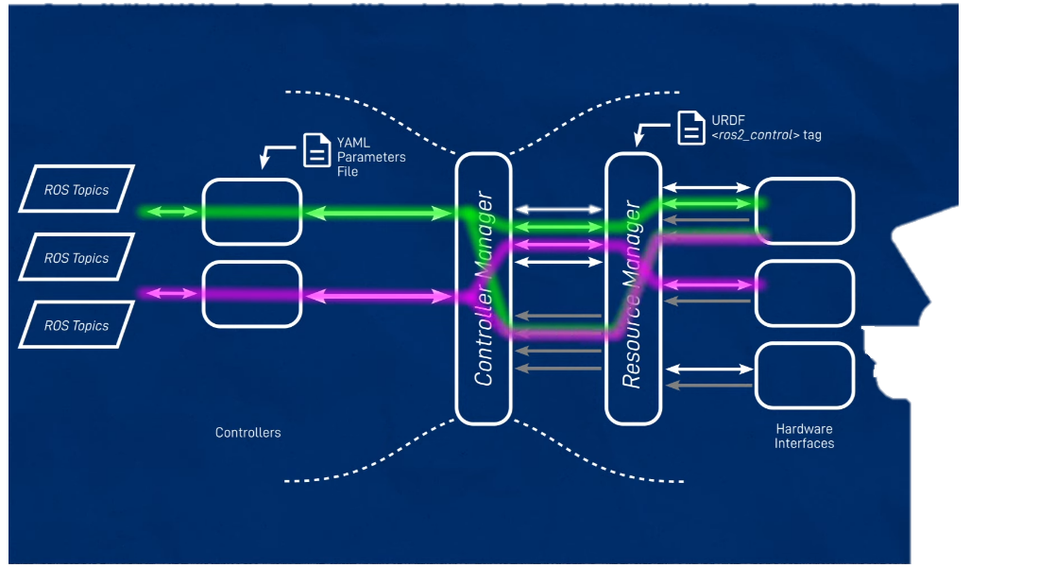

Slide 27
Hardware Interface
Arduino commos
Diffdrive Arduino
Hardware Components
Arduino
Controller Manager
Wheel
Config

Slide 28
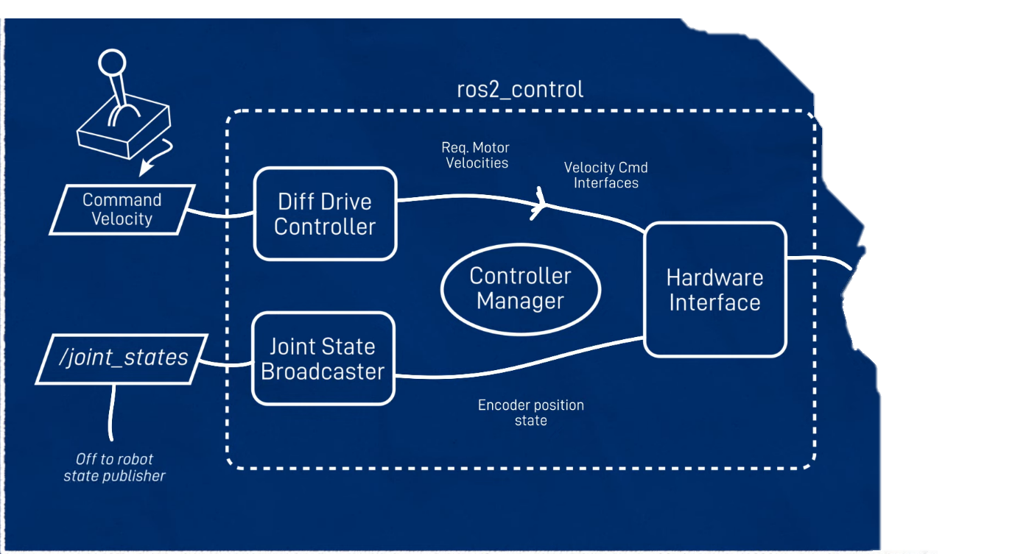

Slide 29

Joystick

Slide 30
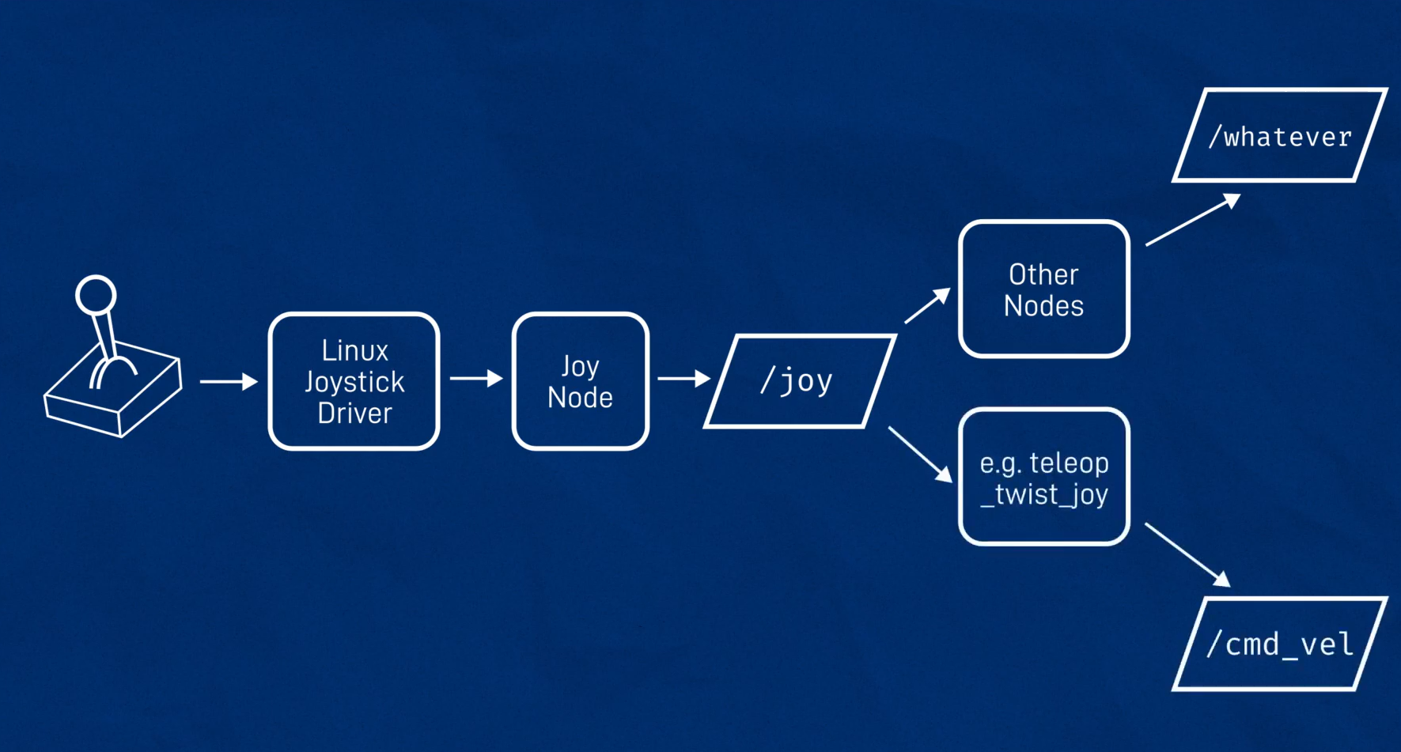

Slide 31
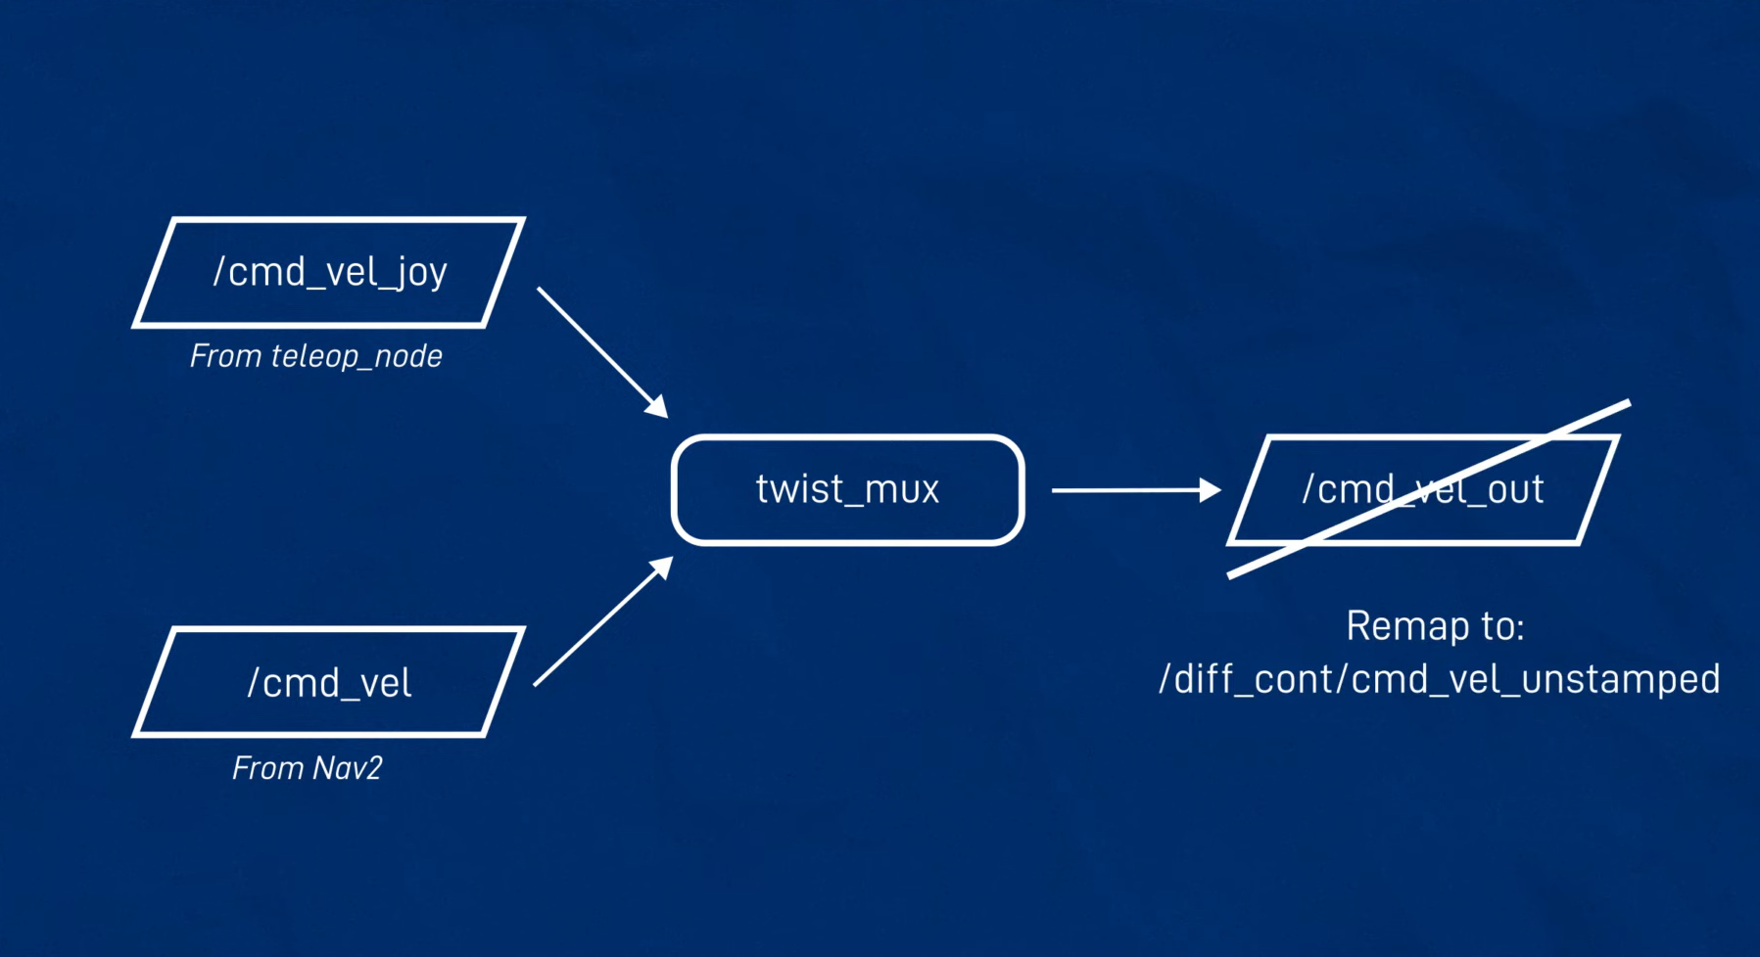

Slide 32


Open AI & Google Cloud
Open AI
Google Cloud

Slide 33
Audio
To review
Speaker
Text to Speech
Storage
Response
Audio player
Response
GPT model
Google Cloud Services
Audio recording
Audio
Audio
Chat history injected
MIC
Speech recognition
Prompt

Slide 34
RoboMealMate
Robot description &
state
Open AI
&
Google Cloud
Hardware interface
SLAM
NAV 2
ROS control
Joystick

Slide 35
Analysis & Recommendation & Future Work

Slide 36
Acknowledgment

