Slide 1
An-Najah National University
Faculty of Engineering
Civil Engineering Department
Evaluation of Existing Pavement Distress for Part of Nablus City Road Network by Utilizing ArcMap-GIS
Prepared by:
Wedad Zyoud
Rasha Abu Amer
Bayan Dwiekat
Hind Tayem
Supervisor: Amjad Issa

Slide 2
Project Outline
Study Area
Objectives
Methodology
Data Analysis
Results
Future work’s Recommendations

Slide 3
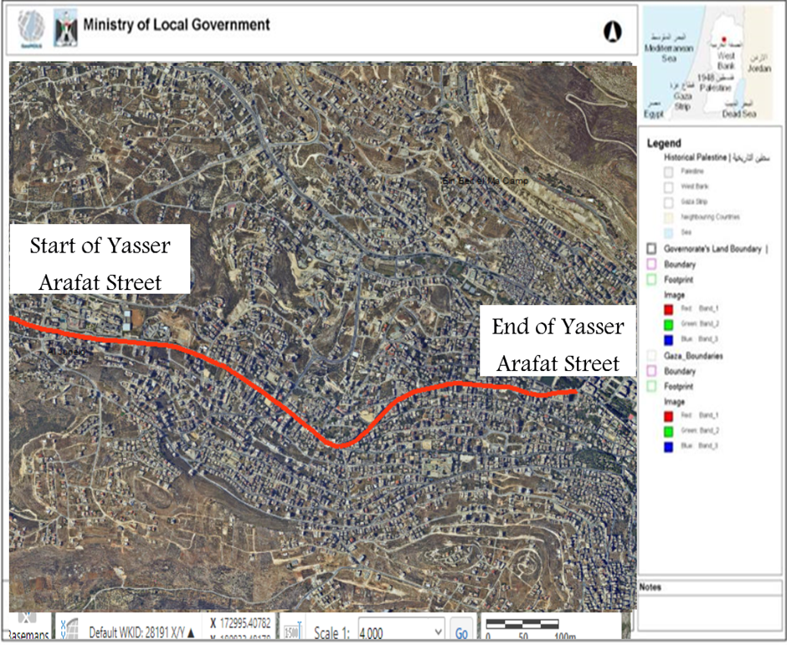
Study Area
Yasser Arafat street

Slide 4
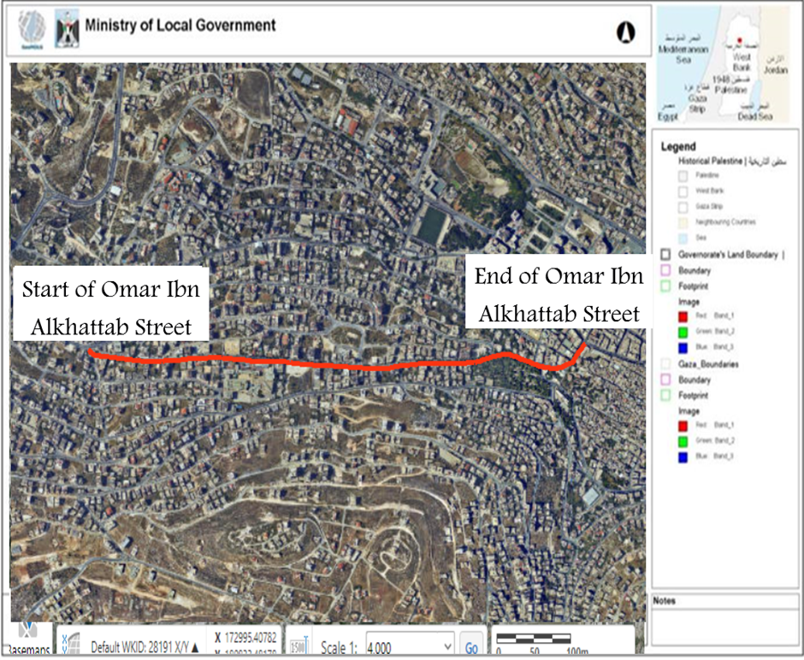
Omar Ibn Al-Khattab street

Slide 5
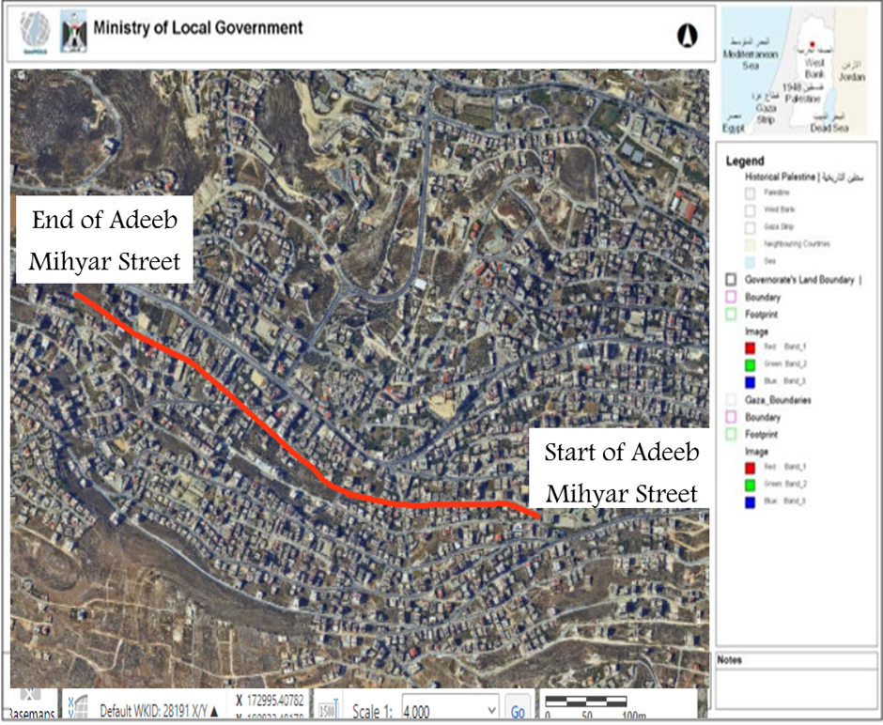
Adeeb Mihyar street

Slide 6
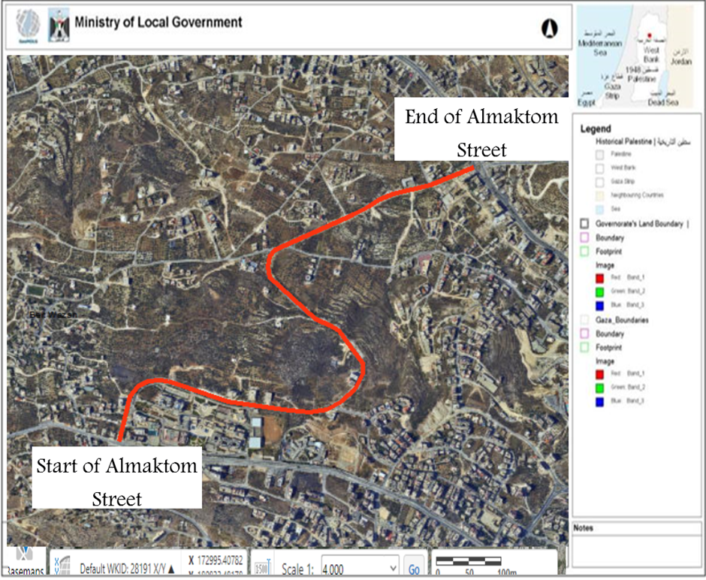
Mohd Bin Rashid Al-Maktom Street

Slide 7
Objectives
To collect data about the defects in terms of coordinates, stations, density and severity.
To enter the collected data in GIS software program, so each point is identified spatially.
To evaluate the PCI for each point of defect and rating it from 0-100, where 0 is very poor and 100 is very good
To compare between the different methods of interpolation using for calculate the PCI value, then choose the best method.
To compare between the different methods that was used to collect data to calculate the PCI value
To identify the proper maintenance treatment.
To help the municipality in applying the required quality control and supervision during construction.

Slide 8
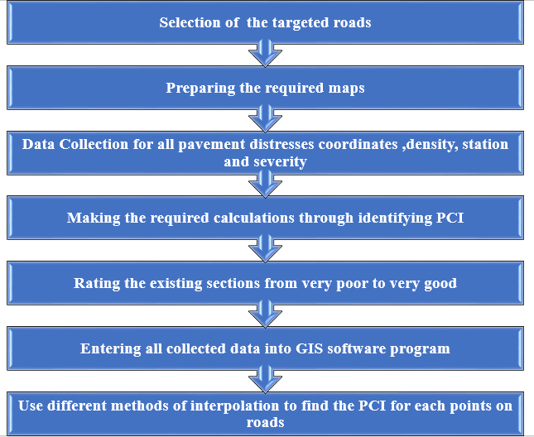
Methodology

Slide 9
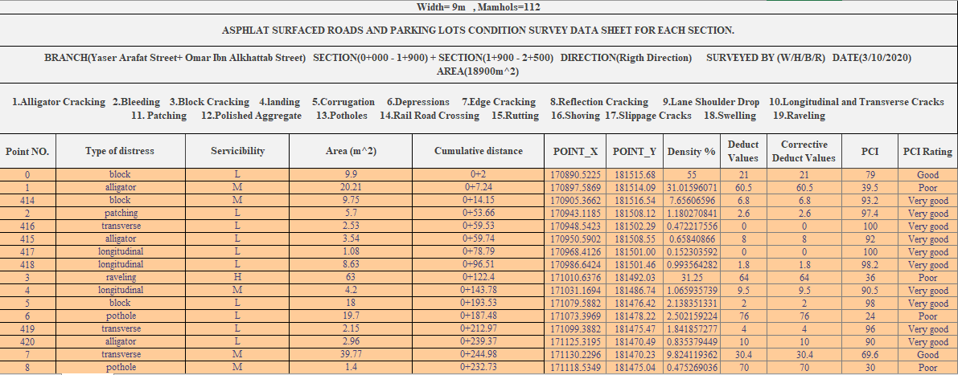

Calculation the PCI value

Slide 10
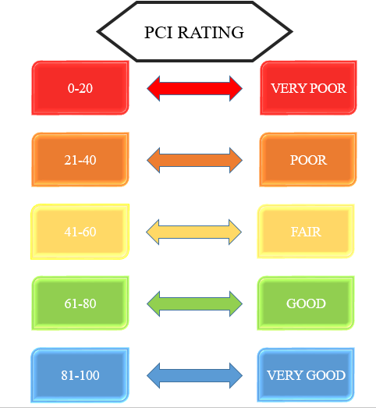
PCI Rating
PCI=100- maxCDV
PCI =100-21=79
The Rating is Good
The suitable treatment is Recent sealcoat or new cold mix. Little or no maintenance required.

Slide 11
Interpolation
Interpolation is the process of using points with known values or sample points to estimate values at other unknown points.
Why interpolate?
Visiting every location to measure the area, severity and other data to find the PCI value for each point on roads is indeed difficult, time consuming and expensive. Instead, dispersed sample of input point locations can be selected and a predicted value can be assigned to all other locations.
The assumption that makes interpolation a viable option is that spatially distributed objects are spatially correlated.

Slide 12
IDW Interpolation (Inverse Distance Weighting)
The Inverse Distance Weighting interpolator assumes that each input point has a local influence that diminishes with distance.
It weights the points closer to the processing cell greater than those further away.
Advantages:
Can estimate extreme changes in the value of any things.
Dense evenly space points are well interpolated (flat areas with cliffs).
Can increase or decrease amount of sample points to influence cell values.
Disadvantages:
Cannot estimate above maximum or below minimum values.
Not very good for peaks or mountainous areas.

Slide 13
Spline Interpolation
Spline interpolation is a form of interpolation where the interpolant is a special type of piecewise polynomial called a spline
There are two Spline types: Regularized and Tension.
The Regularized type creates a smooth, gradually changing surface with values that may lie outside the sample data range.
The Tension type controls the stiffness of the surface according to the character of the modeled phenomenon. It creates a less smooth surface with values more closely constrained by the sample data range.

Slide 14
Spline Interpolation
Advantages:
Useful for estimating above maximum and below minimum points.
Creates a smooth surface effect.
Disadvantages:
Cliffs and fault lines are not well presented because of the smoothing effect.
When the sample points are close together and have extreme differences in value, Spline interpolation doesn’t work as well. This is because Spline uses slope calculations (change over distance) to figure out the shape of the flexible rubber sheet

Slide 15
Kriging
Kriging is a geo-statistical interpolation technique that considers both the distance and the degree of variation between known data points when estimating values in unknown areas.
A kriged estimate is a weighted linear combination of the known sample values around the point to be estimated.

Slide 16
Kriging
Advantages:
Directional influences can be accounted for: Soil Erosion, Siltation Flow, Lava Flow and Winds.
Exceeds the minimum and maximum point values.
Disadvantages
Does not pass through any of the point values and causes interpolated values to be higher or lower then real values.

Slide 17
Trend
Trend is a statistical method that finds the surface that fits the sample points using a least-square regression fit
Advantage
Trend surfaces are good for identifying coarse scale patterns in data; the interpolated surface rarely passes through the sample points.

Slide 18
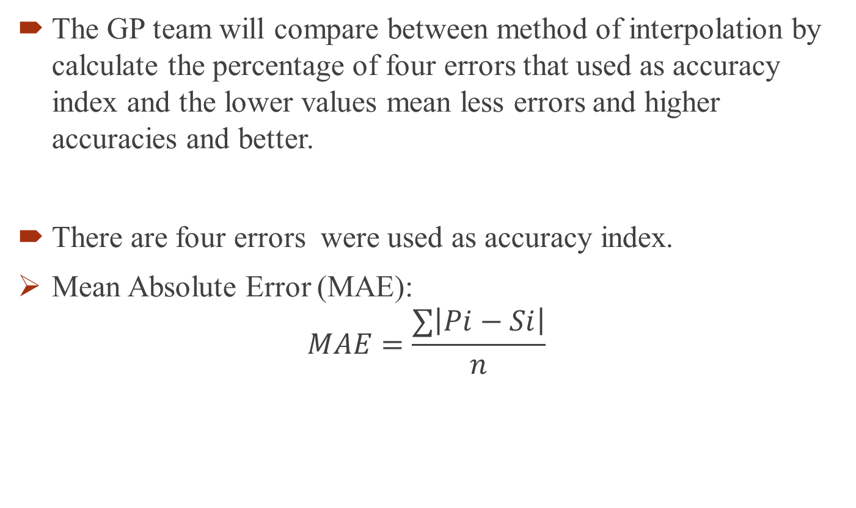
Choosing the Right Interpolation Method
The GP team will compare between method of interpolation by calculate the percentage of four errors that used as accuracy index and the lower values mean less errors and higher accuracies and better.
There are four errors were used as accuracy index.
Mean Absolute Error (MAE):
$$MAE=\frac{∑\left|Pi−Si\right|}{n}$$

Slide 19
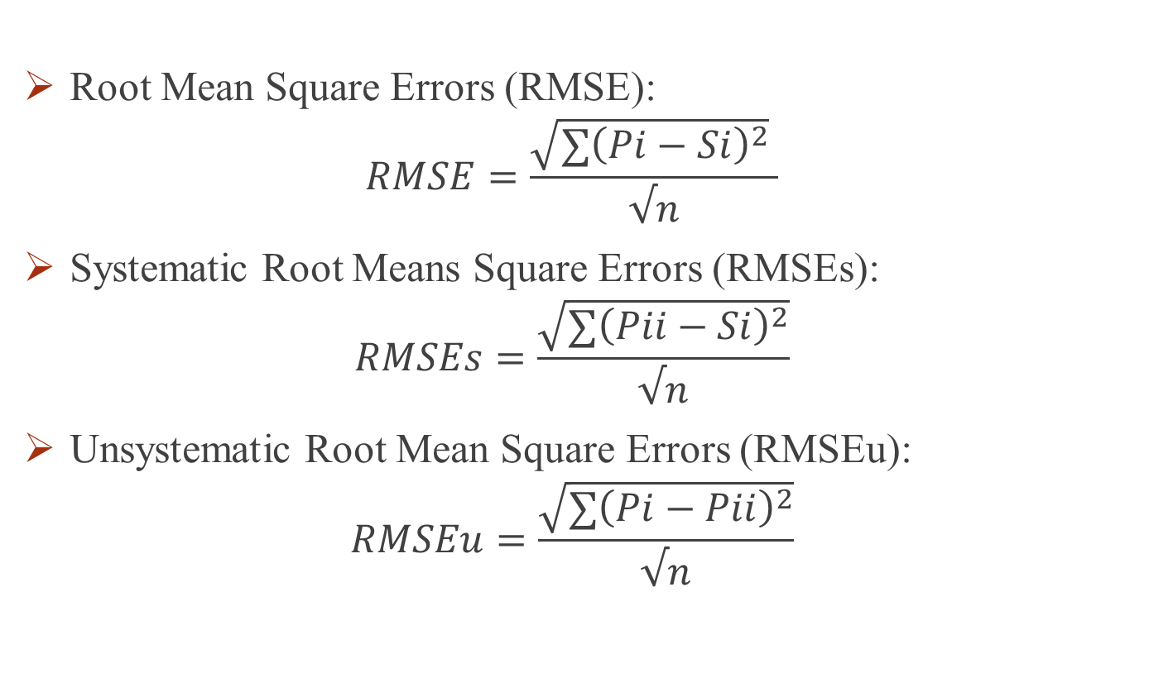
Choosing the Right Interpolation Method
Root Mean Square Errors (RMSE):
$$RMSE=\frac{\sqrt{∑{\left(Pi−Si\right)}^{2}} }{√n}$$
Systematic Root Means Square Errors (RMSEs):
$$RMSEs=\frac{\sqrt{{∑\left(Pii−Si\right)}^{2}}}{√n}$$
Unsystematic Root Mean Square Errors (RMSEu):
$$RMSEu=\frac{\sqrt{∑{\left(Pi−Pii\right)}^{2}}}{√n}$$

Slide 20
Result
Comparing interpolation methods

Slide 21

Result
Kriging process seems to have higher error measures, meaning more errors, and therefore worse performance, RMSEs =35.83
spline interpolation has considerably lower values than the other surfaces in these measures, $RMSEs$ =25.30
IDW method performed similarly to spline method and both are better than Kriging and Trend method of interpolation.

Slide 22
Result
Comparing between the PCI value by conventional method and for each point of defects.
The percentage of errors is larger than the spline interpolation (collect every point of defects),RMSE=47.27
the method of find the PCI value by collected data every section of 100 meter length, it is not accurate and is not represented the real value because a small part of this section may be having cracks and other parts may be in good conditions.

Slide 23
Result
A large parts of Yasser Arafat Street and Omer ibn Al-Khattab Street were in good and very good conditions
A large part of Mohd Bin Rashid Al-Maktom Street was in good and very good conditions.
They noticed that some parts of Adeeb Mihyar Street were very poor, especially from station 0+608m to station 0+670 m and 0+940m to station 0+960m. For these regions, reconstruction or deep patching is highly recommended (extensive base repair). Moreover, other parts were in good and very good conditions. In this case routine and preventive maintenance such as crack filling will be adequate. The very good sections were recently overlaid.

Slide 24
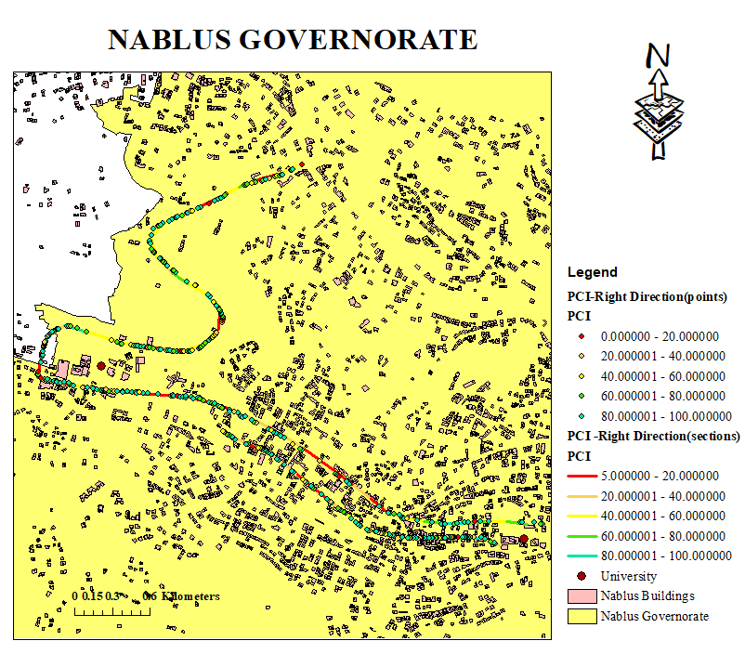
ArcGIS Work

Slide 25
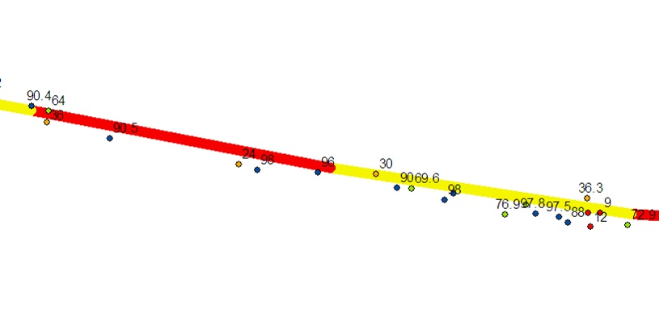
Right direction when section (100 - 200) to( 200 - 300)

Slide 26
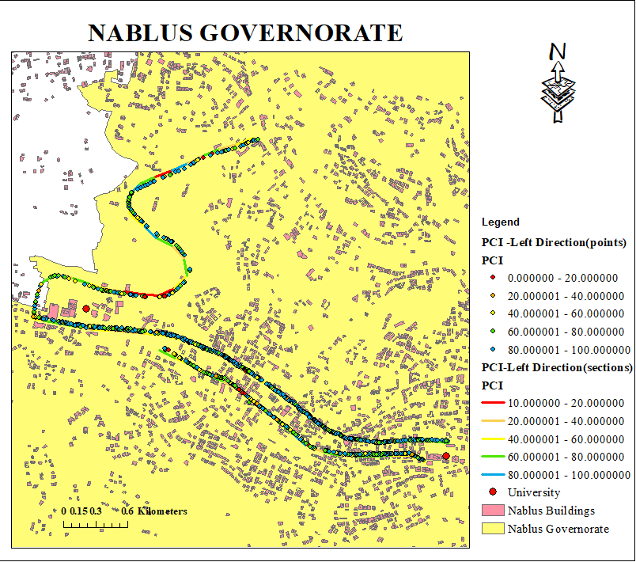
ArcGIS Work

Slide 27
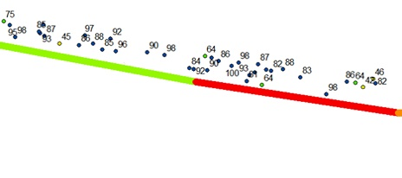
left direction when section (100 - 200 )to (200 – 300)

Slide 28
Future work’s Recommendations
To develop a model of GIS for calculating the PCI value and it necessary to try using different process of GIS .
To develop our study, instead of collected data from gemology site (the GP team obtained a good accuracy, but the difference was 20 centimeters), it necessary to collect the data by GPS. However, using the GPS have some problems because it need open location to work, so we need to make more studies and researches to develop this project.
To study the relation between the existing of the traffic accidents and the corresponding pavement conditions (improving safety and riding comfort).

Slide 29

Thank you

