Slide 1
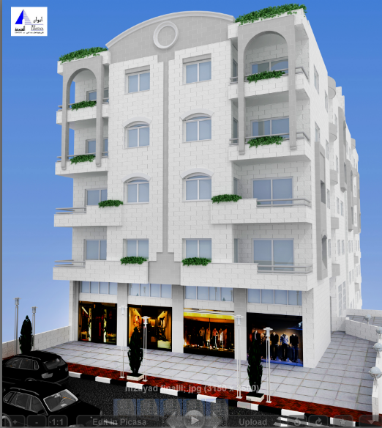
“Analysis and Design of Zamzam residential building”
Prepared by: Hamed Odeh
Helal Shakarna
Mohammad Khalil
Firas Eid
Submitted to: Dr.Monther Diab

Slide 2
Outline
Conceptual approach.
General description of the building.
Loads affecting the building.
Design Of slabs.
Design Of Beams.
Design of columns.
Design of footings.

Slide 3
Conceptual Structural Approaches
Structural Classification systems:
Typological By Geometry
Typological By Stiffness
Typological By Span Type
Typological By Material

Slide 4
Design Process in Structural Engineering:
Many factors must be taken into consideration in the design of any structure; these include economic factors, most important the safety of their inhabitants, compatibility, serviceability, equilibrium and the most important issue is the strength limit state that structural collapse of all part of structure (very low probability of occurrence) and loss of life can occur (a structure will not fail as long as there is a safe load path to the foundation).

Slide 5
Design Process in Structural Engineering
Select material for construction
Determine appropriate structural system for a particular case
Determine forces acting on a structure
Calculate size of members and connections to avoid failure (collapse) or excessive deformation

Slide 6
Building Geometry definition:
The building consists of 9 floors with average height of 3.4 meters except the storage floor which has 5.0 meters height.
This building has malty function stores for residential and commercial uses.
The overall area of this building is (5567) meter square distributed as follows:
The basements 279 m².
First parking floor 245 m².
second parking floor 555 m².
Ground floor is 683 m².
and 683 m² for each one of 5 stores.

Slide 7
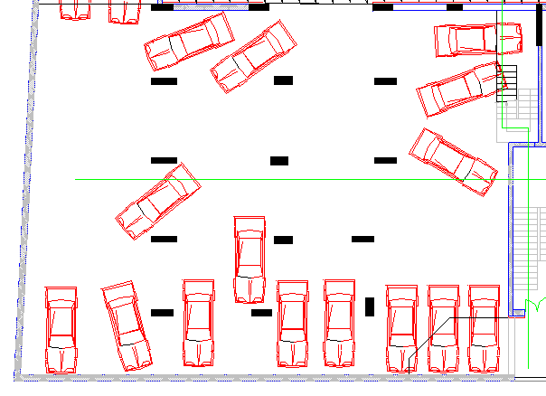
The parking floor:

Slide 8
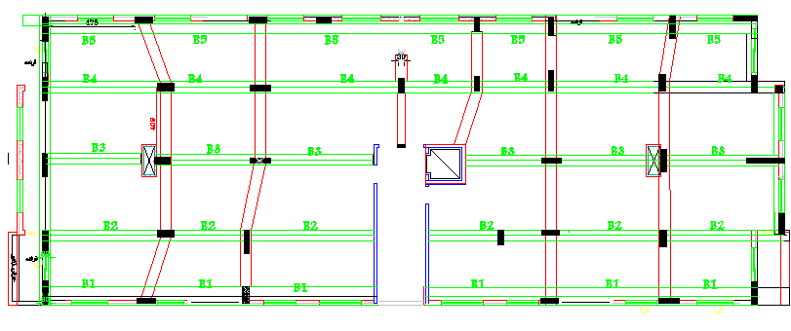
The residential floor:

Slide 9
Philosophy of analysis & design
Structural action (Forces):
The structure is used for different uses. The five upper floors are used for residential purposes and the ground floor for residential and commercial uses and two parking floors and the last one for storage purposes.

Slide 10
:Material selection
The selection of the material type depends on different factors such as:
Geometry.
Material availability.
Type and Quantity of loads.
Experience availability.
Economical factor.
According to the above factors we will use Reinforced Concrete.

Slide 11
Material selection:
The reinforced concrete properties according to our structure are:
Compressive strength of concrete (𝒇'_{c} )
The compressive strength of concrete for slabs and beams is
f_{c}= 24 MPa.
For columns, the compressive strength of concrete is f_{c}= 28 MPa.
Yielding strength of steel (f_{y})
The yield strength of steel for flexural steel (main steel), shear reinforcement, torsion and shrinkage is fy = 420mpa.

Slide 12
Building code used:
The building code used is ACI 318-08 (American
Concrete Institute).
Loads:
Static loads include dead load, live load, super
imposed loads, wall weight.
Dynamic load include Earthquake loads.

Slide 13
Loads:
Dead load = 5 KN/m²
Superimposed dead load on slab = 4.2 KN/m²
Wall weight =22kN/m
Live load on parking = 6 KN/m²
Live load for residential = 2.5 KN/m²

Slide 14
For the dynamic load:
In this section of our project, we analyzed the structure dynamically using RESPONSE SPECTRUM IBC2006 using the suitable parameters for Palestine and for the region where the structure is.
At first, we found the values of the parameters needed to analyze the building dynamically related to the location of our country, soil type and the way of building suitable for the workers which is ordinary.

Slide 15

S_{S} spectral accelerations for short periods
S₁ spectral accelerations for 1-second period

Slide 16

From IBC Map or from local building codes
We can use Ss= .5
S1= .2

Slide 18
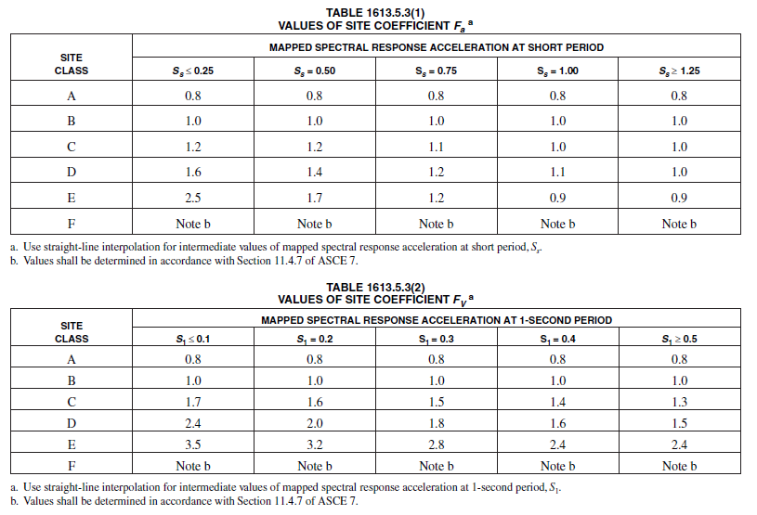
Calculate Response Accelerations:
S_{MS} = F_{a}·S_{S} S_{M1} = F_{v}·S₁
Where: F_{a} and F_{v} are site coefficients

Slide 19
From the table we can get Fa= Fv= 1
S_{MS} = F_{a}·S_{S} =.5 S_{M1} = F_{v}·S₁ =.2
Calculate the 5%-Damped Design Spectral Response Accelerations
S_{DS} = (2/3) S_{MS} =0. 333
S_{D1} = (2/3) S_{M1}=0. 133

Slide 20

Determine Seismic Response Coefficient, C_{s}
Lesser of
Seismic Response Coefficient, C_{s}
Is a function of:
  Spectral response acceleration
  Site soil factors
  Building Period
  Response modification factors
  Importance factor

Slide 21
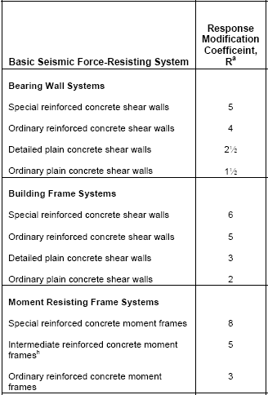
Where:
R = Response Modification Factor
Ι = Seismic Importance Factor

Slide 23
This next figure shows identifying the parameters on response spectrum to get the dynamic analysis, and designing the structure depending on the results we got after analysis complete.

Slide 24
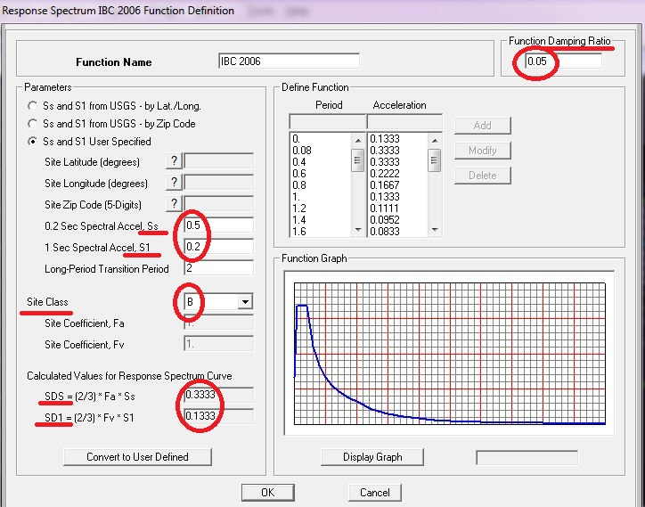

Slide 25
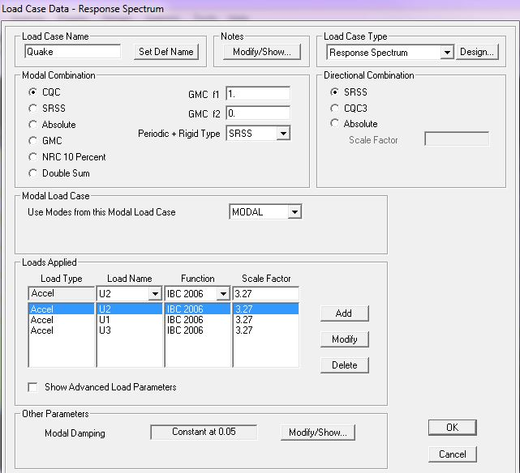

Slide 26
At first, we tried to define response spectrum to the whole structure to get the analysis and design based on it. But the model participating mass ratio was just 62.2% in X direction, and this reading still steady after the 6th mode until the 35th without increasing, so we decided to make a structural break between the two sides of the building and analyzing each side by itself as shown in the following figures to get modal participating mass ratio greater than 90%.

Slide 27
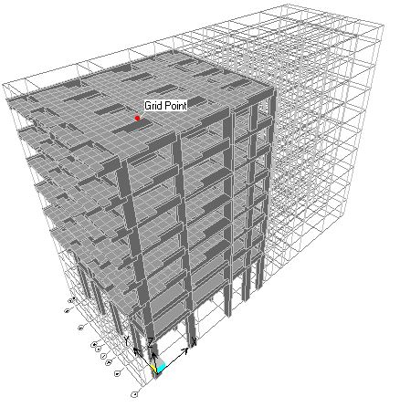
The left side:

Slide 28
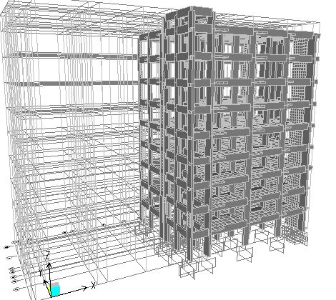
The right side:

Slide 29
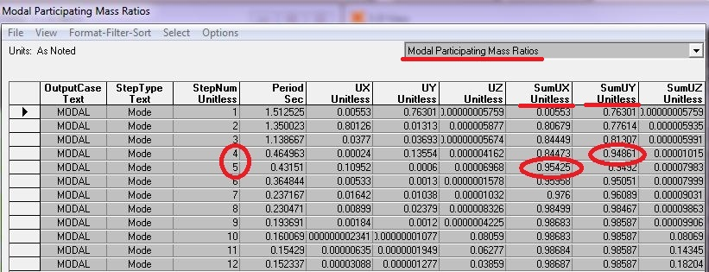
The modal participating mass ratio of the left side:
We got more than 90% by the fourth mode the period T=1.25sec

Slide 30
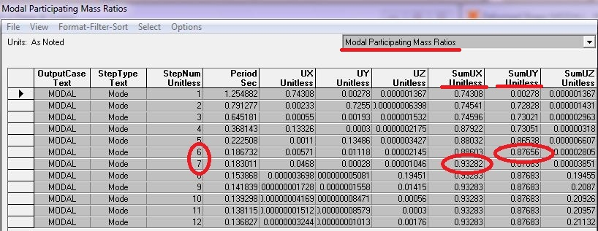
The modal participating mass ratio for the right side:
We got more than 90% by the seventh mode
And the period T=1.51sec.

Slide 31
Design of slabs

Slide 32
In graduation project 1, we analyzed the slabs as one way ribbed slab for the residential floors, and as one way solid slab for the parking and storing floors.
We found the thickness and checked them for shear, compatibility, equilibrium and stress strain relationship and everything was right.
After the dynamic analysis, nothing is changed because its loaded on the beam to the columns and footings which we modified to resist dynamic loads.

Slide 33
Design of the beams :

Slide 34
Type of beams:
.1-Main Hidden Beams (1.2*.3)
.2- secondary Beams(.3*.4)
.3-Parameter Beams (1*.3)
.65*.45).)4-primary drop Beams in the Parking
And then We set the the primary Design from static load
The dimension change due to dynamic load

Slide 36
Example of set primary Dimension
Design of exterior beams
Let b = 40 cm, ρ = 0.012
Ln,max = 6.85m
Wu = 31*(3.55-0.6/2)+22+25*o.4*0.8 = 72 KN
Mu max = Wu*Ln² /10 = 336KN.m
d² = Mn/Rb
∴ d = 540mm, cover = 60mm, h = 600mm
∴ beam weight = 0.4*(0.6-0.2)*25*1.2 = 4.8KN/m
Wu = 73KN/m

Slide 37
Design of the beams:
we became more confident that the Sap is working in the same way that we work But faster than us So we take the Sap Design for the beams but when Sap Design that give us many station for the same member and for practical we take the max station and work on it.

Slide 38
Design of columns:

Slide 40
Design of columns:
Column in architecture and structural engineering is a structural element
that transmits, through compression, the weight of the structure above to
other structural elements below , in other words column is a compression
member. For the purpose of wind or earthquake forces, columns may be
designed to resist lateral forces. Other compression members are often
termed "columns" because of the similar stress conditions. Columns are
frequently used to support beams or arches on which the upper parts of walls
or ceilings rest. In architecture, "column" refers to such a structural element
that also has certain proportional and decorative features

Slide 41
Design of columns:
The design of the columns should satisfy the architecture requirements.
In statics we compare the area of steel from sap and the area of steel from hand calculation and found them closely to each other ,that because we have one ultimate axial force and one moment .
But in Dynamic we have one ultimate axial load and two ultimate moment ,in this cause the Sap use 3D inter action diagram ,and that cant get from hand calculation because we just know 2D.

Slide 42
Design of columns:
Conclusion:
From the static result we found that the sap is working right but faster than us So we can depend on sap for both static and dynamic Design.

Slide 43
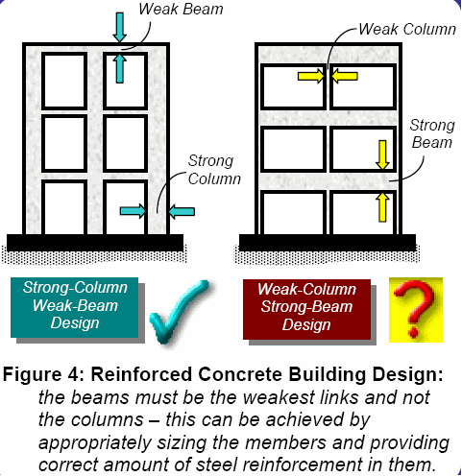

Slide 44
Problem:
We have problem in the parking floor that the column is long column and we try to solve the problem by but braced beams .

Slide 45
Design of footing:

Slide 46
Design of footing:
Foundation design , including the selection of foundation system and the
footing dimensions ,is strongly influenced by type of soil and its properties.
As a result ,skilful foundation design blends knowledge of structural
engineering and geotechnical engineering.
The soil type is rock with qall=400KN/m^2

Slide 47

Type of footing used:
1- single footing.
-2- wall footing.
Footing area= Pu/qall.
Q=$\frac{p}{area}\text{±}\frac{M∗C}{I}$

Slide 48
Thanks
for listening

