Slide 1

AN-Najah National University
Faculty of Engineering & Information Technology
Mechanical and Mechatronics Engineering Department
Graduation Project 2
Indoor Mobile Robot for Wi-Fi Navigation & Mapping
DONE BY:
Abdulkareem Barakat
Zohdi Qawareeq
SUPERVISOR:
Dr. Mohammad Abuabiah
m.abuabiah@najah.edu
November, 2021

Slide 2
Outline
Introduction
Aims
Electrical Design
Mechanical Design
Control System
Practical Part
Conclusion and Future Vision
2/22

Slide 3
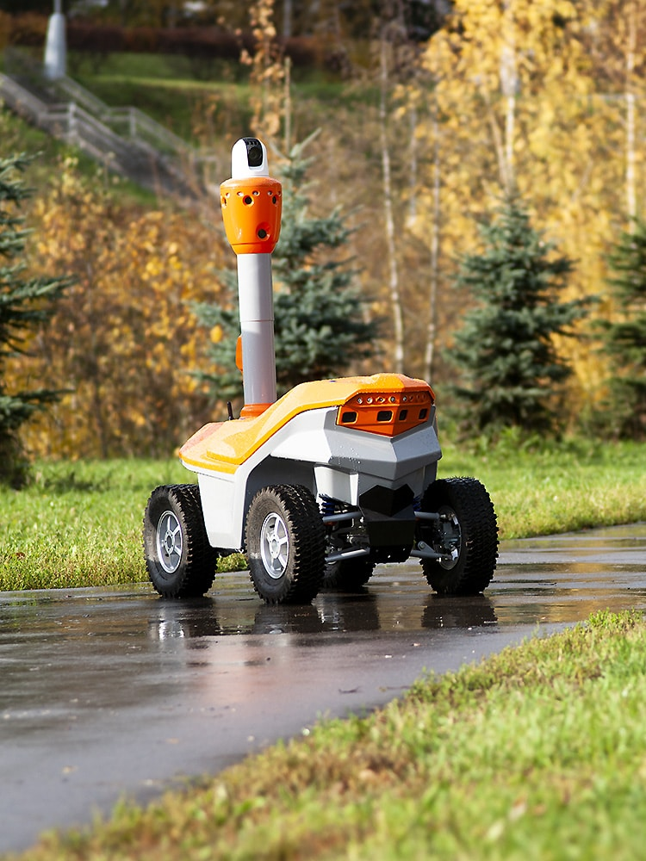
Introduction
One major advantage of mobile robots is their computer vision capabilities. The complex array of sensors used by mobile robots to detect their surroundings allows them to accurately observe their environment in real-time.
Characteristics of mobile robotics: Perceptive ability based on sensors, Adaptable to the presence of changes in the operating space or environment, and Independent navigation, planning, and acting.

Slide 4
Aims
To design a mobile robot that is able to collect Wi-Fi power signal data in indoor environments without the need for humans helps. Saving time and effort on the driver.
To design a mobile robot that can take map for different indoor environments.
To test and understand the signal power of each Wi-Fi in the indoor environment to improve the efficiency of the overall network.
The obtained collected data can be helpful to have an accurate navigation application that helps the user to go at any place in a large indoor environment like Hospitals, Universities and Governmental facilities.

Slide 5
Electrical Design
The electrical parts of the project is:
Arduinos: The Arduino Uno is an open-source micro-controller board programmed in C++. Arduino is an open-source platform used for building electronics projects.
Driver : An H-bridge is an electronic circuit that switches the polarity of a voltage applied to a load. These circuits are often used in robotics and other applications to allow DC motors to run forwards or backward.

Slide 6
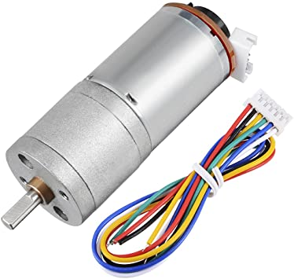
Electrical Design
DC Motor
A 12V 60RPM 25mm High Torque DC Gear Motor with encoder will be used in this project. The main advantages of this motor is:
Easy to control.
Give high torque.
Contain encoder to determine the position and direction.
Low power consumption.

Slide 7
Electrical Design
MPU-9250 Sensor Module: it’s a multi-chip module (MCM) consisting of two dies integrated into a single QFN package. One die houses the 3-Axis gyroscope and the 3-Axis accelerometer. The other die houses the AK8963 3-Axis magnetometer
Bluetooth Module : The HC-06 Bluetooth Module is responsible for enabling Bluetooth Communication between Arduino and Smart Phone, and it is using serial communication.
Power source : There are many different types of batteries available on the market but the best for the mobile robot is the rechargeable 18650 Li-ion battery
7/22

Slide 8
Mechanical Design
The mechanical design consist of :
Wheels : A Two wheels of 85mm diameter and 31mm width will be used in this project
The main specifications of this wheel are :
Made of Metal, Plastic and Rubber.
High diameter helps for withstand the weight of the robot and make it move easier.
High-quality rubber gives high friction coefficient that will prevent slipping.
Contains sponge liner for more strength.

Slide 9
Mechanical Design
Caster Wheel: Two ball Caster wheels which can rotate 360 degree
This Metal Ball Caster Wheel is strong enough to support most small robots while still providing a smooth rolling action.
Caster wheels used to make the differential driving easier.

Slide 10
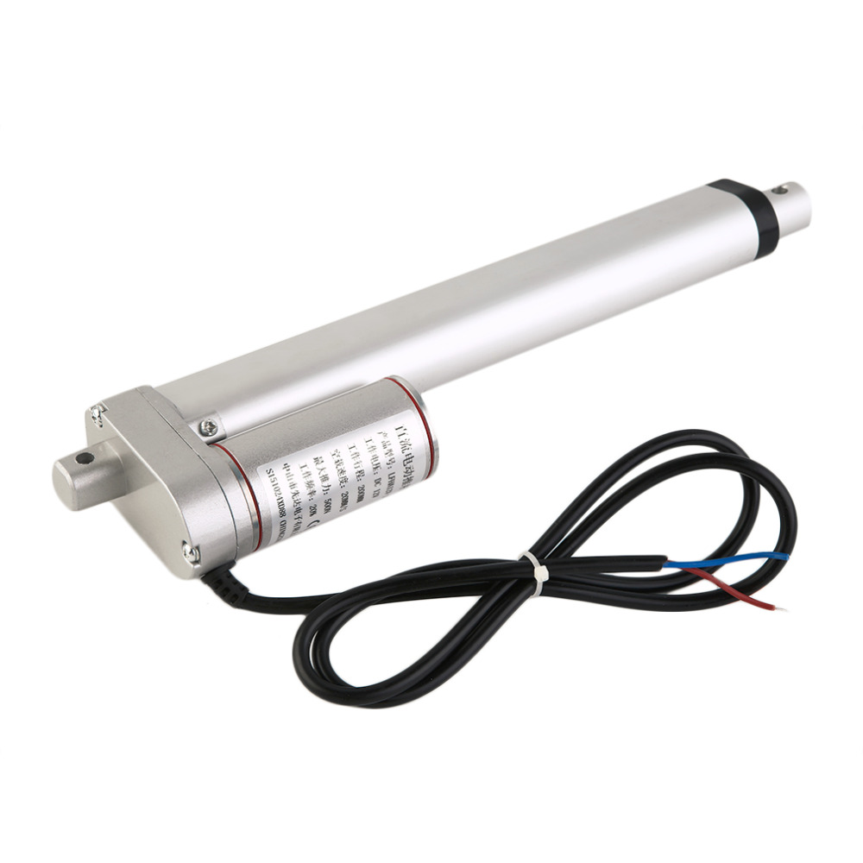
Mechanical Design
Linear actuator and stand : A linear actuator is a piece of equipment that turns rotational motion into linear motion, through the application of linear force.
In this project the linear actuator will be used to handle the mobile phone for different heights.
The heights range that the mobile phone must take the data from it is (155-175) cm. For that the linear actuator will be fixed on a stand of 135cm height. The stand will be fixed with the car from two points, the base of the car and the upper cover of the car at 16cm high.

Slide 11
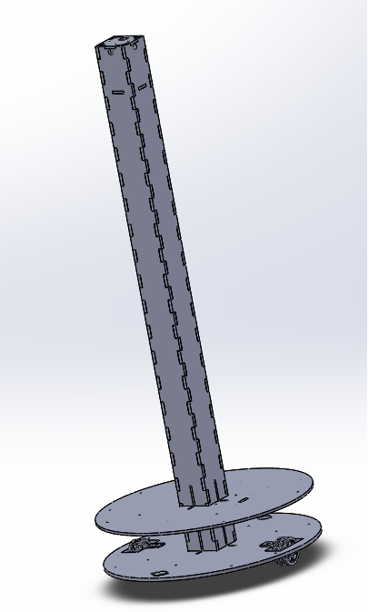
Mechanical Design
Final design: It was decided that the robot’s shape is to be a circular shape of 50cm diameter, where this will allow it to move more smoothly where this allows the robot to easily spin around itself to change the direction. It consist three main parts: base, top and the stand which is 120cm height. As the 20 linear actuator is located above the stand that will make the total height of the robot reaches 170cm. So to avoid flipping we increase the diameter of the base and make the center of mass of the robot 2 cm height from the ground

Slide 12
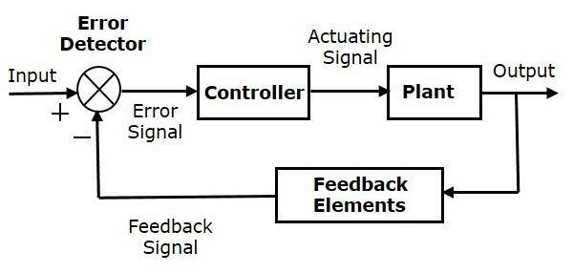
Control System
Control part of the robot is the most important part of designing and developing any robot, without the control, the robot is scrap. A control system is an interconnection of components forming a system configuration that will provide a desired system response.
Closed Loop System: It represent a control system utilizes an additional measure of the actual output to compare the actual output with the desired output response. The measure of the output is called the feedback signal.
12/22

Slide 13
Control System
Feedback System: a feedback system is the one which utilizes presently achieved output of the system for causing variation in the applied input signal in order to get the required output. In this robot three sensors were used for feedback:
1- Gyroscope
2- Digital Compass
3- Encoder

Slide 14
Control System
Mobile Robot: Mobile robots have the capability to move around in their environment and are not fixed to one physical location.
Mobile robots can be "autonomous" (AMR - autonomous mobile robot) which means they are capable of navigating an uncontrolled environment without the need for physical or electro-mechanical guidance devices.

Slide 15
Practical Part
ROS: is a set of software libraries and tools that help you build robot applications. From drivers to state-of-the-art algorithms, and with powerful developer tools.
The main purpose of using ROS is mainly to support individually implemented processes, where each process is called a node. Each node in the system is separated from other nodes, thus they don’t affect other nodes in the system in any way and changing the implementation of one node won’t affect the rest. The only way these nodes communicate with each other is by using the publish and subscribe architecture.

Slide 16
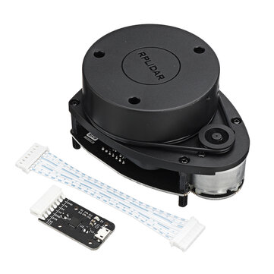
Practical Part
LIDAR: sensor that can use for determining ranges (variable distance) by targeting an object with a laser and measuring the time for the reflected light to return to the receiver. For that reason, RPLiDAR A1 was chosen which consider as a low-range LiDAR scanner that operates at a frequency in range 5.5Hz and 10Hz, equipped with reads for 360 points covering all surrounding directions

Slide 17
Practical Part
Mapping Using ROS: In order to be able to navigate through the room properly, our robot requires that it has a . pre-built map available.
Gmapping was used in the implementation, due to its dependence on Odom in addition to the LiDAR readings.
Gmapping package contains the slam-gmapping node which is responsible for building a 2D map by t converts the laser scan data into something called an occupancy grid.

Slide 18
Practical Part
Mapping using map information: because of a problem happened, we change the idea of mapping by record the following data of the map:
Distance: As the robot will move in known environment, so we take the length of each path that the robot will move in it.
Cardinal coordinate: we record the cardinal coordinate of each path using digital compass sensor by stand and move in the same direction that the robot will move in.

Slide 19
Practical Part
Mapping using map information:
Rotation: As the robot will rotate 90 degree each time it move from one path to another so we determine will the robot move CW or CCW
Array: All the previous data where saved in arrays so that the robot will know the path from the index number of the arrays, and will change when move to the next path.
We use the three sensors mentioned in control section as a feedback for these arrays.

Slide 20
Conclusion
Two different method of mapping where studied in this project
ROS platform give us a lot of library that can help as to control the robot in good way.
Lidar sensor is goof for mapping of unknown environment but as we know it we can use different method for mapping
At the end we present how the mobile robot will be controlled.

Slide 21
Future Vision
Doing more research about different way of mapping.
Study the ability to merge different type of sensor to create accurate mapping method.
Improve the stability of the mechanical design.
Improve the differential driving mechanism.

Slide 22
Thanks !
Any questions ?

