Slide 1
Robot Arm with
Smartphone and
Human hand Gestures Control
Supervisor:
Dr. Manar Qamhiya
Participants:
Ali Moalla ,Baker Dweikat ,Hussien Jabali

Slide 2
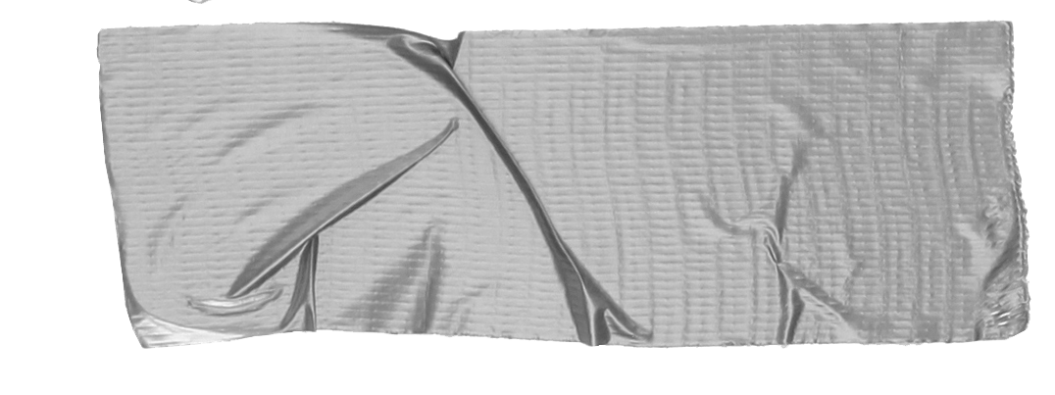

Table of Contents
idea and Objective
.
Implementation and Tools
Constraint and Future Work

Slide 3

Idea and Objective
What made us create this project !
Wide field of use :
Factories, robots, an alternative to the human hand, and much more…
Time and effort Saving :
Especially in large applications
ease of use :
Control using a mobile phone or hand motion simulator

Slide 4
Implementation
Subsystem , Component and mobile app

Slide 5
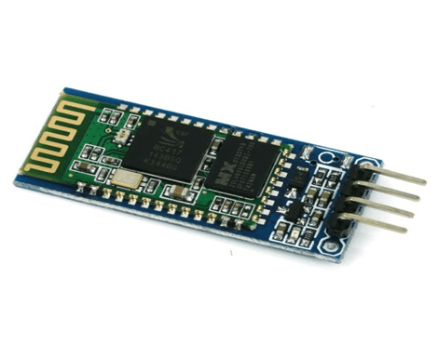
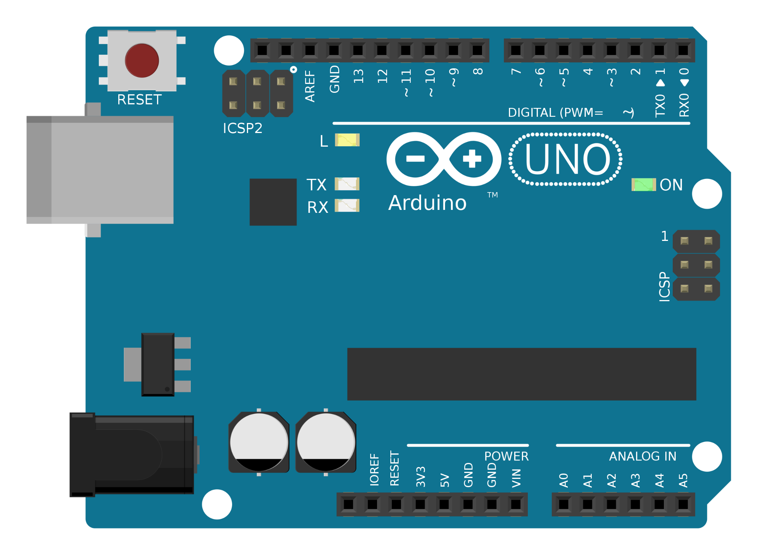
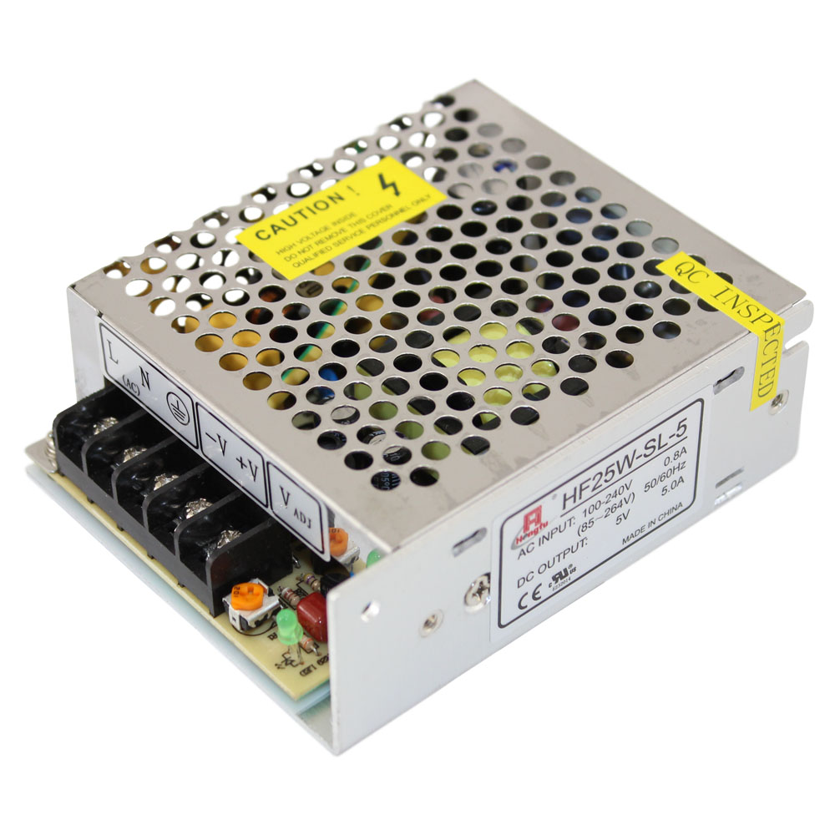
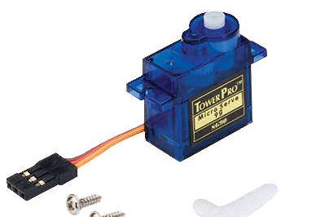
Arduino Robot Arm! ARA.
It is very similar to a human arm
How Does It Work ? it has 6 servo motors to control angle of movement and it takes command from bluetooth .
Tools :
6 servo motors
3 -SG90 Micro Servo Motor
3 -- MG996R Servo Motor
HC-06 Bluetooth
Arduino Board
Power Supply

Slide 6
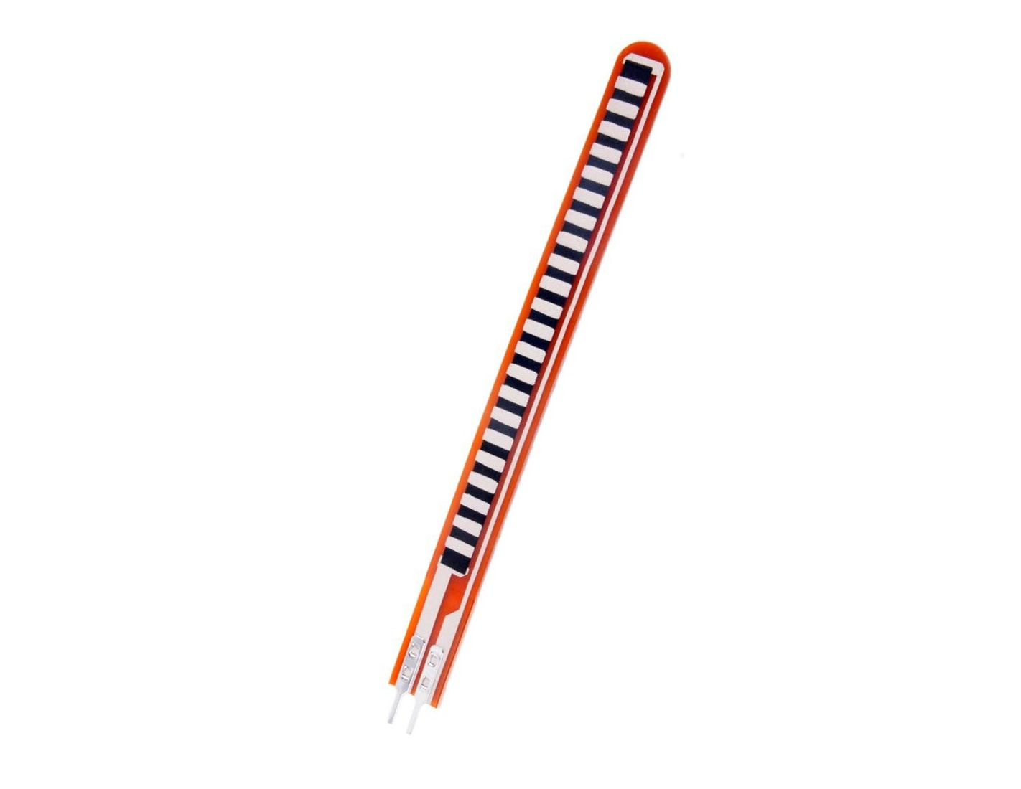
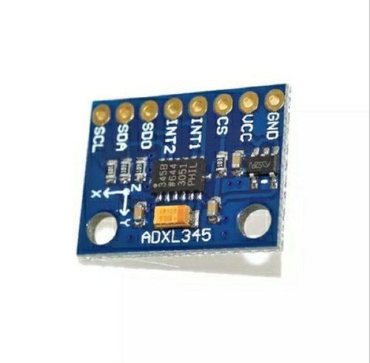
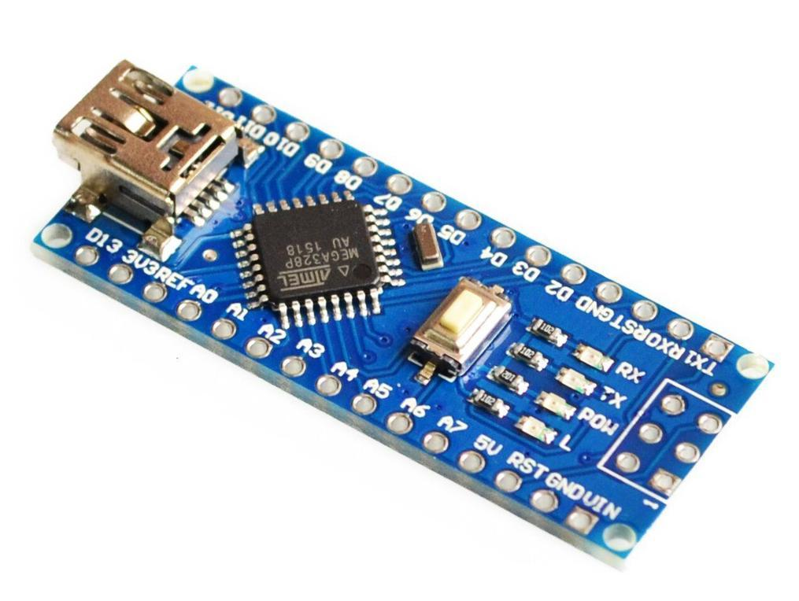
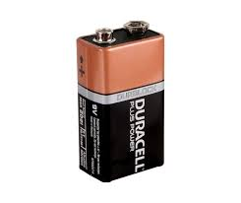
Hand Glove!.
How Does It Work ? it has number of sensor to track hand movements then send data to robot arm by bluetooth
Tools :
2 x MPU6050
(gyroscope )
3 Flex Sensor
HC-06 Bluetooth
Arduino Board
(nano)
9V Battery

Slide 7
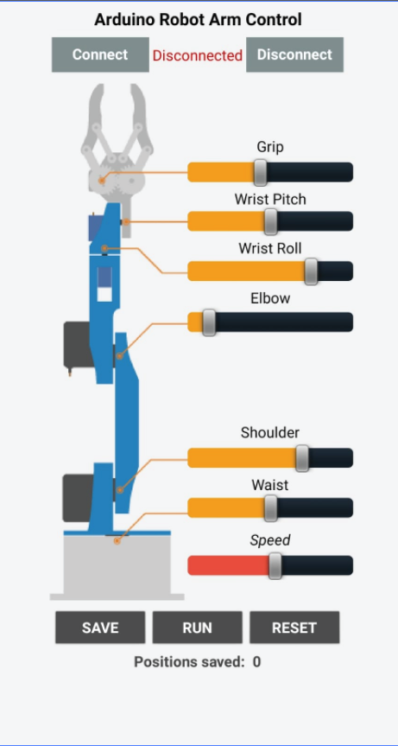
Mobile App
Simple mobile app to control arm when slide the slider .

Slide 8
Constraints
Time limitation .
One of the motors is damaged and there is a damaged wires
high price of the component .
Challenges we faced in this project

Slide 9
Future Work
Changing the head of the hand to perform different functions
Add a camera and connect the pieces through the Internet instead of Bluetooth

Slide 10
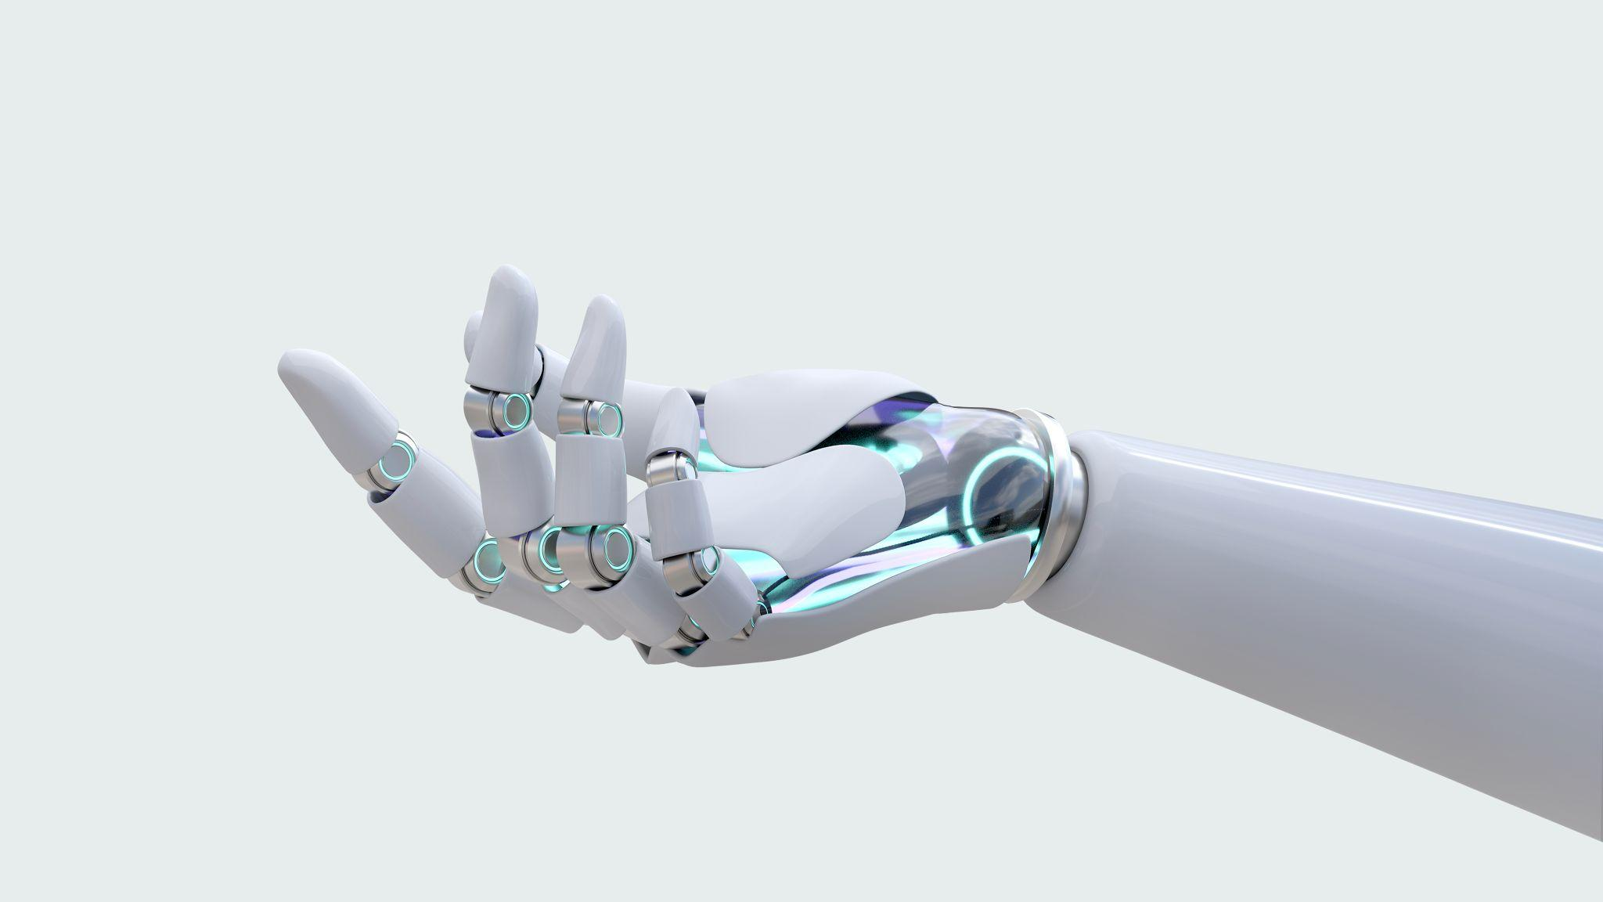
Thanks

